Slide 1
Natural language translation engine for announcements and information dissemination at stations
Submitted in the partial fulfillment for the award of the degree of
BACHELOR OF ENGINEERING
IN
CSE with Hons. In AIML
Submitted by:
Tanisha Nagpal 21BCS5286
Aaditya Singh 21BCS6750
Disha Saini 21BCS6773
Ishaan Shandilya 21BCS6777
Under the Supervision of:
Prof. Preet Kamal
Department of AIT-CSE
DISCOVER . LEARN . EMPOWER

Slide 2
Outline
Introduction to Project
Problem Formulation
Objectives of the work
Methodology used
Timeline
Results and Outputs
Conclusion
Future Scope
References

Slide 3
Introduction to Project
In a world of diverse languages and bustling station environments, effective communication is key. Our project seeks to revolutionize station announcements and information dissemination through a cutting-edge multilingual translation engine. By harnessing advanced technology, we aim to bridge language gaps, overcome noisy ambience challenges, and ensure seamless delivery on mobile devices. Join us as we embark on a journey to enhance accessibility and efficiency in station communication for all passengers.

Slide 4
Problem Formulation
Language Diversity: Stations serve a diverse population speaking various languages, requiring announcements and information to be delivered in multiple languages.
Noise Interference: The ambient noise at stations often disrupts clear communication, impacting the accuracy of voice recognition systems and reducing the effectiveness of announcements.
Computing Power: On-the-fly translation and content generation necessitate robust computing power to ensure real-time delivery of information, posing a challenge in resource-constrained environments.
Mobile Accessibility: With an increasing reliance on mobile devices for accessing information, ensuring seamless delivery on these platforms becomes crucial for passenger convenience and engagement.

Slide 5
Objectives of the Work
Provide real-time announcements and information dissemination for a smoother travelling experience.
Ensure accessibility via IVRS, chatbots, and web interfaces.
Overcome challenges such as noise interference and diverse languages that can accurately capture and translate announcements amidst bustling station environments, ensuring clarity and effectiveness.
Enable efficient delivery on mobile devices for accessing information on-the-go and necessitating seamless integration

Slide 6
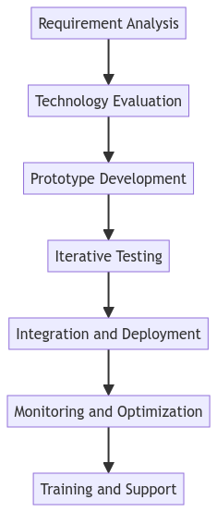
Methodology used
Requirement Analysis: Identify language needs, announcement types, and preferred channels.
Technology Evaluation: Assess NLP, speech recognition, and cloud solutions.
Prototype Development: Build a translation engine prototype; test in controlled environments.
Iterative Testing: Test in real stations; gather feedback for refinement.
Integration and Deployment: Integrate with existing systems; deploy across stations.
Monitoring and Optimization: Implement monitoring; analyze data for improvements.
Training and Support: Provide user training; offer ongoing support and updates.

Slide 7
Timeline for project implementation
MONTH 1 :- Basic Idea of the project (Brainstorming)
MONTH 2:- Research article for the project with a basic working model.
MONTH 3:- Incorporation of voice in model
MONTH 4:- Working model with complete research paper to be published

Slide 8
Results and Outputs
Multilingual Translation Engine: Developed a real-time translation engine for announcements in multiple languages.
Improved Accessibility: Enabled access via IVRS, chatbots, and web interfaces, overcoming language barriers.
Noise Reduction: Implemented algorithms for clear communication in noisy environments.
Efficient Mobile Delivery: Optimized information delivery on mobile devices for on-the-go access.
Enhanced User Experience: Provided clear and timely information, leading to increased satisfaction.

Slide 9
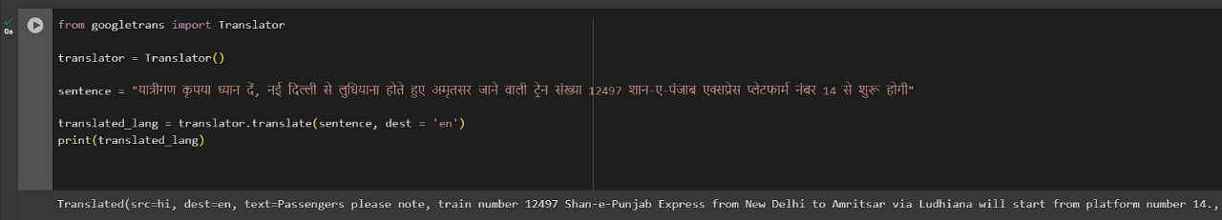
Results and Outputs

Slide 10
Conclusion
Our project tackles the challenges in station communication, including language diversity, noise interference, computing constraints, and mobile accessibility. With the implementation of a robust multilingual translation engine, we've improved information dissemination and accessibility at stations. Real-time announcements, multi-platform accessibility, and optimized mobile delivery have enhanced passenger experience and safety. This project marks a significant advancement in leveraging technology to create inclusive and efficient station environments.

Slide 11
Future Scope
The future of station communications holds exciting possibilities for improvement. The natural language translation engine will continue to evolve, incorporating advanced technology like machine learning and artificial intelligence. These advancements will enhance accuracy, efficiency, and overall effectiveness in disseminating important information to diverse communities, ensuring seamless communication regardless of language barriers.

Slide 12
References
https://www.coursera.org/learn/natural-language-processing-tensorflow?specialization=tensorflow-in-practice
https://www.ibm.com/topics/natural-language-processing
https://localizejs.com/articles/natural-language-processing-nlp/

