Slide 1
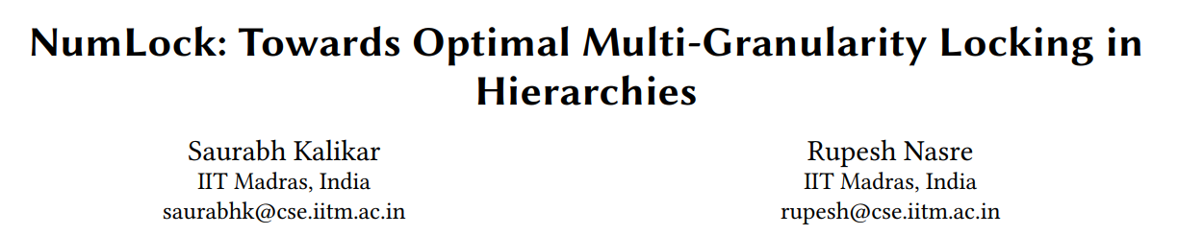
Presenting
-TANISHA RANA SE20UCSE202

Slide 2
Introduction
The paper addresses problem of multi-granularity locking in hierarchical systems. The key points discussed in the paper are:
Hierarchical systems and their locking challenges:
Introduction of multi-granularity locking:
Need for an optimal locking scheme:
Proposed solution: NumLock:
Two-step process for optimal locking selection:

Slide 3
Why NumLock?
Inefficiencies in existing multi-granularity locking schemes
Traditional multi-granularity locking techniques used in hierarchical systems suffer from limitations such as lock contention and reduced concurrency.
Lack of systematic approach for selecting locking options
Choosing the appropriate multi-granularity locking option in a hierarchy is a challenging task.
Performance improvement potential
By addressing the limitations of existing multi-granularity locking schemes, there is potential to significantly enhance the performance of hierarchical systems.

Slide 4
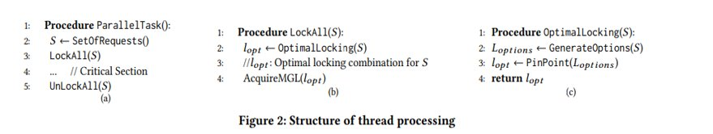
Structure of Thread Processing
It provides a framework for handling lock requests and managing concurrency in hierarchical systems. It involves several components that work together to facilitate effective locking and maximize system performance. The components of Thread Processing are:
Lock Requests:
Lock Pool
Option Generation
Cost Model

Slide 5
Interval Locking Algorithm and Sub-hierarchies with Multiple Intervals
Sub-Hierarchies with Multiple Intervals:
Sub-hierarchies divide the hierarchy into smaller, manageable sections that can be independently locked.
Each sub-hierarchy can have multiple intervals, providing a way to further optimize concurrency and lock granularity.
For locking sub-hierarchies we need to do the following:
Handling request in sub hierarchies
Acquiring locks at appropriate intervals
Efficient Lock Acquisition and Release
Enhancing Concurrency within Sub-hierarchies
Interval locking divides the hierarchy into intervals, where each interval represents a range of nodes in the hierarchy. Locks are acquired and released at the interval level, providing a coarse-grained locking mechanism that reduces lock acquisition overhead.
Interval Locking Algorithm:
Determining Relevant Intervals
Acquiring Locks at Intervals
Minimizing Contentions
Releasing Interval Locks

Slide 6
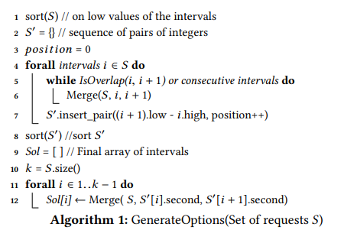
NumLock Algorithm-1
GENERATE OPTIONS
The algorithm takes a set of intervals as input and performs the following steps:
It sorts the intervals based on their low values.
It identifies overlapping and consecutive intervals, merging them together.
It generates a final array of merged intervals by using the sorted set of differences between consecutive intervals.

Slide 7
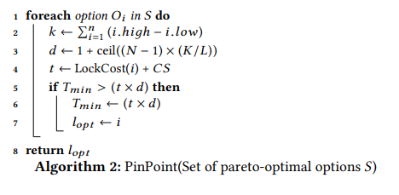
NumLock Algorithm-2
PIN POINT
PinPoint algorithm evaluates each locking option based on the cost model, compares the costs, and selects the option with the minimum cost as the optimal locking option. This algorithm plays a crucial role in determining the locking option that maximizes concurrency and minimizes locking costs in the multi-granularity locking scheme proposed in the paper.

Slide 8
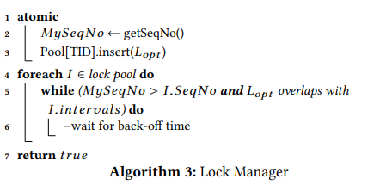
NumLock Algorithm-3
LOCK MANAGER
the lock manager algorithm ensures that lock acquisition requests are handled correctly and with appropriate synchronization. It checks for conflicts between the current lock request (Lopt) and existing locks in the lock pool, and delays the request if necessary to avoid contention. This helps in maintaining the integrity of the locking scheme and improving concurrency in the system.

Slide 9
Experimental Evaluation
The experimental evaluation aims to compare the performance of NumLock with the state-of-the-art hierarchical locking method, DomLock. The evaluation uses two datasets: Treebank XML hierarchy and STMBench benchmark suite.
The evaluation measures two key metrics: throughput and scalability.
The evaluation compares the performance of NumLock and DomLock on the Treebank XML hierarchy dataset.
NumLock achieves a 65% performance improvement over DomLock in terms of throughput.
The evaluation further compares the performance of NumLock and DomLock on the STMBench benchmark suite.
The evaluation conducts a sensitivity analysis to understand the impact of critical section size, the number of threads, and lock request overlapping probability on the performance of NumLock.
The analysis shows that NumLock maintains its performance advantage across different scenarios and demonstrates its robustness.

Slide 10
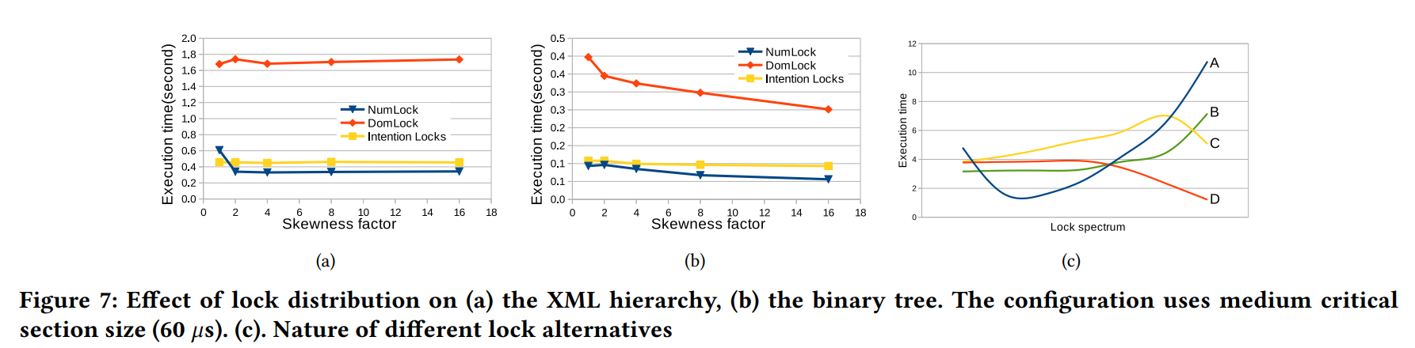
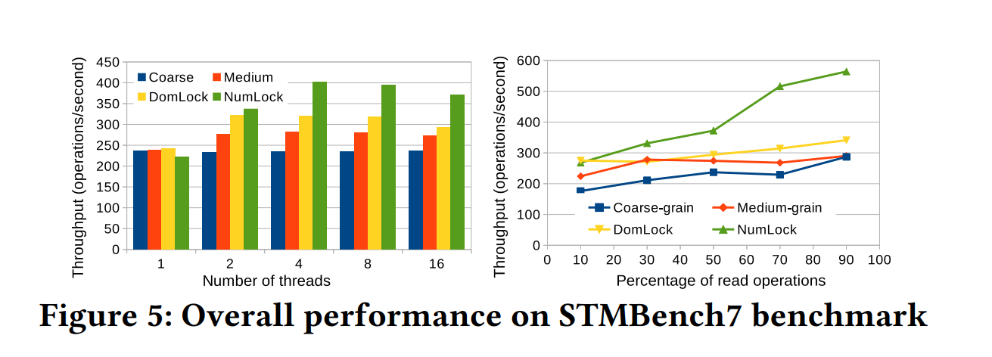

Slide 11
THANK YOU

