Slide 1
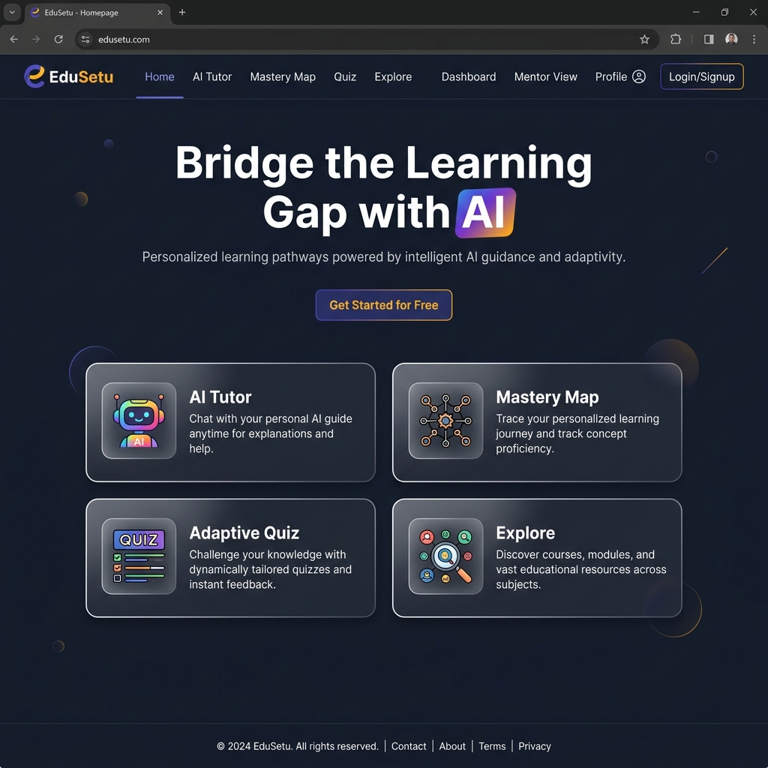
SDG 4 — Quality Education | SDG 10 — Reduced Inequalities
EduSetu
AI-Powered, Multilingual, Diagnostic-First Education Platform
Bridging the learning gap for every student in India — from Class 1 to Graduation
ESD PROJECT REPORT
Student Name: ______________________
Student ID: ______________________
Department: Computer Science & Engineering
Academic Year: 2025–2026
EduSetu — Engineering for Sustainable Development Report | 2025–2026

Slide 2
02 SDG Identification
🎓 SDG 4 — Quality Education
⚖️ SDG 10 — Reduced Inequalities
"Ensure inclusive and equitable quality education and promote lifelong learning opportunities for all."
How EduSetu addresses SDG 4:
▸ AI-powered tutor adapts to each student's learning pace and style
▸ Multilingual support (English + Hindi) removes language barriers
▸ Diagnostic quiz system identifies specific knowledge gaps
▸ Mastery Map visualizes learning progress across all subjects
▸ Covers Class 1 to Graduation — inclusive for all education levels
▸ Offline content support for areas with limited connectivity
"Reduce inequality within and among countries."
How EduSetu addresses SDG 10:
▸ Free, web-based platform accessible on any device with a browser
▸ No expensive textbooks or coaching needed — AI tutors for free
▸ Hindi language support bridges urban-rural education divide
▸ Mentor dashboard helps teachers track at-risk students early
▸ Lightweight design works on low-bandwidth, affordable devices
▸ Democratizes access to quality education for underserved communities
EduSetu — SDG Identification

Slide 3
03 Problem Definition
India faces a severe learning crisis: millions of students lack access to quality, personalized education.
Despite high enrollment rates, learning outcomes remain critically low, particularly in rural and underserved areas.
📊 ASER 2023 Report
📉 World Bank Data
🌐 UDISE+ Report
💰 NSS Survey
Only 25.6% of Class 3 students
in rural India can read a
Class 2 level text fluently.
India's Learning Poverty stands
at 56% — over half of 10-year-olds
cannot read basic text.
Student-teacher ratio averages
26:1 nationally, making
personalized attention impossible.
Private tutoring costs ₹2,000–
₹10,000/month — unaffordable
for 68% of Indian families.
⚡ Core Challenge: How can we deliver personalized, diagnostic-first education at scale, in multiple languages, to students who cannot afford private tutoring?
EduSetu — Problem Definition

Slide 4
04 Proposed Solution
EduSetu — An AI-Powered, Multilingual, Diagnostic-First Education Platform
🤖 AI Tutor (Grok API)
🗺️ Mastery Map
📝 Adaptive Quiz Engine
Powered by xAI's Grok-3-mini model.
Real-time, contextual answers to
any academic question. Supports
English and Hindi.
Interactive knowledge graph using
vis-network. Visualizes concept
relationships and learning progress
across 10+ subjects.
Diagnostic quizzes with misconception
tagging. Identifies exact knowledge
gaps, not just right/wrong scores.
40+ question banks.
🔍 Explore Engine
📊 Analytics Dashboard
👨‍🏫 Mentor View
Google-like topic search spanning
Class 1 to Graduation. 28+ topics
with key points, related concepts,
and study resources.
Chart.js powered visualizations.
Radar charts, progress bars, streak
tracking. Personalized insights
for every student.
Teacher dashboard showing class
overview, student risk indicators,
and weekly engagement insights.
Horizontal bar chart analytics.
EduSetu — Proposed Solution

Slide 5
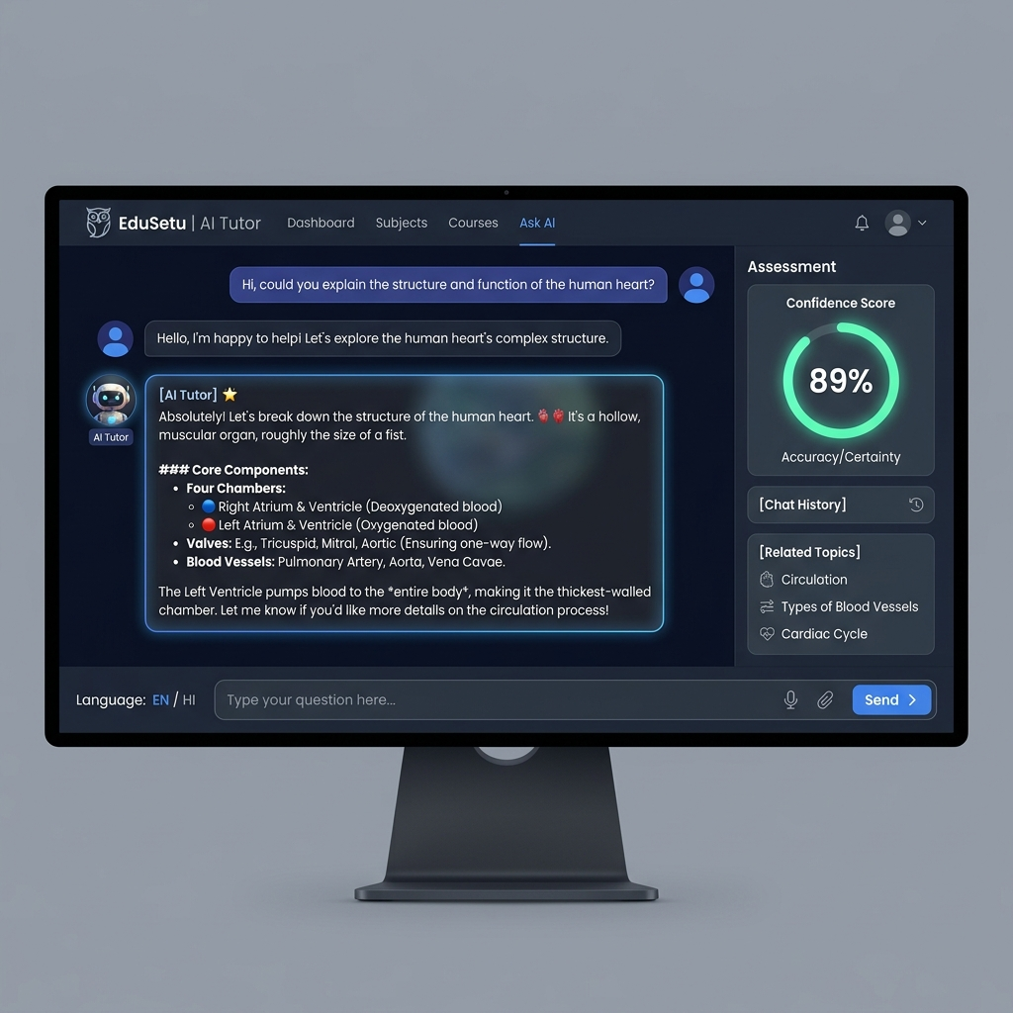
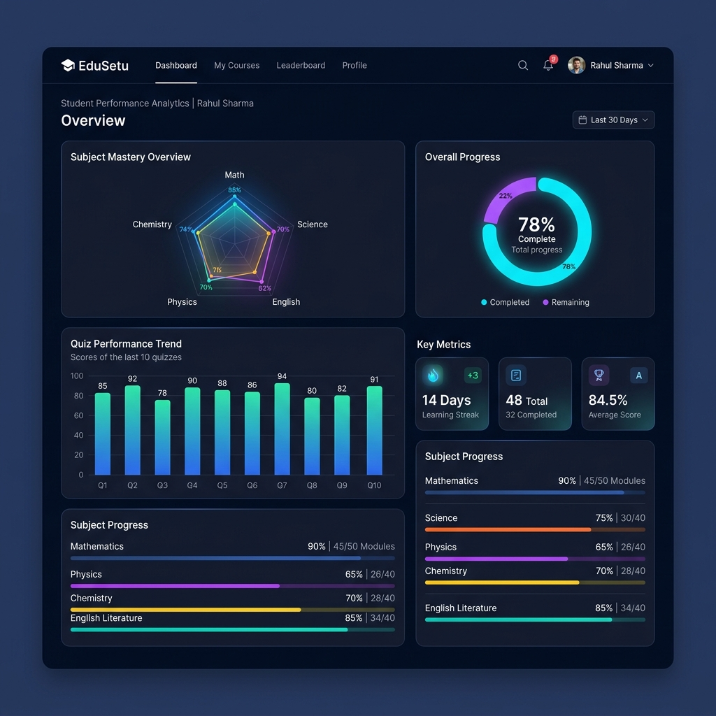
05 Platform Demo — Website Screenshots
Tech Stack: HTML5 + CSS3 + Vanilla JavaScript | Node.js + Express Backend | xAI Grok API | Chart.js + vis-network
AI Tutor — Grok-Powered Chat
Student Analytics Dashboard
🌐 Live Demo: http://localhost:3000 | 8 interconnected pages | Dark theme | Fully responsive
EduSetu — Platform Demo

Slide 6
06 Feasibility Analysis
⚙️ Technical Feasibility
💰 Financial Feasibility
🌍 Social Feasibility
▸ Built with standard web technologies (HTML, CSS, JS)
▸ Node.js + Express backend — lightweight and scalable
▸ xAI Grok API for real-time AI tutoring
▸ Chart.js and vis-network for interactive visualizations
▸ localStorage for offline persistence — no database needed
▸ Works on any modern browser (Chrome, Firefox, Edge, Safari)
▸ Responsive design supports mobile, tablet, and desktop
▸ Open-source technologies — zero licensing costs
▸ Grok API free tier available for prototyping
▸ Static hosting costs: ~₹0–500/month (Vercel, Netlify)
▸ Full platform costs < ₹5,000/month at 1,000 users
▸ No physical infrastructure required — fully cloud-based
▸ Revenue model: Freemium (basic free + premium AI features)
▸ Scalable from 10 to 100,000 users with minimal cost increase
▸ Addresses real need — 260M+ students in India
▸ Hindi + English support covers 75%+ of student population
▸ Designed for low-bandwidth environments
▸ Mentor view enables teacher adoption in schools
▸ Gamification (streaks, scores) increases student engagement
▸ Aligns with NEP 2020's technology integration goals
▸ Can be deployed by NGOs and government education programs
EduSetu — Feasibility Analysis

Slide 7
07 Innovation Factor
What makes EduSetu different from existing EdTech solutions?
🧠 Diagnostic-First Approach
🤖 Grok-Powered AI Tutor
🗺️ Visual Knowledge Graph
Unlike platforms that just deliver content, EduSetu identifies specific misconceptions using tagged quiz responses. Each wrong answer maps to a misconception pattern, enabling targeted remediation.
Real-time AI tutoring using xAI's Grok-3-mini model with a specialized educational system prompt. Provides contextual, step-by-step explanations in both English and Hindi.
Interactive Mastery Map shows how concepts connect. Students see their learning journey as a visual network — not just a linear syllabus. Helps build conceptual understanding.
🔍 Integrated Knowledge Engine
📊 Predictive Mentor Dashboard
🌐 No-Install, Offline-Ready
The Explore page functions as a topic search engine (like Google for education) covering Class 1 to Graduation with structured knowledge cards, key points, and related topics.
Mentor View identifies at-risk students using engagement patterns and mastery scores. Teachers get actionable insights, not just raw data.
Works instantly in any browser. No app download needed. Offline content support ensures accessibility even without consistent internet access.
EduSetu — Innovation Factor

Slide 8
08 References
[1] ASER Centre (2023). Annual Status of Education Report (ASER) 2023 — 'Beyond Basics'. Pratham Foundation.
🔗 https://asercentre.org/report/aser-2023/
[2] World Bank (2022). The State of Global Learning Poverty: 2022 Update. World Bank Group, UNESCO, UNICEF.
🔗 https://www.worldbank.org/en/topic/education/brief/learning-poverty
[3] Ministry of Education, Govt. of India (2023). Unified District Information System for Education Plus (UDISE+) Report 2022–23.
🔗 https://udiseplus.gov.in/
[4] National Education Policy 2020 (NEP 2020). Ministry of Education, Government of India.
🔗 https://www.education.gov.in/nep/about-nep
[5] UNESCO (2023). Global Education Monitoring Report 2023: Technology in Education — A Tool on Whose Terms?
🔗 https://www.unesco.org/gem-report/en/technology
[6] xAI (2025). Grok API Documentation — Chat Completions. xAI Corporation.
🔗 https://docs.x.ai/docs
EduSetu — References

Slide 9
Thank You!
EduSetu — Bridging the Learning Gap with AI
SDG 4: Quality Education × SDG 10: Reduced Inequalities
Built with ❤️ for every student in India
HTML5 • CSS3 • JavaScript • Node.js • Express • xAI Grok API • Chart.js • vis-network
EduSetu — ESD Project Report 2025–2026

