Slide 1

Project Title- Seasonal Agriculture Performance Analysis
Student Name: Tanisha Sharma
College Name: Graphic Era Hill University, Dehradun
AICTE STU ID : STU6988d386466281770574726

Slide 2

PROBLEM STATEMENT
Agricultural activities are influenced by seasonal variations in environmental conditions, farming practices, resource availability and market conditions. As a result, agricultural performance may differ from one season to another. However, raw agricultural data does not clearly explain how agricultural performance changes across seasons or what patterns can be observed in different seasonal conditions. The problem is to analyze the given agricultural dataset and investigate seasonal differences in agricultural performance by identifying meaningful patterns, trends, relationships and variations within the available data.

Slide 3
Project Description:
This Data Analytics project, investigate how agricultural performance varies across seasons and identify meaningful patterns, trends, relationships and differences in the available data. OBJECTIVES:
Understand the structure and quality of the agricultural dataset.
Clean and prepare the data for analysis.
Explore seasonal patterns in the dataset.
Perform descriptive and statistical analysis.
Investigate relationships among relevant variables.
Compare agricultural performance across seasons and other meaningful groups.
Use appropriate univariate, bivariate and multivariate visualizations.
Identify significant findings from the data.
Develop evidence-based insights and recommendations.

Slide 4

WHO ARE THE END USERS?
Farmers and Farm Owners Better crop and resource decisions
Agribusinesses Production and profitability planning
Government Departments Agricultural planning & resource allocation
Researchers and Consultants Data-driven agricultural insights

Slide 5

Technology Used
Python – Data analysis and processing Pandas – Data cleaning and manipulation NumPy – Numerical computation Matplotlib – Data visualization Seaborn – Statistical visualization Google Colab – Development and execution environment

Slide 6
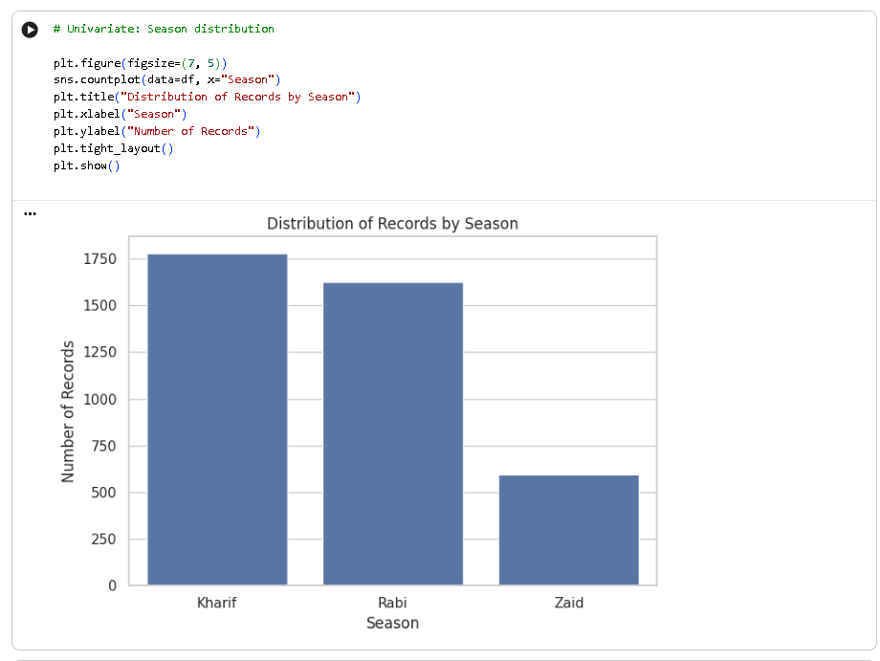
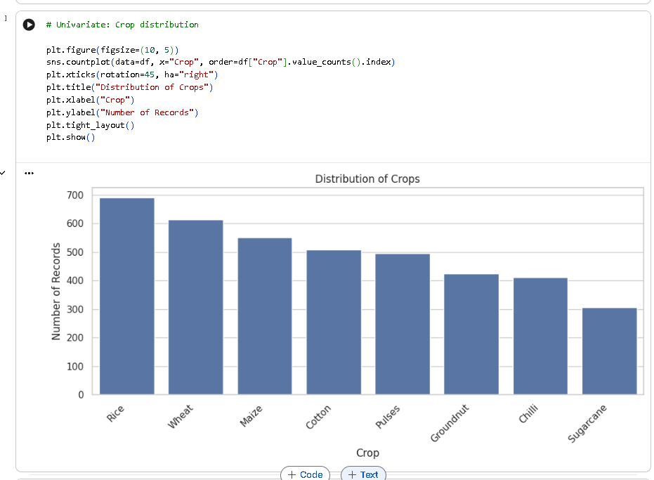
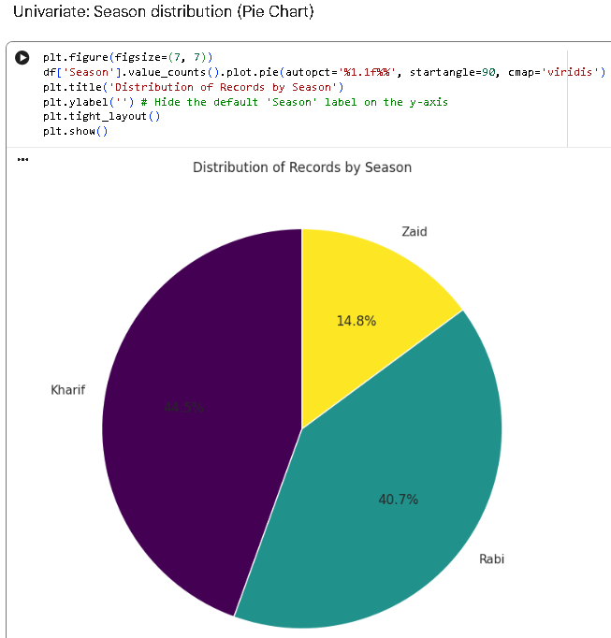
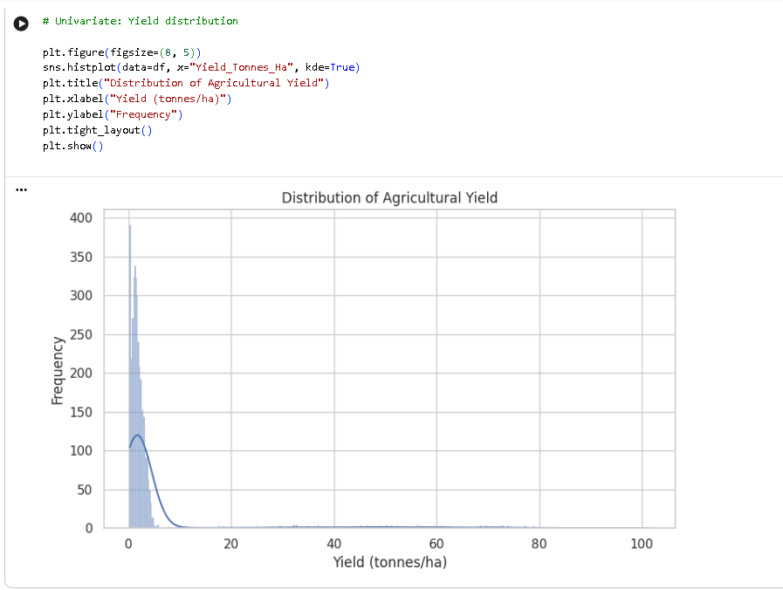
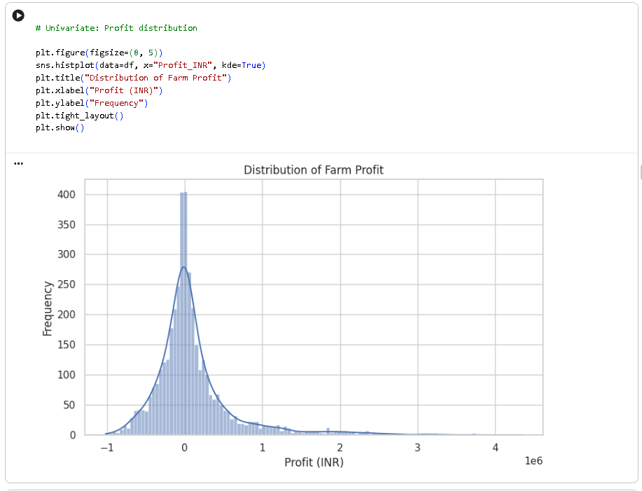
RESULTS: Univariate Analysis

Slide 7
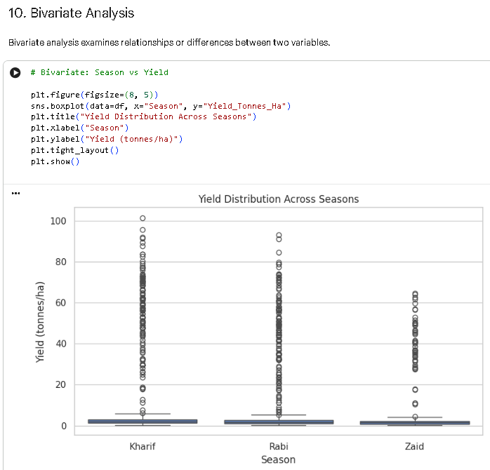
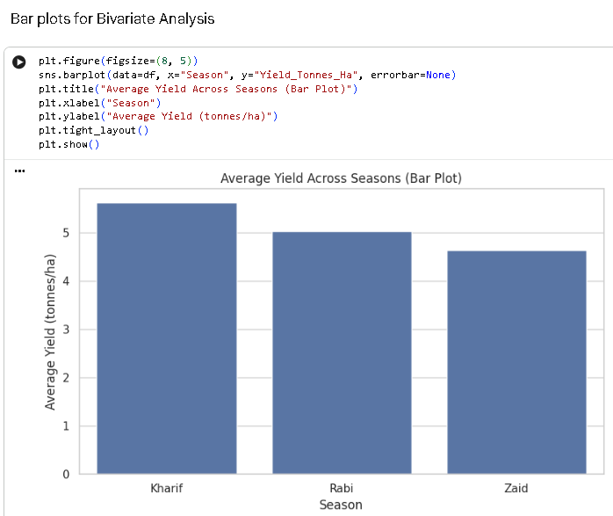
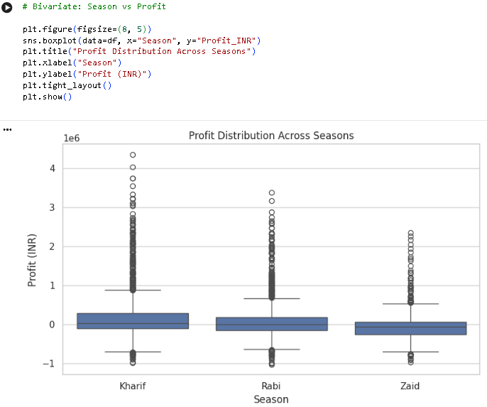
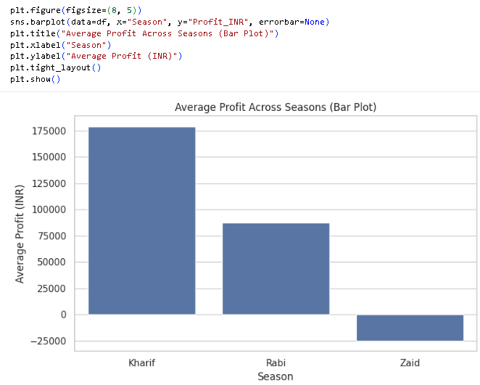
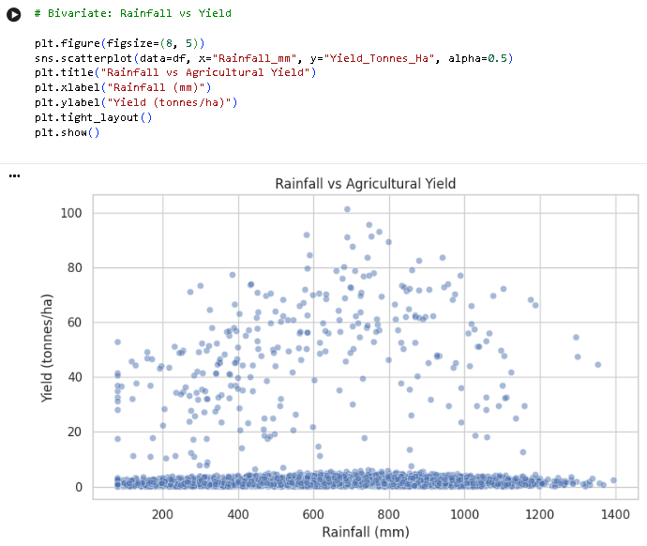
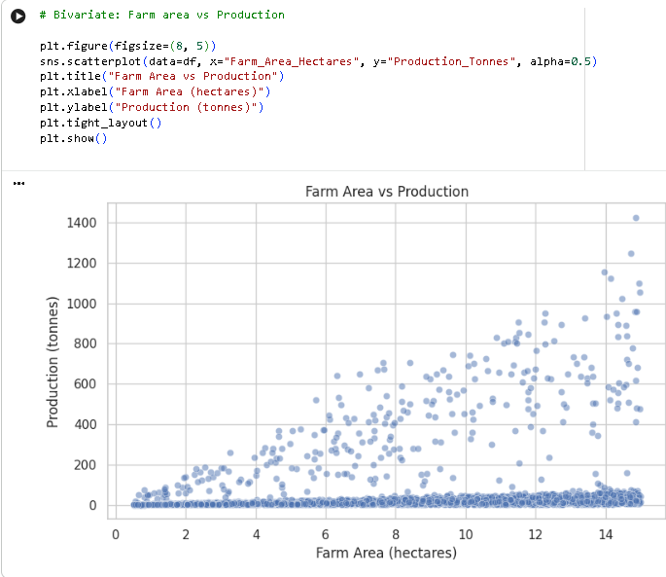
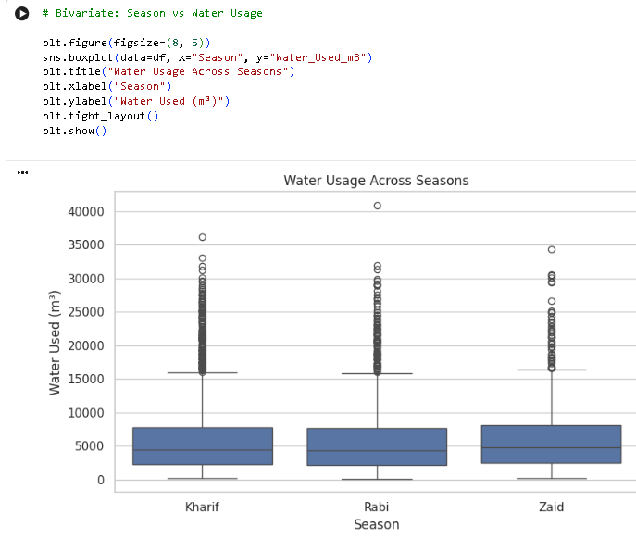
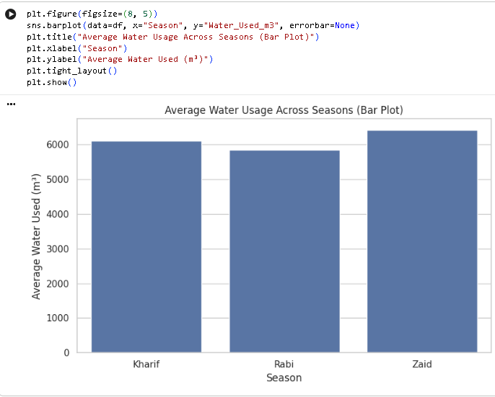
RESULTS : Bivariate Analysis

Slide 8
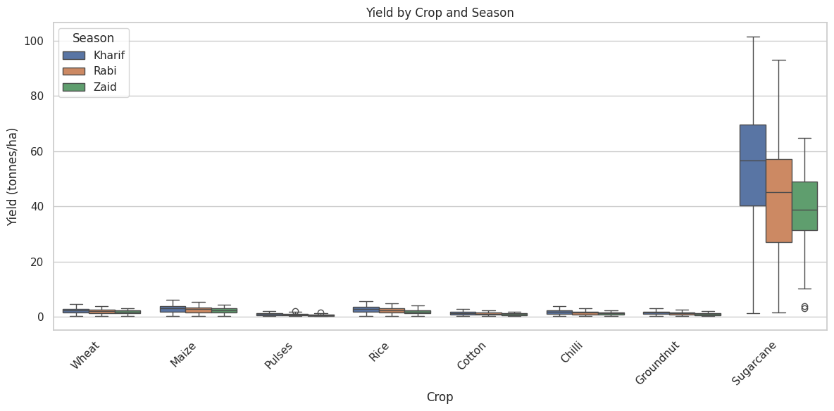
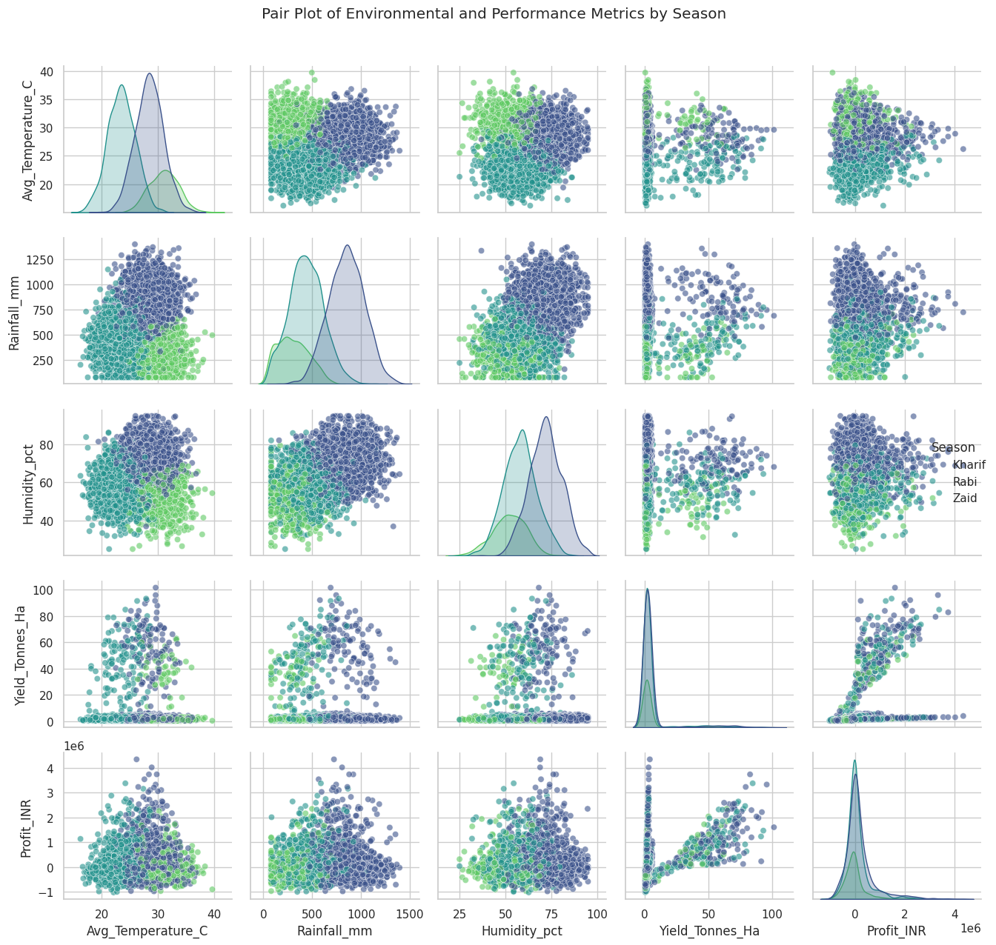
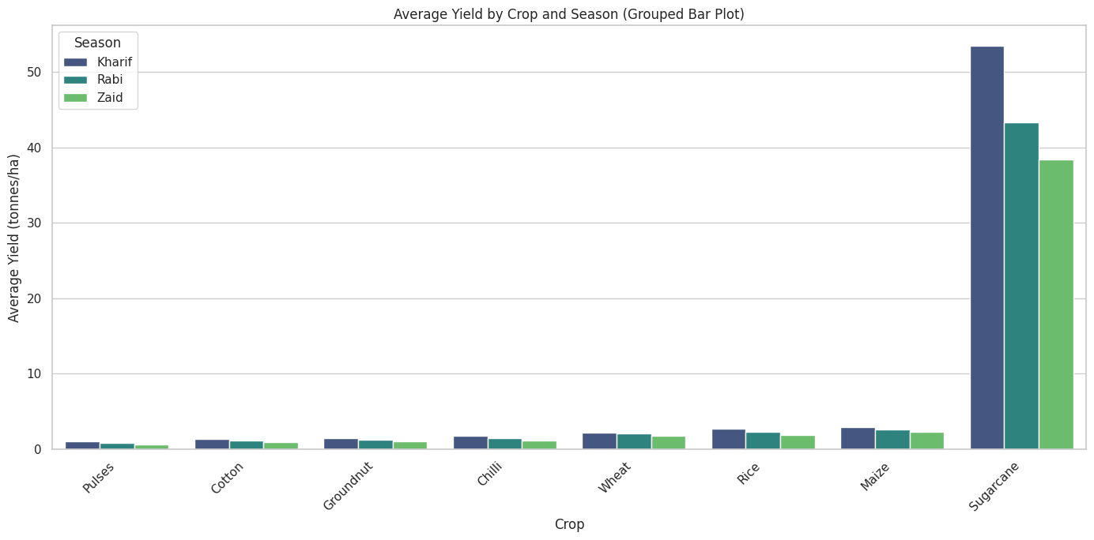
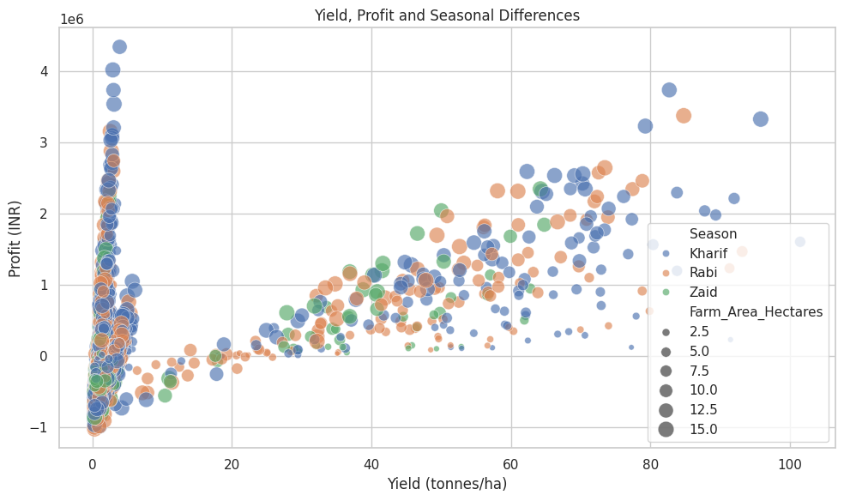
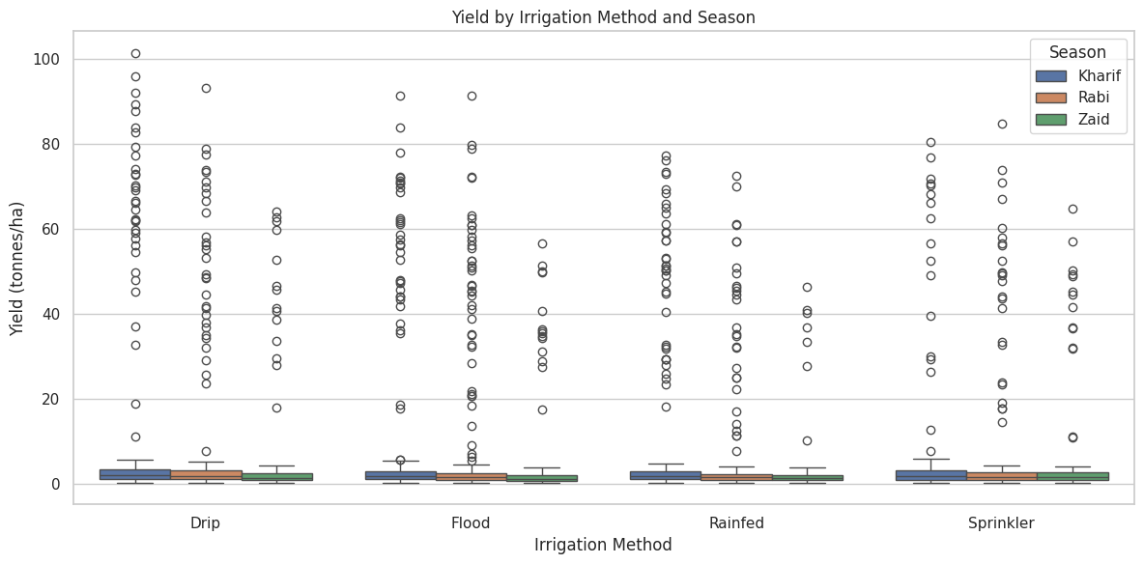
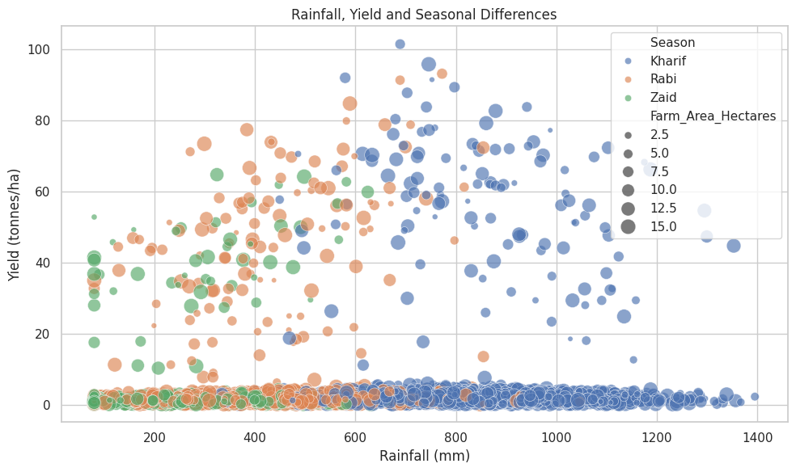
RESULTS: Multivariate Analysis

Slide 9
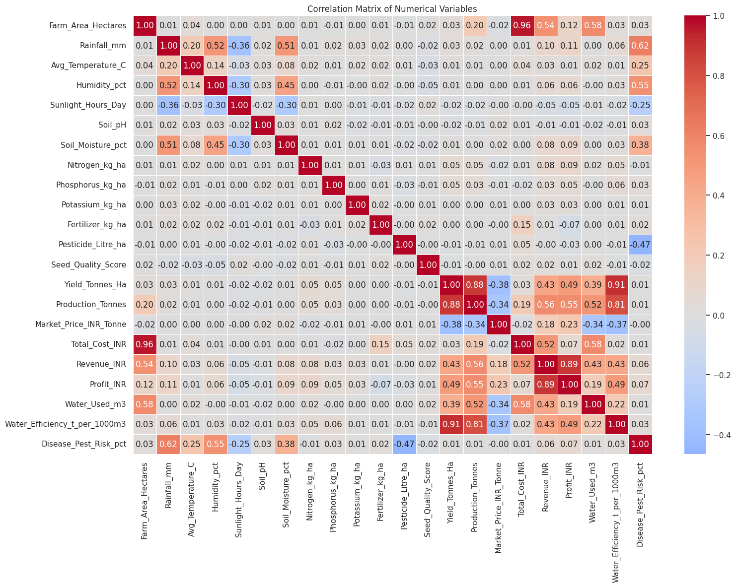
RESULTS

Slide 10
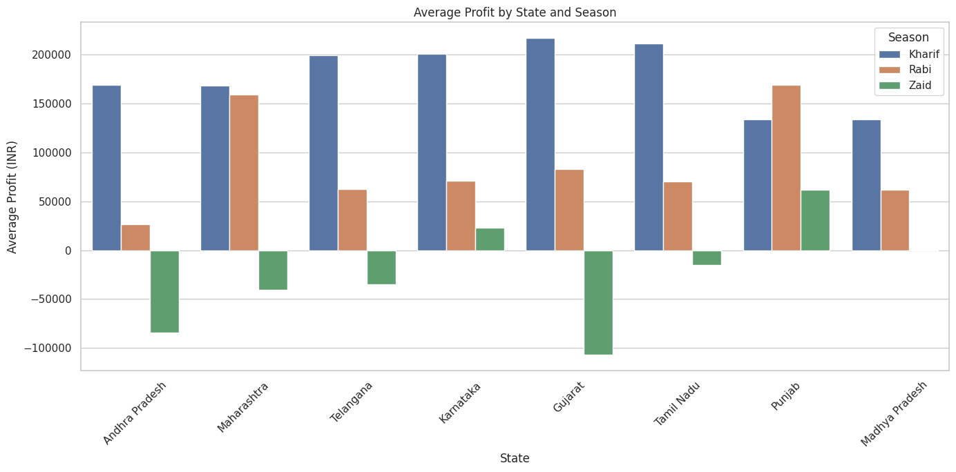
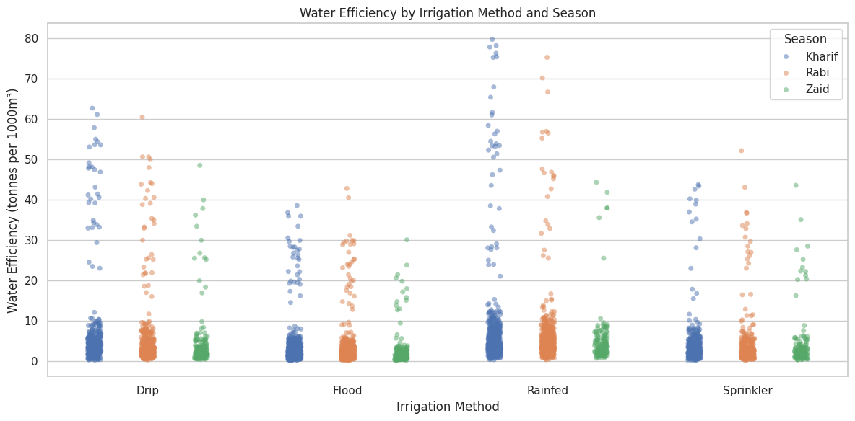
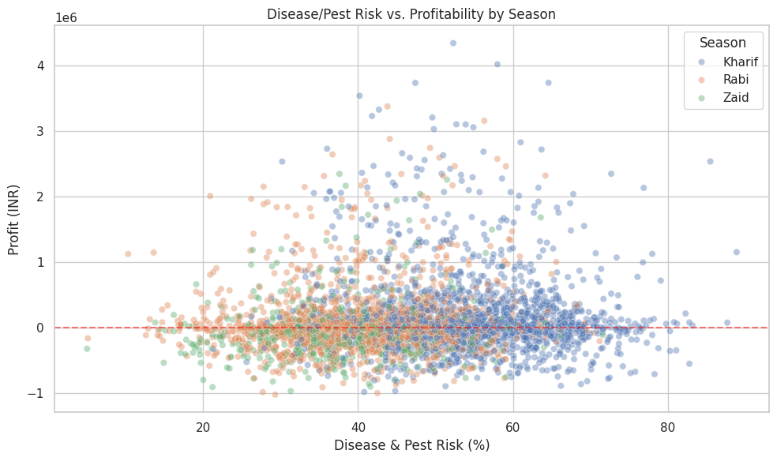
RESULTS

Slide 11
Final Project Response to Research Questions
Based on the analysis performed, here are the answers to the primary research questions:
Seasonal Yield Variation: Kharif shows the highest average yields (5.63 t/ha), largely driven by high rainfall, while Zaid yields are the lowest (4.64 t/ha).
Crop Performance: Sugarcane is the highest-performing crop across all seasons, while Pulses and Cotton generally show the lowest yields.
Irrigation Efficiency: Drip irrigation is the most efficient method, consistently associated with higher average yields compared to flood or rainfed methods.
Economic Viability: The Zaid season presents the highest economic risk, with average profits falling into the negative (-24,804 INR).
Environmental Impacts: Rainfall and humidity are the strongest environmental predictors of seasonal performance clusters.
Regional Patterns: States like Gujarat show higher vulnerability to profit losses during the Zaid season compared to states like Punjab.
Risk Correlation: There is a clear threshold at 50% Disease/Pest risk where profitability begins to decline sharply across all crops.

Slide 12
Future scope
1. Predictive Analytics — Forecast yield, profit and agricultural risks 2. Interactive Dashboard — Enable real-time exploration of insights 3. Weather Integration — Incorporate real-time environmental data 4. Resource Optimization — Improve water, fertilizer and input efficiency 5. Regional Expansion — Compare performance across regions

Slide 13
GitHub Link
https://github.com/tanishasharma1111/Seasonal_Agriculture_Performance_Data_Analytics

Slide 14
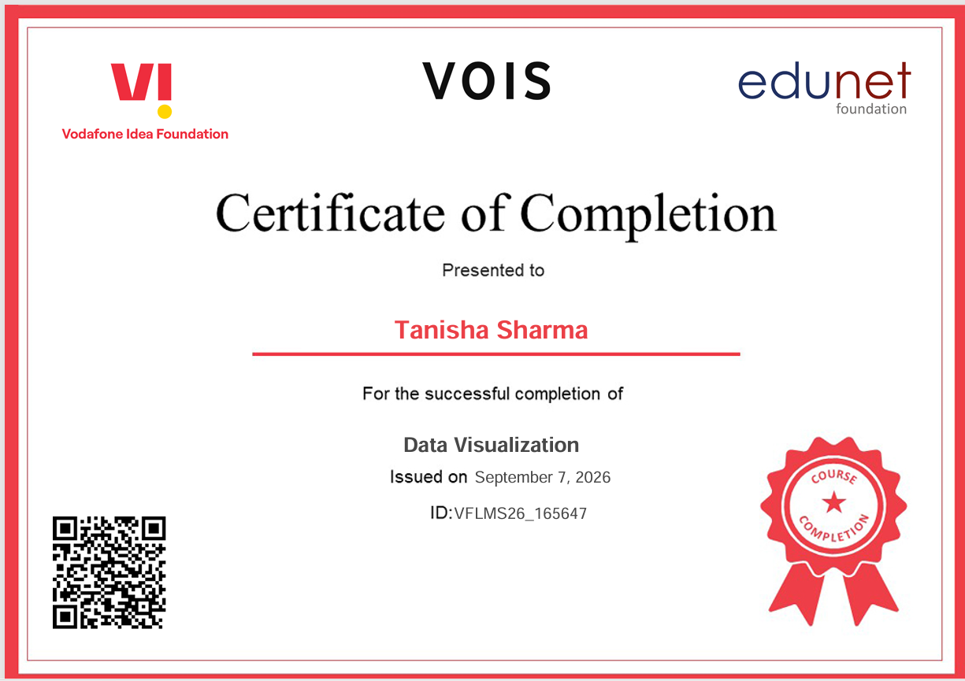
VOIS Course completion certificate - Course name- Data Visualization

Slide 15
Thank you
.
.

