Slide 1
Bank Loan Case Study
Final Project – 2
SUBMITTED BY: Tanisha Sodani
COURSE: Data Analytics – Trainity
TOOLS USED: Microsoft Excel 2021
DATE: AUGUST 13, 2025

Slide 2
CONTENTS
Project Description
Approach
Tech-Stack Used
Data Cleaning & Preprocessing
Data analytics tasks
Insights
Result

Slide 3
PROJECT DESCRIPTION
This project analyzes loan application data for a finance company to identify factors that influence loan default risk. The dataset contains customer demographics, financial attributes, and loan details.
The objective is to perform Exploratory Data Analysis (EDA) to uncover patterns that distinguish customers likely to default from those who will repay on time. The study includes:
  Identifying and handling missing data.
  Detecting and treating outliers.
  Assessing data imbalance in the target variable.
  Conducting univariate, segmented univariate, and bivariate analyses.
  Finding top correlations between variables and loan default.
The findings aim to help the company improve its loan approval process, reduce financial losses, and approve more capable borrowers.

Slide 4
APPROACH
  Cleaned data: handled missing values, removed irrelevant columns, treated outliers.
  Performed EDA: univariate, segmented univariate, and bivariate analysis.
  Used Excel functions & charts for statistical insights.
  Identified key variables affecting loan default.

Slide 5
TECH-STACK USED
  Microsoft Excel 2021 –
Data cleaning, statistical analysis, visualization.
  Excel Functions –
COUNT, COUNTIF, IF, MEDIAN, QUARTILE, CORREL.
  Excel Features –
Pivot Tables, Conditional Formatting, Filters, Sorting, Charts.

Slide 6
Data Analytics Tasks:

Slide 7
Identify Missing Data
OBJECTIVE:
To identify and handle missing values in the loan application dataset to ensure accurate analysis.
APPROACH
  Calculated missing percentage using:
=COUNTBLANK(range)/COUNTA(range) * 100
  Created a summary table of columns with missing values
  Deleted columns with high missing % or low relevance
  Used Excel functions: COUNTBLANK, IF, MEDIAN (for imputation)

Slide 8
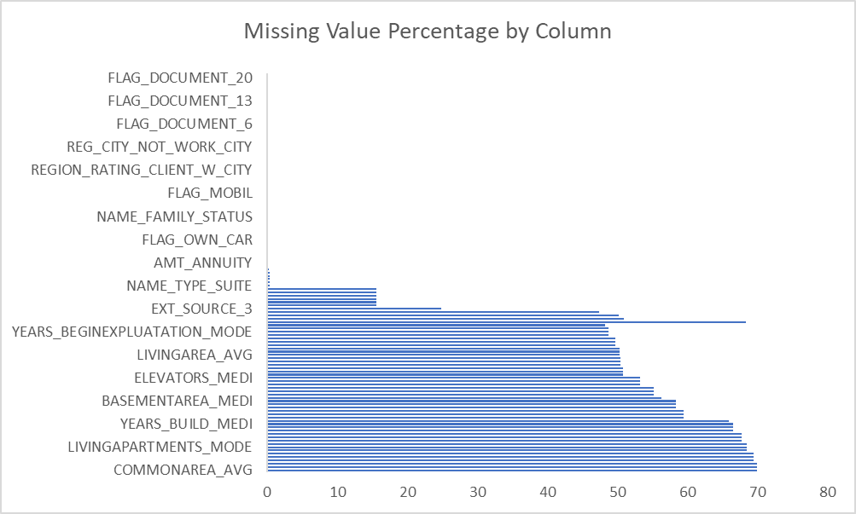
Deal with Missing Data Appropriatel
VISUALIZATION
Prepared a bar chart to show the % of missing values per column (sorted by highest %).
INSIGHTS
  Removed 40+ columns with high missing percentages
  Imputed key numeric fields (e.g., EXT_SOURCE, AMT_ANNUITY) using median values
  Filled low-missing categorical columns using direct/manual fill
  Retained relevant features like OCCUPATION_TYPE (31% missing) due to its analytical importance

Slide 9
Outlier Detection and Analysis
Objective:
Detect and examine outliers in key loan application fields to improve data quality.
Approach:
  Selected main numeric columns:
AMT_CREDIT, AMT_ANNUITY, AMT_GOODS_PRICE, AMT_INCOME_TOTAL
  Used Excel to:
    Calculate Q1 and Q3 with QUARTILE
    Compute the IQR (Interquartile Range)
    Define Lower and Upper Bounds
  Applied Conditional Formatting to flag outlier cells
  Built box plots to visualize distributions

Slide 10
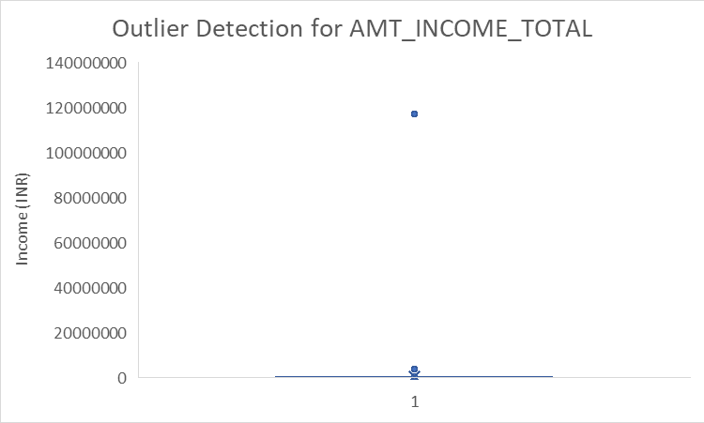
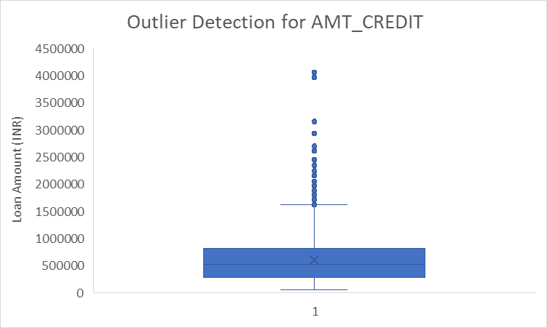
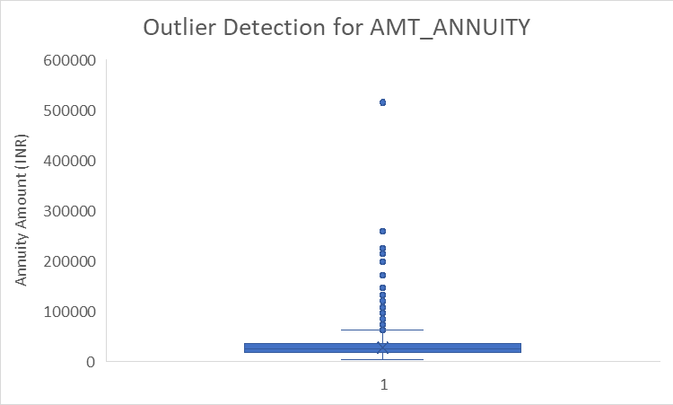
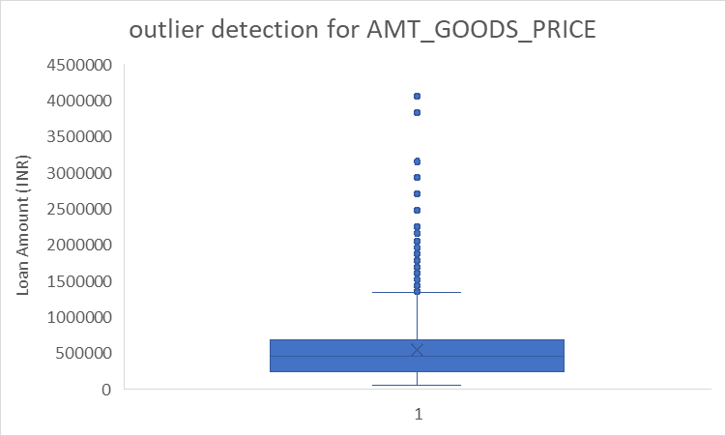
Outlier Visualization

Slide 11
Outlier Insights
  All analyzed variables show clear presence of outliers above the upper threshold.
  AMT_CREDIT and AMT_GOODS_PRICE have many moderate to high outliers.
  AMT_ANNUITY contains fewer but notable outlier payments.
  AMT_INCOME_TOTAL displays extreme income values that are significantly higher than the majority of observations and may skew results.

Slide 12
Data Imbalance Analysis
Objective & Approach
Objective:
Analyze the distribution of target classes to understand class imbalance.
Approach
  Used Excel functions (COUNTIF, SUM) to calculate the frequency of each target class.
  Computed the proportion and imbalance ratio between classes.
  Created a pie chart to visualize the distribution.

Slide 13
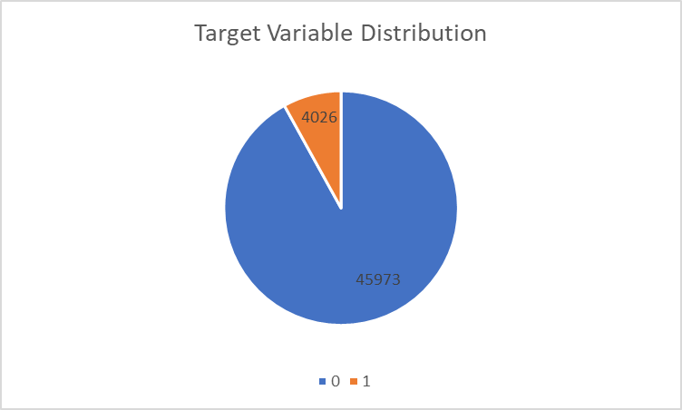
Data Imbalance Analysis
Visualization & Insights
Insights
  Dataset is highly imbalanced: ~92% non-defaulters, ~8% defaulters.
  Imbalance ratio ≈ 11.4:1, showing a strong class skew.
  This may bias models and reduce accuracy for defaulter prediction.
  Balancing techniques will be needed during model building.

Slide 14
Perform Univariate, Segmented Univariate, and Bivariate Analysis
Objective:
To analyze loan applicant and loan attributes individually and in relation to loan default status, identifying patterns and differences between defaulters and non-defaulters.
Approach:
  Univariate Analysis: Studied individual variable distributions using descriptive statistics (COUNT, AVERAGE, MEDIAN).
  Segmented Univariate Analysis: Compared variable distributions between TARGET=0 and TARGET=1.
  Bivariate Analysis: Explored relationships between two variables and the target variable using pivot tables and scatter plots.

Slide 15
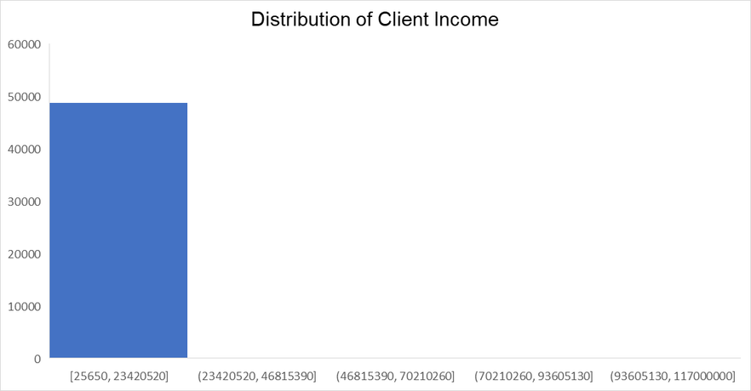
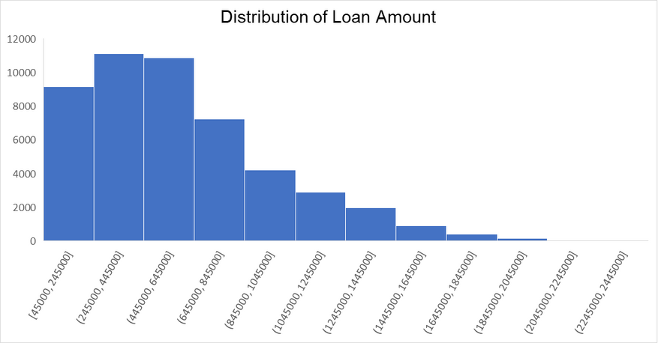
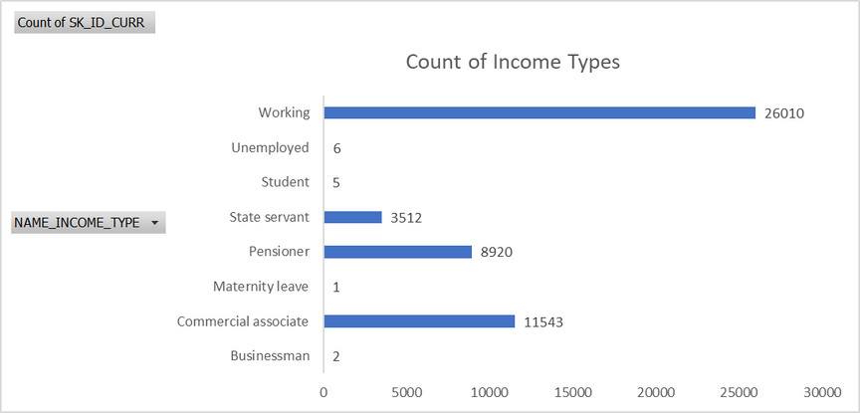
Univariate Analysis

Slide 16
Univariate Analysis Insights
  Most applicants have lower income and smaller loan amounts; distributions are right-skewed.
  Majority of loans are Cash loans.
  Most are Working, have Secondary education, and work as Laborers or Sales staff.

Slide 17
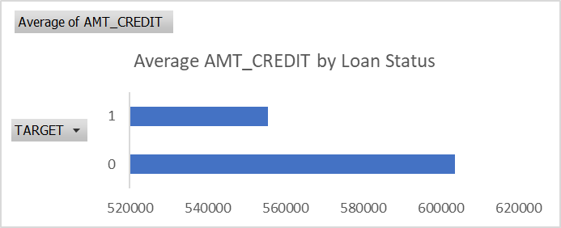
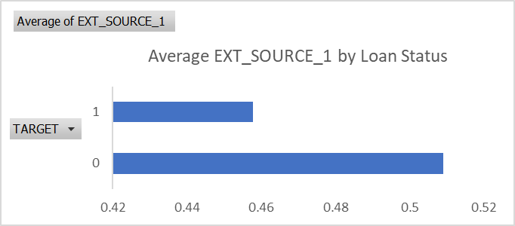
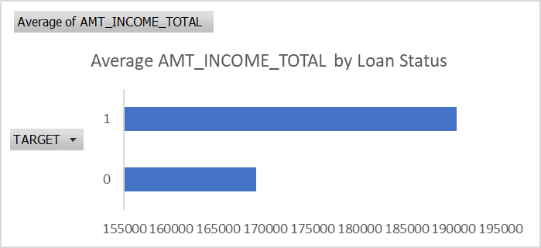
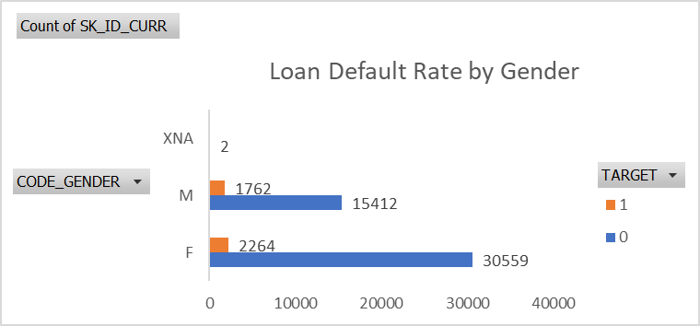
Segmented Univariate Analysis

Slide 18
Segmented Univariate Analysis Insights
  Non-defaulters have slightly higher average income, loan amounts, and external scores.
  Lower education levels and certain occupations (Laborers, Drivers) have higher default rates.
  Male applicants show a slightly higher proportion of defaults compared to females.

Slide 19
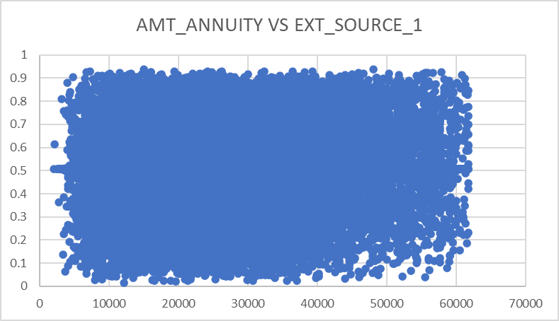
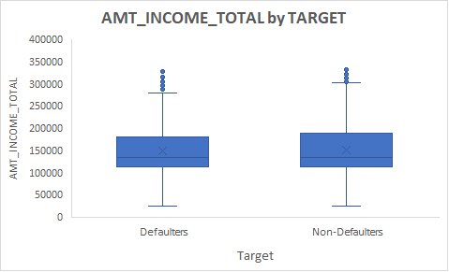
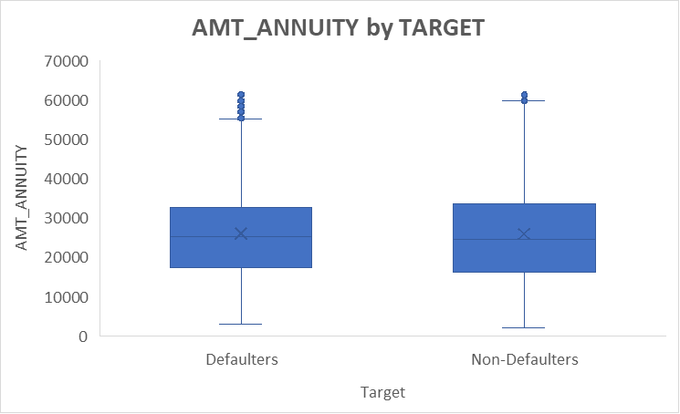
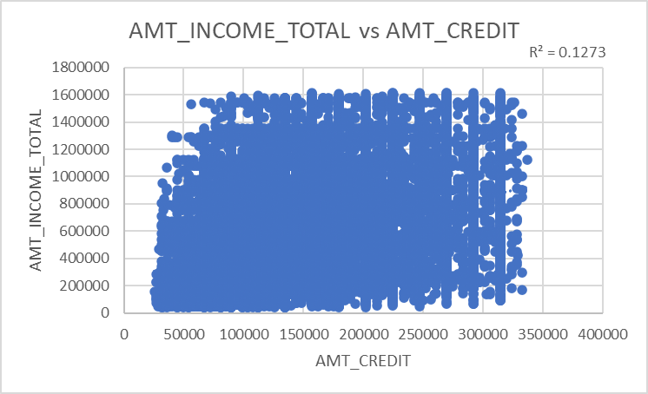
Bivariate Analysis

Slide 20
Bivariate Analysis Insights
  AMT_CREDIT vs AMT_ANNUITY: Very strong positive correlation (~0.77).
  AMT_INCOME_TOTAL vs AMT_CREDIT: Moderate positive correlation (~0.36).
  External source scores have weak correlations with amounts but are still valuable predictors.

Slide 21
Top Correlations for Different Scenarios
Objective:
To identify the strongest predictors of loan default by analyzing correlations for defaulters and non-defaulters separately
Approach:
  Segmented the dataset into two groups based on TARGET.
  Used Excel =CORREL() to calculate correlations between numeric variables and TARGET.
  Ranked variables by absolute correlation value.
  Highlighted top 3 indicators for each segment.
  Visualized results using correlation heatmaps and summary tables.

Slide 22
Understanding the Correlation Heatmaps
  These heatmaps display the correlation patterns for two groups:
    Target = 0: Clients without payment difficulties
    Target = 1: Clients with payment difficulties
  Color legend:
    Yellow: Strong positive correlation
    Pink/Red: Strong negative correlation
    Green: Weak correlation

Slide 23
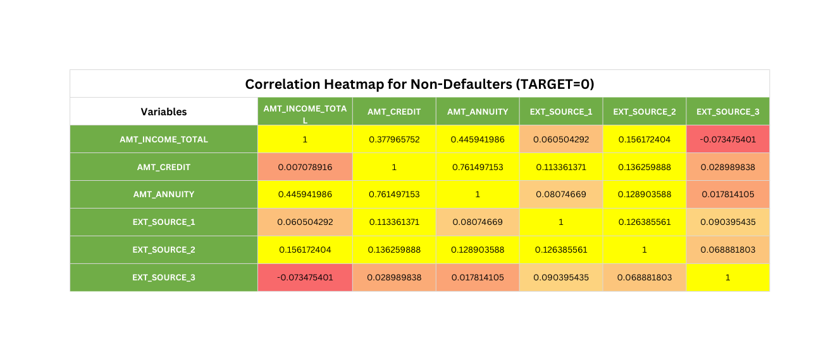
Visualization: Defaulters (TARGET=0)
Insights:
  Strongest correlation: AMT_CREDIT & AMT_ANNUITY (0.76) – consistent loan-payment relationship.
  Income–Credit relationship: Moderate (0.38) – loan amounts are better aligned with client incomes, supporting repayment ability.

Slide 24
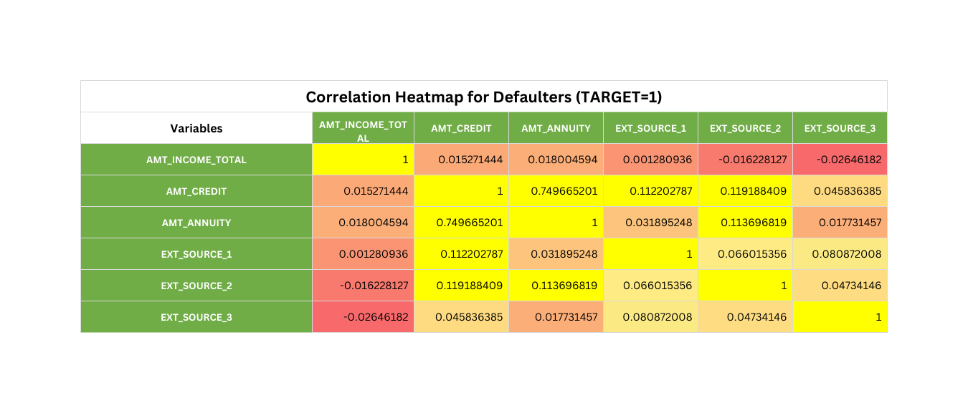
Visualization: Defaulters (TARGET=1)
Insights:
  Strongest correlation: AMT_CREDIT & AMT_ANNUITY (0.75) – higher loan amounts lead to higher annuity payments.
  Income–Credit relationship: Very weak (0.015) – indicates loans may not be proportionate to income, possibly leading to defaults.

Slide 25
Insights
  Missing Data Handling: Many columns had high missing values; 40+ were removed, and key numeric/categorical fields were imputed to preserve useful information.
  Outlier Detection: Outliers were identified in variables like income, credit, and annuity; extreme anomalies were reviewed to prevent skewed analysis.
  Data Imbalance: The target variable showed imbalance, with non-defaulters forming the majority, requiring attention for fair modeling.
  Univariate & Segmented Analysis: Loan defaults were more common among lower-income, lower-education, and certain occupational groups; non-defaulters had higher external scores and incomes.
  Bivariate & Correlation Analysis: Strong link between loan amount and annuity across all clients; income-to-loan relationship is weaker among defaulters, highlighting risk in granting high loans without income alignment.

Slide 26
Result
  Successfully cleaned the dataset by handling missing values and removing irrelevant columns.
  Identified and addressed outliers to improve analysis accuracy.
  Detected target variable imbalance and quantified its ratio.
  Analyzed variable distributions (univariate, segmented, bivariate) to uncover loan default patterns.
  Identified top correlated variables for different customer segments (defaulters vs. non-defaulters).
  Generated actionable insights to support risk assessment and loan approval decisions.

Slide 27
THANK YOU

