Slide 1
IMDB MOVIE ANALYSIS
Final Project – 1
SUBMITTED BY: Tanisha Sodani
COURSE: Data Analytics – Trainity
TOOLS USED: Microsoft Excel 2021
DATE: JULY 19, 2025

Slide 2
CONTENTS
  PROJECT DESCRIPTION
  APPROACH
  TECH-STACK USED
  DATA CLEANING & PREPROCESSING
  DATA ANALYTICS TASKS
  INSIGHTS
  RESULT

Slide 3
PROJECT DESCRIPTION
This project explores key factors influencing the success of movies on IMDB. The goal was to analyze the dataset using Excel to identify trends in ratings, genres, durations, languages, directors, and budgets.
The approach included:
  Data cleaning & preprocessing
  Descriptive statistics & Pivot Tables
  Visualization using charts and correlation analysis
The insights help stakeholders understand what drives higher ratings and profits.

Slide 4
APPROACH
  Used Microsoft Excel (2021) for all analysis and visualizations
  Applied Power Query to clean data and split multi-value columns (e.g., genres)
  Handled missing values using techniques like median imputation and removal
  Created Pivot Tables, used functions like AVERAGE, MEDIAN, MODE, STDEV, CORREL, and PERCENTILE
  Built visualizations (scatter plots, trendlines) to understand relationships
  Performed task-wise analysis (A to E) and extracted insights based on each category.

Slide 5
TECH-STACK USED
Microsoft Excel 2021
Used for data cleaning, transformation, statistical analysis, Pivot Tables, and visualizations.
Power Query (Excel Add-in)
Used to split multi-value columns (e.g., genres) and reshape data efficiently

Slide 6
DATA CLEANING & PREPROCESSING
Performed the following cleaning steps to prepare the dataset for analysis:
  Removed 45 duplicate rows using Excel’s built-in feature
  Deleted 5 rows with both budget and gross missing — not useful for financial analysis
  Filled 14 blank color entries with "Color" (most common value)
  Handled 12 rows with both color and gross missing — retained for non-financial analysis
  Retained 101 rows with missing director_name — excluded from Director-based insights
  Filled blanks in num_critic_for_reviews, duration, facebook_likes, etc. using median
  Missing country, language, content_rating filled with "Unknown" or "Unrated"
  Retained blanks in gross, budget, title_year, aspect_ratio — excluded from specific tasks
  Corrected 51 invalid aspect_ratio values:
    4 → 1.33
    16 → 1.78

Slide 7
Data Analytics Tasks:

Slide 8
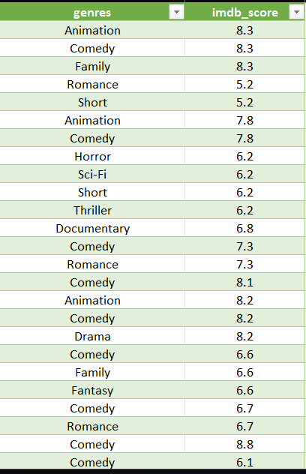
GENRE ANALYSIS
Objective:
To analyze the distribution of movie genres and understand their impact on IMDB ratings using descriptive statistics.
Approach:
• Used Power Query to split multi-genre movies into separate rows using the "|" delimiter
• Created a cleaned sheet with one genre per row linked to IMDB score
• Built a Pivot Table to calculate:
    Count, Average, Min, Max, Std Dev, Variance
    Used Excel formulas to manually calculate Median and Mode for each genre

Slide 9
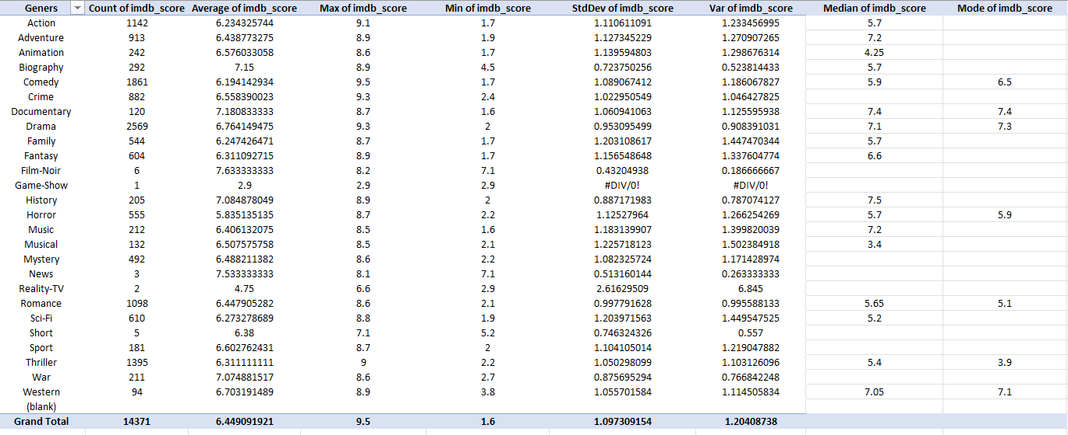
MOVIE GENRE ANALYSIS -
Statistical Summary

Slide 10
MOVIE GENRE ANALYSIS -
Insights & Conclusion
Key Insights
  Most Common Genres: Drama, Comedy, Action, Thriller, Romance
  Highest Avg Ratings:
    Film-Noir: 7.63
    Documentary: 7.18
    Biography: 7.15
  Lowest Avg Rating: Reality-TV (4.75)
  Niche genres tend to receive higher ratings
  Popular genres show greater variation
Conclusion:
Genre influences ratings significantly. Niche genres may be less common but often receive better reviews, while mainstream genres attract large audiences but show inconsistent scores.

Slide 11

MOVIE DURATION ANALYSIS –
Objective & Approach
Objective:
To analyze the distribution of movie durations and evaluate how movie length affects the IMDB score.
Approach:
  Calculated key descriptive statistics:
    Average (Mean) duration
    Median duration
    Standard Deviation to measure spread
  Used Excel functions: AVERAGE(), MEDIAN(), and STDEV()
  Created a scatter plot of Duration vs IMDB Score
  Added a trendline to analyze the strength and direction of the relationship

Slide 12
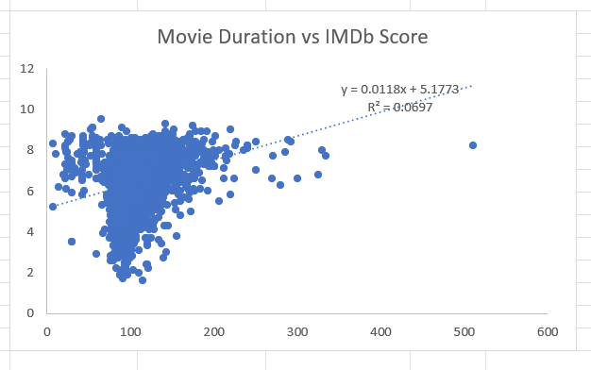
MOVIE DURATION ANALYSIS –
Insights – Duration vs IMDB Score
Key Insights:
  Average duration of movies is around 107 minutes
  Median duration is 103 minutes (indicating slightly left-skewed distribution)
  Standard deviation is 25.17 minutes, showing moderate spread
  Scatter plot shows a weak positive correlation between movie length and IMDB score
  R² value is low (~0.069) → Duration alone doesn't strongly influence rating

Slide 13
LANGUAGE ANALYSIS -
Approach
Objective
To examine how different movie languages influence IMDB ratings using descriptive statistics like mean, median, and standard deviation.
Approach
  Used Excel formulas:
    COUNTIF – to count number of movies per language
    AVERAGEIF, MEDIAN, STDEV.P – to compute statistical measures
  Filtered dataset by unique languages
  Created a summary table for comparison of IMDB scores

Slide 14
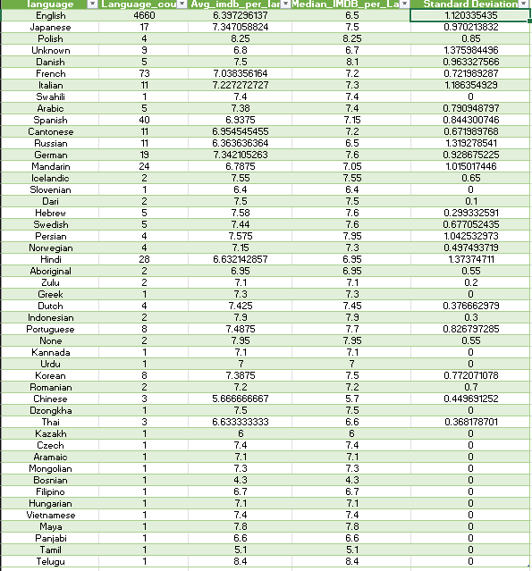
LANGUAGE-WISE IMDB SCORE SUMMARY

Slide 15
LANGUAGE ANALYSIS -
Insights
Key Insights:
  Most Common Language: English – 4660 movies
  Top Rated Languages (by Avg IMDB):
      Polish – 8.25, Indonesian – 7.9, Portuguese – 7.49
  English Films:
      Avg: 6.37, Median: 6.5, Std Dev: 1.12
  Hindi Films: Avg: 6.63 (28 movies)
  Highly Consistent Ratings:
      Urdu, Dzongkha, Kannada – Std Dev: 0
Observation:
Lesser-known languages often show higher or more consistent ratings, possibly due to niche audiences or curated content.

Slide 16
DIRECTOR ANALYSIS -
Objective & Approach
Objective:
To analyze the influence of directors on IMDB ratings by identifying top-performing directors and evaluating their contribution using percentile scores.
Approach:
  Calculated average IMDB score per director using Excel Pivot Table.
  Used PERCENTILE.EXC function to determine the cutoff for top directors (e.g., 90th percentile).
  Filtered directors above the percentile threshold to identify the highest-rated.
  Compared their scores to the overall distribution to highlight excellence.

Slide 17
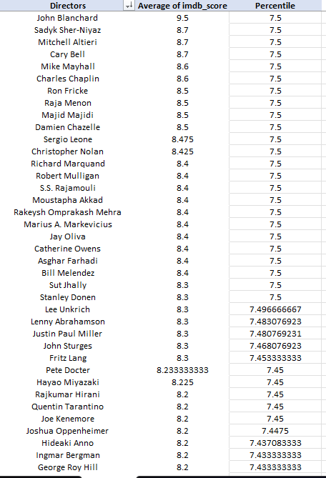
DIRECTOR ANALYSIS -
Insights
Key Insights:
  Directors like John Blanchard (9.5), Sadyk Sher-Niyaz (8.7), and Christopher Nolan (8.42) ranked among the highest.
  Top directors consistently scored above the 75th percentile, indicating strong influence on movie success.
  Directors with 8.2+ average IMDB scores formed the top tier.
  The list includes filmmakers from diverse genres and cultural backgrounds, proving that high-quality storytelling transcends boundaries.

Slide 18
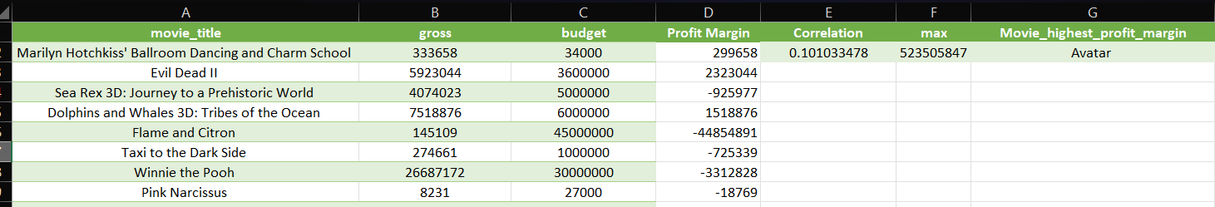
BUDGET ANALYSIS -
Objective & Approach
Objective:
To explore the relationship between movie budgets and financial success using correlation and profit margin analysis.
Approach:
• Filtered dataset to exclude rows with missing budget or gross values.
• Calculated Profit Margin as Gross – Budget.
• Used Excel's CORREL function to find correlation between Budget and Gross.
• Used MAX and INDEX + MATCH to find the movie with the highest profit margin

Slide 19
BUDGET ANALYSIS -
Insights
Insights:
  There is a weak positive correlation between budget and gross revenue (~0.10), suggesting that bigger budgets don’t always guarantee higher returns.
  Some low-budget films achieved impressive profits, indicating strong content or marketing.
  Avatar had the highest profit margin in the dataset.

Slide 20
INSIGHTS
  Drama, Comedy, and Action were the most frequent genres; Film-Noir had the highest average rating.
  Longer movies showed a weak positive correlation with higher IMDB ratings.
  English was the dominant language, but some non-English films scored higher on average.
  Top directors (based on percentiles) consistently delivered higher-rated movies.
  Budget vs. Gross showed a moderate positive correlation; however, profit margins varied widely.

Slide 21
RESULT
  Gained practical experience in cleaning and analyzing real-world data
  Improved Excel skills: used functions, Pivot Tables, and Power Query
  Understood how genres, budgets, and directors impact movie success
  Learned to apply statistical methods to draw actionable insights
  Enhanced data storytelling and presentation skills through visualization

Slide 22
THANK YOU

