Slide 1


INSTAGRAM USER ANALYTICS PROJECT
SUBMITTED BY: Tanisha Sodani
COURSE: MySQL – Trainity
TOOLS USED: MySQL Workbench, SQL
DATE: JUNE 12, 2025

Slide 2
CONTENT
Project Description
Tech Stack Used
SQL Tasks & Approach
SQL Queries & Output
Insights & Observations
Conclusion & Learnings

Slide 3
APPROACH
Step-by-step process followed:
✅ Set up the Instagram user database in MySQL Workbench
🛠️ Wrote SQL queries to solve each business question
📊 Analyzed and interpreted the results to derive insights
🖼️ Took screenshots of SQL queries and output tables for reporting

Slide 4
TECH STACK USED
Tools & Technologies Used:
MySQL Workbench 💻
Used to write and execute SQL queries
User-friendly interface for database management and visualization
SQL (Structured Query Language) 🗂️
Used for data retrieval, filtering, and analysis
Helped answer business questions by writing precise queries
Why These Tools?
MySQL Workbench is widely used in data analytics for working with structured data.
It allows for quick testing, debugging, and visualization of query results.
SQL is the foundational language for relational database management.

Slide 5
MARKETING ANALYSIS

Slide 6
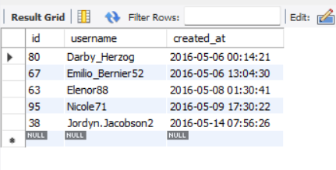
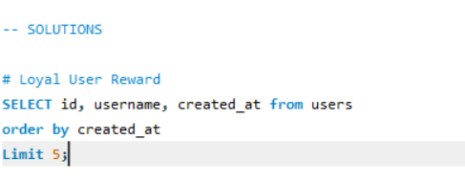
LOYAL USER REWARD
🔹Objective:
To identify the top 5 most loyal users i.e., i.e., those who have been using the platform for the longest time.
SQL Query Used:
Output:
💡Insight:
These users — Darby_Herzog, Emilio_Bernier52, Elenor88, Nicole71, and Jordyn.Jacobson2 — are the earliest users of the platform and can be rewarded through loyalty programs or exclusive offers.

Slide 7
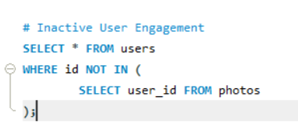
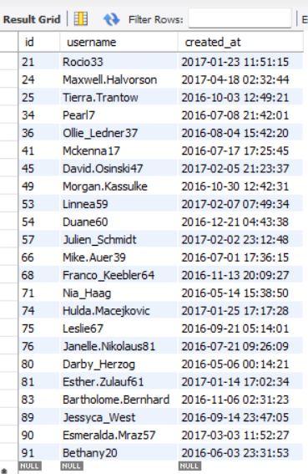
INACTIVE USER ENGAGEMENT
🔹Objective:
Identify users who have never posted any photo on Instagram, so the team can target them with promotional emails.
Output:
SQL Query Used:
💡Insight:
These users have registered but never uploaded any photo. They can be targeted with promotional emails to encourage them to start posting and become active users.

Slide 8
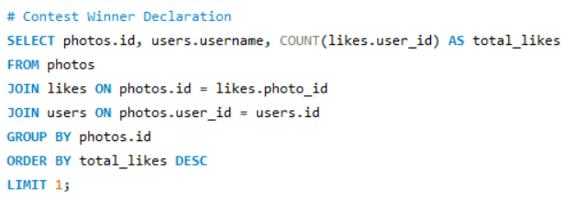

CONTEST WINNER DECLARATION
🔹Objective:
Identify the photo with the highest number of likes and find the user who posted it, so they can be declared the contest winner.
SQL Query Used:
Output:
💡Insight:
The contest winner is Zack_Kemmer93, whose photo received the highest number of likes on the platform.

Slide 9
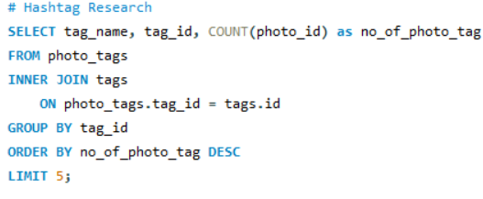
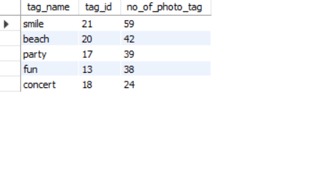
HASHTAG RESEARCH
🔹Objective:
Identify the top 5 most commonly used hashtags on the platform so a partner brand can use them to boost their reach.
SQL Query Used:
Output:
💡Insight:
The top 5 most used hashtags on the platform can help brands maximize their post reach and engagement.

Slide 10
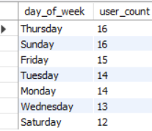
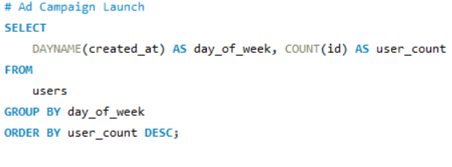
AD CAMPAIGN LAUNCH
🔹Objective:
Find out which day of the week most users register on Instagram, so the team can schedule ad campaigns for maximum reach.
Output:
SQL Query Used:
💡Insight:
Most users register on Thursday and Sunday, making these the ideal days to launch ad campaigns for better reach and engagement.

Slide 11
INVESTOR METRICS

Slide 12
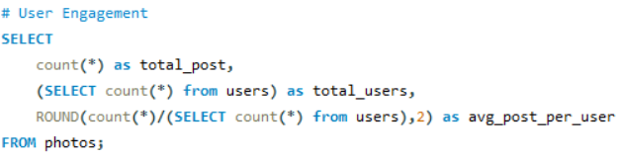

USER ENGAGEMENT
🔹Objective:
To check if users are actively posting by calculating total posts, total users, and average posts per user.
SQL Query Used:
Output:
💡Insight:
There are 257 posts and 100 users on the platform. On average, each user shares 2.57 photos — giving a clear view of overall user activity.

Slide 13
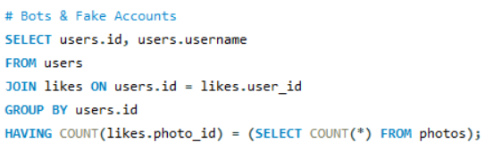
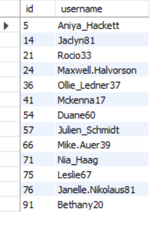
BOTS & FAKE ACCOUNTS
🔹Objective:
Identify suspicious users who have liked every single photo on the platform — a possible sign of fake or bot accounts.
SQL Query Used:
Output:
💡Insight:
Users like Aniya_Hackett, Jadyn81, Rocio33, and others have liked every photo on the platform, indicating possible bot activity or fake accounts.

Slide 14
INSIGHTS
Key Takeaways from the Analysis:
Thursday and Sunday are the most popular days for user sign-ups — a great time to launch ads.
Many users have never posted anything — a chance to re-engage them through email campaigns.
On average, users post around 2.57 photos, showing that people are actively sharing content.
Some accounts liked every single photo, which is not normal — these could be bots and should be reviewed.
The top 5 hashtags give useful ideas for brands to reach more people with their posts.

Slide 15
RESULTS
What I learned through this project:
This project helped me get comfortable with SQL by practicing real queries, not just theory.
I learned how to look at data like a business problem and find useful insights, not just numbers.
It showed me how data can support decisions — like when to launch ads or how to spot fake users.
Overall, this project helped me build confidence in working with data and sharing my findings in a simple way.

Slide 16
THANK YOU

