Slide 1

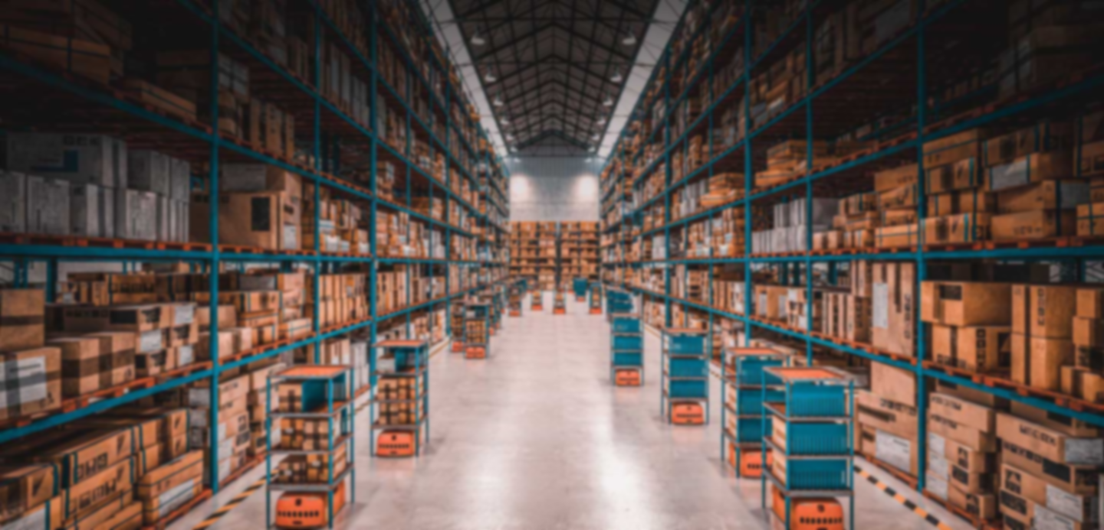

Inventory Management System For Emergency Supplies
An Inventory Management System for Emergency Supplies is
specialized and focused on managing critical supplies needed in
emergencies.
Inventory Management System For Emergency Supplies

Slide 2
Inventory Management System For Emergency Supplies
Inventory Management System For Emergency Supplies
The System is specialized and focused to improve the efficiency, speed, and
effectiveness of emergency response operations, ultimately saving lives
and reducing suffering during crises

Slide 3



Submitted By
Inventory Innovators
Jannatul Fardaus Nirjum
Id: 22201193
Section : D(1)
Email:22201193@uap-bd.edu
Tanisha Taranoon Hridy
Id:22201169
Section :D(1)
Email: 22201169@uap-bd.edu
Hridita Lasker Id:22201184
Section :D(1)
Email:22201184@uap-bd.edu

Slide 4

Submitted By
Inventory Innovators
Hridita Lasker Id:22201184
Section :D(1)
Email:22201184@uap-bd.edu
Tanisha Taranoon Hridy
Id:22201169
Section :D(1)
Email: 22201169@uap-bd.edu
Jannatul Fardaus Nirjum
Id: 22201193
Section : D(1)
Email:22201193@uap-bd.edu

Slide 5

Alif Ruslan
Lecturer
Department of Computer Science & Engineering
University of Asia Pacific
Submitted To

Slide 6

Alif Ruslan
Lecturer
Department of Computer Science & Engineering
University of Asia Pacific

Slide 7
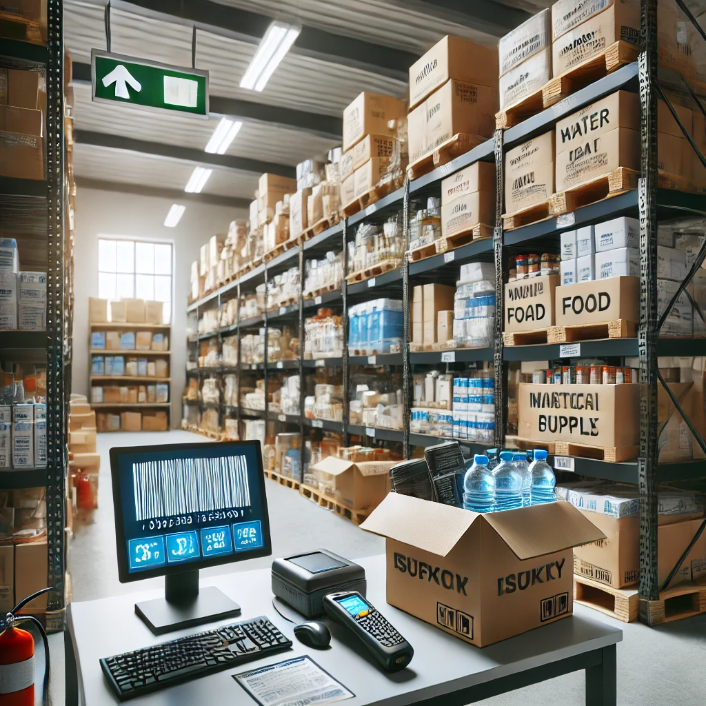
Topic Description
Impact
This project enhances disaster response capabilities, potentially saving lives during crises.
It will substantially impact real life by improving
disaster response and emergency preparedness. I
Purpose
The purpose of the project is to streamline the tracking, replenishment, and distribution of essential resources during emergencies.

Slide 8
Topic Description
Impact
This project enhances disaster response capabilities, potentially saving lives during crises.
It will substantially impact real life by improving
disaster response and emergency preparedness. I
Purpose
The purpose of the project is to streamline the tracking, replenishment, and distribution of essential resources during emergencies.

Slide 9
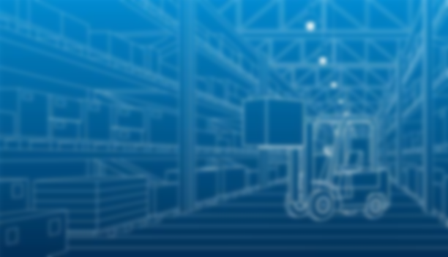


Who are the users?
Government Emergency Planners
Emergency Response Coordinators
First Responders
Medical Teams
Relief Workers
Logistics Teams

Slide 10
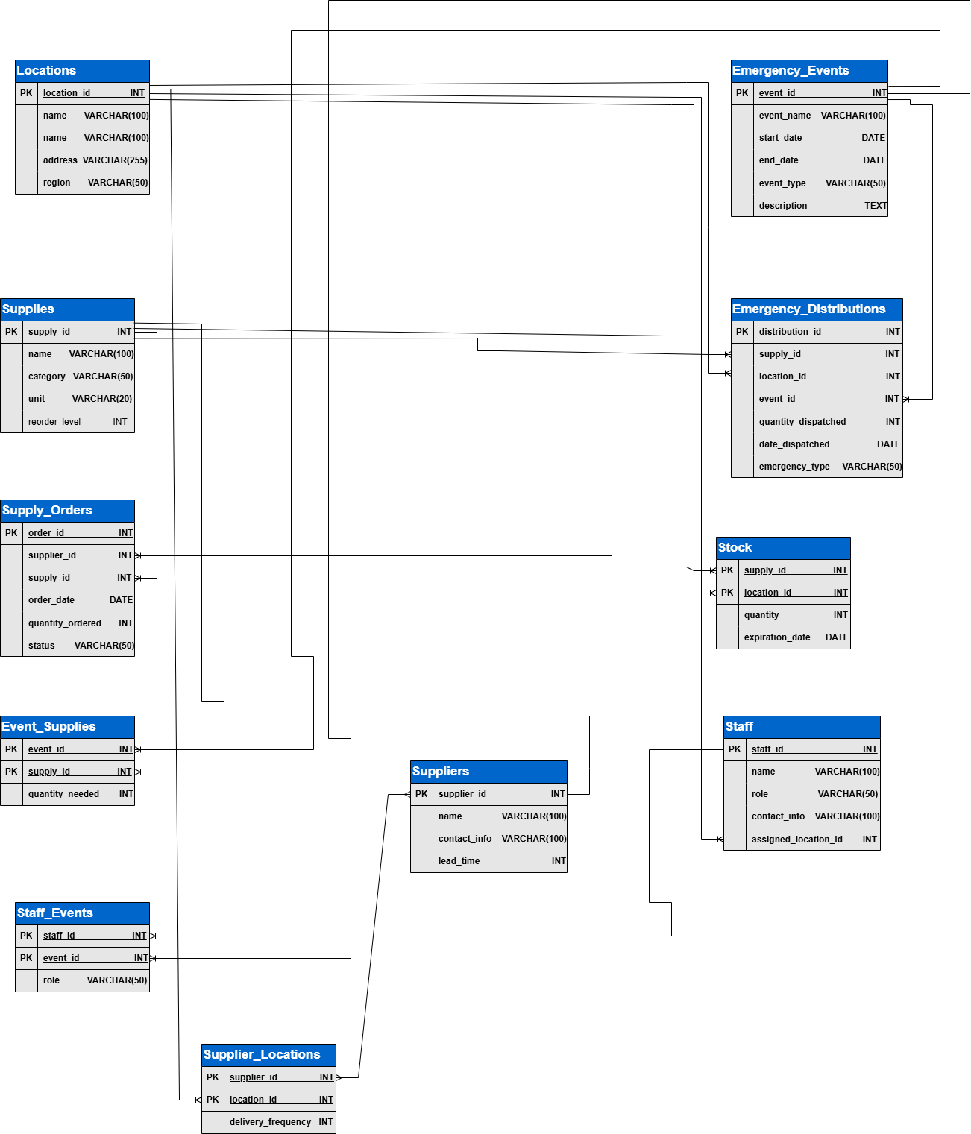
Schema Diagram

Slide 11
Schema Diagram

Slide 12
Tables (1)
1
2
3
4
5
Supplies
Tracks all items available for disaster response, ensuring proper categorization and inventory thresholds.
Locations
Tracks physical locations
involved in storage, dispatch, and distribution of supplies
Suppliers
Ensures reliable sourcing of supplies by maintaining supplier contact and delivery timelines.
Stock
It helps track where and how much of each supply is stored and identifies items approaching expiration.
Supply_Orders
Manages procurement of supplies and monitors order progress.

Slide 13
Tables (1)
1
2
3
4
5
Supplies
Tracks all items available for disaster response, ensuring proper categorization and inventory thresholds.
Locations
Tracks physical locations
involved in storage, dispatch, and distribution of supplies
Suppliers
Ensures reliable sourcing of supplies by maintaining supplier contact and delivery timelines.
Stock
It helps track where and how much of each supply is stored and identifies items approaching expiration.
Supply_Orders
Manages procurement of supplies and monitors order progress.

Slide 14
Tables (1)
1
2
3
4
5
Supplies
Tracks all items available for disaster response, ensuring proper categorization and inventory thresholds.
Locations
Tracks physical locations
involved in storage, dispatch, and distribution of supplies
Suppliers
Ensures reliable sourcing of supplies by maintaining supplier contact and delivery timelines.
Stock
It helps track where and how much of each supply is stored and identifies items approaching expiration.
Supply_Orders
Manages procurement of supplies and monitors order progress.

Slide 15
Tables (1)
1
2
3
4
5
Supplies
Tracks all items available for disaster response, ensuring proper categorization and inventory thresholds.
Locations
Tracks physical locations
involved in storage, dispatch, and distribution of supplies
Suppliers
Ensures reliable sourcing of supplies by maintaining supplier contact and delivery timelines.
Stock
It helps track where and how much of each supply is stored and identifies items approaching expiration.
Supply_Orders
Manages procurement of supplies and monitors order progress.

Slide 16
Tables (1)
1
2
3
4
5
Supplies
Tracks all items available for disaster response, ensuring proper categorization and inventory thresholds.
Locations
Tracks physical locations
involved in storage, dispatch, and distribution of supplies
Suppliers
Ensures reliable sourcing of supplies by maintaining supplier contact and delivery timelines.
Stock
It helps track where and how much of each supply is stored and identifies items approaching expiration.
Supply_Orders
Manages procurement of supplies and monitors order progress.

Slide 17
Tables (2)
6
7
8
9
10
11
Emergency_Events
Offers guidance for allocating resources and responding to specific emergencies
Emergency_Distributions
Records and monitors supply dispatch during emergency responses.
Staff
Manages human resources for inventory and emergency operations
Event_
Supplies
Monitors supplies needed for emergencies and their quantities
Staff_Events
Assigns staff members to emergencies with specific roles.
Supplier_Locations
Tracks supplier connections, delivery frequency, and agreements for specific locations..

Slide 18
Tables (2)
6
7
8
9
10
11
Emergency_Events
Offers guidance for allocating resources and responding to specific emergencies
Emergency_Distributions
Records and monitors supply dispatch during emergency responses.
Staff
Manages human resources for inventory and emergency operations
Event_
Supplies
Monitors supplies needed for emergencies and their quantities
Staff_Events
Assigns staff members to emergencies with specific roles.
Supplier_Locations
Tracks supplier connections, delivery frequency, and agreements for specific locations..

Slide 19
Tables (2)
6
7
8
9
10
11
Emergency_Events
Offers guidance for allocating resources and responding to specific emergencies
Emergency_Distributions
Records and monitors supply dispatch during emergency responses.
Staff
Manages human resources for inventory and emergency operations
Event_
Supplies
Monitors supplies needed for emergencies and their quantities
Staff_Events
Assigns staff members to emergencies with specific roles.
Supplier_Locations
Tracks supplier connections, delivery frequency, and agreements for specific locations..

Slide 20
Tables (2)
6
7
8
9
10
11
Emergency_Events
Offers guidance for allocating resources and responding to specific emergencies
Emergency_Distributions
Records and monitors supply dispatch during emergency responses.
Staff
Manages human resources for inventory and emergency operations
Event_
Supplies
Monitors supplies needed for emergencies and their quantities
Staff_Events
Assigns staff members to emergencies with specific roles.
Supplier_Locations
Tracks supplier connections, delivery frequency, and agreements for specific locations..

Slide 21
Tables (2)
6
7
8
9
10
11
Emergency_Events
Offers guidance for allocating resources and responding to specific emergencies
Emergency_Distributions
Records and monitors supply dispatch during emergency responses.
Staff
Manages human resources for inventory and emergency operations
Event_
Supplies
Monitors supplies needed for emergencies and their quantities
Staff_Events
Assigns staff members to emergencies with specific roles.
Supplier_Locations
Tracks supplier connections, delivery frequency, and agreements for specific locations..

Slide 22
Tables (2)
6
7
8
9
10
11
Emergency_Events
Offers guidance for allocating resources and responding to specific emergencies
Emergency_Distributions
Records and monitors supply dispatch during emergency responses.
Staff
Manages human resources for inventory and emergency operations
Event_
Supplies
Monitors supplies needed for emergencies and their quantities
Staff_Events
Assigns staff members to emergencies with specific roles.
Supplier_
Locations
Tracks supplier connections, delivery frequency, and agreements for specific locations..

Slide 23
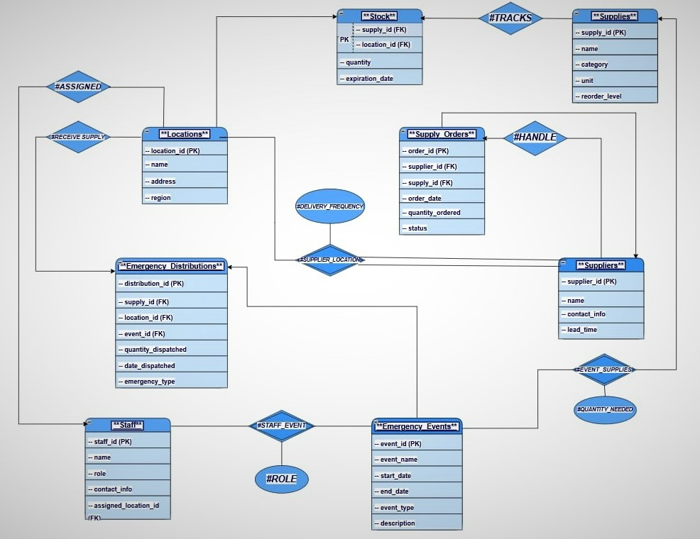
Entity Diagram

Slide 24
Entity Diagram

Slide 25
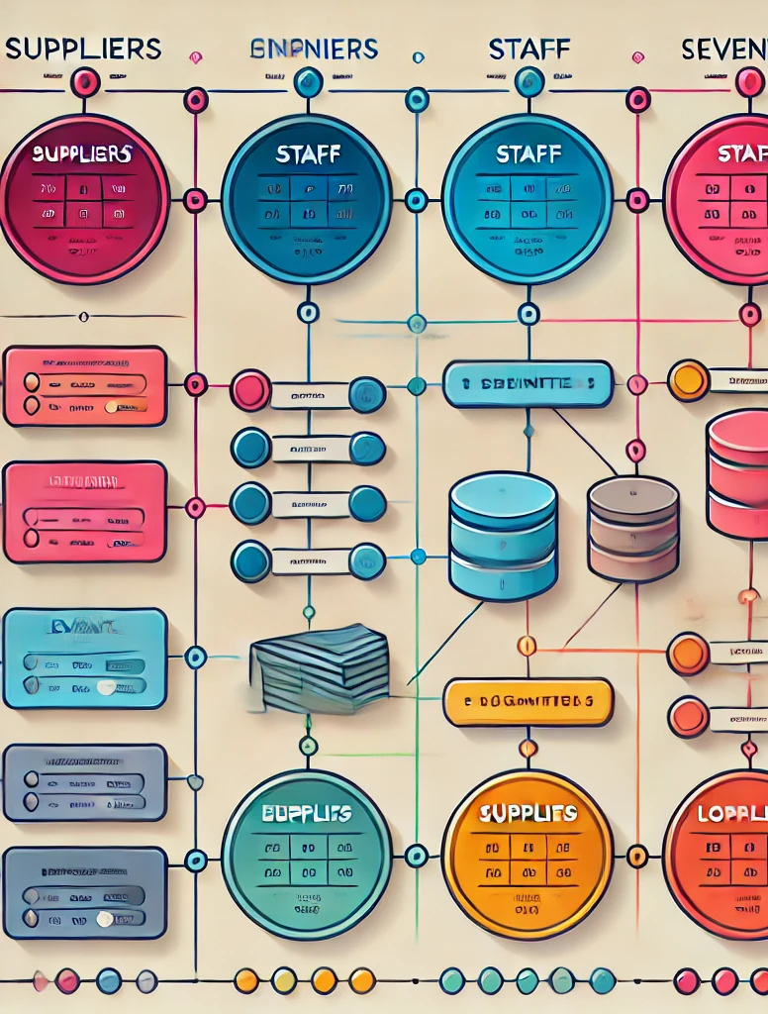
Relationship Overview
1
One-to-Many Relationship
2
Many-to-Many Relationship
Supplies To Stock
Location to Stock, Supplies to Supply_order,
Suppliers to Supply_order,
emergency_events to Emergency_Distribution,
Staff to Locations etc.
Suppliers to Location through the supplier location table

Slide 26
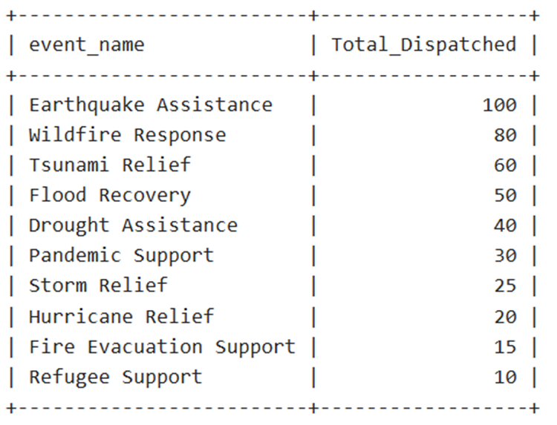
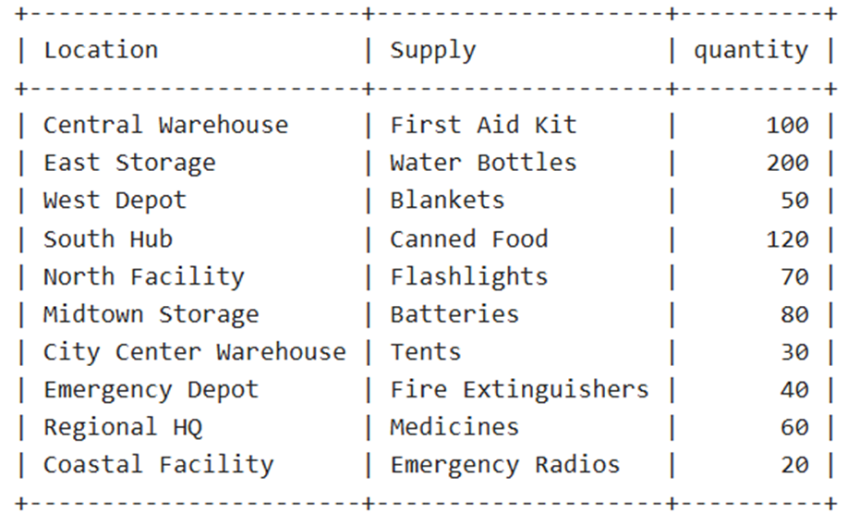
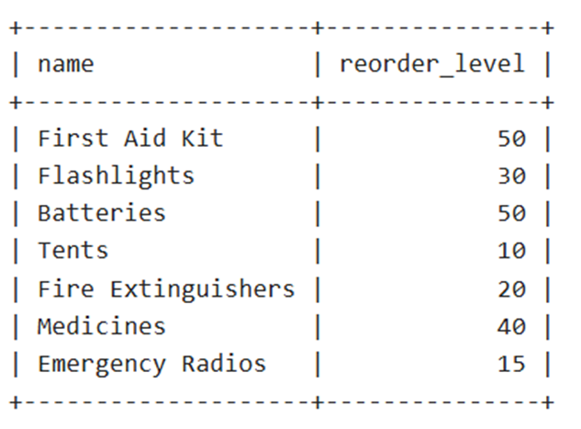
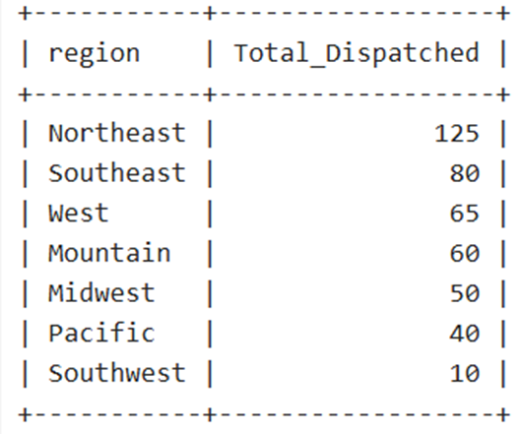
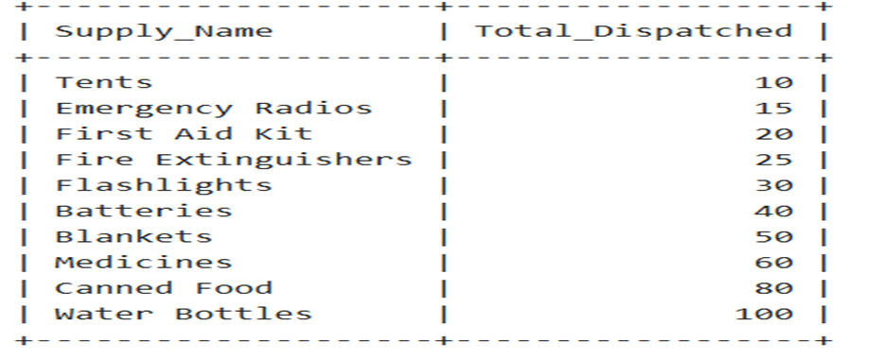
Find the Total Quantity of Each Supply Dispatched Across All Events
Retrieve supplies and their current stock level for each location
Find Supplies That Are Below the Average Reorder Level
Calculate Total Supplies Dispatched per Event
5
Regions With Highest Emergency Distributions
Queries
Code:
SELECT s.name AS Supply_Name,
SUM(ed.quantity_dispatched) AS Total_Dispatched
FROM Supplies s Join Emergency_Distributions ed
ON s.supply_id = ed.supply_id
GROUP BY s.name ORDER BY Total_Dispatched ;
Code:
SELECT ee.event_name,
SUM(ed.quantity_dispatched) AS Total_Dispatched
FROM Emergency_Events eeINNER JOIN
Emergency_Distributions ed ON ee.event_id = ed.event_id
GROUP BY ee.event_nameORDER BY Total_Dispatched DESC;
Code:
SELECT l.region,
SUM(ed.quantity_dispatched) AS Total_Dispatched
FROM Emergency_Distributions ed
JOIN Locations l ON ed.location_id = l.location_id
GROUP BY l.region ORDER BY Total_Dispatched DESC;
Code:
SELECT l.name AS "Location", s.name AS "Supply", st.quantity
FROM Stock st
JOIN Supplies s ON st.supply_id = s.supply_id
JOIN Locations l ON st.location_id = l.location_id;
Code:
SELECT name, reorder_level FROM Supplies
WHERE
reorder_level < (SELECT AVG(reorder_level) FROM Supplies);
4
3
That represents the importance of this system
2
1

Slide 27
Find the Total Quantity of Each Supply Dispatched Across All Events
Retrieve supplies and their current stock level for each location
Find Supplies That Are Below the Average Reorder Level
Calculate Total Supplies Dispatched per Event
5
Regions With Highest Emergency Distributions
Code:
SELECT s.name AS Supply_Name,
SUM(ed.quantity_dispatched) AS Total_Dispatched
FROM Supplies s Join Emergency_Distributions ed
ON s.supply_id = ed.supply_id
GROUP BY s.name ORDER BY Total_Dispatched ;
Queries
Code:
SELECT ee.event_name,
SUM(ed.quantity_dispatched) AS Total_Dispatched
FROM Emergency_Events eeINNER JOIN
Emergency_Distributions ed ON ee.event_id = ed.event_id
GROUP BY ee.event_nameORDER BY Total_Dispatched DESC;
Code:
SELECT l.region,
SUM(ed.quantity_dispatched) AS Total_Dispatched
FROM Emergency_Distributions ed
JOIN Locations l ON ed.location_id = l.location_id
GROUP BY l.region ORDER BY Total_Dispatched DESC;
Code:
SELECT l.name AS "Location", s.name AS "Supply", st.quantity
FROM Stock st
JOIN Supplies s ON st.supply_id = s.supply_id
JOIN Locations l ON st.location_id = l.location_id;
Code:
SELECT name, reorder_level FROM Supplies
WHERE
reorder_level < (SELECT AVG(reorder_level) FROM Supplies);
4
3
That represents the importance of this system
2
1

Slide 28
Find the Total Quantity of Each Supply Dispatched Across All Events
Retrieve supplies and their current stock level for each location
Find Supplies That Are Below the Average Reorder Level
Calculate Total Supplies Dispatched per Event
5
Regions With Highest Emergency Distributions
Code:
SELECT s.name AS Supply_Name,
SUM(ed.quantity_dispatched) AS Total_Dispatched
FROM Supplies s Join Emergency_Distributions ed
ON s.supply_id = ed.supply_id
GROUP BY s.name ORDER BY Total_Dispatched ;
Queries
Code:
SELECT ee.event_name,
SUM(ed.quantity_dispatched) AS Total_Dispatched
FROM Emergency_Events eeINNER JOIN
Emergency_Distributions ed ON ee.event_id = ed.event_id
GROUP BY ee.event_nameORDER BY Total_Dispatched DESC;
Code:
SELECT l.region,
SUM(ed.quantity_dispatched) AS Total_Dispatched
FROM Emergency_Distributions ed
JOIN Locations l ON ed.location_id = l.location_id
GROUP BY l.region ORDER BY Total_Dispatched DESC;
Code:
SELECT name, reorder_level FROM Supplies
WHERE
reorder_level < (SELECT AVG(reorder_level) FROM Supplies);
Code:
SELECT l.name AS "Location", s.name AS "Supply", st.quantity
FROM Stock st
JOIN Supplies s ON st.supply_id = s.supply_id
JOIN Locations l ON st.location_id = l.location_id;
4
3
That represents the importance of this system
2
1

Slide 29
Find the Total Quantity of Each Supply Dispatched Across All Events
Retrieve supplies and their current stock level for each location
Calculate Total Supplies Dispatched per Event
Find Supplies That Are Below the Average Reorder Level
5
Regions With Highest Emergency Distributions
Code:
SELECT s.name AS Supply_Name,
SUM(ed.quantity_dispatched) AS Total_Dispatched
FROM Supplies s Join Emergency_Distributions ed
ON s.supply_id = ed.supply_id
GROUP BY s.name ORDER BY Total_Dispatched ;
Queries
Code:
SELECT ee.event_name,
SUM(ed.quantity_dispatched) AS Total_Dispatched
FROM Emergency_Events eeINNER JOIN
Emergency_Distributions ed ON ee.event_id = ed.event_id
GROUP BY ee.event_nameORDER BY Total_Dispatched DESC;
Code:
SELECT l.region,
SUM(ed.quantity_dispatched) AS Total_Dispatched
FROM Emergency_Distributions ed
JOIN Locations l ON ed.location_id = l.location_id
GROUP BY l.region ORDER BY Total_Dispatched DESC;
Code:
SELECT l.name AS "Location", s.name AS "Supply", st.quantity
FROM Stock st
JOIN Supplies s ON st.supply_id = s.supply_id
JOIN Locations l ON st.location_id = l.location_id;
Code:
SELECT name, reorder_level FROM Supplies
WHERE
reorder_level < (SELECT AVG(reorder_level) FROM Supplies);
4
3
That represents the importance of this system
2
1

Slide 30
Retrieve supplies and their current stock level for each location
Find the Total Quantity of Each Supply Dispatched Across All Events
Find Supplies That Are Below the Average Reorder Level
5
Calculate Total Supplies Dispatched per Event
Regions With Highest Emergency Distributions
Code:
SELECT s.name AS Supply_Name,
SUM(ed.quantity_dispatched) AS Total_Dispatched
FROM Supplies s Join Emergency_Distributions ed
ON s.supply_id = ed.supply_id
GROUP BY s.name ORDER BY Total_Dispatched ;
Code:
SELECT ee.event_name,
SUM(ed.quantity_dispatched) AS Total_Dispatched
FROM Emergency_Events eeINNER JOIN
Emergency_Distributions ed ON ee.event_id = ed.event_id
GROUP BY ee.event_nameORDER BY Total_Dispatched DESC;
Queries
Code:
SELECT l.region,
SUM(ed.quantity_dispatched) AS Total_Dispatched
FROM Emergency_Distributions ed
JOIN Locations l ON ed.location_id = l.location_id
GROUP BY l.region ORDER BY Total_Dispatched DESC;
Code:
SELECT l.name AS "Location", s.name AS "Supply", st.quantity
FROM Stock st
JOIN Supplies s ON st.supply_id = s.supply_id
JOIN Locations l ON st.location_id = l.location_id;
Code:
SELECT name, reorder_level FROM Supplies
WHERE
reorder_level < (SELECT AVG(reorder_level) FROM Supplies);
4
3
That represents the importance of this system
2
1

Slide 31
Retrieve supplies and their current stock level for each location
Find Supplies That Are Below the Average Reorder Level
Calculate Total Supplies Dispatched per Event
Find the Total Quantity of Each Supply Dispatched Across All Events
5
Regions With Highest Emergency Distributions
Code:
SELECT s.name AS Supply_Name,
SUM(ed.quantity_dispatched) AS Total_Dispatched
FROM Supplies s Join Emergency_Distributions ed
ON s.supply_id = ed.supply_id
GROUP BY s.name ORDER BY Total_Dispatched ;
Queries
Code:
SELECT ee.event_name,
SUM(ed.quantity_dispatched) AS Total_Dispatched
FROM Emergency_Events eeINNER JOIN
Emergency_Distributions ed ON ee.event_id = ed.event_id
GROUP BY ee.event_nameORDER BY Total_Dispatched DESC;
Code:
SELECT l.region,
SUM(ed.quantity_dispatched) AS Total_Dispatched
FROM Emergency_Distributions ed
JOIN Locations l ON ed.location_id = l.location_id
GROUP BY l.region ORDER BY Total_Dispatched DESC;
Code:
SELECT l.name AS "Location", s.name AS "Supply", st.quantity
FROM Stock st
JOIN Supplies s ON st.supply_id = s.supply_id
JOIN Locations l ON st.location_id = l.location_id;
Code:
SELECT name, reorder_level FROM Supplies
WHERE
reorder_level < (SELECT AVG(reorder_level) FROM Supplies);
4
3
That represents the importance of this system
2
1

Slide 32
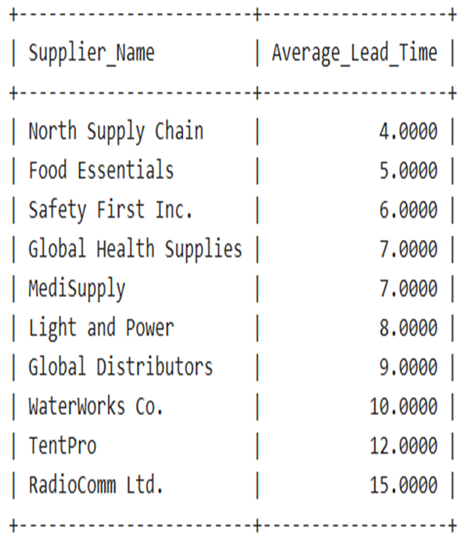
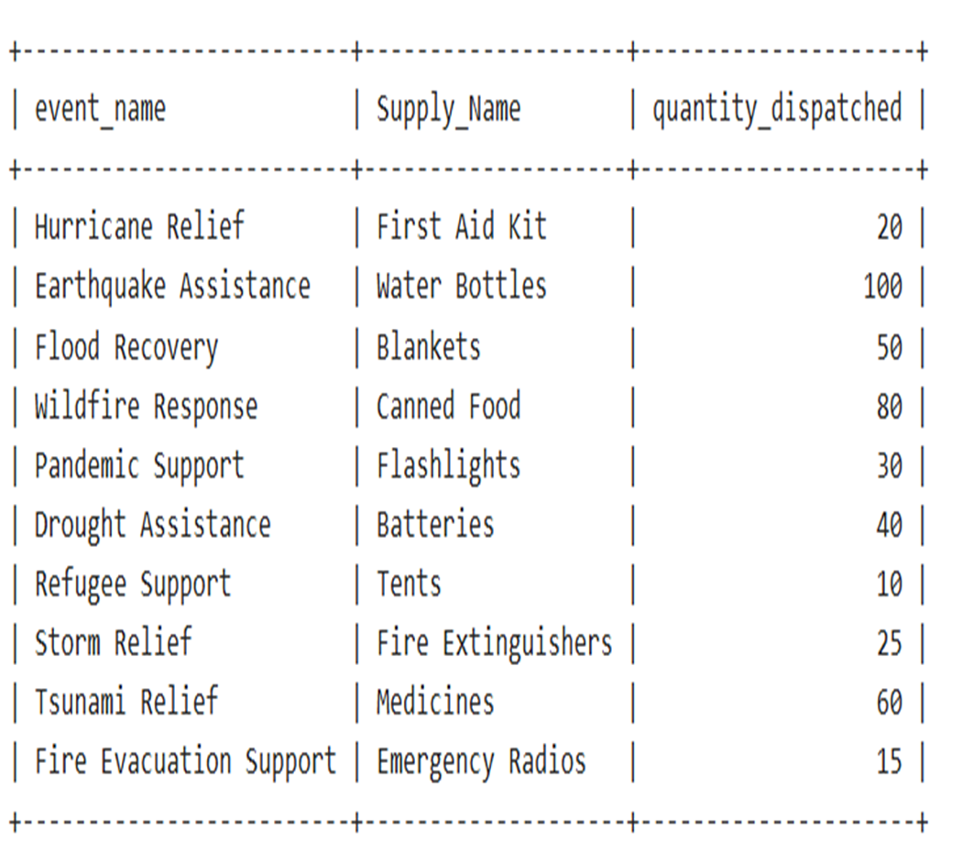
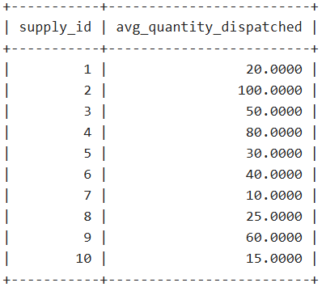
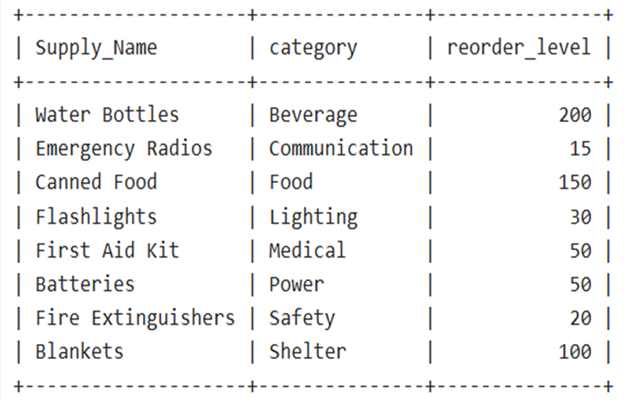
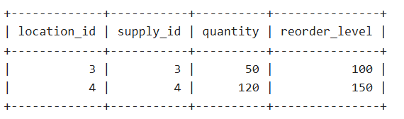
Predict Future Supply Needs Based on Past Usage Data
List Locations with Stock Levels Below Critical Thresholds
List Suppliers and Their Average Lead Time for Supplies They Provide
Retrieve Supplies with the Highest Quantity in Each Category
Retrieve Emergency Events with Dispatched Supplies
10
Code:
SELECT s.location_id,s.supply_id,s.quantity,sp.reorder_level
FROM Stock s JOIN Supplies sp
ON s.supply_id = sp.supply_id
WHERE s.quantity < sp.reorder_level;
Code:
SELECT s1.name AS Supply_Name, s1.category, s1.reorder_level
FROM Supplies s1 WHERE
s1.reorder_level = (SELECT MAX(s2.reorder_level)
FROM Supplies s2 WHERE s2.category = s1.category)
ORDER BY s1.category;
;
Code:
SELECT supply_id, AVG(quantity_dispatched)
AS avg_quantity_dispatched FROM Emergency_Distributions
GROUP BY supply_id;
Code:
SELECT sp.name AS Supplier_Name, AVG(sp.lead_time) AS Average_Lead_Time
FROM Suppliers spJOIN Supply_Orders so ON sp.supplier_id = so.supplier_id
GROUP BY sp.nameORDER BY Average_Lead_Time ASC;
;
Code:
SELECT ee.event_name, s.name AS Supply_Name,ed.quantity_dispatched
FROM Emergency_Events ee INNER JOIN
Emergency_Distributions ed ON ee.event_id = ed.event_id
INNER JOIN Supplies s ON ed.supply_id = s.supply_id;
9
8
7
6

Slide 33
Predict Future Supply Needs Based on Past Usage Data
List Locations with Stock Levels Below Critical Thresholds
List Suppliers and Their Average Lead Time for Supplies They Provide
Retrieve Supplies with the Highest Quantity in Each Category
10
Retrieve Emergency Events with Dispatched Supplies
Code:
SELECT s.location_id,s.supply_id,s.quantity,sp.reorder_level
FROM Stock s JOIN Supplies sp
ON s.supply_id = sp.supply_id
WHERE s.quantity < sp.reorder_level;
Code:
SELECT s1.name AS Supply_Name, s1.category, s1.reorder_level
FROM Supplies s1 WHERE
s1.reorder_level = (SELECT MAX(s2.reorder_level)
FROM Supplies s2 WHERE s2.category = s1.category)
ORDER BY s1.category;
;
Code:
SELECT supply_id, AVG(quantity_dispatched)
AS avg_quantity_dispatched FROM Emergency_Distributions
GROUP BY supply_id;
Code:
SELECT sp.name AS Supplier_Name, AVG(sp.lead_time) AS Average_Lead_Time
FROM Suppliers spJOIN Supply_Orders so ON sp.supplier_id = so.supplier_id
GROUP BY sp.nameORDER BY Average_Lead_Time ASC;
;
Code:
SELECT ee.event_name, s.name AS Supply_Name,ed.quantity_dispatched
FROM Emergency_Events ee INNER JOIN
Emergency_Distributions ed ON ee.event_id = ed.event_id
INNER JOIN Supplies s ON ed.supply_id = s.supply_id;
;
9
8
7
6

Slide 34
Predict Future Supply Needs Based on Past Usage Data
List Locations with Stock Levels Below Critical Thresholds
List Suppliers and Their Average Lead Time for Supplies They Provide
Retrieve Supplies with the Highest Quantity in Each Category
10
Retrieve Emergency Events with Dispatched Supplies
Code:
SELECT s.location_id,s.supply_id,s.quantity,sp.reorder_level
FROM Stock s JOIN Supplies sp
ON s.supply_id = sp.supply_id
WHERE s.quantity < sp.reorder_level;
Code:
SELECT s1.name AS Supply_Name, s1.category, s1.reorder_level
FROM Supplies s1 WHERE
s1.reorder_level = (SELECT MAX(s2.reorder_level)
FROM Supplies s2 WHERE s2.category = s1.category)
ORDER BY s1.category;
;
Code:
SELECT supply_id, AVG(quantity_dispatched)
AS avg_quantity_dispatched FROM Emergency_Distributions
GROUP BY supply_id;
Code:
SELECT sp.name AS Supplier_Name, AVG(sp.lead_time) AS Average_Lead_Time
FROM Suppliers spJOIN Supply_Orders so ON sp.supplier_id = so.supplier_id
GROUP BY sp.nameORDER BY Average_Lead_Time ASC;
Code:
SELECT ee.event_name, s.name AS Supply_Name,ed.quantity_dispatched
FROM Emergency_Events ee INNER JOIN
Emergency_Distributions ed ON ee.event_id = ed.event_id
INNER JOIN Supplies s ON ed.supply_id = s.supply_id;
;
9
8
7
6

Slide 35
List Locations with Stock Levels Below Critical Thresholds
List Suppliers and Their Average Lead Time for Supplies They Provide
Retrieve Supplies with the Highest Quantity in Each Category
Predict Future Supply Needs Based on Past Usage Data
Retrieve Emergency Events with Dispatched Supplies
10
Code:
SELECT s.location_id,s.supply_id,s.quantity,sp.reorder_level
FROM Stock s JOIN Supplies sp
ON s.supply_id = sp.supply_id
WHERE s.quantity < sp.reorder_level;
Code:
SELECT s1.name AS Supply_Name, s1.category, s1.reorder_level
FROM Supplies s1 WHERE
s1.reorder_level = (SELECT MAX(s2.reorder_level)
FROM Supplies s2 WHERE s2.category = s1.category)
ORDER BY s1.category;
;
Code:
SELECT sp.name AS Supplier_Name, AVG(sp.lead_time) AS Average_Lead_Time
FROM Suppliers spJOIN Supply_Orders so ON sp.supplier_id = so.supplier_id
GROUP BY sp.nameORDER BY Average_Lead_Time ASC;
;
Code:
SELECT supply_id, AVG(quantity_dispatched)
AS avg_quantity_dispatched FROM Emergency_Distributions
GROUP BY supply_id;
Code:
SELECT ee.event_name, s.name AS Supply_Name,ed.quantity_dispatched
FROM Emergency_Events ee INNER JOIN
Emergency_Distributions ed ON ee.event_id = ed.event_id
INNER JOIN Supplies s ON ed.supply_id = s.supply_id;
;
9
8
7
6

Slide 36
List Locations with Stock Levels Below Critical Thresholds
List Suppliers and Their Average Lead Time for Supplies They Provide
Retrieve Supplies with the Highest Quantity in Each Category
Retrieve Emergency Events with Dispatched Supplies
Predict Future Supply Needs Based on Past Usage Data
10
Code:
SELECT s.location_id,s.supply_id,s.quantity,sp.reorder_level
FROM Stock s JOIN Supplies sp
ON s.supply_id = sp.supply_id
WHERE s.quantity < sp.reorder_level;
Code:
SELECT s1.name AS Supply_Name, s1.category, s1.reorder_level
FROM Supplies s1 WHERE
s1.reorder_level = (SELECT MAX(s2.reorder_level)
FROM Supplies s2 WHERE s2.category = s1.category)
ORDER BY s1.category;
;
Code:
SELECT supply_id, AVG(quantity_dispatched)
AS avg_quantity_dispatched FROM Emergency_Distributions
GROUP BY supply_id;
Code:
SELECT sp.name AS Supplier_Name, AVG(sp.lead_time) AS Average_Lead_Time
FROM Suppliers spJOIN Supply_Orders so ON sp.supplier_id = so.supplier_id
GROUP BY sp.nameORDER BY Average_Lead_Time ASC;
;
Code:
SELECT ee.event_name, s.name AS Supply_Name,ed.quantity_dispatched
FROM Emergency_Events ee INNER JOIN
Emergency_Distributions ed ON ee.event_id = ed.event_id
INNER JOIN Supplies s ON ed.supply_id = s.supply_id;
;
9
8
7
6

Slide 37
T
H
A
N
K
Y
O
U

