Slide 1

Summer Internship
Innovation Labs
Tanish Goel

Slide 2
Content
Induction
Co-Pilot for Health Claims Adjudicator
1) Project Phases
2) Work Completed
3) Wireframes
Telegram Bot for agents
1) Flow of the Bot
2) Prototype Working
PAYD Benchmarking
Claim Assure User Guide

Slide 3
Timeline
Week 1 & 2
Week 5 & 6
Introduction
Defining the Problem statement
Deciding on project phases
Market Exploration
Addition of additional features in Telegram Bot
Bot deployment
PAYD Benchmarking
01
02
03
04
PRD
Testing different models
Cost Analysis
Figma Design
Telegram bot POC
User guide for claim assure app
Week 3 & 4
Week 7 & 8

Slide 4
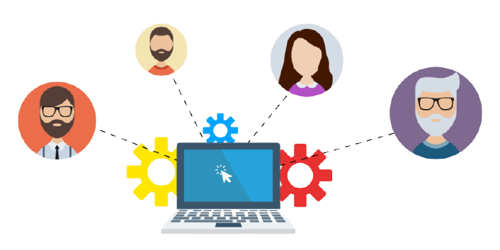
Internship Commencement
Two day induction program
Day 1:
Understanding of Basics of Insurance
HR policies
Insightful conversation with full time employees
Day 2:
Deep dive into the world of Insurance
Interaction with the Innovation Lab Team
Understanding the projects done by the Lab

Slide 5
Defining the Problem Statement
Problem Statement | Co-Pilot for Health Claims Adjudicator | Auto inspection tool for Fire Insurance | Image Similarity Score
Functions | Assisting health claims adjudicators in processing health insurance claims | Tool for auto risk assessment of an asset for fire insurance | Find similarity of a given image with other image in a dataset
Purpose | Faster and streamlined claims processing by leveraging automation and AI | Assist underwriters to evaluate the condition of an asset for risk assessment | Detect cropping, editing, tampering of an image for fraud detection.
Benefits | Reduce manual effort Faster claims processing Reduce fraud detection | Reduce the contingency costs Speeds up risk assessment | Prevents frauds hence saving money on claims Prevent reputational damage
Decision | Unexplored problem statement Build the solution from the Base | Already explored problem Lower bandwidth for interns to contribute | Low return on investment

Slide 6
Project Phases
Phases
Deciding and Exploring the problem statement
Model Evaluation Phase
Concept Development
Handover to Dev Team
Activities
Deciding on the Problem Statement
Performing Market Research
Identifying the tech stack
Comparing the OCR and LLM models
Implementing the models on test document
Creating a detailed Product Requirements Document
Perform the Cost Analysis
Start working on the UI/UX of application
Dev team progresses with the development of the Project

Slide 7



Progress and Future
Completed:
Performed Market Exploration
Created a Figma design of the hospital side
Created a Figma design of the adjudicator side
Made a prototype using Figma
Detail the Product Requirements Document
Compared the pricing plans of models
Future:
MVP Delivery by the development team

Slide 8
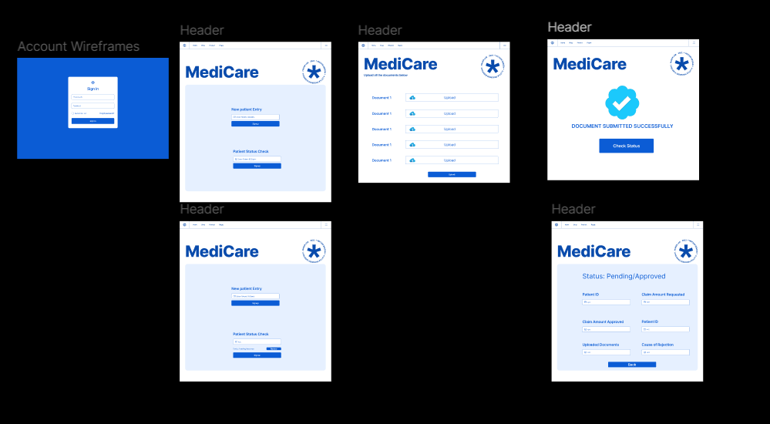
Hospital Side Wireframe

Slide 9
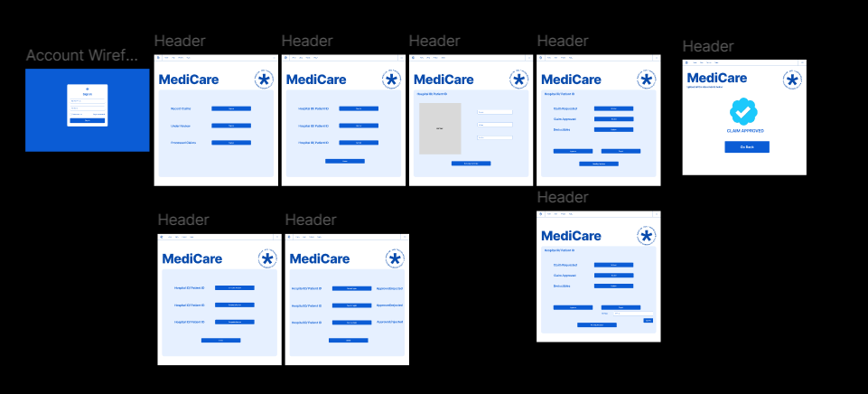
Adjudicator side wireframe

Slide 10

Problem Statement 2
Telegram Bot
TPM
Use Case:
Assisting the agents to extract the Insurance Premium and plans using Telegram Chatbot
Benefits:
Reduced time for calculating premium
Increased customer satisfaction
Necessary Features:
Premium calculation via API
Automatic Plans suggestions

Slide 11
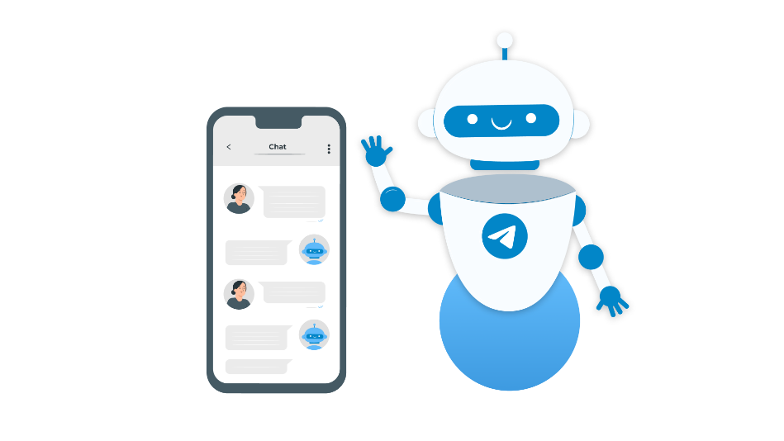
Flow
Start
Input plan type
Input Tenure
(1/2/3)
Input Pin Code
Start again
Start
Again
Input Insurer Details
(Sum Insured, DOB, Relationship)
Display All
Add-Ons
yes
Ask for more members
(yes/no)
Ask for Add-Ons
(yes/no)
Display plans along with the premium
Bot Processes Plans and Premium
no
yes
no

Slide 12
Work Completed
Tasks Performed:
Interacted with the Health Insurance Team to know the necessary field
Analyzed and Designed an Interaction flow for the agent
Completed the Proof of concept
Serverless Deployment of the Bot on AWS
Displayed Discount information on Telegram
Displayed Add-Ons on the telegram

Slide 13
POC Working

Slide 14

PAYD Competitive Benchmarking
Performed market exploration of the PAYD techniques and processes used in the market
Added suggestions for implementing fraud detection
Researched and gave suggestions on making our process faster and smoother.
Benchmarked our process with the other companies doing the same process

Slide 15
Motor Claim Assure User Flow
Purpose | Benefits
Simplification: The journey flow of the "Motor Claim Assure" app is designed to simplify the process for users, making it easy for them to understand each step of the claim process. | Enhanced User Understanding: Users can quickly grasp how to use the app, reducing the learning curve and minimizing errors. Efficiency: With a clear journey flow, users can complete the claim process faster, leading to quicker resolutions.
Clarity: By providing a clear and structured overview, the flow helps users know what to expect at each stage, from logging in to submitting a claim | Consistency: Ensures that all users follow a consistent process, leading to more reliable and predictable outcomes.

Slide 16
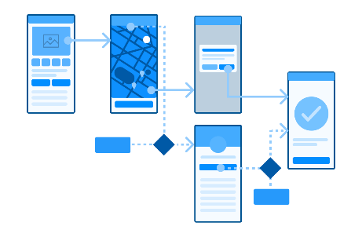
Motor Claim Assure User Guide
Work Done-
Gained a comprehensive understanding of the Motor Claim Assure App.
Developed a detailed user guide for workshop and surveyors to navigate the application easily.
Provided valuable suggestions to enhance the application's flow and user experience.

Slide 17
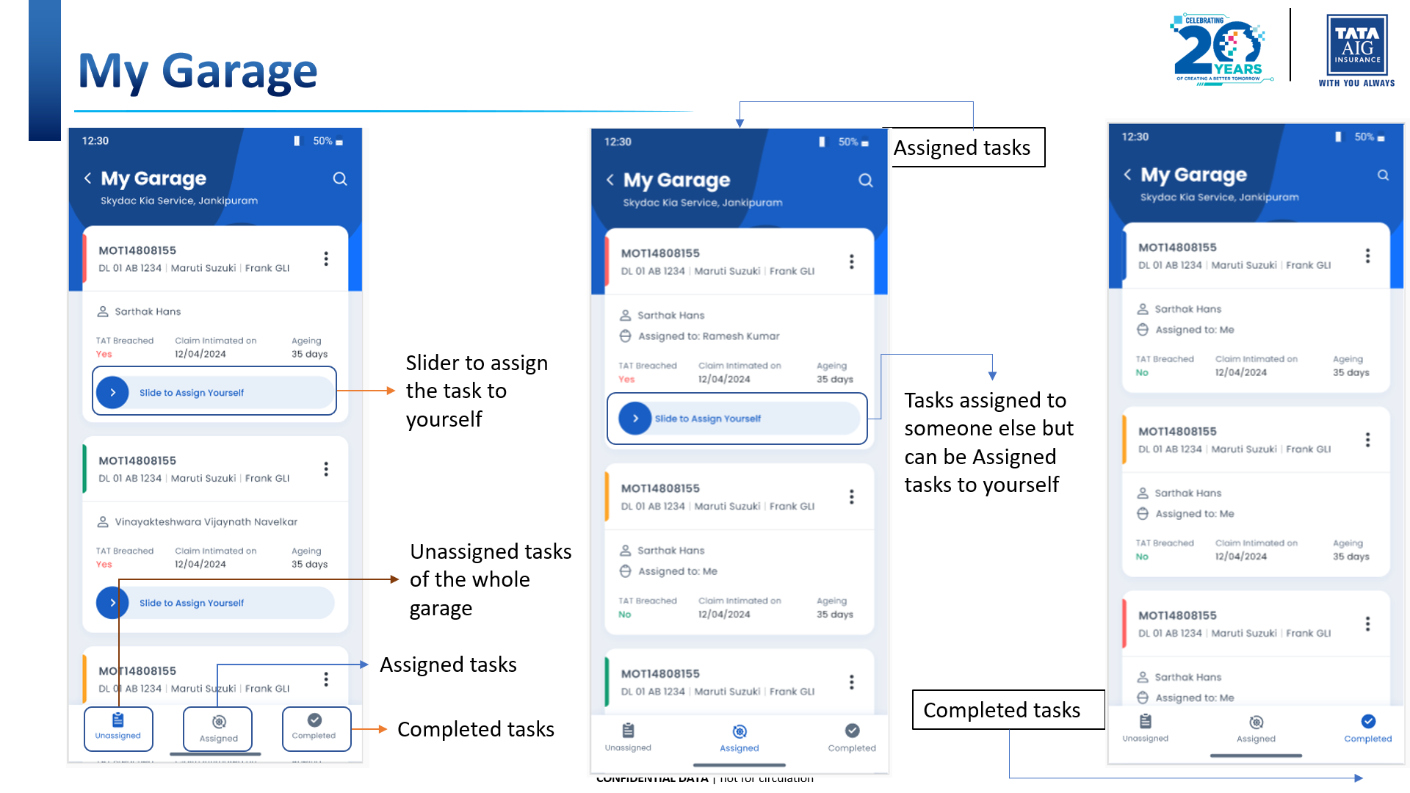
Sample Flow

Slide 18

Internship Learnings
Cross-Functional Collaboration
Benchmarking Techniques
User-Centric Problem Solving
Flow Creation
API Integration Skills
Working with Figma and Adobe XD

Slide 19
Appendix
Telegram Bot - https://t.me/Medical_insurance_help_bot
Figma Design and Prototype - https://www.figma.com/proto/5FfbvOMYFz3hCdBNxQSOIz/Untitled?node-id=0-1&t=TO5T99ViVMcNmrwB-1
PAYD Analysis – https://tataaig-my.sharepoint.com/:w:/p/tanish1_tagic/EZGntjrnKANMmMVn_uYFUaUBNOd3zs7PZJa7cNNrgg4aHA
Motor Claim Assure Flow - https://tataaig-my.sharepoint.com/:p:/p/tanish1_tagic/EdkR7Wgj19BPv-lX5w8rBbwBE05dVldo8tzqsSLr7jEWYw

Slide 20
Thank You

