Slide 1
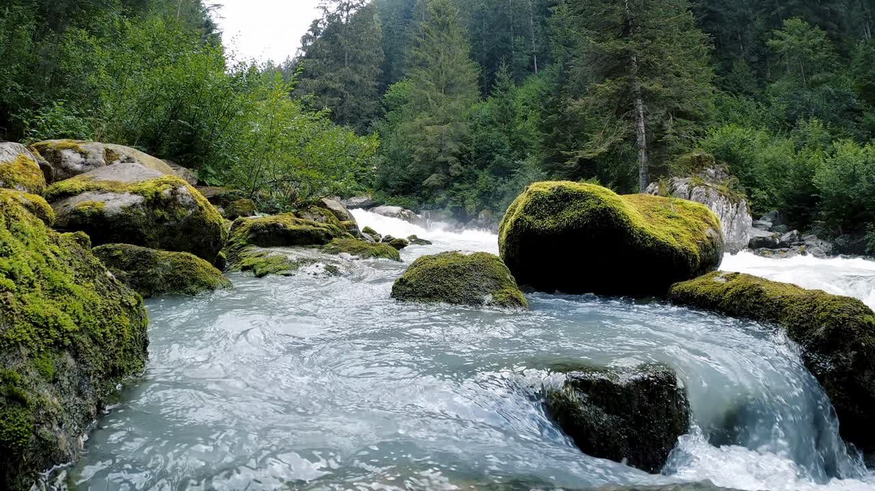
Statistical Analysis and
Predictive Modelling of
Surface Water Quality
Kerala CWC Surface Water Quality Dataset, 1980–2020
GROUP
10
Tanmay Sandip Dhule (25B4208) | Teertha Pankaj Gandhi (25B4233)
Sri Vishnu Vikyath S (25B4246) | Tanish Vishal Jain (25B4244)
ES225 - AI & DATA SCIENCE
01

Slide 2

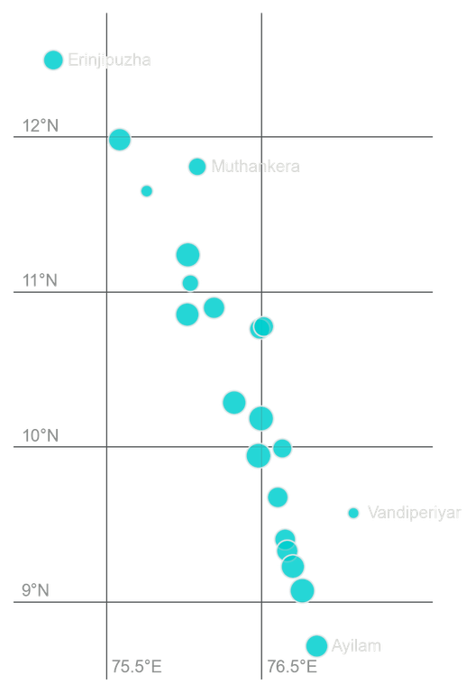
Data and Approach
5,433
samples
21
monitoring stations
13
rivers
1980–2020
sampling period
33
chemical parameters
4,252 / 1,064
training / test samples
01 · Assess (Q1)
02 · Clean (Q2–Q3)
03 · Predict (Q4–Q8)
  Stats vs standards
  Seasonal and spatial tests
  DO trend
  Missingness
  MAR
  Imputation
• Hardness • linear, regularised, tree models
• PCA
COMMON PROTOCOL Every model uses the same cleaned dataset, the same 80/20 train–test split
(seed 42) and the same metrics (MSE, RMSE and R²).
1 | INTRODUCTION
02

Slide 3
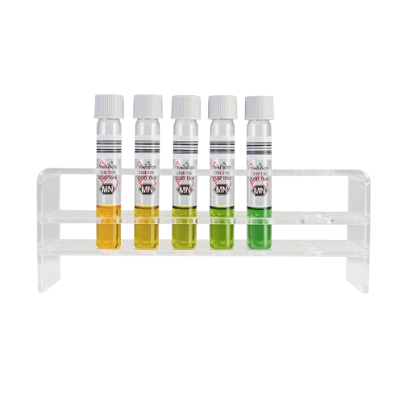
Data Coverage: What Was Measured
Dropped
All 8 heavy metals (As, Cd, Cr, Cu, Pb, Hg, Ni, Zn), ammonia, iron, and both nitrogen species. Boron, manganese, potassium, nitrate, fluoride, and magnesium hardness have no values at all.
19 of 33
Kept, nearly complete (about 2%)
chemical parameters are more than 80% empty. Six of them have no values at all.
Major ions (calcium, magnesium, chloride) and total hardness
High Missingness in Retained Parameters
· Sulphate 25.2%
· DO 32.0%
· Total phosphorus 48.4%
· TDS 65.1%
INFERENCE This dataset can assess the major ions, DO and pH, but not heavy-metal contamination.
2 | DATA QUALITY
03

Slide 4
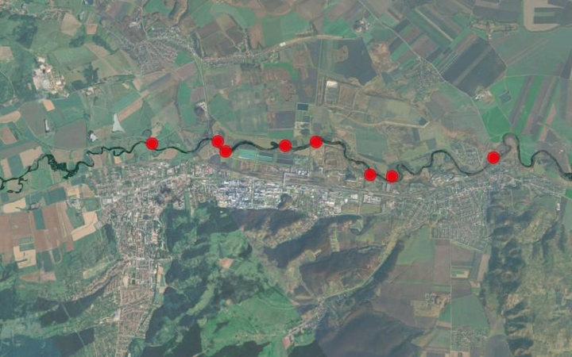
Missing Data: Pattern and Mechanism
% missing, by decade
Why are values missing? (likely causes)
1980s
1990s
2000s
2010s
Dissolved oxygen
100%
9%
13%
20%
MCAR · random one-offs
A lost sample or a missed visit. Likely behind the small ~2% gaps in the major ions.
TDS
41%
100%
46%
44%
MAR · our main case
Readings likely weren't taken: not yet in the programme, or the station lacked the set-up. DO is 15% to 57% missing by station.
Total phosphorus
93%
14%
22%
99%
77%
3%
3%
35%
MNAR · can't rule out
Sulphate
Values below the detection limit may be left blank. Possible for heavy metals but the data can't confirm it.
INFERENCE The data are missing at random, driven by the monitoring programme, so every summary statistic depends on what was sampled.
2 | DATA QUALITY
04

Slide 5
Imputation: Effect on Variance
Variance kept after median imputation. Across all three methods, sulphate keeps about 75%, TDS only 35 to 39%. Skewness rises everywhere; DO, being near-symmetric, barely changes.
Each method protects one number and bends the rest
75%
Mean
68%
Keeps the mean, but shifts the TDS median from 38 up to 56.6 mg/L
52%
37%
Median (what we used)
Robust to skew and outliers; the default for the predictive models
Mode (depends on rounding)
Least reliable for continuous data; moved the phosphorus median from 0.066 to 0.01
Sulphate
25.2% missing
DO
32.0% missing
Total P
48.4% missing
TDS
65.1% missing
INFERENCE Median imputation suits this skewed data best, but every method shrinks variance, so imputed values are not measurements.
2 | DATA QUALITY
05

Slide 6
Train–Test Split and Preprocessing
5,433
5,316
4,252 / 1,064
Train-only
samples, with the 19 empty parameters removed
117 rows with no hardness dropped. The target is never imputed.
train / test, 80/20 with seed 42. Same rows for everyone.
Medians learned from training data, then imputed on test dataset
Why train-only?
Why median as the default?
If the fill values came from all rows, the test set would quietly leak into training, and every model would look better than it really is.
Q3 showed median holds up best on right-skewed parameters like TDS and phosphorus.
INFERENCE Because imputation and scaling are fitted on the training data alone, the test set remains unseen and every model is evaluated on equal terms.
2 | DATA QUALITY
06

Slide 7








Compliance Assessment: What Exceeds the Limits
10.3%
of samples with DO < 6 mg/L (CPCB Class A)
Share of samples not meeting the applicable standard
Why does it matter?
11.8%
Sensitive fish may be stressed; signals organic load or warm, slow water
Iron
DO
Cadmium + pH
Arsenic + Lead
Ammonia-N
Copper
Nickel
Magnesium
Nitrate-N
Total hardness
Zinc
Chromium
Total alkalinity
TDS
Mercury
Calcium
Sulphate
Chloride
10.3%
10.0%
8.4%
6.5%
4.7%
8.2%
of samples with
pH < 6.5 (BIS)
1.5%
1.2%
Why does it matter?
0.9%
0.6%
Acidic water keeps iron and metals dissolved; weak buffering (median alkalinity 17 mg/L)
0.4%
0.4%
0.4%
0.4%
0.4%
0.1%
11.8%
of samples with Fe > 0.3 mg/L, mostly 2010–2012
0.0%
0.0%
0.0%
Why does it matter?
0
2
4
6
8
10
12
High Fe conc affects staining, and raises treatment cost
% of samples outside the standard
* exceedances come from single years (arsenic 2012; cadmium 2005–2006), not read as river concerns
INFERENCE Most parameters sit well inside the limits; DO, pH and iron are the real concerns.
03 · WATER-QUALITY ASSESSMENT
07

Slide 8
Hypothesis Testing: Seasonal Variation
WHY TEST? Sample means always differ by chance; z-test checks whether the gap is larger than sampling noise.
H₀: μ₁ − μ₂ = 0 · Hₐ: μ₁ − μ₂ ≠ 0 · α = 0.05 · reject H₀ if |z| > 1.96
Parameter
Pre-monsoon mean
Monsoon mean
Difference
z
p-value
Decision
DO (mg/L)
6.78
7.15
−0.37
−7.98
1.5 × 10−15
Reject H₀
pH
7.21
7.02
+0.19
10.18
2.3 × 10−24
Reject H₀
TDS (mg/L)
69.3
49.5
+19.8
4.73
2.2 × 10−6
Reject H₀
Chloride (mg/L)
14.5
12.1
+2.47
8.18
2.9 × 10−16
Reject H₀
Total hardness (mg/L as CaCO₃)
40.5
32.8
+7.67
4.88
1.1 × 10−6
Reject H₀
Nitrate-N (mg N/L)
0.737
0.599
+0.138
1.44
0.150
Do not reject H₀
INFERENCE This shows that (with 95% confidence) all parameters mean values except Nitrate-N depends on the season.
03 · WATER-QUALITY ASSESSMENT
08

Slide 9
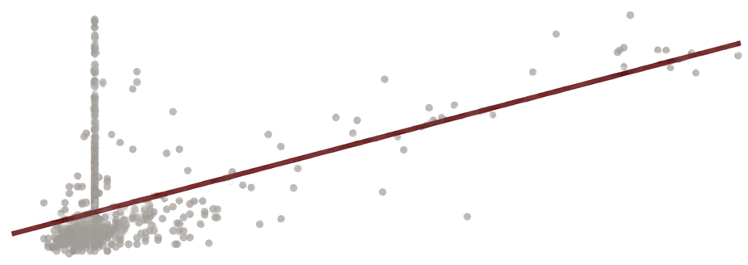

Simple Linear Regression: Explanatory Limits
Hardness vs TDS, held-out test set (R² = 0.212)
Hardness = 18.160 + 0.4144 × TDS
Fitted by OLS on training data; the 95% CI of the slope is 0.384–0.444.
350
Fitted: 18.16 + 0.4144 × TDS
300
median-imputed TDS
250
0.212
test R²
29.74
test RMSE (mg CaCO₃/L)
−21.5%
MSE vs mean baseline
200
Total hardness (mg CaCO₃/L)
150
100
  64% of the training TDS values were replaced by the median, which forms a vertical band in the plot and flattens the slope.
  When only complete cases are used, the slope rises to 0.4771 and the test RMSE falls to 18.62.
50
0
TDS (mg/L)
0
50
100
150
200
250
300
350
INFERENCE Predictive performance is limited by data quality as much as by the choice of model.
04 · PREDICTIVE MODELLING
09

Slide 10
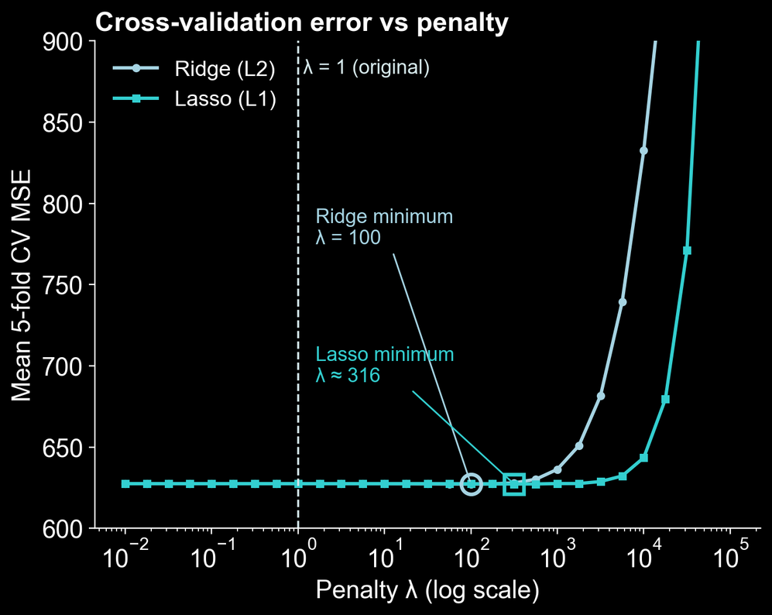
Regularisation: Cross-Validated Penalty Selection
  λ was selected by five-fold cross-validation on the training set over 29 values from 10−2 to 10⁵, with imputation and scaling refitted within each fold.
  The CV error is flat for λ ≤ 10³, because nine predictors are few relative to 4,252 samples.
Ridge (L2)
The CV-selected λ is 100. The test MSE is 431.76 and the test R² is 0.615.
Lasso (L1)
The CV-selected λ is about 316, and all nine predictors are kept (test R² = 0.615). The one-SE rule keeps five predictors with R² = 0.590.
INFERENCE Cross-validation shows that only a light penalty is optimal, so regularisation adds little accuracy here.
04 · PREDICTIVE MODELLING
10

Slide 11










Principal Component Analysis: Latent Structure
PCA loadings on the first two components
36.6%
of variance is explained by PC1, a dissolved-ion gradient.
11.9%
of variance is explained by PC2, driven by phosphorus and carbonate.
Bicarbonate
Sodium
Chloride
TDS
The first two components explain 48.4% of the variance, and six are required to reach 80%. Therefore, the dimensionality cannot be reduced substantially.
Sulphate
pH
Carbonate
Dissolved oxygen
PC1 (36.6%)
Total phosphorus
PC2 (11.9%)
−0.75
−0.50
−0.25
0.00
0.25
0.50
0.75
Loading (correlation with component)
INFERENCE The predictors share a common ionic signal, which influences every subsequent model.
04 · PREDICTIVE MODELLING
11

Slide 12









Tree-Based Models: Variance and Generalisation
Training vs test performance
Training R²
Test R²
Unrestricted Decision Tree
1.0
1.000
0.957
The tree grew to a depth of 36 with 3,625 leaves and fitted the training data perfectly (R² = 1.000). Its test R² of 0.570 shows that it memorised the data.
0.8
0.775
0.722
0.719
Cross-Validated Decision Tree
R²
0.6
0.570
We searched 126 combinations:
max_depth {3, 5, 7, 10, 15, None} ×
min_samples_leaf {1, 2, 5, 10, 20, 30, 50} ×
min_samples_split {2, 10, 20}.
Five-fold CV selected a depth of 10 and at least 20 samples per leaf. Test MSE fell by 34.6%, and test R² became 0.719
0.4
0.2
0.0
Unrestricted tree
CV-tuned
tree
Random Forest (100 trees)
Random Forest (100 Trees)
INFERENCE : Random forest gives the best results because feature importance is spread more evenly.
Averaging 100 bootstrap trees reduces variance and gave the best test result (MSE = 252.59, R² = 0.775).
04 · PREDICTIVE MODELLING
12

Slide 13
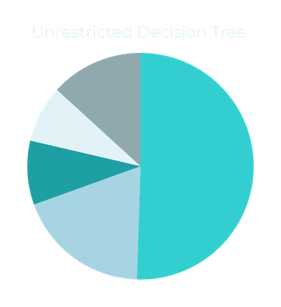
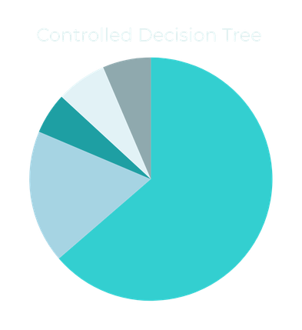
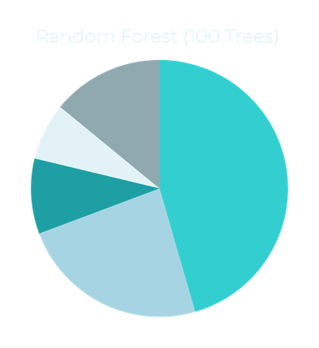
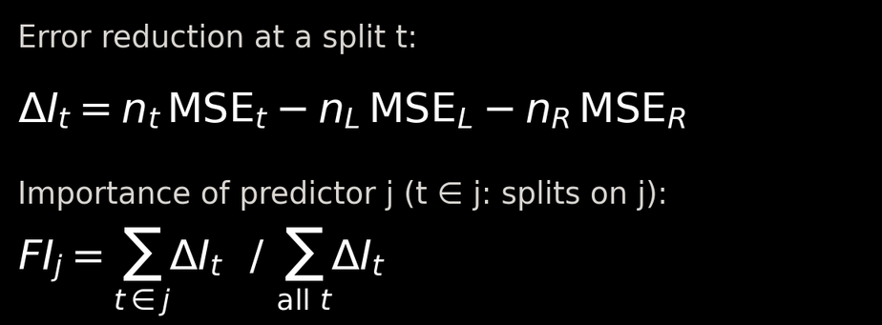
Why the Random Forest Generalises Best
Feature Importance Distribution Across Tree-Based Models
What is feature importance?
It is the share of the total reduction in squared error that splits on a predictor achieve, normalised to sum to 100%.
Test R²: 0.570
Test R²: 0.719
Test R²: 0.775
Sodium
Chloride
Bicarbonate
pH
Other five
INFERENCE The Random Forest spreads importance most evenly (sodium falls to 45.5%) because each split considers a random subset of predictors. Combined with averaging over 100 trees, which reduces variance, this gives the most reliable predictions.
04 · PREDICTIVE MODELLING
13

Slide 14










Comparative Model Performance and Feature Importance
Model | Test MSE | Test R²
Mean baseline | 1126.67 | –
Simple linear regression (TDS) | 884.52 | 0.212
Ridge regression (CV λ = 100) | 431.76 | 0.615
Lasso regression (CV λ ≈ 316) | 432.07 | 0.615
Unrestricted decision tree | 482.54 | 0.570
CV-tuned decision tree | 315.64 | 0.719
Random Forest (100 trees) | 252.59 | 0.775
Impurity-based feature importance
Sodium
45.5%
63.7%
Chloride
17.7%
23.8%
Bicarbonate
5.5%
9.5%
pH
7.2%
6.7%
Sulphate
5.0%
3.2%
Dissolved oxygen
2.8%
0.7%
Total phosphorus
2.2%
0.3%
Carbonate
2.1%
1.5%
Random Forest
TDS
2.1%
CV-tuned tree
0.7%
0
10
20
30
40
50
60
70
Feature importance (%)
INFERENCE Accuracy rises with model flexibility once complexity is controlled, and every method identifies sodium and chloride as the dominant predictors of hardness.
04 · PREDICTIVE MODELLING
14

Slide 15

Notes:
Close and invite questions.
15

Slide 16

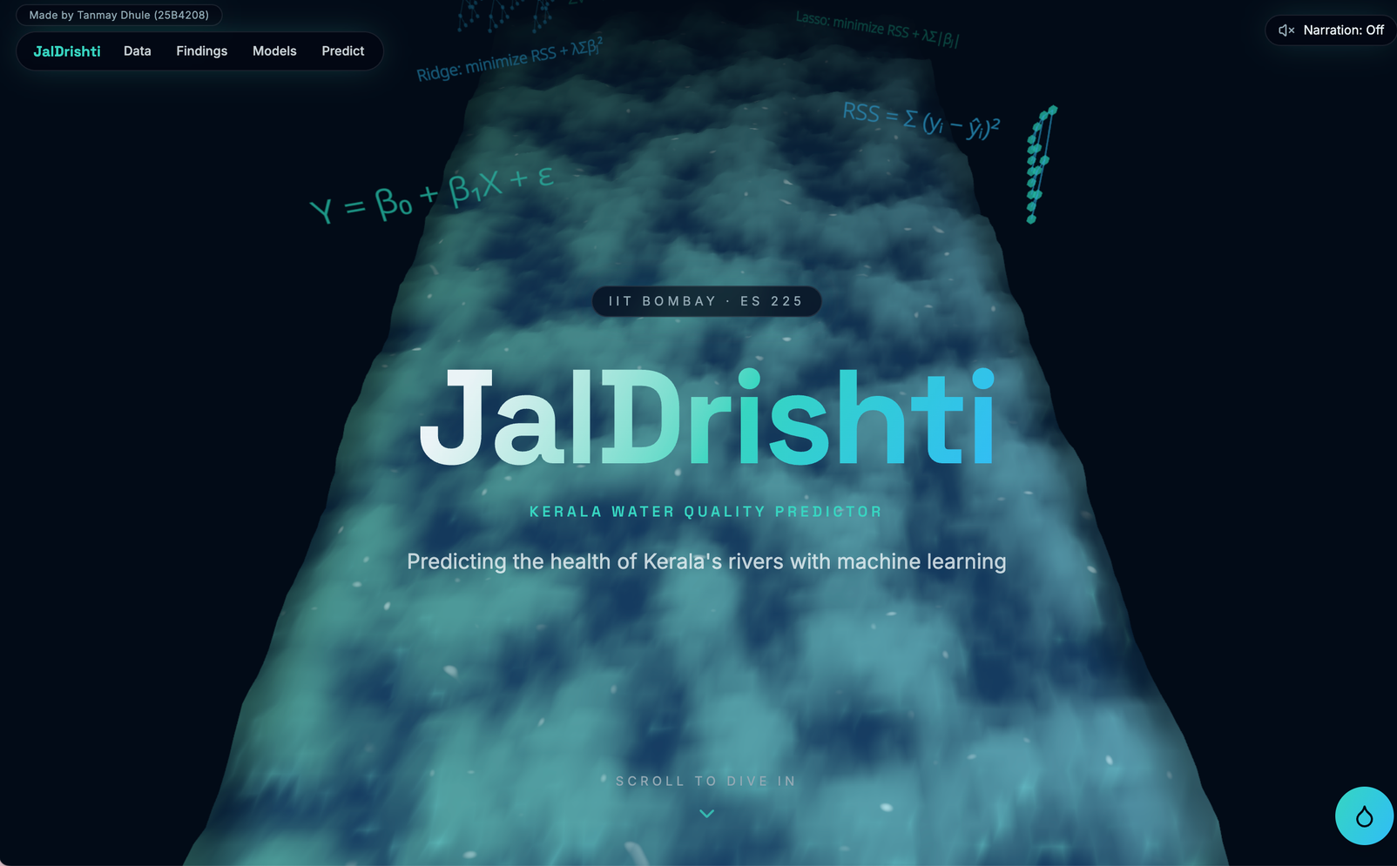
OUR WEBSITE

