Slide 1

Faculty of Engineering & Technology, University of Lucknow
Department of Mechanical Engineering
MAJOR PROJECT PRESENTATION
on
Assessment of Combustion Instability in Cryogenic Engines
Presented by:
Aditya Kumar Patel (2210013105002)
Ashish Kumar Raj (2210013105011)
Ayush Mishra (2210013105012)
Prashant Patel (2210013105026)
Tanishq Maurya (2210013105036)
Under the guidance of :
Dr. RAJENDRA BHADUR
Assistant Professor
Department of Mechanical Engineering

Slide 2

Combustion Instability in Cryo-LREs
By- Group 3

Slide 3
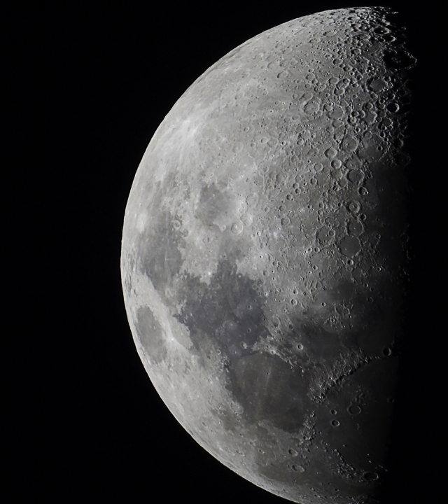
Agenda
THEORY OF CRYO-LREs
DESIGN
PRE-PROCESSING

Slide 4
“Reach for the moon, even if you miss, you'll land among the stars.”
Norman Vincent Peale

Slide 5

Nozzle theory and gas dynamics
A concise definition of Gas Dynamics, is the behavior of gases when their motion is fast enough (typically at high Mach numbers) that changes in density and temperature become significant, treating the gas as a continuous medium.
This behaviors of gas is expressed by Prandtl-Meyer relation
$$dv=\frac{\sqrt{M^{2}−1}}{1+\frac{γ−1}{2}M^{2}}\frac{dM}{M}$$

Slide 6
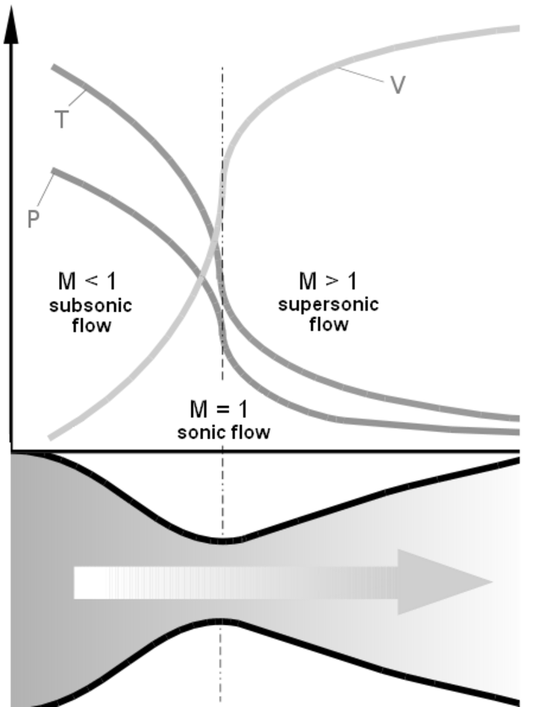
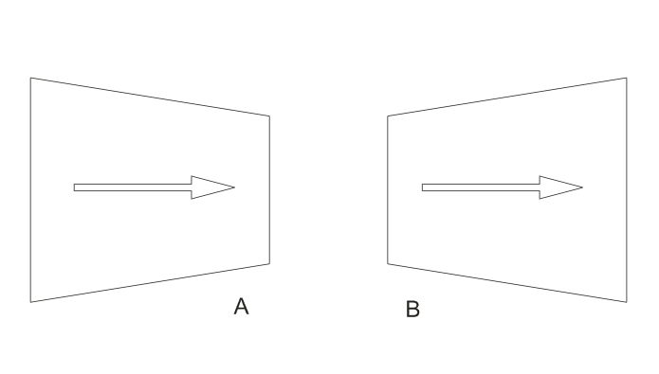

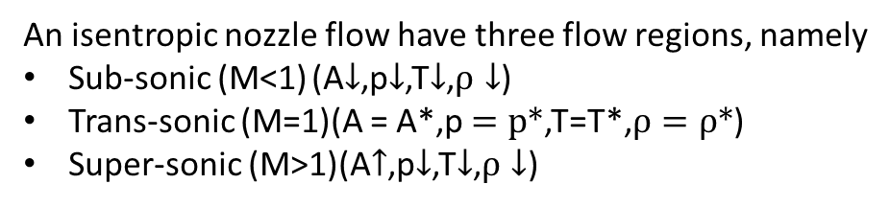
Flow Characteristics
An isentropic nozzle flow have three flow regions, namely
Sub-sonic (M<1) (A$↓$,p$↓$,T$↓$,$ρ↓$)
Trans-sonic (M=1)(A = A*,p $=p∗$,T=T*,$ρ=ρ∗$)
Super-sonic (M>1)(A$↑$,p$↓$,T$↓$,$ρ↓$)
$$\frac{dV}{V}=\frac{1}{M^{2}−1}\frac{dA}{A}$$

Slide 7
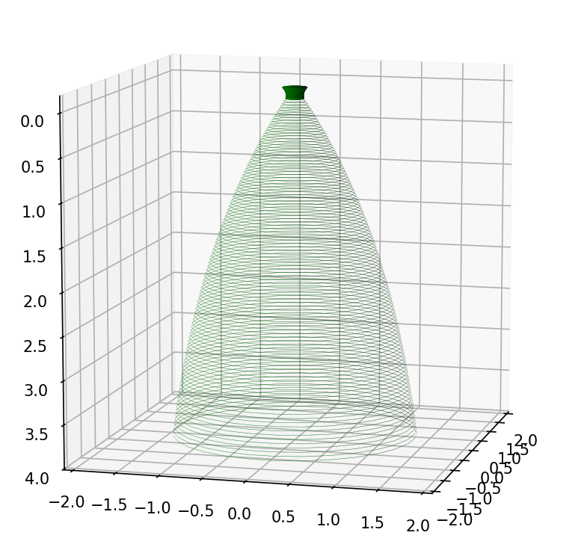
Cryogenic LREs
A Cryogenic Liquid Rocket Engine, uses cryogenic Fuel and oxidizer as propellants .Cryogenic engines are excellent in providing very high specific impulse across a range of design conditions. Providing high specific impulse making it suitable for both light, medium and heavy payload applications and at upper, medium and low orbit applications.
Notable example:
NASA- RL10 class
SpaceX- MERLIN class
ISRO- CE20

Slide 8
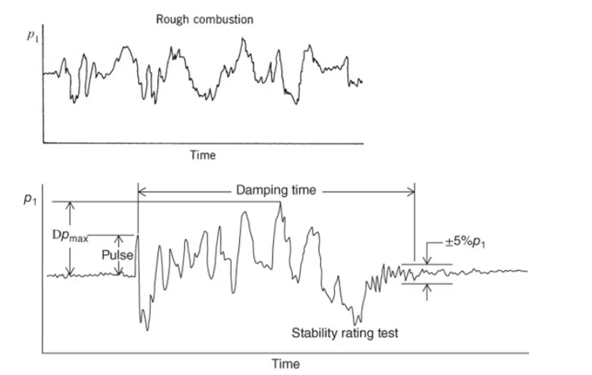







Combustion Instability
Combustion instabilities are physical phenomena that occurs in a reacting flow in which some perturbations, even very small ones, grow and then become large enough to alter the features of the flow in a particular way.
Types of instabilities:
Low frequency (10-400Hz){chug}
Source- Feed & Chamber Design
Mid frequency (400-1000Hz){Buzz}
Source- Injector Manifold resonance
High frequency (<1000Hz) {Screech}
Source-Chamber acoustics
$$Instability growth =\int_{V}{\overline{p^{′}\left(t\right)q^{′}\left(t\right)}ⅆV}>0$$
$$p\left(t\right)$$
$$→$$
fluctuations in acoustic pressure
$$q\left(t\right)$$
$$→$$
fluctuations in heat release rate
$$\overline{.}$$
$$→$$
timed average correction

Slide 9
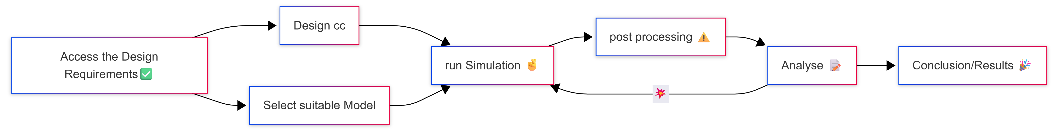
Phase I
Phase II
Phase I

Slide 10
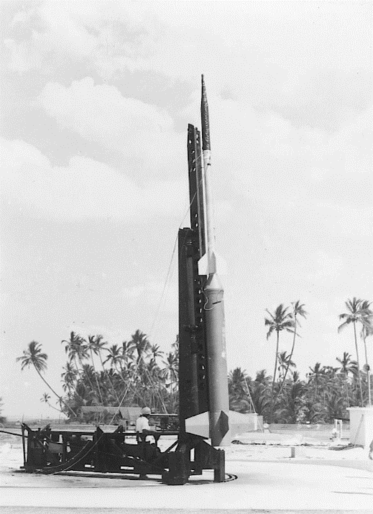
DESIGN

Slide 11
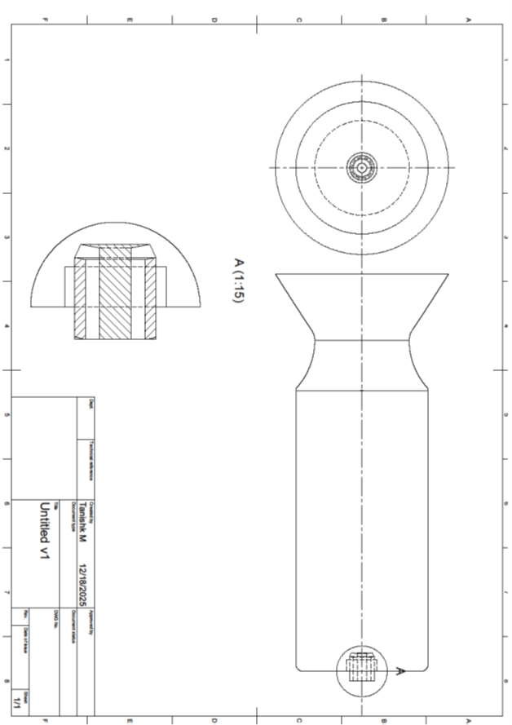
Design of Chamber
DESIGN OF COMBUSTION CHAMBER
WORKING OF PINTLE MANIFOLD
LOX
GH2
DESIGN OF INJECTOR PINTLE

Slide 12


Cryogenic Propellants
Fuel
Molecular mass $≈$ 2.016 g/mol
M.R = 6 (@ max Isp=450s)
$C_{P}$ $≈ 9.6 − 14.3 KJ/Kg.K$
$ρ$ $≈ 70.8 Kg/m3$
Oxidizer
Molecular mass $≈ 32$ g/mol
M.R = 6 (@ max Isp=450s)
$C_{P}$ $≈ 1.7 KJ/Kg.K$
$ρ$ $≈ 1141 Kg/m3$
H-H
O=O
$$H_{2}\left(l\right)+ O_{2}\left(l\right)→H_{2}\left(g\right)+O_{2}\left(g\right) + H_{2}O\left(l\right)+ H_{2}O_{2}+ {HO}_{2}+H∗+O∗+OH∗$$

Slide 13
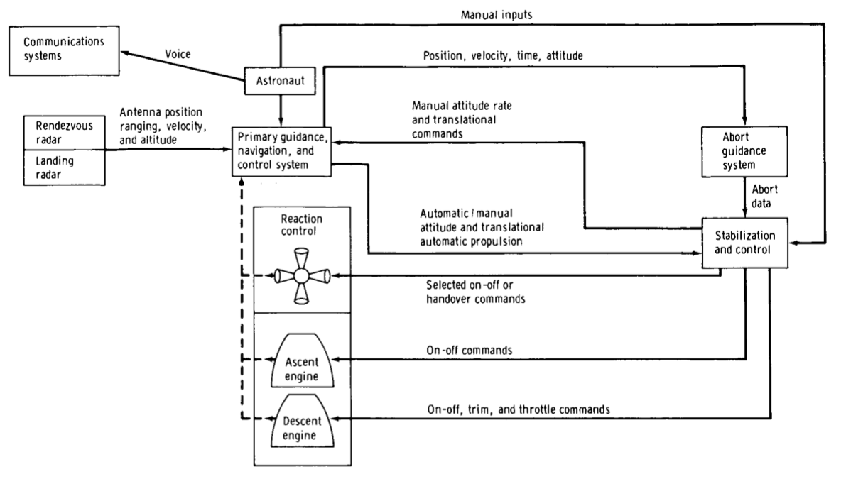
Active Stabilization
Control system design refers to a microcontrollers & actuators used as active control measures against high frequency combustion instability. There are various active control measures that are highly effective. However, due to the physical processes such as injection, vaporization and combustion involved there is always a time lag between instability and response.
Using Active Stabilization;
Active pulse cancellation
Throttling of fuel
Active feedback Control
Adjusting Injection pressure
Notable example:

Slide 14
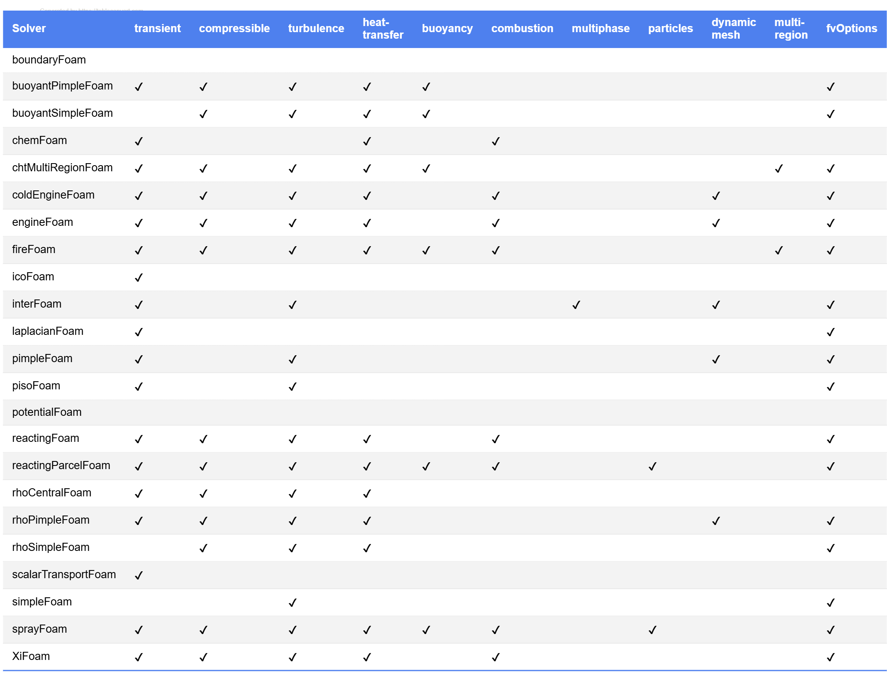
Model
Accessing Requirements
Transient state
Compressible
Turbulence
HT
Buoyancy
Combustion
Particles
fvOptions

Slide 15



Meshing of Geometry
Boundary types:
Wall – count(2)
Empty – count(N/A)
Patch – count(3){2- inlet & 1-outlet}
Symmetry –count(1)
Fig : 2D- Section geometry of chamber
Outlet
Wall
Inlet
Fig : Single block 1D flow
Fig : Chamber wall 2D (reduced resolution)

Slide 16
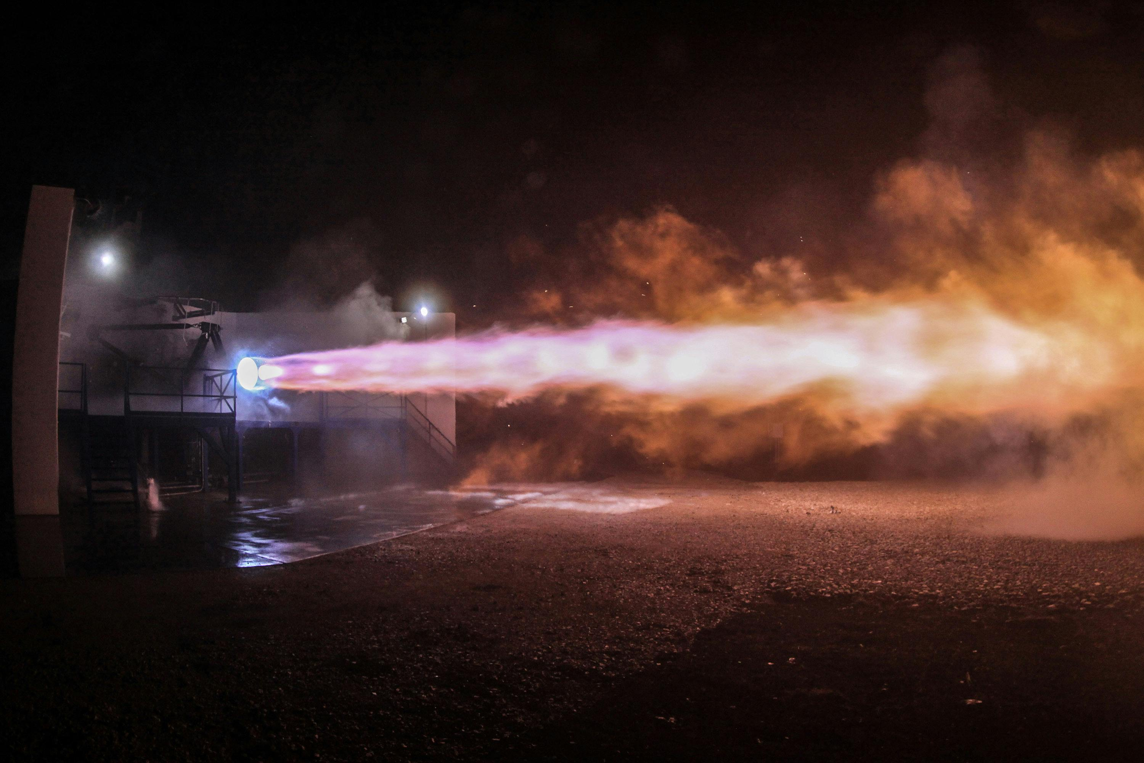
QUESTIONS?

Slide 17

THANKYOU
Thank
you

