Slide 1

Sanjivani Rural Education Society's
Sanjivani College of Engineering, Kopargaon-423 603
Department of Computer Engineering
Presented By
Smitraj Dinkar Bankar
UCS23M1009
A Presentation On
Tanishka Sharad Bhakare
UCS23F1011
Mini Project Activity | Advance Data Science Lab (PECO412B)
Power Consumption Prediction
Shraddha Sunil Anap
UCS23F1003
Vaishnavi Sandesh Borse
UCS23F1019
Guided By
Prof. S. A. Shivarkar
Group CMG2 | B.Tech 7th Sem | AY 2026-27 Sem-I
Multi-zone smart-grid load forecasting using deep learning
Case study: Tetouan City, Morocco
Notes:
Introduce the team and guide. This is the Advance Data Science Lab mini project (PECO412B): Power Consumption Prediction for Tetouan City using deep learning.

Slide 2
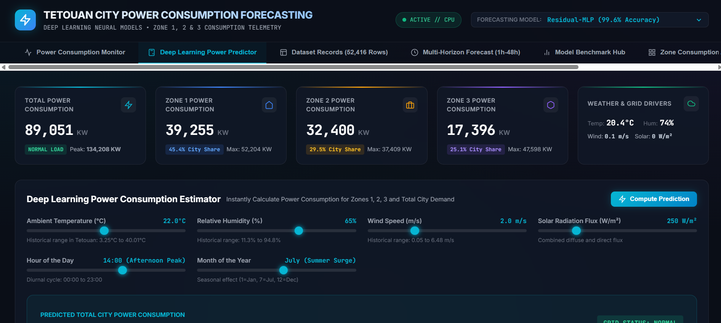
Introduction
A city's electricity demand changes every minute with human activity and weather
Utilities must generate and route exactly that load, so load forecasting is a core smart-grid function
Demand is non-linear and non-stationary, which classical models such as ARIMA struggle to capture
Deep learning on 10-minute telemetry gives accurate zone-wise forecasts in milliseconds
52,416
3
10 min
telemetry records
distribution zones
sampling interval
Our dashboard: Deep Learning Power Predictor
Notes:
Electricity demand is driven by people and weather. Accurate short-term forecasts help utilities balance supply and demand. We used 52,416 ten-minute records from three zones of Tetouan.

Slide 3


Problem Statement & Objectives
Problem Statement
Objectives
Demand depends on weather, time of day and zone behaviour
Over-estimating idles costly reserve plants; under-estimating risks congestion, transformer tripping and blackouts
Manual estimation and ARIMA fail on non-linear, multi-seasonal load
Zones behave very differently, so one aggregate model is not enough
1
Analyse the 52,416-record Tetouan dataset
2
Engineer features and build a leak-free chronological pipeline
3
Train and compare five deep-learning architectures
4
Evaluate with R², RMSE, MAE, MAPE and latency
5
Deploy as a FastAPI service with a live dashboard
Notes:
Forecast errors are costly in both directions. Our objective: predict next-step load for each of the three zones and the total grid, compare five deep models, and deploy the best one.

Slide 4



Proposed Solution
INPUT
MODEL
OUTPUT
Weather, calendar and recent zone loads
2-hour window: 12 steps × 17 features
Residual-MLP, LSTM, GRU,
Transformer, CNN-BiLSTM
Next 10-minute load (KW) for
Zone 1, Zone 2, Zone 3 and Total
Next-step forecasting
Five architectures, one protocol
Deployed on FastAPI
Predicts every zone and the whole grid at once, so dispatchers see where a peak will land
Strictly chronological, leak-free evaluation so the models are compared fairly
REST endpoints plus a Chart.js dashboard: live stream, multi-horizon forecast and what-if sandbox
Notes:
Input is a two-hour window of weather, calendar and load history. Output is the next ten-minute load for each zone plus the total. The best model is served through FastAPI.

Slide 5

Dataset Description
SOURCE
Zone | Profile | Mean (KW) | Peak (KW) | Share
Zone 1 | Downtown commercial | 32,345 | 52,204 | 45.4%
Zone 2 | Industrial corridor | 21,043 | 37,409 | 29.5%
Zone 3 | Residential & coastal | 17,835 | 47,598 | 25.0%
Total | Whole grid | 71,223 | 134,208 | 100%
UCI "Power Consumption of Tetouan City" (Salam & El Hibaoui)
SIZE
52,416 records × 9 columns, one every 10 minutes
PERIOD
1 Jan to 30 Dec 2017, no missing values
INPUTS
Zone profiles are taken from the project documentation; the dataset labels them only as Zone 1, 2 and 3.
Temperature, humidity, wind speed, two solar-diffuse indices
Zone 1 carries almost half of the city load; Zone 3 is the most variable (tourism and households).
TARGETS
Zone 1, 2, 3 power (KW); Total = Z1 + Z2 + Z3
Notes:
The data comes from UCI. Three zones with different profiles. Zone 1 is downtown (45%), Zone 2 industrial (30%), Zone 3 residential and coastal (25%).

Slide 6
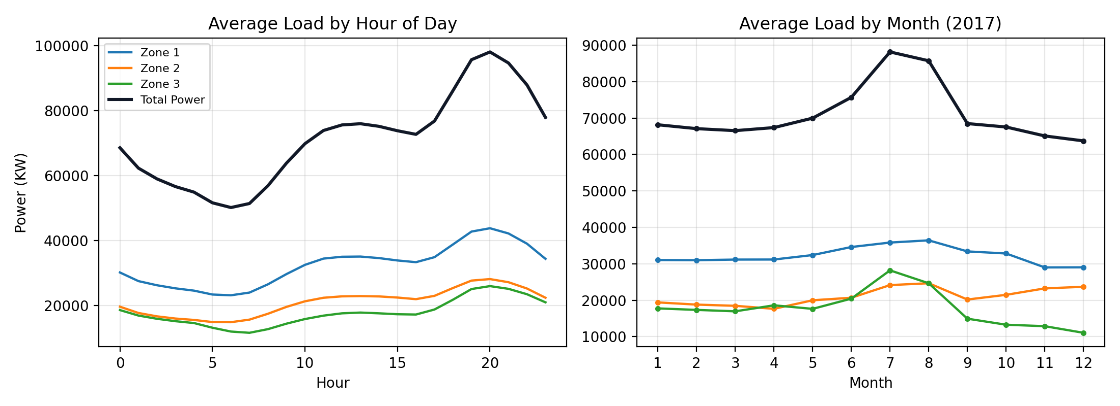
Exploratory Data Analysis
20:00
evening peak, 98,037 KW
06:00
daily low, 50,190 KW
July
highest month, 88,174 KW
Notes:
Load bottoms out around 6 AM and peaks around 8 PM. July and August are highest because of cooling. Temperature has the strongest positive correlation (+0.488), humidity a moderate negative one (-0.299).

Slide 7



Pre-processing & Feature Engineering
Strictly chronological split: no shuffling, so no future information leaks into training
Training 70% | 36,691 records
1 Jan to about 13 Sep
Val 15%
7,862
Test 15%
7,863
17-dimensional feature vector per time step
5
2
6
1
3
Weather
Physical proxies
Cyclical time
Calendar flag
Lagged loads
temperature, humidity, wind, 2 solar indices
heat index, total solar flux
sin/cos of hour, month, day of week
weekend indicator
Zone 1, 2, 3 at current step
StandardScaler fitted on training data only
12-step (2 h) sliding window: B × 12 × 17
Huber loss and gradient clipping handle sensor spikes
Notes:
Split 70/15/15 in time order. Each time step becomes a 17-dimensional vector. Scalers are fitted on training data only. Inputs are 12-step windows of two hours.

Slide 8
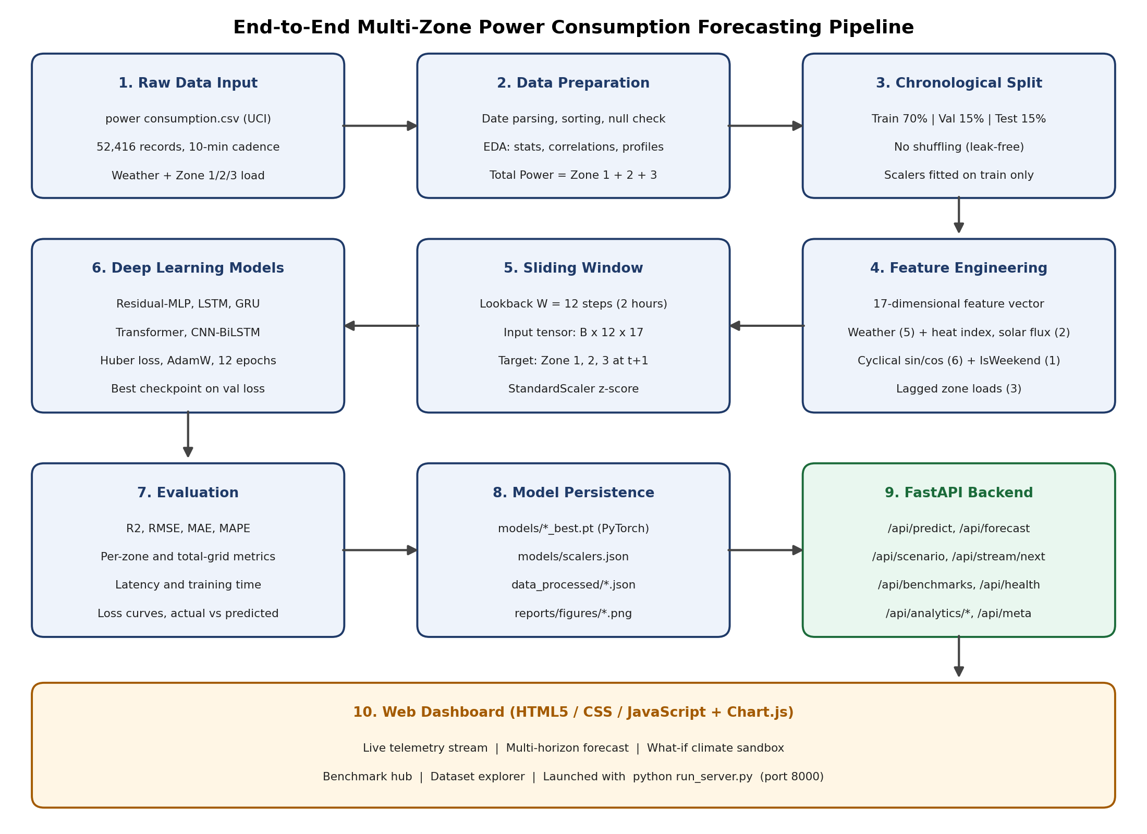
System Architecture
1
Raw telemetry from power consumption.csv
2
Cleaning and chronological split
3
Feature engineering and 12-step window
4
Train five deep networks
5
Evaluate: R², RMSE, MAE, MAPE
6
Serve via FastAPI + web dashboard
Notes:
Walk through the pipeline left to right, top to bottom: raw data, preparation, split, features, window, models, evaluation, persistence, FastAPI backend, and the dashboard.

Slide 9
Deep Learning Models Compared
BEST
DENSE RESNET
RECURRENT
RECURRENT
SELF-ATTENTION
HYBRID
Residual-MLP
LSTM
GRU
Transformer
CNN-BiLSTM
60,163
parameters
56,707
parameters
43,075
parameters
70,275
parameters
30,723
parameters
204 → 128 units, two residual blocks (LayerNorm, GELU)
2 layers, hidden size 64, gated memory cell
2 layers, hidden size 64, update and reset gates
2 encoder layers, 4 heads, d_model 64
Conv1D (64 filters) feeding a bidirectional LSTM
Huber loss
AdamW
12 epochs
CPU, seed 42
δ = 1.0, robust to spikes
lr 1e-3, weight decay 1e-4
batch 128, LR on plateau
best val-loss checkpoint
Notes:
Five architectures, one per family: dense residual, two recurrent, attention, and hybrid. All share the input 12 x 17 and output of 3 zone loads. Training configuration is identical.

Slide 10
Results: Model Benchmark
Model | R² | RMSE (KW) | MAE (KW) | MAPE % | ms/sample
Residual-MLP | 0.9964 | 853.1 | 640.9 | 1.06 | 0.004
LSTM | 0.9873 | 1,605.7 | 1,301.9 | 2.05 | 0.065
GRU | 0.9836 | 1,823.0 | 1,580.9 | 2.68 | 0.065
Transformer | 0.9824 | 1,889.9 | 1,529.6 | 2.48 | 0.025
CNN-BiLSTM | 0.9751 | 2,247.6 | 1,960.7 | 3.34 | 0.046
Persistence baseline | 0.9932 | 1,177.9 | 786.2 | 1.24 | n/a
Evaluated on 7,851 unseen windows (about 6 Nov to 30 Dec 2017), total grid load.
0.9964
R² (total load)
1.06%
MAPE
−47%
RMSE vs LSTM
Notes:
Residual-MLP wins on every aggregate metric: R2 0.9964, RMSE 853 KW, MAPE 1.06%, and it is also the fastest at 0.004 ms per sample. It beats the persistence baseline on total load. The other four deep models have a higher total RMSE than persistence.

Slide 11
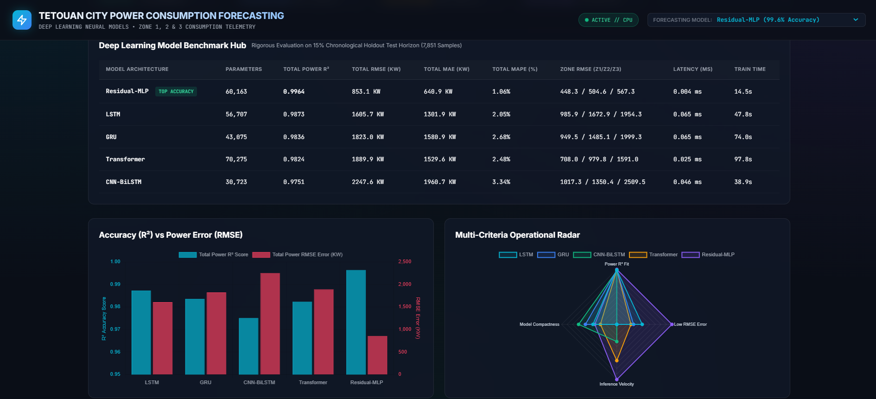
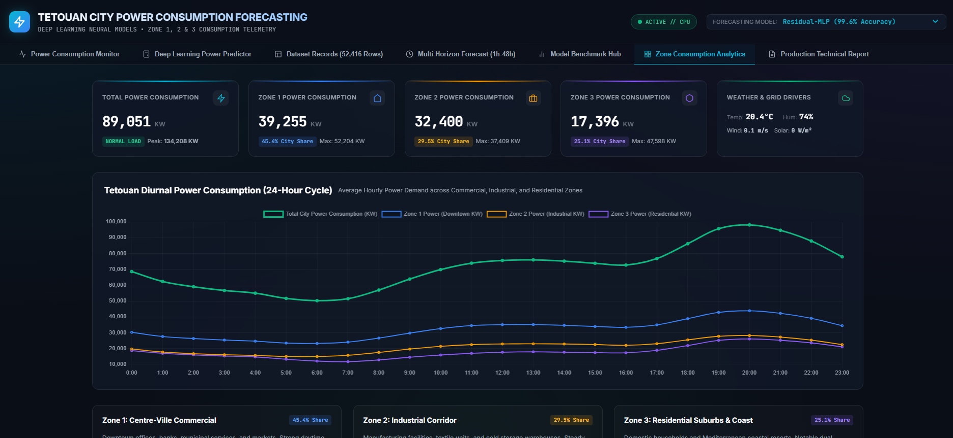
Zone-wise Results & Dashboard
Zone 1 Downtown
Zone 2 Industrial
Zone 3 Residential, hardest zone
0.9945
448 KW
1.25%
0.9919
505 KW
1.50%
0.9715
567 KW
4.22%
R²
RMSE
MAPE
R²
RMSE
MAPE
R²
RMSE
MAPE
Model Benchmark Hub
Zone Consumption Analytics
Notes:
Residual-MLP is accurate on Zones 1 and 2. Zone 3 has the largest relative error (MAPE 4.22%) and is the hardest zone for every model. The dashboard shows the benchmark hub and zone analytics, plus live stream, multi-horizon forecast and what-if sandbox.

Slide 12
Conclusion
Built a deep-learning smart-grid forecaster on 52,416 ten-minute records from three Tetouan zones
Residual-MLP is best: R² 0.9964, RMSE 853 KW, MAPE 1.06%, 0.004 ms per sample
It beats the persistence baseline on total load; Zone 3 stays the hardest
FastAPI and the dashboard give live monitoring, multi-hour projection and what-if analysis
Limitations
One year of data (2017), no holiday effects
One-step model, no hyper-parameter search
Persistence is competitive in Zones 2 and 3
Future Scope
Multi-year data and tourism calendars
Residual and multi-horizon learning
Probabilistic intervals; SCADA and edge deployment
Thank You!
Notes:
Summarise: best model, deployment, honest limitations (single year, one-step model, persistence is strong on Zones 2 and 3), and future work. Then invite questions.

