Slide 1

AIML PROJECT REPORT TOPIC :AI-Powered Expense Tracker
Submitted By:
Name: Tanishka Jain
Registration Number: 25BAI10021
Program: B. Tech(CSE)
Specialization: Artificial Intelligence and Machine Learning
Year: First Year
Course Code: CSE0001
Course Title: Digital Literacy

Slide 2
Introduction
In today’s fast-paced digital world, managing personal finances has become increasingly important yet challenging. Many individuals struggle to keep track of their daily expenses, often leading to unplanned spending and poor financial decisions. Traditional methods of expense tracking are either manual or lack intelligent insights, making them inefficient and time-consuming.
To address this issue, this project presents an AI-Powered Expense Tracker that combines simplicity with smart automation. By leveraging basic Machine Learning techniques, the system not only records expenses but also automatically categorizes them based on user input. This reduces the need for manual classification and improves accuracy in tracking financial activities.
The project demonstrates how Artificial Intelligence can be integrated into everyday applications to make them more efficient and user-friendly. It serves as a practical example of applying machine learning concepts to solve real-world problems, making expense management smarter, faster, and more reliable.

Slide 3
Problem Statement
Managing daily expenses is a common challenge faced by individuals, especially students and working professionals. Most people either rely on manual methods or simple applications that only record expenses without providing meaningful insights. These methods are often time-consuming, prone to errors, and require users to manually categorize each expense, which can lead to inconsistency and inefficiency.
Additionally, users often fail to analyze their spending patterns due to the lack of intelligent features in traditional expense tracking systems. Without proper categorization and analysis, it becomes difficult to control unnecessary spending or make informed financial decisions.
Therefore, there is a need for a smart and automated solution that not only records expenses but also intelligently categorizes them and provides a clear overview of spending. This project aims to solve this problem by developing an AI-Powered Expense Tracker that simplifies expense management using Machine Learning techniques.

Slide 4
Objective
To develop a system for recording daily expenses efficiently
To implement a Machine Learning model for automatic expense categorization
To reduce manual effort and improve accuracy in tracking expenses
To provide a clear summary of total spending
To demonstrate the practical application of AI in solving real-world problems

Slide 5
Methodology
The project follows a step-by-step approach to design and implement the AI-powered system. First, a small dataset of common expense-related keywords is created and labeled into categories such as Food, Travel, and Entertainment. Next, the data is preprocessed and converted into numerical form using text vectorization techniques.
A Machine Learning model, specifically the Naive Bayes algorithm, is then trained on this dataset to learn patterns and relationships between words and categories. After training, the model is integrated into the expense tracker application.
When a user enters an expense, the system processes the input and uses the trained model to predict its category automatically. The expense details along with the predicted category are stored and displayed. Finally, the system calculates the total expenses, providing users with a clear summary of their spending.

Slide 6
Machine Learning Model
The AI-Powered Expense Tracker uses the Naive Bayes classification algorithm, which is a simple yet effective Machine Learning model for text-based classification tasks. It is especially suitable for this project because it works well with small datasets and provides fast and reliable predictions.
In this project, the model is trained on a dataset of expense-related keywords such as “pizza,” “bus ticket,” and “shopping,” which are labeled into categories like Food, Travel, and Shopping. Before training, the text data is converted into numerical form using a technique called Count Vectorization, where each word is represented as a frequency vector.
The Naive Bayes model then learns the probability of each word belonging to a particular category. When a user enters a new expense, the system processes the input text and uses the trained model to calculate the probability of it belonging to each category. The category with the highest probability is selected as the predicted output.
This model is chosen because it is easy to implement, requires less computational power, and performs well for basic text classification tasks. Although it may not achieve very high accuracy with limited data, it provides a strong foundation for building more advanced models in the future.

Slide 7
Technologies Used
Python
Scikit-learn
Machine Learning

Slide 8
Working
The AI-Powered Expense Tracker works in a simple and user-friendly manner by combining basic expense management with Machine Learning. First, a Machine Learning model is trained using a small dataset of expense-related keywords categorized into groups such as Food, Travel, and Entertainment. This training enables the system to learn patterns and identify relationships between words and their respective categories.
When the user runs the application, a menu is displayed with options to add expenses, view expenses, or exit. Upon selecting the option to add an expense, the user is prompted to enter the expense name and amount. The entered expense name is then processed and passed to the trained Machine Learning model, which predicts the most appropriate category automatically.
After prediction, the system displays the category to the user and stores the expense details, including name, amount, and predicted category, in a list. When the user chooses to view expenses, all stored entries are displayed along with their categories, and the system calculates the total expenditure.
This workflow ensures that the user can easily record and monitor expenses while the AI component handles categorization, making the process faster, more accurate, and efficient.

Slide 9
Results
System correctly categorizes common expenses.
Improves tracking efficiency.

Slide 10
Challenges
Limited dataset: The model was trained on a small set of keywords, which affected prediction accuracy for unfamiliar inputs.
Handling unknown inputs: The system sometimes struggled to correctly categorize new or uncommon expense names.
Model accuracy: Achieving high accuracy with a simple algorithm like Naive Bayes was challenging.
Data preprocessing: Converting text into a suitable numerical format required proper understanding of vectorization techniques.
Integration issues: Combining the Machine Learning model with the expense tracker functionality required careful implementation.
User input errors: Incorrect or unclear input by users could lead to wrong predictions.

Slide 11
Future Scope
Better dataset
Graphs & visualization
Web/mobile app

Slide 12
Conclusion
The AI-Powered Expense Tracker successfully demonstrates how Machine Learning can be integrated into a simple application to make it more intelligent and efficient. By automating the categorization of expenses, the system reduces manual effort and improves accuracy in tracking daily spending. It provides users with a clear overview of their expenses, helping them make better financial decisions.
This project highlights the practical application of AI in solving real-world problems and showcases the potential of using basic machine learning techniques in everyday tools. Although the current system is built on a small dataset, it establishes a strong foundation for further enhancements such as improved accuracy, data visualization, and advanced analytics.
Overall, the project proves that even simple AI integration can significantly enhance user experience and functionality, making expense management smarter and more effective.

Slide 13
System Flow
User Input → AI Model → Category Prediction → Store Data → Display Summary

Slide 14
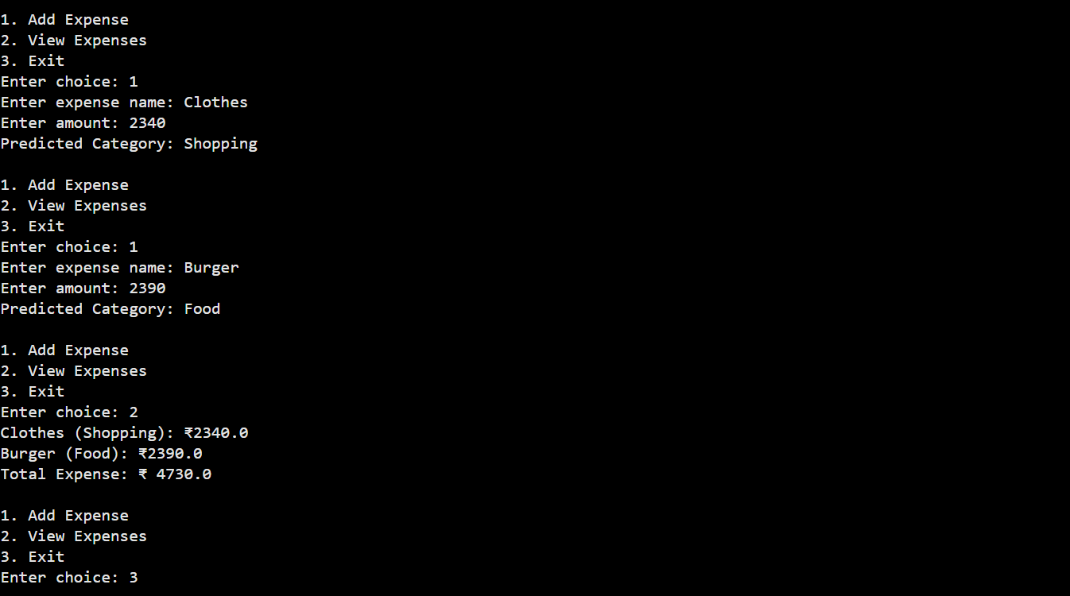
Project Output (Sample)

