Slide 1




Intelligent Invoice Processing
& Semantic Search Engine
GenAI-Powered Multimodal OCR, Vector Search & Cloud-Native Architecture
FastAPI
PostgreSQL
React
Docker
Presented by: Tanishka Gupta | Roll No: 23UCS722 Department of Computer Science & Engineering, The LNM Institute of Information Technology Faculty Mentors: Dr. Aniket Pal
Industry Mentor: Mr. Kailash Gupta – Senior Manager, Accounts

Slide 2




The Enterprise Challenge: Unstructured Invoice Ingestion
High Volume & Heterogeneity
Manual Entry Bottlenecks
Businesses handle thousands of invoices daily in variable formats — scanned paper, native PDFs, photo receipts.
Transcribing invoice fields manually is labor-intensive (5–10 min/invoice) and error-prone (~4% error rate).
Fragility of Legacy OCR
Search Limitations
Template-based OCR breaks whenever layout structures change across vendors.
Traditional SQL search cannot execute natural language queries like "find logistics expenses over $5k last quarter".
Intelligent Invoice Processing & Semantic Search Engine
2

Slide 3




Solution: Decoupled GenAI Document Intelligence Engine
Automated Ingestion
Cloud blob archiving via Azurite (Azure Blob Storage emulation).
Multimodal Layout Extraction
Azure AI Document Intelligence + fallback parsers for key-value & line-item structuring.
Semantic Vector Indexing
Encodes document context into 384-dimensional dense vectors using SentenceTransformers.
Hybrid Search Capabilities
Combines exact SQL metadata filters with Qdrant vector similarity search.
Glassmorphic User Dashboard
React 18 frontend with live infrastructure status monitoring and instant PDF preview.
Intelligent Invoice Processing & Semantic Search Engine
3

Slide 4



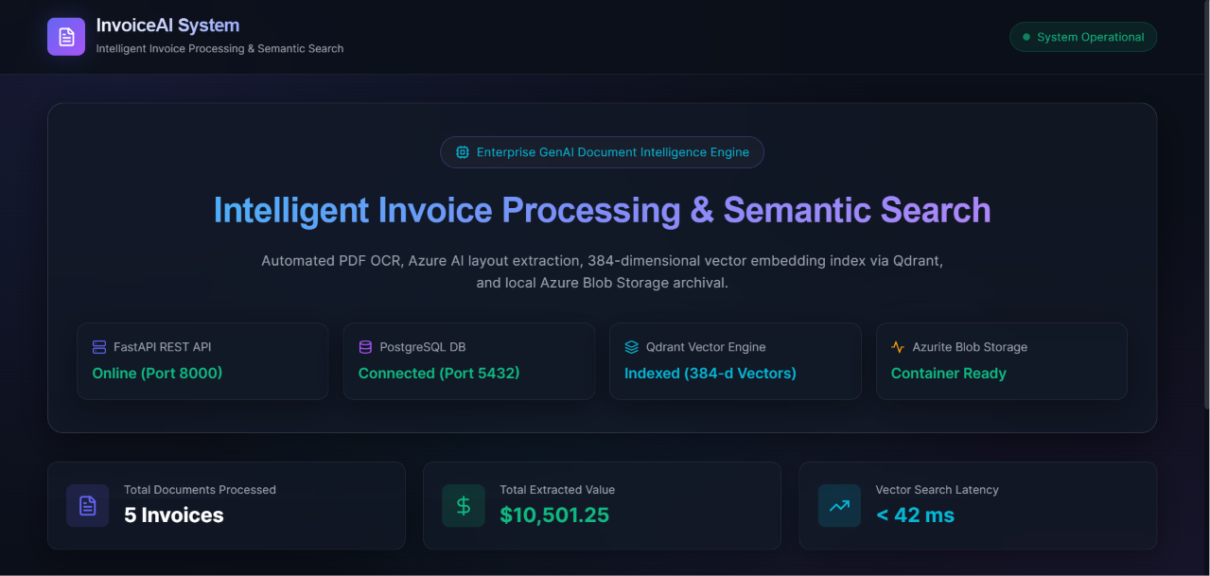

Core Project Objectives & Capabilities
Zero Data Loss Ingestion
Live Infrastructure Health Monitoring
Containerized Deployment
01
Binary PDF stream storage with local failover handling.
Real-time status chips for FastAPI, PostgreSQL, Qdrant, and Azurite.
One-command initialization using Docker Compose.
Automated Field Structuring
02
Extracts Vendor, Invoice #, Date, Currency, Tax, Total Amount, and Line Items.
Natural Language Semantic Search
03
Contextual similarity matching (e.g., "office stationery supplies").
Intelligent Invoice Processing & Semantic Search Engine
4

Slide 5
End-to-End Microservice Architecture
React Frontend
FastAPI Backend
Azurite
Document AI
PostgreSQL
Qdrant
Blob Storage
OCR / Layout
Structured DB
Vector Engine
Client Upload › Azurite Archival › Doc AI / OCR Parsing › Relational Commit › Vector Encoding › Qdrant Indexing
Intelligent Invoice Processing & Semantic Search Engine
5

Slide 6
Modern Decoupled Technology Stack
Layer | Technologies
Backend API | Python 3.11, FastAPI
Relational DB | PostgreSQL 16 — Structured metadata & audit logs
Vector DB | Qdrant Vector Engine — 384-d Cosine similarity
Cloud Blob Storage | Azurite (Azure Blob Emulator)
AI Models | Azure AI Document Intelligence (prebuilt-invoice) & SentenceTransformers (all-MiniLM-L6-v2)
Frontend UI | React 18, Vite, Lucide Icons, Glassmorphic Vanilla CSS
Orchestration | Docker & Docker Compose
Intelligent Invoice Processing & Semantic Search Engine
6

Slide 7
Dual Data Strategy: Relational + Vector + Blob Storage
Azurite Blob Storage
PostgreSQL Database
Qdrant Vector DB
Preserves raw PDF files (invoices-raw container) for compliance and auditing.
Relational schema storing structured metrics — vendor_name, total_amount, invoice_date, line_items_json.
Vector collection invoices_vector_index holding 384-dimensional dense embeddings for natural language search.
Intelligent Invoice Processing & Semantic Search Engine
7

Slide 8

Document AI Extraction & Semantic Search Workflow
1
2
3
4
Key-Value Extraction
Fallback Parsing
Vector Embedding
Similarity Search
Maps unstructured layout fields to Pydantic models.
PyPDF & local regex fallback when cloud keys are offline.
Encodes text chunks into dense 384-d vectors using all-MiniLM-L6-v2.
Performs Cosine Distance calculation over Qdrant collections.
Intelligent Invoice Processing & Semantic Search Engine
8

Slide 9
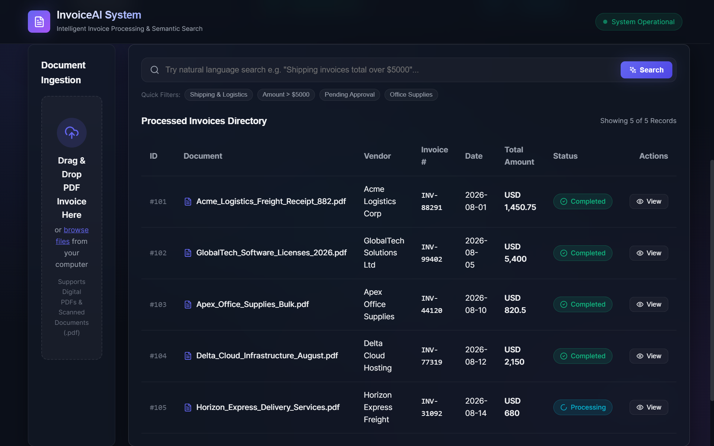

High-End Glassmorphic Dashboard
React 18 Interface — Modern Glassmorphism Design Principles
Drag-and-drop document upload dropzone
Live system status indicators (ports 8000, 5432, 6333, 10000)
Search filter chips & natural-language query box
Interactive invoice list with side-by-side document preview
Intelligent Invoice Processing & Semantic Search Engine
9

Slide 10
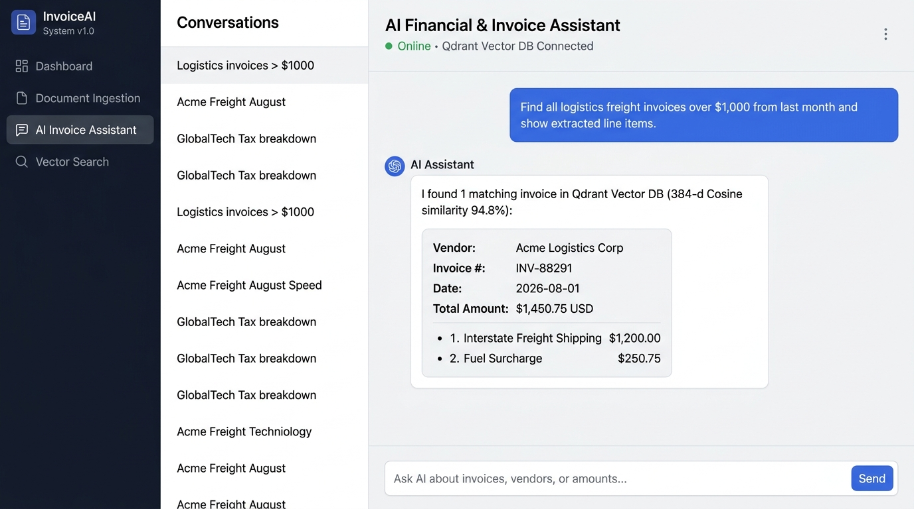
Development Methodology & Verification
Agile Architecture
Component-driven development with decoupled microservices.
AI-Assisted Prototyping
Accelerated schema design, FastAPI route setup, and container orchestration.
Verification & Testing
End-to-end validation of PDF stream upload, vector scoring accuracy, and database transactions.
Intelligent Invoice Processing & Semantic Search Engine
10

Slide 11
Limitations & Future Roadmap
FUTURE ROADMAP
1
Multi-Format Ingestion
CURRENT CONSTRAINTS
Support for image formats (PNG/JPEG), Word, and EML attachments.
Restrictive to PDF documents (.pdf) only.
2
ERP Integration
Automated export webhooks to SAP, NetSuite, and QuickBooks.
Native invoice currencies without live exchange rate conversion.
3
Fine-Tuned LLM Embeddings
Specialized domain transformers (e.g., FinBERT) for complex financial syntax.
4
Security & RBAC
JWT authentication and role-based multi-tenant isolation.
Intelligent Invoice Processing & Semantic Search Engine
11

Slide 12

Conclusion & Q&A
Successfully automated enterprise invoice ingestion, extraction, and semantic search.
Combines cloud blob storage, relational databases, and vector engines into a unified platform.
Built with modern production-ready technologies — FastAPI, React, PostgreSQL, Qdrant, Docker.
Thank You!
Intelligent Invoice Processing & Semantic Search Engine
12

