Slide 1
IBM University Engagement Project Submission
“Exploring the Power of Agentic AI with IBM Granite and IBM Bob”

Slide 2

Project Tile – Interview Trainer Agent
Domain of Project – EdTech (Educational Technology) & Human Resources (HR) Tech / Artificial Intelligence (Agentic AI)
Student Name | Recent Passport Photo | Email ID | Mobile number [WhatsApp]
Tanishka Kishor Dakare |  | tanishkadakare@gmail.com | 9529130898
Recommended font style and size:
Font Style: Arial
Font Size (Heading): 28
Font Size (Content): 20

Slide 3
Problem Statement -
Problem Statement : Interview Trainer Agent
The Challenge Preparing for competitive job interviews is challenging because candidate preparation is often generic. Candidates lack access to tailored, role-specific evaluation, realistic industry expectations, and real-time feedback aligned with their experience level and targeted company.
The Objective Build an AI-powered Interview Trainer Agent using RAG (Retrieval-Augmented Generation) that delivers personalized mock interviews, realistic question sets, and intelligent performance evaluation. The solution should:
Tailored Question Generation – Dynamically generate role-specific questions based on candidate profile, experience level, and target role.
Knowledge RAG Retrieval – Retrieve industry standards, behavioral scenarios, technical expectations, and HR guidelines from recruitment knowledge bases.
Technical & Soft Skill Assessment – Evaluate candidate submissions across domain knowledge, communication, and response structure.
Instant Feedback & Scoring – Deliver automated scores (out of 10), strengths, areas of improvement, and detailed model answers.
Multi-Agent System Capabilities –
  Question Generator Agent (fetches & tailors questions using RAG)
  Evaluation Agent (scores responses & provides detailed feedback)
  Analytics & Progress Agent (tracks historical candidate performance)
Visualization Dashboard – Present session scores, historical progress charts, and actionable improvement tips to build candidate confidence.

Slide 4
Proposed Solution -
Proposed Solution:
Agentic Architecture Built on IBM Bob: Leverages IBM Bob and IBM Granite models to drive an end-to-end, multi-stage agentic workflow tailored for automated interview training and candidate evaluation.
Profile-Adaptive Question Generation: Automatically processes key candidate metadata (Name, Job Role, Experience Level, Target Company) to generate personalized, context-aware interview questions covering both technical concepts and soft skills.
RAG-Powered Knowledge Retrieval: Integrates Retrieval-Augmented Generation (RAG) capabilities to draw upon industry-specific question banks, standard HR guidelines, behavioral scenario templates, and ideal answer criteria.
Automated Answer Scoring & Feedback Engine: Evaluates user text responses across structural clarity, keyword relevance, and technical accuracy—delivering an instant overall score (out of 10), identified strengths, and actionable improvement areas.
Interactive Benchmarking & Model Answers: Provides benchmark model answers alongside candidate submissions to highlight key terminology, structured STAR-method expectations, and optimal response strategies.
Session Tracking & Progress Analytics: Persists candidate attempts using local storage/SQLite, rendering visual historical trends via Streamlit dashboard analytics to measure score progression over time.

Slide 5
Technology Used
IBM Bob platform - Used as the primary IDE and orchestration layer for rapid development, workspace environment management, and multi-agent workflow construction.
IBM Granite model - (ibm-granite-3-2-8b) - Drives natural language understanding, dynamic interview question synthesis, automated candidate response evaluation, and personalized feedback generation.
Streamlit Framework - Serves as the interactive web frontend, delivering real-time user input forms, candidate profile customization, custom CSS themes, and analytics dashboards.
RAG & Knowledge Integration - Leverages Retrieval-Augmented Generation principles to dynamically pull role-specific criteria, domain questions, and behavioral expectations into model prompts.
IBM Cloud & Streamlit Community Cloud - Provides scalable infrastructure and live public hosting to ensure reliable access, secure deployment, and global submission verification.

Slide 6
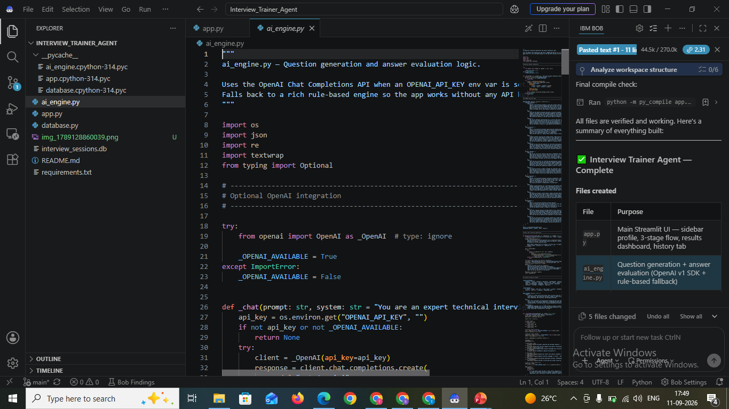
Required Files created using IBM bob -

Slide 7
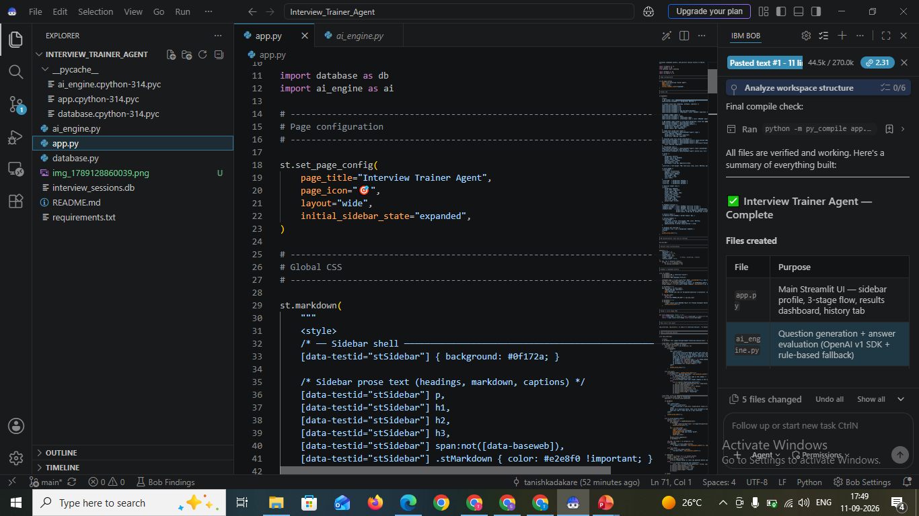
IBM Bob Screenshots:

Slide 8
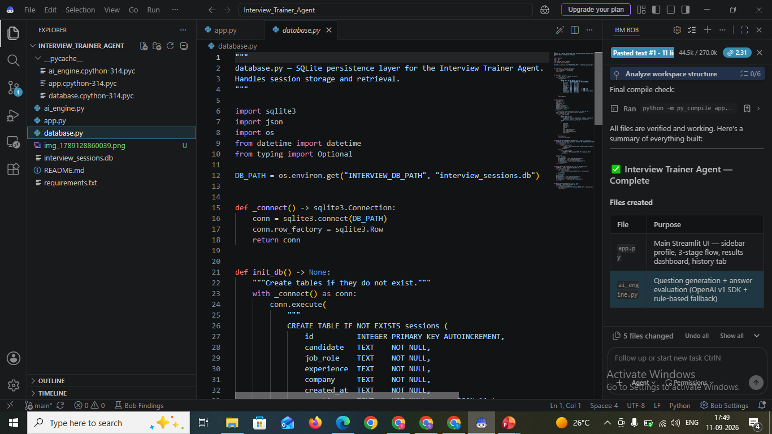
IBM Bob Screenshots:

Slide 9
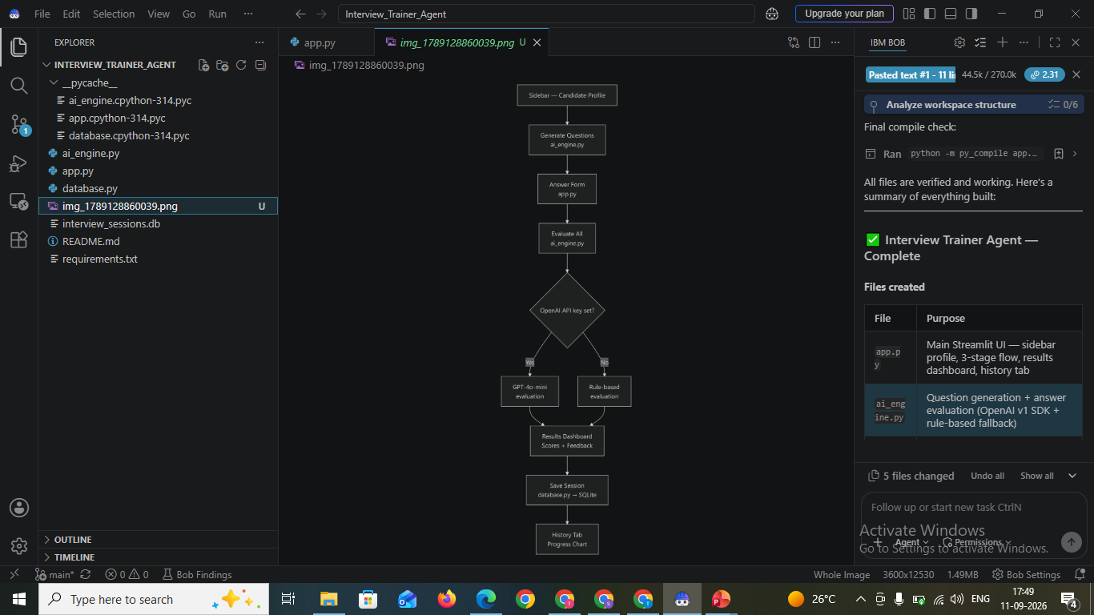
IBM Bob Screenshots:

Slide 10
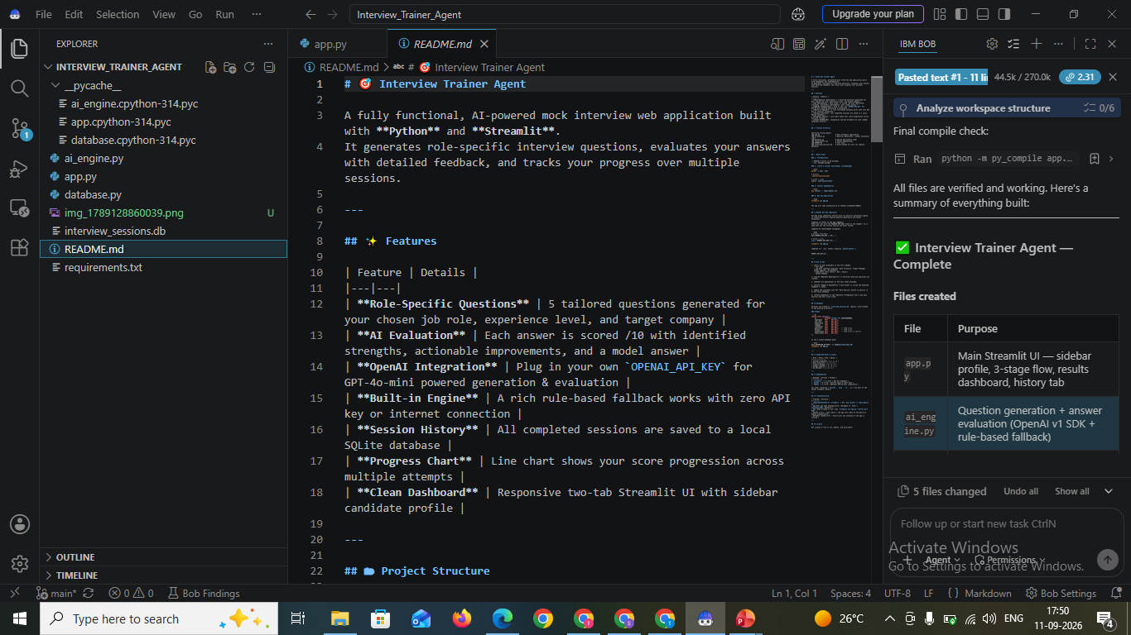
IBM Bob Screenshots:

Slide 11
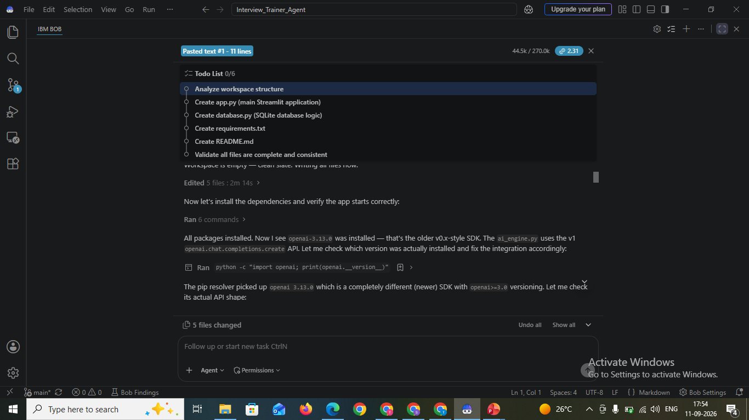
IBM Bob Screenshots:

Slide 12
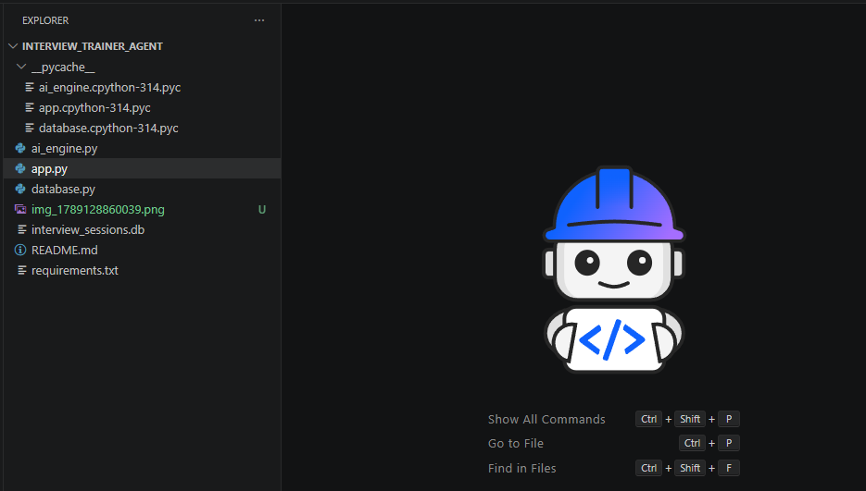
IBM Bob Screenshots:

Slide 13
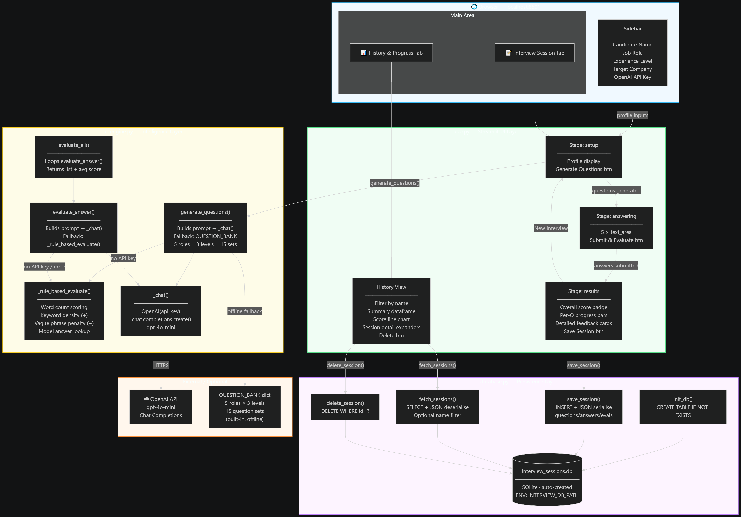
Architecture blueprint for IBM bob:

Slide 14

Role of Agentic AI in the solution
Agentic AI enables the Interview Trainer Agent to function as an intelligent, autonomous system rather than a static question bank. Powered by IBM Granite models and RAG capabilities, it coordinates specialized workflows to deliver end-to-end candidate evaluation and feedback.
Each internal sub-agent handles a targeted execution phase—such as retrieving role-specific interview standards, tailoring behavioral and technical questions, evaluating text responses against model benchmarks, and tracking candidate progress over time. This collaborative multi-agent approach ensures accurate, structured evaluation.
Agentic AI brings high context-awareness by processing candidate profiles (Job Role, Experience Level, Target Company). It continuously adapts during practice sessions, updating recommendations based on individual answers and highlighting key skill gaps.
Overall, Agentic AI transforms the system into a proactive, goal-driven career assistant, helping candidates refine response structures (like the STAR method) and maximize interview readiness.

Slide 15
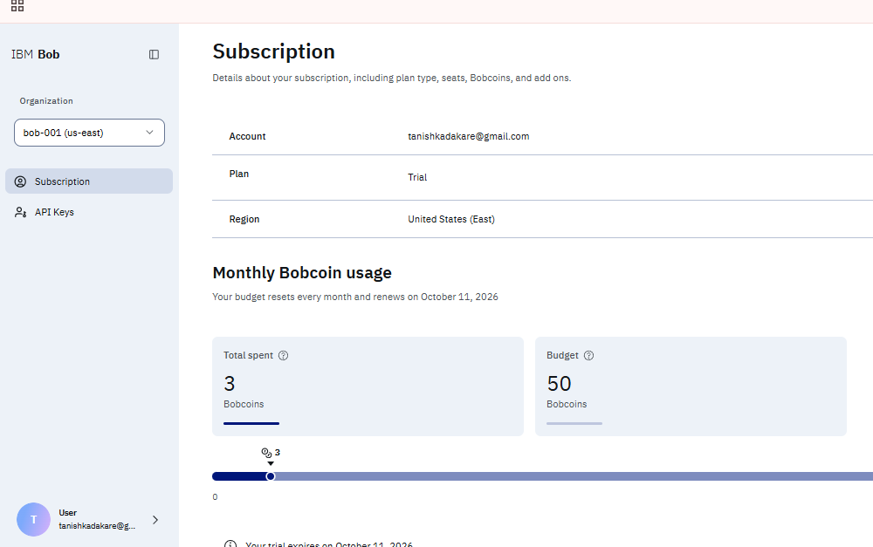
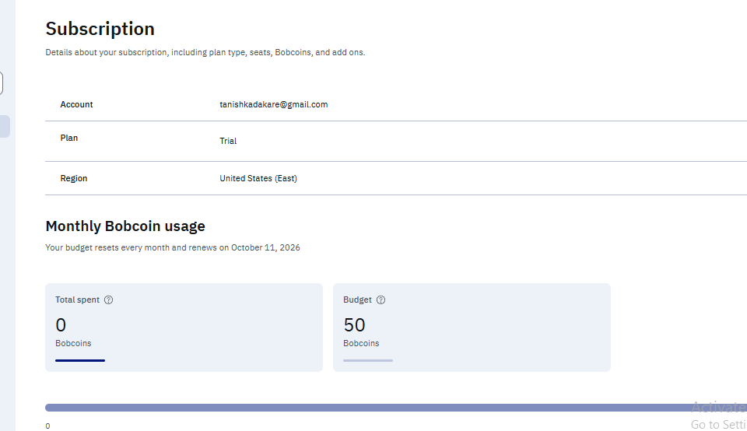
Token Usage
Before
After

Slide 16
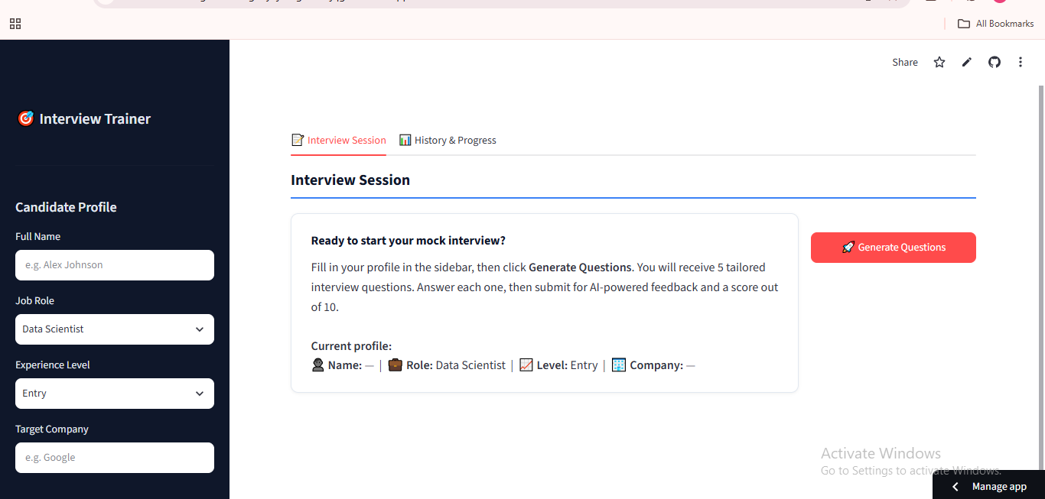
Project Output Screenshot
·
·
·

Slide 17
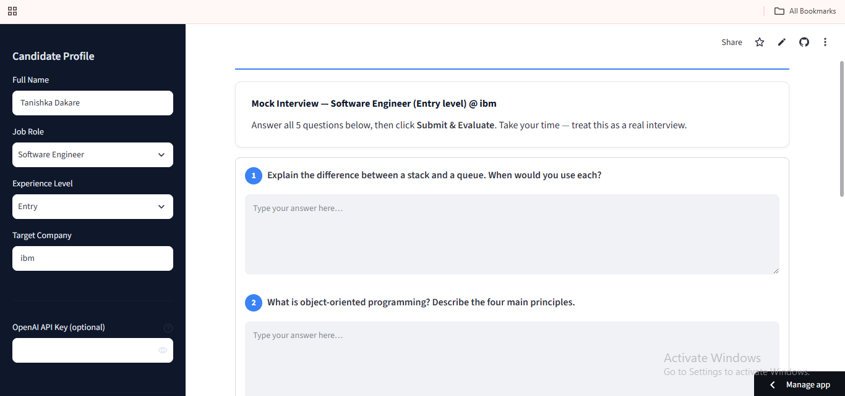
Project Output Screenshot
·
·
·

Slide 18
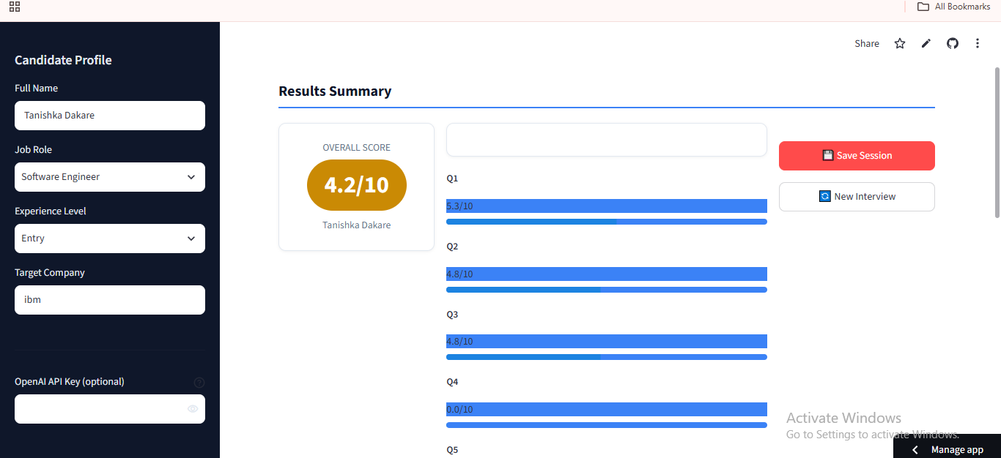
Project Output Screenshot
·
·
·

Slide 19
The Wow Factor Behind Your Project
Dynamic Hyper-Personalized Scenario Generation: Unlike static practice tools, the agent crafts highly specific interview scenarios by dynamically synthesizing target company expectations, exact job roles, and experience levels in real time using IBM Granite models.
RAG-Powered HR & Technical Alignment: Integrates Retrieval-Augmented Generation to benchmark candidate responses against curated industry question banks, optimal STAR-method response frameworks, and domain-specific knowledge bases.
Instant Multi-Metric Feedback & Benchmarking: Evaluates candidate answers across technical accuracy, structure, and communication clarity—delivering a calculated numerical score alongside side-by-side model answer comparison for immediate skill gap closure.
Fail-Safe Offline Mode: Features an intelligent dual-mode fallback architecture that guarantees full functionality and response output during live evaluations without depending on external API uptime or keys
·
·
·

Slide 20
Novelty and Uniqueness
The proposed Interview Trainer Agent stands out by combining Agentic AI, RAG, and personalization into a single intelligent system.
Multi-Agent Intelligence – Instead of a single chatbot, multiple specialized agents (Question Generator, Evaluator, Analytics Agent) collaborate to deliver structured and context-aware interview guidance.
RAG-Based Accuracy – Integrates real-time retrieval from curated recruitment databases with AI generation, reducing generic responses and ensuring industry-aligned questions.
Hyper-Personalization – Tailors question sets and evaluation rubrics based on target company, specific job role, experience level, and candidate profile.
Real-Time Feedback Loop – Continuously evaluates candidate answers, generating numerical scores, detailed strengths, and STAR-method improvements.
STAR & Domain Alignment – Goes beyond standard QA by evaluating response structure, technical depth, and soft skills against proven interview frameworks.
Scalable & Enterprise-Ready – Built with IBM Bob using IBM Granite models, ensuring high reliability, fast processing, and enterprise governance.

Slide 21
Future Scope
Real-Time Audio/Video Analysis & Mock Interviews – The system can be enhanced with speech-to-text and computer vision capabilities to analyze verbal delivery, tone, speaking pace, body language, and facial expressions during mock interview sessions. This will enable the Interview Trainer Agent to provide holistic feedback on soft skills and executive presence alongside textual accuracy.
AI-Powered Multilingual Support & Localized HR Frameworks – Integrating multilingual capabilities will allow job seekers to practice interviews in regional languages or train for specific international corporate standards. The RAG pipeline can be expanded to include global and regional hiring practices, culture-fit criteria, and regional employment compliance standards.
.
·
·
·

Slide 22
Git Hub Link
https://github.com/tanishkadakare/Interview_Trainer_Agent
Project link
·
https://interviewtraineragent-cudagkhy4jdksgdkncajqg.streamlit.app/
·
·

Slide 23
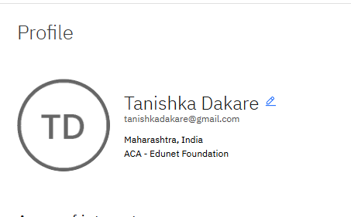
Skills build profile screen shot

Slide 24
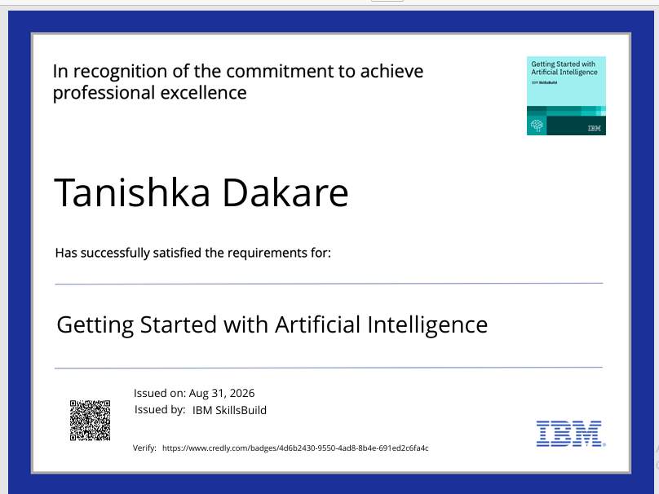
Certificates Earned:
Please add your credly certificate(Getting Started with Artificial Intelligence)

Slide 25
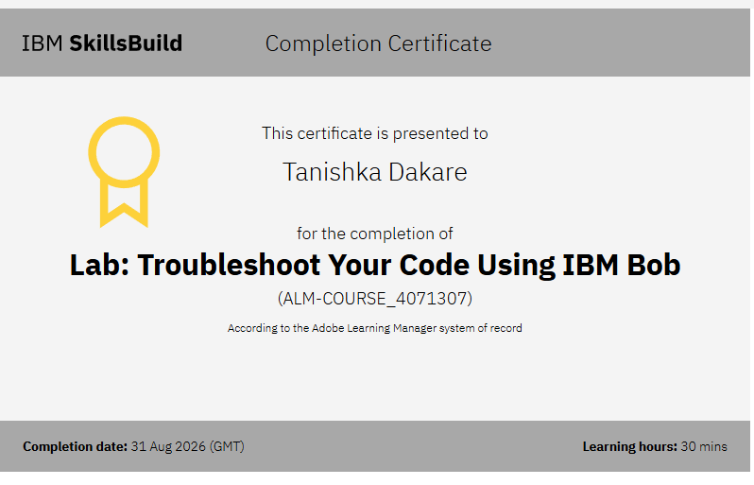
Certificates Earned:​
Add your IBM BOB Certificate

Slide 26


