Slide 1

Student Task Scheduler using Linked List, Stack, and Queue in Java
Group Member: Tanishk joshi – 2510030361
Harshil kokney-2510030370
rithwik reddy-2510030318
Guided By: Mahesh babu
KL University Hyderabad

Slide 2
Introduction
• Demonstrates use of Linked List, Stack, and Queue in Java
• Manages student records such as roll number and marks
• Shows how multiple data structures work together
• Console-based Java application

Slide 3
Project Objective
• Store and manage student data dynamically
• Perform operations like add, remove, display, and sort
• Implement undo functionality using Stack
• Process students using Queue (FIFO)

Slide 4
Technologies Used
• Programming Language: Java
• Concepts Used:
- Linked List
- Stack
- Queue
- Sorting Logic
- Object-Oriented Programming

Slide 5
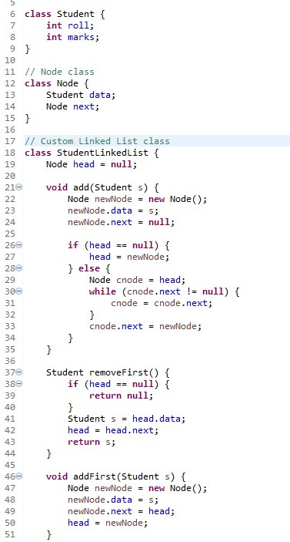

Operation: Add Student
• User enters roll number and marks
• Student is added to Linked List
• Student is also added to Queue
output

Slide 6
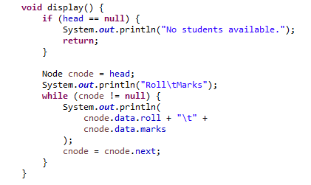
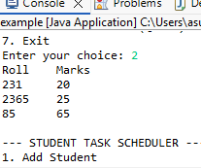
Operation: Display Students
• Traverses Linked List
• Displays Roll Number and Marks
• Shows all stored student records
[Insert Code Screenshot]
[Insert Output Screenshot]
Display output

Slide 7
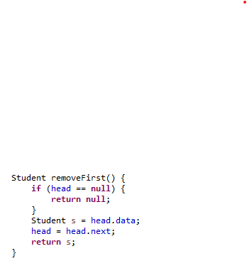
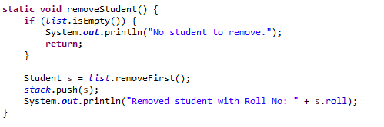

Operation: Remove Student
• Removes first student from Linked List
• Removed student pushed into Stack
• Allows undo functionality
[Insert Code Screenshot]
[Insert Output Screenshot]
Output

Slide 8
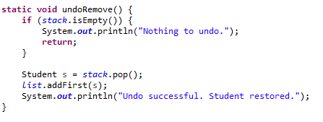

Operation: Undo Remove
• Uses Stack data structure
• Pops last removed student
• Adds student back to beginning of Linked List
Display output
[Insert Code Screenshot]
[Insert Output Screenshot]
output

Slide 9
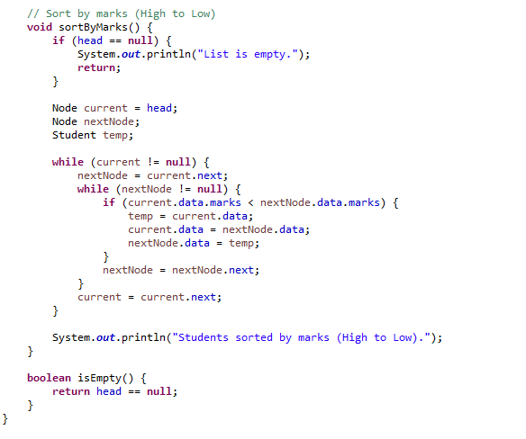


Operation: Sort by Marks
• Sorts students in descending order
• Compares marks between nodes
• Helps identify top-performing students
[Insert Code Screenshot]
[Insert Output Screenshot]
output

Slide 10
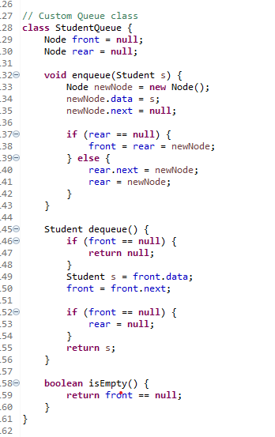
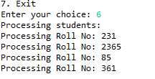
Operation: Process Students (Queue)
• Queue follows FIFO order
• Students processed in same order as added
• Demonstrates queue scheduling
[Insert Output Screenshot]
Output

Slide 11
Conclusion
• Project combines multiple data structures
• Linked List stores student records
• Stack enables undo operation
• Queue processes students sequentially
• Improves understanding of Data Structures in Java

Slide 12
Thank you for your time and attention.
We hope this presentation helped you understand the Student Task Scheduler using Linked List, Stack, and Queue in Java.
We welcome any questions or suggestions.

