Slide 1
Edge-Deployable
Rock Detection and
Burial-Status
Classification
YOLO model evaluation • Raspberry Pi 5 edge deployment • Tableau dashboard story

Slide 2
From Jupyter Notebook to Tableau Dashboard
The original project contained model-training outputs, exported YOLO formats, and Raspberry Pi edge-deployment benchmark logs. The dashboard turns those technical details into a visual story that a non-technical reviewer can follow.
Jupyter Notebook
⇣
1 Dataset readiness → split, class balance, augmentation, KPIs
2 Detector selection → precision, recall, mAP, model efficiency
3 Edge deployment choice → speed, latency, resources, thermals, stability
Edge Testing
⇣
Tableau Dashboard

Slide 3
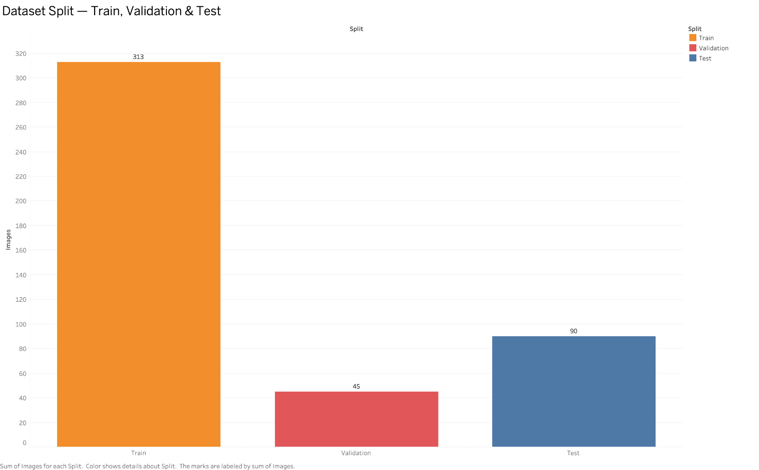
Sheet 1 - Dataset Split
DATA PREPARATION
What this sheet explains
Shows how images were separated before training.
Train: 313 images; Validation: 45 images; Test: 90 images.
The test set is kept separate so final results are not measured on training images.

Slide 4
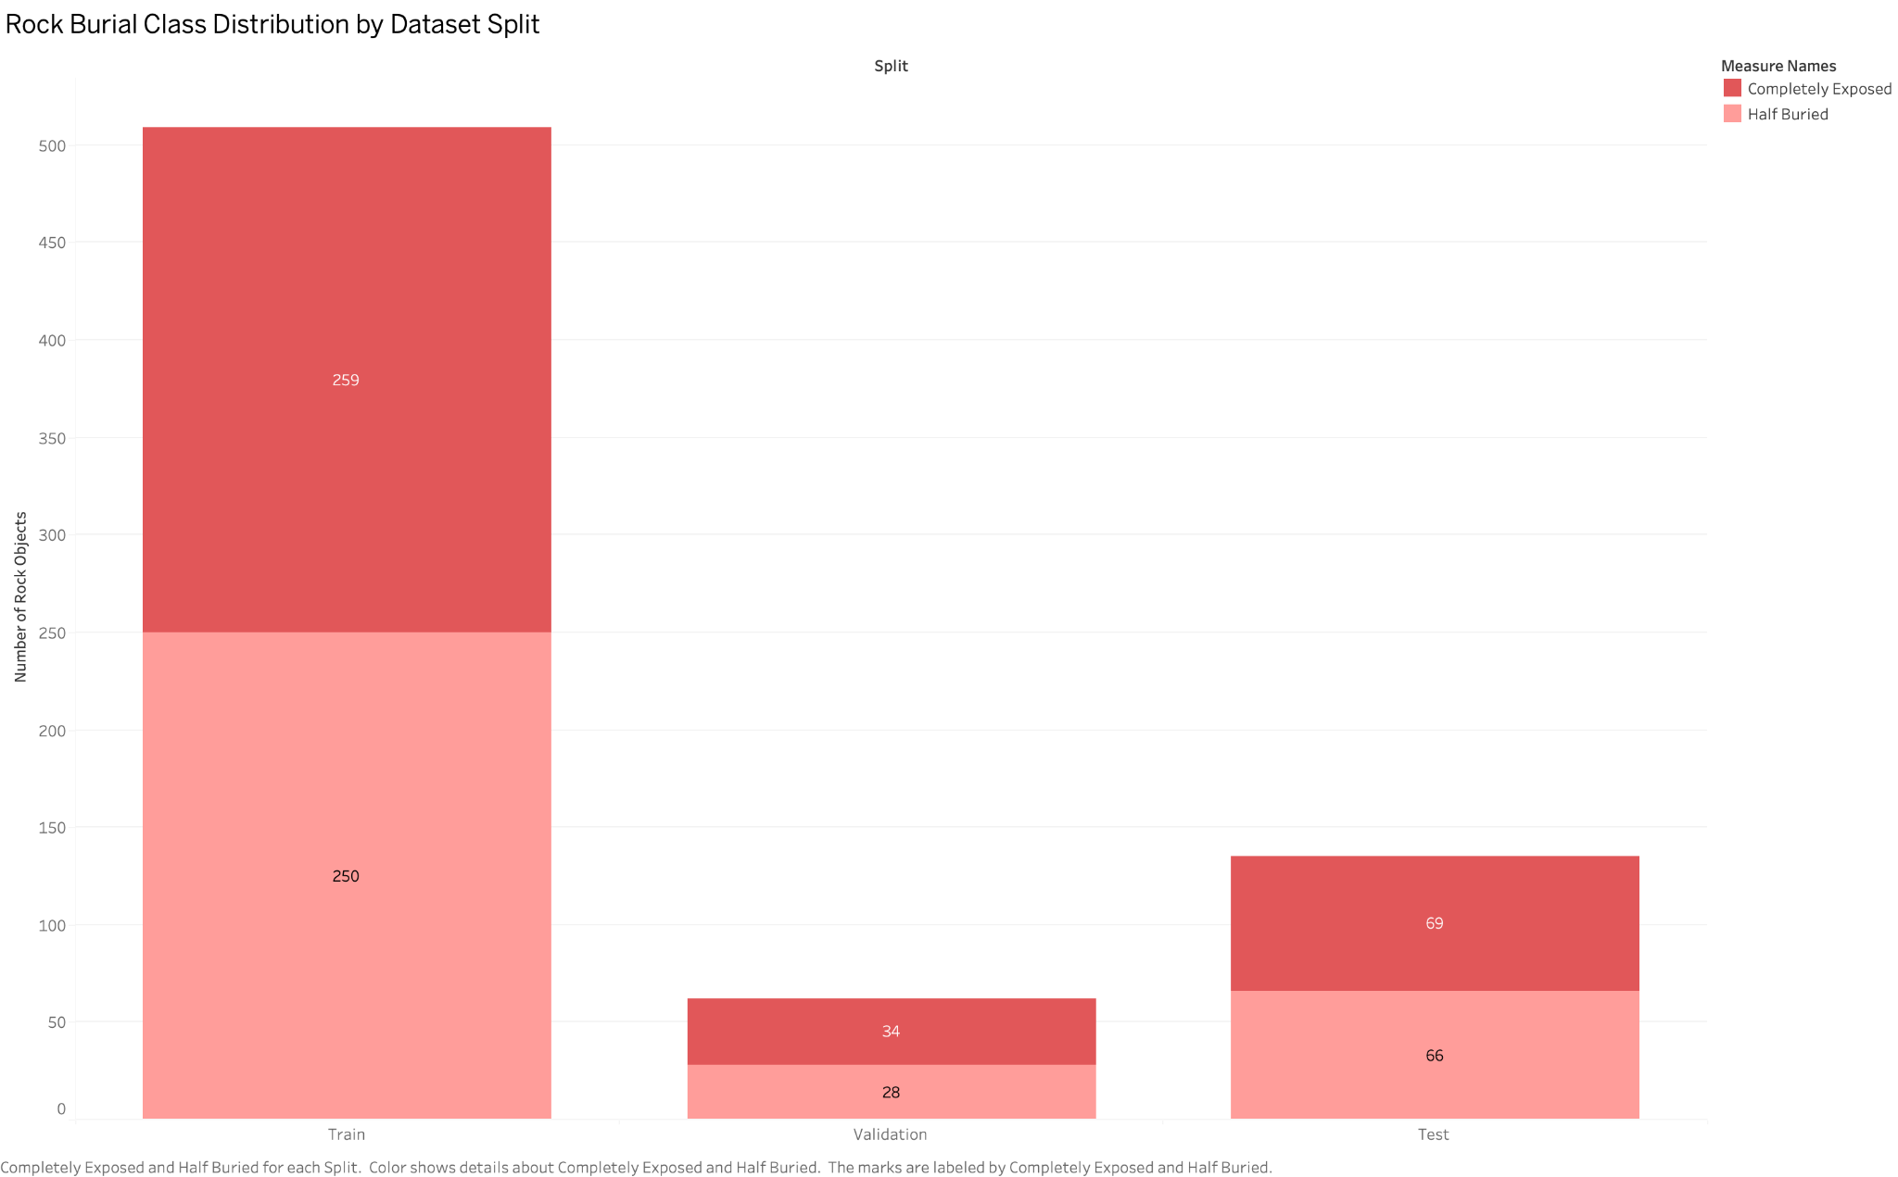
Sheet 2 - Rock Burial Class Distribution
DATA PREPARATION
What this sheet explains
Tracks two burial-status classes: completely exposed and half buried.
Training objects are nearly balanced: 259 exposed and 250 half-buried.
Validation and test splits keep both classes represented.

Slide 5
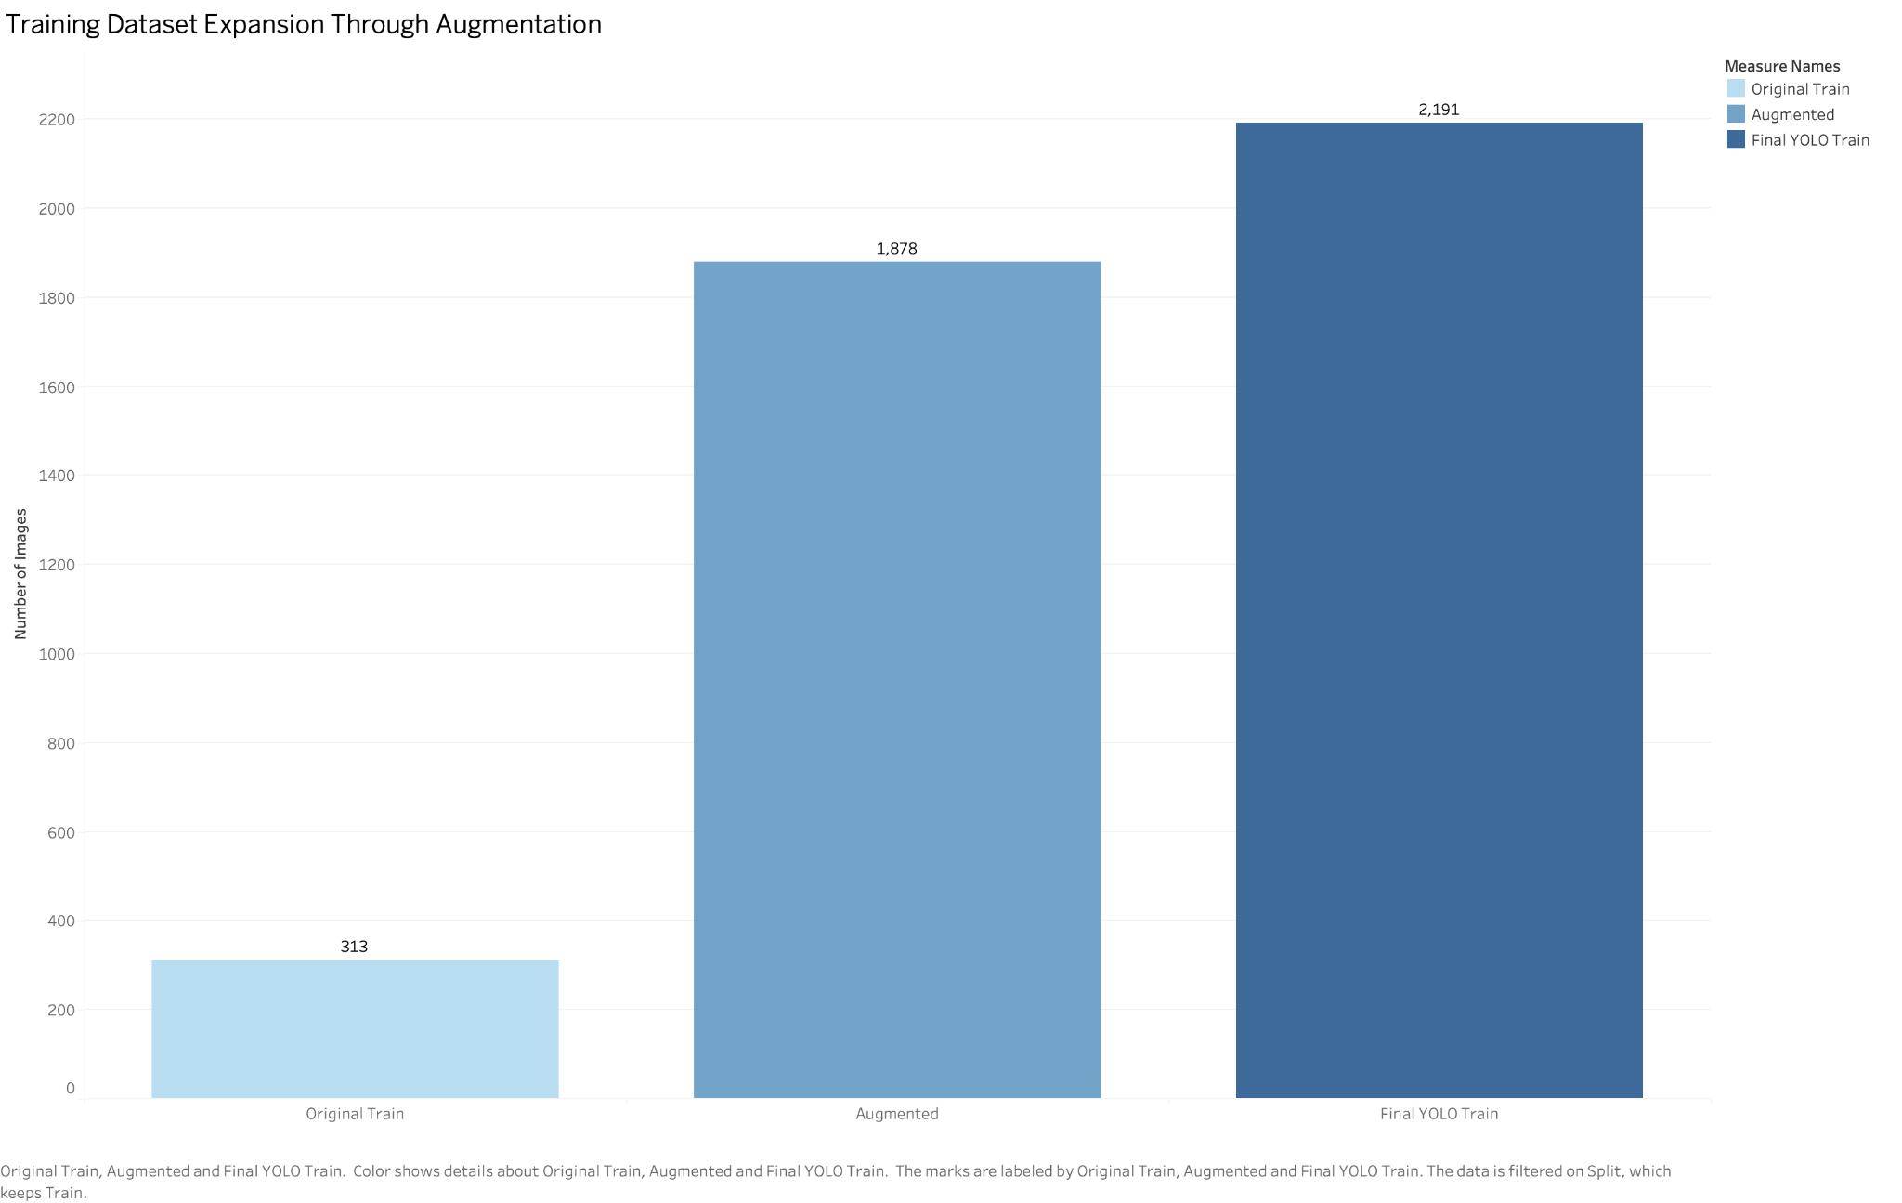
Sheet 3 - Training Expansion Through Augmentation
DATA PREPARATION
What this sheet explains
Starts with 313 original training images.
Augmentation adds 1,878 generated variations.
Final YOLO training set reaches 2,191 images.

Slide 6
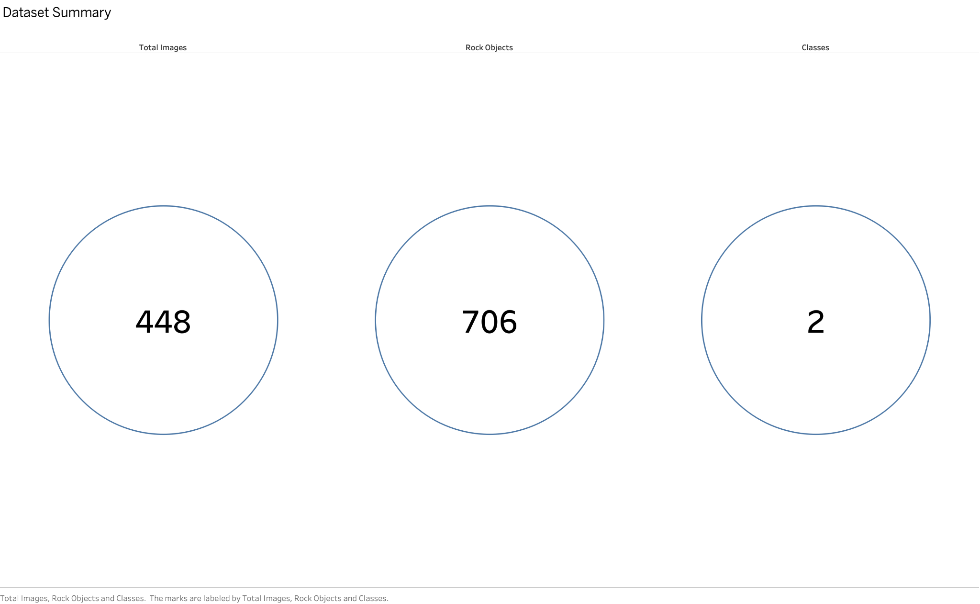
Sheet 4 - Dataset Summary KPIs
DATA PREPARATION
What this sheet explains
Summarizes the entire dataset in three simple numbers.
448 total images and 706 labeled rock objects.
Only two classes are used, which keeps the task understandable.

Slide 7
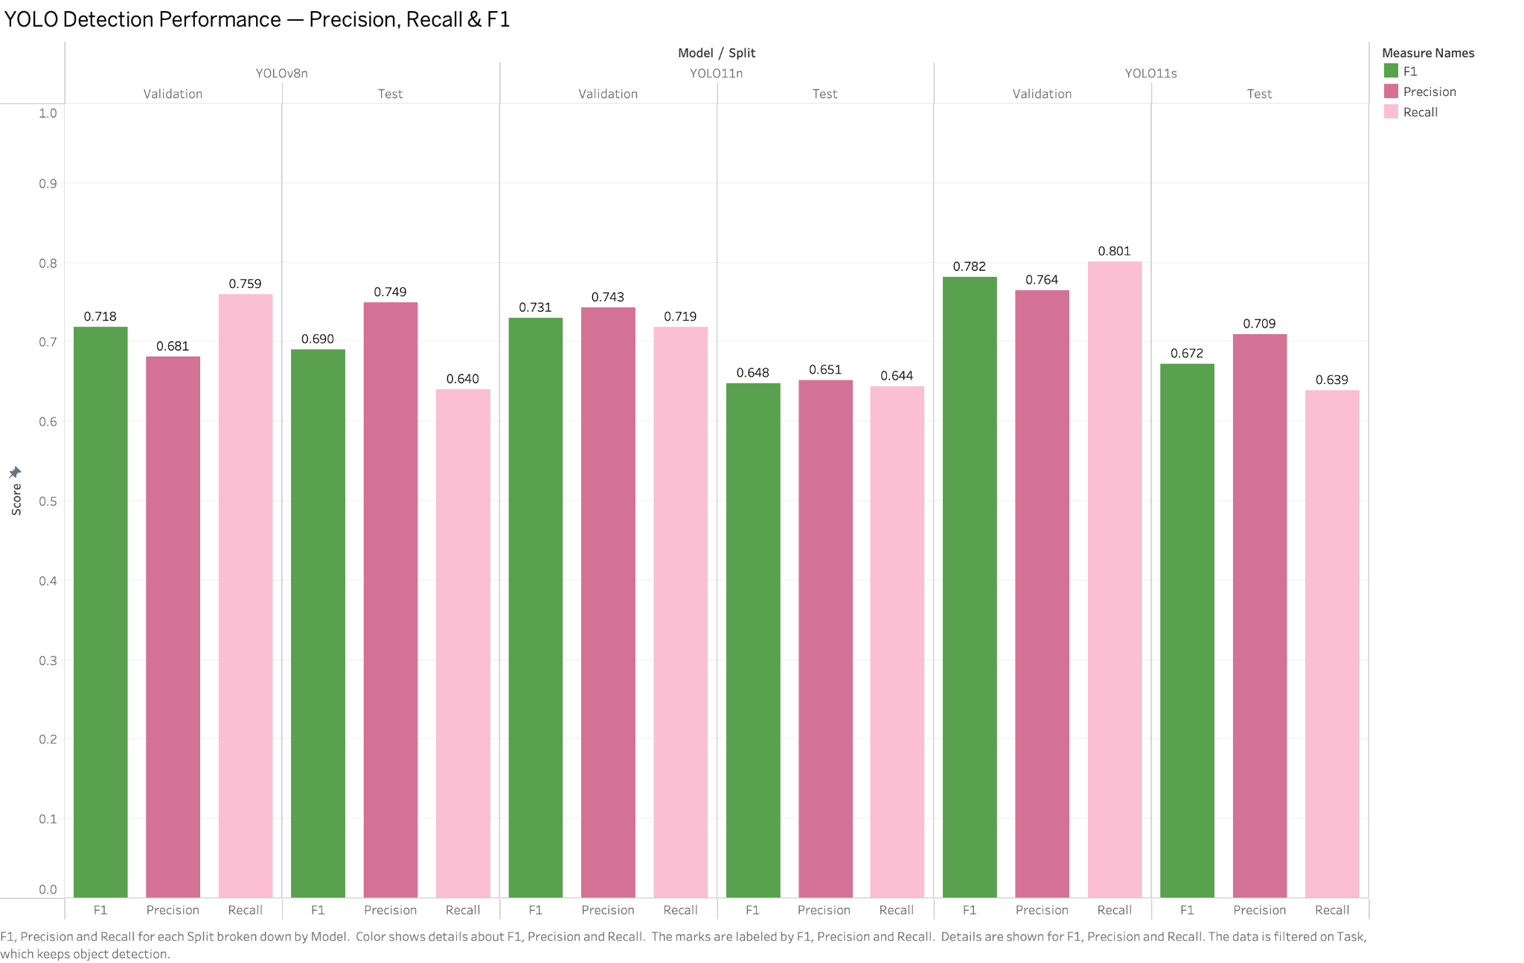
Sheet 5 - YOLO Detection Performance
MODEL COMPARISON
What this sheet explains
Compares precision, recall and F1 for each model and split.
YOLO11s gives strong validation recall, while test scores show generalization behavior.
F1 helps balance precision and recall into one review metric.

Slide 8
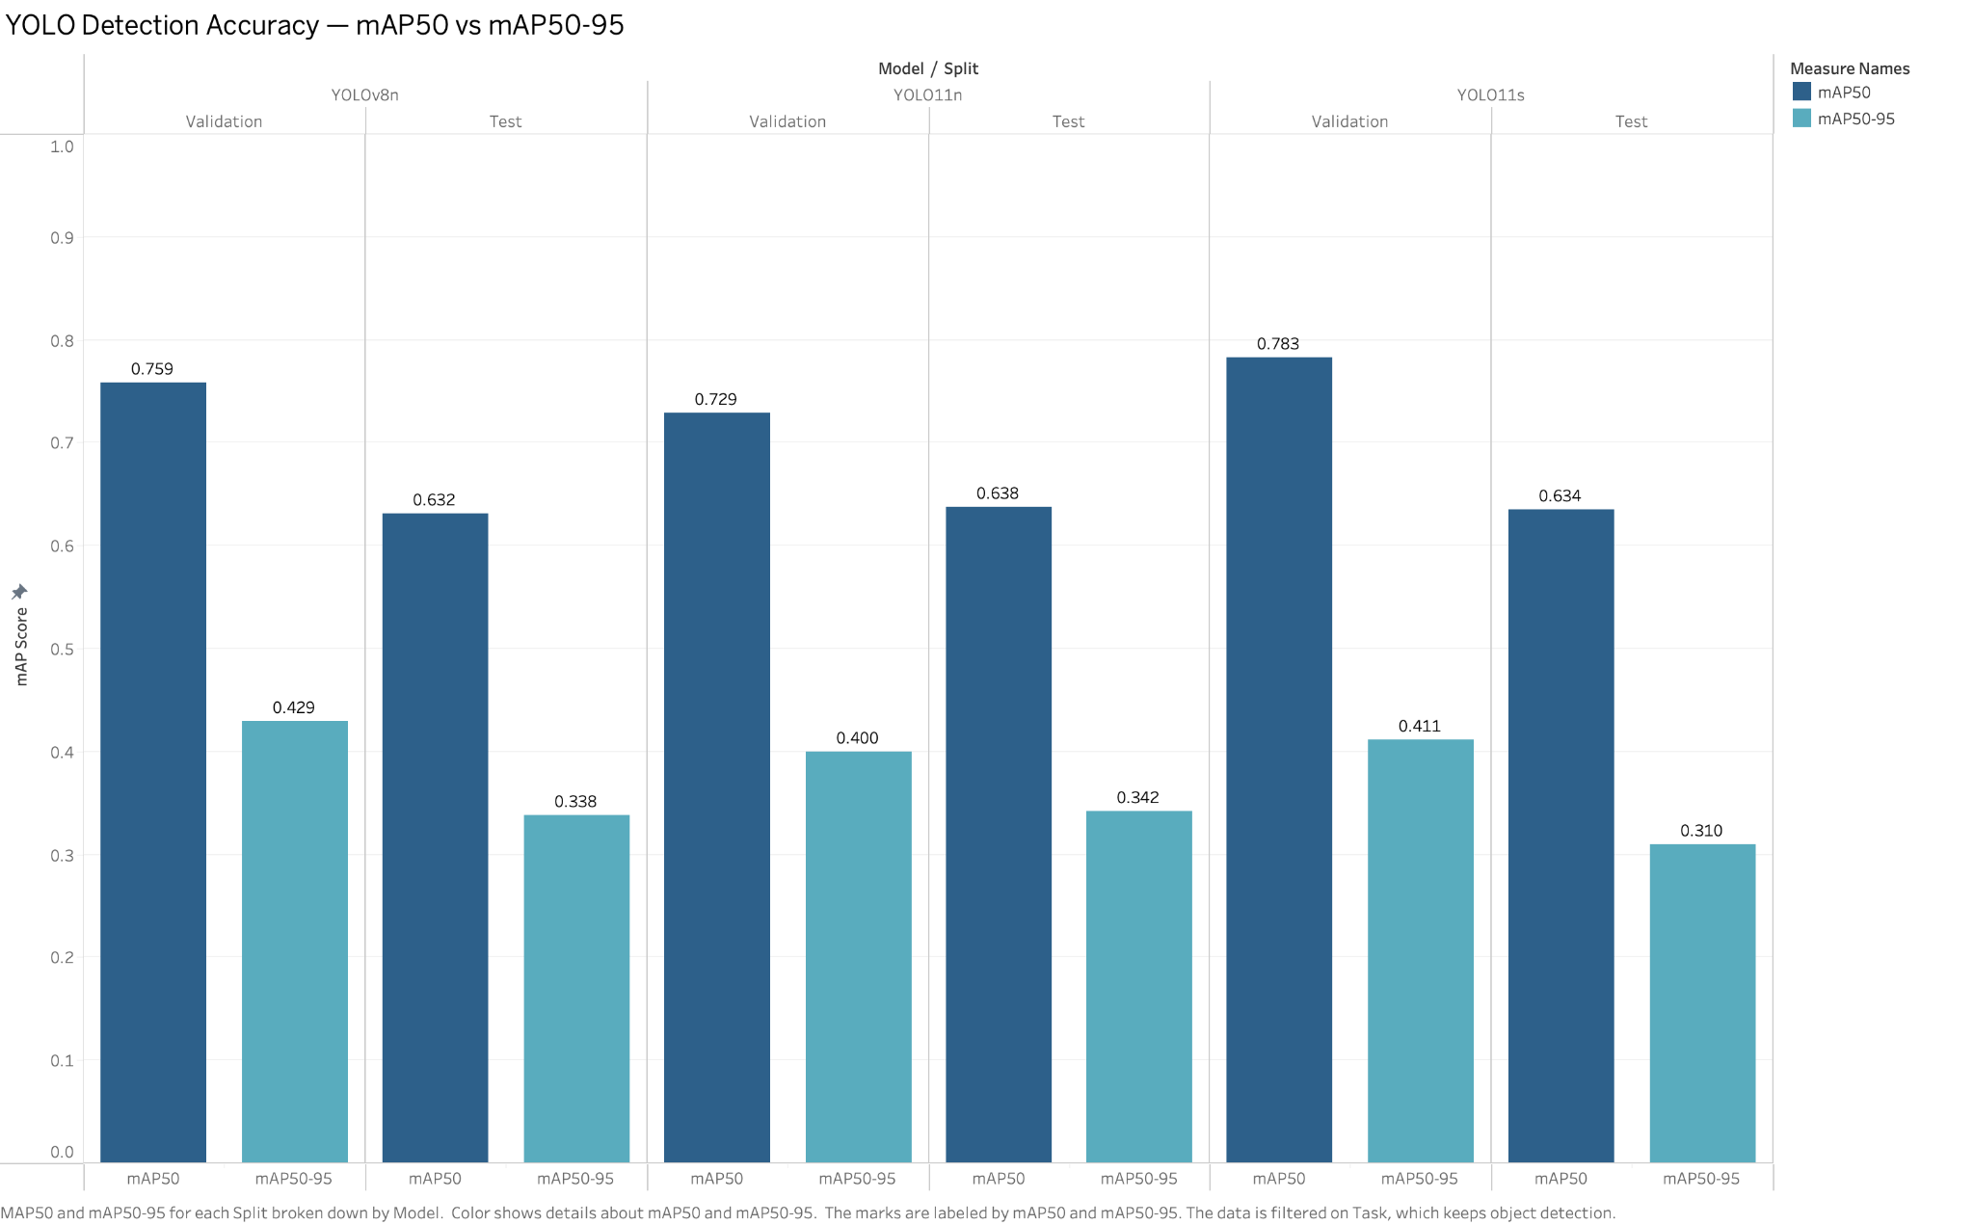
Sheet 6 - YOLO Detection Accuracy
MODEL COMPARISON
What this sheet explains
Compares mAP50 and stricter mAP50-95 scores.
Validation mAP50 is strongest for YOLO11s, while test scores are lower across models.
The stricter mAP50-95 metric shows detection precision under tougher matching rules.

Slide 9
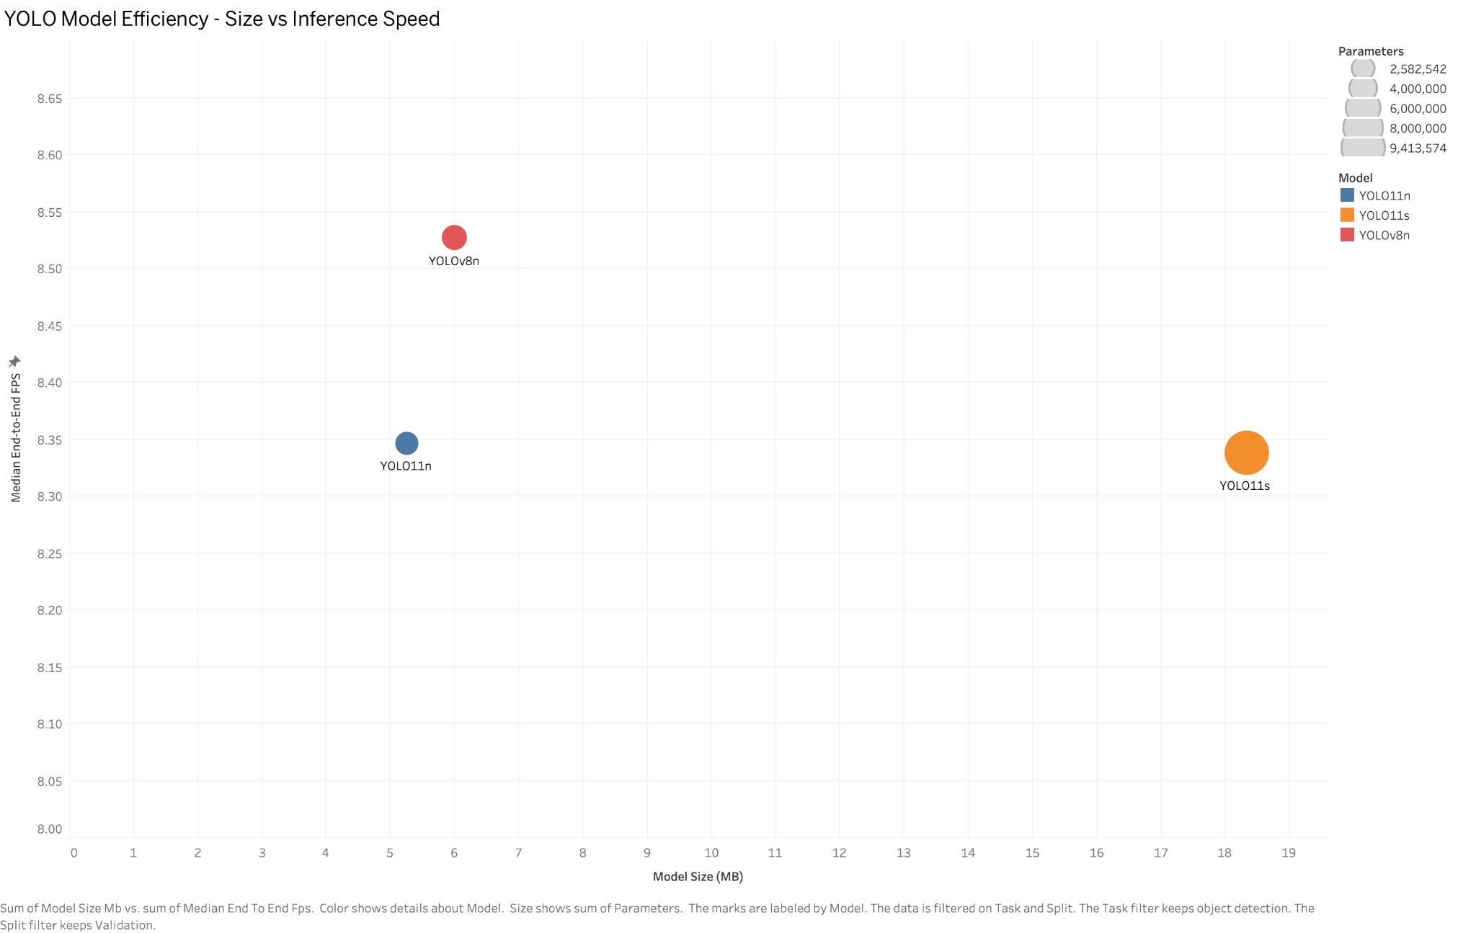
Sheet 7 - YOLO Model Efficiency
MODEL COMPARISON
What this sheet explains
Plots model size against median end-to-end FPS.
YOLOv8n stays compact while giving the fastest measured validation speed.
YOLO11s is much larger, so it is less attractive for edge deployment.

Slide 10
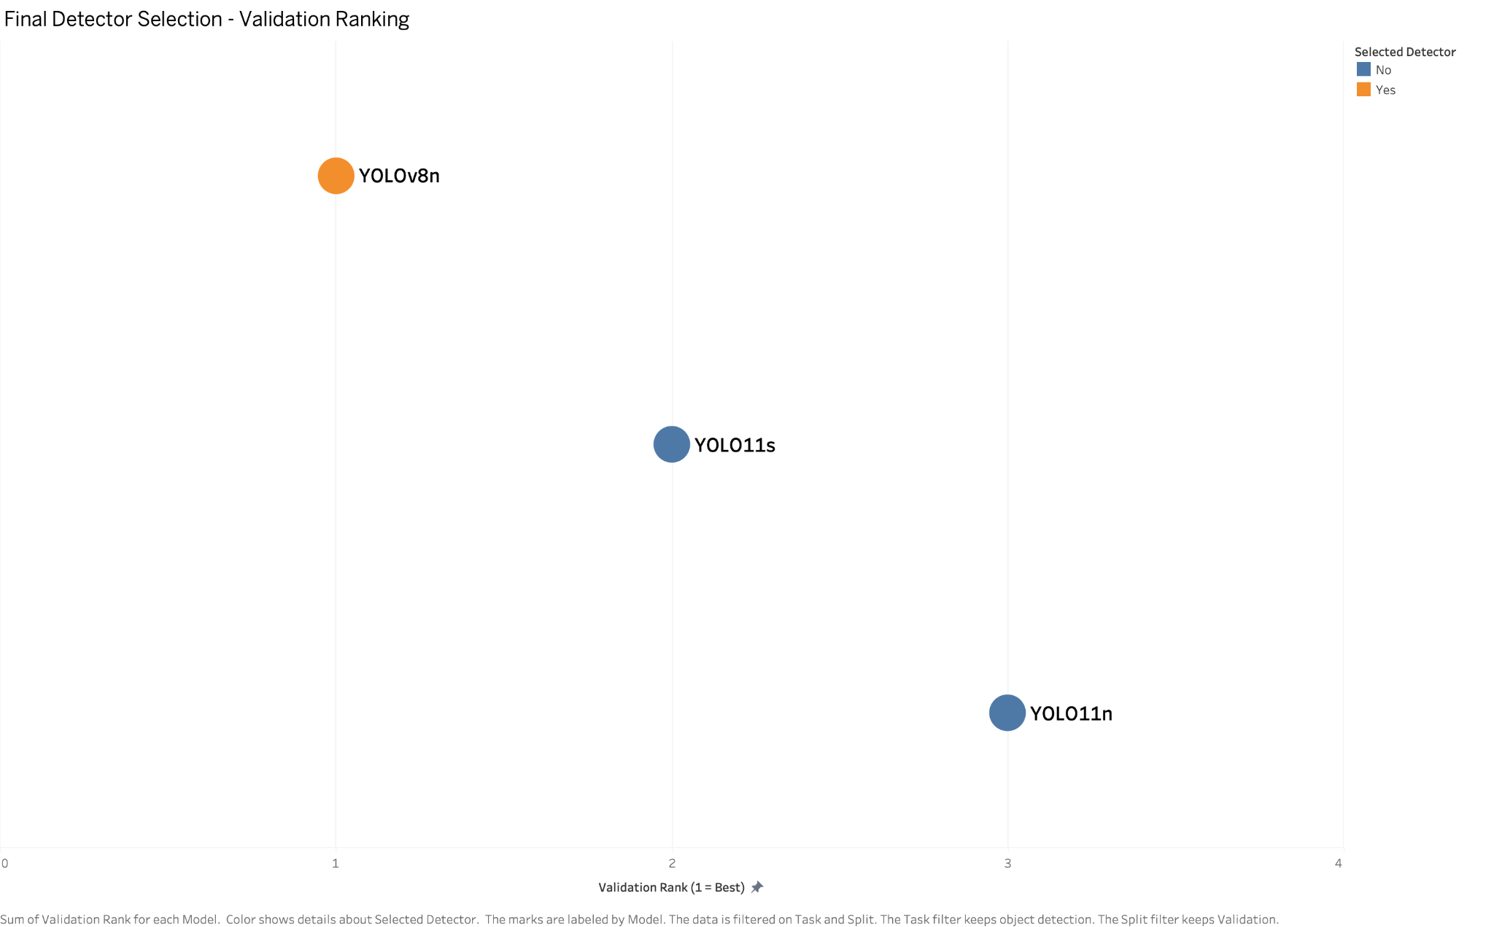
Sheet 8 - Final Detector Selection
MODEL COMPARISON
What this sheet explains
Ranks candidate detectors on validation performance.
YOLOv8n is marked as the selected detector.
The ranking explains the first major project decision before edge export.

Slide 11
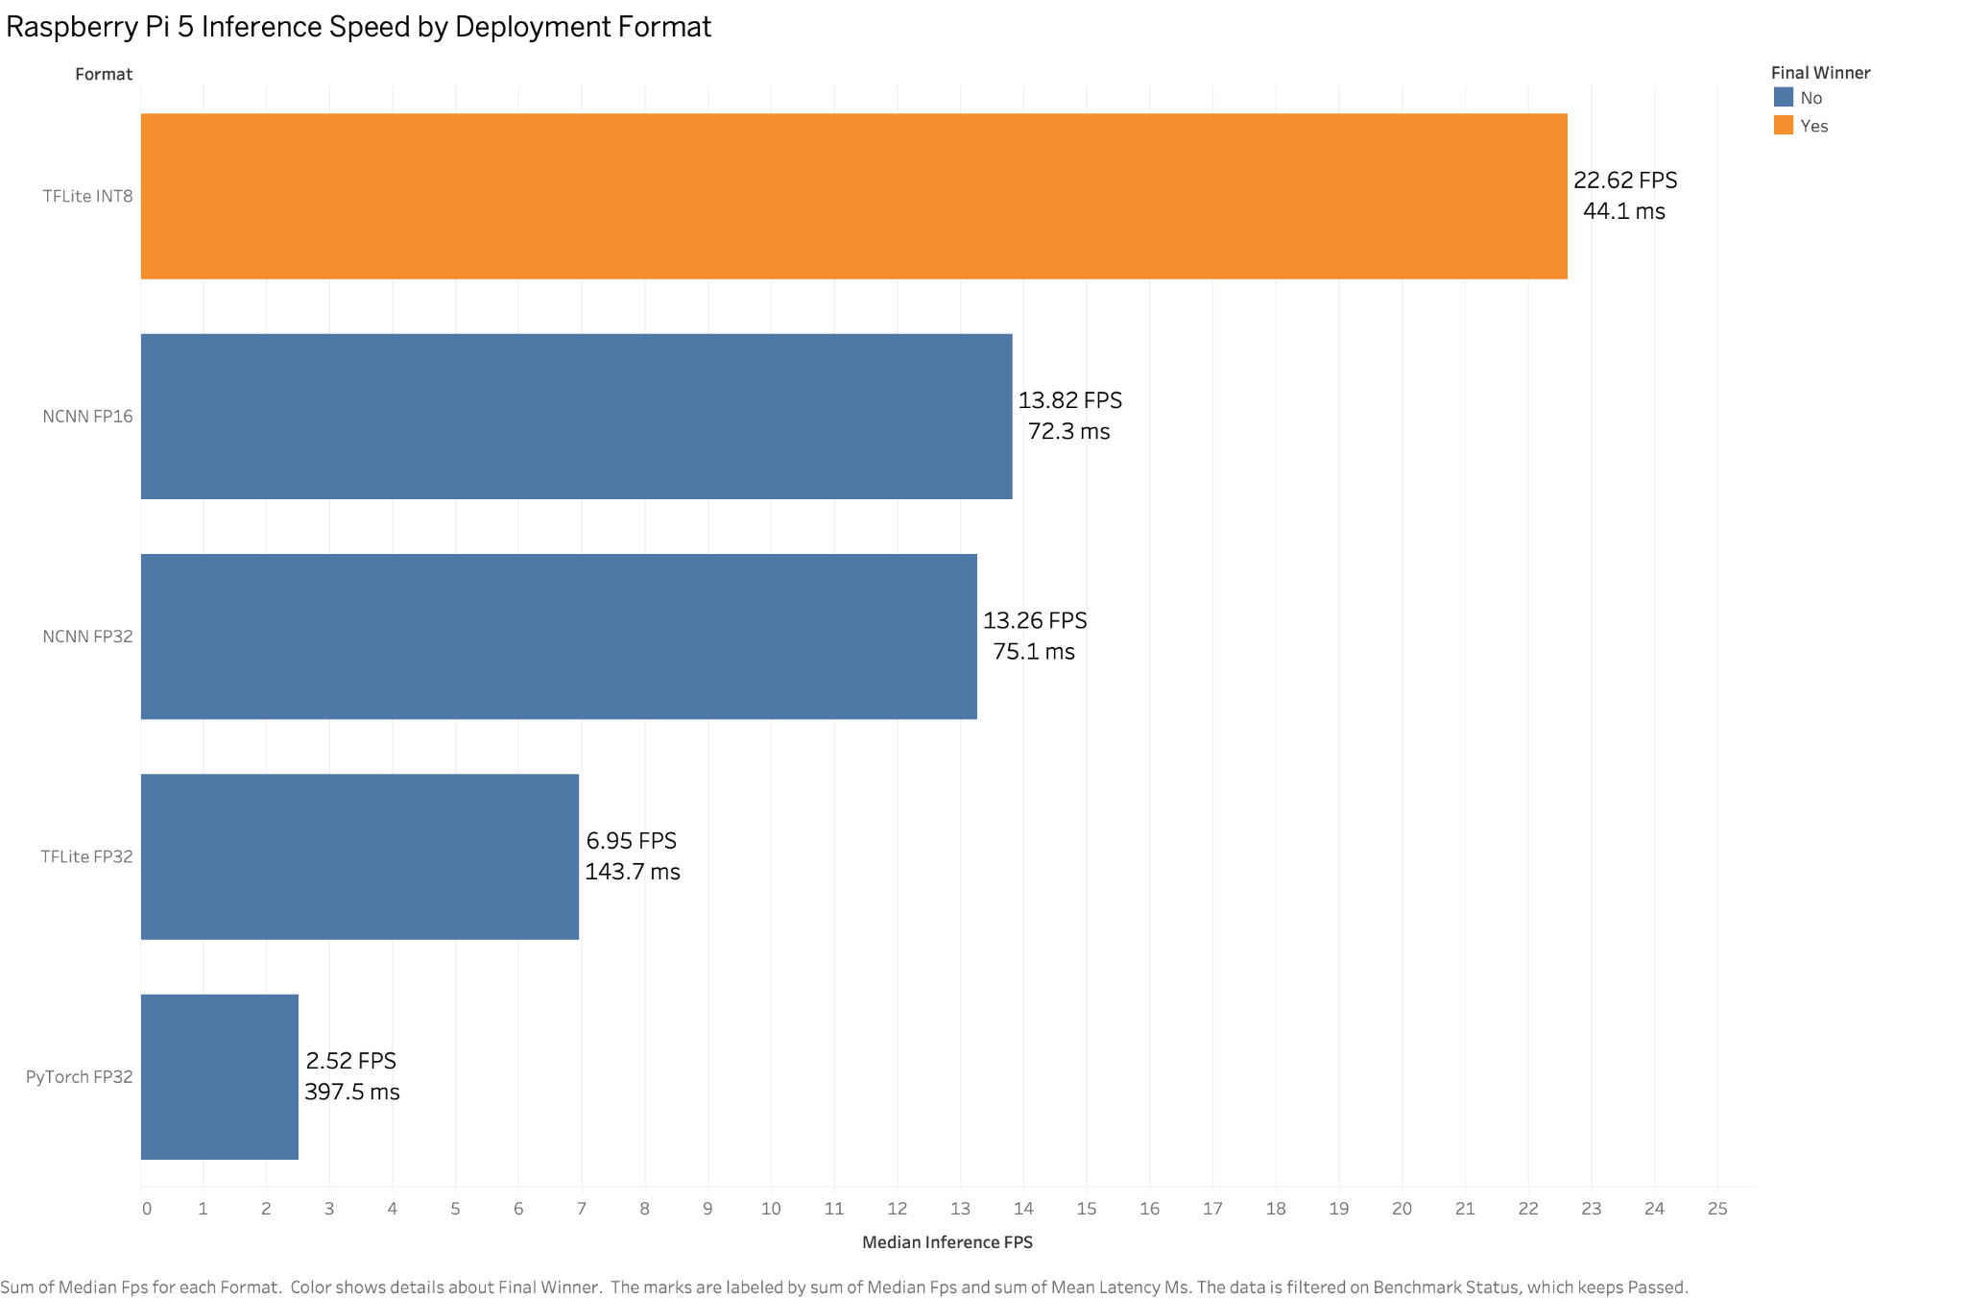
Sheet 9 - Raspberry Pi 5 Inference Speed
EDGE DEPLOYMENT
What this sheet explains
Shows FPS and latency for each deployment format on Raspberry Pi 5.
TFLite INT8 reaches 22.62 FPS and 44.1 ms latency.
PyTorch FP32 is much slower at 2.52 FPS.

Slide 12
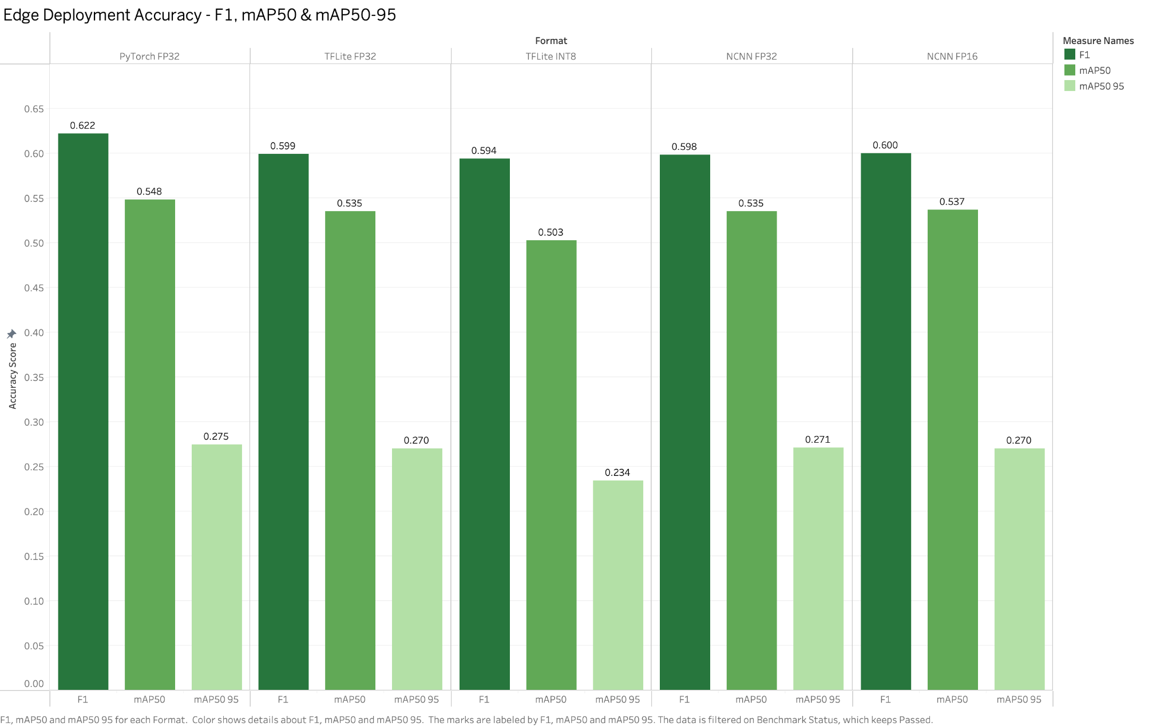
Sheet 10 - Edge Deployment Accuracy
EDGE DEPLOYMENT
What this sheet explains
Compares F1, mAP50 and mAP50-95 after export to edge formats.
PyTorch FP32 keeps the highest accuracy reference.
TFLite INT8 sacrifices some accuracy but remains usable for the proof-of-concept.

Slide 13
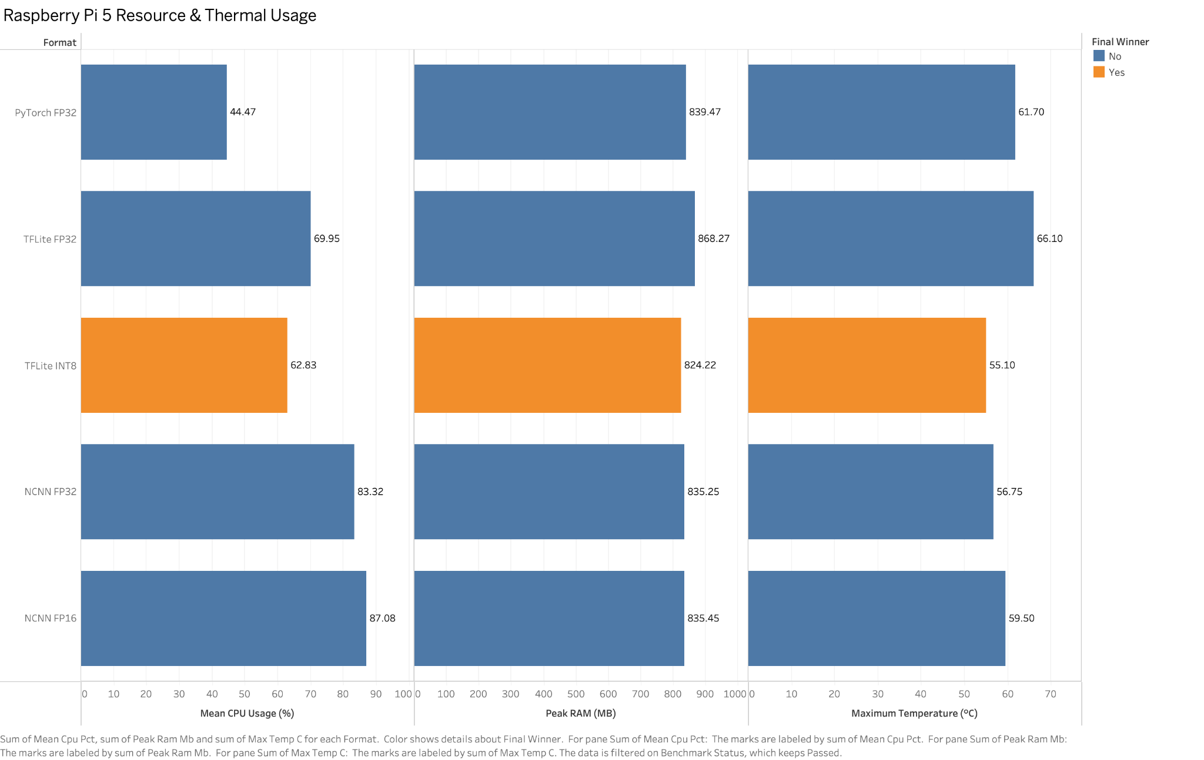
Sheet 11 - Raspberry Pi Resource & Thermal Usage
EDGE DEPLOYMENT
What this sheet explains
Shows CPU usage, peak RAM and maximum temperature.
TFLite INT8 uses the lowest peak RAM among completed benchmarks.
Temperature stays lower for TFLite INT8 than FP32 and NCNN alternatives.

Slide 14
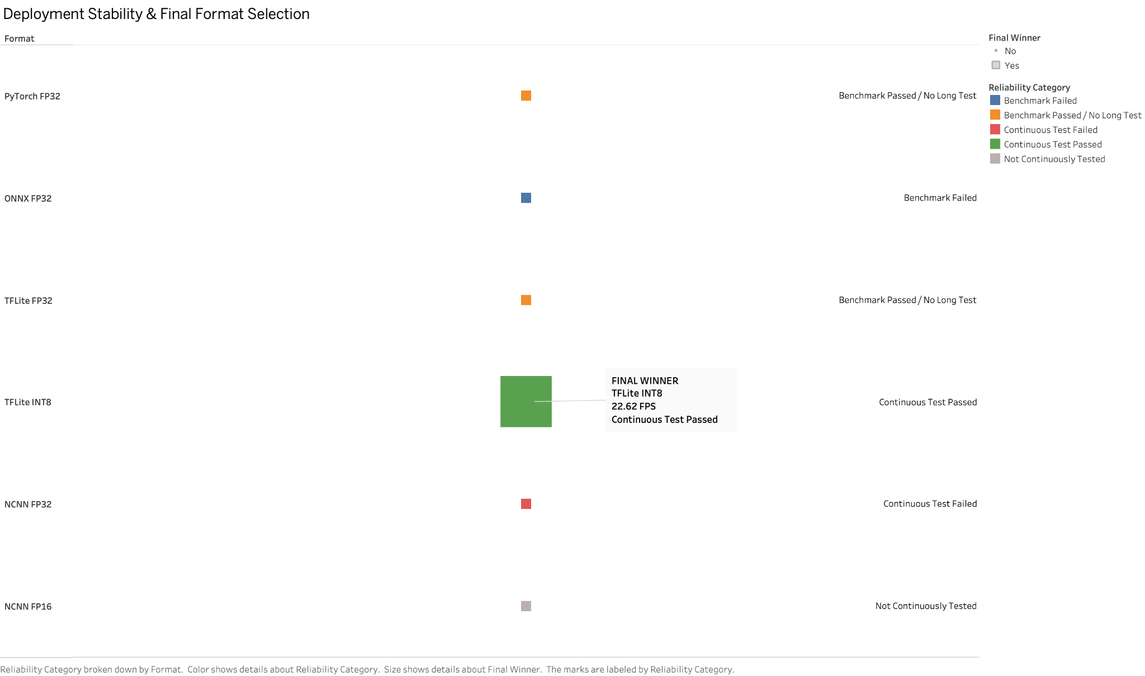
Sheet 12 - Stability & Final Format Selection
EDGE DEPLOYMENT
What this sheet explains
Combines reliability categories with final format selection.
TFLite INT8 is highlighted as the final winner.
ONNX failed benchmarking, and NCNN FP32 failed continuous testing.

Slide 15
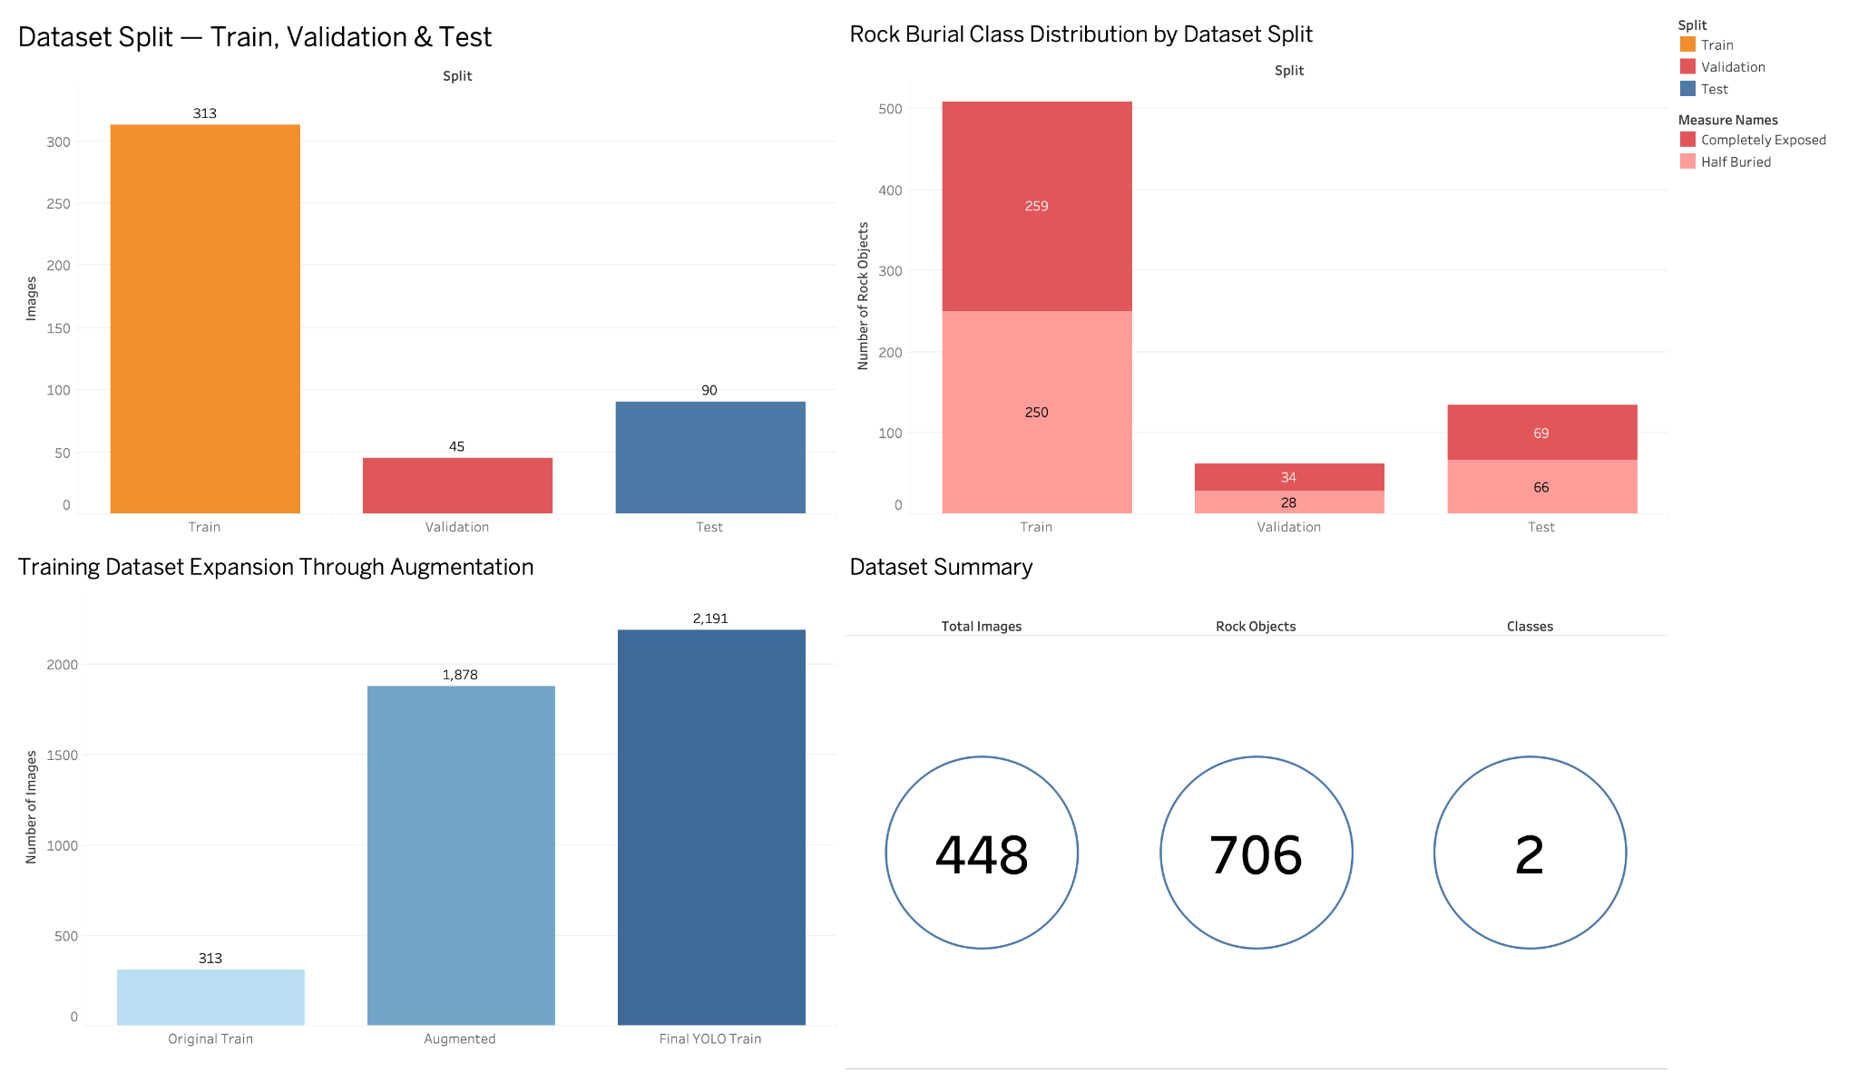
Dashboard 1 - Dataset Preparation Overview

Slide 16
Dashboard 1 Explanation - Dataset Readiness
448 images are split into 313 train, 45 validation and 90 untouched test images; only training data is fitted.
706 labeled rocks cover two classes; training labels are near-even at 259 exposed and 250 half buried.
Train-only augmentation adds 1,878 variants, expanding 313 originals to 2,191 training images.
Validation and test remain unaugmented, limiting leakage and keeping evaluation independent.
Result: later model comparisons rest on balanced, reproducible data.

Slide 17
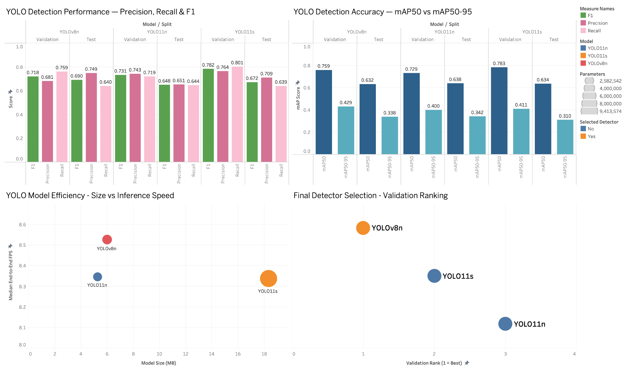
Dashboard 2 - YOLO Model Selection Overview

Slide 18
Dashboard 2 Explanation - Detector Choice
Three candidates YOLOv8n, YOLO11n and YOLO11s are compared on validation and untouched test data.
Precision and recall track false alarms and misses; F1 balances both, and mAP50-95 tests stricter localization.
YOLOv8n ranks first on validation mAP50-95 (0.429), even though YOLO11s leads some looser headline metrics.
YOLOv8n is also compact and records the fastest measured detector benchmark.
Selection uses validation before test review, preserving an independent generalization check.

Slide 19
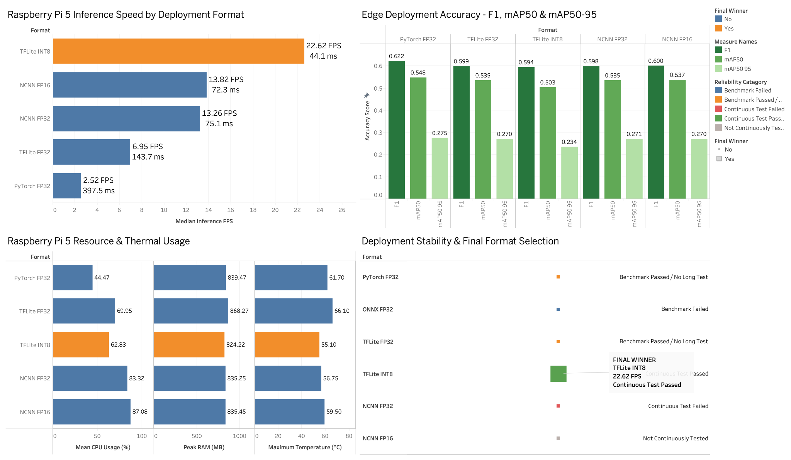
Dashboard 3 - Raspberry Pi Edge Deployment Overview
FULL DASHBOARD

Slide 20
Dashboard 3 Explanation - Final Edge Format
The same YOLOv8n and 90-image, 640 × 640 benchmark isolate export-format effects.
TFLite INT8 leads at 22.62 FPS, 44.13 ms mean latency and 824.22 MB peak RAM.
That is 8.99× PyTorch speed while retaining 91.8% of mAP50 (0.503 versus 0.548).
It alone passed the two-minute continuous test: about 2,533 inferences, no reboot or recorded throttling.
Caveat: the run reached about 76 °C without an Active Cooler; longer tests were not attempted.
TFLite INT8 wins the proof-of-concept; NCNN FP16 remains the accuracy-speed research alternative.

