Slide 1
ENGLAND
MORTALITY &
DEPRIVATION
ANALYTICS
National trends and local inequalities, 2001–03 to 2022–24
Tanishk Nanasaheb Shinde
Notes:
Final project presentation based on five supplied CSV extracts, fourteen worksheet images and four dashboard images. Design reference: Global_Finance_Operations_Analytics(1).pptx.

Slide 2
Project overview
OVERVIEW
Objective
Describe changes in England mortality and compare local outcomes with deprivation and the national benchmark.
Scope
Five mortality indicators across 22 rolling periods. Local comparisons use the latest period, 2022–24.
Deliverables
Five analytical CSVs support fourteen Tableau worksheets and four dashboards.
The analysis describes population patterns and supports further local investigation.
England Mortality & Deprivation Analytics
02
Notes:
Sources: indicator_definitions(1).csv, mortality_trends(1).csv and supplied dashboard images.

Slide 3
Long-term improvement coexists with recent increases
KEY FINDINGS
National change
Infant mortality fell from 5.36 to 4.17 per 1,000 between 2001–03 and 2022–24, a 22.2% reduction.
Recent direction
The latest infant rate is 7.5% above the 2014–16 low. Child mortality is 15.4% above its 2019–21 low.
Local inequality
Mean infant mortality is 5.10 in Q5 and 3.37 in Q1, a 1.51× ratio across authorities with assigned quintiles.
Quintile results are unweighted authority means and describe association.
England Mortality & Deprivation Analytics
03
Notes:
Calculations from mortality_trends(1).csv and deprivation_inequality(1).csv. Q1 n=47, Q5 n=51. All rates in final row per 1,000.

Slide 4
Analytical workflow
METHODOLOGY
Source measures
Fingertips supplies mortality values, counts, denominators and confidence intervals.
Population checks
Nomis population estimates validate the child mortality denominator using official area codes.
Deprivation join
IMD 2019 fields add child-population-weighted scores and exposure measures. Boundary mismatches remain null.
Tableau reporting
Separate extracts support national trends, local comparison, deprivation analysis and quality reporting.
Fingertips remains the authoritative source for the reported mortality rate.
England Mortality & Deprivation Analytics
04
Notes:
Source: data_quality_summary(1).csv and schemas of the supplied analytical CSVs. This describes the evidenced data flow, without asserting an unseen notebook or SQL implementation.

Slide 5
Five extracts define the reporting layer
DATA SCOPE
Extract | Rows | Analytical grain
mortality_trends | 110 | Indicator × England reporting period
local_authority_comparison | 988 | Indicator × latest local authority
deprivation_inequality | 988 | Local mortality row with deprivation fields
indicator_definitions | 5 | One summary per mortality indicator
data_quality_summary | 15 | One row per validation metric
The two local extracts describe the same 988 mortality records.
England Mortality & Deprivation Analytics
05
Notes:
Sources: complete supplied CSVs. Row counts exclude headers.

Slide 6
Latest England mortality indicators
INDICATOR SCOPE
Indicator | Age | Rate scale | 2022–24
Child mortality | 1–17 years | per 100,000 | 11.59
Infant mortality | Under 1 year | per 1,000 | 4.17
Neonatal mortality | Under 28 days | per 1,000 | 3.07
Post-neonatal mortality | 28 days to under 1 year | per 1,000 | 1.10
Stillbirth | Source age: 0 years | per 1,000 | 3.90
Indicator scales and denominators differ. Values should retain their original units.
England Mortality & Deprivation Analytics
06
Notes:
Source: indicator_definitions(1).csv. Formal Fingertips definitions were not supplied. Values rounded to two decimals.

Slide 7
Local coverage differs by indicator
DATA COVERAGE
Indicator | Authorities | Available | Missing
Child mortality | 132 | 114 | 18
Infant mortality | 296 | 291 | 5
Neonatal mortality | 132 | 130 | 2
Post-neonatal mortality | 132 | 121 | 11
Stillbirth | 296 | 287 | 9
Infant mortality and stillbirth cover 164 Districts and 132 UAs. The other indicators cover 132 UAs.
England Mortality & Deprivation Analytics
07
Notes:
Source: local_authority_comparison(1).csv, grouped by IndicatorID. UA and District are supplied AreaType labels.

Slide 8
Quality rules retain the evidence
DATA PREPARATION
Unique records
Zero duplicate national indicator-period keys and zero duplicate local indicator-area keys.
Missing mortality
45 of 988 local rows have unavailable or suppressed rates. These values remain missing.
Valid intervals
No reported interval violates LowerCI95 ≤ Value ≤ UpperCI95.
Area matching
Nomis matches all 296 area codes. IMD 2019 matches 289, leaving seven current authorities unmatched.
A missing or suppressed value does not imply zero mortality.
England Mortality & Deprivation Analytics
08
Notes:
Source: data_quality_summary(1).csv. Recalculation from local_authority_comparison(1).csv confirms 45 missing rates.

Slide 9
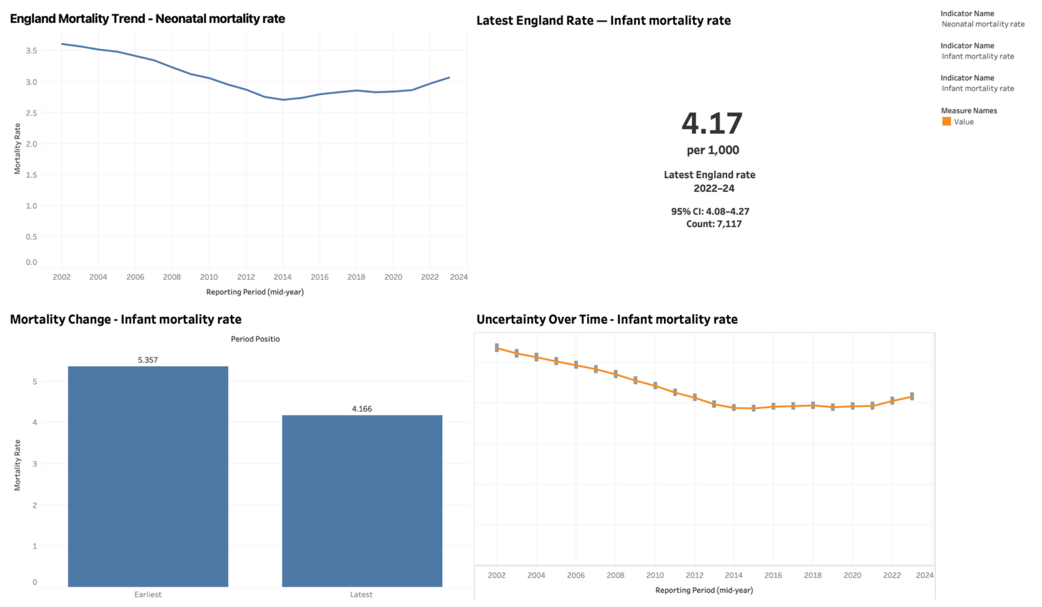
National mortality trends
DASHBOARD 1
Trend: neonatal mortality. Other panels: infant mortality. KPI interval discrepancy: see slide 11.
England Mortality & Deprivation Analytics
09
Notes:
Source: National Mortality Trends(1).png. The trend panel shows neonatal mortality. The other three panels show infant mortality.

Slide 10
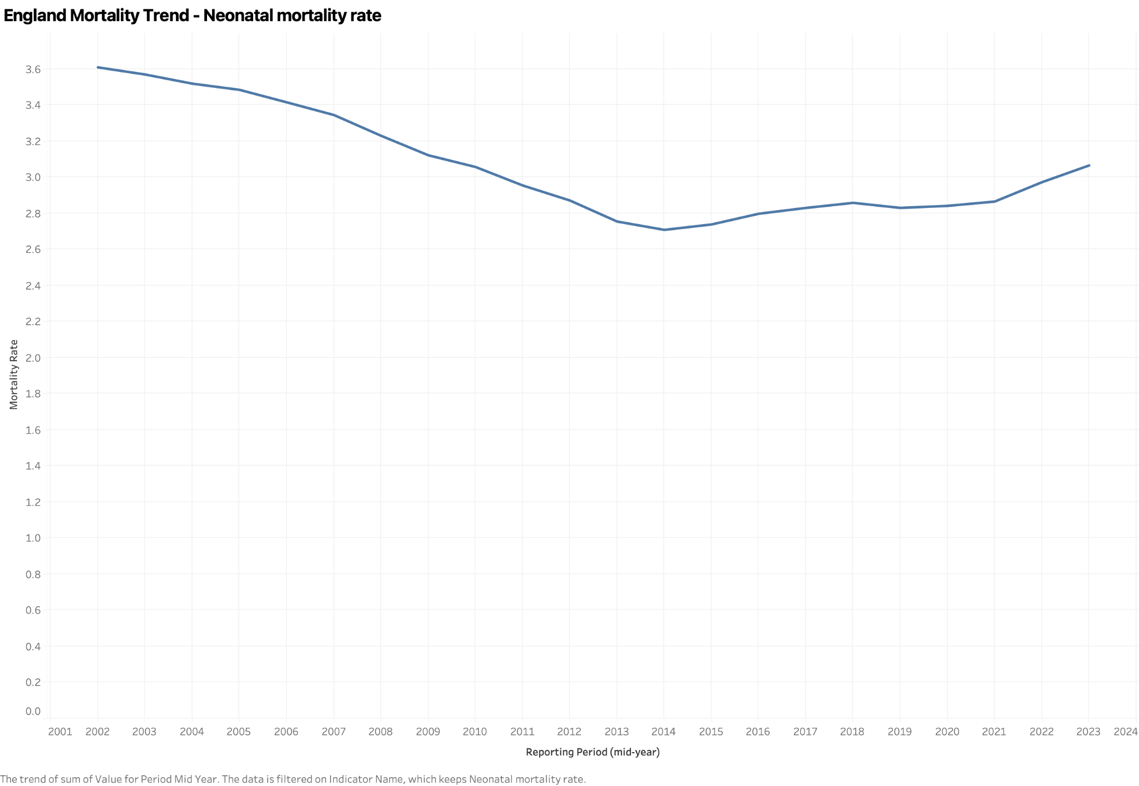
Neonatal mortality declined, then increased
WORKSHEET S1
WHAT IT SHOWS
England neonatal mortality across 22 rolling three-year periods.
RESULT
The rate fell from 3.61 to 3.07 per 1,000 over the full period.
INTERPRETATION
The latest rate is 13.2% above the 2013–15 low of 2.71.
England Mortality & Deprivation Analytics
10
Notes:
Source: S1 - England Mortality Trend(1).png. Source: mortality_trends(1).csv, IndicatorID 92705. Changes use unrounded values. Overlapping periods are not independent annual observations.

Slide 11
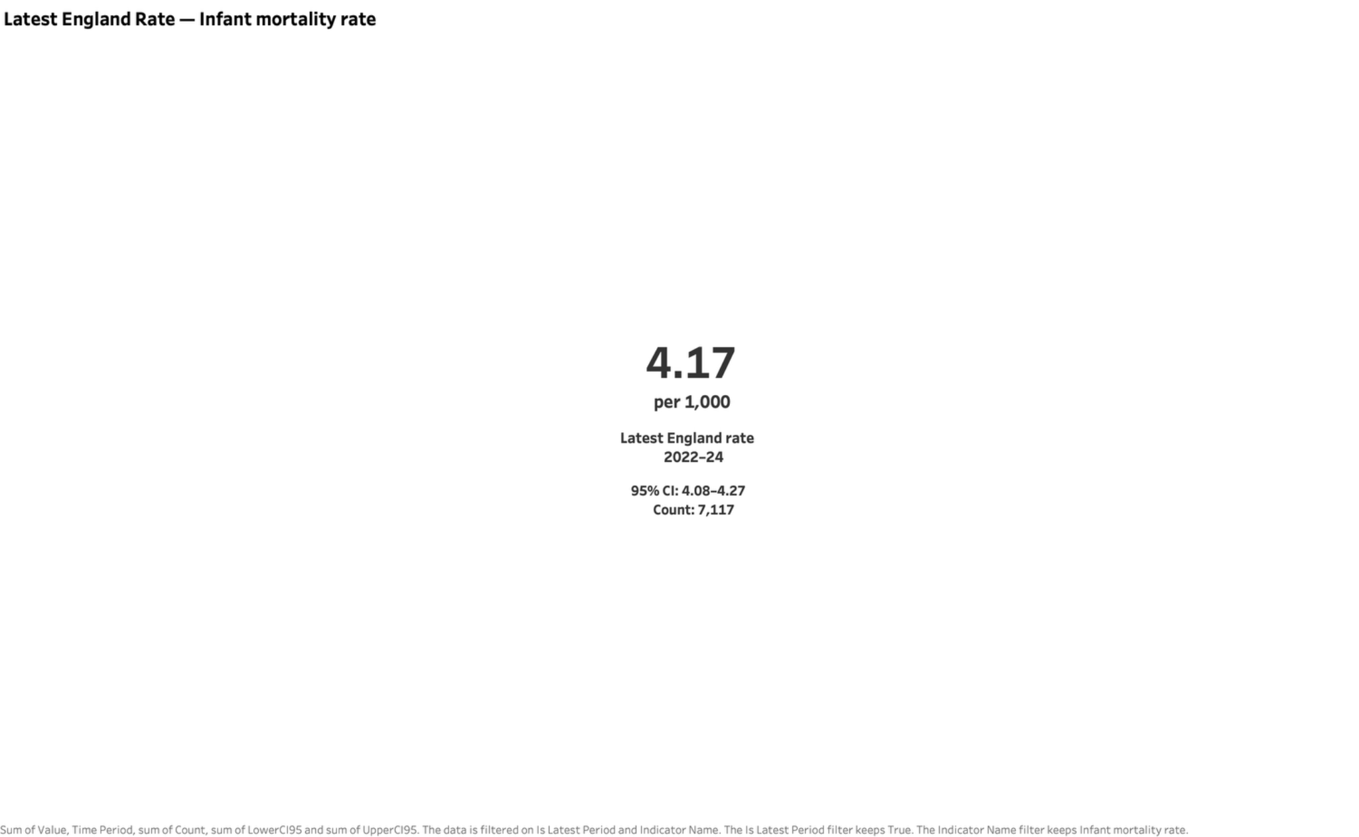
England infant mortality reached 4.17 per 1,000
WORKSHEET S2
WHAT IT SHOWS
The latest infant mortality rate for England, covering 2022–24.
PRECISION
CSV 95% CI: 4.07–4.26. The image shows 4.08–4.27. Count: 7,117 deaths.
INTERPRETATION
This national benchmark provides context for local authority comparisons.
England Mortality & Deprivation Analytics
11
Notes:
Sources: S2 - Latest England KPI(1).png and indicator_definitions(1).csv, IndicatorID 92196. The screenshot CI of 4.08–4.27 differs from the CSV interval of 4.069859–4.264029. This presentation uses the supplied CSV for numerical interpretation and retains the original image as visual evidence. The exact cause of the discrepancy cannot be determined from supplied files.

Slide 12
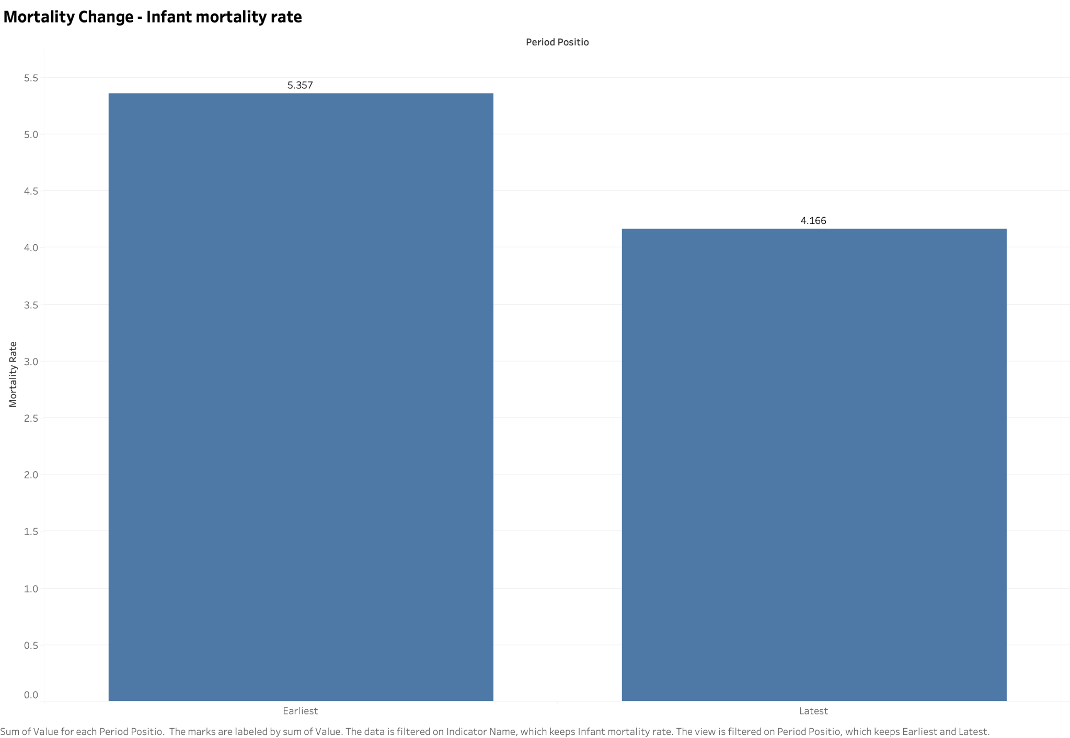
Infant mortality fell 22.2% over the full period
WORKSHEET S3
COMPARISON
5.36 per 1,000 in 2001–03 compared with 4.17 in 2022–24.
ABSOLUTE CHANGE
A reduction of 1.19 deaths per 1,000 in the reported rate.
INTERPRETATION
The endpoint comparison hides the decline followed by a recent increase.
England Mortality & Deprivation Analytics
12
Notes:
Source: S3 - Mortality Change(1).png. Source: mortality_trends(1).csv, IndicatorID 92196. Percentage change = (latest / earliest − 1) × 100.

Slide 13
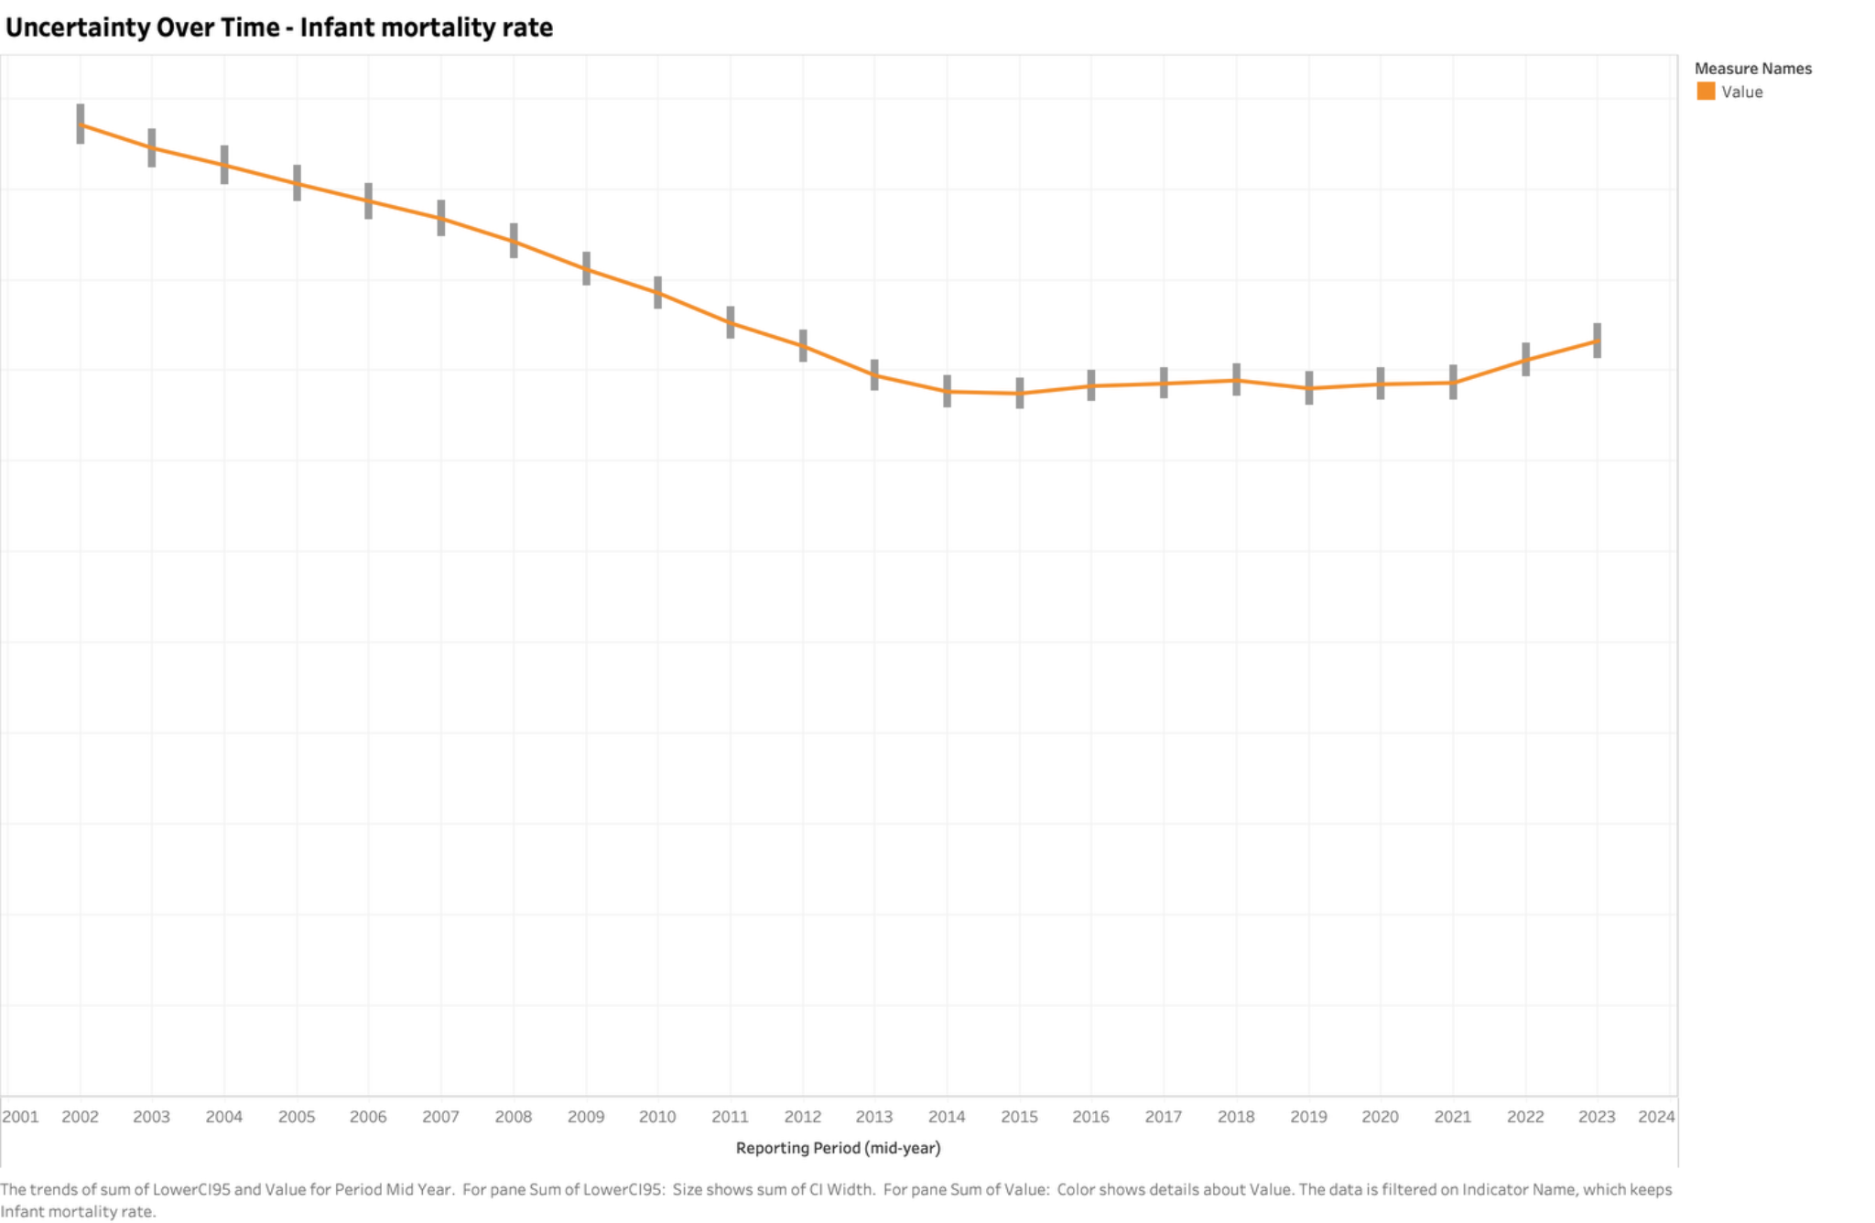
Confidence intervals add context to the trend
WORKSHEET S4
WHAT IT SHOWS
Infant mortality estimates with their reported 95% confidence intervals.
RECENT CHANGE
4.17 in 2022–24 compared with the 2014–16 low of 3.88 per 1,000.
CAUTION
Adjacent periods share two years of data. No independent annual trend test is supplied.
England Mortality & Deprivation Analytics
13
Notes:
Source: S4 - Mortality Uncertainty(1).png. Source: mortality_trends(1).csv, IndicatorID 92196. RecentTrend at the latest period is Cannot be calculated.

Slide 14
All five indicators remain below their first-period rates
NATIONAL SUMMARY
Indicator | 2001–03 | 2022–24 | Change
Child mortality | 18.04 | 11.59 | −35.7%
Infant mortality | 5.36 | 4.17 | −22.2%
Neonatal mortality | 3.61 | 3.07 | −15.1%
Post-neonatal mortality | 1.75 | 1.10 | −37.0%
Stillbirth | 5.55 | 3.90 | −29.7%
Child mortality is per 100,000. All other rates are per 1,000.
England Mortality & Deprivation Analytics
14
Notes:
Source: mortality_trends(1).csv. Full-period relative changes use unrounded values.

Slide 15
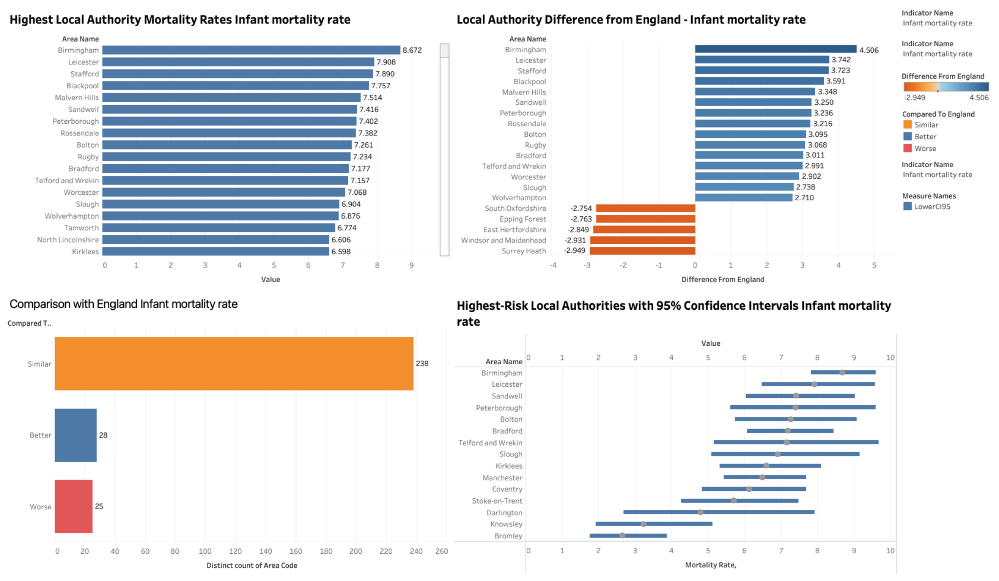
Local authority comparison
DASHBOARD 2
Infant mortality, 2022–24. Rankings require confidence intervals and official comparison categories.
England Mortality & Deprivation Analytics
15
Notes:
Source: Local Authority Comparison(1).png. Infant mortality, 2022–24. Rankings require confidence intervals and official comparison categories.

Slide 16
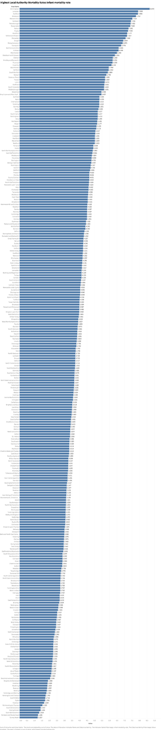
Higher point estimates do not always mean “Worse”
WORKSHEET S5
Authority | Rate per 1,000 | England comparison
Birmingham | 8.67 | Worse
Leicester | 7.91 | Worse
Stafford | 7.89 | Worse
Blackpool | 7.76 | Worse
Malvern Hills | 7.51 | Similar
Sandwell | 7.42 | Worse
Peterborough | 7.40 | Worse
Malvern Hills has a wide 95% CI of 4.00–12.85. Its supplied comparison category is “Similar”.
England Mortality & Deprivation Analytics
16
Notes:
Sources: S5 - Local Authority Ranking(1).png and local_authority_comparison(1).csv, IndicatorID 92196. The full source ranking is preserved at left. Selected highest values appear in the editable table.

Slide 17
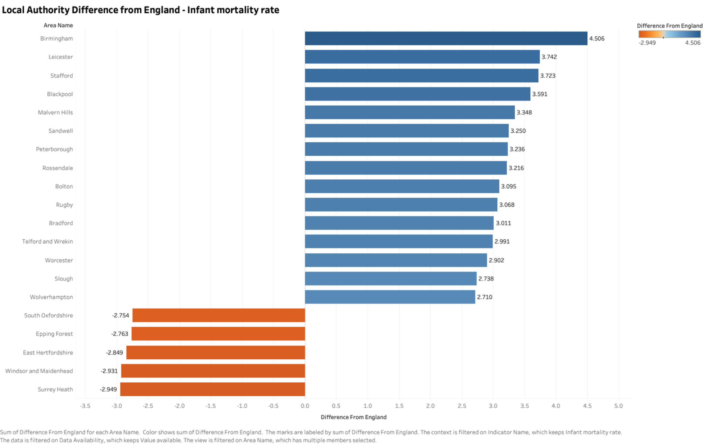
Differences from England identify areas for review
WORKSHEET S6
WHAT IT SHOWS
Local infant mortality minus the England rate of 4.17 per 1,000.
EXAMPLE
Birmingham is 4.51 per 1,000 above England, with a rate of 8.67.
INTERPRETATION
The size of a point-estimate gap should be read alongside the confidence interval.
England Mortality & Deprivation Analytics
17
Notes:
Source: S6 - Difference from England(1).png. Source: local_authority_comparison(1).csv. DifferenceFromEngland preserves rate units.

Slide 18
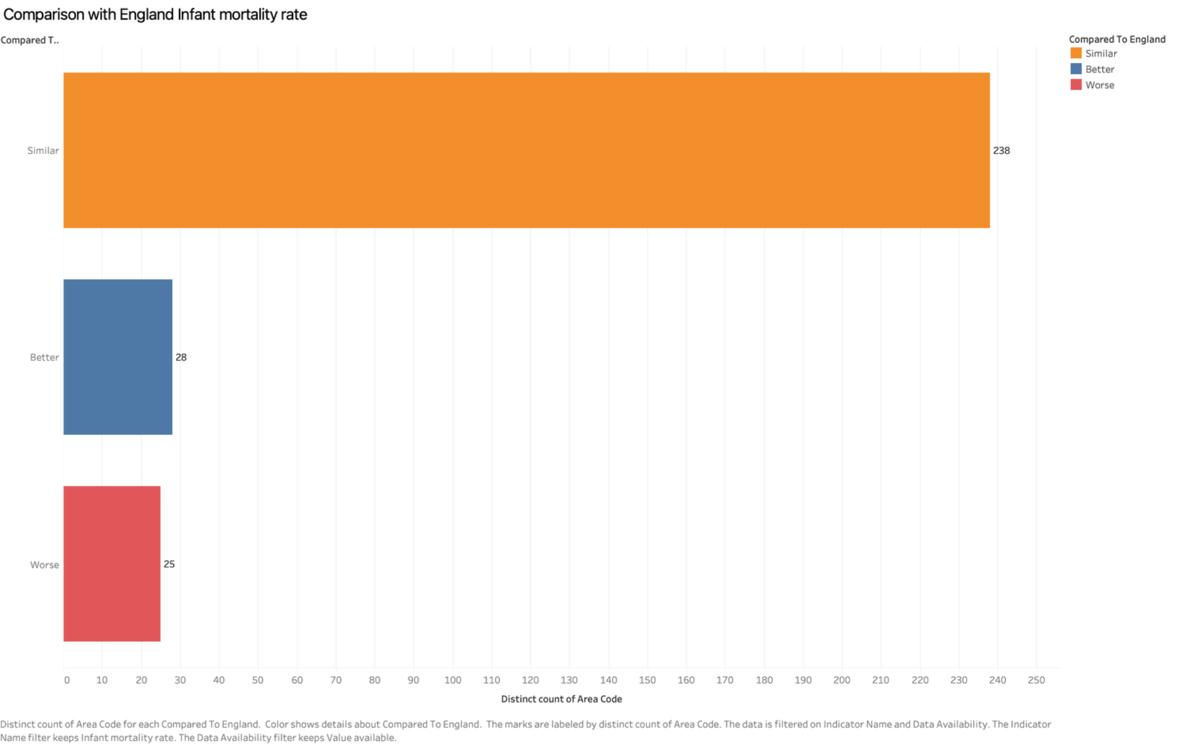
Most authorities fall in the “Similar” category
WORKSHEET S7
RESULT
238 Similar, 28 Better and 25 Worse among the 291 authorities with available infant rates.
MISSING VALUES
Five additional authorities have unavailable rates and are Not compared.
INTERPRETATION
Similar indicates the supplied benchmark category. It does not establish identical outcomes.
England Mortality & Deprivation Analytics
18
Notes:
Source: S7 - England Comparison Summary(1).png. Source: local_authority_comparison(1).csv, IndicatorID 92196, ComparedToEngland counts.

Slide 19
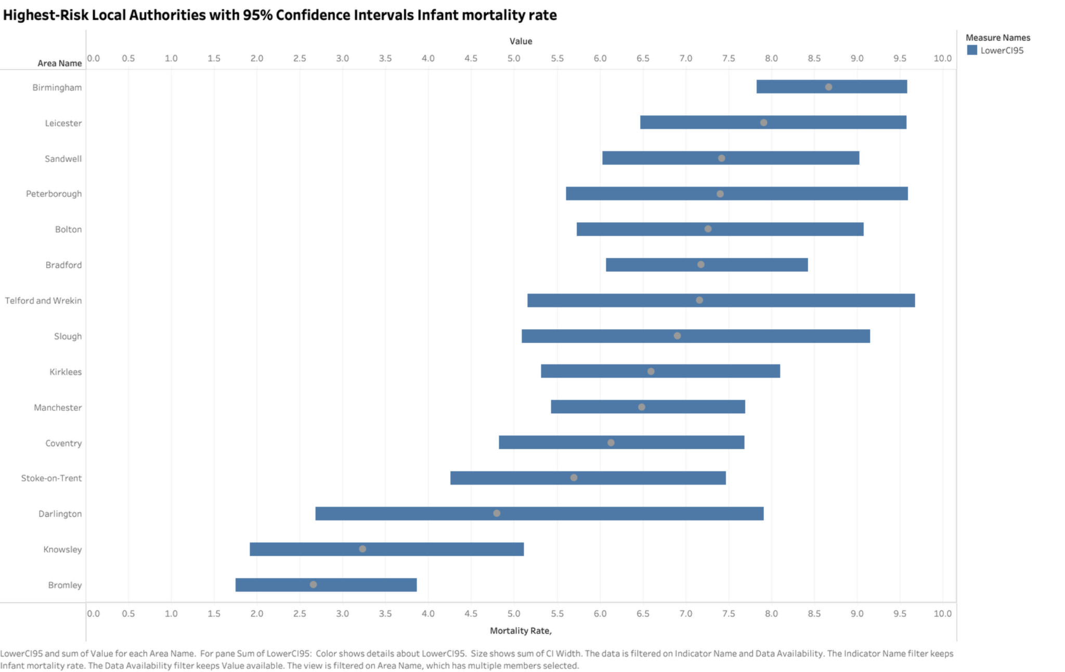
Local confidence intervals reveal ranking uncertainty
WORKSHEET S8
WHAT IT SHOWS
Reported 95% confidence intervals for selected higher-rate authorities.
CONTRAST
Birmingham: 7.83–9.58. Stafford: 5.24–11.40 deaths per 1,000.
INTERPRETATION
Wide intervals reduce precision. A point-estimate rank is not a precise ordering of underlying risk.
England Mortality & Deprivation Analytics
19
Notes:
Source: S8 - Local Authority Confidence Intervals(1).png. Source: local_authority_comparison(1).csv, IndicatorID 92196. Screenshot uses selected authorities.

Slide 20
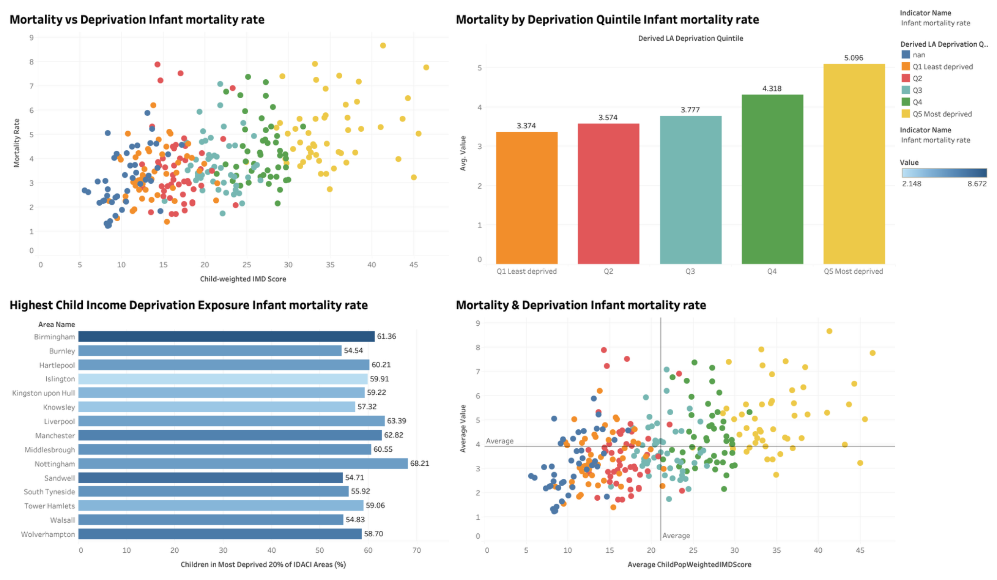
Deprivation and mortality inequality
DASHBOARD 3
Infant mortality, 2022–24, linked to IMD 2019. Area associations do not establish causation.
England Mortality & Deprivation Analytics
20
Notes:
Source: Deprivation & Mortality Inequality(1).png. Infant mortality, 2022–24, linked to IMD 2019. Area associations do not establish causation.

Slide 21
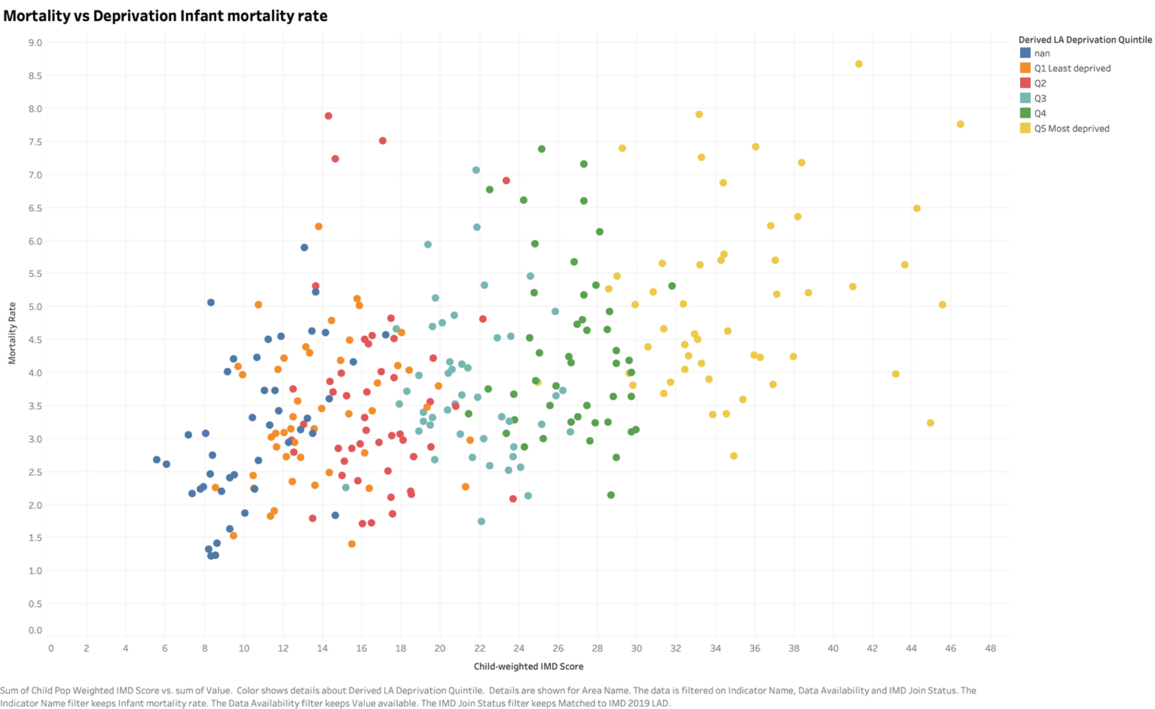
Higher deprivation is associated with higher infant mortality
WORKSHEET S9
WHAT IT SHOWS
Each point represents an authority, with weighted IMD score on the horizontal axis.
PATTERN
Higher deprivation scores generally accompany higher mortality, with substantial variation.
CAUTION
Some points have no assigned quintile. The chart compares areas, not individual families.
England Mortality & Deprivation Analytics
21
Notes:
Source: S9 - Mortality vs Deprivation(1).png. Source: deprivation_inequality(1).csv and S9 image. Child population weighting refers to ages 0–15 in 2015. Mortality refers to infants in 2022–24.

Slide 22
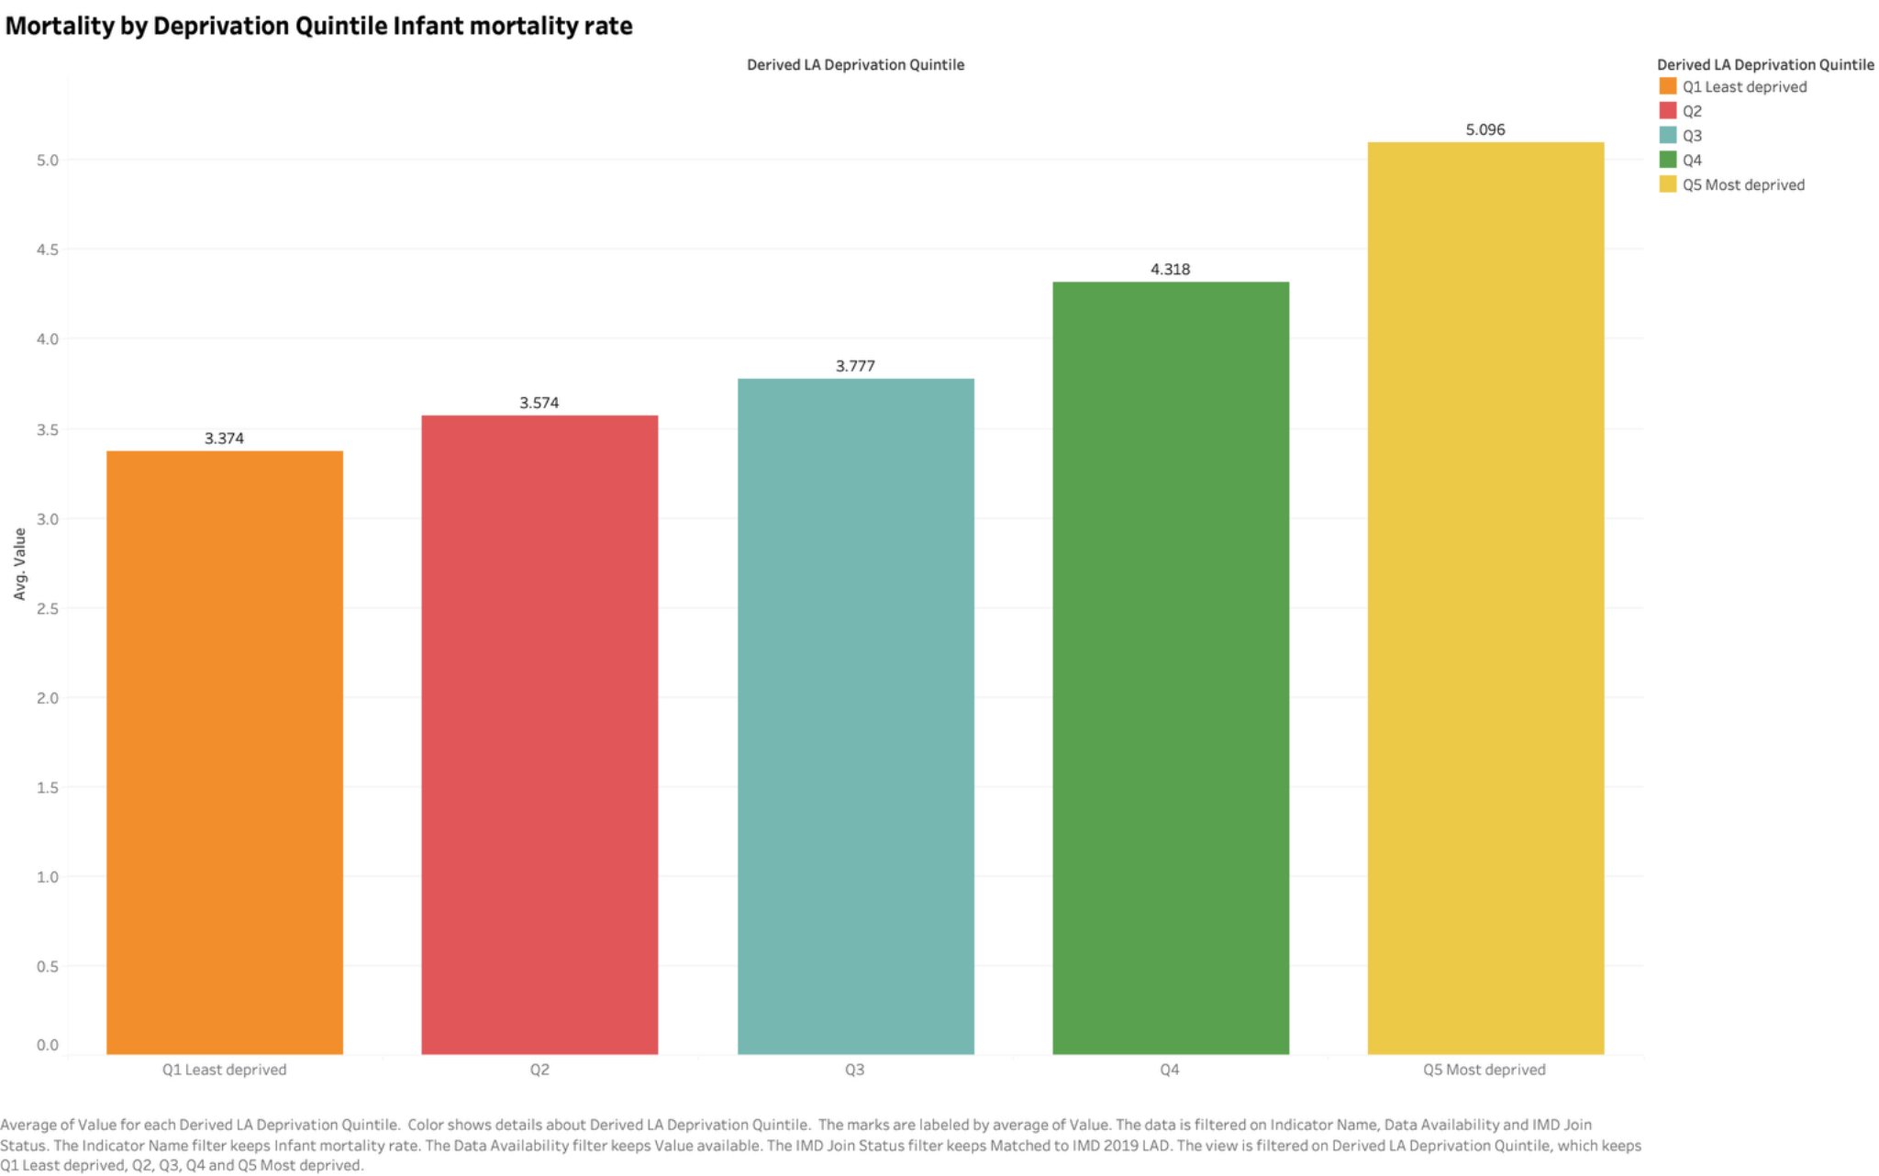
Mean infant mortality rises across the assigned quintiles
WORKSHEET S10
RESULT
Q1 mean: 3.37. Q5 mean: 5.10 deaths per 1,000.
SIZE OF GAP
The Q5 mean is 1.72 per 1,000 higher, or approximately 51% above Q1.
AGGREGATION
Each authority receives equal weight. These are not pooled population mortality rates.
England Mortality & Deprivation Analytics
22
Notes:
Source: S10 - Mortality by Deprivation Quintile(1).png. Source: deprivation_inequality(1).csv. Group means reproduce S10 to three decimals: 3.374, 3.574, 3.777, 4.318, 5.096.

Slide 23
The quintile comparison uses 241 authorities
DEPRIVATION COVERAGE
Assigned quintile | Available rates | Mean per 1,000
Q1 Least deprived | 47 | 3.374
Q2 | 48 | 3.574
Q3 | 48 | 3.777
Q4 | 47 | 4.318
Q5 Most deprived | 51 | 5.096
55 of 296 authorities have no assigned quintile, including the seven without an IMD match. The assigned groups are therefore not a full-coverage national comparison.
England Mortality & Deprivation Analytics
23
Notes:
Source: deprivation_inequality(1).csv, IndicatorID 92196. Group counts restrict to nonmissing Value and assigned quintile.

Slide 24
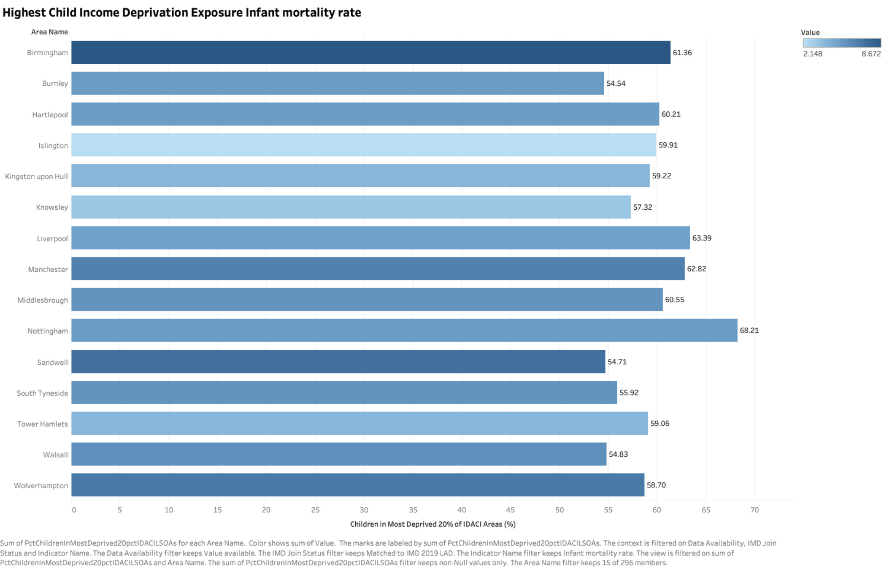
Deprivation exposure adds context to mortality rates
WORKSHEET S11
WHAT IT SHOWS
Selected authorities with high child income-deprivation exposure, coloured by infant mortality.
MEASURE
Exposure is the percentage of children in the most deprived 20% of IDACI LSOAs.
CAUTION
The exposure measure uses historical deprivation and child population data. It is not current infant exposure.
England Mortality & Deprivation Analytics
24
Notes:
Source: S11 - Child Deprivation Exposure(1).png. Source: deprivation_inequality(1).csv, PctChildrenInMostDeprived20pctIDACILSOAs. LSOA = Lower-layer Super Output Area. IDACI = Income Deprivation Affecting Children Index.

Slide 25
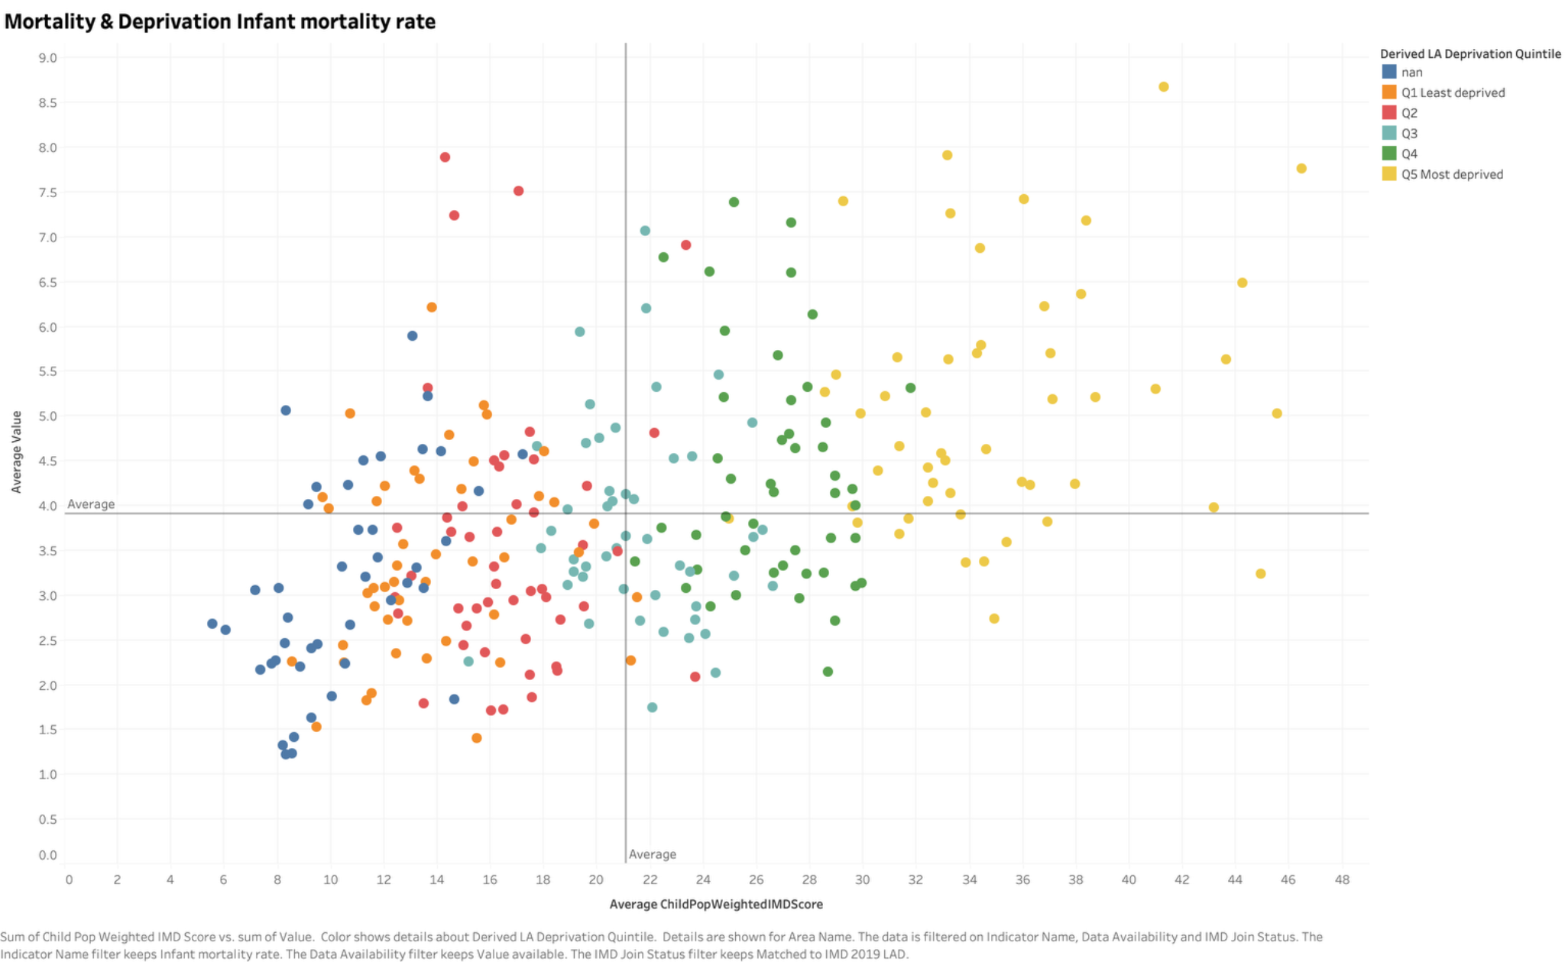
The priority matrix supports exploratory review
WORKSHEET S12
WHAT IT SHOWS
Mortality and weighted IMD score, divided by average reference lines.
POTENTIAL USE
Authorities above both averages are candidates for closer contextual review.
CAUTION
The lines are chart averages, not clinical thresholds or the official England mortality benchmark.
England Mortality & Deprivation Analytics
25
Notes:
Source: S12 - Priority Matrix(1).png. Source: S12 - Priority Matrix(1).png. The horizontal line lies near 3.9 rather than the England infant rate of 4.166. No validated risk score or intervention effect is supplied.

Slide 26
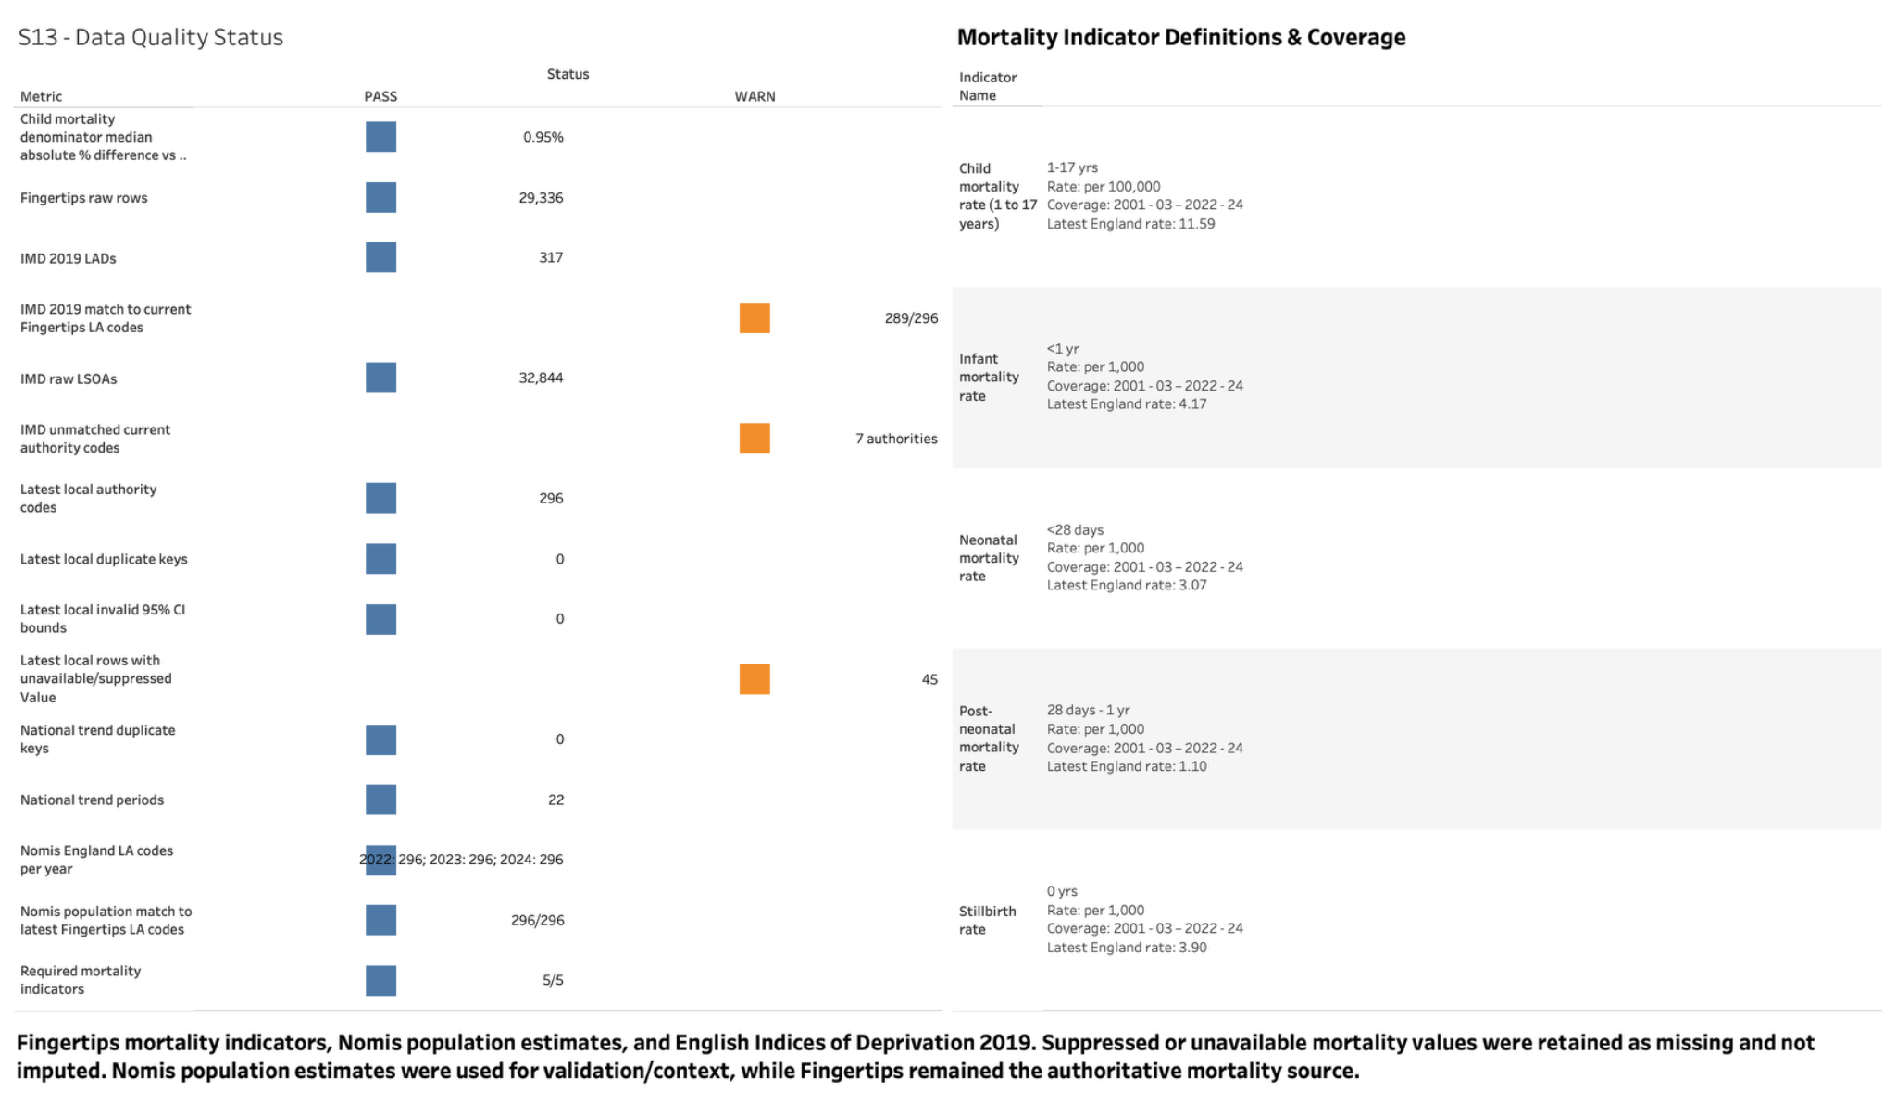
Data quality and methodology
DASHBOARD 4
Suppressed values remain missing. Nomis validates population coverage while Fingertips supplies mortality.
England Mortality & Deprivation Analytics
26
Notes:
Source: Data Quality & Methodology(1).png. Suppressed values remain missing. Nomis validates population coverage while Fingertips supplies mortality.

Slide 27
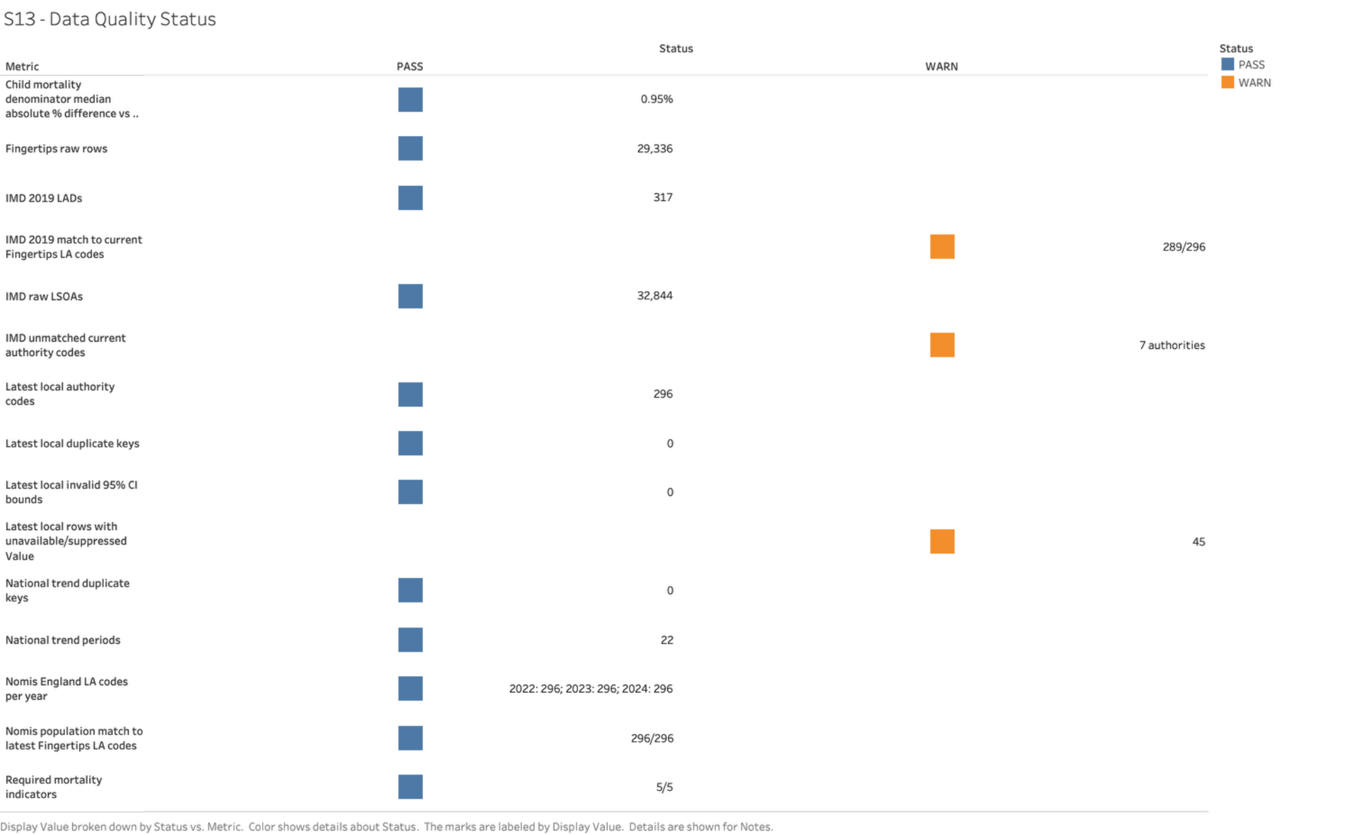
Quality checks pass with visible coverage warnings
WORKSHEET S13
PASSED CHECKS
Five required indicators, no duplicate analytical keys and no invalid reported interval bounds.
WARNINGS
45 unavailable local rates and seven unmatched IMD authority codes remain visible.
VALIDATION
The median absolute child-denominator difference versus Nomis is 0.95%.
England Mortality & Deprivation Analytics
27
Notes:
Source: S13 - Data Quality Status(1).png. Source: data_quality_summary(1).csv. The seven unmatched names are Buckinghamshire UA, Cumberland, North Northamptonshire, North Yorkshire UA, Somerset UA, West Northamptonshire, Westmorland and Furness.

Slide 28
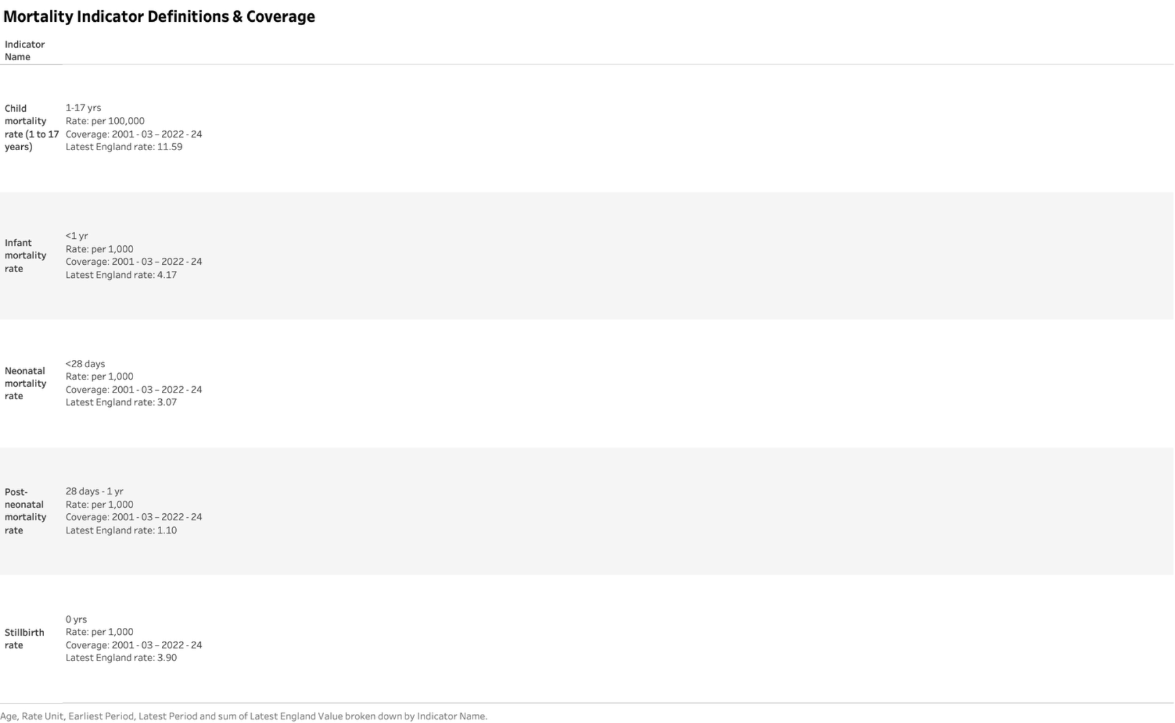
Indicator definitions preserve age and rate scale
WORKSHEET S14
WHAT IT SHOWS
Five mortality indicators, each with 22 periods from 2001–03 to 2022–24.
UNIT DISTINCTION
Child mortality uses per 100,000. The remaining four indicators use per 1,000.
METADATA LIMIT
These summaries derive from indicator data. The formal Fingertips definitions file was not supplied.
England Mortality & Deprivation Analytics
28
Notes:
Source: S14 - Indicator Definitions(1).png. Source: indicator_definitions(1).csv and S14 - Indicator Definitions(1).png.

Slide 29
Interpretation limits
LIMITATIONS
Time and geography
Rolling periods overlap. IMD 2019 and its 2015 child weights precede the 2022–24 mortality outcome.
Incomplete coverage
Suppressed rates and missing quintiles restrict the available comparisons. Missing values remain unknown.
Area-level inference
Deprivation associations can reflect other local factors. The data do not isolate individual risk or causal effects.
Static evidence
Dashboard exports capture visible states. A Tableau workbook, preparation code and formal definitions are outside the supplied evidence.
Findings support descriptive reporting and further investigation.
England Mortality & Deprivation Analytics
29
Notes:
Sources: supplied CSV fields, metadata notes and dashboard exports. No causal model, forecast or intervention evaluation is included.

Slide 30
Potential uses of the reporting
PROPOSED NEXT STEPS
Local review
Use higher mortality, official Worse comparisons and deprivation exposure to shortlist authorities for contextual investigation.
Further validation
Resolve boundary changes using a documented geography method and check why matched authorities lack assigned quintiles.
Ongoing reporting
Refresh compatible periods and definitions, retain suppressed values, and track coverage alongside the mortality indicators.
These are proposed uses of the findings, not evaluated intervention recommendations.
England Mortality & Deprivation Analytics
30
Notes:
Recommendations derive from the limitations observed in supplied data. The current evidence does not identify causes or establish effectiveness of any intervention.

Slide 31
The project makes mortality patterns and limitations visible
CONCLUSION
National perspective
Mortality is lower than at the start of the series, while recent increases warrant continued monitoring.
Local perspective
Confidence intervals and England comparison categories add essential context to authority rankings.
Inequality perspective
Assigned deprivation quintiles show a clear gradient, with coverage and historical-data caveats.
Four dashboards connect descriptive findings with the evidence needed to interpret them.
England Mortality & Deprivation Analytics
31
Notes:
Sources: mortality_trends(1).csv, local_authority_comparison(1).csv and deprivation_inequality(1).csv.

Slide 32
Sources and analytical notes
REFERENCES
Mortality evidence
mortality_trends(1).csv, local_authority_comparison(1).csv and indicator_definitions(1).csv. Underlying source identified as Fingertips.
Deprivation evidence
deprivation_inequality(1).csv links IMD 2019 and historical child-population measures to local mortality.
Quality evidence
data_quality_summary(1).csv records joins, missing values, duplicate keys and Nomis denominator validation.
Visual evidence
Four dashboard PNGs and worksheets S1–S14. Design follows Global_Finance_Operations_Analytics(1).pptx.
Each evidence slide includes source details and relevant calculation notes.
England Mortality & Deprivation Analytics
32
Notes:
All numerical claims come from the supplied extracts. No external data refresh. Derived percentage change = (latest / earliest − 1) × 100. Quintile means use available local rates with assigned quintiles and no population weighting.

