Slide 1
GLOBAL FINANCE OPERATIONS ANALYTICS
Notes:
[Sources]
- Global_Finance_Operations_Analytics_V2.ipynb
- Global_Finance_SQL_Report.docx
- User-provided Tableau images

Slide 2
PROJECT OVERVIEW
Objective
Build a traceable analytics pipeline that converts operational finance data into validated KPIs, investigation flags and dashboard-ready reporting views.
Processes
OTC evaluates billing, receivables and customer payment behaviour. PTP analyses valid procurement spend and concentration. RTR explains revenue, expenses, profit and account movements.
Delivery
Python performs EDA and data preparation; PostgreSQL enforces the analytical model; Tableau communicates trends, concentration, risk and executive performance.
Global Finance Operations Analytics
02
Notes:
[Sources]
- Global_Finance_Operations_Analytics_V2.ipynb

Slide 3
A five-stage workflow
PROJECT OVERVIEW
1
2
3
4
5
Source files
Jupyter
Processed CSVs
PostgreSQL
Tableau
OTC CSV
PTP workbook
RTR workbook
Clean fields
EDA + validation
Flags + forecast
Dimensions
Facts
Monthly marts
Core model
Constraints
Analytical views
16 worksheets
4 dashboards
Executive story
Global Finance Operations Analytics
03
Notes:
[Sources]
- Global_Finance_Operations_Analytics_V2.ipynb
- Global_Finance_SQL_Report.docx

Slide 4
The three processes cover different reporting periods
DATA SCOPE
OTC | Accounts receivable
45,839 rows · 33 columns · 69 customers · 23 Nov 2011 to 17 Mar 2016 · no exact duplicate rows
PTP | Procurement
75,349 rows · 31 selected columns · 61,924 valid positive-spend lines · 16 Jul 2012 to 9 Apr 2019 · no exact duplicate rows
RTR | General ledger
27,909 rows · 21 columns · 3,992 entries · 1 Jan 2018 to 31 Dec 2020 · no exact duplicate rows
Global Finance Operations Analytics
04
Notes:
[Sources]
- Global_Finance_Operations_Analytics_V2.ipynb

Slide 5
Notebook preparation
JUPYTER NOTEBOOK
Load
The notebook locates the data folder, reads the OTC CSV, selected PTP columns, RTR GL and master-data sheets, and the OTC data dictionary.
Standardise
Column names are cleaned, duplicate names are made unique, dates are parsed from strings or Excel serials, and financial measures are converted to numeric types.
Derive
Payment delay, late-payment flags, valid-spend flags, monthly periods, account mappings, KPI marts and investigation flags are built before visual analysis.
Validate
Quality checks flag unusual records without silently deleting them; reconciliations confirm that processed totals still match the source transactions.
Global Finance Operations Analytics
05
Notes:
[Sources]
- Global_Finance_Operations_Analytics_V2.ipynb

Slide 6
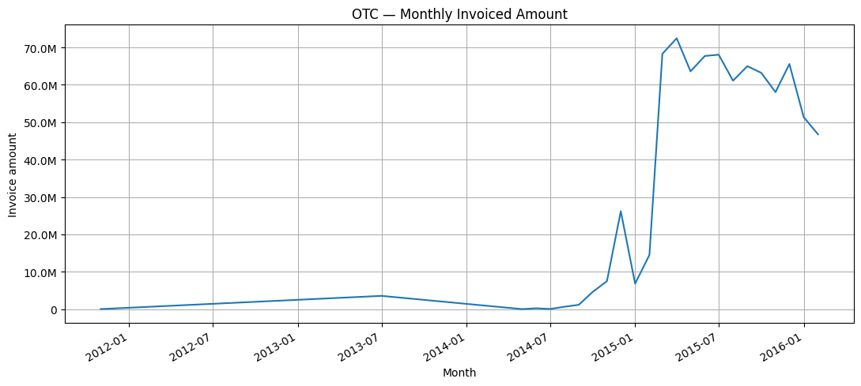
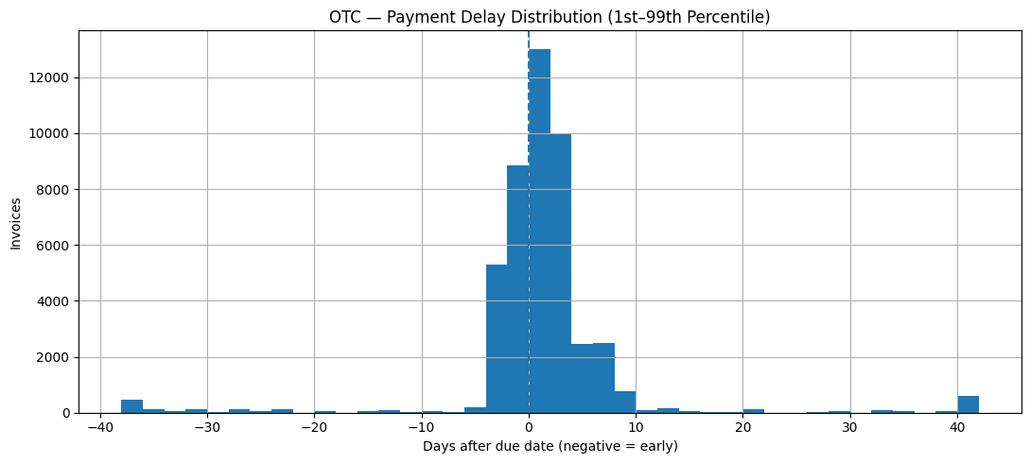
OTC EDA exposed billing scale and payment behaviour
JUPYTER EDA
Portfolio scale
45,839 invoices, 69 customers and £816.26M equivalent total invoice amount were analysed.
Payment behaviour
The calculated late-payment rate is 53%; average and median delays are close to one day, while the clipped distribution reveals material early/late outliers.
Global Finance Operations Analytics
06
Notes:
[Sources]
- Global_Finance_Operations_Analytics_V2.ipynb

Slide 7
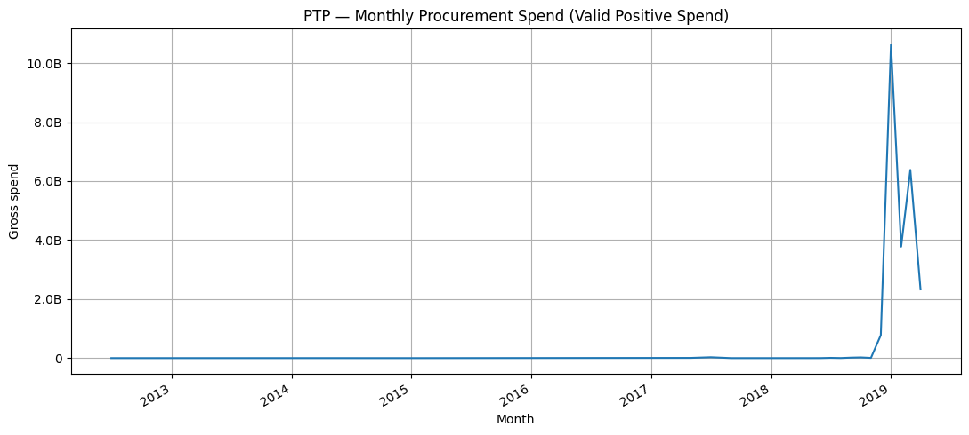
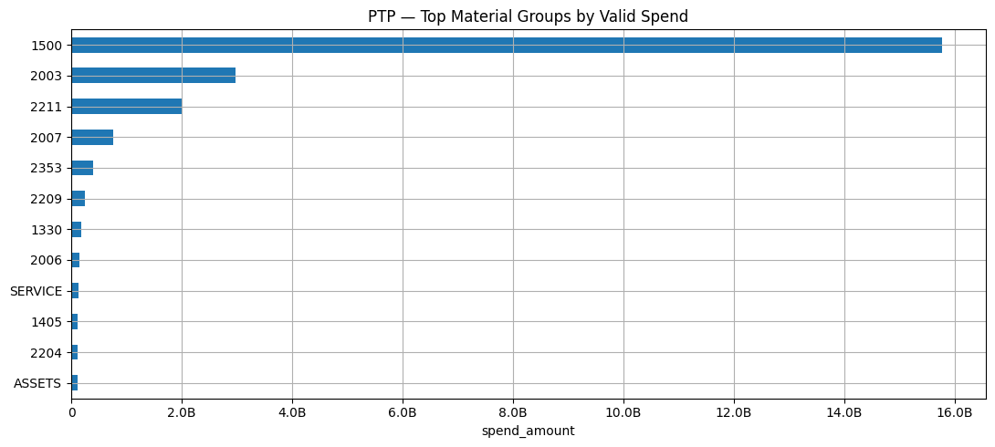
PTP EDA separated valid spend from audit-only rows
JUPYTER EDA
Valid KPI population
61,924 positive-spend lines across 42,596 purchase documents, 2,756 materials and 116 plants generated £24.00B equivalent valid gross spend.
Audit treatment
13,425 zero or invalid-spend rows remain in the fact table for traceability but are excluded from spend totals, Pareto analysis and growth KPIs.
Global Finance Operations Analytics
07
Notes:
[Sources]
- Global_Finance_Operations_Analytics_V2.ipynb

Slide 8
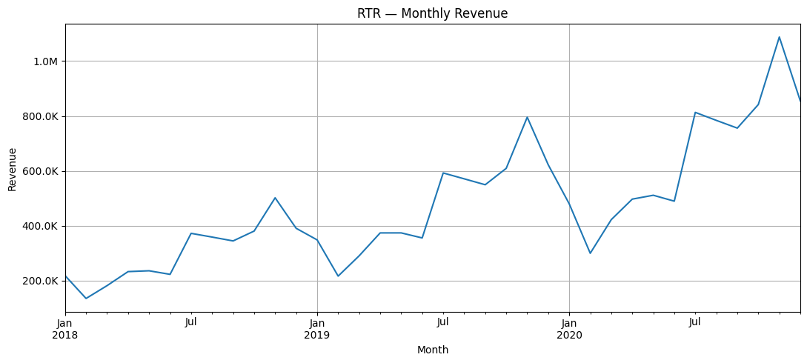
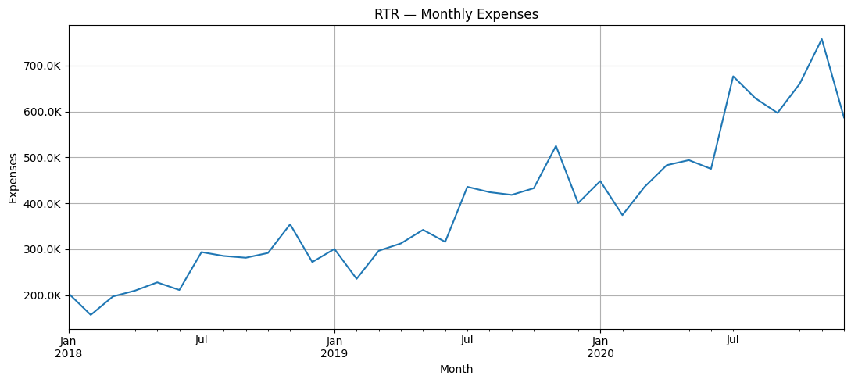
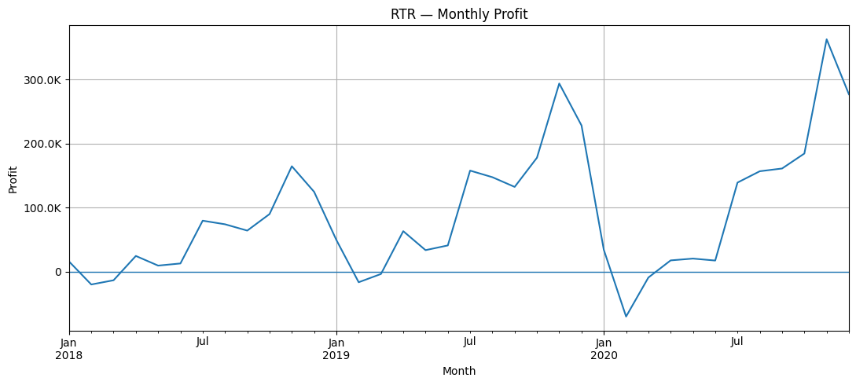
RTR EDA linked revenue, expenses and profit
JUPYTER EDA
Ledger scope
27,909 journal lines, 3,992 unique entries, 38 mapped accounts, seven countries and 9,660 P&L rows support the analysis.
Monthly P&L
Revenue and expenses are aggregated using the source sign convention; profit equals the monthly net P&L movement and margin equals profit divided by revenue.
Global Finance Operations Analytics
08
Notes:
[Sources]
- Global_Finance_Operations_Analytics_V2.ipynb

Slide 9
Quality rules preserved auditability and reconciled totals
JUPYTER VALIDATION
OTC checks
No duplicate documents, invalid date sequences, payment-delay mismatches, missing amounts or missing customer numbers were flagged.
PTP decision
13,425 zero/invalid-spend rows and 1,598 missing materials were identified. Missing material keys were later mapped to an explicit UNKNOWN member in SQL.
RTR screening
Account-relative 99th-percentile logic flagged 385 large journals for investigation without treating them as automatic errors.
Reconciliation
OTC £816.26M, PTP £24.00B valid spend and RTR £24.64M net movement all reconcile with a zero difference between source and processed facts.
Global Finance Operations Analytics
09
Notes:
[Sources]
- Global_Finance_Operations_Analytics_V2.ipynb

Slide 10
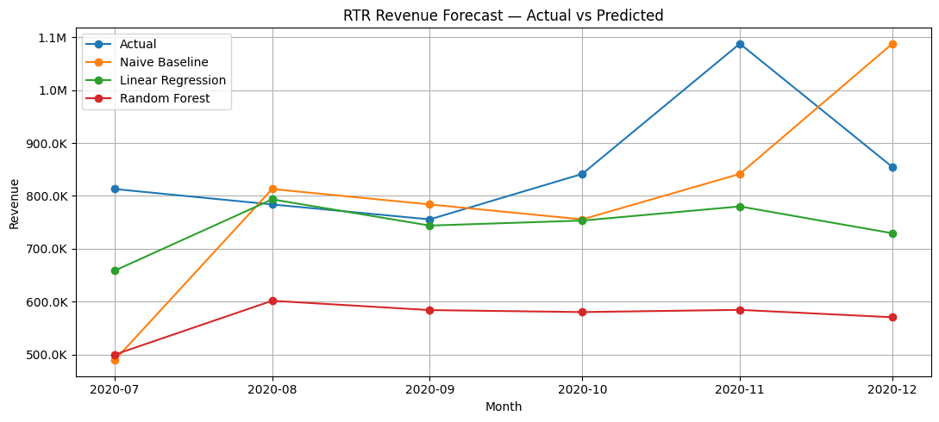
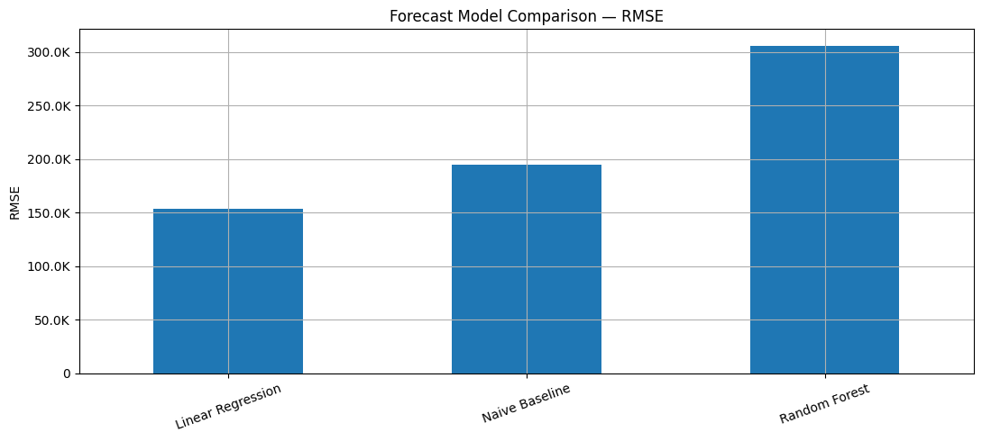
Chronological forecasting favored a simple linear model
JUPYTER MODELLING
Validation design
The most recent six months of 2020 were held out. Lagged revenue, rolling averages, trend and seasonal features were created from historical data only.
Result
Linear Regression achieved RMSE 153.8K, improving 21.17% on the naive baseline. Random Forest underperformed, illustrating the limits of a small 30-month modelling set.
Global Finance Operations Analytics
10
Notes:
[Sources]
- Global_Finance_Operations_Analytics_V2.ipynb

Slide 11
PostgreSQL separated modelling from reporting
POSTGRESQL
STAGING
CORE
MART
TABLEAU
Optional intermediate
cleaning and load area
5 dimensions
3 transaction facts
keys + indexes
3 monthly marts
7 analytical views
reusable KPIs
CSV extracts or
direct connection
visual analytics
The mart layer prevents Tableau from repeating complex finance calculations in every worksheet.
Global Finance Operations Analytics
11
Notes:
[Sources]
- Global_Finance_SQL_Report.docx

Slide 12
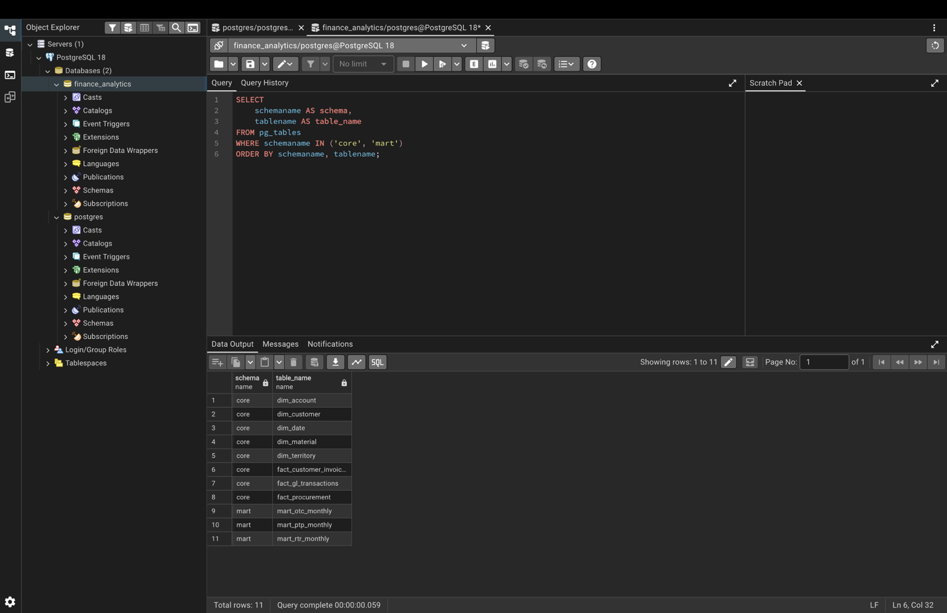
SQL evidence 1: core and mart objects were loaded
POSTGRESQL EVIDENCE 1
PURPOSE
Confirm that the database contains a structured model rather than a single flat import.
METHOD
Query pg_tables for the core and mart schemas, ordered by schema and table name.
RESULT
The inventory shows five dimensions, three facts and three monthly marts available for downstream checks.
Global Finance Operations Analytics
12
Notes:
[Sources]
- Global_Finance_SQL_Report.docx

Slide 13
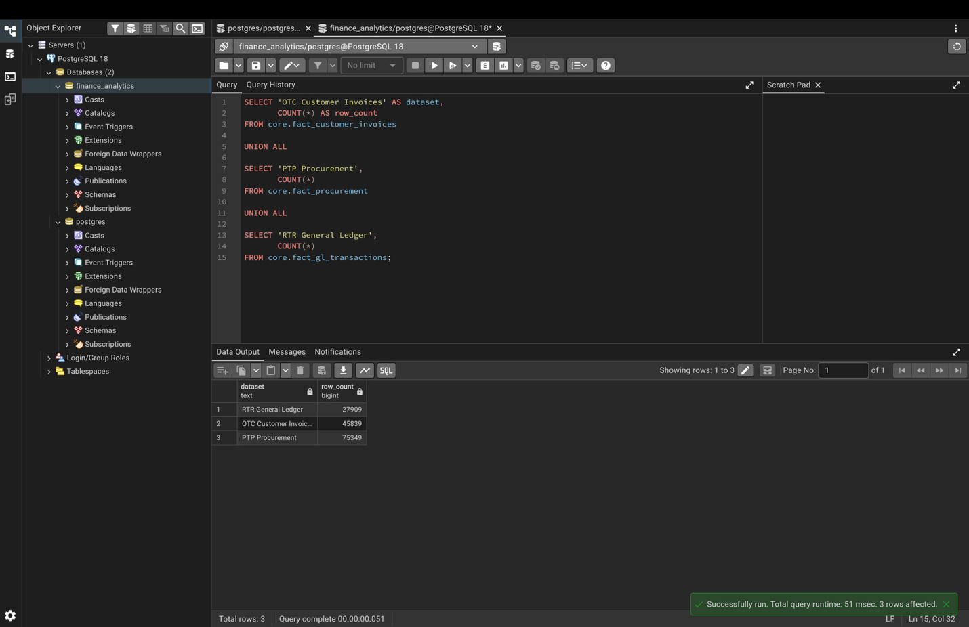
SQL evidence 2: fact-row counts reconciled
POSTGRESQL EVIDENCE 2
PURPOSE
Prove that the processed transaction populations were loaded completely.
METHOD
COUNT(*) is applied to the OTC invoice, PTP procurement and RTR general-ledger facts using UNION ALL.
RESULT
The database contains 45,839 OTC, 75,349 PTP and 27,909 RTR rows, matching the notebook outputs.
Global Finance Operations Analytics
13
Notes:
[Sources]
- Global_Finance_SQL_Report.docx

Slide 14
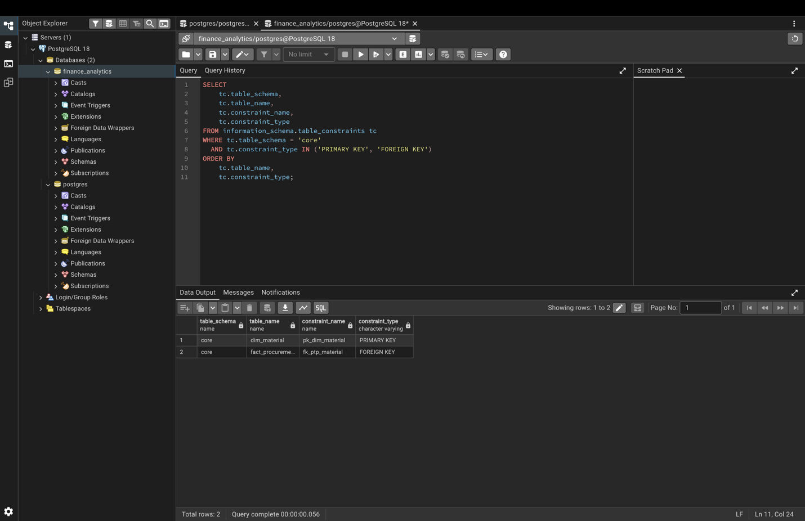
SQL evidence 3: keys enforced the relational model
POSTGRESQL EVIDENCE 3
PURPOSE
Protect dimension uniqueness and fact-to-dimension relationships.
METHOD
Primary keys were added to date, customer, material, account and territory dimensions; foreign keys connect the three facts.
RESULT
Constraint metadata verifies that PostgreSQL, not only notebook logic, enforces the model structure.
Global Finance Operations Analytics
14
Notes:
[Sources]
- Global_Finance_SQL_Report.docx

Slide 15
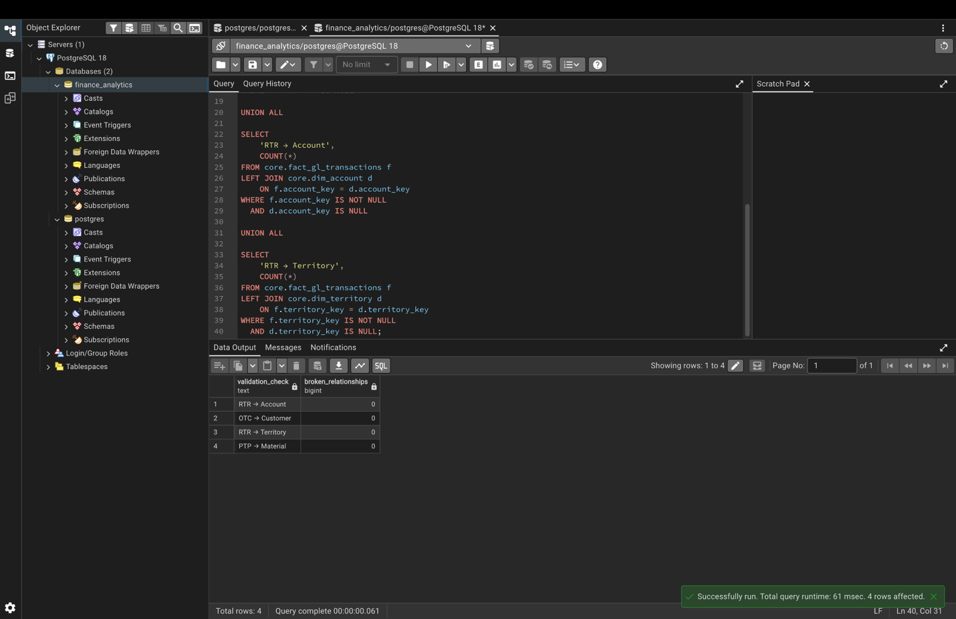
SQL evidence 4: relationship checks returned zero breaks
POSTGRESQL EVIDENCE 4
PURPOSE
Detect incomplete dimensions or incorrect join keys before reporting views are used.
METHOD
LEFT JOIN checks test OTC→customer, PTP→material, RTR→account and RTR→territory mappings.
RESULT
Zero unmatched rows across the four checks confirms clean referential integrity after the UNKNOWN-material repair.
Global Finance Operations Analytics
15
Notes:
[Sources]
- Global_Finance_SQL_Report.docx

Slide 16
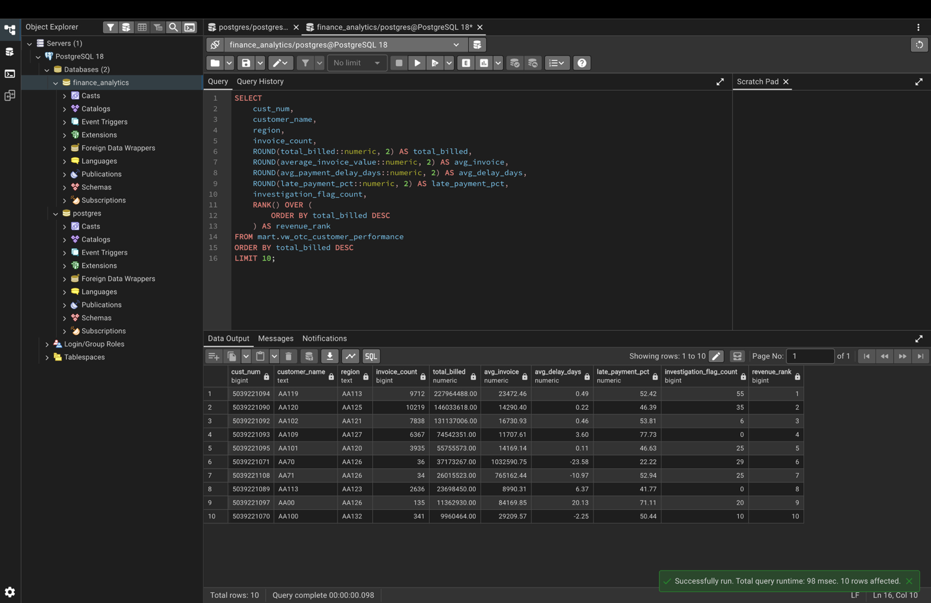
SQL evidence 5: OTC customers were ranked by value
POSTGRESQL EVIDENCE 5
PURPOSE
Turn invoice-level data into customer-level revenue and payment-performance evidence.
METHOD
The customer view aggregates invoices, billing, average delay, late-payment percentage and flags; RANK() OVER() orders total billed.
RESULT
The top-customer output provides the analytical source for the Tableau concentration and payment-risk worksheets.
Global Finance Operations Analytics
16
Notes:
[Sources]
- Global_Finance_SQL_Report.docx

Slide 17
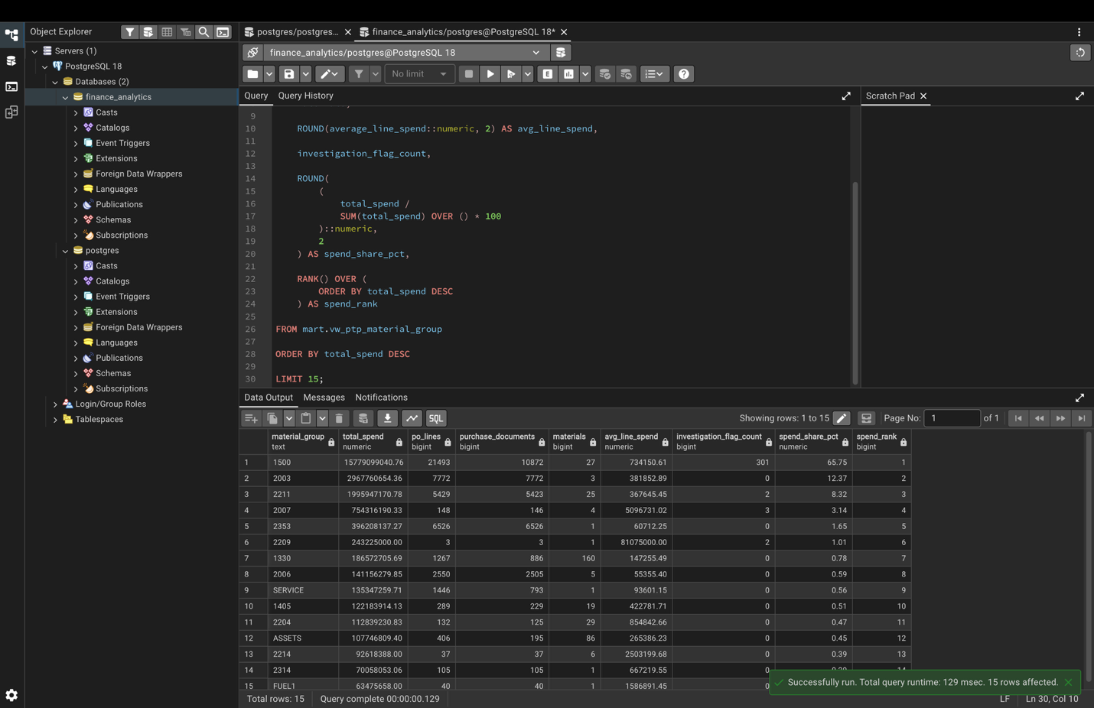
SQL evidence 6: spend share quantified PTP concentration
POSTGRESQL EVIDENCE 6
PURPOSE
Measure both absolute procurement spend and each material group’s share of the valid-spend portfolio.
METHOD
SUM(total_spend) OVER() calculates percentage of total; RANK() OVER() creates the spend ranking.
RESULT
The output identifies dominant material groups and carries PO-line, document, material and investigation counts into Tableau.
Global Finance Operations Analytics
17
Notes:
[Sources]
- Global_Finance_SQL_Report.docx

Slide 18
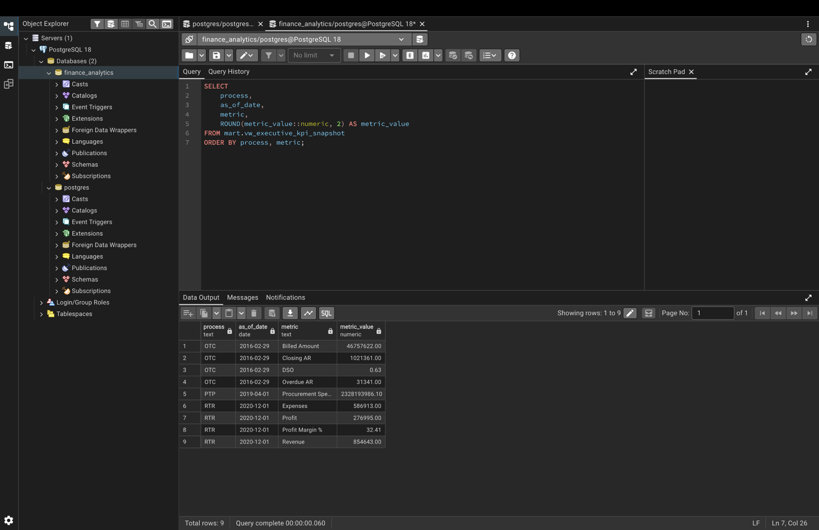
SQL evidence 7: an executive view unified nine KPIs
POSTGRESQL EVIDENCE 7
PURPOSE
Create a compact management layer across OTC, PTP and RTR without pretending the source periods overlap.
METHOD
The executive snapshot returns process, as-of date, metric and value for the latest meaningful reporting point in each process.
RESULT
Nine KPI rows feed the executive Tableau snapshot while retaining process-specific timing context.
Global Finance Operations Analytics
18
Notes:
[Sources]
- Global_Finance_SQL_Report.docx

Slide 19
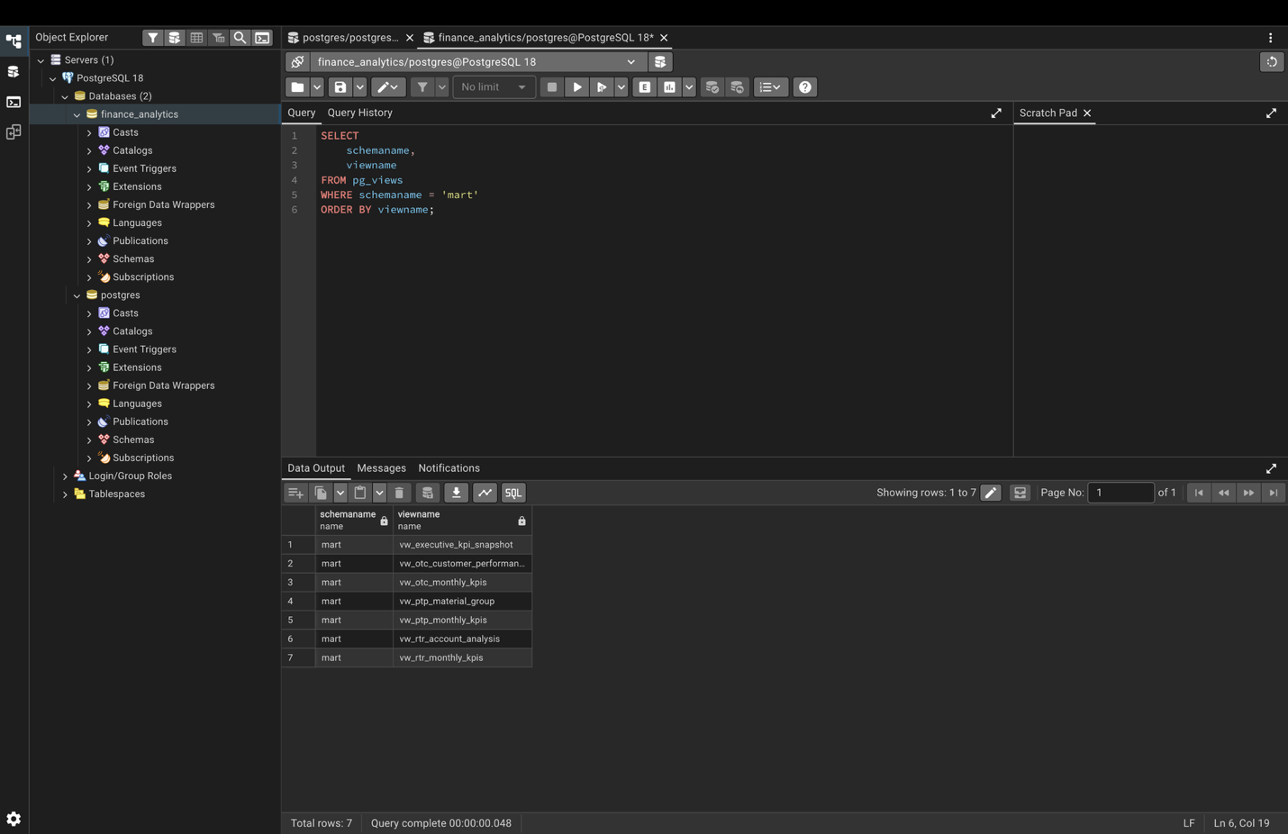
SQL evidence 8: seven views formed the Tableau layer
POSTGRESQL EVIDENCE 8
PURPOSE
Verify the complete reusable reporting interface in the mart schema.
METHOD
pg_views lists executive, OTC monthly/customer, PTP monthly/material-group and RTR monthly/account-analysis views.
RESULT
The final view inventory proves that every Tableau worksheet can use a governed analytical source.
Global Finance Operations Analytics
19
Notes:
[Sources]
- Global_Finance_SQL_Report.docx

Slide 20
Jupyter exported SQL views back to local CSV files
SQL-TO-DEVICE HANDOFF
WHAT THE CODE DOES
from pathlib import Path
import pandas as pd
TABLEAU_DIR = Path("tableau_data")
TABLEAU_DIR.mkdir(exist_ok=True)
views = [
"vw_executive_kpi_snapshot",
"vw_otc_monthly_kpis",
"vw_otc_customer_performance",
"vw_ptp_monthly_kpis",
"vw_ptp_material_group",
"vw_rtr_monthly_kpis",
"vw_rtr_account_analysis"
]
for view in views:
df = pd.read_sql(f"SELECT * FROM mart.{view};", engine)
df.to_csv(TABLEAU_DIR / f"{view}.csv", index=False)
Creates a local tableau_data folder, queries each governed mart view through the SQLAlchemy engine, and writes one CSV per view.
GENERATED FILES
Seven files were produced: 9 executive rows, 54 OTC months, 69 customers, 26 PTP months, 145 material groups, 36 RTR months and 38 accounts.
WHY IT MATTERS
The extracted files can be copied, opened or connected in Tableau without exposing database credentials on another device.
Global Finance Operations Analytics
20
Notes:
[Sources]
- Global_Finance_Operations_Analytics_V2.ipynb

Slide 21
Exported files preserved a clear grain for Tableau
EXPORTED-FILE EDA 1 OF 2
FILE
ROWS
ANALYTICAL GRAIN
vw_executive_kpi_snapshot.csv
9
One row per process KPI
vw_otc_monthly_kpis.csv
54
One row per OTC month
vw_otc_customer_performance.csv
69
One row per customer
vw_ptp_monthly_kpis.csv
26
One row per PTP month
vw_ptp_material_group.csv
145
One row per material group
vw_rtr_monthly_kpis.csv
36
One row per RTR month
vw_rtr_account_analysis.csv
38
One row per account/subaccount
The seven compact extracts contain 377 governed analytical rows in total.
Global Finance Operations Analytics
21
Notes:
[Sources]
- Global_Finance_Operations_Analytics_V2.ipynb

Slide 22
Basic EDA confirmed the downloaded files were analysis-ready
EXPORTED-FILE EDA 2 OF 2
files = sorted(TABLEAU_DIR.glob("*.csv"))
for file in files:
df = pd.read_csv(file)
print(file.name, df.shape)
print("missing:", df.isna().sum().sum())
print("duplicates:", df.duplicated().sum())
print(df.describe(include="all").T)
# Additional checks
# - parse monthly date columns
# - confirm distinct business keys
# - review min / max / totals
# - reconcile with SQL outputs
Shape and schema
Confirm the expected row/column count and required Tableau fields in every view.
Completeness
Inspect missing values, duplicate analytical rows and null business keys before visualisation.
Distribution
Review numeric summaries, date ranges, distinct categories and extreme values at the view’s natural grain.
Reconciliation
Compare KPI totals and record counts with PostgreSQL and notebook evidence; investigate any non-zero difference.
These checks prevent a visually correct dashboard from masking a broken extract.
Global Finance Operations Analytics
22
Notes:
[Sources]
- Global_Finance_Operations_Analytics_V2.ipynb

Slide 23
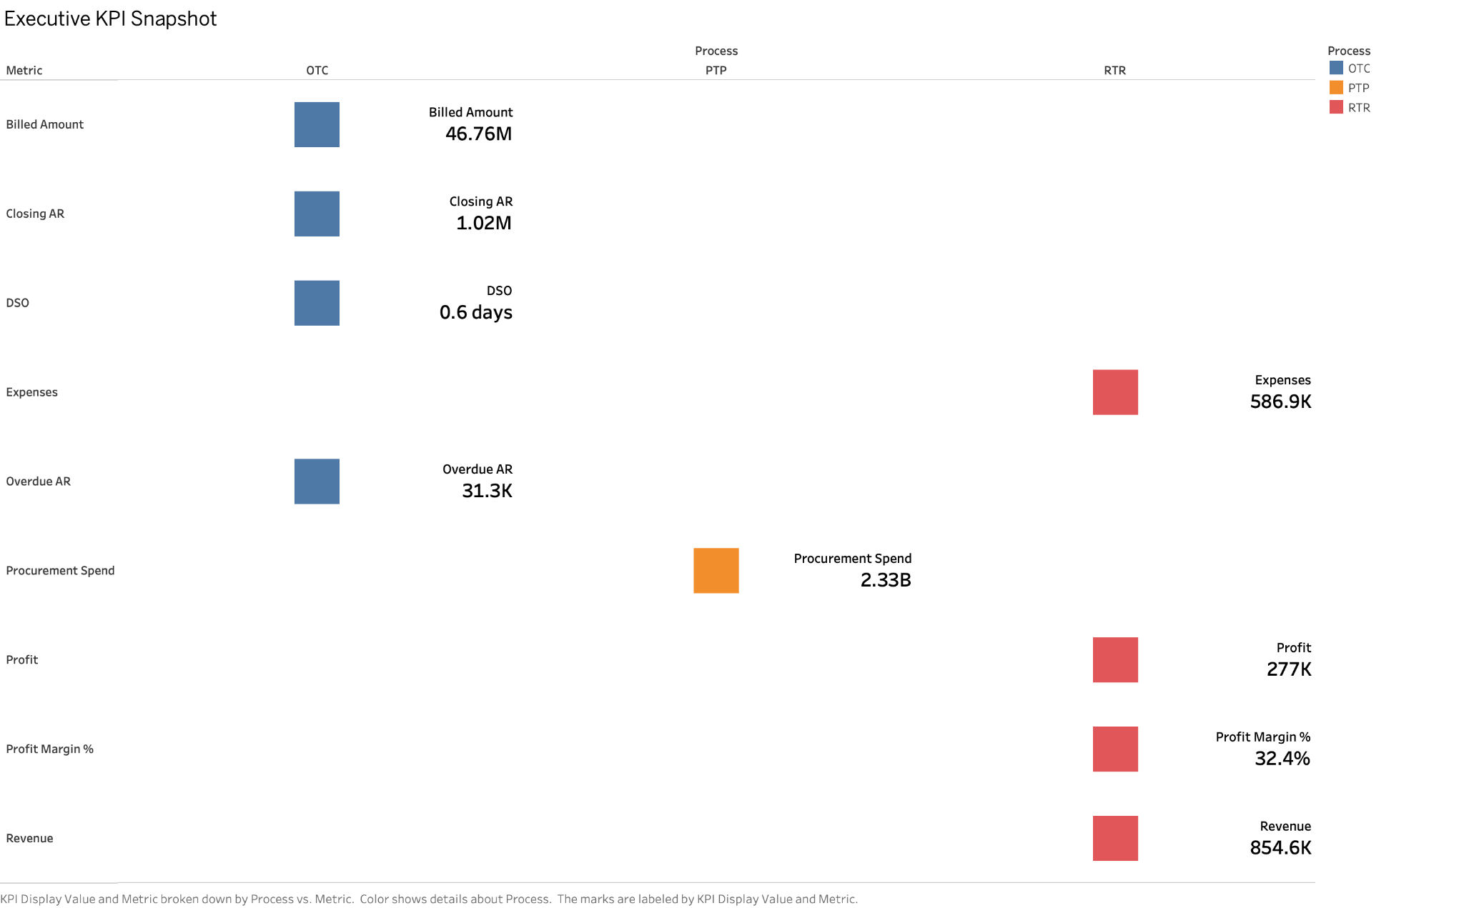
Executive KPI Snapshot
TABLEAU WORKSHEET 1
WHAT IT SHOWS
Latest meaningful KPIs across OTC, PTP and RTR: billing, AR, DSO, overdue AR, procurement spend, revenue, expenses, profit and margin.
HOW IT WORKS
Metric labels are positioned by process and coloured consistently: OTC blue, PTP orange and RTR red. Each mark displays the KPI name and formatted value.
INTERPRETATION
The snapshot gives immediate scale: OTC billed 46.76M, PTP spend 2.33B and RTR profit 277K at a 32.4% margin. Values use process-specific as-of dates.
Global Finance Operations Analytics
23
Notes:
[Sources]
- 01 Executive KPI Cards(3).png

Slide 24
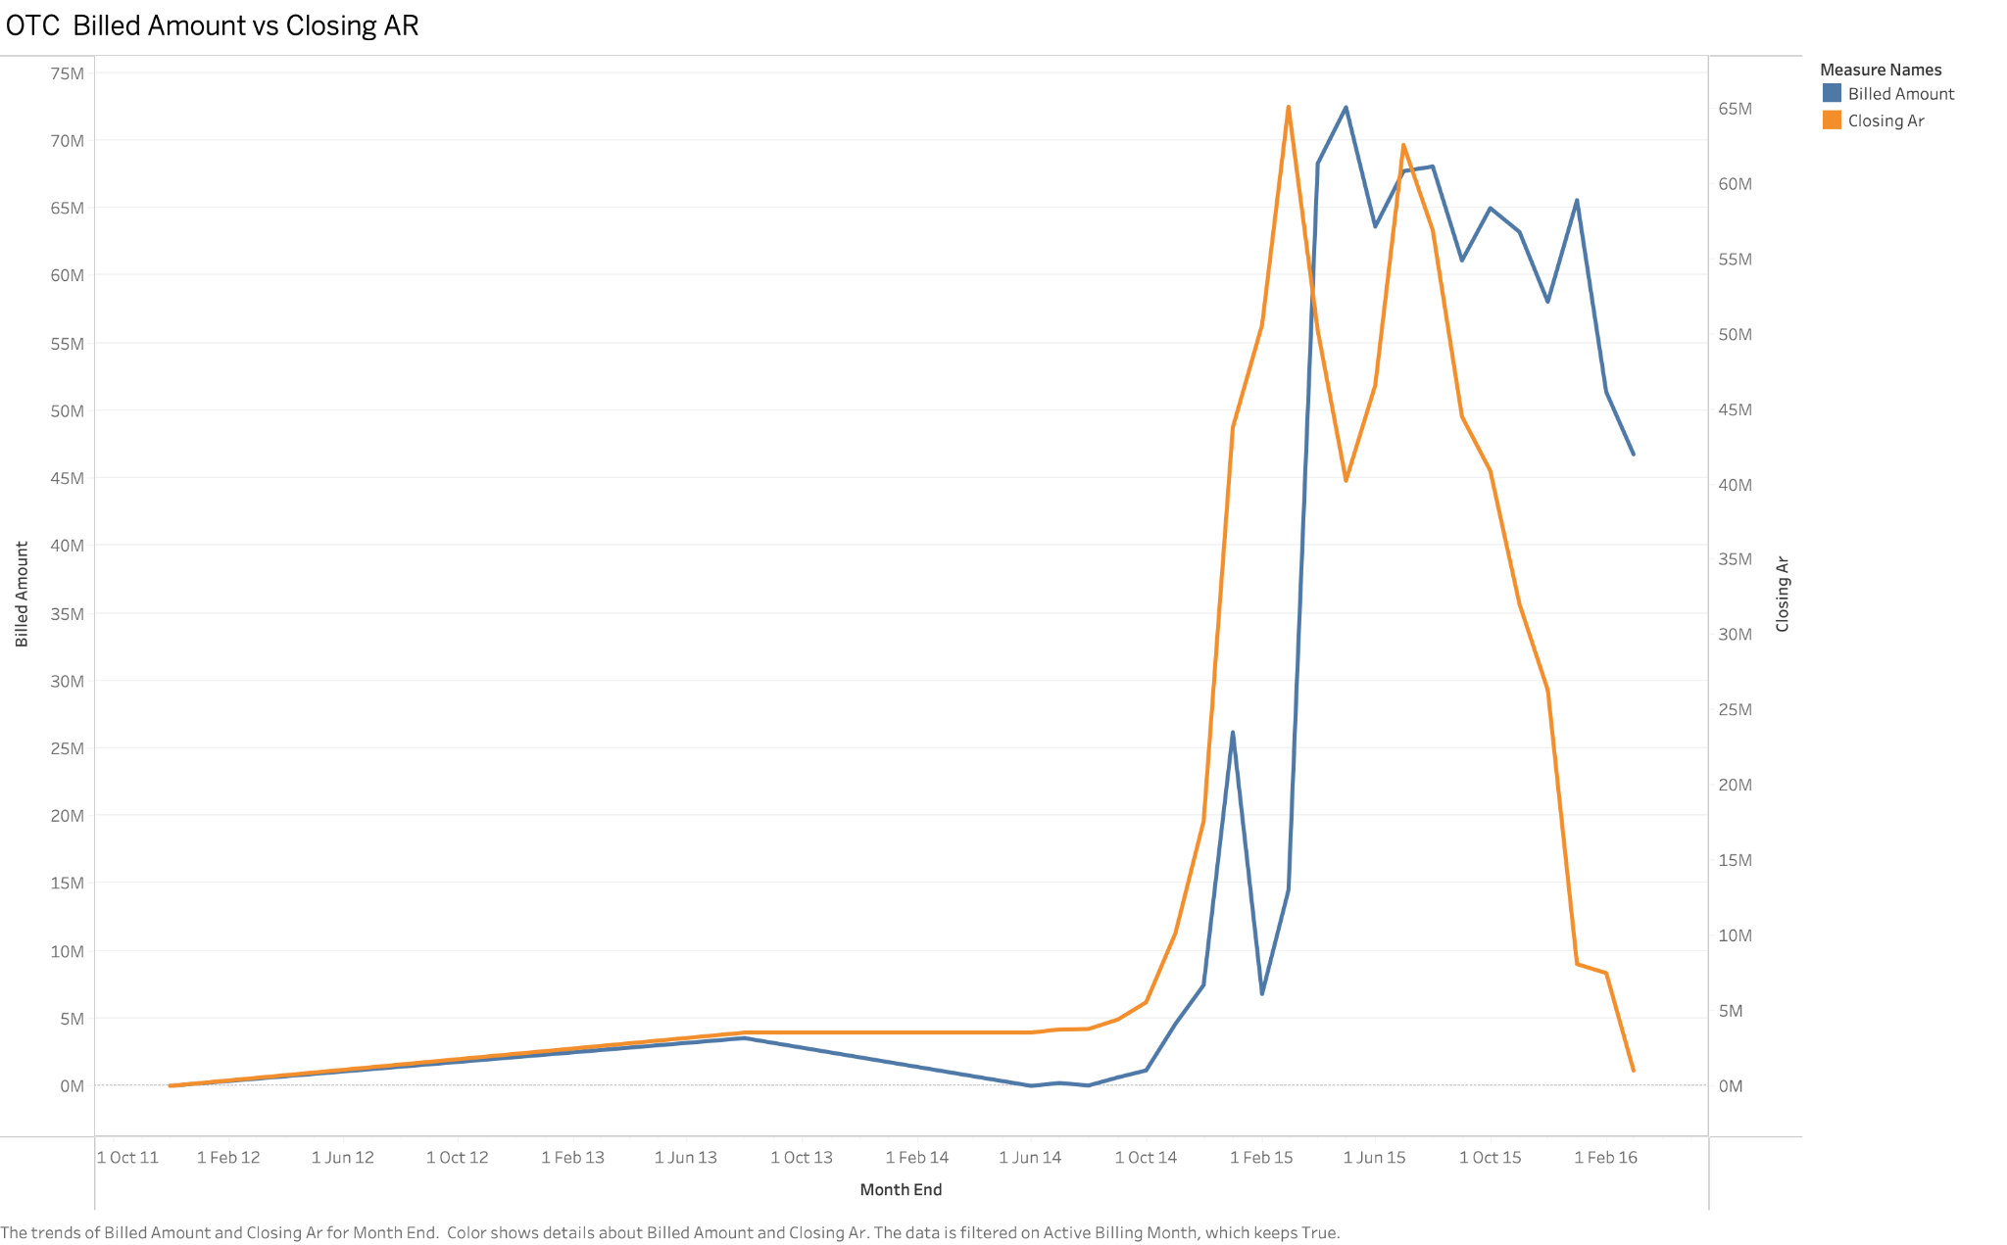
OTC Billed Amount vs Closing AR
TABLEAU WORKSHEET 2
WHAT IT SHOWS
Monthly billed amount and the corresponding closing accounts-receivable balance on a dual-axis time series.
HOW IT WORKS
Billing is displayed as bars while closing AR is overlaid as a line, allowing operating volume and working-capital exposure to be compared over time.
INTERPRETATION
The chart separates sales activity from unpaid balance. Divergence between billing and AR can signal slower collection, timing effects or a changing customer mix.
Global Finance Operations Analytics
24
Notes:
[Sources]
- 02 OTC Billing & AR Trend(1).png

Slide 25
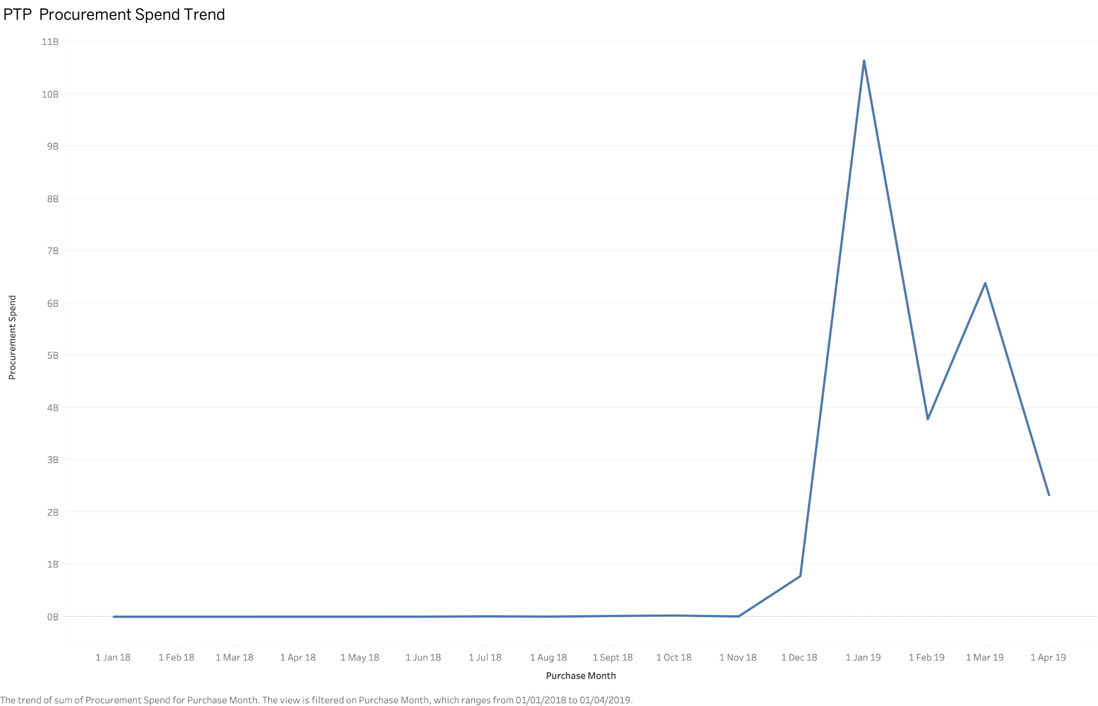
PTP Procurement Spend Trend
TABLEAU WORKSHEET 3
WHAT IT SHOWS
Procurement spend by purchase month for the focused executive trend period.
HOW IT WORKS
Valid positive spend is summed at month grain and plotted as a line, preserving the large month-to-month changes in the source.
INTERPRETATION
Spend rises sharply to about 10.6B in Jan 2019, then falls to 3.8B, rebounds to 6.4B and ends near 2.3B. The volatility requires concentration analysis.
Global Finance Operations Analytics
25
Notes:
[Sources]
- 03 PTP Procurement Spend Trend(1).png

Slide 26
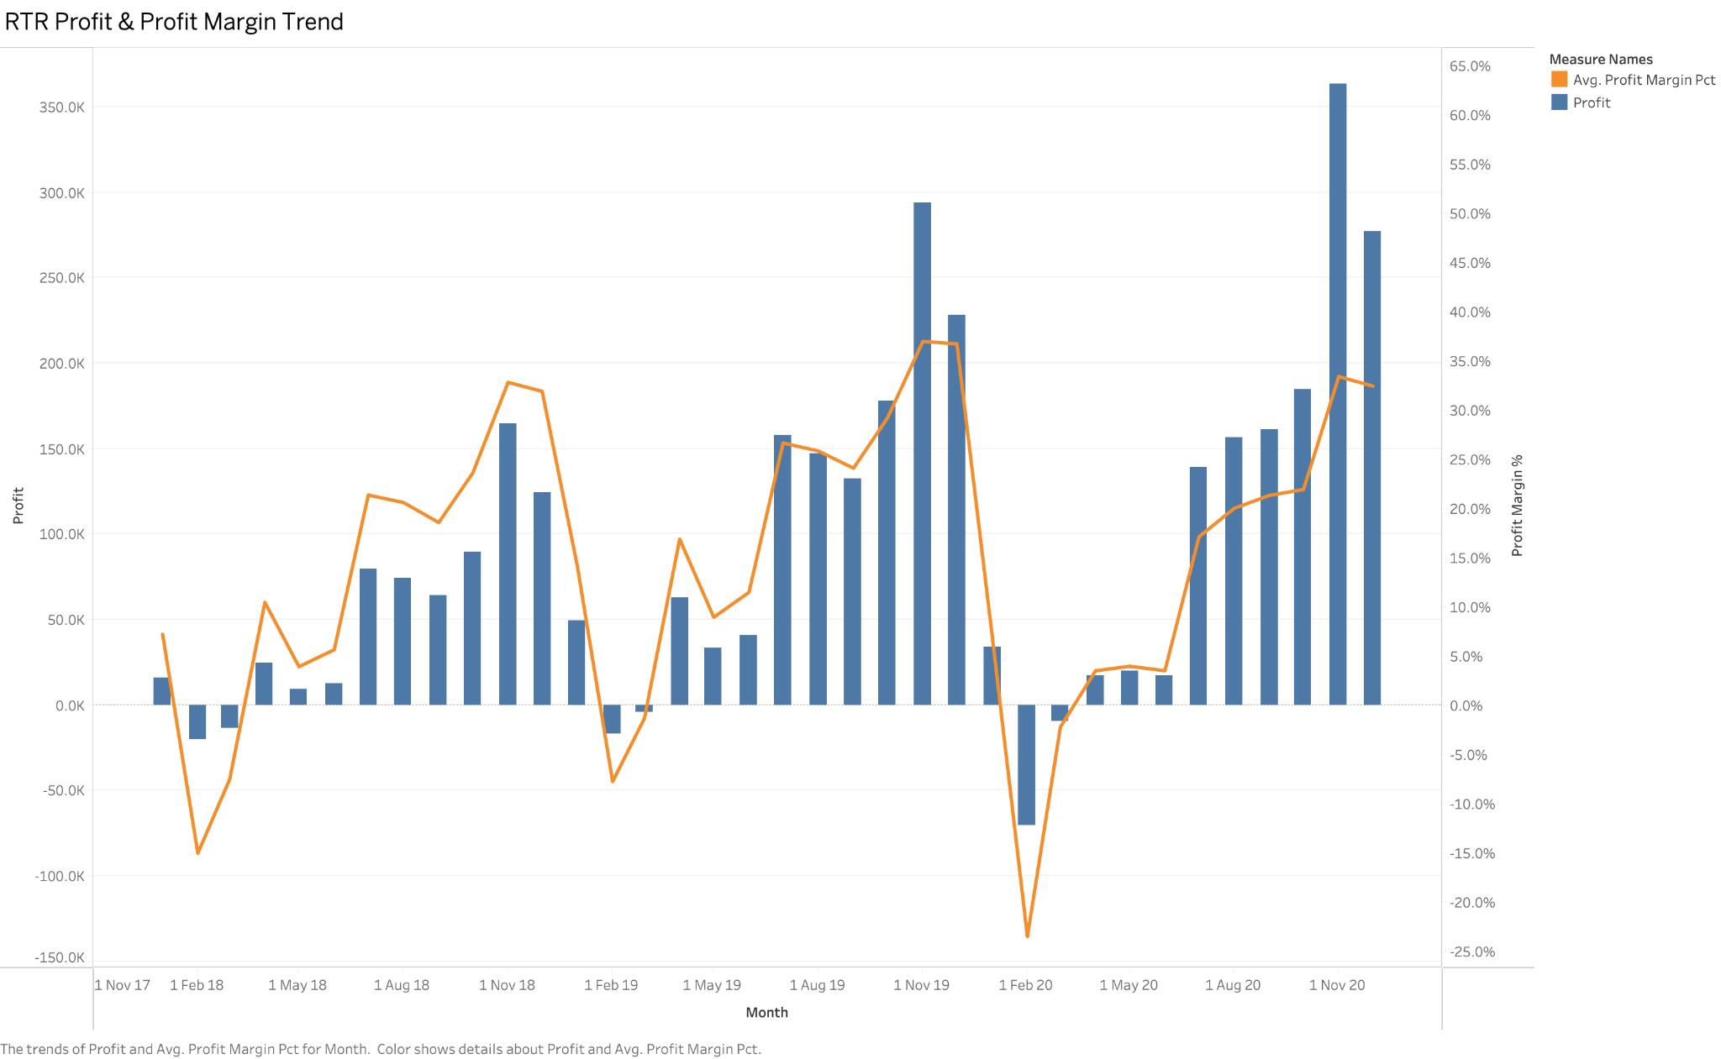
RTR Profit & Profit Margin Trend
TABLEAU WORKSHEET 4
WHAT IT SHOWS
Monthly profit bars with the average profit-margin percentage overlaid as a line.
HOW IT WORKS
A zero reference line separates profit from loss. The secondary percentage axis keeps the margin trend comparable with absolute profit.
INTERPRETATION
Loss months appear intermittently, but profitability strengthens through late 2020. The highest profit is roughly 365K with margin above 30%.
Global Finance Operations Analytics
26
Notes:
[Sources]
- 04 RTR Profit & Margin Trend(1).png

Slide 27
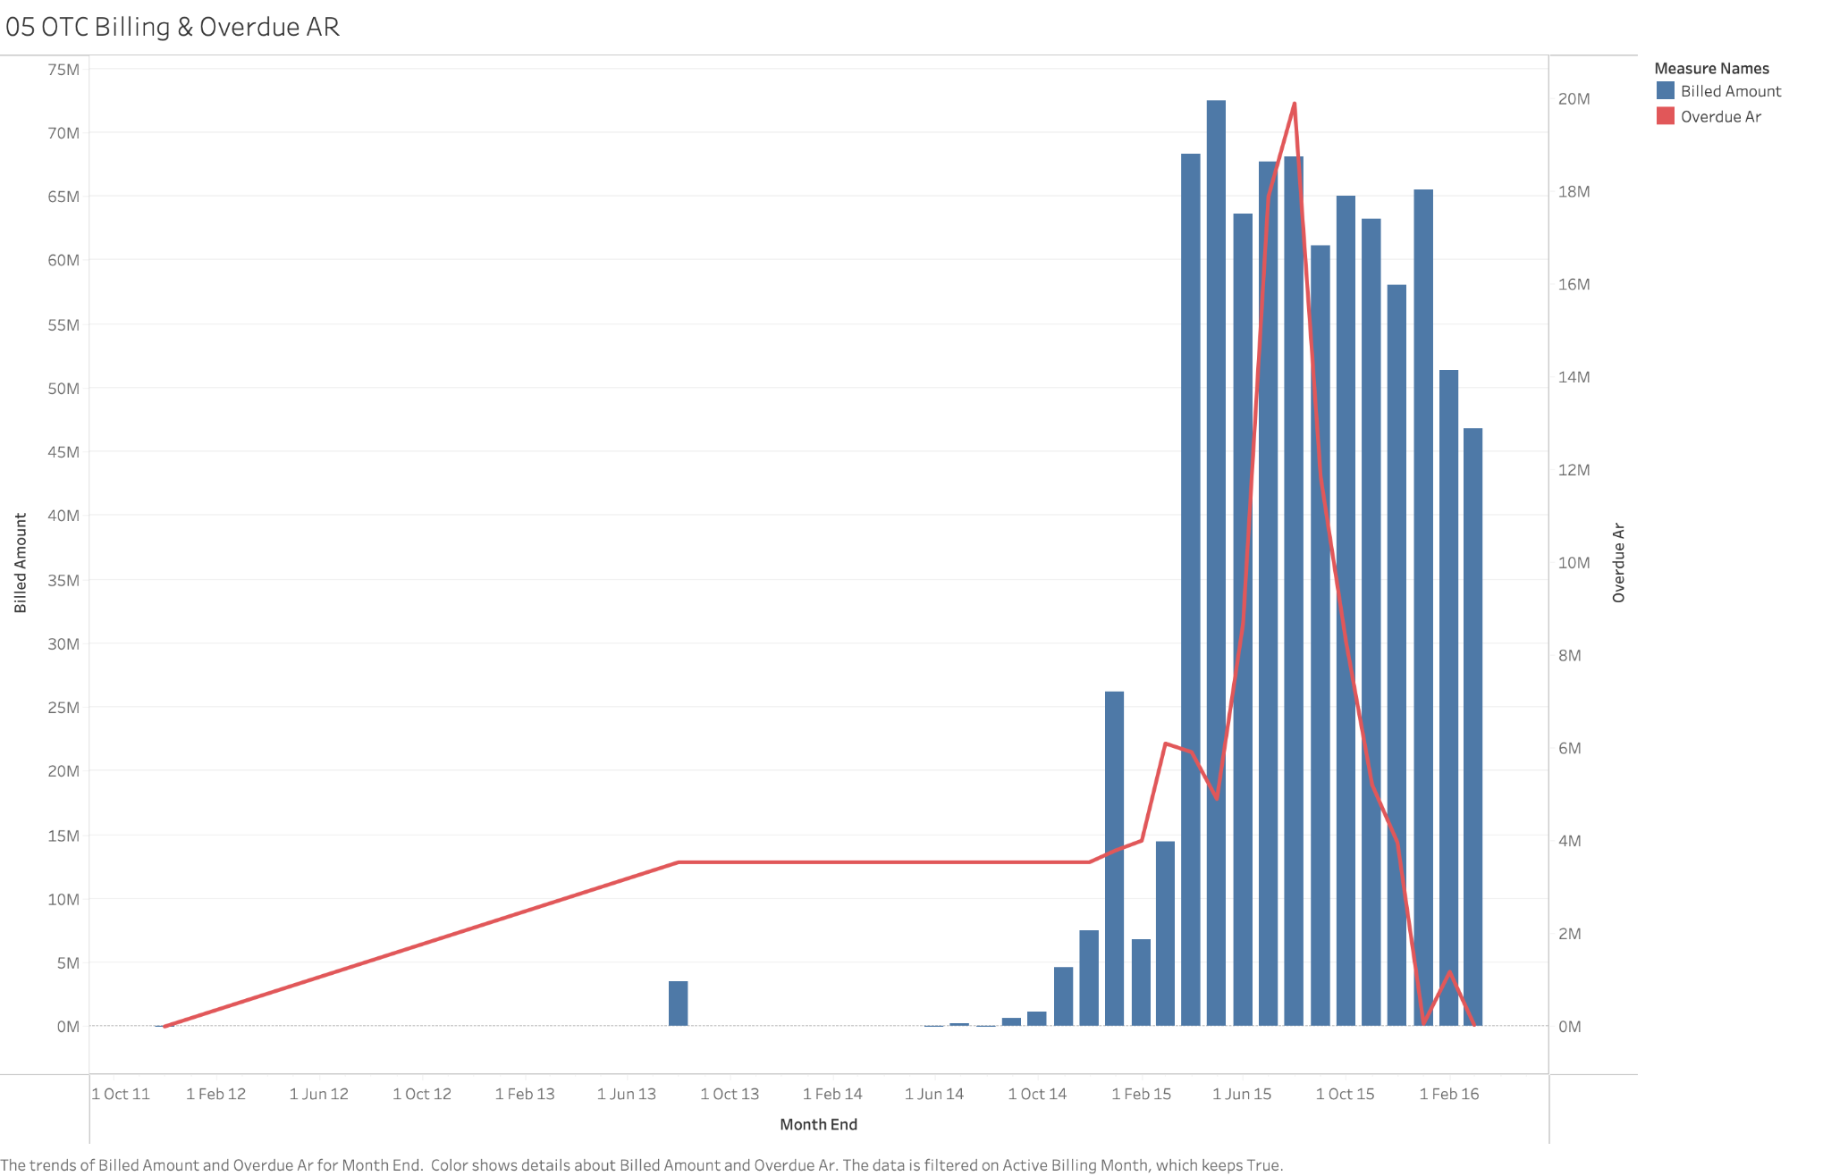
OTC Billing & Overdue AR
TABLEAU WORKSHEET 5
WHAT IT SHOWS
Monthly billed amount as bars and overdue receivables as a red line.
HOW IT WORKS
The dual axes preserve the different scales. Active billing periods are retained so collection exposure is read in the context of invoice volume.
INTERPRETATION
Overdue AR peaks near 20M in mid-2015 while billing remains around 60–70M, then overdue exposure falls rapidly toward zero by early 2016.
Global Finance Operations Analytics
27
Notes:
[Sources]
- 05 OTC Billing & Overdue AR(1).png

Slide 28
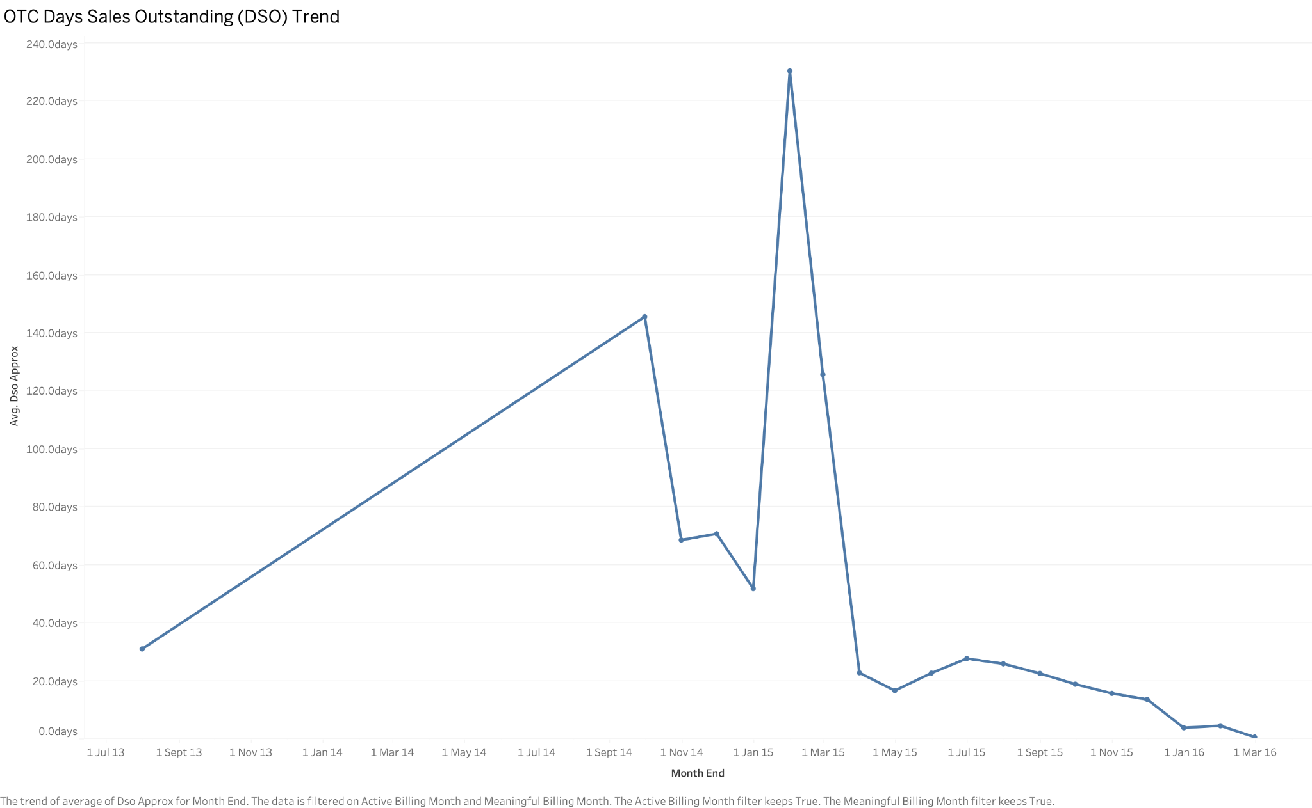
OTC Days Sales Outstanding (DSO) Trend
TABLEAU WORKSHEET 6
WHAT IT SHOWS
Approximate monthly DSO, a working-capital indicator of collection speed.
HOW IT WORKS
Average DSO is calculated at month end and plotted with markers so extreme periods and subsequent recovery are visible.
INTERPRETATION
DSO spikes to roughly 230 days in early 2015 before dropping below 30 days and approaching zero by Mar 2016, indicating a major collection improvement.
Global Finance Operations Analytics
28
Notes:
[Sources]
- 06 OTC DSO Trend(1).png

Slide 29
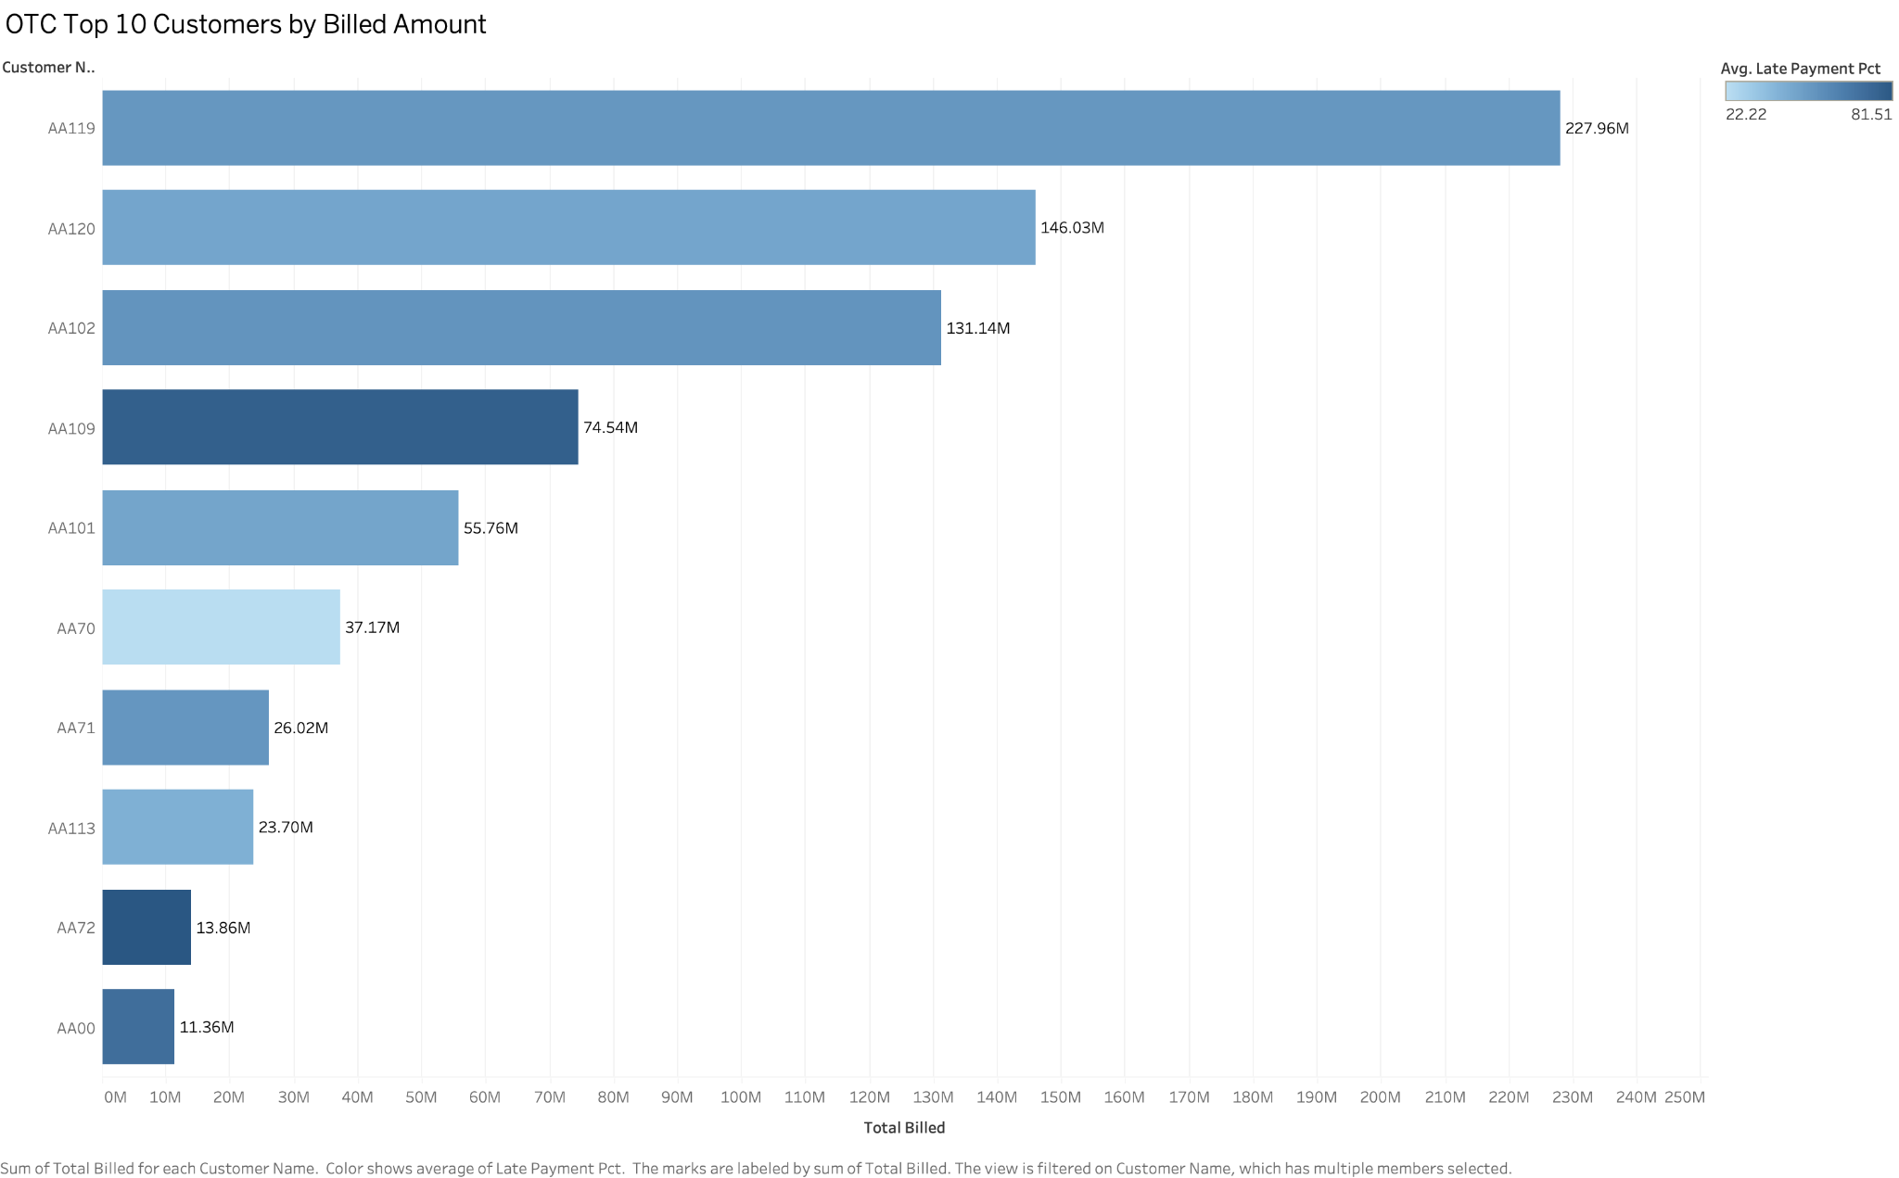
OTC Top 10 Customers by Billed Amount
TABLEAU WORKSHEET 7
WHAT IT SHOWS
The ten highest-billed customers, with bar colour representing average late-payment percentage.
HOW IT WORKS
Customers are ranked by total billed and labelled in millions. The colour scale adds payment behaviour without changing the revenue ordering.
INTERPRETATION
AA119 leads at 227.96M, followed by AA120 at 146.03M and AA102 at 131.14M. The top three account for about 62% of total invoice value.
Global Finance Operations Analytics
29
Notes:
[Sources]
- 07 Top 10 Customers(1).png

Slide 30
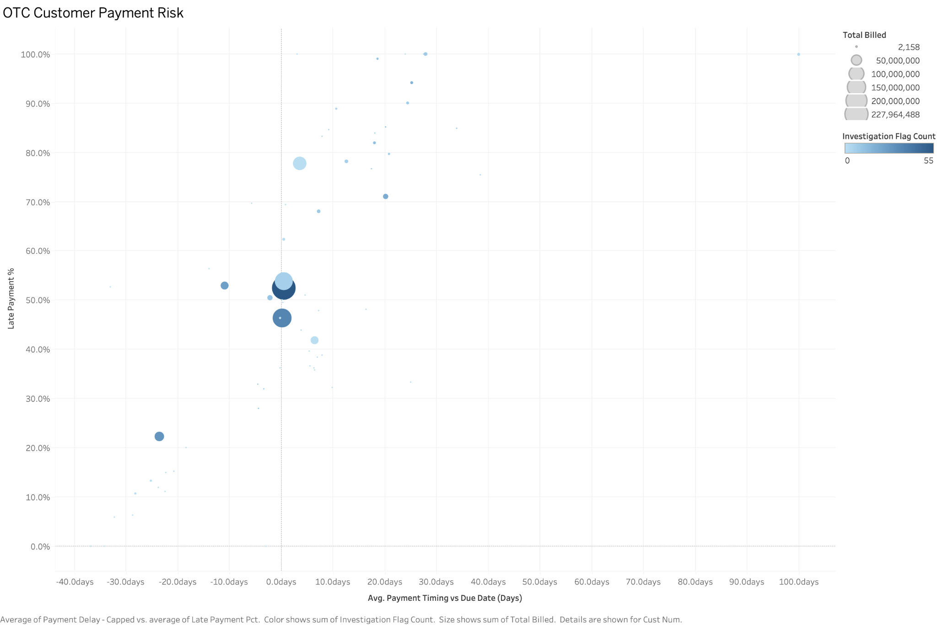
OTC Customer Payment Risk
TABLEAU WORKSHEET 8
WHAT IT SHOWS
Customer payment timing versus late-payment rate. Bubble size indicates billed value and colour indicates investigation flags.
HOW IT WORKS
Reference lines divide early/on-time versus late payment and lower versus higher late-rate behaviour, creating an action-oriented risk map.
INTERPRETATION
Priority customers sit in the upper-right or appear as large, dark bubbles near the centre: they combine value, lateness and investigation evidence.
Global Finance Operations Analytics
30
Notes:
[Sources]
- 08 Customer Payment Risk(1).png

Slide 31
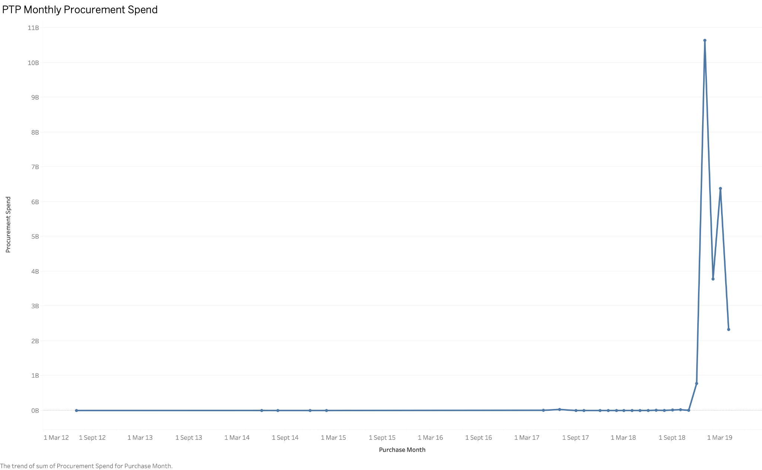
PTP Monthly Procurement Spend
TABLEAU WORKSHEET 9
WHAT IT SHOWS
Full monthly valid procurement spend across the available PTP history.
HOW IT WORKS
Valid positive spend is summed at purchase-month grain. Markers preserve sparse periods and make the 2019 surge explicit.
INTERPRETATION
Most earlier months are small relative to 2019; Jan 2019 reaches about 10.6B, Mar 2019 about 6.4B and Apr 2019 about 2.3B.
Global Finance Operations Analytics
31
Notes:
[Sources]
- 09 PTP Procurement Spend Trend(1).png

Slide 32
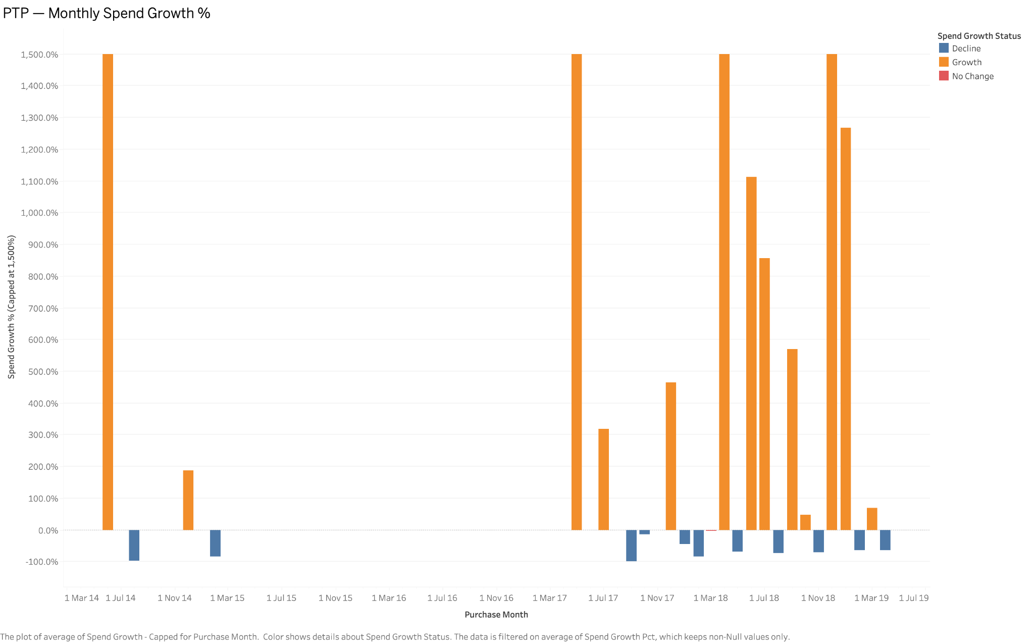
PTP Monthly Spend Growth %
TABLEAU WORKSHEET 10
WHAT IT SHOWS
Month-over-month spend change classified as growth, decline or no change.
HOW IT WORKS
Growth is capped at 1,500% to prevent extreme low-base effects from destroying readability; positive and negative months use different colours.
INTERPRETATION
Large orange spikes show high volatility, while repeated blue declines follow peaks. Growth should be interpreted together with absolute spend, not alone.
Global Finance Operations Analytics
32
Notes:
[Sources]
- 10 PTP Spend Growth(1).png

Slide 33
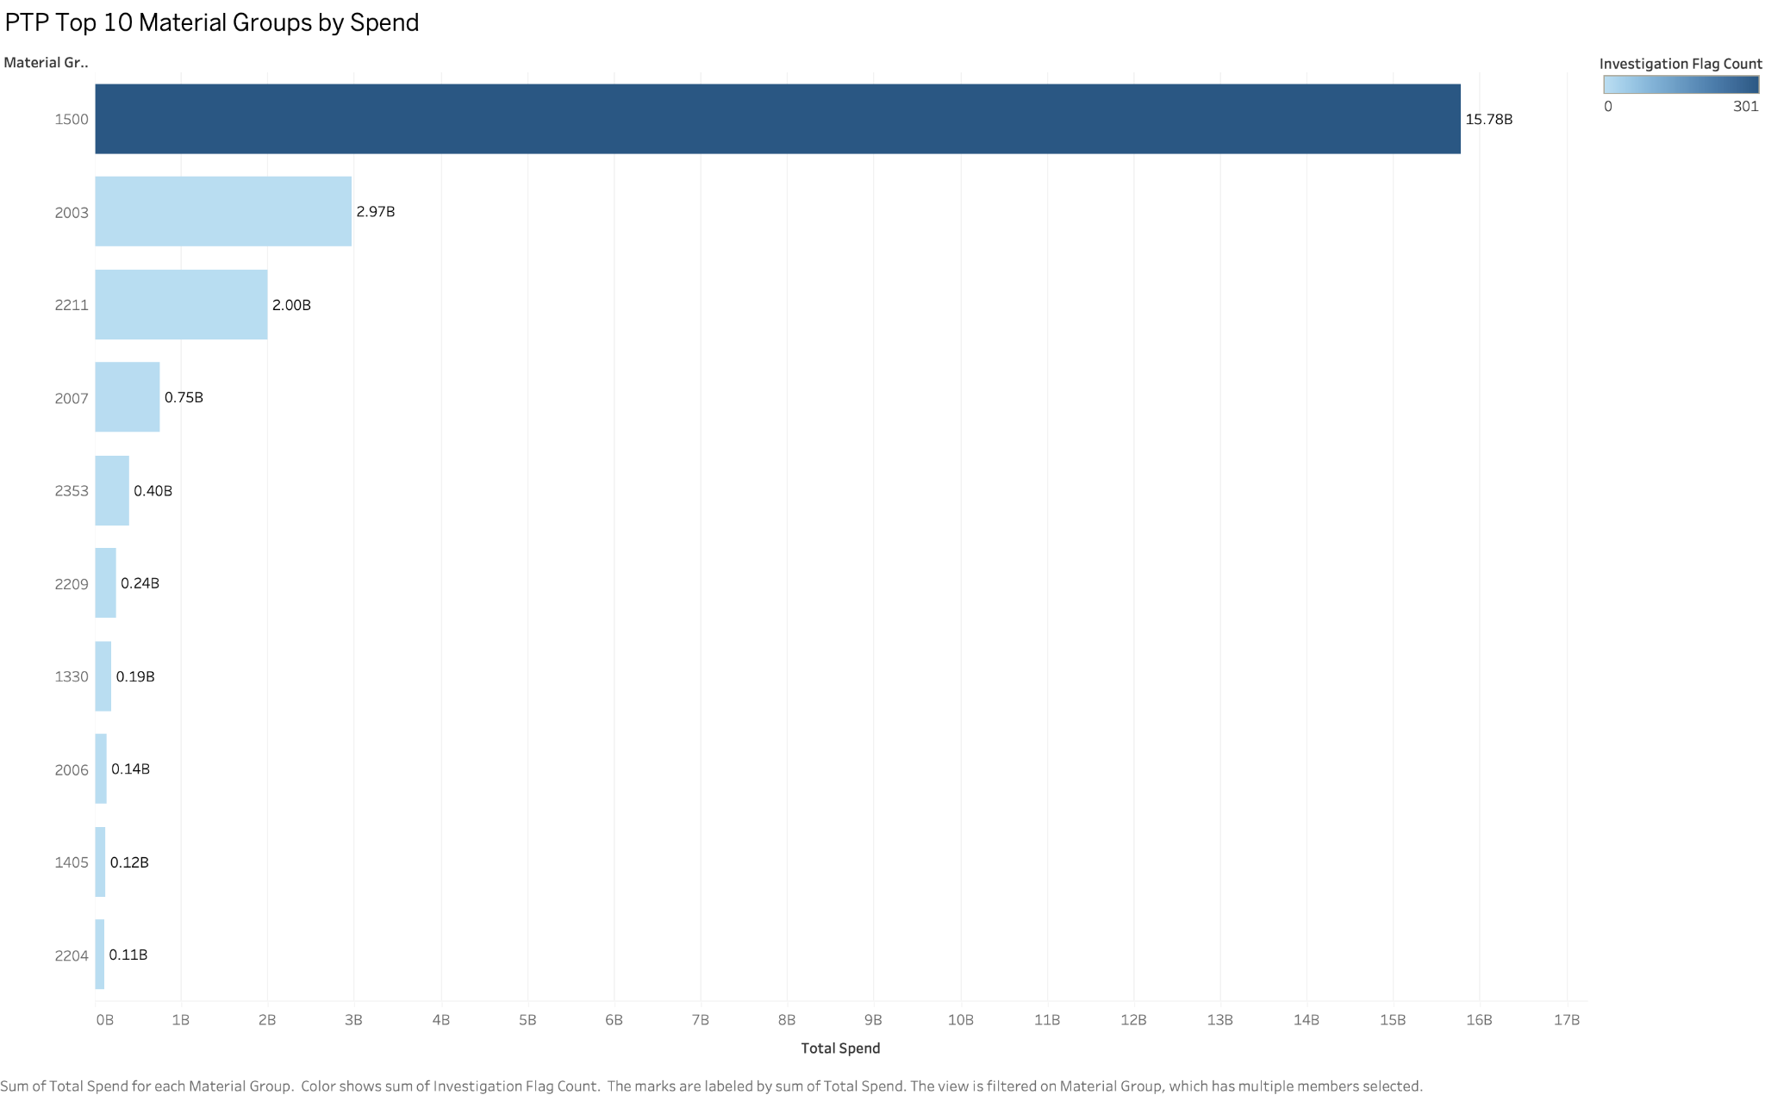
PTP Top 10 Material Groups by Spend
TABLEAU WORKSHEET 11
WHAT IT SHOWS
The ten largest material groups by valid total spend, coloured by investigation-flag count.
HOW IT WORKS
Material groups are aggregated, ranked and labelled in billions; the colour scale adds an anomaly dimension to the concentration view.
INTERPRETATION
Group 1500 dominates at 15.78B, followed by 2003 at 2.97B and 2211 at 2.00B. The top three represent about 86% of valid procurement spend.
Global Finance Operations Analytics
33
Notes:
[Sources]
- 11 Top 10 Material Groups(1).png

Slide 34
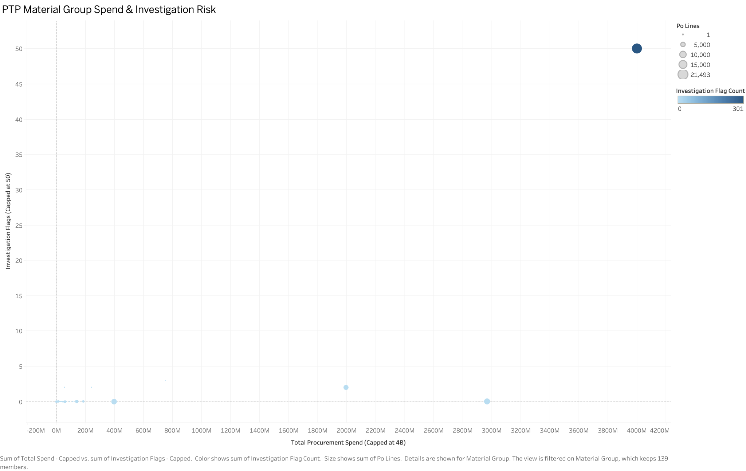
PTP Material Group Spend & Investigation Risk
TABLEAU WORKSHEET 12
WHAT IT SHOWS
Total spend versus investigation flags by material group. Bubble size represents PO lines and colour reinforces flag intensity.
HOW IT WORKS
Spend and flags are capped for readable comparison while the original values remain available in the underlying data and tooltips.
INTERPRETATION
The top-right bubble combines very high spend, high transaction volume and 50 capped flags, making it the clearest procurement-review priority.
Global Finance Operations Analytics
34
Notes:
[Sources]
- 12 PTP Material Group Risk(1).png

Slide 35
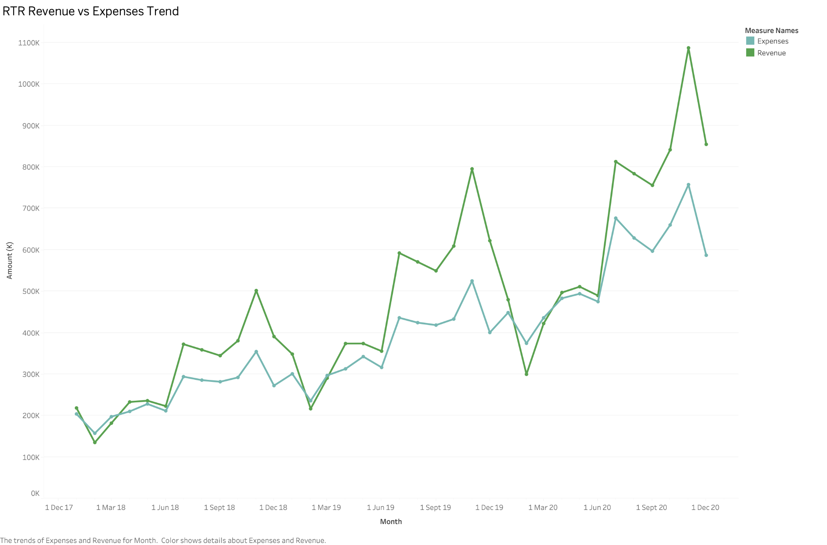
RTR Revenue vs Expenses Trend
TABLEAU WORKSHEET 13
WHAT IT SHOWS
Monthly revenue and expenses from Jan 2018 to Dec 2020.
HOW IT WORKS
Both measures use a common axis and monthly markers so their gap can be read directly as the main driver of profit movement.
INTERPRETATION
Revenue generally stays above expenses and grows over time. After an early-2020 dip, revenue peaks near 1.09M in Nov 2020 versus expenses near 0.76M.
Global Finance Operations Analytics
35
Notes:
[Sources]
- 13 RTR Revenue vs Expenses(1).png

Slide 36
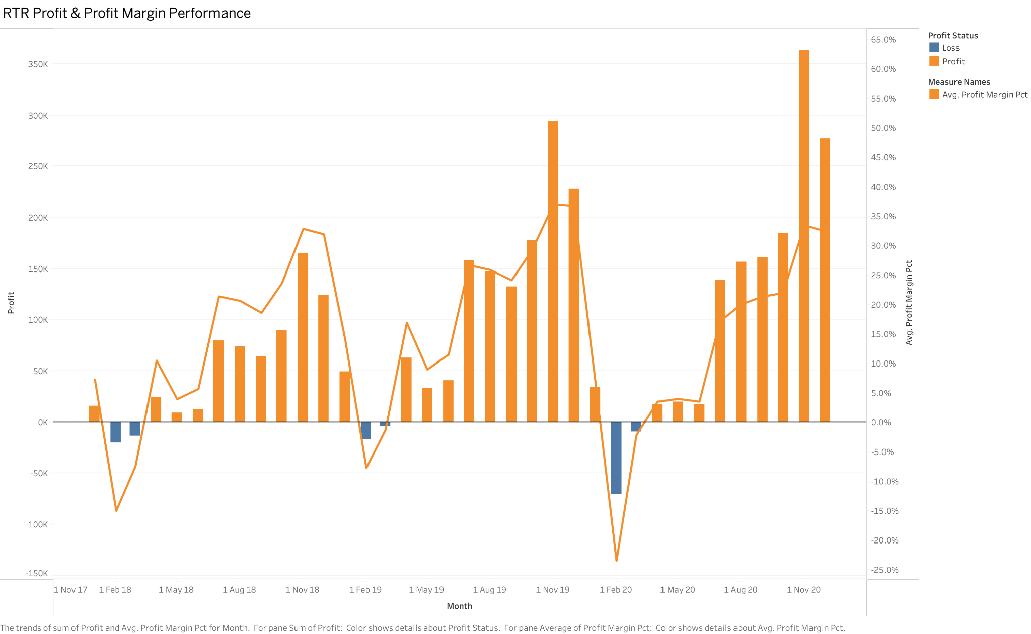
RTR Profit & Profit Margin Performance
TABLEAU WORKSHEET 14
WHAT IT SHOWS
Monthly profit/loss bars plus the corresponding margin percentage.
HOW IT WORKS
Profit months are orange, losses are blue, and the zero reference line makes sign changes explicit. Margin uses the secondary axis.
INTERPRETATION
A deep loss appears in Feb 2020, followed by recovery and accelerating profitability. The strongest month reaches about 365K profit.
Global Finance Operations Analytics
36
Notes:
[Sources]
- 14 RTR Profit & Margin(1).png

Slide 37
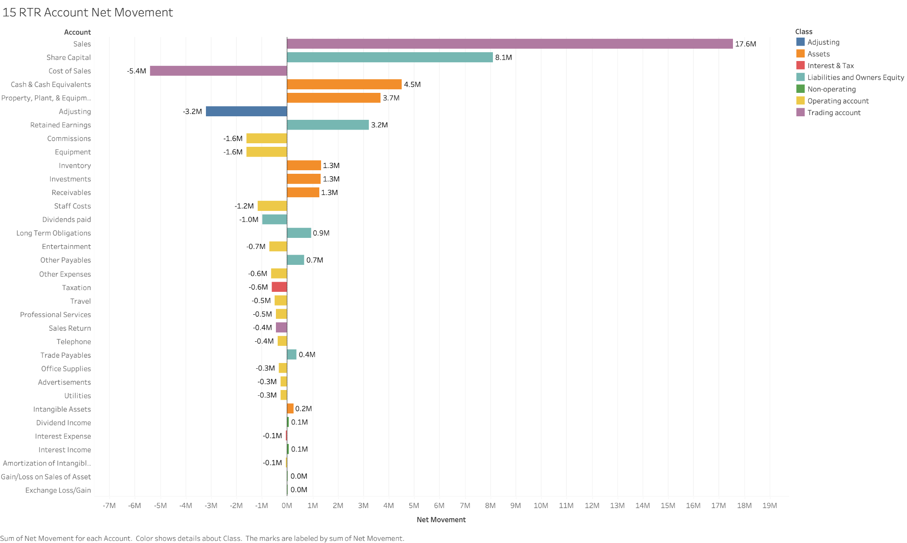
RTR Account Net Movement
TABLEAU WORKSHEET 15
WHAT IT SHOWS
Diverging account movements, coloured by financial-statement class.
HOW IT WORKS
Accounts are ordered by net movement and plotted around a zero reference line, separating debit/credit direction while preserving class context.
INTERPRETATION
Sales is the largest positive movement at 17.6M; Share Capital adds 8.1M. Cost of Sales is the largest negative movement at −5.4M.
Global Finance Operations Analytics
37
Notes:
[Sources]
- 15 RTR Account Net Movement(1).png

Slide 38
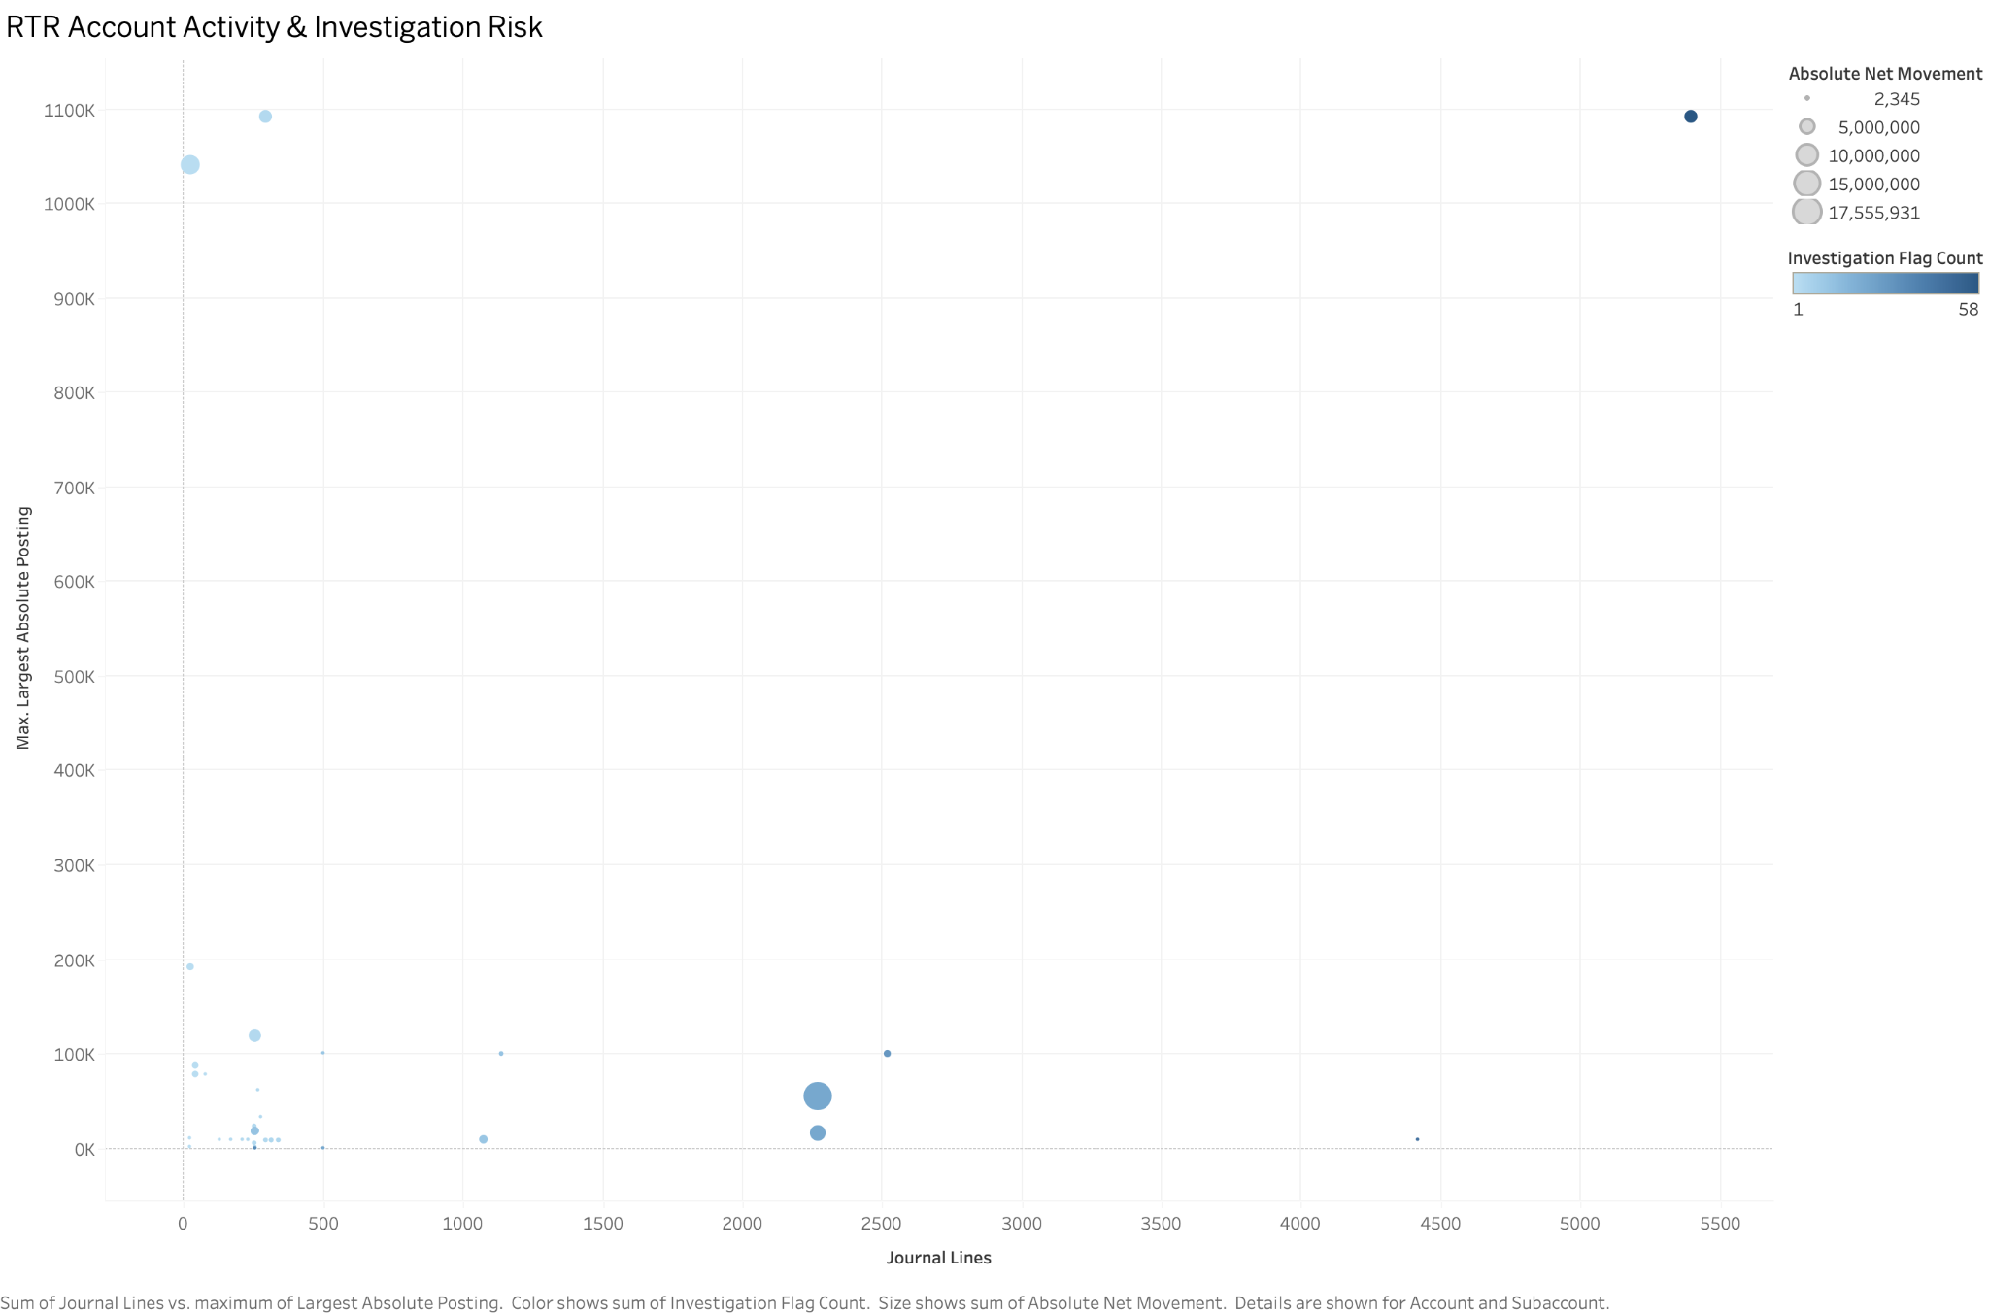
RTR Account Activity & Investigation Risk
TABLEAU WORKSHEET 16
WHAT IT SHOWS
Journal-line volume versus the largest absolute posting. Bubble size represents absolute net movement and colour represents flags.
HOW IT WORKS
The scatter distinguishes high-frequency accounts from accounts dominated by unusually large postings; reference lines anchor the baseline.
INTERPRETATION
Review is prioritised in two directions: high-volume/high-flag accounts and low-volume accounts with exceptionally large individual postings.
Global Finance Operations Analytics
38
Notes:
[Sources]
- 16 RTR Account Investigation Risk(1).png

Slide 39
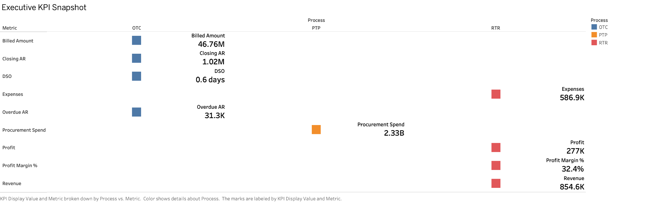
D01 Executive KPI Snapshot
DASHBOARD 1 - IMAGE
Global Finance Operations Analytics
39
Notes:
[Sources]
- 01 Executive KPI Cards(2).png

Slide 40
D01 explains the cross-process executive position
DASHBOARD 1 - EXPLANATION
Business purpose
Provide one management snapshot for billing, receivables, collection efficiency, procurement scale and financial performance.
Reading sequence
Read left-to-right by process: OTC billing/AR/DSO/overdue exposure, PTP procurement spend, then RTR revenue/expenses/profit/margin. Colour identifies process ownership.
Decision value
The view sets scale and directs attention to the detailed dashboards. Because the three datasets do not share a common date window, each process represents its latest meaningful snapshot.
Use D01 for orientation and KPI scale-not for same-period cross-process variance analysis.
Global Finance Operations Analytics
40
Notes:
[Sources]
- 01 Executive KPI Cards(2).png

Slide 41
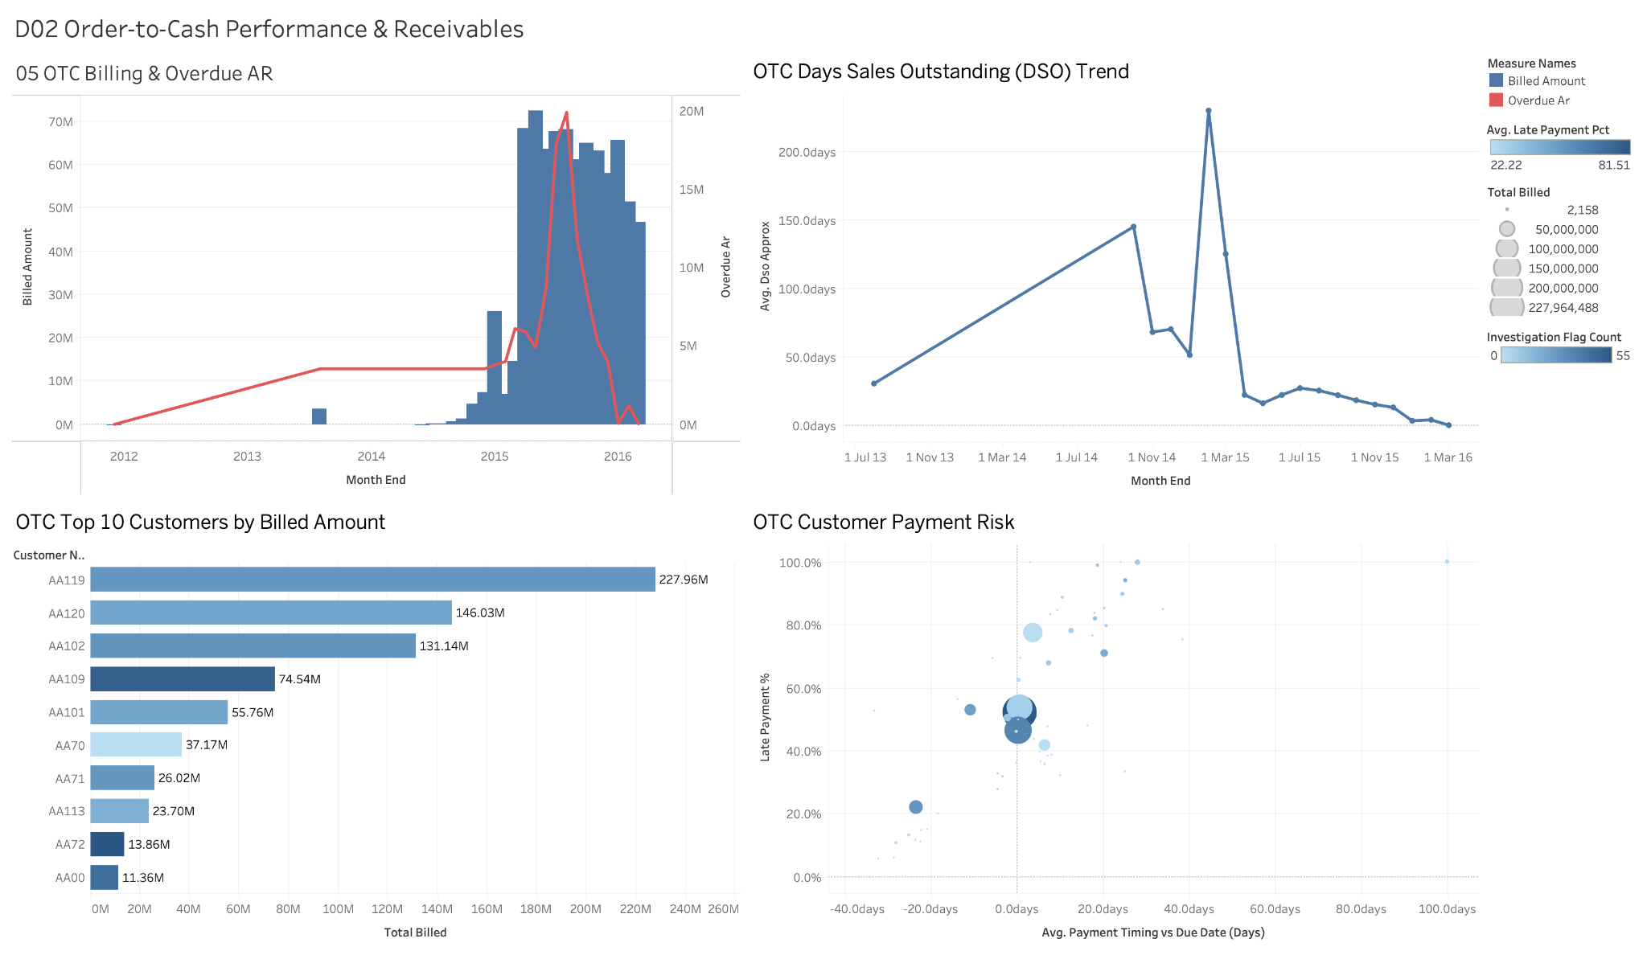
D02 Order-to-Cash Performance & Receivables
DASHBOARD 2 - IMAGE
Global Finance Operations Analytics
41
Notes:
[Sources]
- D02 Order-to-Cash Performance & Receivables(1).png

Slide 42
D02 turns receivables data into collection priorities
DASHBOARD 2 -EXPLANATION
Business purpose
Explain how billing, overdue exposure, DSO, customer concentration and payment risk interact in the OTC cycle.
Reading sequence
Start with billed amount versus overdue AR, then confirm collection efficiency through DSO. Move to the Top 10 customers and finish with the payment-risk scatter to select accounts for action.
Decision value
Collections teams can prioritise large customers with high late-payment rates or investigation flags, while finance monitors whether DSO and overdue AR improve after intervention.
The dashboard moves from portfolio trend to customer-level action in one analytical path.
Global Finance Operations Analytics
42
Notes:
[Sources]
- D02 Order-to-Cash Performance & Receivables(1).png

Slide 43
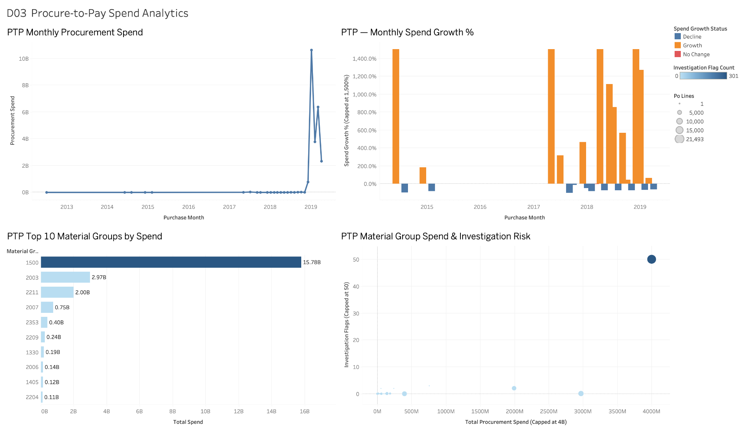
D03 Procure-to-Pay Spend Analytics
DASHBOARD 3 - IMAGE
Global Finance Operations Analytics
43
Notes:
[Sources]
- D03 Procure-to-Pay Spend Analytics.png

Slide 44
D03 links spend volatility to concentration and risk
DASHBOARD 3 - EXPLANATION
Business purpose
Monitor valid procurement spend, distinguish structural growth from low-base volatility and identify dominant material groups.
Reading sequence
Read the monthly spend trend first, then use growth status to locate unusual changes. The Top 10 view explains concentration, and the risk scatter identifies groups combining spend, PO volume and flags.
Decision value
Procurement can focus category reviews on material group 1500 and other high-spend/high-risk groups while keeping zero-spend rows outside KPI totals but inside the audit trail.
The dashboard converts a volatile spend history into a ranked category-review agenda.
Global Finance Operations Analytics
44
Notes:
[Sources]
- D03 Procure-to-Pay Spend Analytics.png

Slide 45
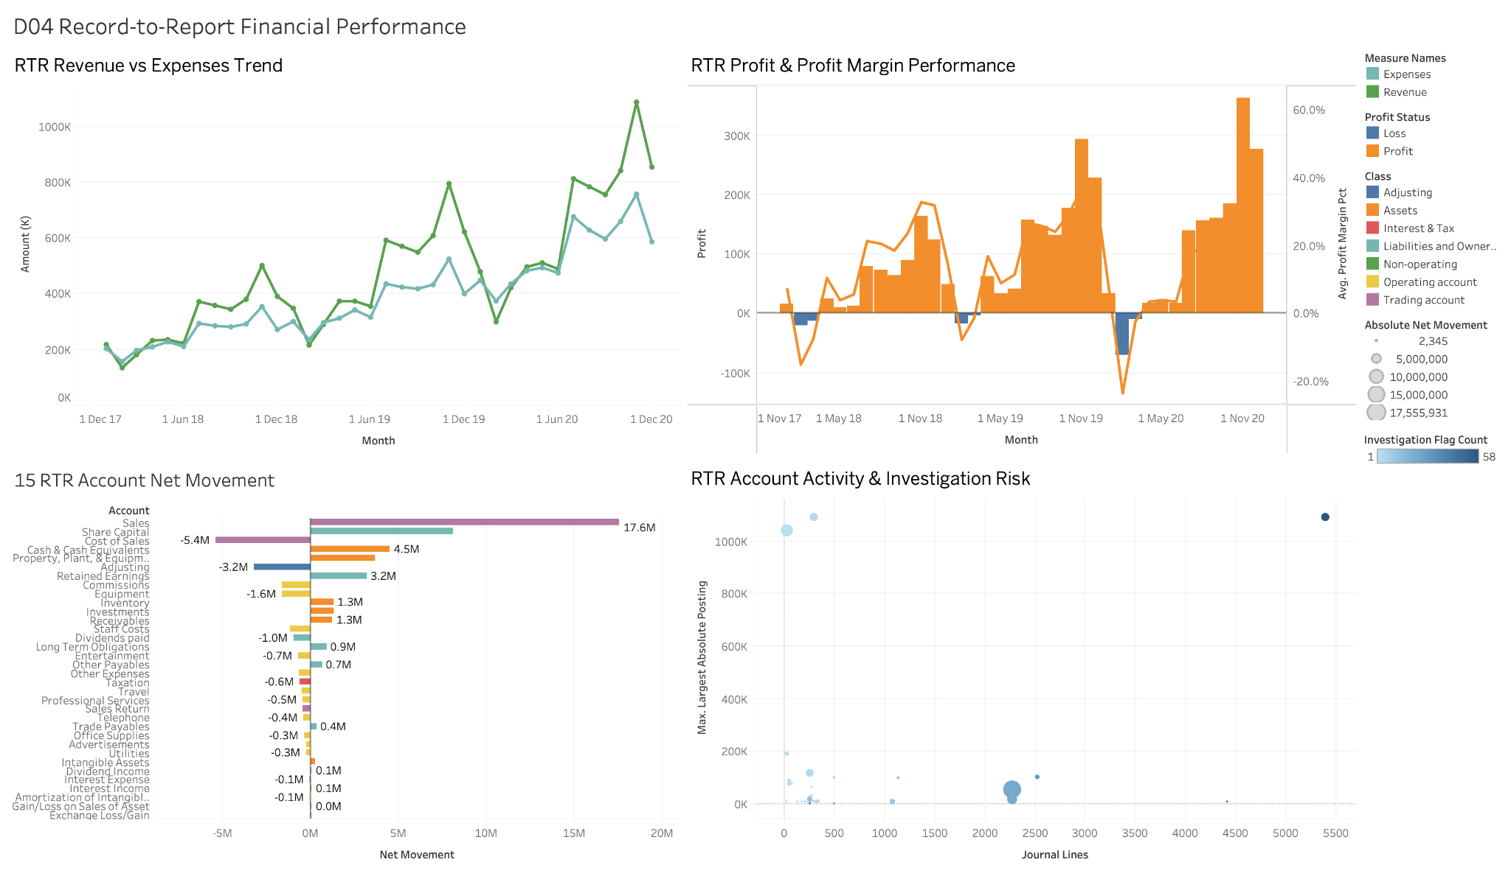
D04 Record-to-Report Financial Performance
DASHBOARD 4 - IMAGE
Global Finance Operations Analytics
45
Notes:
[Sources]
- D04 Record-to-Report Financial Performance.png

Slide 46
D04 explains performance and the accounts behind it
DASHBOARD 4 - EXPLANATION
Business purpose
Connect revenue and expense movements to profit, margin, account contributions and journal-level investigation risk.
Reading sequence
Begin with revenue versus expenses, then verify the effect on profit and margin. Use net movement to identify the main financial drivers and the risk scatter to locate accounts needing review.
Decision value
Controllers can distinguish operating performance from accounting-driver effects and prioritise accounts with large postings, high volume or elevated investigation flags.
The dashboard progresses from P&L outcome to account-level explanation and control review.
Global Finance Operations Analytics
46
Notes:
[Sources]
- D04 Record-to-Report Financial Performance.png

Slide 47
The project delivers a traceable finance analytics pipeline
CONCLUSION
Analytical integrity
Source-specific date coverage is respected, unusual records are flagged rather than hidden, and processed totals reconcile to source data.
Governed data layer
PostgreSQL schemas, keys, indexes and reusable analytical views provide a controlled interface for downstream reporting.
Decision-ready reporting
Sixteen worksheets and four dashboards translate finance operations into trends, concentration, profitability and investigation priorities.
Reusable handoff
Seven view extracts can be moved to another device or connected in Tableau, while the notebook and SQL report preserve the full technical evidence trail.
Outcome: an end-to-end portfolio project spanning Python, PostgreSQL and Tableau.
Global Finance Operations Analytics
47
Notes:
[Sources]
- Global_Finance_Operations_Analytics_V2.ipynb
- Global_Finance_SQL_Report.docx
- User-provided Tableau images

