Slide 1
UK Contracts for Difference: Energy Analytics
01
Renewable generation, CfD settlements, auction outcomes and forward looking forecasts
Analysis period
June 2016 to September 2026 for historical data
October 2026 to March 2027 for paired payment forecasts
Independent portfolio project
Low Carbon Contracts Company public datasets
Python | Jupyter Notebook | Tableau
INDEPENDENT PORTFOLIO ANALYSIS | LCCC PUBLIC DATA
PROJECT INTRODUCTION

Slide 2
Research aim and questions
02
MAIN FINDING
I used LCCC published data to understand how renewable generation, market prices, contractual payments and forecasts relate to one another.
Generation
Financial performance
How much CfD supported electricity has been produced over time? I look at annual and monthly totals, technology shares and leading projects, while separating supported generation from total UK renewable output.
How have the signed payments to generators changed, especially during periods of high electricity prices? I compare payments with generation weighted strike and reference prices rather than treating all payments as positive.
Contracts and auctions
Forecasting and delivery
What does the current contract portfolio show about capacity and technology mix? I distinguish awarded capacity and contract status from projects that have actually started operating.
How do updated forward payment estimates differ from their initial versions? I compare matched dates and describe revisions, while avoiding actual versus forecast accuracy claims where actual payments are missing.
INDEPENDENT PORTFOLIO ANALYSIS | LCCC PUBLIC DATA
PROJECT INTRODUCTION

Slide 3
Data sources and reporting grain
03
Six LCCC public CSV snapshots were analysed. Each dataset was retained at its own reporting level.
DATASET
ROWS
OBSERVATION LEVEL
Historical generation and avoided GHG
117,877
CfD unit and settlement day
CfD contract portfolio
610
Contract status snapshot
Auction outcomes
570
Published project award
Financial year strike and market prices
323
Financial year and technology
Forecast market reference prices
2,505
Forecast determination and day
In period tracking
457
Forecast settlement day
A row by row merge would duplicate values, so the Tableau export was built as a long format table with a reporting group and metric.
INDEPENDENT PORTFOLIO ANALYSIS | LCCC PUBLIC DATA
PROJECT INTRODUCTION

Slide 4
Data preparation and integrity
04
MAIN FINDING
The analysis preserves the original meaning of each input instead of forcing unrelated sources into one wide table.
Loading and standardisation
Missing information
I loaded all six CSV files from the data/raw folder. I normalised date types, trimmed labels and checked for exact duplicates before calculating performance indicators. The notebook retains executed results for review.
Missing payments are not replaced with zeros. The tracking download had no populated actual CfD payment records, so the forecast section studies changes between releases rather than accuracy against real outcomes.
Economic interpretation
Quality controls
Generation remains in MWh before conversion to TWh. Payments retain their positive and negative signs. For a price comparison I use generation weighted means, because a straight unit average would overrepresent small units.
The final Tableau dataset reconciles with the raw files for generation, net payments, estimated avoided GHG, portfolio capacity and auction capacity. Those five checks passed within numeric rounding tolerance.
INDEPENDENT PORTFOLIO ANALYSIS | LCCC PUBLIC DATA
PROJECT INTRODUCTION

Slide 5
Python analysis and EDA
05
18 executed notebook visualisations
First I inspect source coverage and data quality to understand what can be compared safely.
I then analyse generation, market prices, settlement payments and estimated carbon outcomes.
UK CfD
LCCC open data
Portfolio contracts and auction awards provide the project pipeline context.
Finally, forecast tables are evaluated and consolidated for use in Tableau.
INDEPENDENT PORTFOLIO ANALYSIS | LCCC PUBLIC DATA
PYTHON NOTEBOOK

Slide 6
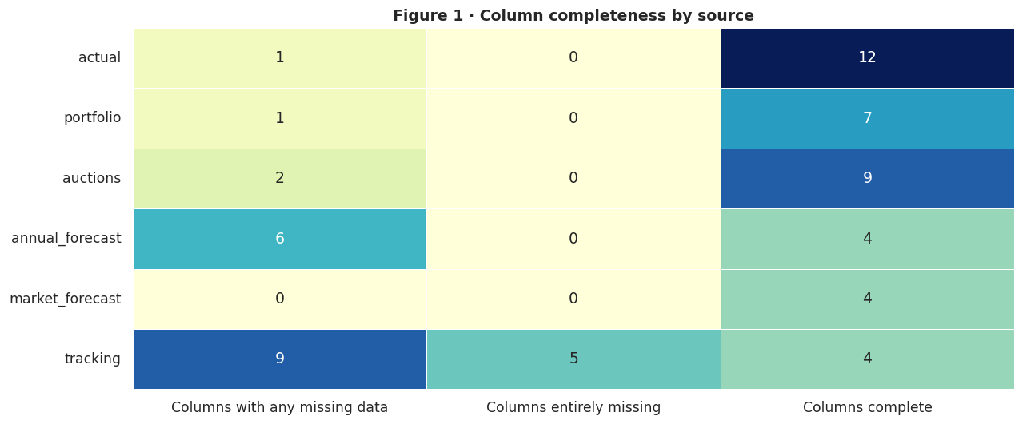
Notebook Figure 01 - Column completeness by data source
06
Source: LCCC open data. The visualisation is taken directly from the executed Python notebook.
INDEPENDENT PORTFOLIO ANALYSIS | LCCC PUBLIC DATA
PYTHON NOTEBOOK

Slide 7
Notebook Analysis - Column completeness by data source
07
MAIN FINDING
The data quality scan identifies incomplete fields before any aggregation or financial comparisons are made.
Chart purpose
Historical versus forecasts
Figure 1 summarises the proportion of missing values by column and source. It is a check on source coverage, not a score of organisational data quality.
Historical unit settlement data provides the base for generation and payments. In period tracking contains 457 rows, but the actual CfD payment field has no populated observations.
What I preserved
Decision for Tableau
Observed zeros and negative amounts are valid financial or operational records. I removed only exact duplicate rows and avoided filling missing observations with zeros.
Forecasts are tagged separately from actual historical settlement values. This prevents a dashboard from accidentally presenting forecast revisions as realised financial outcomes.
INDEPENDENT PORTFOLIO ANALYSIS | LCCC PUBLIC DATA
PYTHON NOTEBOOK

Slide 8
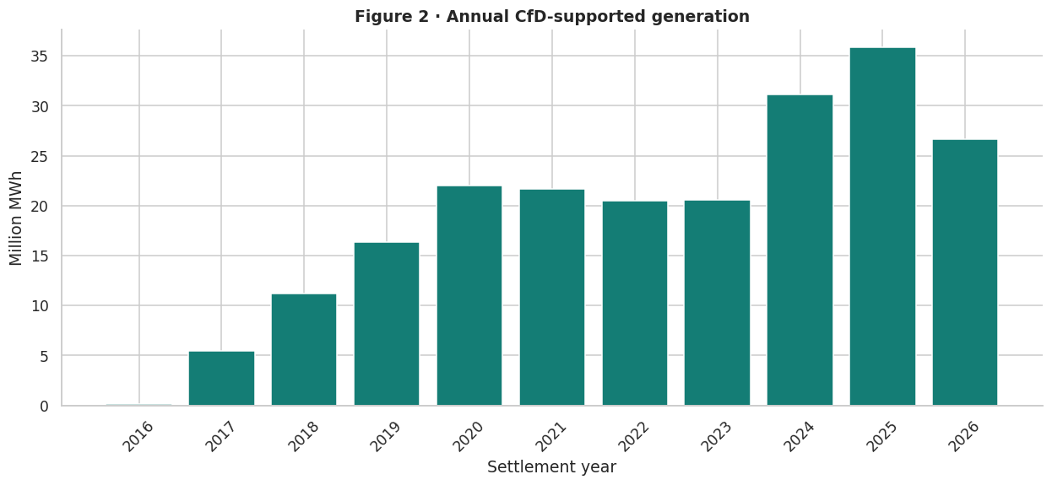
Notebook Figure 02 - Annual CfD supported generation
08
Source: LCCC open data. The visualisation is taken directly from the executed Python notebook.
INDEPENDENT PORTFOLIO ANALYSIS | LCCC PUBLIC DATA
PYTHON NOTEBOOK

Slide 9
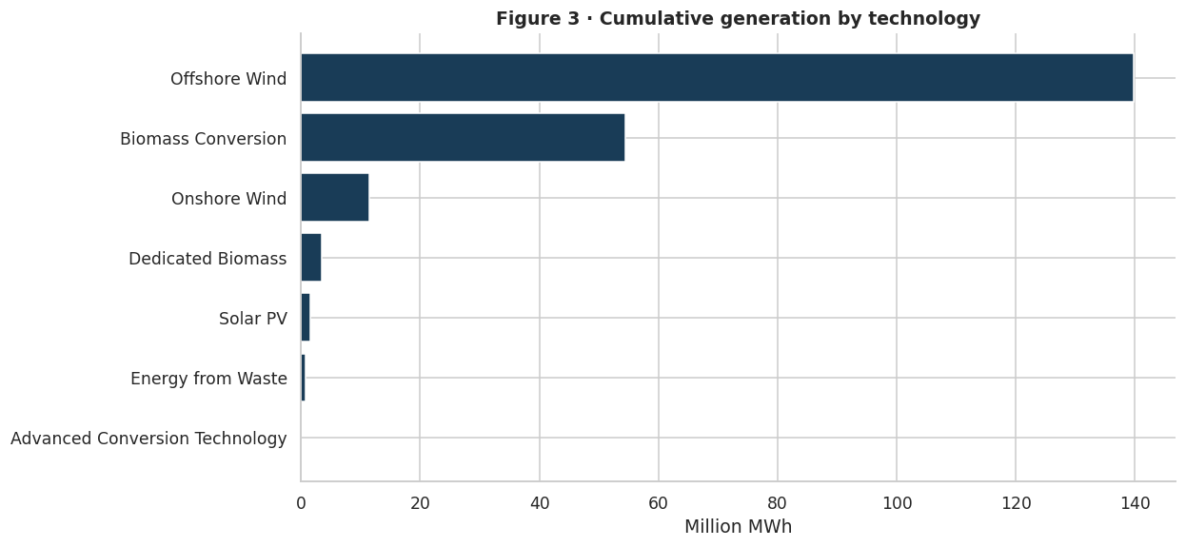
Notebook Figure 03 - Cumulative generation by technology
09
Source: LCCC open data. The visualisation is taken directly from the executed Python notebook.
INDEPENDENT PORTFOLIO ANALYSIS | LCCC PUBLIC DATA
PYTHON NOTEBOOK

Slide 10
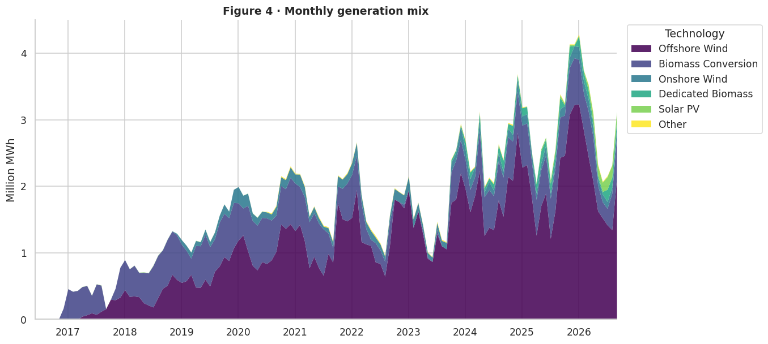
Notebook Figure 04 - Monthly generation mix
10
Source: LCCC open data. The visualisation is taken directly from the executed Python notebook.
INDEPENDENT PORTFOLIO ANALYSIS | LCCC PUBLIC DATA
PYTHON NOTEBOOK

Slide 11
Notebook Analysis - Monthly generation mix
11
MAIN FINDING
The historical generation charts show expanding CfD eligible output and a changing contribution by technology.
Annual movement
Technology leaders
Recorded CfD eligible generation totals 211.54 TWh from June 2016 to September 2026. The complete year 2025 contributes about 35.84 TWh, up from approximately 31.14 TWh in 2024.
Offshore wind supplies roughly 139.85 million MWh across the source period. Biomass conversion contributes about 54.38 million MWh, with smaller contributions from onshore wind and the other technologies.
Monthly perspective
Interpretation boundary
The month by month stacked view shows the rise of offshore wind in the supported generation mix. Variation within a year can reflect both resource conditions and changes in the active contract portfolio.
These are eligible units published in LCCC settlement data rather than all renewable generation in Britain. Calendar 2016 and 2026 are partial years, so they are not comparable with complete years.
INDEPENDENT PORTFOLIO ANALYSIS | LCCC PUBLIC DATA
PYTHON NOTEBOOK

Slide 12
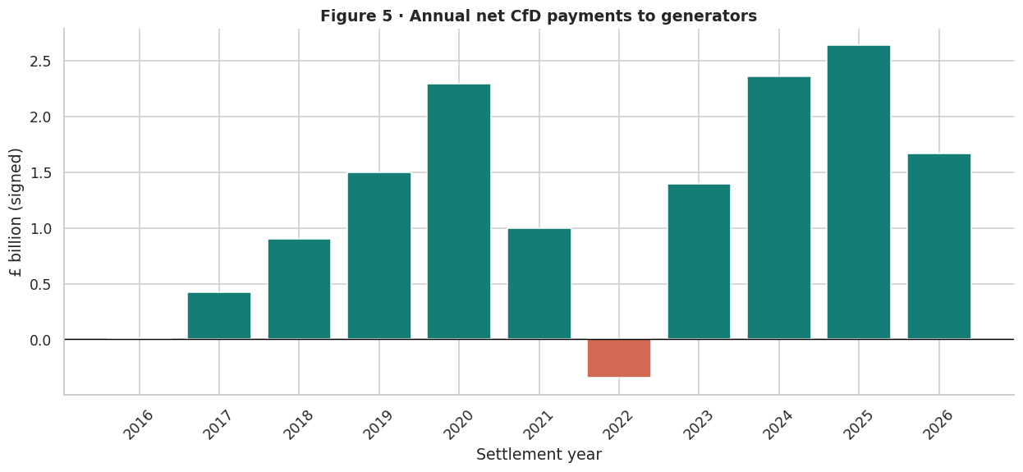
Notebook Figure 05 - Annual signed CfD payments
12
Source: LCCC open data. The visualisation is taken directly from the executed Python notebook.
INDEPENDENT PORTFOLIO ANALYSIS | LCCC PUBLIC DATA
PYTHON NOTEBOOK

Slide 13
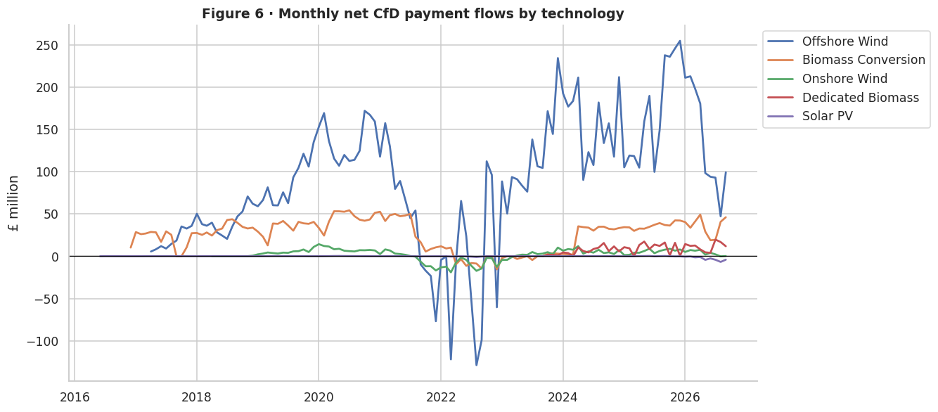
Notebook Figure 06 - Monthly payment flows by technology
13
Source: LCCC open data. The visualisation is taken directly from the executed Python notebook.
INDEPENDENT PORTFOLIO ANALYSIS | LCCC PUBLIC DATA
PYTHON NOTEBOOK

Slide 14
Notebook Analysis - Monthly payment flows by technology
14
MAIN FINDING
The payment analysis retains signed financial flows so that generator repayments remain visible.
Signed payments
The 2022 reversal
The historical source records a net £13.84 billion across the full available period. Focusing on complete years 2017 to 2025 gives approximately £12.16 billion in net CfD payments.
In 2022 the annual net payment is around negative £0.346 billion. This is consistent with a two way scheme where generators may repay money when the relevant market reference price is above the strike price.
Technology differences
Meaning of negative values
Offshore wind and biomass conversion account for much of the absolute payment activity. A technology level view reveals opposing financial contributions that could disappear in a simple annual total.
Negative net payments should not be called losses without naming the party concerned. The accounting direction and contract rules matter for interpreting settlement flows.
INDEPENDENT PORTFOLIO ANALYSIS | LCCC PUBLIC DATA
PYTHON NOTEBOOK

Slide 15
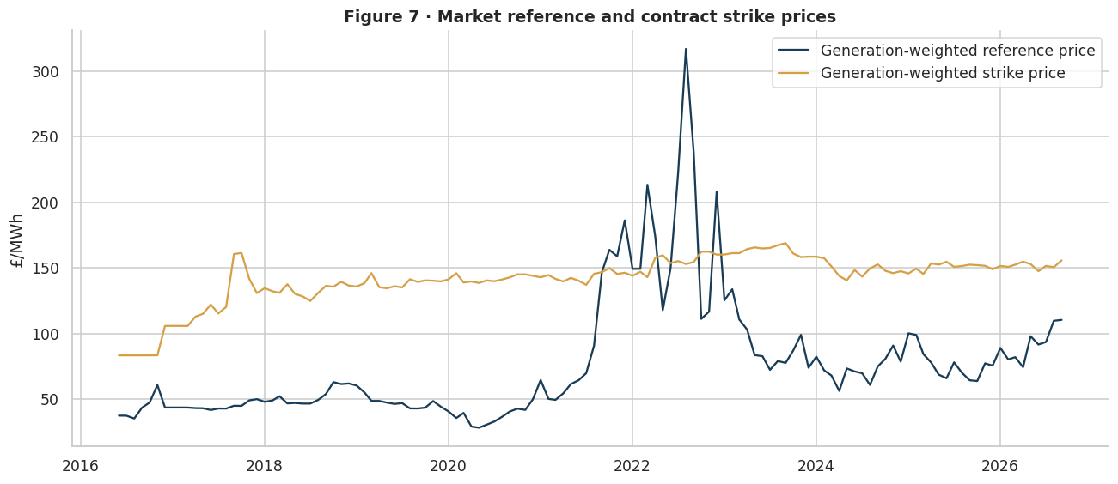
Notebook Figure 07 - Generation weighted price trends
15
Source: LCCC open data. The visualisation is taken directly from the executed Python notebook.
INDEPENDENT PORTFOLIO ANALYSIS | LCCC PUBLIC DATA
PYTHON NOTEBOOK

Slide 16
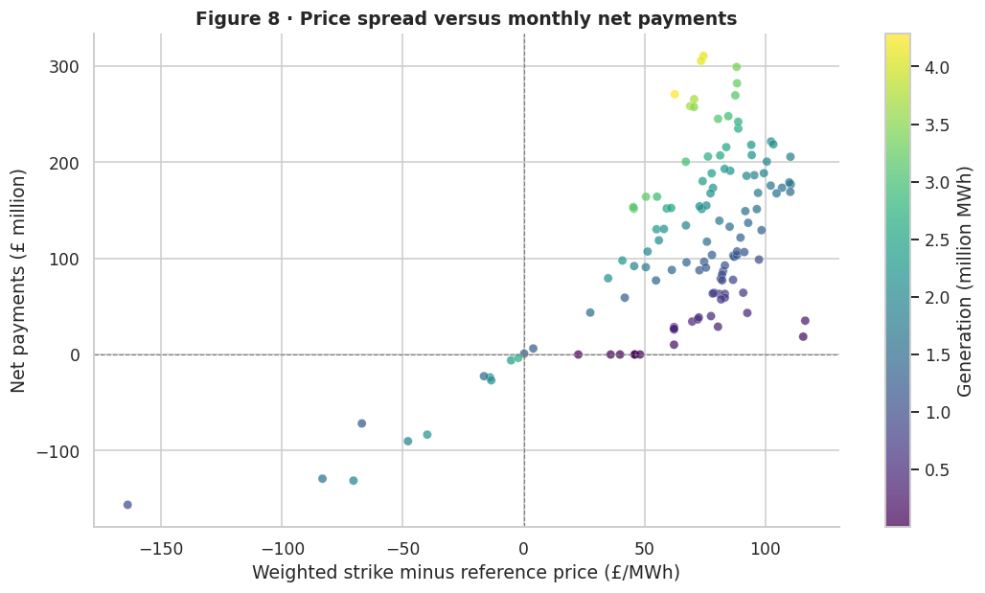
Notebook Figure 08 - Price spread and payment relationship
16
Source: LCCC open data. The visualisation is taken directly from the executed Python notebook.
INDEPENDENT PORTFOLIO ANALYSIS | LCCC PUBLIC DATA
PYTHON NOTEBOOK

Slide 17
Notebook Analysis - Price spread and payment relationship
17
MAIN FINDING
Generation weighted strike and market reference prices help explain variations in signed CfD payments.
Price methodology
Market conditions
I calculate aggregate prices using generation weights. This keeps an eligible MWh from a larger producing unit from being treated equally to a tiny settlement observation.
The weighted market reference price rises above the weighted strike price in 2022. In the annual Tableau view these values are approximately £172.3 and £153.8 per MWh respectively.
Relationship to payments
Other influences
Figure 8 compares the weighted price spread with monthly signed payments. It is useful for recognising the design of the two way settlement mechanism, not for assigning statistical causality.
Eligible generation volumes, contract specific reference prices, terms and settlement adjustments also affect CfD payments. Market reference price alone does not explain every individual observation.
INDEPENDENT PORTFOLIO ANALYSIS | LCCC PUBLIC DATA
PYTHON NOTEBOOK

Slide 18
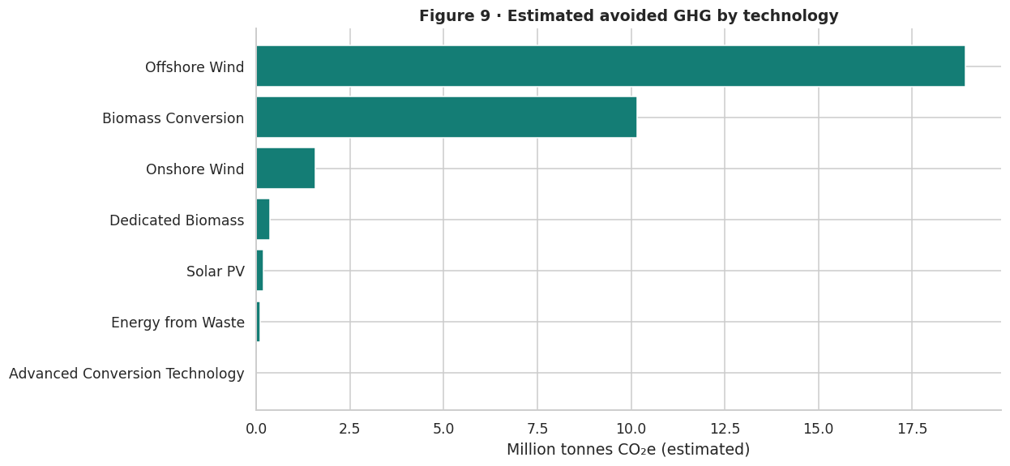
Notebook Figure 09 - Estimated avoided GHG by technology
18
Source: LCCC open data. The visualisation is taken directly from the executed Python notebook.
INDEPENDENT PORTFOLIO ANALYSIS | LCCC PUBLIC DATA
PYTHON NOTEBOOK

Slide 19
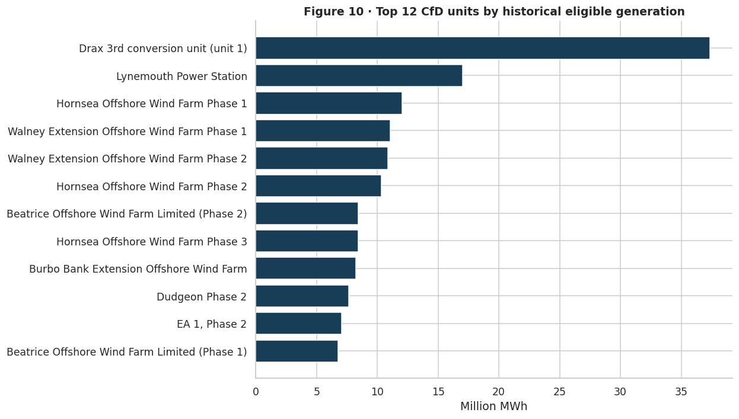
Notebook Figure 10 - Highest generating CfD units
19
Source: LCCC open data. The visualisation is taken directly from the executed Python notebook.
INDEPENDENT PORTFOLIO ANALYSIS | LCCC PUBLIC DATA
PYTHON NOTEBOOK

Slide 20
Notebook Analysis - Highest generating CfD units
20
MAIN FINDING
The emissions estimates and project rankings show the environmental and operational concentration of supported output.
Estimated GHG impact
Technology mix
The historical dataset reports approximately 31.31 million tonnes of estimated avoided CO2 equivalent. The figure describes the source methodology and is not a directly measured counterfactual reduction.
Offshore wind accounts for around 18.93 million tonnes of the source estimates, followed by biomass conversion at around 10.16 million tonnes. Other categories contribute smaller shares.
Project scale
Interpretation boundary
The project ranking displays the twelve units with the greatest eligible historical generation. It helps identify concentration and the role of larger assets in aggregate settlement figures.
More generation can be associated with a larger emissions estimate, but the implied displacement factor and baseline affect results. The ranking is also cumulative, favouring projects present for longer.
INDEPENDENT PORTFOLIO ANALYSIS | LCCC PUBLIC DATA
PYTHON NOTEBOOK

Slide 21
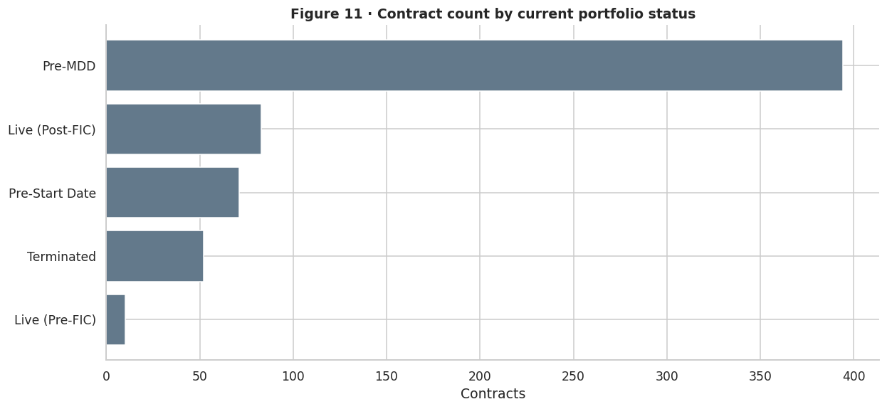
Notebook Figure 11 - Contract counts by portfolio status
21
Source: LCCC open data. The visualisation is taken directly from the executed Python notebook.
INDEPENDENT PORTFOLIO ANALYSIS | LCCC PUBLIC DATA
PYTHON NOTEBOOK

Slide 22
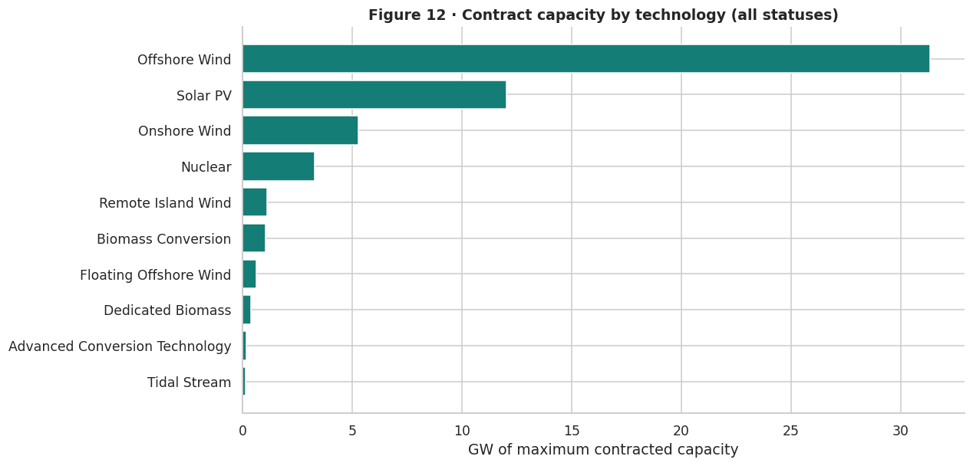
Notebook Figure 12 - Contract capacity by technology
22
Source: LCCC open data. The visualisation is taken directly from the executed Python notebook.
INDEPENDENT PORTFOLIO ANALYSIS | LCCC PUBLIC DATA
PYTHON NOTEBOOK

Slide 23
Notebook Analysis - Contract capacity by technology
23
MAIN FINDING
The current contract portfolio needs to be read as a snapshot rather than a historical generation series.
Portfolio size
Capacity composition
The source contains 610 contract records with a summed published maximum capacity of around 55.48 GW when all statuses are included.
Offshore wind is the largest capacity category at about 31.35 GW. Solar PV has around 12.01 GW, with onshore wind and other technologies making up the remainder.
Dashboard distinction
What capacity means
The portfolio KPI uses about 49.78 GW after excluding terminated contracts. The full EDA chart includes every status, explaining why the two totals are not identical.
An awarded or non terminated contract is not proof that a plant is operating. MW capacity does not translate into MWh generation without actual output and a time period.
INDEPENDENT PORTFOLIO ANALYSIS | LCCC PUBLIC DATA
PYTHON NOTEBOOK

Slide 24
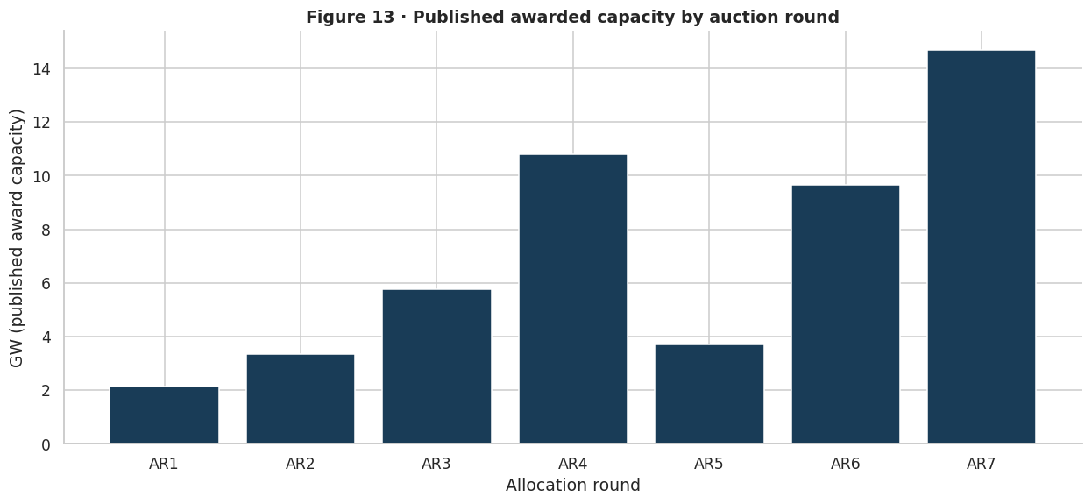
Notebook Figure 13 - Awarded capacity by auction round
24
Source: LCCC open data. The visualisation is taken directly from the executed Python notebook.
INDEPENDENT PORTFOLIO ANALYSIS | LCCC PUBLIC DATA
PYTHON NOTEBOOK

Slide 25
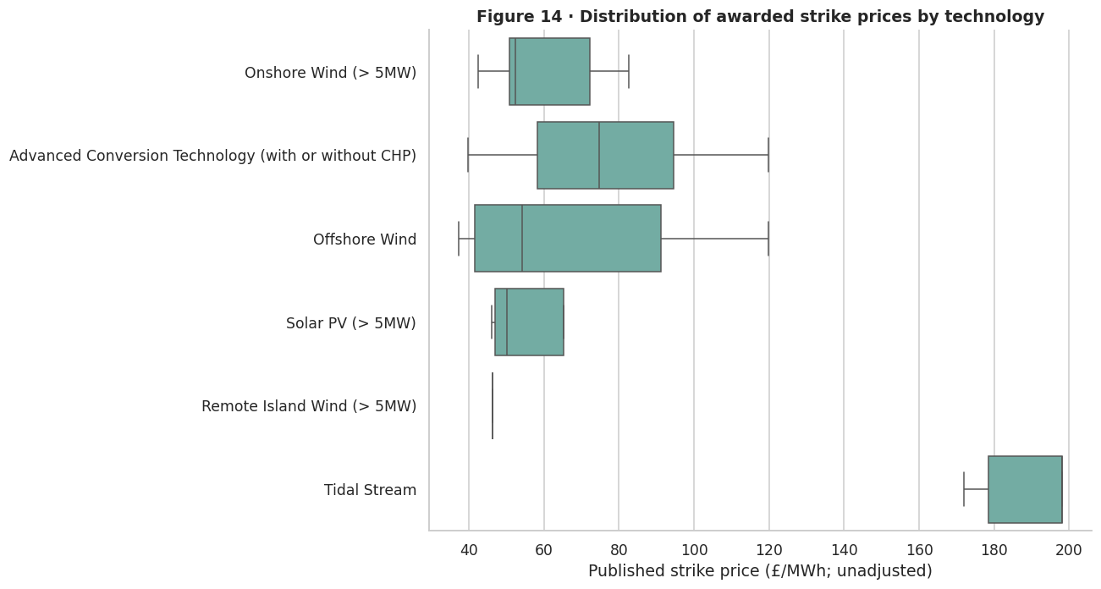
Notebook Figure 14 - Auction strike prices by technology
25
Source: LCCC open data. The visualisation is taken directly from the executed Python notebook.
INDEPENDENT PORTFOLIO ANALYSIS | LCCC PUBLIC DATA
PYTHON NOTEBOOK

Slide 26
Notebook Analysis - Auction strike prices by technology
26
MAIN FINDING
Auction outcomes describe awarded capacity and published strike prices, but not realised plant operation.
Awarded scale
Round comparison
The auction source has 570 award rows and around 50.07 GW of reported awarded capacity. This is a separate reporting perspective from the current contract portfolio.
Figure 13 groups awards by allocation round. This shows changes in the published award pipeline, not the year in which capacity becomes available to the grid.
Strike price spread
Comparability warning
Figure 14 compares published award strike prices by technology. Differences include technology type, award timing and the price base used for each contract.
Raw published strike prices across rounds are not automatically inflation adjusted. The Tableau round averages are descriptive means of project awards, not capacity weighted or real terms price comparisons.
INDEPENDENT PORTFOLIO ANALYSIS | LCCC PUBLIC DATA
PYTHON NOTEBOOK

Slide 27
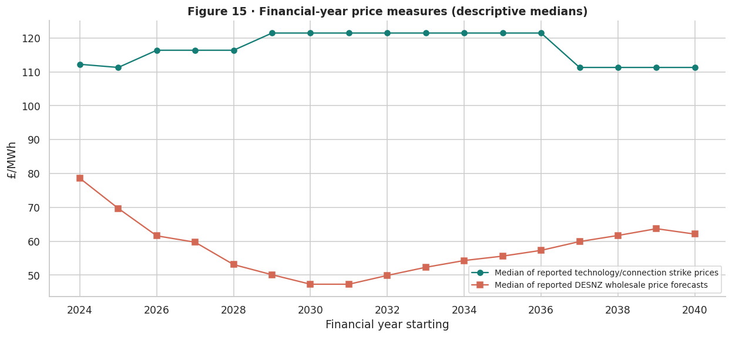
Notebook Figure 15 - Financial year price benchmarks
27
Source: LCCC open data. The visualisation is taken directly from the executed Python notebook.
INDEPENDENT PORTFOLIO ANALYSIS | LCCC PUBLIC DATA
PYTHON NOTEBOOK

Slide 28
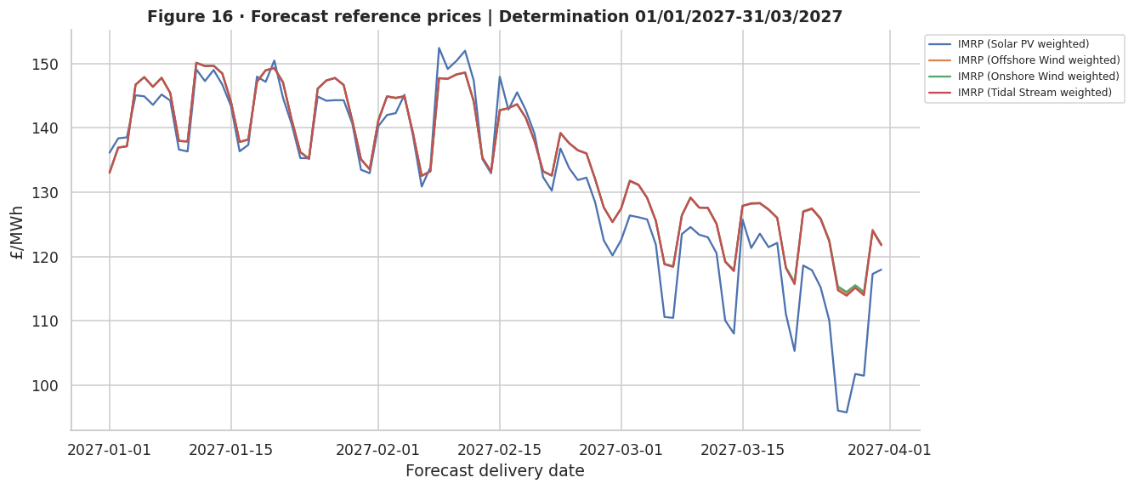
Notebook Figure 16 - Forecast reference prices by technology
28
Source: LCCC open data. The visualisation is taken directly from the executed Python notebook.
INDEPENDENT PORTFOLIO ANALYSIS | LCCC PUBLIC DATA
PYTHON NOTEBOOK

Slide 29
Notebook Analysis - Forecast reference prices by technology
29
MAIN FINDING
Forward prices are reported at defined forecast windows and cannot be presented as historical market observations.
Financial year view
Determination periods
Figure 15 compares descriptive medians of technology and connection level weighted strike prices with published DESNZ wholesale price forecasts. It does not reconstruct a portfolio wide weighted average.
Figure 16 follows forecast reference prices within one selected determination window. The source has several windows, so labels are retained to prevent mixing different release assumptions.
Technology behaviour
Interpretation boundary
Baseload benchmark prices can be relatively steady within a seasonal period, while intermittent reference price series vary over forecast delivery dates.
These are forward estimates. Prices and future payment requirements can change as market expectations, policy assumptions and the contract population evolve.
INDEPENDENT PORTFOLIO ANALYSIS | LCCC PUBLIC DATA
PYTHON NOTEBOOK

Slide 30
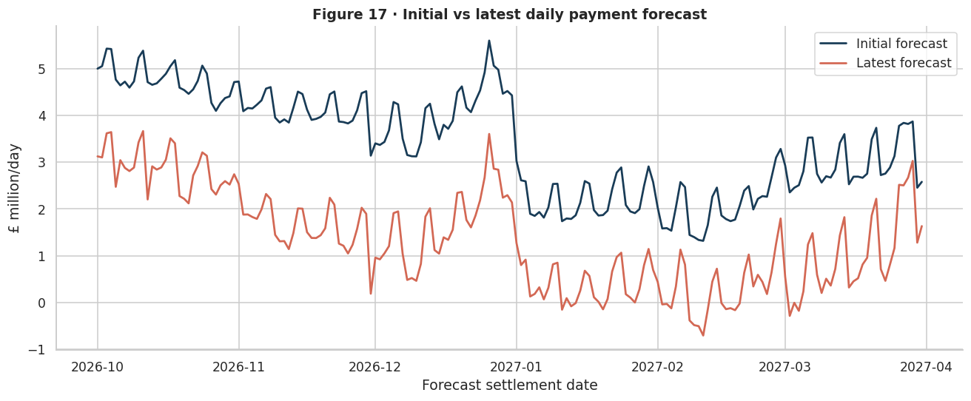
Notebook Figure 17 - Initial and latest daily payment forecasts
30
Source: LCCC open data. The visualisation is taken directly from the executed Python notebook.
INDEPENDENT PORTFOLIO ANALYSIS | LCCC PUBLIC DATA
PYTHON NOTEBOOK

Slide 31
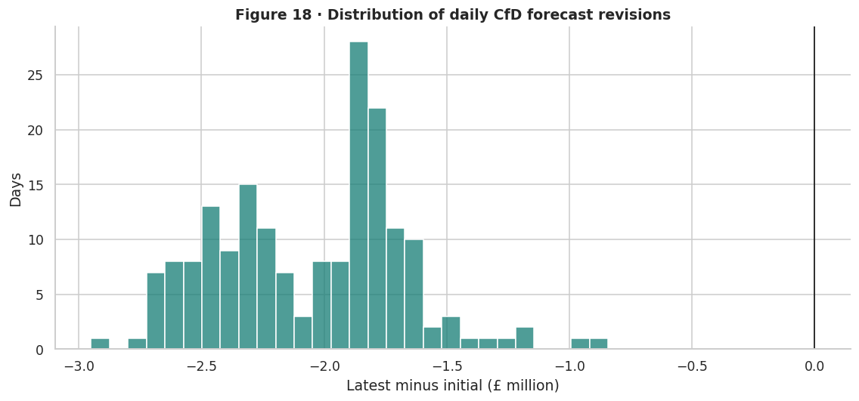
Notebook Figure 18 - Daily forecast revision distribution
31
Source: LCCC open data. The visualisation is taken directly from the executed Python notebook.
INDEPENDENT PORTFOLIO ANALYSIS | LCCC PUBLIC DATA
PYTHON NOTEBOOK

Slide 32
Notebook Analysis - Daily forecast revision distribution
32
MAIN FINDING
Matched forecast releases point to a substantial downward revision in expected CfD payments over six months.
Matched comparison
Revision size
Initial and latest daily payment forecasts exist together for 182 dates from October 2026 through March 2027. Comparisons use only this overlapping horizon.
The paired forecast totals are approximately £617.39 million initially and £244.17 million in the latest version. The difference is negative £373.22 million, or about a 60.45 percent reduction.
Day level distribution
Critical limitation
Figure 18 displays negative revisions across the matched dates, with a median absolute daily change close to £1.97 million. The histogram shows how concentrated these revisions are.
The actual payments field in the in period source is empty. These are revisions to forecasts, not measured forecast errors, realised savings or a loss to a named party.
INDEPENDENT PORTFOLIO ANALYSIS | LCCC PUBLIC DATA
PYTHON NOTEBOOK

Slide 33
Tableau export and validation
33
MAIN FINDING
Six inputs were transformed into one long format Tableau table containing 47,361 rows and 26 metrics, with explicit reporting groups.
Why long format
Common fields
The original CSV files describe different things and different dates. Keeping one metric per reporting observation avoids multiplying values through inappropriate joins and lets Tableau select what is being measured.
Each record carries a reporting group, metric, value, unit, date or reporting period, and relevant dimensions such as technology, project, auction and contract status. Not every dimension applies to every source.
Aggregation rules
Reconciliation checks
Generation and payments can be summed inside well defined historical groups. Prices require averages or properly weighted calculations. Forecasts and auction awards should not be combined with historical unit records in a single total.
The export was checked against the original CSVs. Generation, historical net payments, estimated emissions, total portfolio capacity and awarded auction capacity reconciled, preserving the source totals.
INDEPENDENT PORTFOLIO ANALYSIS | LCCC PUBLIC DATA
PYTHON NOTEBOOK

Slide 34
Tableau worksheets
34
17 worksheet views with a dedicated explanation after every screenshot
Sheets 01 to 07 summarise renewable generation, emissions and the contract portfolio.
Sheets 08 to 12 examine the two way CfD payment mechanism and auction pricing.
UK CfD
LCCC open data
Sheets 13 to 17 explore matched payment forecasts, revisions and forward reference prices.
Each view uses a metric selection appropriate to its source and aggregation method.
INDEPENDENT PORTFOLIO ANALYSIS | LCCC PUBLIC DATA
TABLEAU WORKSHEETS

Slide 35
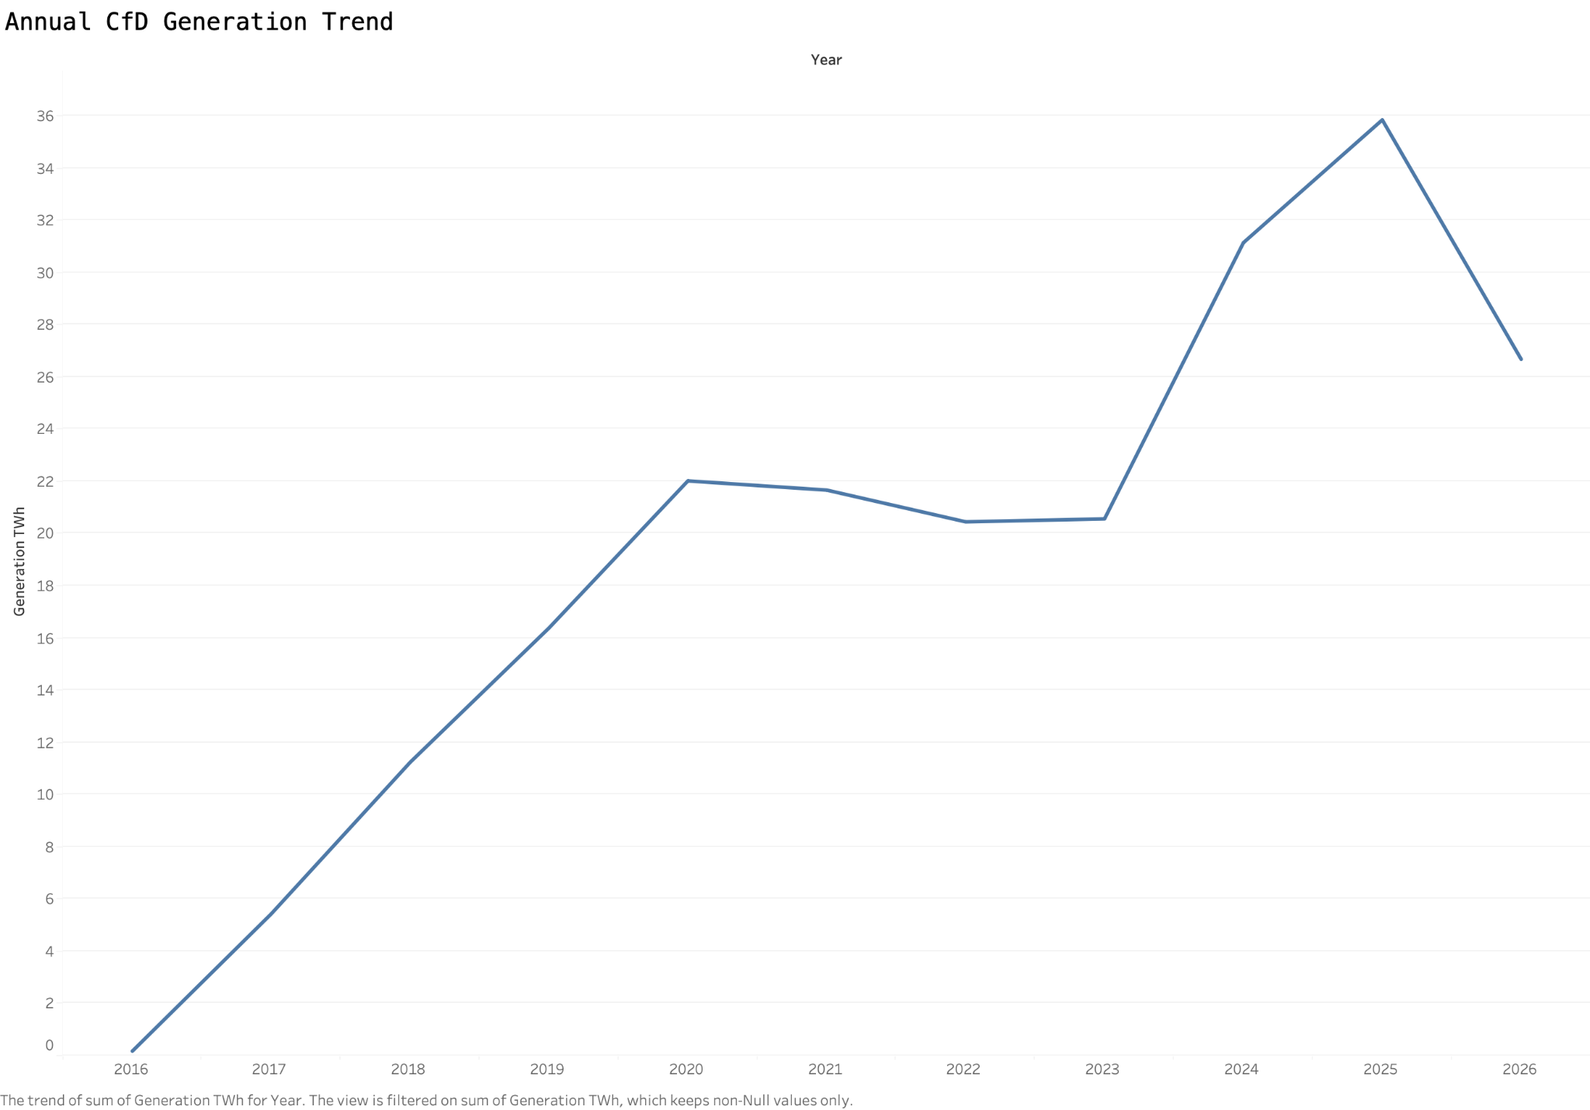
Worksheet 01 - Annual Electricity Generation
35
Source: Tableau worksheet created from the consolidated LCCC data export.
INDEPENDENT PORTFOLIO ANALYSIS | LCCC PUBLIC DATA
TABLEAU WORKSHEETS

Slide 36
Worksheet 01 - Analysis and Findings
36
MAIN FINDING
Historical CfD eligible electricity generation increases markedly across the complete calendar years, reaching 35.84 TWh in 2025.
What the worksheet measures
Observed pattern
I summed historical CfD eligible generation by settlement year and converted MWh to TWh. The time series is restricted to the historical generation metric instead of mixing data from the contract or forecast records.
Annual output rose to approximately 22.01 TWh in 2020, remained near 20 to 22 TWh through 2023 and increased again to 31.14 TWh in 2024 and 35.84 TWh in 2025.
Why it matters
Comparison note
The pattern suggests increasing generation from projects supported through the CfD scheme. It provides the baseline for examining technology mix, payment flows and estimated environmental outcomes.
The chart includes only one day from June 2016 and ends in September 2026. Those are partial calendar years, so the lower 2026 total cannot be described as a confirmed full year decline.
INDEPENDENT PORTFOLIO ANALYSIS | LCCC PUBLIC DATA
TABLEAU WORKSHEETS

Slide 37
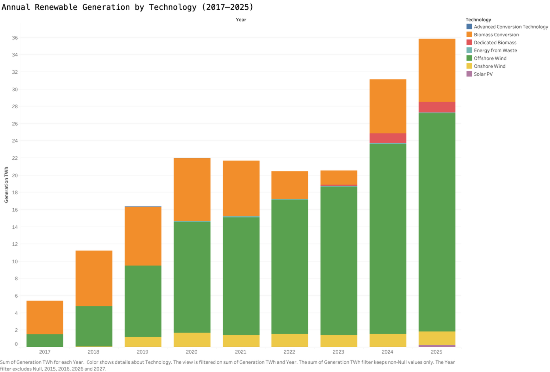
Worksheet 02 - Generation by Technology
37
Source: Tableau worksheet created from the consolidated LCCC data export.
INDEPENDENT PORTFOLIO ANALYSIS | LCCC PUBLIC DATA
TABLEAU WORKSHEETS

Slide 38
Worksheet 02 - Analysis and Findings
38
MAIN FINDING
Offshore wind becomes increasingly prominent within the CfD supported generation mix from 2017 to 2025.
Construction
Technology pattern
I stacked yearly generation totals by renewable technology. The comparison uses complete years and applies the same historical unit month generation metric as the overall annual chart.
Biomass conversion has a large share in the earlier years. Offshore wind grows over the period and supplies most of the total in 2024 and 2025. Onshore wind and other technologies form smaller sections.
Analytical value
Interpretation note
Breaking the aggregate total into technologies shows what underlies the growth in annual generation. It also gives a clearer context for differences in contracted strike prices and net CfD payments.
These categories describe CfD eligible electricity in the source rather than every renewable generator in Britain. Changes can reflect new support contracts as well as variation at projects already reporting.
INDEPENDENT PORTFOLIO ANALYSIS | LCCC PUBLIC DATA
TABLEAU WORKSHEETS

Slide 39
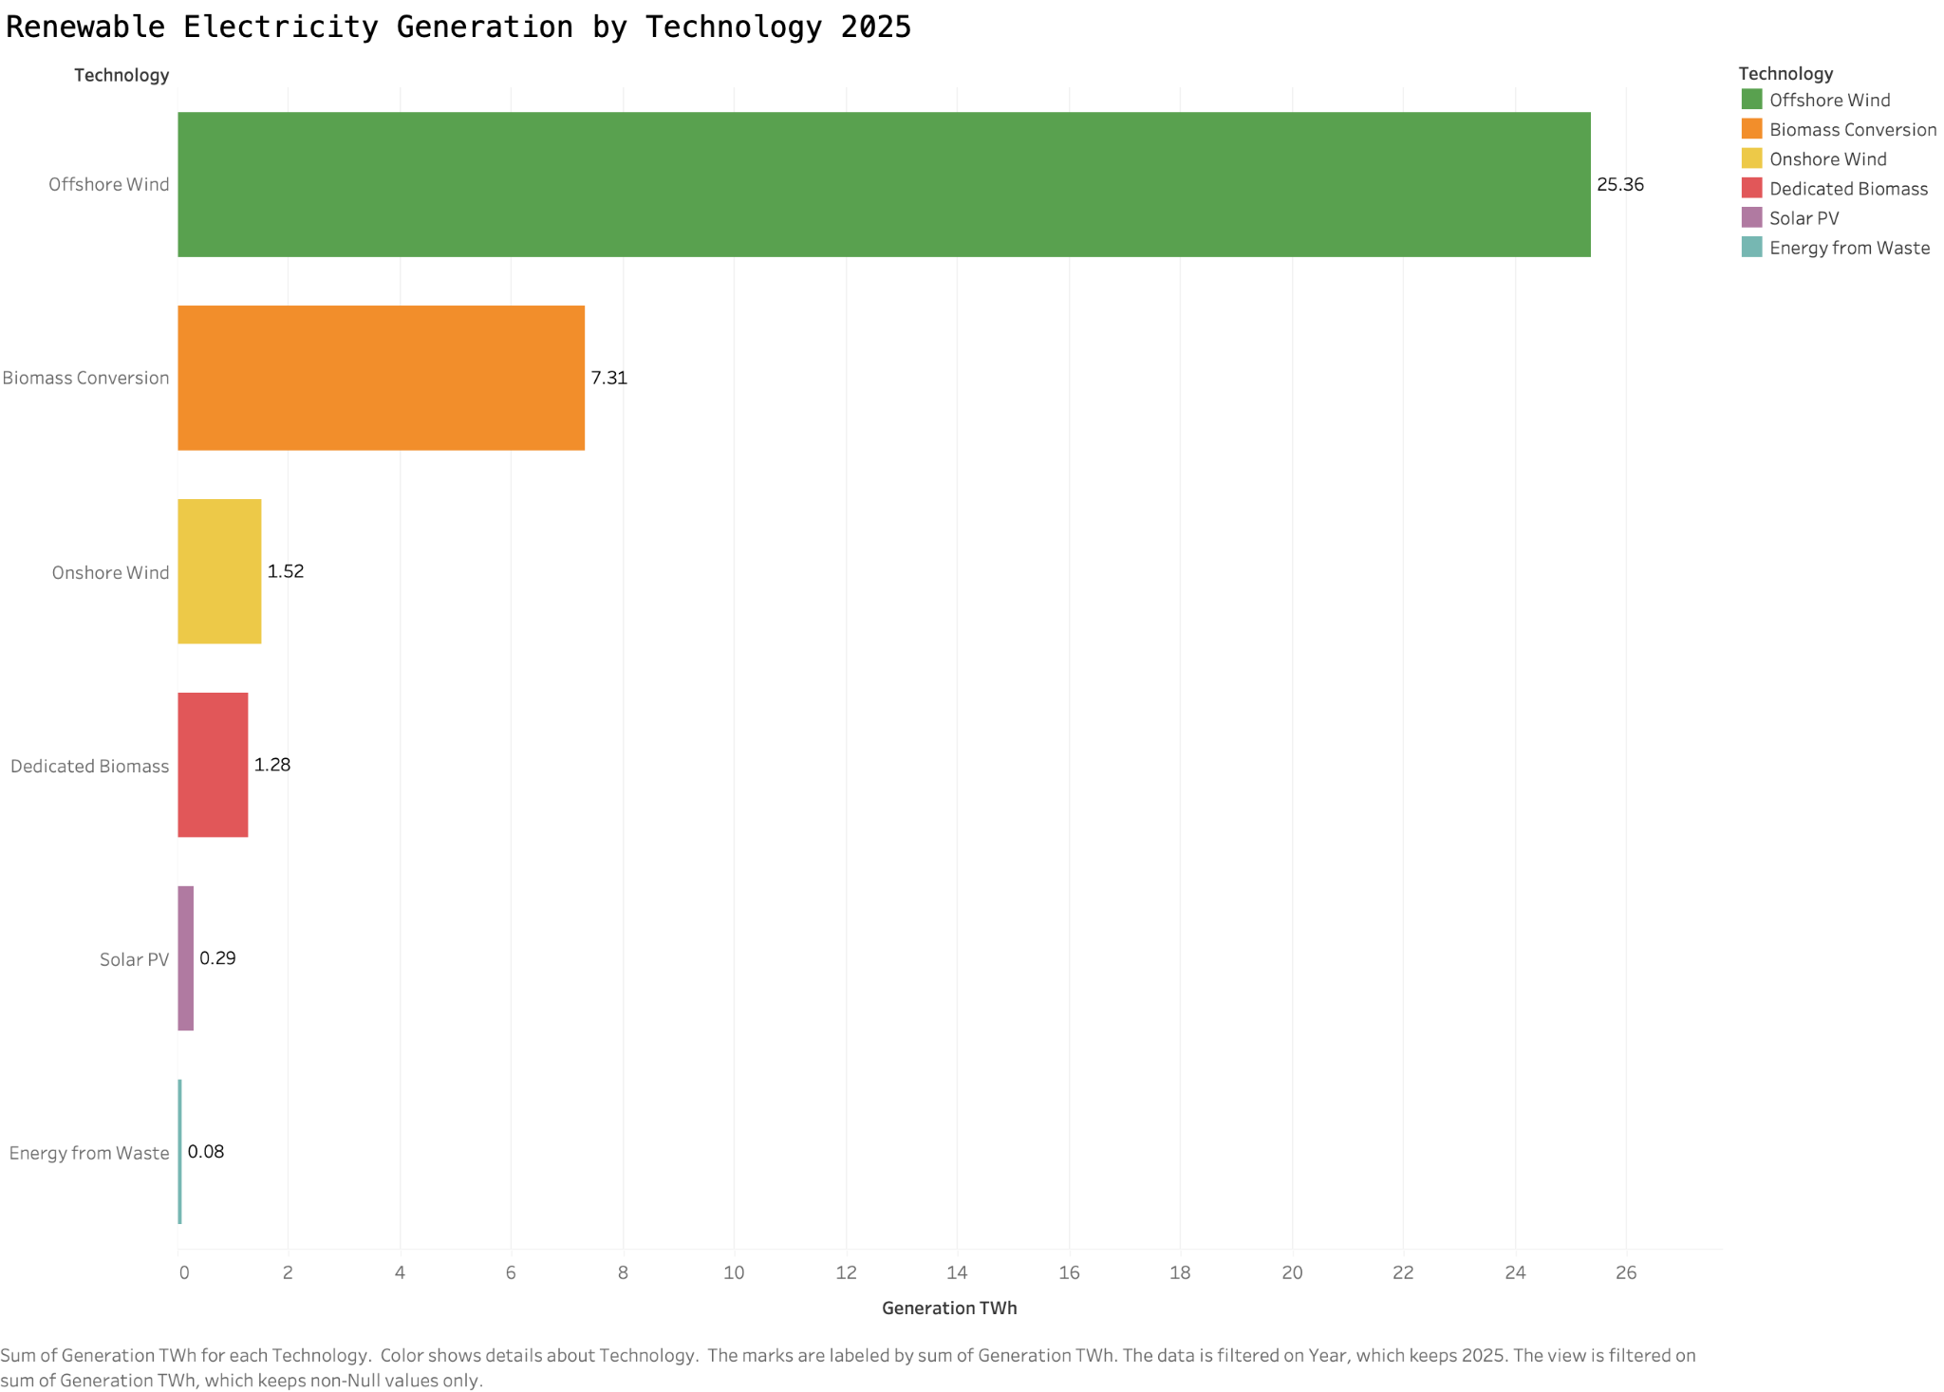
Worksheet 03 - Technology Ranking (2025)
39
Source: Tableau worksheet created from the consolidated LCCC data export.
INDEPENDENT PORTFOLIO ANALYSIS | LCCC PUBLIC DATA
TABLEAU WORKSHEETS

Slide 40
Worksheet 03 - Analysis and Findings
40
MAIN FINDING
Offshore wind supplied 25.36 TWh in 2025, representing about 71 percent of the displayed CfD eligible generation.
Chart definition
Largest contributors
I ranked technologies by their 2025 generation in TWh and used horizontal bars so the complete category names and numeric labels remain readable.
Offshore wind generated 25.36 TWh. Biomass conversion followed at 7.31 TWh. Onshore wind provided 1.52 TWh and dedicated biomass approximately 1.28 TWh.
Smaller contributors
How I use this result
Solar PV provided 0.29 TWh and energy from waste 0.08 TWh. Altogether the six categories account for around 35.84 TWh for the calendar year.
A technology ranking helps prioritise which sources matter most when explaining total generation and payment movements. Small generation does not necessarily mean a technology has little long term pipeline capacity.
INDEPENDENT PORTFOLIO ANALYSIS | LCCC PUBLIC DATA
TABLEAU WORKSHEETS

Slide 41
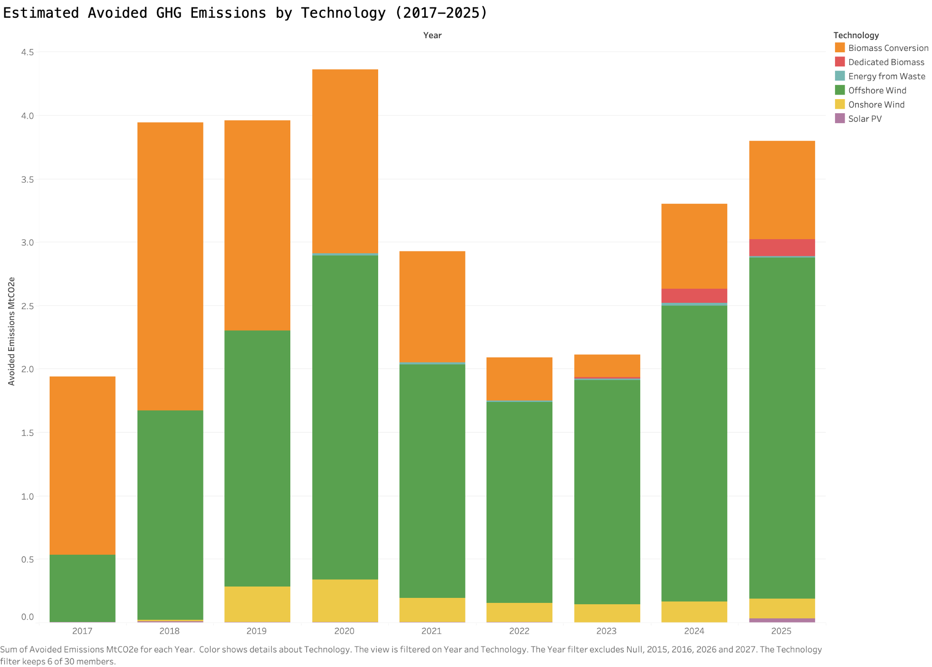
Worksheet 04 - Avoided GHG Emissions
41
Source: Tableau worksheet created from the consolidated LCCC data export.
INDEPENDENT PORTFOLIO ANALYSIS | LCCC PUBLIC DATA
TABLEAU WORKSHEETS

Slide 42
Worksheet 04 - Analysis and Findings
42
MAIN FINDING
Estimated avoided greenhouse gas emissions vary by year, with the highest shown annual level in 2020.
Measure and units
Observed outcome
The chart sums LCCC reported estimated avoided GHG by settlement year and technology, converted from tonnes of CO2 equivalent to million tonnes. It covers 2017 through 2025.
Estimated annual avoided emissions reach approximately 4.36 MtCO2e in 2020. The total is about 3.30 MtCO2e in 2024 and 3.80 MtCO2e in 2025.
Technology contribution
Interpretation boundary
Offshore wind and biomass conversion account for most of the displayed estimated emissions avoidance. The changing mix mirrors their substantial shares of CfD supported output.
The figures are the source provider estimates, not directly measured carbon reductions. The calculation depends on assumptions about which alternative generation would otherwise have supplied electricity.
INDEPENDENT PORTFOLIO ANALYSIS | LCCC PUBLIC DATA
TABLEAU WORKSHEETS

Slide 43
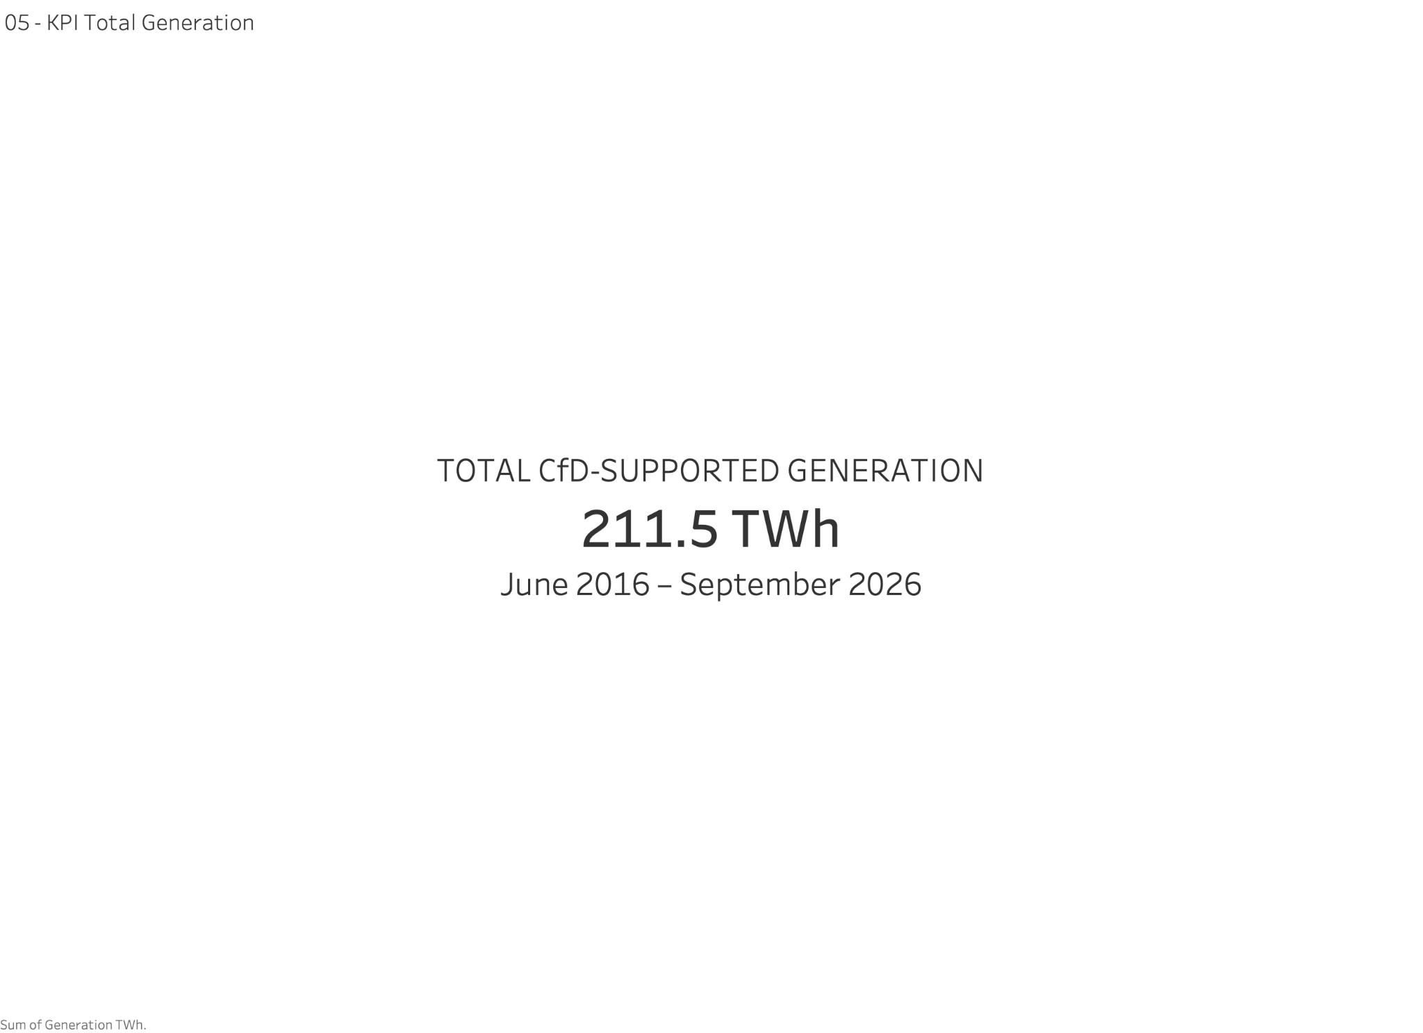
Worksheet 05 - Total Generation KPI
43
Source: Tableau worksheet created from the consolidated LCCC data export.
INDEPENDENT PORTFOLIO ANALYSIS | LCCC PUBLIC DATA
TABLEAU WORKSHEETS

Slide 44
Worksheet 05 - Analysis and Findings
44
MAIN FINDING
The historical data records approximately 211.54 TWh of CfD supported electricity generation through September 2026.
What the KPI captures
Reconciliation
This headline value sums eligible historical generation from June 2016 through September 2026 and displays the result in TWh. It is an accumulated output figure.
The notebook source check reports 211,542,758.72 MWh, equivalent to 211.54 TWh. The Tableau worksheet displays the same total rounded to a readable value.
Where the metric helps
Important distinction
The KPI provides an immediate measure of historical scheme supported generation and serves as the lead statistic in the Energy Portfolio Overview dashboard.
Accumulated generation is an energy quantity, whereas the separate capacity KPI is in GW. The values cannot be compared directly without a time period and operational assumptions.
INDEPENDENT PORTFOLIO ANALYSIS | LCCC PUBLIC DATA
TABLEAU WORKSHEETS

Slide 45

Worksheet 06 - Avoided Emissions KPI
45
Source: Tableau worksheet created from the consolidated LCCC data export.
INDEPENDENT PORTFOLIO ANALYSIS | LCCC PUBLIC DATA
TABLEAU WORKSHEETS

Slide 46
Worksheet 06 - Analysis and Findings
46
MAIN FINDING
The source reports approximately 31.31 MtCO2e of estimated avoided greenhouse gas emissions during the historical period.
What the KPI captures
Reconciliation
This measure sums source reported avoided GHG estimates and expresses the result in million tonnes of CO2 equivalent, using the available historical settlement records.
The Python check reports 31,307,245.23 tonnes of estimated avoided CO2 equivalent, agreeing with the Tableau total of 31.31 MtCO2e after rounding.
Where it appears
Limitations
The indicator sits alongside generation and contract capacity on the Portfolio Overview dashboard. It adds an environmental perspective to the physical output measures.
It is an estimate based on source methodology and assumptions. I do not describe it as an independently measured reduction or infer a causal impact without a defined alternative electricity system.
INDEPENDENT PORTFOLIO ANALYSIS | LCCC PUBLIC DATA
TABLEAU WORKSHEETS

Slide 47
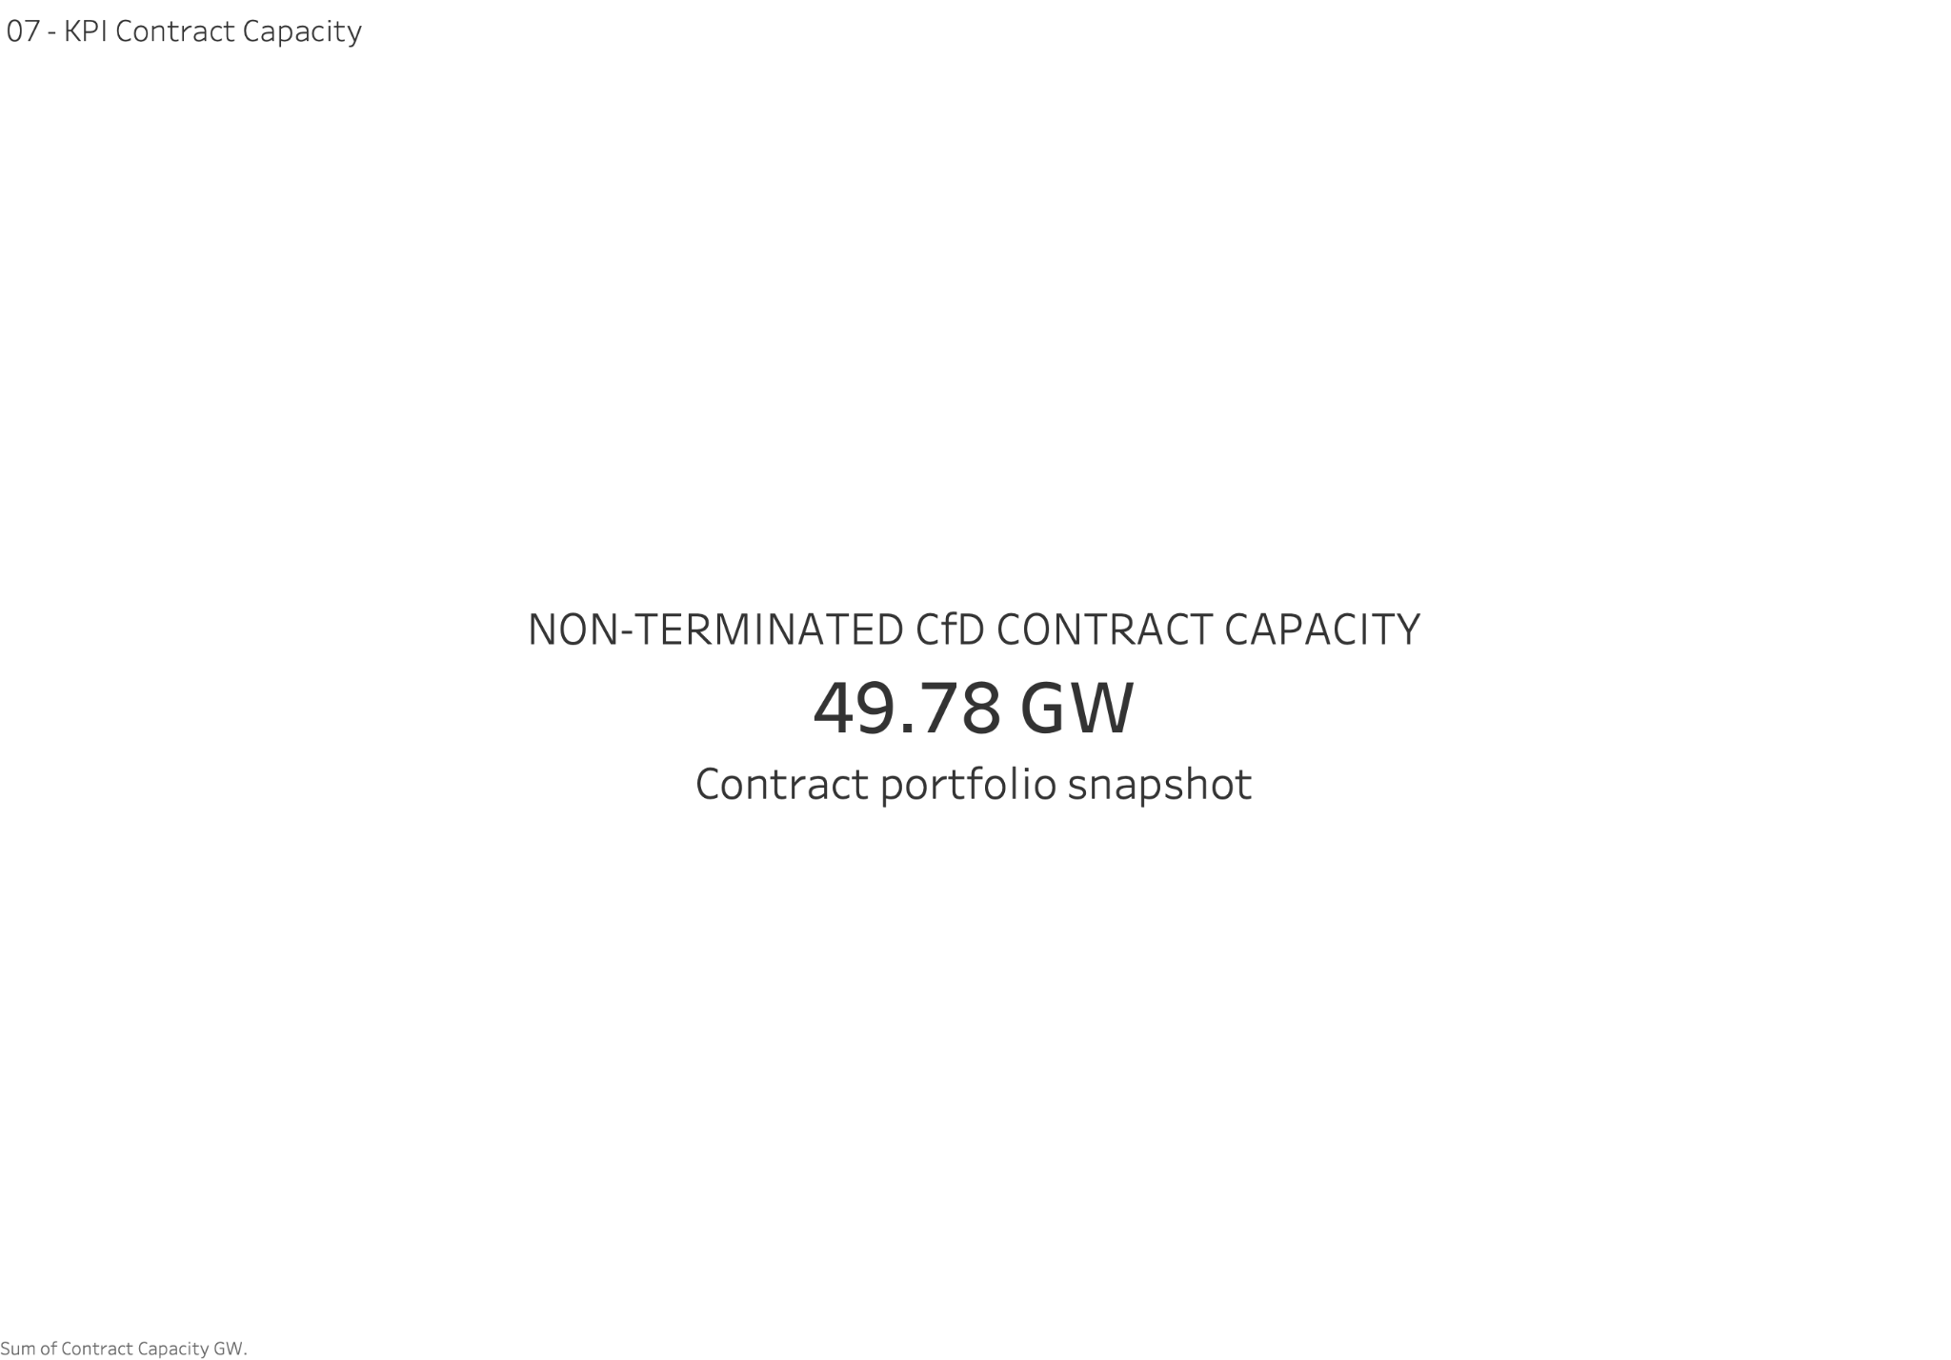
Worksheet 07 - Contract Capacity KPI
47
Source: Tableau worksheet created from the consolidated LCCC data export.
INDEPENDENT PORTFOLIO ANALYSIS | LCCC PUBLIC DATA
TABLEAU WORKSHEETS

Slide 48
Worksheet 07 - Analysis and Findings
48
MAIN FINDING
The non terminated CfD contract portfolio has approximately 49.78 GW of maximum contracted capacity.
KPI construction
Comparison with source
I summed published maximum contract capacity in MW, divided by 1,000 to express GW and excluded contract records whose published status was Terminated.
The full contract status snapshot totals approximately 55.48 GW across all statuses. The smaller non terminated KPI deliberately applies a different status definition.
Business interpretation
Important distinction
This is a useful measure of the contracted pipeline and present portfolio. It provides a planning view alongside historical electricity generation.
Non terminated is not the same as generating today. Some contracts can still be under development or awaiting their start date. The KPI is not a measure of installed operational generating capacity.
INDEPENDENT PORTFOLIO ANALYSIS | LCCC PUBLIC DATA
TABLEAU WORKSHEETS

Slide 49
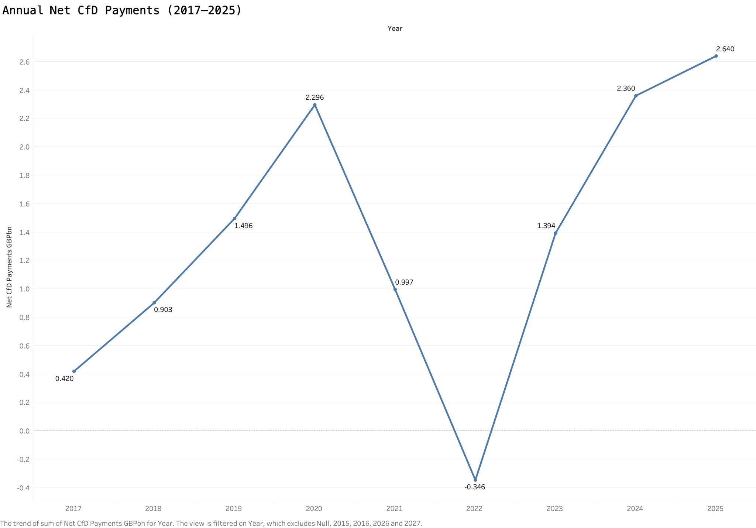
Worksheet 08 - Annual Net CfD Payments
49
Source: Tableau worksheet created from the consolidated LCCC data export.
INDEPENDENT PORTFOLIO ANALYSIS | LCCC PUBLIC DATA
TABLEAU WORKSHEETS

Slide 50
Worksheet 08 - Analysis and Findings
50
MAIN FINDING
Net CfD payments are highly sensitive to market conditions and turn negative in 2022.
Measure definition
Key years
The worksheet sums signed historical CfD payments to generators for complete years 2017 through 2025, expressed in billions of pounds. Negative settlement flows are retained.
The series shows about £2.30bn in 2020, negative £0.346bn in 2022, £2.36bn in 2024 and £2.64bn in 2025. Across the displayed nine years the net total is about £12.16bn.
Economic mechanism
Reading the numbers
Contracts for Difference can produce positive or negative payment flows depending on the relationship between the applicable strike and market reference prices.
A signed net total is not the same as gross financial support. Negative payments are part of the CfD design and should not automatically be labelled financial losses.
INDEPENDENT PORTFOLIO ANALYSIS | LCCC PUBLIC DATA
TABLEAU WORKSHEETS

Slide 51
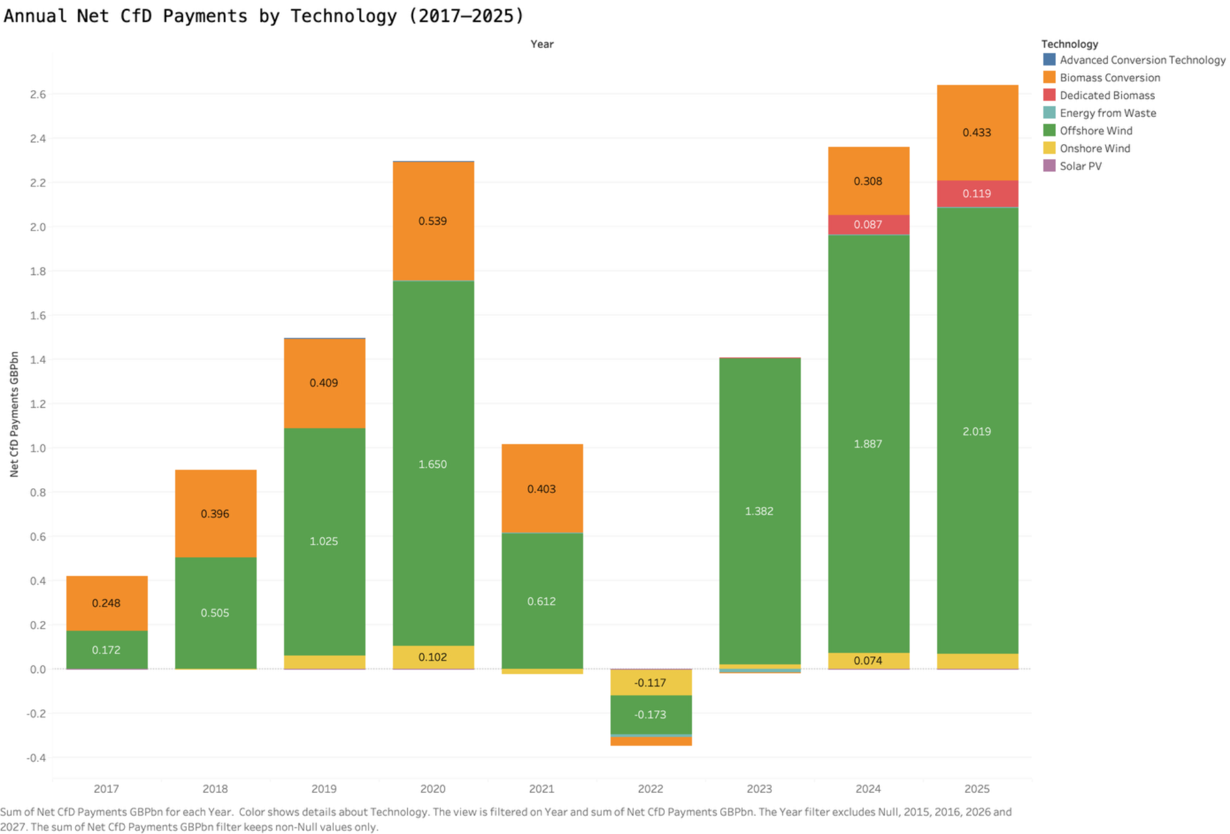
Worksheet 09 - Payments by Technology
51
Source: Tableau worksheet created from the consolidated LCCC data export.
INDEPENDENT PORTFOLIO ANALYSIS | LCCC PUBLIC DATA
TABLEAU WORKSHEETS

Slide 52
Worksheet 09 - Analysis and Findings
52
MAIN FINDING
Technology level payment flows reveal which sources drive changes in signed net CfD payments.
Chart definition
Large contributors
I split annual net settlement payments by technology while retaining negative values. Tableau stacks positive and negative contributions on opposite sides of the zero line.
Offshore wind contributes about £2.019bn of the total in 2025, while biomass conversion contributes roughly £0.433bn. Their combined effect dominates the visible positive stack.
The year 2022
Why it matters
Several technology contributions fall below zero in 2022, including offshore and onshore wind. The signed breakdown helps explain why the overall annual result is negative.
Technology shares of settlement payments need not match generation shares. Contract strike prices, output and the relevant market reference index affect the payment per unit of eligible electricity.
INDEPENDENT PORTFOLIO ANALYSIS | LCCC PUBLIC DATA
TABLEAU WORKSHEETS

Slide 53
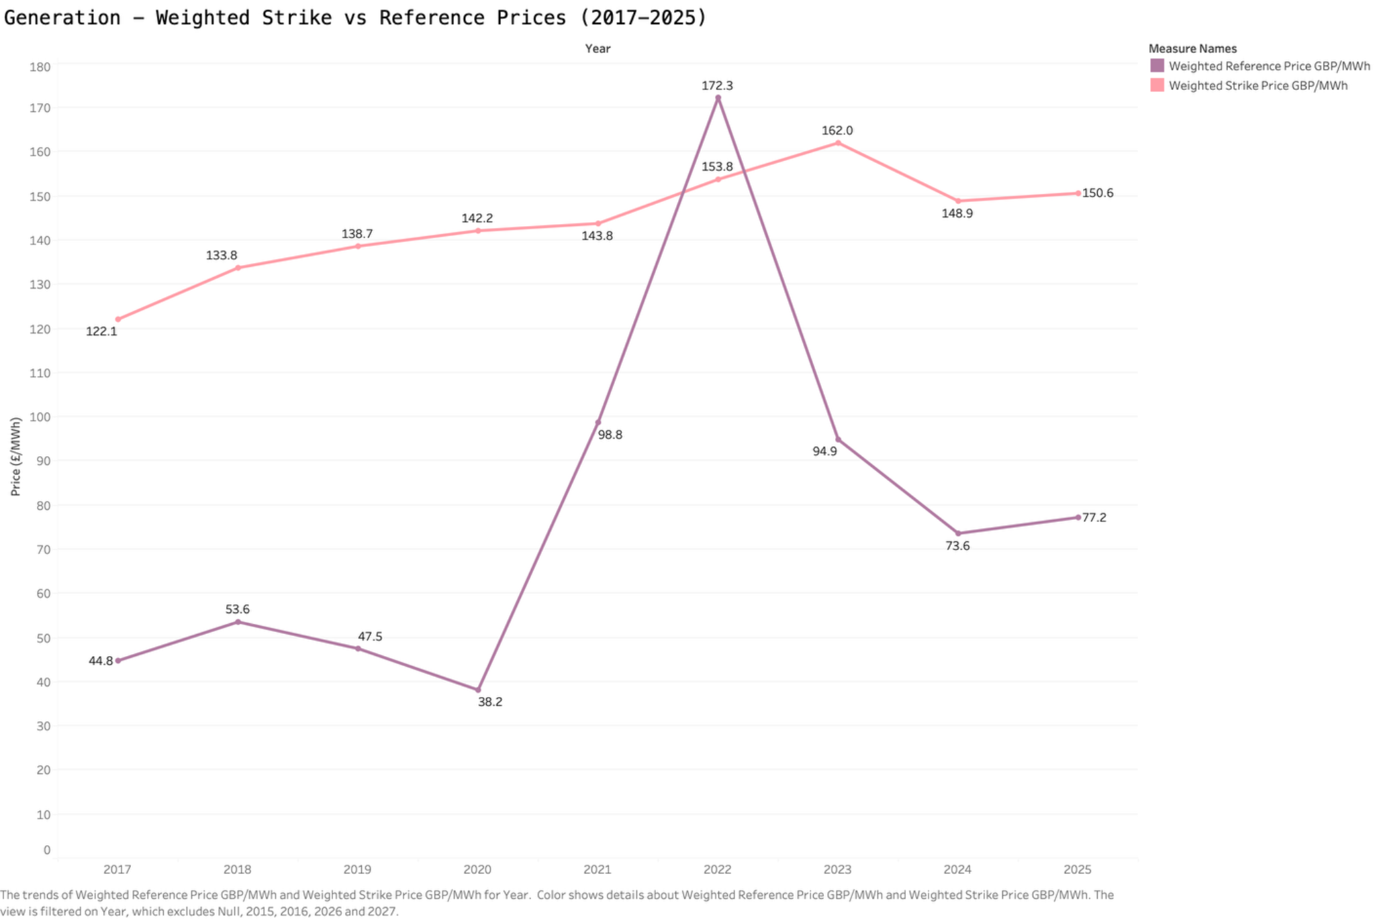
Worksheet 10 - Strike vs Reference Prices
53
Source: Tableau worksheet created from the consolidated LCCC data export.
INDEPENDENT PORTFOLIO ANALYSIS | LCCC PUBLIC DATA
TABLEAU WORKSHEETS

Slide 54
Worksheet 10 - Analysis and Findings
54
MAIN FINDING
In 2022 the generation weighted reference price exceeds the generation weighted strike price, providing context for net repayments.
Calculated measures
2022 comparison
I divided generation multiplied by each unit price by the total eligible generation, separately for strike and reference prices. This keeps weights consistent with reported generation.
The displayed weighted strike price is approximately £153.8 per MWh and the reference price about £172.3 per MWh. The difference, strike minus reference, is negative £18.5 per MWh.
Additional context
Scope of interpretation
By 2023 the reference series falls toward £94.9 per MWh while the strike series remains around £162.0 per MWh. Positive CfD payment requirements return in the payment chart.
The annual weighted difference summarises the eligible portfolio in the data. Real settlement payments also depend on contract rules, appropriate price indexes and monthly or daily eligible output.
INDEPENDENT PORTFOLIO ANALYSIS | LCCC PUBLIC DATA
TABLEAU WORKSHEETS

Slide 55
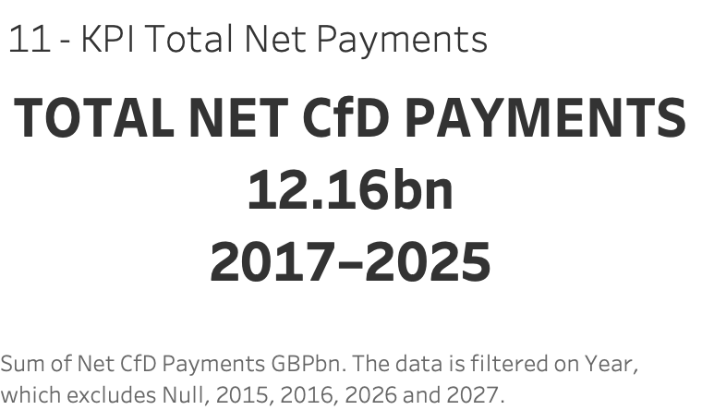
Worksheet 11 - Net Payments KPI
55
Source: Tableau worksheet created from the consolidated LCCC data export.
INDEPENDENT PORTFOLIO ANALYSIS | LCCC PUBLIC DATA
TABLEAU WORKSHEETS

Slide 56
Worksheet 11 - Analysis and Findings
56
MAIN FINDING
Net CfD payments for the complete years 2017 through 2025 total approximately £12.16bn.
Definition
Reconciliation
This KPI adds the signed yearly payments in the historical settlement data after limiting the reporting period to nine complete calendar years.
The value corresponds to the annual payments chart and preserves the negative net result in 2022 rather than adding only positive amounts.
Why I selected this horizon
Financial interpretation
The source begins during 2016 and ends during 2026. Restricting the financial headline to 2017 through 2025 avoids presenting two partial years as directly comparable annual outcomes.
This is an aggregate net amount paid to generators, not gross payments, expenditure for the entire policy, or a fixed future liability. Signed payment conventions remain essential to the reading.
INDEPENDENT PORTFOLIO ANALYSIS | LCCC PUBLIC DATA
TABLEAU WORKSHEETS

Slide 57
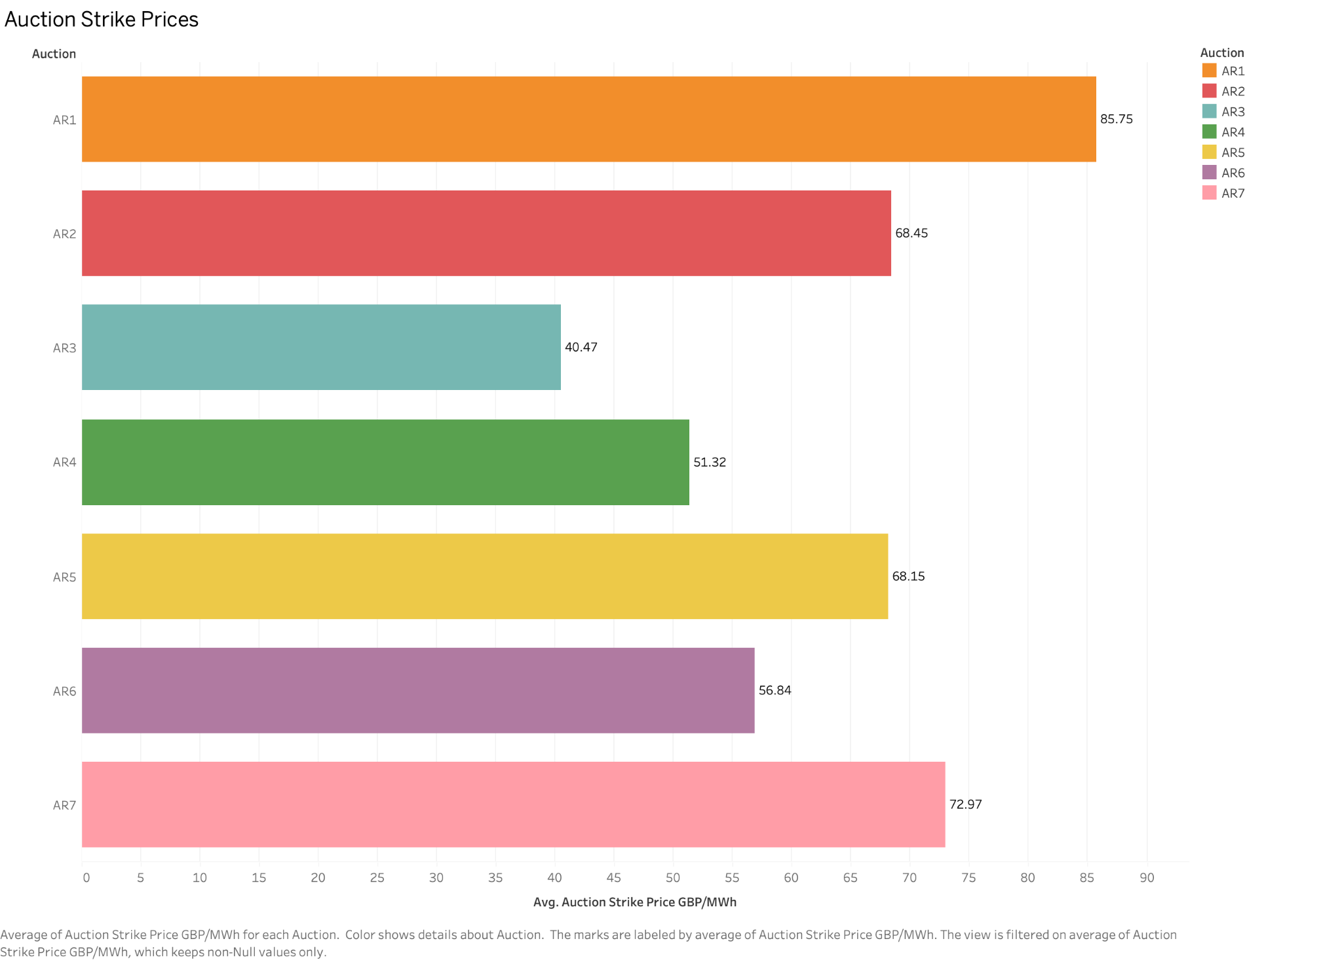
Worksheet 12 - Auction Strike Prices
57
Source: Tableau worksheet created from the consolidated LCCC data export.
INDEPENDENT PORTFOLIO ANALYSIS | LCCC PUBLIC DATA
TABLEAU WORKSHEETS

Slide 58
Worksheet 12 - Analysis and Findings
58
MAIN FINDING
Published average auction strike prices differ substantially across allocation rounds AR1 to AR7.
Statistic used
Values
I computed an unweighted arithmetic mean of reported award strike prices for each allocation round. Every published project award contributes equally to the mean.
AR1 has a mean of £85.75 per MWh, AR3 reaches £40.47 per MWh and AR7 is £72.97 per MWh. These are descriptive differences, not adjusted measures of equivalent technology costs.
Why it matters
Comparison caution
Auction outcomes provide context on how new CfD contracts are awarded and how published pricing differs across auction rounds and technology mixes.
Published price bases and the mix of technologies can change between auction rounds. A fair real terms comparison would require inflation rebasing and probably technology and capacity adjustments.
INDEPENDENT PORTFOLIO ANALYSIS | LCCC PUBLIC DATA
TABLEAU WORKSHEETS

Slide 59
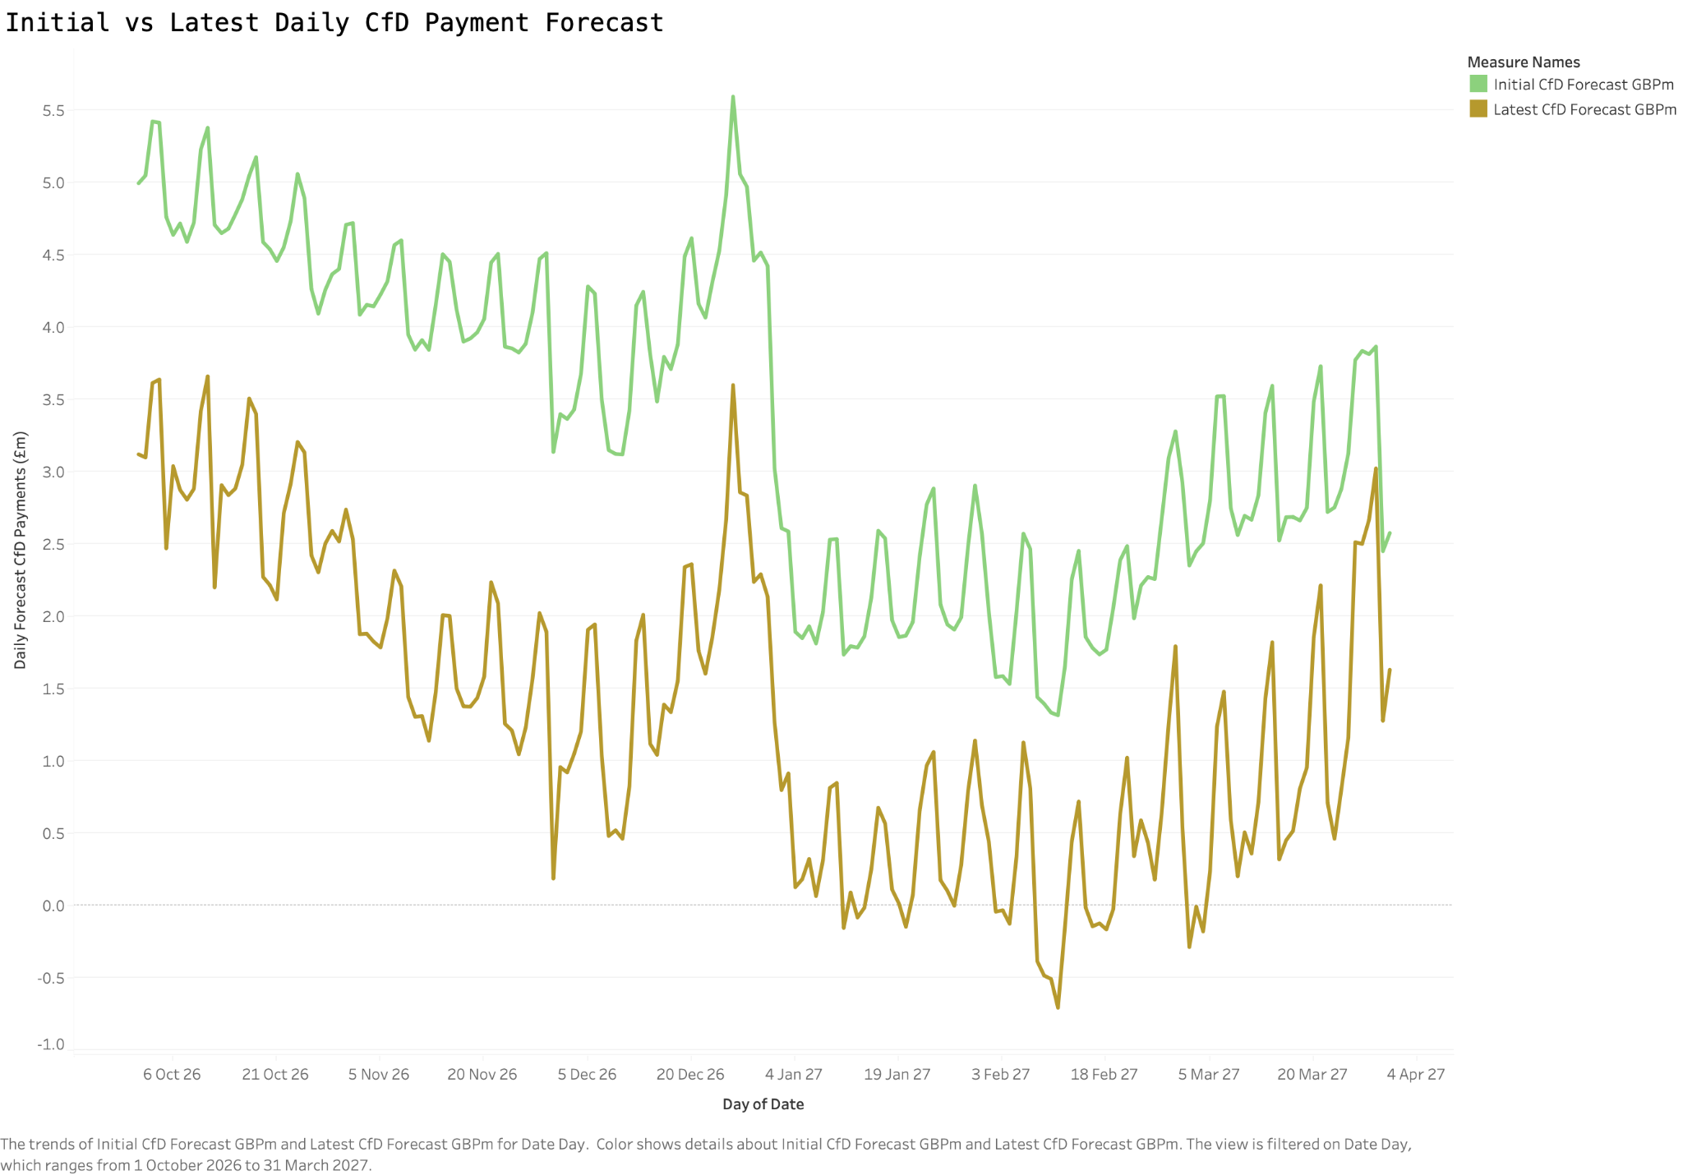
Worksheet 13 - Daily Payment Forecasts
59
Source: Tableau worksheet created from the consolidated LCCC data export.
INDEPENDENT PORTFOLIO ANALYSIS | LCCC PUBLIC DATA
TABLEAU WORKSHEETS

Slide 60
Worksheet 13 - Analysis and Findings
60
MAIN FINDING
Latest payment forecasts are lower than initial forecasts on every overlapping settlement date in the selected six month window.
Source and period
Expected payments
The two series come from LCCC in period tracking, restricted to the 182 dates where both initial and latest payment forecasts exist from October 2026 to March 2027.
The initial forecast totals approximately £617.39m across paired dates. The latest forecast totals around £244.17m. Daily estimates show substantial variation over the window.
Pattern in the chart
What this does not show
Both versions fluctuate, including periodic short term peaks. The latest series remains below the initial series in the compared dates, revealing a consistent downward reassessment.
The file has no populated actual payment values. This comparison measures changes in forecasts, not realised support costs or a forecast accuracy score.
INDEPENDENT PORTFOLIO ANALYSIS | LCCC PUBLIC DATA
TABLEAU WORKSHEETS

Slide 61
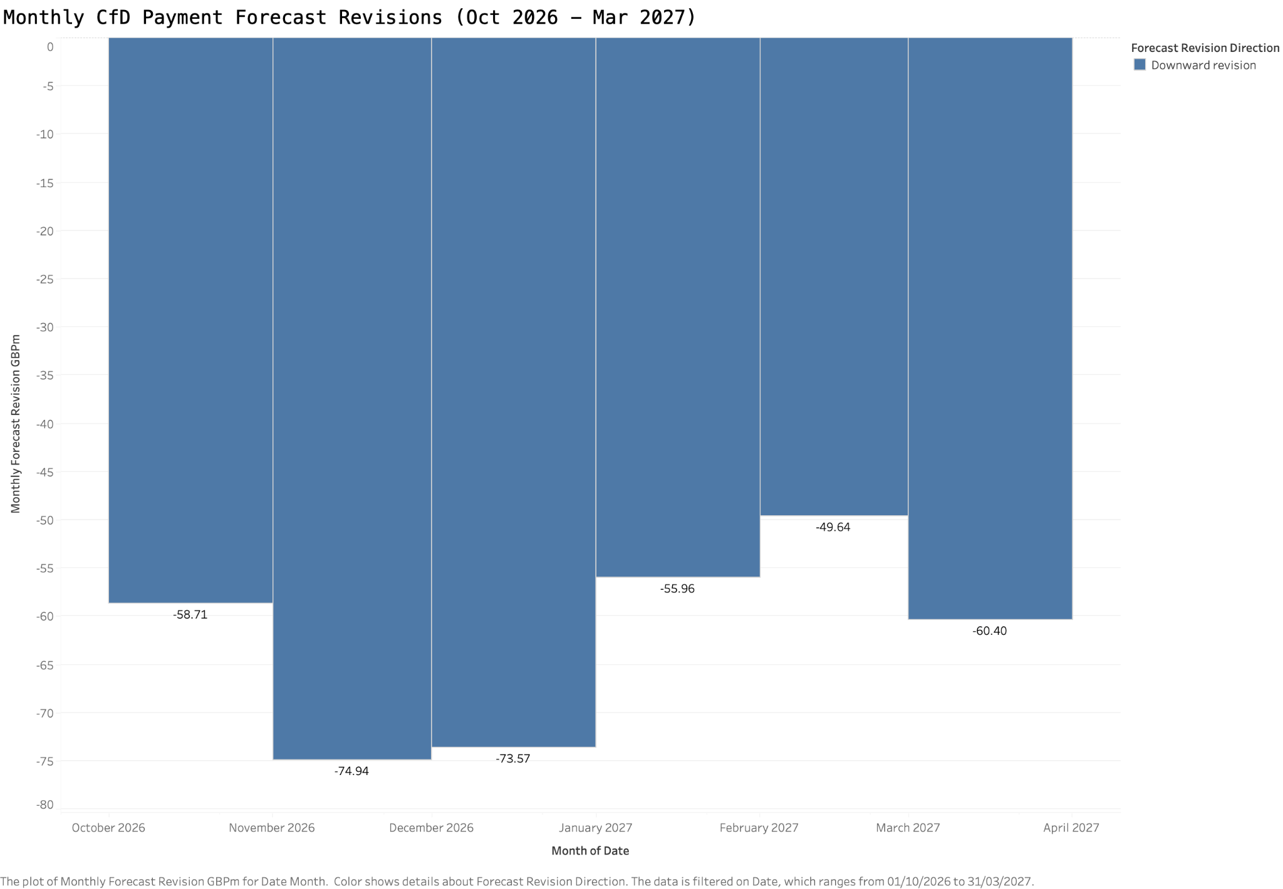
Worksheet 14 - Monthly Forecast Revisions
61
Source: Tableau worksheet created from the consolidated LCCC data export.
INDEPENDENT PORTFOLIO ANALYSIS | LCCC PUBLIC DATA
TABLEAU WORKSHEETS

Slide 62
Worksheet 14 - Analysis and Findings
62
MAIN FINDING
All six months show downward net revisions in projected CfD payments, totalling approximately negative £373.22m.
How it is calculated
Largest revisions
For each month I subtract the sum of initial forecasts from the sum of latest forecasts on matching settlement dates. Negative results mean the expected payment is lower in the latest release.
November 2026 has a revision near negative £74.94m, followed by December 2026 near negative £73.57m. February 2027 has the smallest monthly reduction at about negative £49.64m.
Why this view helps
Scope of the figure
A monthly view makes the financial revision easier to interpret than a busy daily line chart. It identifies the periods contributing most to the aggregate £373.22m reassessment.
This is not monthly realised expenditure or a forecast error. All values come from two forward looking forecast snapshots and the result depends on restricting both to identical dates.
INDEPENDENT PORTFOLIO ANALYSIS | LCCC PUBLIC DATA
TABLEAU WORKSHEETS

Slide 63
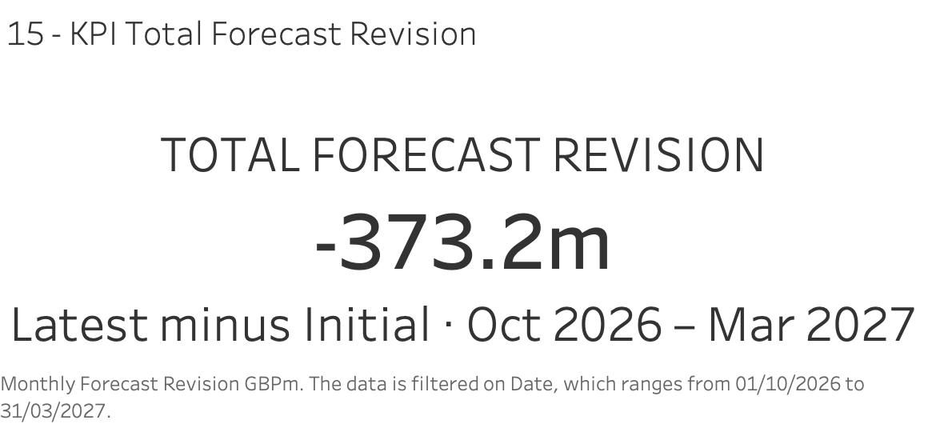
Worksheet 15 - Forecast Revision KPI
63
Source: Tableau worksheet created from the consolidated LCCC data export.
INDEPENDENT PORTFOLIO ANALYSIS | LCCC PUBLIC DATA
TABLEAU WORKSHEETS

Slide 64
Worksheet 15 - Analysis and Findings
64
MAIN FINDING
Expected CfD payments decrease by about £373.22m from the initial to the latest forecast over the matched period.
KPI definition
Relative size
The number is the latest payment forecast total minus the initial forecast total for dates from 1 October 2026 to 31 March 2027 where both values exist.
The initial paired forecast is about £617.39m and the latest about £244.17m. This gives a downward change equivalent to approximately 60.45 percent of the initial amount.
Dashboard contribution
Interpretation caution
The KPI places the most important forecast revision in one clear figure. The daily and monthly charts below it explain how the aggregate change develops across time.
A lower forecast does not prove the amount was saved or lost. The actual payment series is unavailable in the provided tracking source, so the result remains a change in expectations.
INDEPENDENT PORTFOLIO ANALYSIS | LCCC PUBLIC DATA
TABLEAU WORKSHEETS

Slide 65
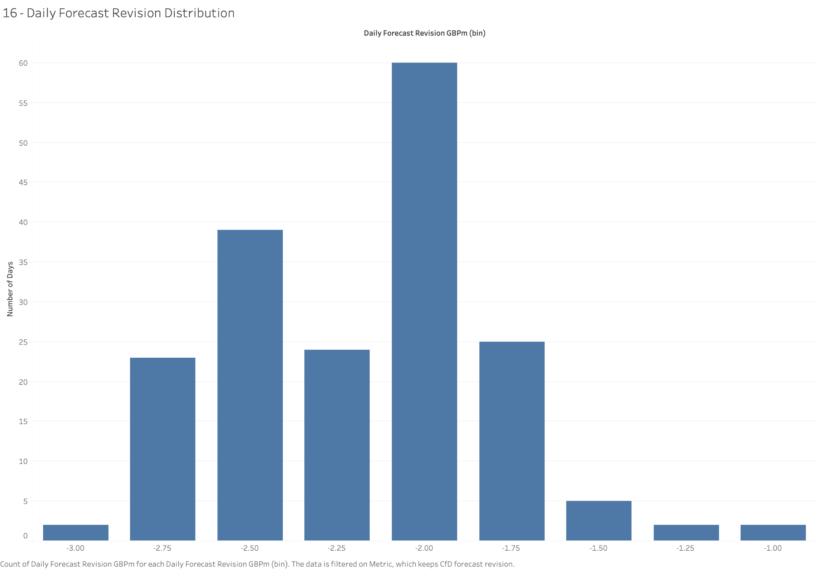
Worksheet 16 - Daily Revision Distribution
65
Source: Tableau worksheet created from the consolidated LCCC data export.
INDEPENDENT PORTFOLIO ANALYSIS | LCCC PUBLIC DATA
TABLEAU WORKSHEETS

Slide 66
Worksheet 16 - Analysis and Findings
66
MAIN FINDING
The distribution shows negative forecast revisions on all 182 paired days, concentrated around negative £2m per day.
Histogram definition
Observed distribution
I grouped daily latest minus initial payment revisions into bins of £0.25m. The horizontal axis expresses revisions in millions of pounds and the vertical axis counts forecast days.
All bars lie below zero. The bin near negative £2.00m contains 60 days and is the modal range. The notebook also reports a median absolute daily revision close to £1.97m.
What the shape adds
Limits
A histogram shows whether the total change comes from a few exceptional dates or a broad pattern. Here negative revisions are spread across the entire matched period.
The bin width affects the apparent concentration. Observations are daily revisions rather than independent accuracy errors, and this graphic cannot establish their economic causes.
INDEPENDENT PORTFOLIO ANALYSIS | LCCC PUBLIC DATA
TABLEAU WORKSHEETS

Slide 67
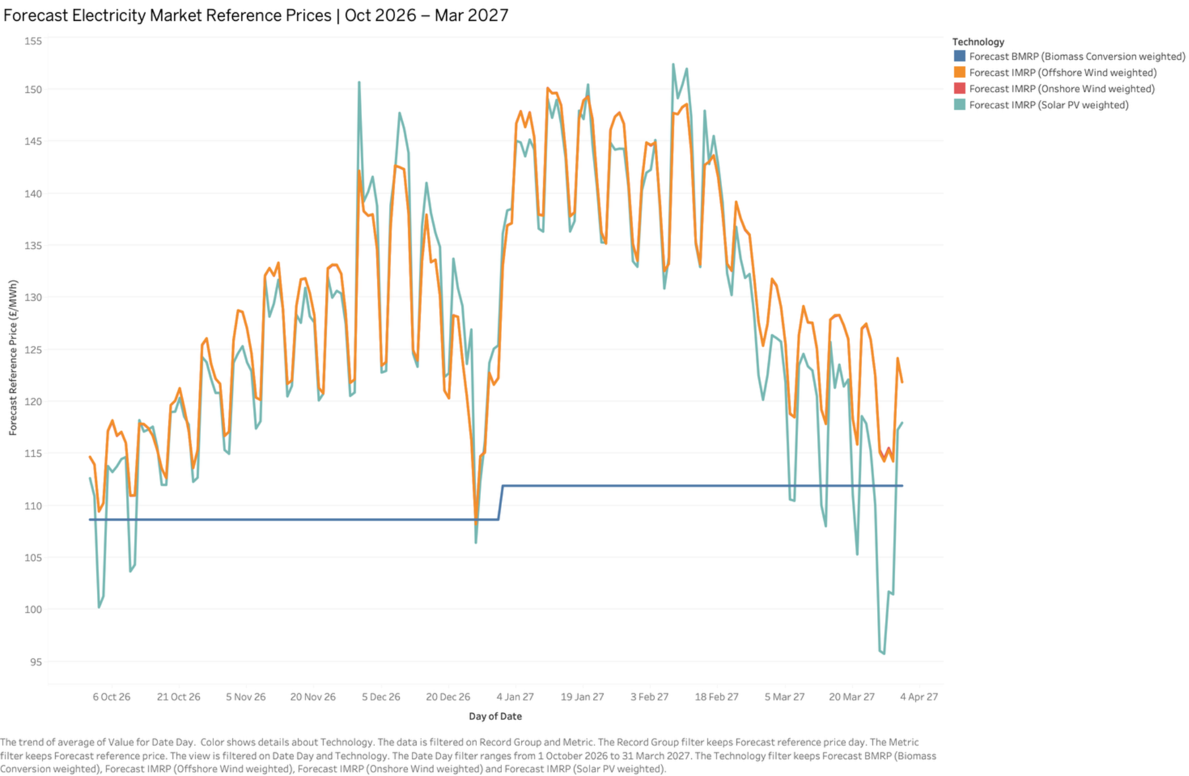
Worksheet 17 - Forecast Reference Prices
67
Source: Tableau worksheet created from the consolidated LCCC data export.
INDEPENDENT PORTFOLIO ANALYSIS | LCCC PUBLIC DATA
TABLEAU WORKSHEETS

Slide 68
Worksheet 17 - Analysis and Findings
68
MAIN FINDING
Forecast reference prices vary by technology and delivery date, with intermittent series fluctuating more than the baseload benchmark.
Series plotted
Forecast behaviour
The graph includes forecasts weighted for offshore wind, onshore wind, solar PV and a baseload reference for biomass conversion. Each series is labelled with its relevant forecast price definition.
The biomass baseload benchmark remains close to £108.65 per MWh in late 2026 and about £111.90 per MWh in early 2027. Intermittent wind and solar prices change much more frequently.
What I learn
Data boundary
Technology specific price profiles matter because the applicable reference price influences how the CfD settlement amount differs from the contracted strike price.
These are estimated future reference prices, not observed prices. The forecast determination context should be retained if a later portal download includes updated or overlapping delivery windows.
INDEPENDENT PORTFOLIO ANALYSIS | LCCC PUBLIC DATA
TABLEAU WORKSHEETS

Slide 69
Four Tableau dashboards
69
Executive views of generation, technology, finance and forecast risk
Dashboard 1 integrates the historical generation and emissions indicators with capacity.
Dashboard 2 compares renewable technology production and estimated environmental outcomes.
UK CfD
LCCC open data
Dashboard 3 brings together signed CfD payments, price relationships and auction outcomes.
Dashboard 4 examines forecast revisions and expected market reference prices.
INDEPENDENT PORTFOLIO ANALYSIS | LCCC PUBLIC DATA
TABLEAU DASHBOARDS

Slide 70
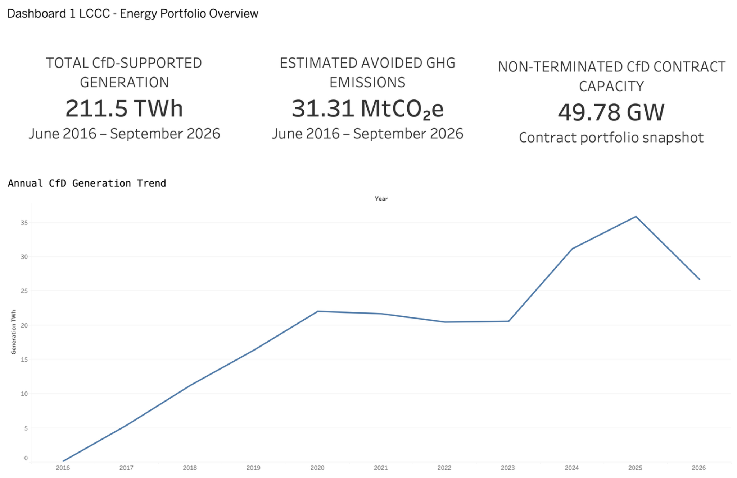
Dashboard 1 - Energy Portfolio Overview
70
Source: Tableau dashboards made from the public LCCC datasets.
INDEPENDENT PORTFOLIO ANALYSIS | LCCC PUBLIC DATA
TABLEAU DASHBOARDS

Slide 71
Dashboard 1 - Interpretation
71
MAIN FINDING
The opening dashboard brings together 211.54 TWh of CfD eligible generation, 31.31 MtCO2e of estimated avoided emissions and 49.78 GW of non terminated contracted capacity.
Summary of the portfolio
Trend through 2025
The three KPI indicators show the scale of electricity supplied through CfD eligible units, the source estimated emissions associated with that output, and the current non terminated contract capacity.
Historical annual generation reaches about 35.84 TWh in 2025, following a strong rise in 2024. The growth is visible in the line chart without mixing it with project award or forecast data.
Different metric types
How to read it
Generation and estimated emissions are accumulated historical totals through September 2026. Capacity is a snapshot of contracts rather than energy generated during that period.
Use this dashboard as the high level orientation before exploring which technologies generate the electricity and how much settlement support flows to their projects.
INDEPENDENT PORTFOLIO ANALYSIS | LCCC PUBLIC DATA
TABLEAU DASHBOARDS

Slide 72
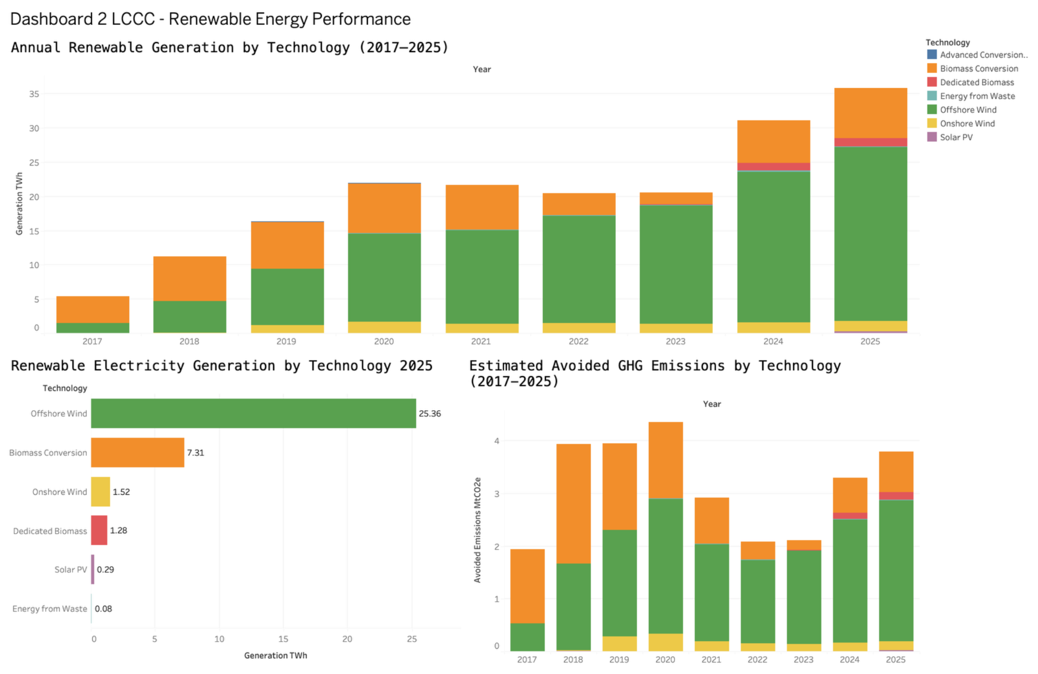
Dashboard 2 - Renewable Energy Performance
72
Source: Tableau dashboards made from the public LCCC datasets.
INDEPENDENT PORTFOLIO ANALYSIS | LCCC PUBLIC DATA
TABLEAU DASHBOARDS

Slide 73
Dashboard 2 - Interpretation
73
MAIN FINDING
The second dashboard explains the changing generation mix and shows how the source attributes estimated avoided greenhouse gas emissions to technologies.
Changing generation mix
Detailed 2025 ranking
Annual stacked bars show offshore wind becoming the largest CfD supported source. By 2025 the technology supplies around 25.36 TWh of the 35.84 TWh recorded for the year.
Biomass conversion ranks second with 7.31 TWh. Onshore wind, dedicated biomass, solar PV and energy from waste account for much smaller amounts in the displayed historical dataset.
Environmental view
Limits of interpretation
The estimated avoided emissions chart reaches about 4.36 MtCO2e in 2020 and around 3.80 MtCO2e in 2025. Offshore wind and biomass conversion dominate the reported technology allocation.
The electricity series covers only CfD eligible output. Avoided greenhouse gases are model based source estimates, and a technology category with low historic generation may still have substantial future contracted capacity.
INDEPENDENT PORTFOLIO ANALYSIS | LCCC PUBLIC DATA
TABLEAU DASHBOARDS

Slide 74
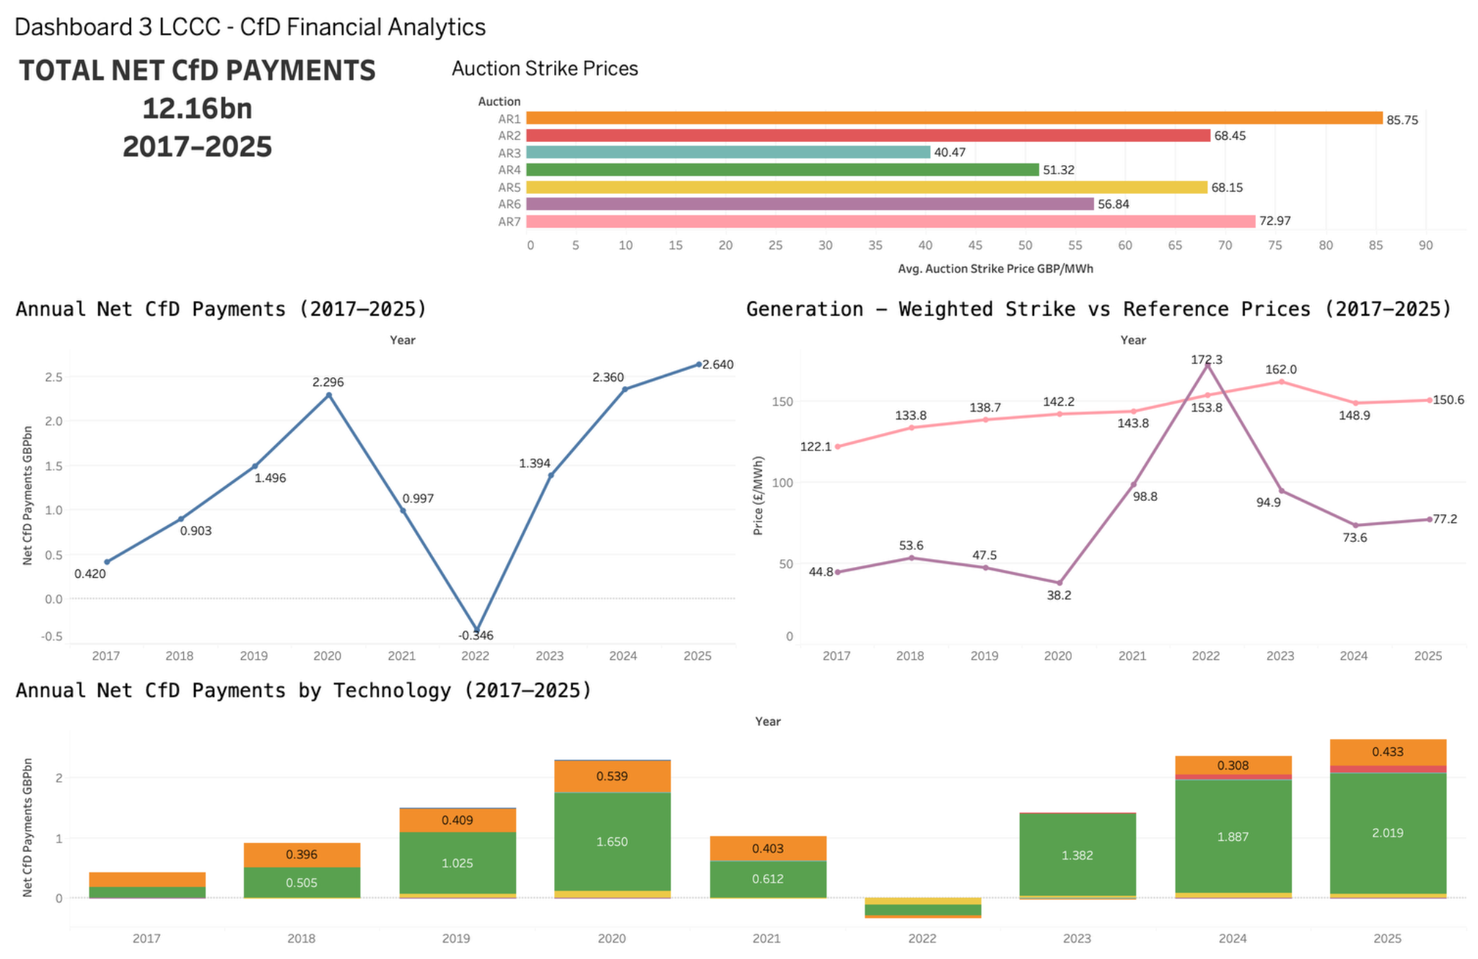
Dashboard 3 - CfD Financial Analytics
74
Source: Tableau dashboards made from the public LCCC datasets.
INDEPENDENT PORTFOLIO ANALYSIS | LCCC PUBLIC DATA
TABLEAU DASHBOARDS

Slide 75
Dashboard 3 - Interpretation
75
MAIN FINDING
This financial dashboard connects £12.16bn of net payments in complete years 2017 to 2025 with strike prices, market reference prices and technology contributions.
Payment fluctuations
Why 2022 stands out
The net annual payment series moves from about £2.30bn in 2020 to negative £0.346bn in 2022 before increasing to approximately £2.64bn in 2025. The signed convention is retained.
In 2022 the generation weighted reference price reaches about £172.3 per MWh versus a strike price near £153.8. This aligns with the scheme requirement for repayments under some conditions.
Technology and auctions
Limitations
Offshore wind accounts for a large share of more recent positive payments. Auction strike prices vary from around £40.47 per MWh for AR3 to £85.75 for AR1 as simple award means.
Auction averages are not inflation normalised or capacity weighted. Net payments cannot be interpreted as gross support, and weighted annual prices summarise rather than determine every project settlement.
INDEPENDENT PORTFOLIO ANALYSIS | LCCC PUBLIC DATA
TABLEAU DASHBOARDS

Slide 76
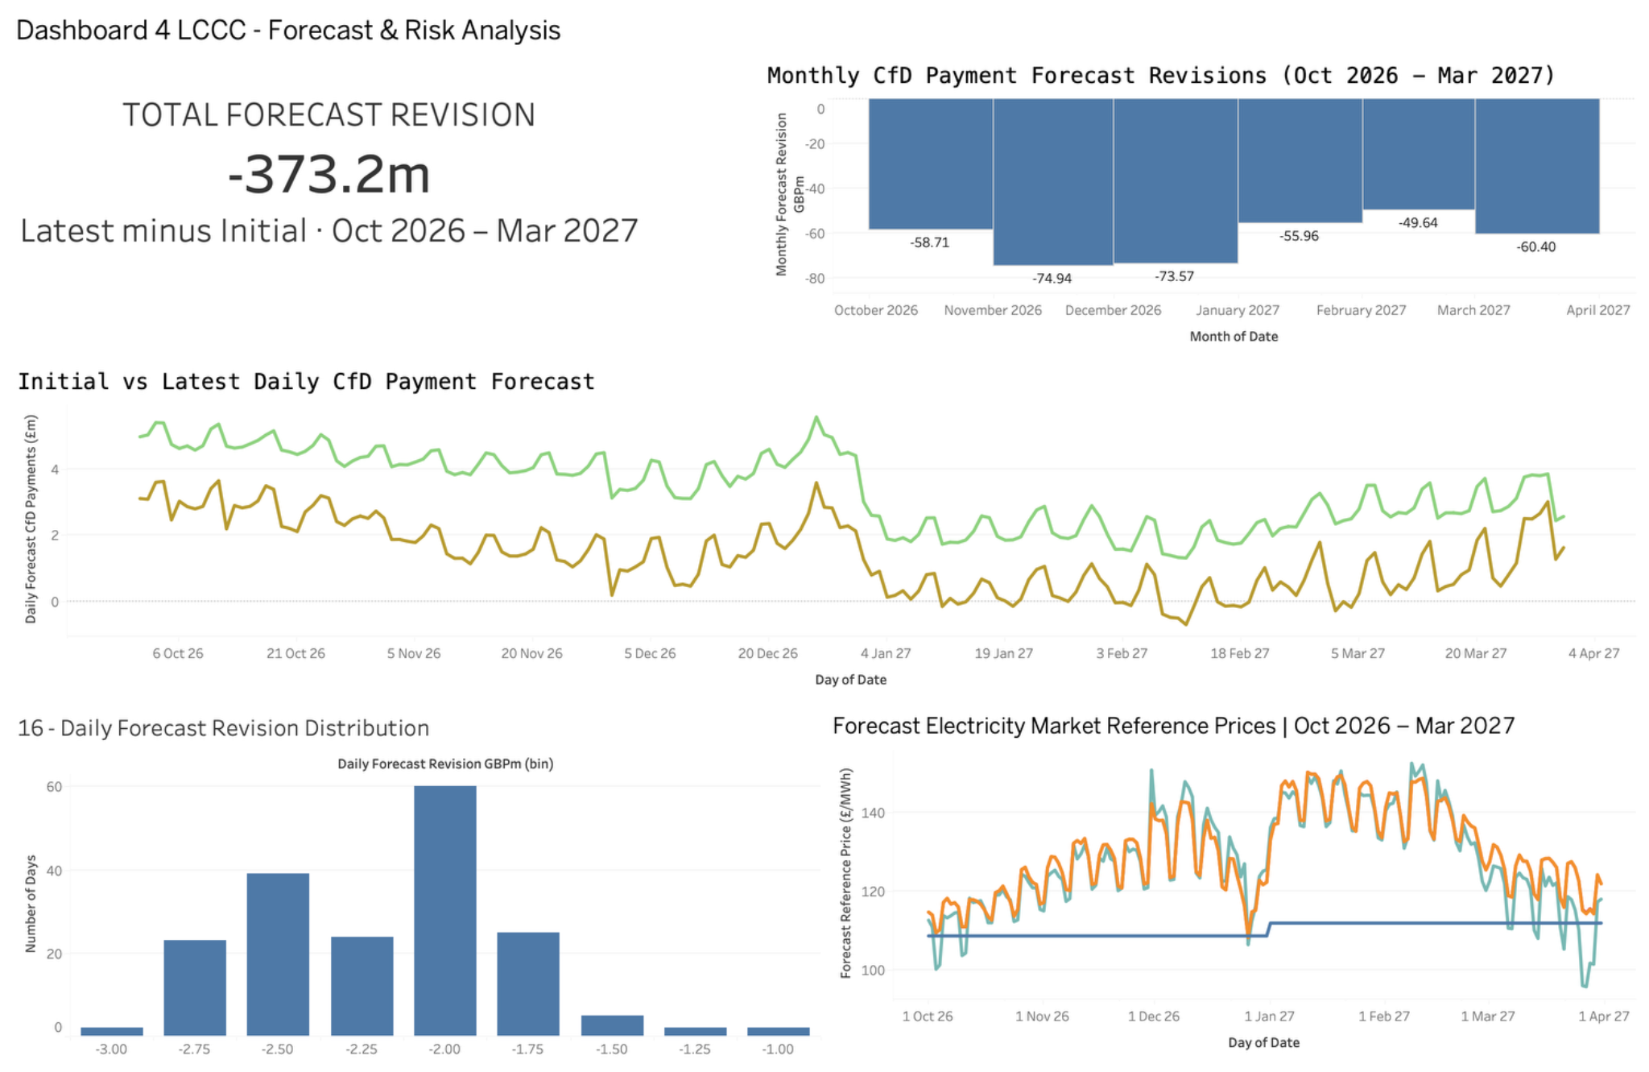
Dashboard 4 - Forecast and Risk Analysis
76
Source: Tableau dashboards made from the public LCCC datasets.
INDEPENDENT PORTFOLIO ANALYSIS | LCCC PUBLIC DATA
TABLEAU DASHBOARDS

Slide 77
Dashboard 4 - Interpretation
77
MAIN FINDING
The final dashboard shows that the latest payment forecast is £373.22m lower than the initial forecast across 182 overlapping days from October 2026 to March 2027.
Daily comparison
Monthly revisions
The initial forecast totals about £617.39m and the latest approximately £244.17m across matched dates. Both series fluctuate while the updated estimate remains lower each day.
Every month has a downward revision. November and December 2026 have the largest monthly reductions, near £74.94m and £73.57m respectively.
Distribution and prices
What risk means here
The histogram shows all daily revisions below zero, concentrated around negative £2m. Technology specific forward reference price series show substantially greater short term volatility than the baseload benchmark.
This is a reassessment of expected payments, not realised loss, saving or forecast accuracy. Future values remain conditional on market expectations, settlement assumptions and source updates.
INDEPENDENT PORTFOLIO ANALYSIS | LCCC PUBLIC DATA
TABLEAU DASHBOARDS

Slide 78
Key conclusions from the project
78
MAIN FINDING
The combined analysis connects what supported generators produce, how CfD payments respond to prices and why forecast revisions must be interpreted carefully.
Electricity generation
Two way settlement design
The historical source records 211.54 TWh of eligible generation through September 2026. Offshore wind is the largest contributor and accounts for about 71 percent of the 2025 total.
Net payments change substantially with reference market prices relative to contract strike prices. The negative 2022 annual total illustrates that CfD cash flows can reverse.
Contract pipeline
Forecast revisions
The snapshot contains around 49.78 GW of non terminated contracted capacity. However, this is not a statement about the operating generation fleet, and it requires status based interpretation.
The matched forward payment estimates show a 60.45 percent downward revision across October 2026 to March 2027. This is informative about changing expectations, but not actual payment performance.
INDEPENDENT PORTFOLIO ANALYSIS | LCCC PUBLIC DATA
CONCLUSION

Slide 79
Scope and reporting limitations
79
MAIN FINDING
I kept the limitations visible because a credible energy analytics project must distinguish observed values, published estimates, contract obligations and forecasts.
Partial periods
Different populations
The historical source begins during June 2016 and ends during September 2026. Annual comparisons use complete years when possible; partial years are labelled and not treated as full year outcomes.
Settlement observations, contract statuses and auction awards describe different populations. I do not assume awarded capacity is operating, or that non terminated capacity represents live generation.
Published estimates
Missing actuals
Avoided GHG values depend on the source calculation methodology. Forecast reference prices and payment forecasts can change with later publications. Published strike prices can use different price bases.
The in period tracking dataset contains no populated actual CfD payments in this extract. Forecast comparisons are limited to 182 paired dates and cannot produce a defensible accuracy or realised savings calculation.
INDEPENDENT PORTFOLIO ANALYSIS | LCCC PUBLIC DATA
CONCLUSION

Slide 80
Project delivery and reproducibility
80
MAIN FINDING
The final work combines a documented Python analysis with a checked single CSV and four Tableau dashboards.
Notebook
Tableau dataset
The executed Jupyter Notebook loads raw data from data/raw, runs quality checks, visualises the six sources and provides written interpretation directly alongside the analysis code.
The consolidated CSV contains 47,361 rows and 26 metrics. Reporting groups and units remain explicit so that renewable generation, settlement payments, auction awards and forecasts can be selected safely.
Visual outputs
Independent project
There are 18 notebook figures, 17 Tableau worksheets and four assembled dashboards. Screenshot pairs in this presentation preserve the original visual results and describe their meaning.
This portfolio study uses publicly available LCCC data. It is not an internal report for LCCC, and the findings should be reviewed against current published definitions before external decisions are made.
INDEPENDENT PORTFOLIO ANALYSIS | LCCC PUBLIC DATA
CONCLUSION

Slide 81
Sources and project material
81
Primary source
Low Carbon Contracts Company Open Data Portal
https://dp.lowcarboncontracts.uk/
Project components
Six source datasets and a documented analysis notebook
Single validated Tableau CSV with 47,361 records and 26 metrics
17 worksheet visualisations and four Tableau dashboards
INDEPENDENT PORTFOLIO ANALYSIS | LCCC PUBLIC DATA
CONCLUSION

