Slide 1
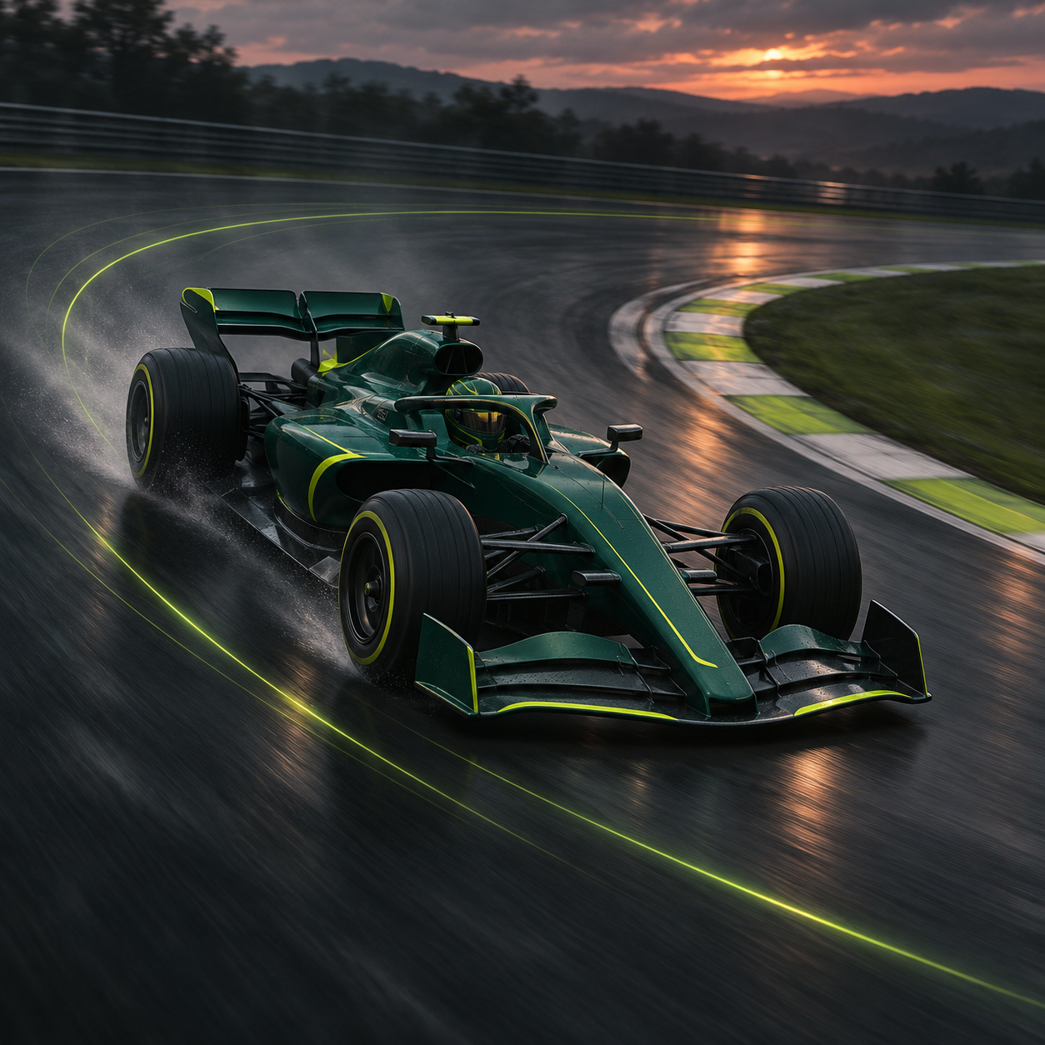
Formula 1 Vehicle Performance Analysis
Silverstone 2025 qualifying and race analysis, with lap-time predictions tested at Spielberg and Silverstone.
Four Tableau dashboards
01 Vehicle Performance
02 Telemetry and Track Sections
03 Tyres, Weather and Race Pace
04 Model Performance and Diagnostics
Notes:
Cover artwork: motorsport concept illustration. Underlying project data: OpenF1 timing, telemetry and weather.

Slide 2
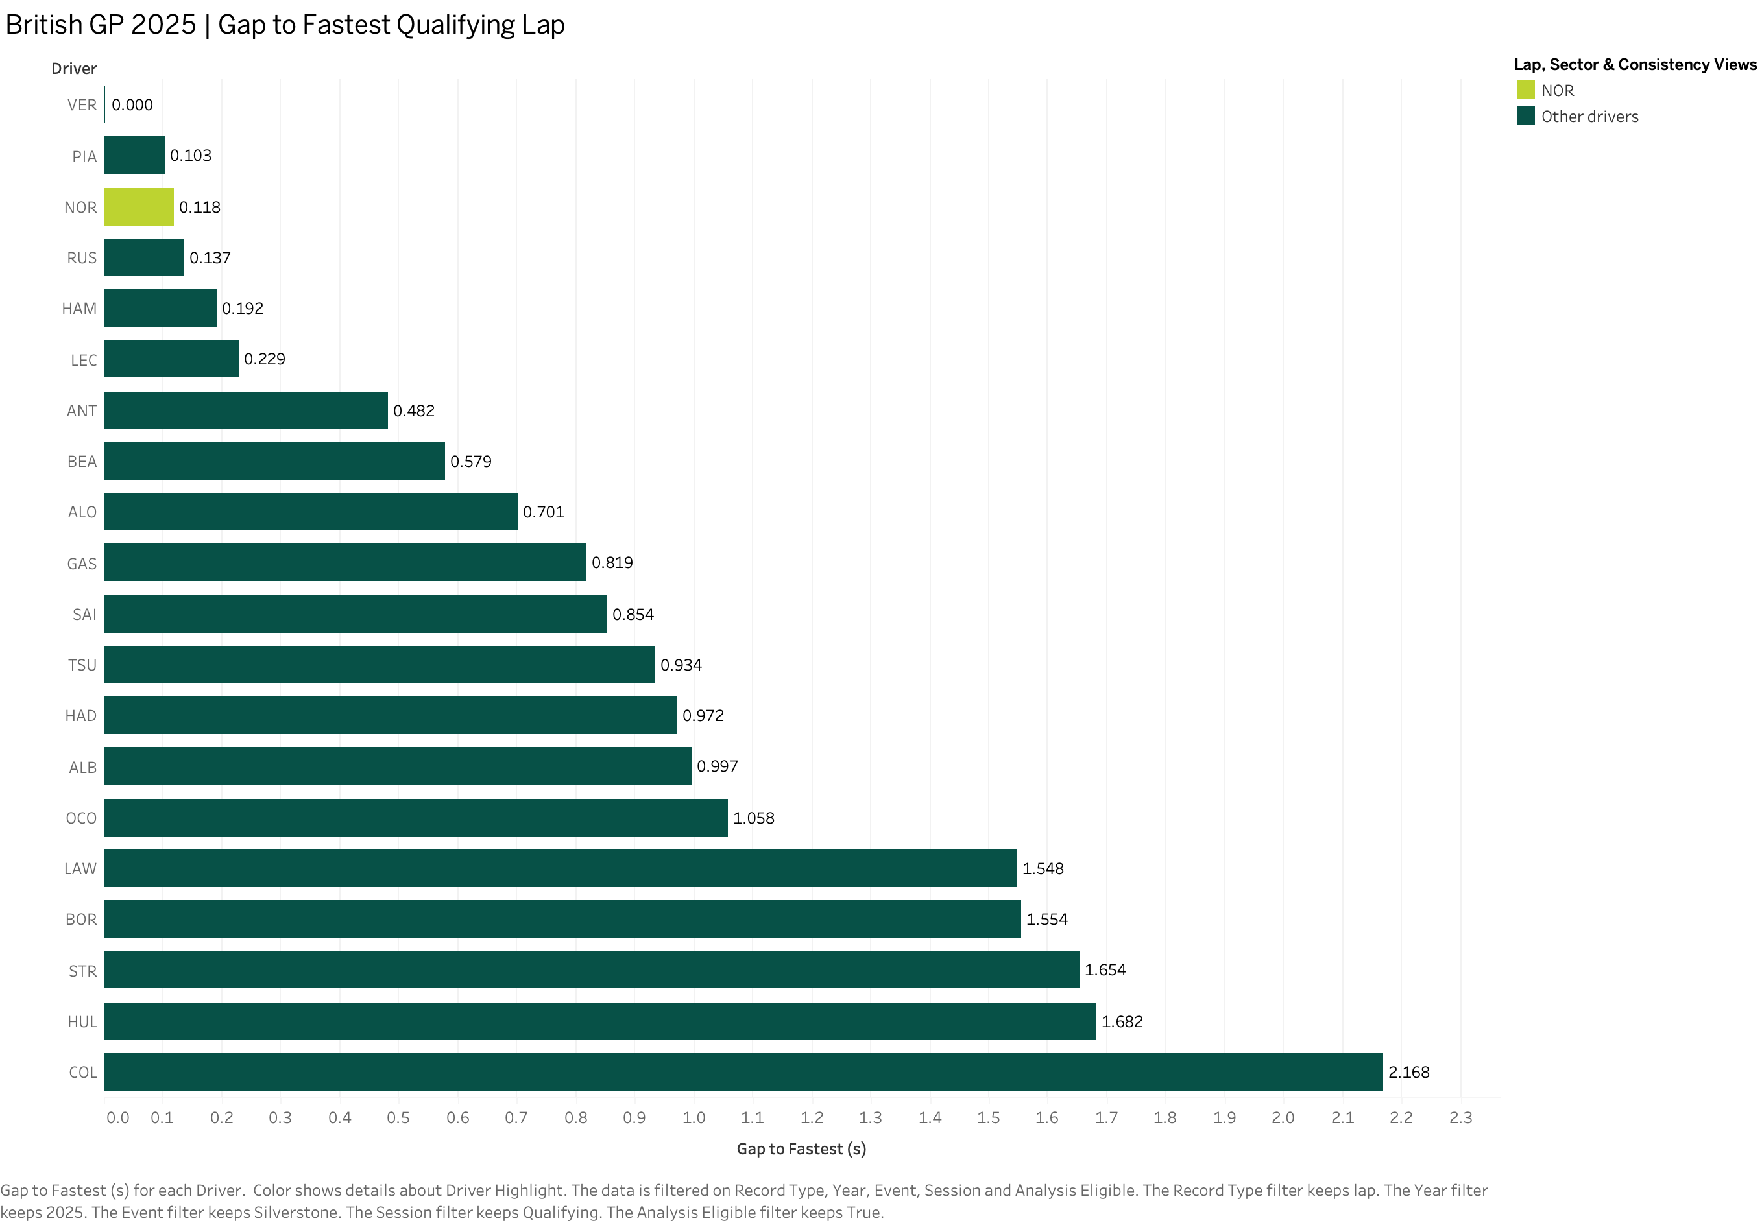
Qualifying lap gaps
D1_S1 Silverstone qualifying, 2025
What the bars show
Each bar compares a driver’s fastest eligible qualifying lap with the session’s fastest eligible lap.
At the front
Verstappen set the benchmark at 84.892 s. Piastri was 0.103 s behind and Norris was 0.118 s behind.
Across the field
The gap reached 2.168 s for Colapinto. The zero at the top represents the benchmark itself.
02
Notes:
Source image: D1_S1 Lap Comparison.png (Tableau export). Underlying project data: OpenF1.

Slide 3
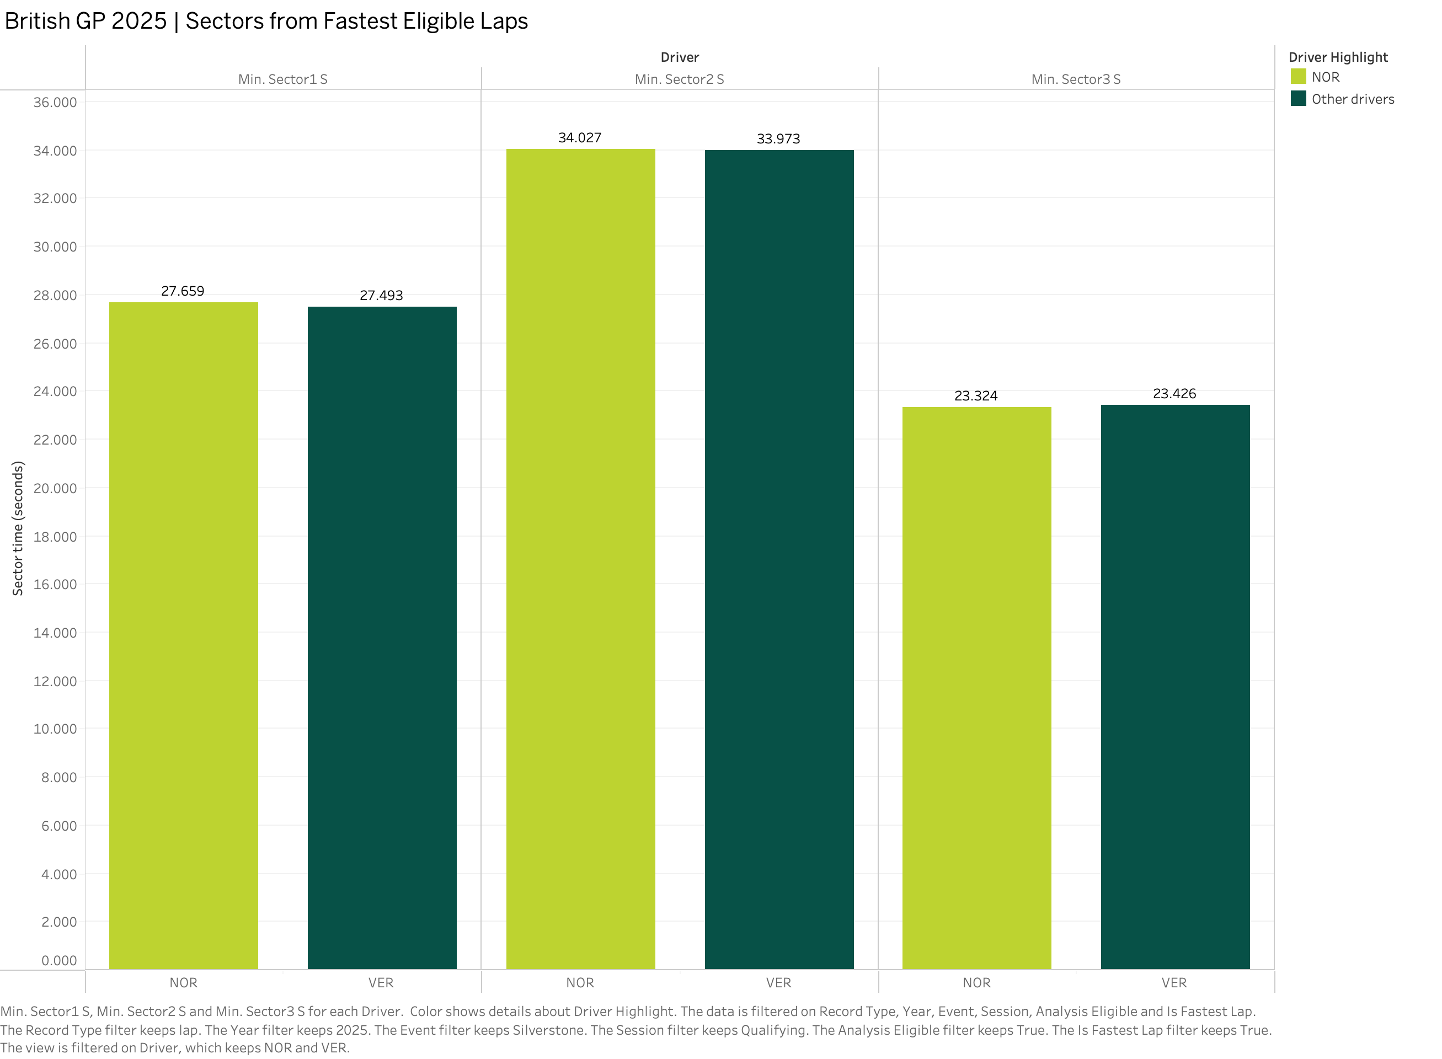
Sector times: Norris and Verstappen
D1_S2 Silverstone qualifying, 2025
Which laps are compared?
The three sectors come from each driver’s fastest eligible lap.
Where Norris lost time
Norris gave up 0.166 s in Sector 1 and 0.054 s in Sector 2.
Where he gained it back
Norris recovered 0.102 s in Sector 3, leaving him 0.118 s behind over the full lap.
03
Notes:
Source image: D1_S2 Sector Comparison.png (Tableau export). Underlying project data: OpenF1.

Slide 4
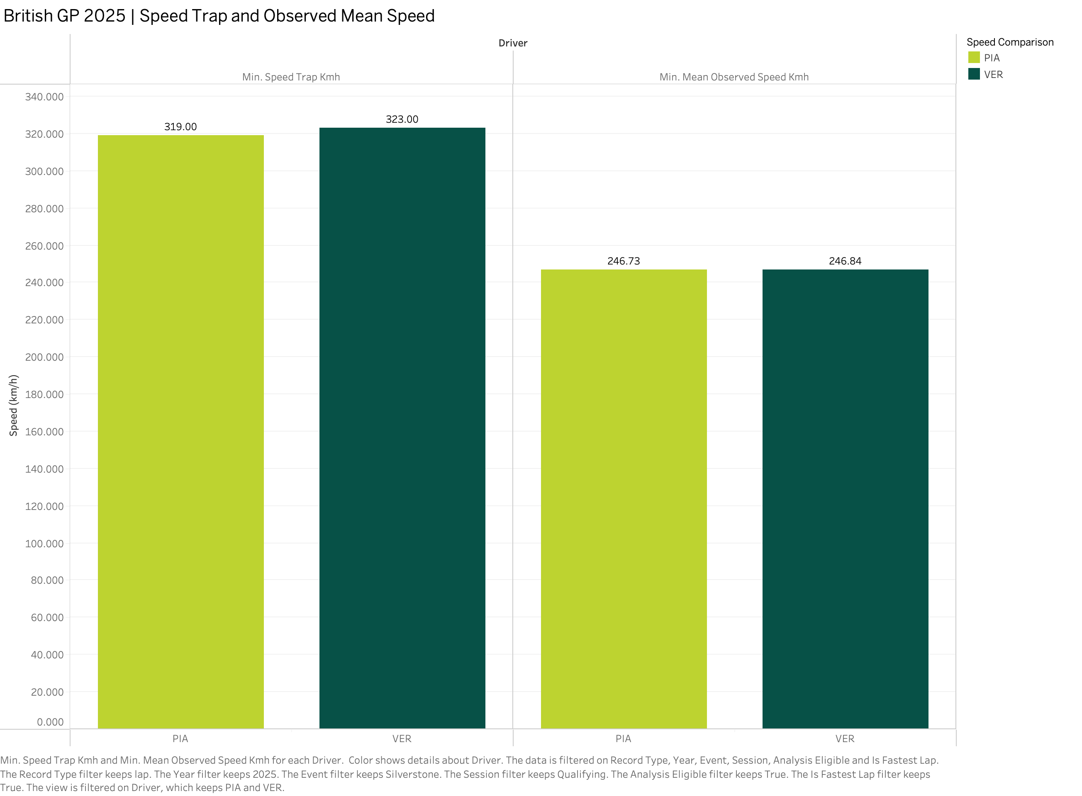
Speed trap and observed mean speed
D1_S3 Silverstone qualifying, 2025
Speed at one point
Verstappen reached 323 km/h at the trap, compared with 319 km/h for Piastri.
Speed across the lap
Their observed means were much closer: 246.84 km/h for Verstappen and 246.73 km/h for Piastri.
Why both measures matter
The trap captures speed at one location. The observed mean uses the available telemetry across the lap.
04
Notes:
Source image: D1_S3 Speed Comparison.png (Tableau export). Underlying project data: OpenF1.

Slide 5
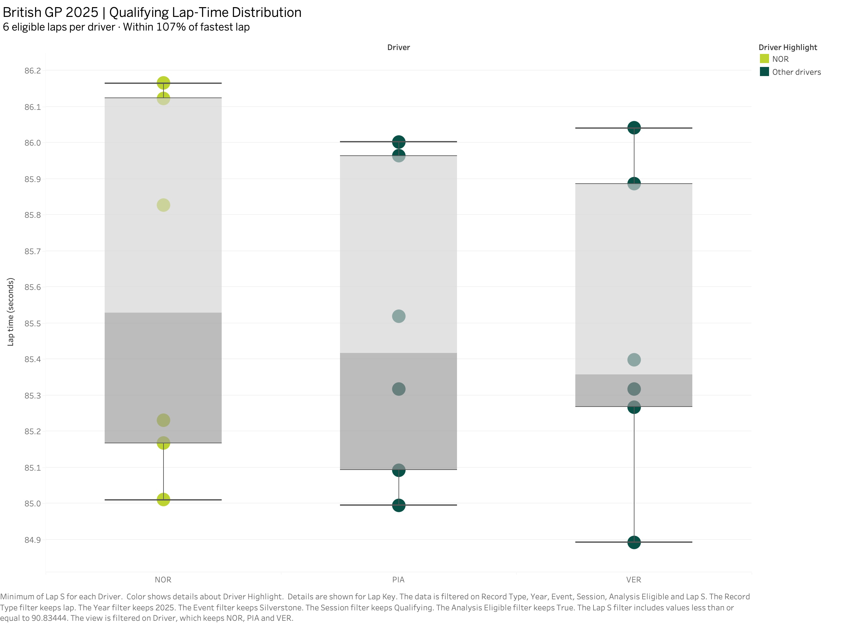
Qualifying lap-time consistency
D1_S4 Silverstone qualifying, 2025
Repeated laps
Each driver contributes six eligible laps within 107% of the fastest qualifying time.
Reading the box plots
The box shows the middle half of the lap times. The dots show individual laps.
What stands out
Verstappen had the tightest middle spread in this sample. This comparison uses six laps per driver.
05
Notes:
Source image: D1_S4 Lap Consistency.png (Tableau export). Underlying project data: OpenF1.

Slide 6
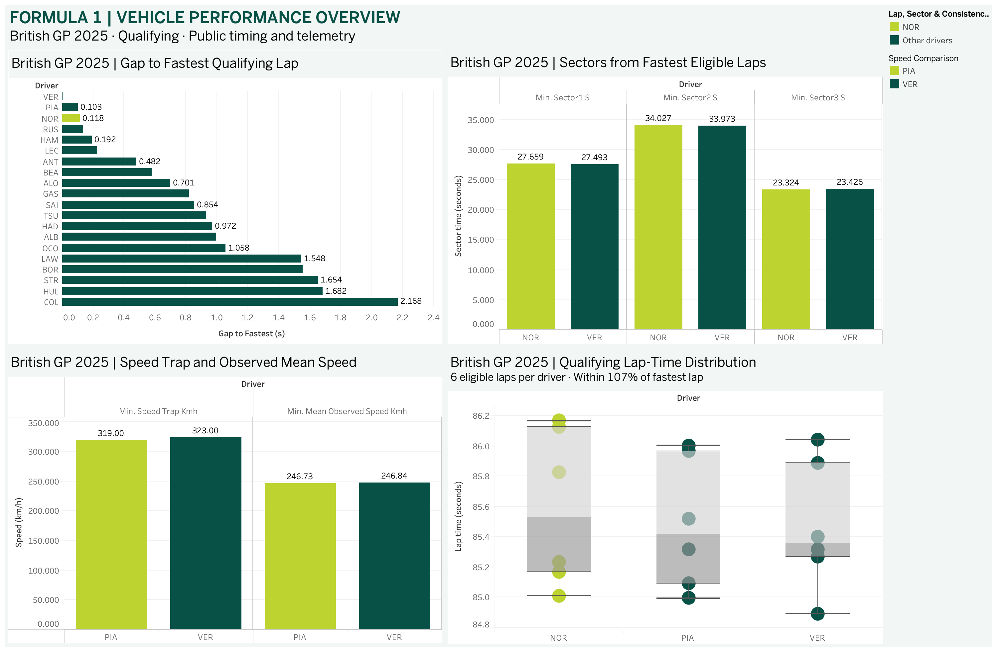
Dashboard 1: Vehicle Performance Overview
Silverstone qualifying, 2025
The starting point
The gap chart ranks the field by each driver’s best eligible lap. The sector chart breaks down Norris’s gap to Verstappen.
Two different checks
Speed compares Piastri with Verstappen. The box plots add Norris and show how lap times varied across repeat attempts.
Main takeaway
Norris recovered time in Sector 3. His losses in the first two sectors were larger.
06
Notes:
Source image: Vehicle Performance Overview.png (Tableau export). Underlying project data: OpenF1.

Slide 7
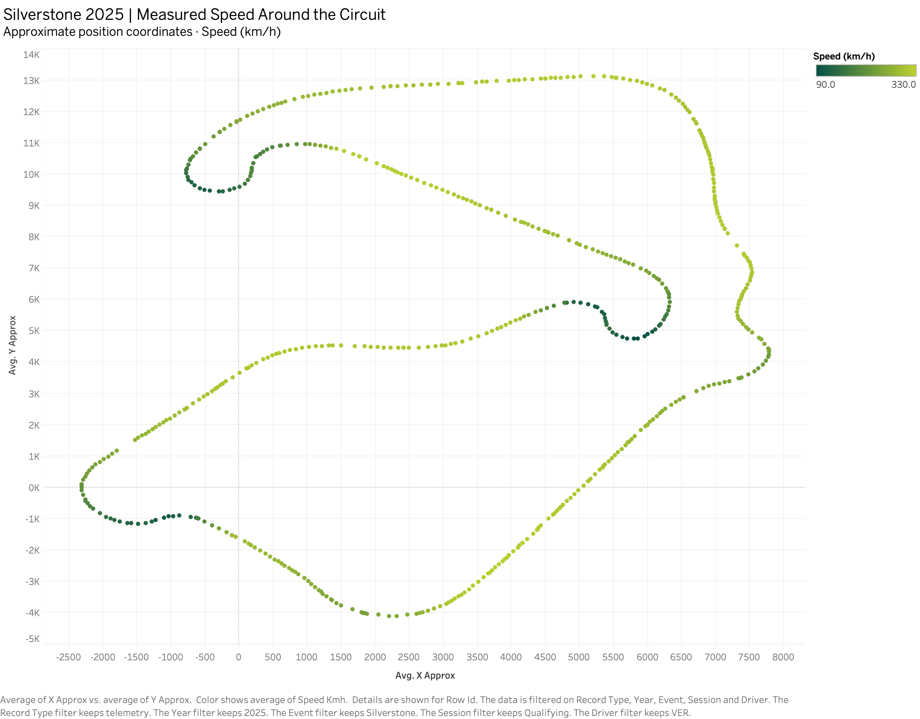
Speed around Silverstone
D2_S1 Silverstone qualifying, 2025
Reading the map
Each point uses an approximate track position. The colour scale runs from slower green points to faster lime points.
Verstappen’s trace
The display shows Verstappen’s qualifying lap. Slower points cluster in several bends, while the faster stretches are easier to spot in lime.
Map scale
The position coordinates are approximate. The later traces use integrated distance in metres.
07
Notes:
Source image: D2_S1 Circuit Speed Map.png (Tableau export). Underlying project data: OpenF1.

Slide 8
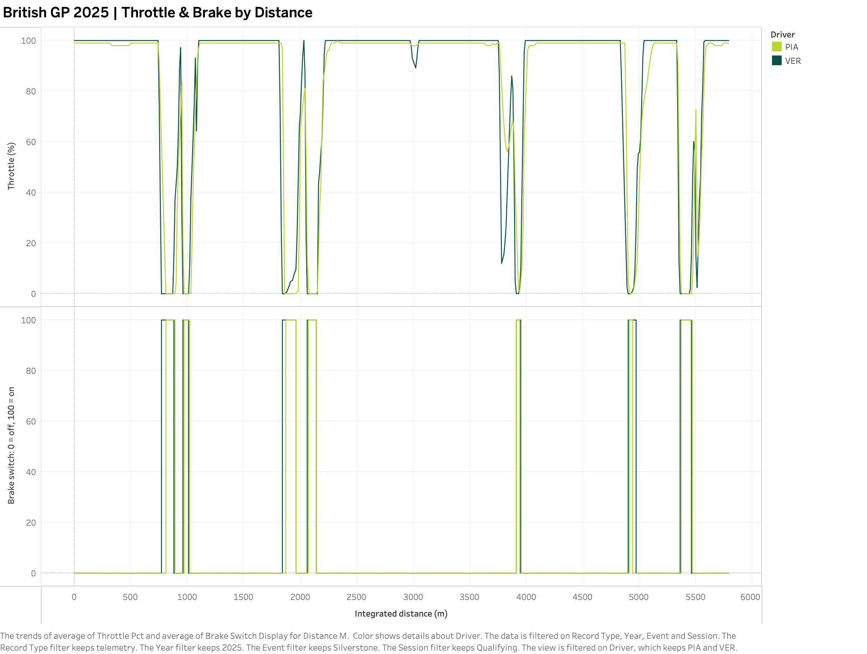
Throttle and brake by distance
D2_S2 Silverstone qualifying, 2025
Two drivers on one distance axis
Piastri is lime and Verstappen is green. The upper trace shows throttle position as a percentage.
Brake application
The lower trace shows when each driver applied the brake. Zero means off and 100 means on.
Comparing the traces
The steep throttle drops and brake pulses help locate braking zones. The brake trace does not measure pressure.
08
Notes:
Source image: D2_S2 Throttle & Brake Trace.png (Tableau export). Underlying project data: OpenF1.

Slide 9
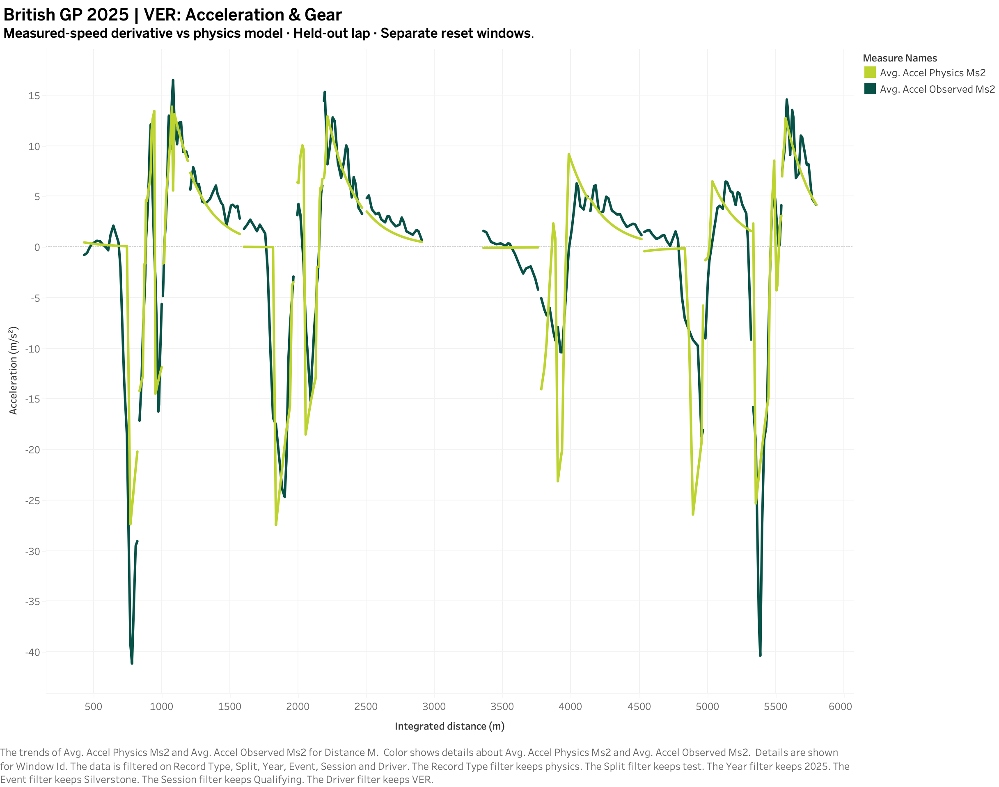
Observed and modelled acceleration
D2_S3 Silverstone qualifying, 2025
What I compared
For Verstappen, I compared the acceleration inferred from measured speed with the physics model’s estimate.
What the gaps mean
The model restarts from measured speed in each separate five-second test window. The lines stop at window boundaries.
Where it differs
The model follows several changes in direction but misses the depth of some of the strongest deceleration peaks.
09
Notes:
Source image: D2_S3 Gear & Acceleration.png (Tableau export). Underlying project data: OpenF1.

Slide 10
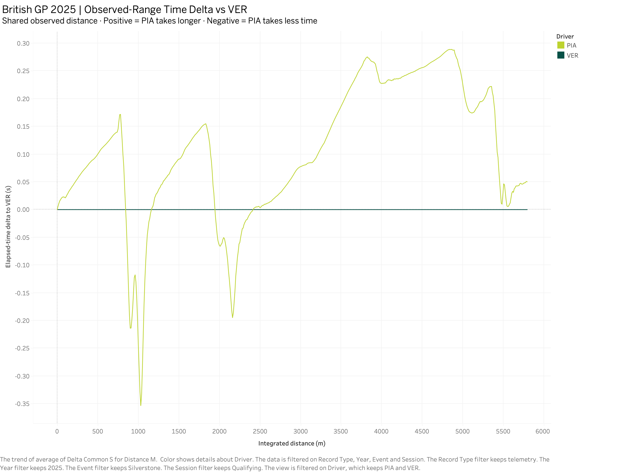
Time gained and lost by track section
D2_S4 Silverstone qualifying, 2025
The zero line
Verstappen is the reference. Positive values mean Piastri has taken longer to reach that distance.
Changes across the lap
Piastri gains time early in the trace, then gives time back. He ends about 0.05 s behind over the shared range.
Distance covered
The trace uses the shared telemetry range. The 0.103 s qualifying gap comes from official lap timing.
10
Notes:
Source image: D2_S4 Track-Section Time Delta.png (Tableau export). Underlying project data: OpenF1.

Slide 11
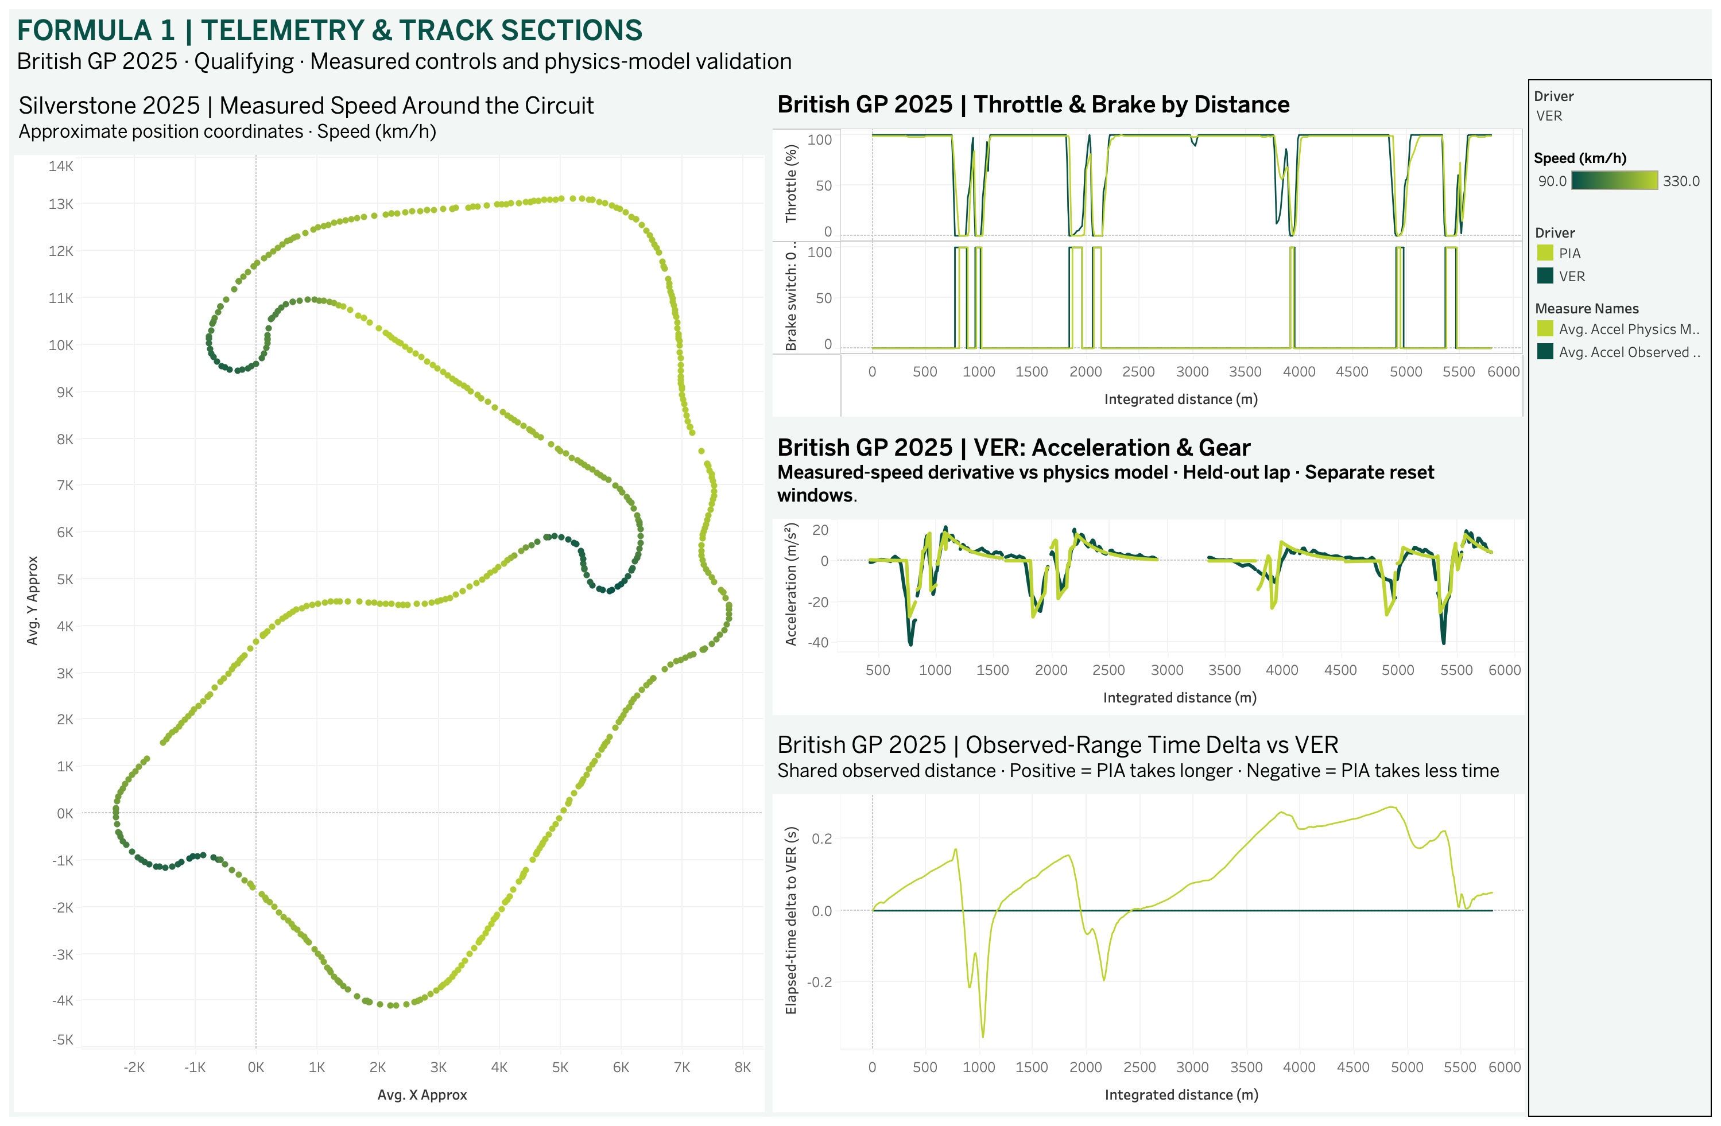
Dashboard 2: Telemetry and Track Sections
Silverstone qualifying, 2025
Map and controls
The speed map locates slower parts of the circuit. The throttle and brake traces show what the drivers were doing around those stretches.
Model and time delta
The acceleration view checks the physics estimate within test windows. The time delta shows where the gap to Verstappen changes.
Reading the scales
The map uses approximate positions. The three traces on the right use integrated distance.
11
Notes:
Source image: D2 Telemetry & Track Sections.png (Tableau export). Underlying project data: OpenF1.

Slide 12
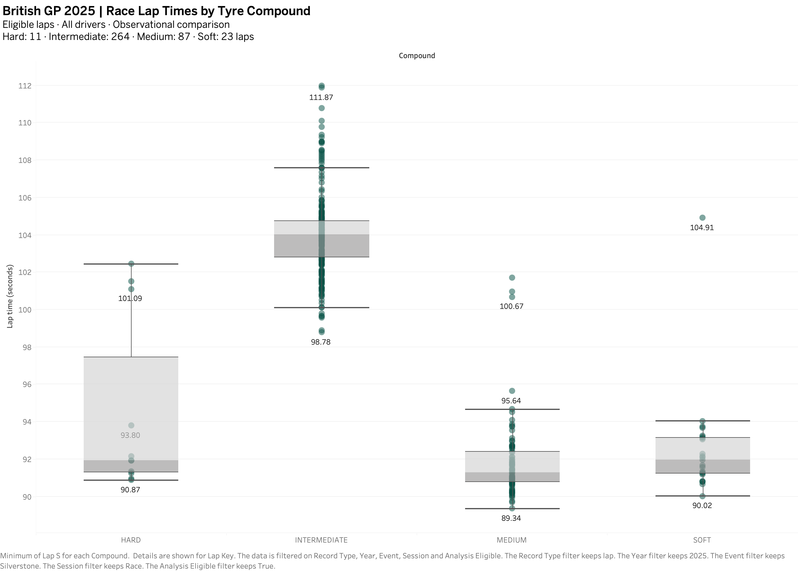
Race lap times by tyre compound
D3_S1 Silverstone race, 2025
Eligible race laps
The chart compares 385 laps: 264 intermediate, 87 medium, 23 soft and 11 hard.
The main difference
The intermediate median was about 104.0 s. The three slick medians were between 91 and 92 s.
Conditions matter
The compounds ran in different conditions and had uneven sample sizes. Those differences limit what the chart can tell us about the tyres alone.
12
Notes:
Source image: D3_S1 Tyre Compound Comparison.png (Tableau export). Underlying project data: OpenF1.

Slide 13
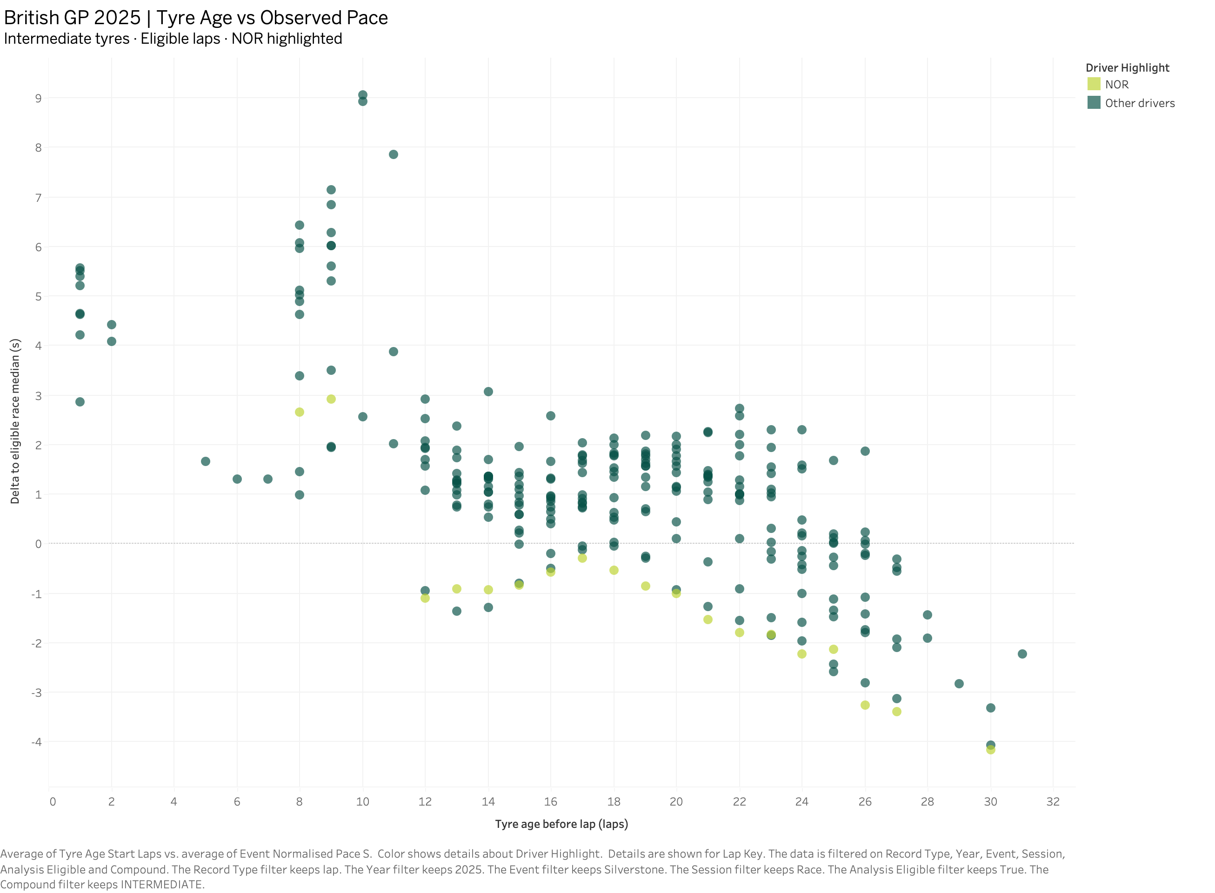
Tyre age and observed race pace
D3_S2 Silverstone race, 2025
The zero line
Zero is the median across eligible race laps. Points below it are faster than that benchmark.
Intermediate tyres
The scatter shows 264 eligible intermediate laps, with Norris highlighted in lime.
What the pattern means
Many older-tyre laps were quicker relative to the benchmark. Track conditions and race progression may also explain part of that pattern.
13
Notes:
Source image: D3_S2 Tyre Age vs Observed Pace.png (Tableau export). Underlying project data: OpenF1.

Slide 14
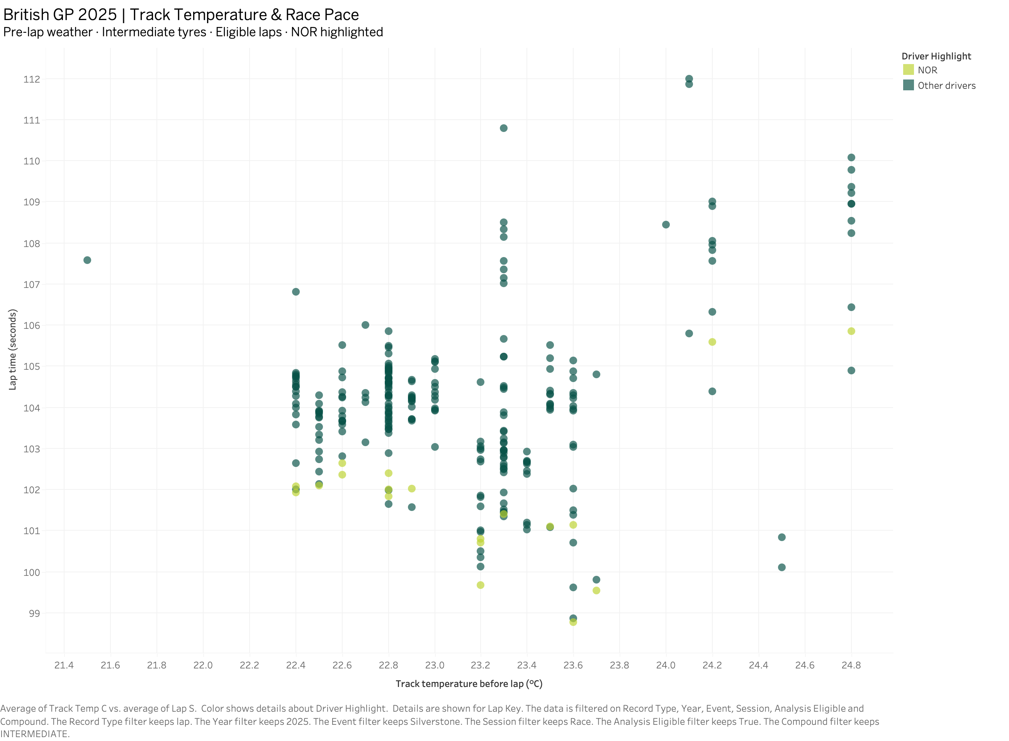
Track temperature and race pace
D3_S3 Silverstone race, 2025
Weather before each lap
Each dot pairs the latest available pre-lap track temperature with an eligible intermediate-tyre lap time.
Why the dots stack
Several laps share the same temperature reading but have different lap times. Norris is highlighted in lime.
What I can conclude
The spread at similar temperatures makes it hard to isolate a temperature effect from this race alone.
14
Notes:
Source image: D3_S3 Track Temperature & Pace.png (Tableau export). Underlying project data: OpenF1.

Slide 15
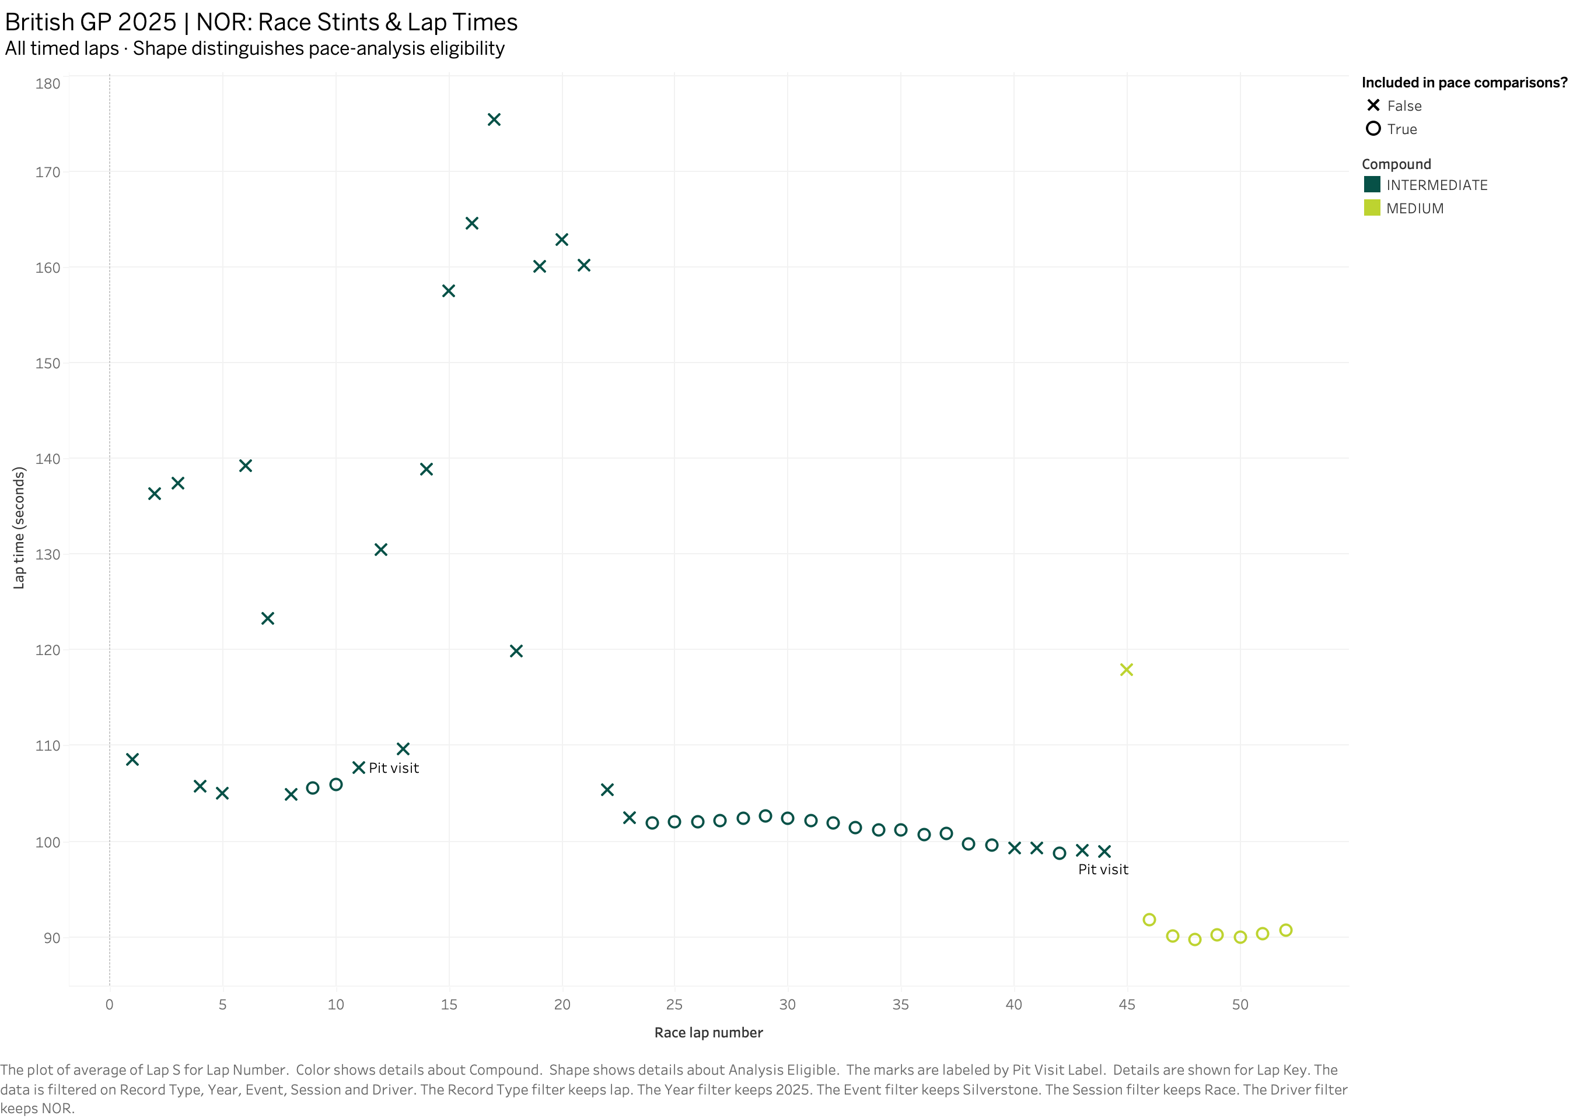
Norris’s race stints and pit visits
D3_S4 Silverstone race, 2025
All 52 timed laps
Circles mark laps included in the pace comparisons. Crosses keep the other timed laps visible for context.
Pit visits and compounds
The timeline flags pit visits on laps 11 and 44. The chart switches from green intermediates to lime mediums after the second visit.
Late-race pace
The final eligible medium laps are around 90 s. The timeline shows when those quicker laps occurred.
15
Notes:
Source image: D3_S4 Stint Pace Timeline.png (Tableau export). Underlying project data: OpenF1.

Slide 16
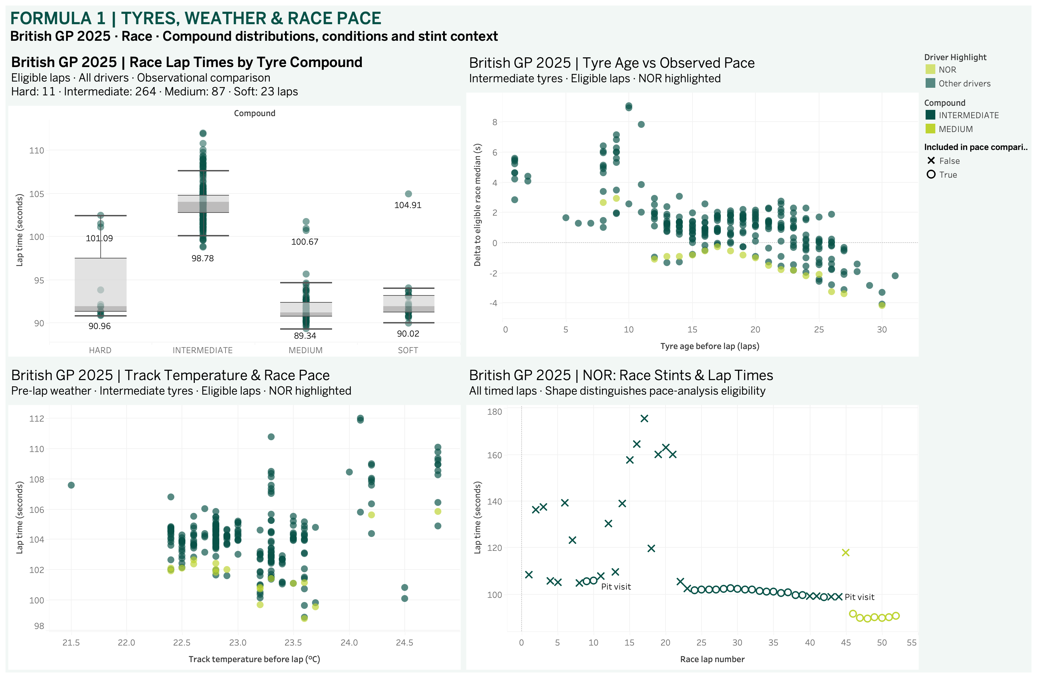
Dashboard 3: Tyres, Weather and Race Pace
Silverstone race, 2025
The field and the driver
The compound chart shows the field’s lap-time spread. The stint timeline shows Norris’s laps in race order.
Putting pace in context
Tyre age and track temperature give context for the intermediate laps. The timeline retains pit and other excluded laps so the race sequence stays visible.
Main takeaway
Lap times changed as the race unfolded. The views show why a simple compound comparison needs context.
16
Notes:
Source image: D3 Tyres, Weather & Race Pace.png (Tableau export). Underlying project data: OpenF1.

Slide 17
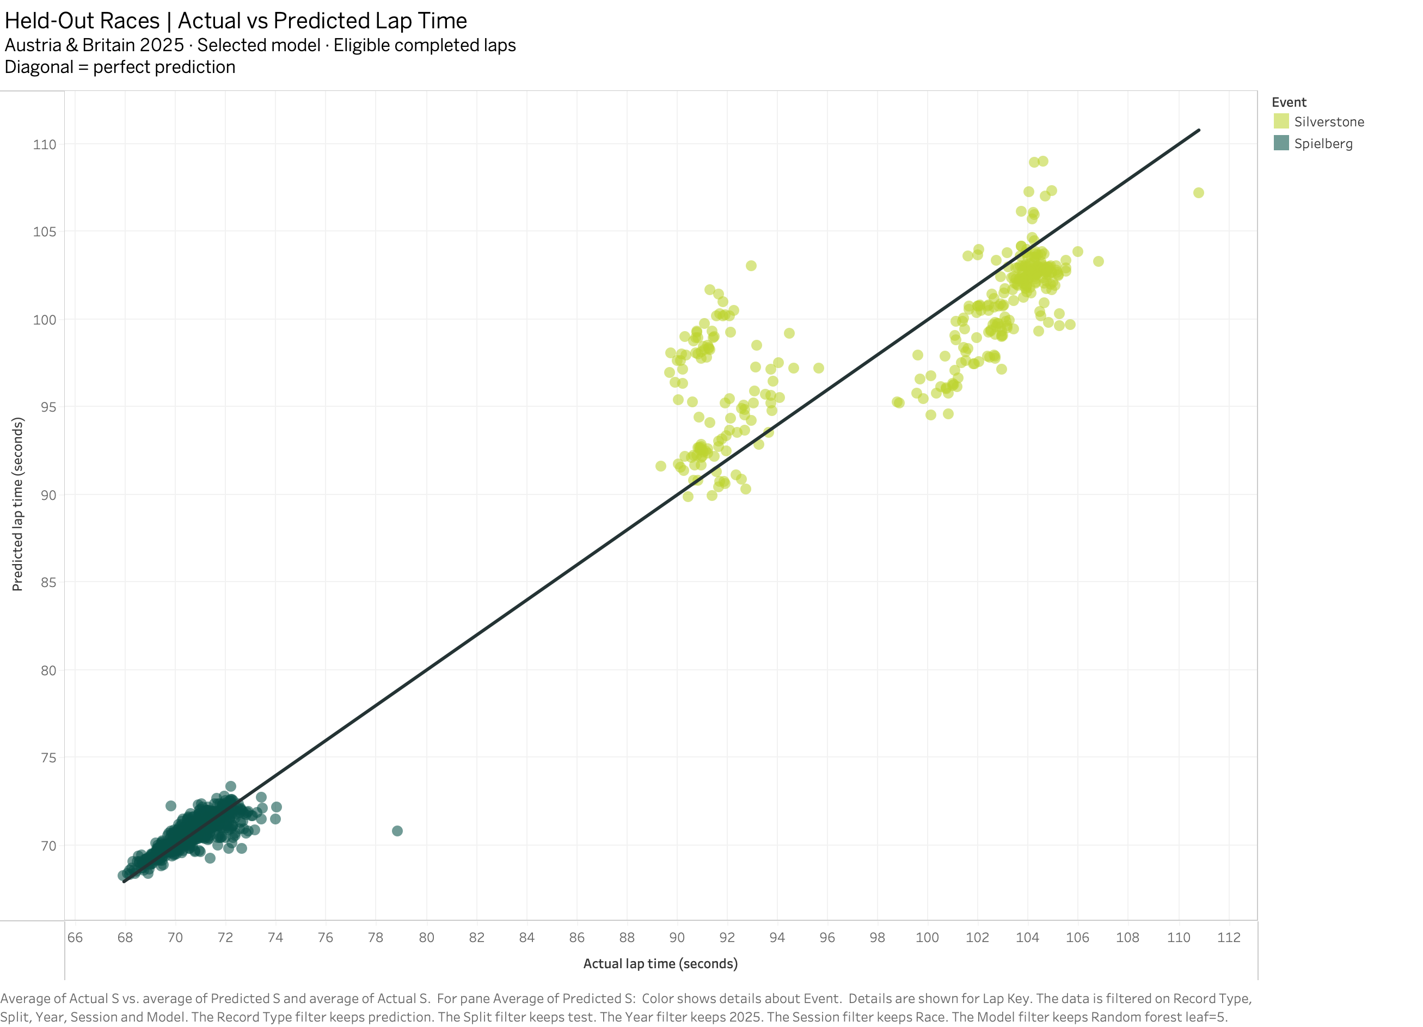
Actual and predicted lap times
D4_S1 2025 race prediction
How to read the dots
Actual time is on the horizontal axis. Predicted time is on the vertical axis. The diagonal marks a perfect prediction.
Test races
The random forest view shows 1,245 eligible test laps from Spielberg and Silverstone. The two circuits have different lap-time ranges.
Direction of error
Points above the line are overpredictions. Points below the line are underpredictions.
17
Notes:
Source image: D4_S1 Actual vs Predicted.png (Tableau export). Underlying project data: OpenF1.

Slide 18
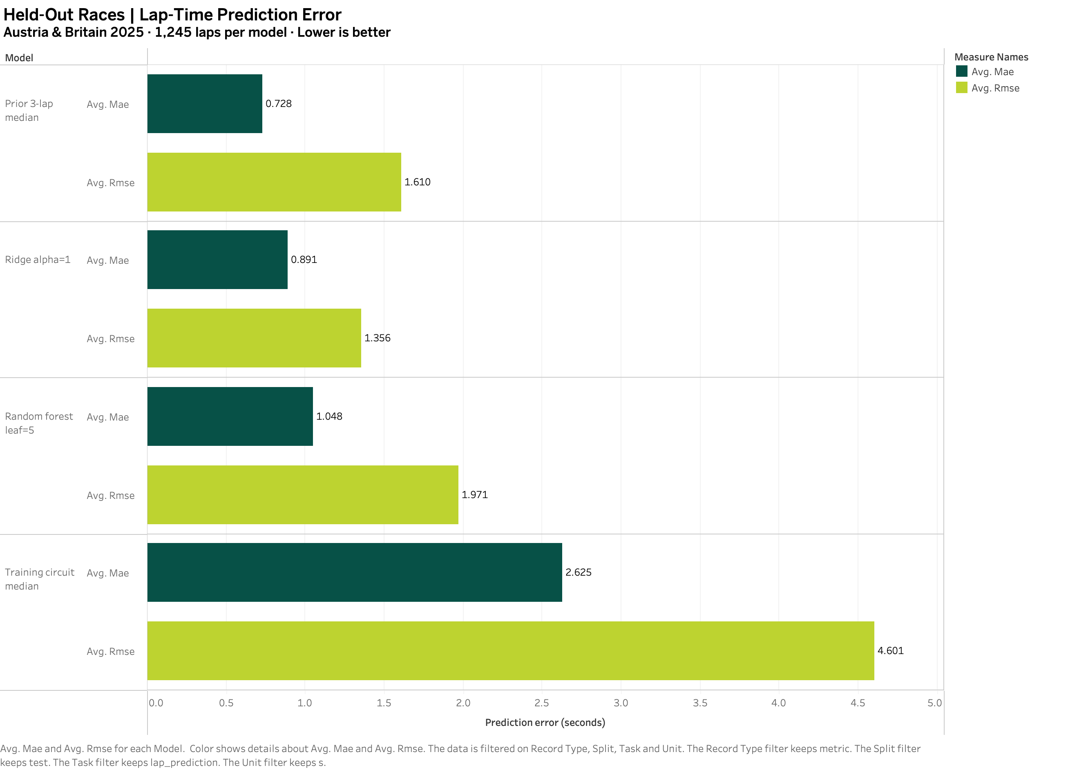
Lap-time prediction error by model
D4_S2 2025 race prediction
Same laps for every model
The four models use the same 1,245 test laps. MAE is the average absolute error. RMSE gives more weight to large errors.
Lowest test MAE
The prior 3-lap median was best on MAE at 0.728 s.
Lowest test RMSE
Ridge led on RMSE at 1.356 s. The random forest, chosen on validation, scored 1.048 s MAE and 1.971 s RMSE on test.
18
Notes:
Source image: D4_S2 Model Error Comparison.png (Tableau export). Underlying project data: OpenF1.

Slide 19
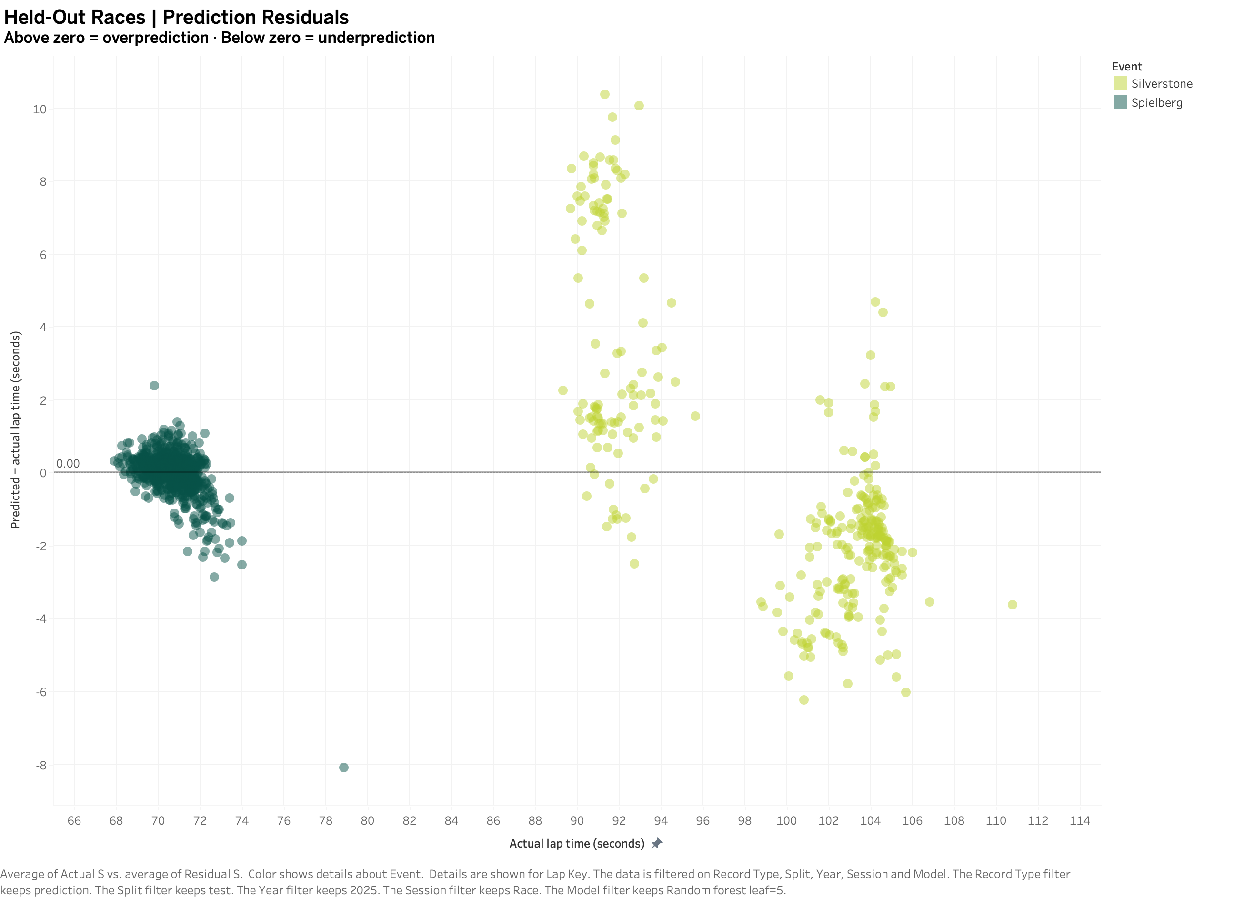
Where the random forest missed
D4_S3 2025 race prediction
Reading the residual
Each residual is predicted time minus actual time. Zero is an exact match.
Difference by circuit
Silverstone has a wider spread. Several laps near 91 s were overpredicted, while many laps around 104 seconds were underpredicted.
Why keep this view?
The residuals show where the model misses by several seconds, which the overall error scores cannot locate.
19
Notes:
Source image: D4_S3 Residual Diagnostics.png (Tableau export). Underlying project data: OpenF1.

Slide 20
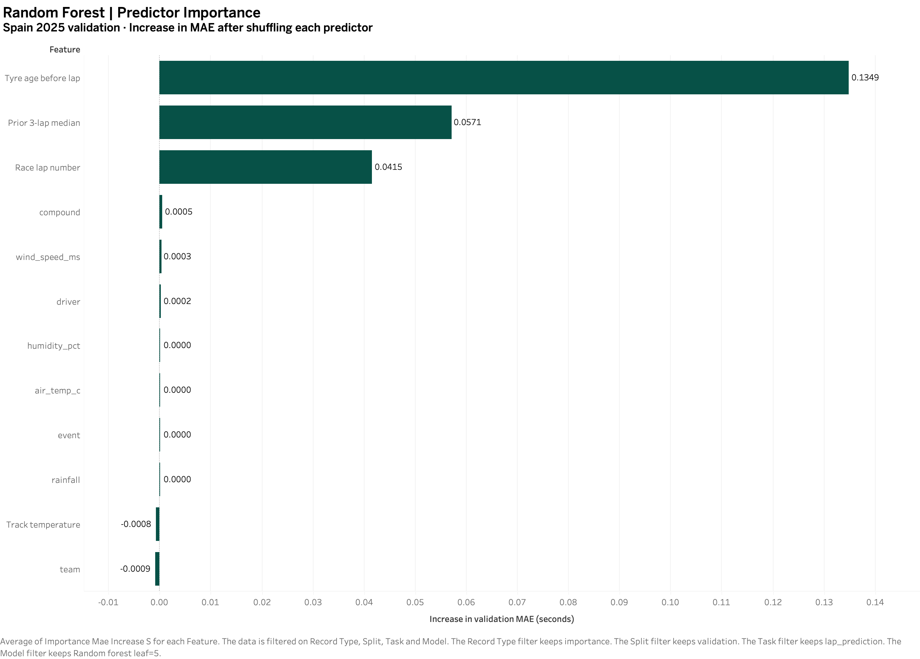
Random forest predictor importance
D4_S4 2025 race prediction
How I measured it
I shuffled one predictor at a time on Spain 2025 validation laps and measured the change in MAE.
Largest changes
Tyre age had the largest increase at 0.1349 s, followed by prior 3-lap median at 0.0571 s and race lap number at 0.0415 s.
Scope
These scores describe what the forest relied on in this validation race. They cannot establish what caused faster laps.
20
Notes:
Source image: D4_S4 Predictor Importance.png (Tableau export). Underlying project data: OpenF1.

Slide 21
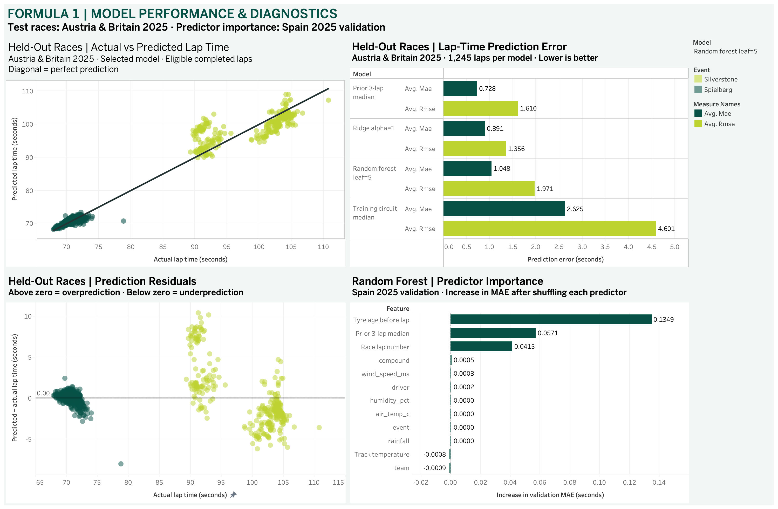
Dashboard 4: Model Performance and Diagnostics
2025 race prediction
Two levels of evidence
The prediction and residual views show individual test laps. The bar chart compares all four models on the same test sample.
Model selector
In Tableau, the dropdown changes the two scatter plots. The error comparison retains all models and importance stays on the validation random forest.
Main takeaway
The prior-lap baseline leads on test MAE. Ridge leads on test RMSE.
21
Notes:
Source image: D4 Model Performance & Diagnostics.png (Tableau export). Underlying project data: OpenF1.

