Slide 1

Edge-Deployable Rock Detection & Burial-Status Classification
Real-Time Embedded Computer Vision for Precision Agriculture on Raspberry Pi 5
Project Team: 1. Tanishk Shinde • 2. Megh Kashilkar • 3. Sanskar Gade • 4. Jitendra Suwalka
Academic Supervisor: Dr. Felipe Campelo (University of Bristol)
External Supervisors: Dr. Ahmad Al-Mallahi & Jason McLaren (Dalhousie University / McCain Foods)
University of Bristol • Faculty of Engineering • Department of Engineering Mathematics • 16 September 2026
Notes:
Welcome everyone. This presentation details our MSc Data Science project on Edge-Deployable Rock Detection and Burial Status Classification, presented by Tanishk Shinde, Megh Kashilkar, Sanskar Gade, and Jitendra Suwalka.

Slide 2
02 | CONTEXT & MOTIVATION
Rocks Cause Severe Operational & Equipment Costs in Potato Farming
Agricultural Need & Operational Impact
• Commercial potato harvesting machinery suffers severe mechanical wear and blade damage from unmapped field rocks.
• Manual rock picking is labour-intensive, hazardous, and causes costly harvesting bottlenecks during peak season.
• Precision removal requires detecting not just rock location, but also burial status (completely exposed vs. half-buried) to apply appropriate mechanical force.
• Dalhousie University and McCain Foods initiated this project to enable autonomous on-the-go vision systems directly on field machinery.
Industry Collaboration Objective
• Partner: McCain Foods & Dalhousie University Agricultural Engineering.
• Goal: Deploy real-time object detection directly on tractor-mounted edge hardware.
• Constraint: Real field environments lack cloud connectivity, demanding fully offline edge inference.
• Challenge: Variable soil appearance, partial occlusions, and severe compute/power limitations on embedded devices.
University of Bristol • MSc Data Science Dissertation Project • McCain Foods & Dalhousie Collaboration
Notes:
Rocks create severe mechanical damage and downtime in commercial potato farming. Our goal is to enable real-time detection on tractor-mounted hardware.

Slide 3
03 | CONTEXT & MOTIVATION
High Model Accuracy Does Not Guarantee Real-Time Edge Feasibility
The Academic vs. Edge Deployment Gap
• Standard vision research prioritises heavy GPU models (e.g. YOLOv8x, ViT) and high precision (FP32).
• On-the-go tractor operations operate at ~5–10 km/h, requiring at least 15–20 FPS to guide hydraulic actuators in real time.
• PyTorch models on low-cost single-board computers (Raspberry Pi 5) achieve only 2.5 FPS (~400 ms latency) — completely unacceptable for real-time control.
• Quantisation (FP16, INT8) and edge-optimised runtimes (TFLite, NCNN, ONNX) are mandatory, but their accuracy–speed–stability trade-offs were previously unbenchmarked.
Key Technical Constraints
• Compute: Low-power quad-core ARM Cortex-A76 processor without discrete GPU acceleration.
• Memory: Peak RAM must remain well within device limits without paging or out-of-memory crashes.
• Thermal: Continuous field operation without active cooling must prevent thermal CPU throttling.
• Reliability: The runtime must maintain 100% stability across continuous hours without segmentation faults.
University of Bristol • MSc Data Science Dissertation Project • McCain Foods & Dalhousie Collaboration
Notes:
Standard high-accuracy models fail on edge devices due to latency. We need an end-to-end edge deployment pipeline.

Slide 4
04 | CONTEXT & MOTIVATION
Core Research Question & Empirical Hypotheses
The Central Research Question
• "How effectively can lightweight YOLO models be optimised, quantised, and deployed for real-time rock detection and burial-status classification on a low-cost edge device (Raspberry Pi 5)?"
• Sub-question 1: How does model architecture selection (YOLOv8n vs YOLO11n vs YOLO11s) impact detection of challenging half-buried rocks?
• Sub-question 2: What is the exact empirical trade-off between numerical precision (FP32 vs FP16 vs INT8) in terms of latency, accuracy (mAP50-95), and system stability?
Guiding Empirical Hypotheses
• H1 (Speedup): Quantised edge-runtime representations (TFLite INT8 / NCNN) will yield at least a 5x latency reduction compared to PyTorch FP32 baseline.
• H2 (Accuracy Cost): INT8 quantisation will incur a measurable localisation degradation (mAP50-95 drop < 5%) due to 8-bit dynamic range compression.
• H3 (Operational Robustness): Deployment formats will exhibit non-trivial divergence in CPU, thermal, and stability behaviours under continuous operation.
University of Bristol • MSc Data Science Dissertation Project • McCain Foods & Dalhousie Collaboration
Notes:
We formulated a precise research question and three testable hypotheses around speedup, accuracy cost, and operational stability.

Slide 5
05 | METHODOLOGY OVERVIEW
Rigorous Five-Stage End-to-End Project Architecture
Project Execution Workflow
• 1. Data Integrity & Splitting: Pre-augmentation split into 313 train, 45 val, and 90 test images to prevent data leakage.
• 2. Controlled Augmentation: 6 safe photometric transforms expanding the training set to 2,191 images (3,563 rock instances).
• 3. Controlled Model Selection: Identical training of YOLOv8n, YOLO11n, and YOLO11s; selection strictly based on validation mAP50-95.
• 4. Six-Format Edge Export: Exporting frozen YOLOv8n into PyTorch, TorchScript, ONNX, TFLite (FP32/INT8), and NCNN (FP32/FP16).
• 5. Systematic Pi 5 Benchmark: Fair, letterboxed 90-image test set evaluation measuring FPS, latency, mAP, count MAE, RAM, CPU, and thermals.
Controlled Variables & Principles
• Zero Test-Set Leakage: Test set (90 images) never augmented and never used during model selection.
• Frozen Weights: Identical neural network weights exported across all six runtime formats.
• Identical Letterboxing: Standardized 640x640 input with symmetric fill value (114) for all backends.
• Repeatable Protocol: 3 warmup runs followed by timed inference with hardware telemetry logging.
University of Bristol • MSc Data Science Dissertation Project • McCain Foods & Dalhousie Collaboration
Notes:
Our methodology follows five strict stages ensuring no data leakage, fair model selection, and standardized edge evaluation.

Slide 6
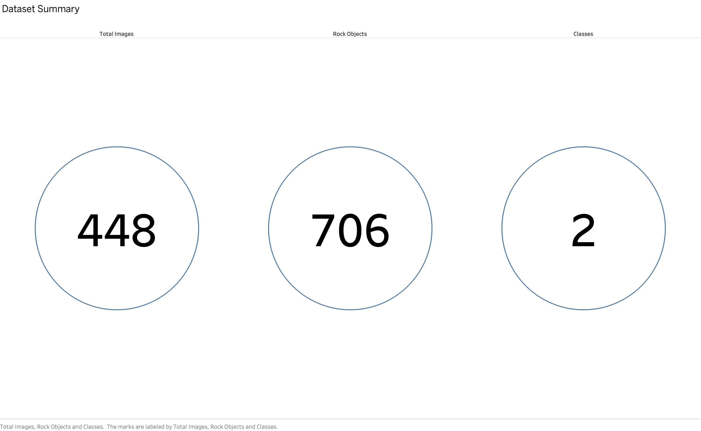
06 | DATASET PREPARATION
Original Field Dataset: 448 Images & 706 Annotated Rocks
Dataset Composition & Class Balance
• 448 high-resolution aerial and ground-level field images collected from real potato cultivation plots.
• 706 manually verified bounding box annotations across two critical operational classes:
• • Completely Exposed: 362 objects (51.3%) — clear surface boundary, high visual contrast against soil.
• • Half-Buried: 344 objects (48.7%) — partially occluded by soil clods, irregular silhouettes, lower contrast.
• Near 50:50 class balance allows performance differences to be interpreted as visual difficulty rather than class imbalance.
Dataset Distribution Summary
Figure 3.4: Dataset summary showing 448 original images, 706 annotated rocks, and 2 balanced burial classes.
University of Bristol • MSc Data Science Dissertation Project • McCain Foods & Dalhousie Collaboration
Notes:
The dataset has 448 images and 706 rocks, cleanly balanced between completely exposed and half-buried classes.

Slide 7
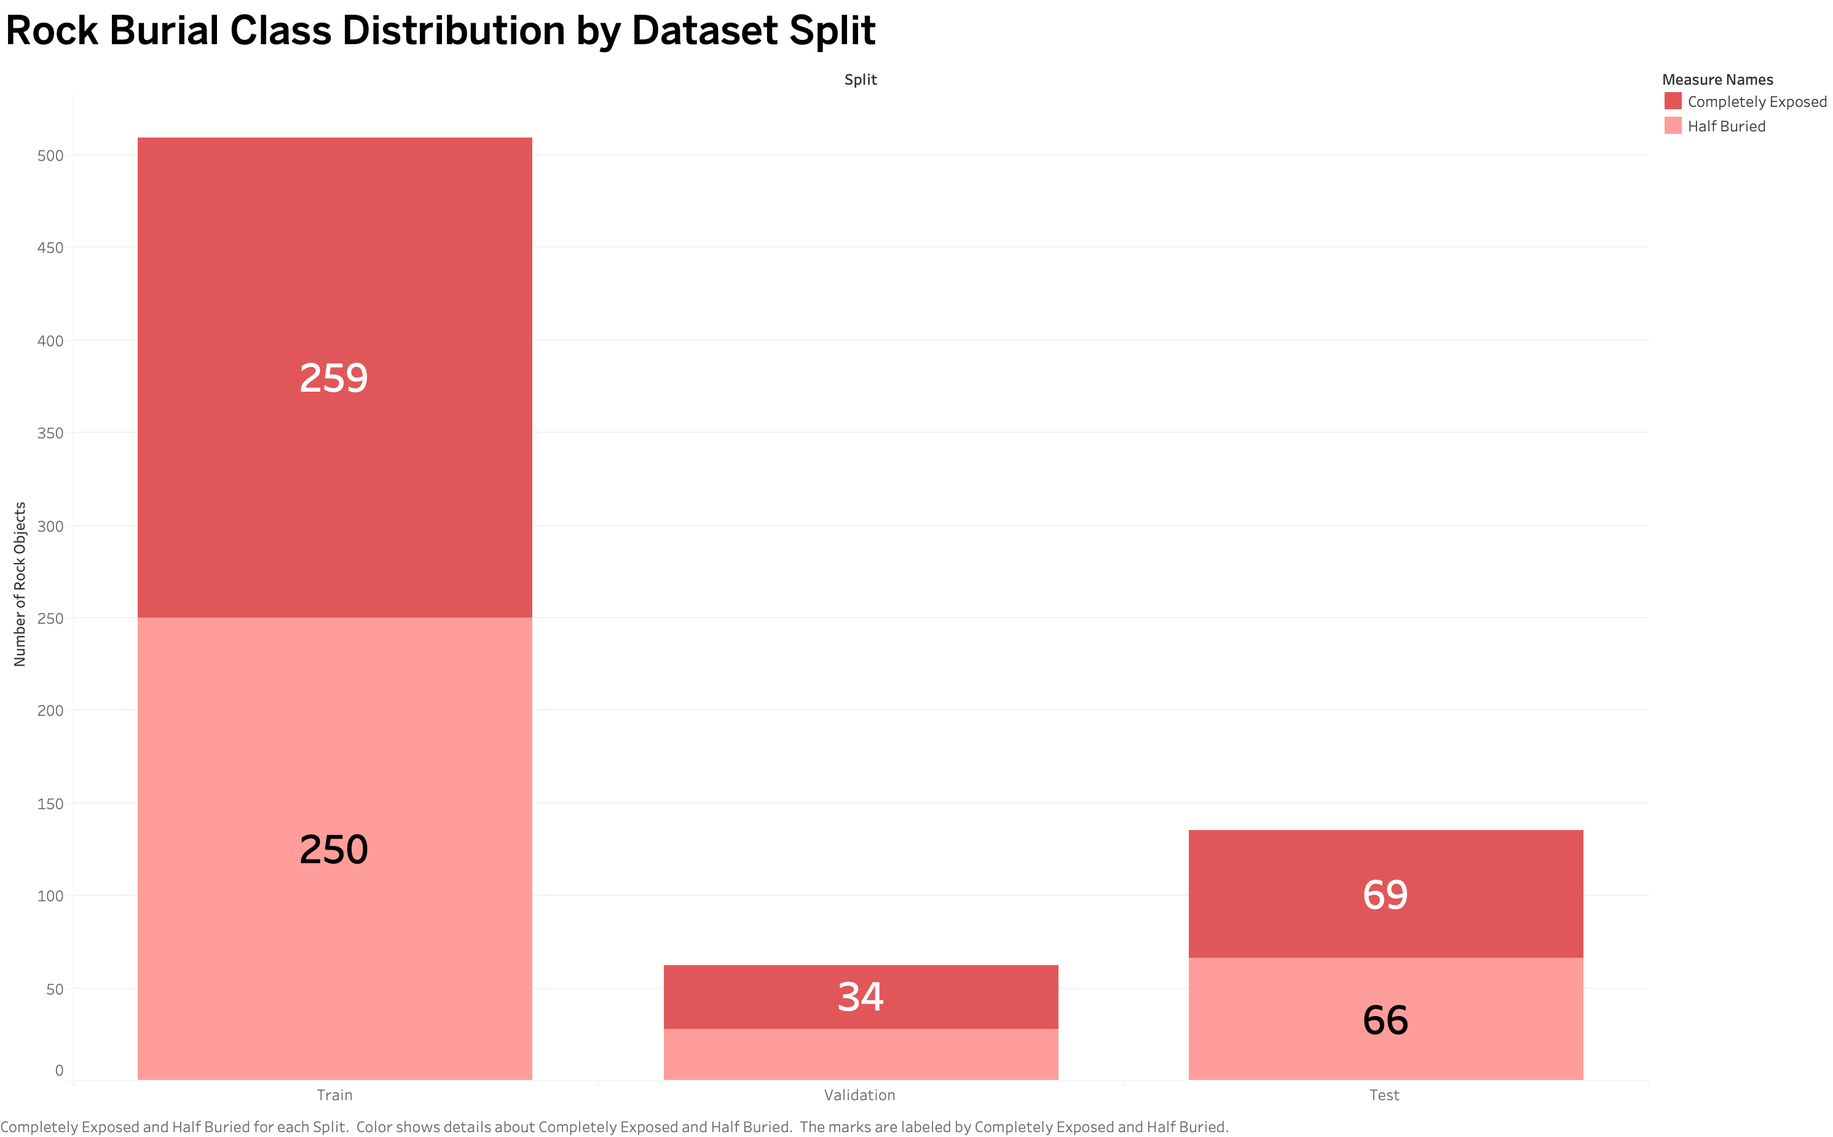
07 | DATASET PREPARATION
Pre-Augmentation Splitting Prevents Data Leakage
Partitioning Strategy
• Partitioning was performed BEFORE any augmentation occurred to ensure zero duplicate variants leaked into evaluation.
• • Training Partition: 313 images (259 exposed, 250 half-buried) — 69.9% of dataset.
• • Validation Partition: 45 images (34 exposed, 28 half-buried) — 10.0% used exclusively for architecture selection.
• • Test Partition: 90 images (69 exposed, 66 half-buried) — 20.1% untouched held-out edge benchmark set.
• Preserves absolute independence for all subsequent Raspberry Pi runtime comparisons.
Class Splits Across Partitions
Figure 3.2: Class-level annotation counts across Train, Val, and Test splits showing balanced proportions.
University of Bristol • MSc Data Science Dissertation Project • McCain Foods & Dalhousie Collaboration
Notes:
We partitioned the data prior to augmentation to guarantee that no test or validation image had augmented counterparts in training.

Slide 8
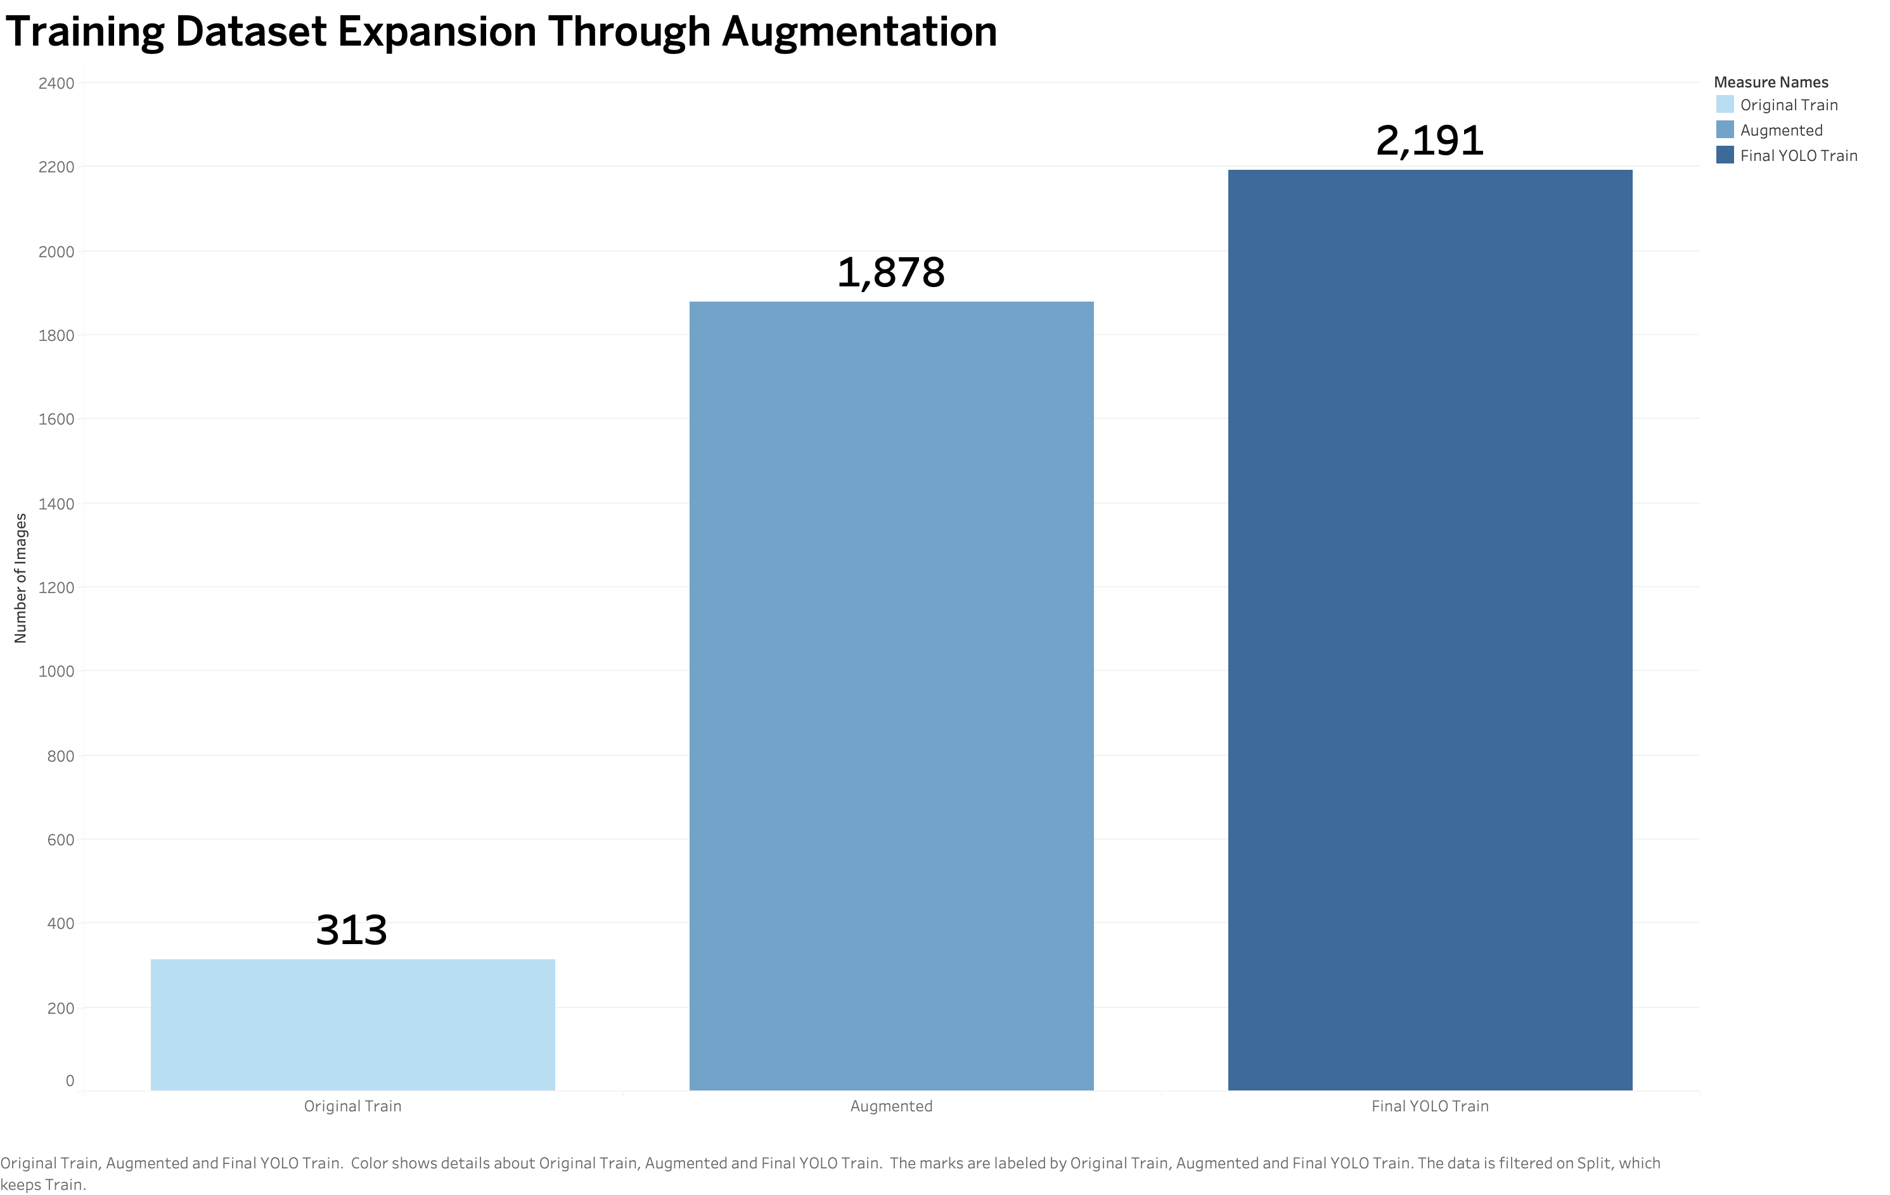
08 | DATASET PREPARATION
Controlled Photometric Augmentation Expands Training to 2,191 Images
Safe Offline Augmentation Strategy
• Each of the 313 training images generated 6 photometric variants (+1,878 images), expanding training set to 2,191 images.
• Total training annotation instances increased from 509 to 3,563 rock objects.
• Augmentations simulated real field illumination shifts:
• • Brightness & Contrast adjustment (cloud cover vs bright direct sunlight)
• • Gamma correction & HSV colour jitter (dry vs moist soil tones)
• • Gaussian noise & slight blur (camera motion / vibration)
• Geometric distortion (shear, extreme crop) was strictly avoided to prevent invalidating bounding box boundaries.
Training Set Augmentation Expansion
Figure 3.3: 7x expansion of training data from 313 original images to 2,191 augmented images.
University of Bristol • MSc Data Science Dissertation Project • McCain Foods & Dalhousie Collaboration
Notes:
We expanded training data safely using 6 photometric transforms per image, avoiding geometric distortions that corrupt bounding boxes.

Slide 9
09 | MODEL ARCHITECTURE
Single-Stage YOLO Detects Location & Burial Status Simultaneously
Why Single-Stage YOLO for Field Edge AI?
• Two-stage detectors (Faster R-CNN) require separate region proposals, resulting in prohibitively high latency (>800 ms on ARM).
• Single-stage YOLO architectures predict bounding boxes [x, y, w, h] and class probabilities in a single forward pass.
• Unified loss function optimizes bounding box regression (CIoU / DFL) alongside classification loss (BCE).
• Anchor-free design in modern YOLO (v8, 11) enhances small rock detection and adapts to irregular rock shapes without manual anchor tuning.
Edge Output Tensor Representation
• Input: Standardized 640x640x3 RGB image tensor.
• Output: 8,400 candidate anchor predictions decoded into [x, y, w, h, p_exposed, p_buried].
• Post-Processing:
• • Confidence Threshold: Filtering candidates with confidence < 0.25.
• • Non-Maximum Suppression (NMS): IoU threshold 0.70 to eliminate duplicate detections.
• • Counting Aggregator: Outputs total detected rocks, exposed count, and half-buried count per field frame.
University of Bristol • MSc Data Science Dissertation Project • McCain Foods & Dalhousie Collaboration
Notes:
YOLO performs simultaneous localization and classification in a single pass, ideal for low-latency edge deployment.

Slide 10
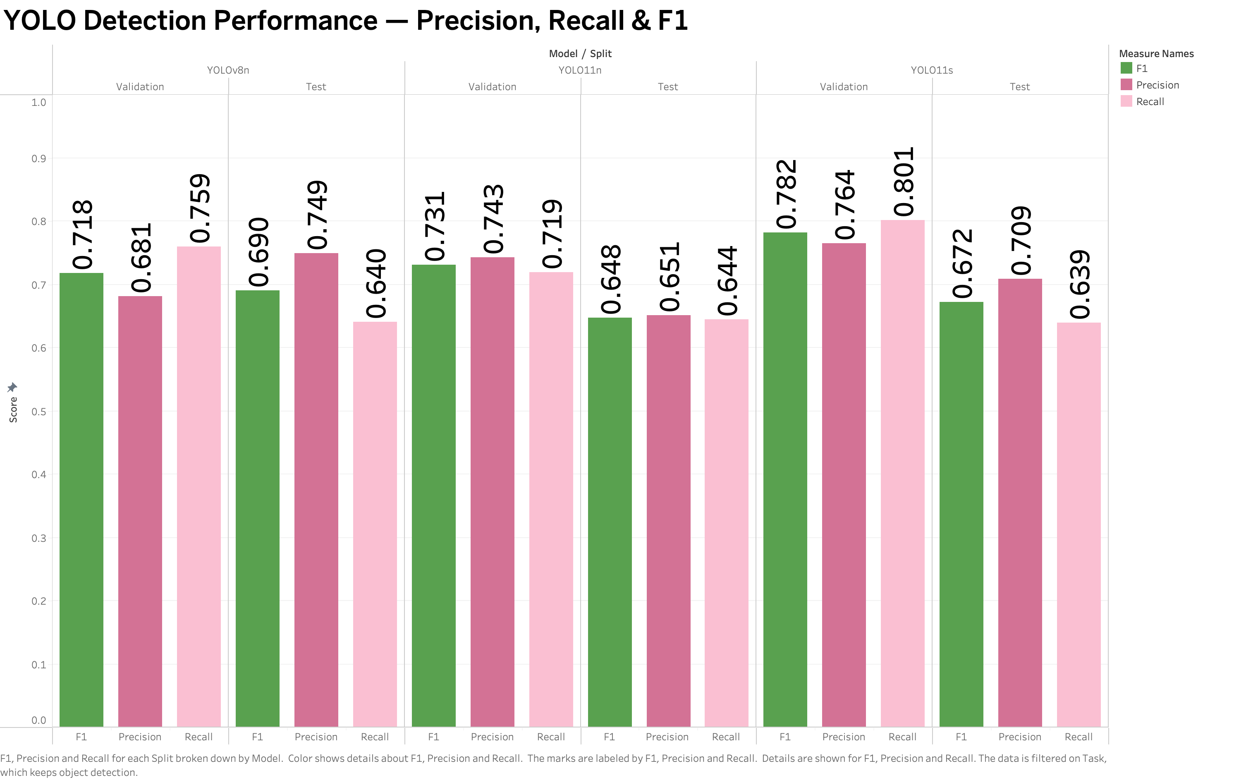
10 | MODEL DEVELOPMENT
Controlled Training of Lightweight YOLO Candidates
Rigorous Experimental Controls
• Three candidate lightweight architectures evaluated: YOLOv8n (3.2M params), YOLO11n (2.6M params), and YOLO11s (9.4M params).
• Common training setup across all models to ensure fair comparison:
• • Epochs: 20 epochs with early checkpoint saving
• • Image Resolution: 896x896 training, 1024x1024 validation
• • Optimizer: AdamW with Cosine learning rate scheduling
• • Batch Size: 32 with Automatic Mixed Precision (AMP)
• • Pre-trained Weights: COCO transfer learning initialization
Precision, Recall & F1 Scores
Figure 3.5: Validation & test precision, recall, and F1 comparison across YOLOv8n, YOLO11n, and YOLO11s.
University of Bristol • MSc Data Science Dissertation Project • McCain Foods & Dalhousie Collaboration
Notes:
All candidate models were trained under strictly identical hyperparameters to prevent tuning bias from favoring any single model.

Slide 11
11 | MODEL SELECTION
Predefined Primary Criterion: Validation mAP50–95
Avoiding Post-Hoc Metric Cherry-Picking
• Architecture selection was governed by a predefined primary metric: Validation mAP50–95.
• Why mAP50–95 over mAP50?
• • mAP50 averages IoU threshold at 0.50 only — loose localisation boundary.
• • mAP50–95 averages IoU from 0.50 to 0.95 in 0.05 steps, strictly punishing sloppy box localisation.
• For precision agriculture, accurate boundary estimation is crucial for mechanical rock pickers to avoid striking rock edges.
• The test set was strictly locked during this phase.
Candidate Validation Performance
• Validation Results (45 validation images):
• • YOLOv8n: Precision 0.681, Recall 0.759, F1 0.718, mAP50 0.759, mAP50-95 = 0.4288 (WINNER)
• • YOLO11n: Precision 0.743, Recall 0.719, F1 0.731, mAP50 0.729, mAP50-95 = 0.4002
• • YOLO11s: Precision 0.764, Recall 0.801, F1 0.782, mAP50 0.783, mAP50-95 = 0.4107
• Decision: YOLOv8n selected as the definitive detector for all edge deployment experiments.
University of Bristol • MSc Data Science Dissertation Project • McCain Foods & Dalhousie Collaboration
Notes:
YOLOv8n won the predefined validation mAP50-95 criterion with 0.4288, making it our frozen checkpoint for edge export.

Slide 12
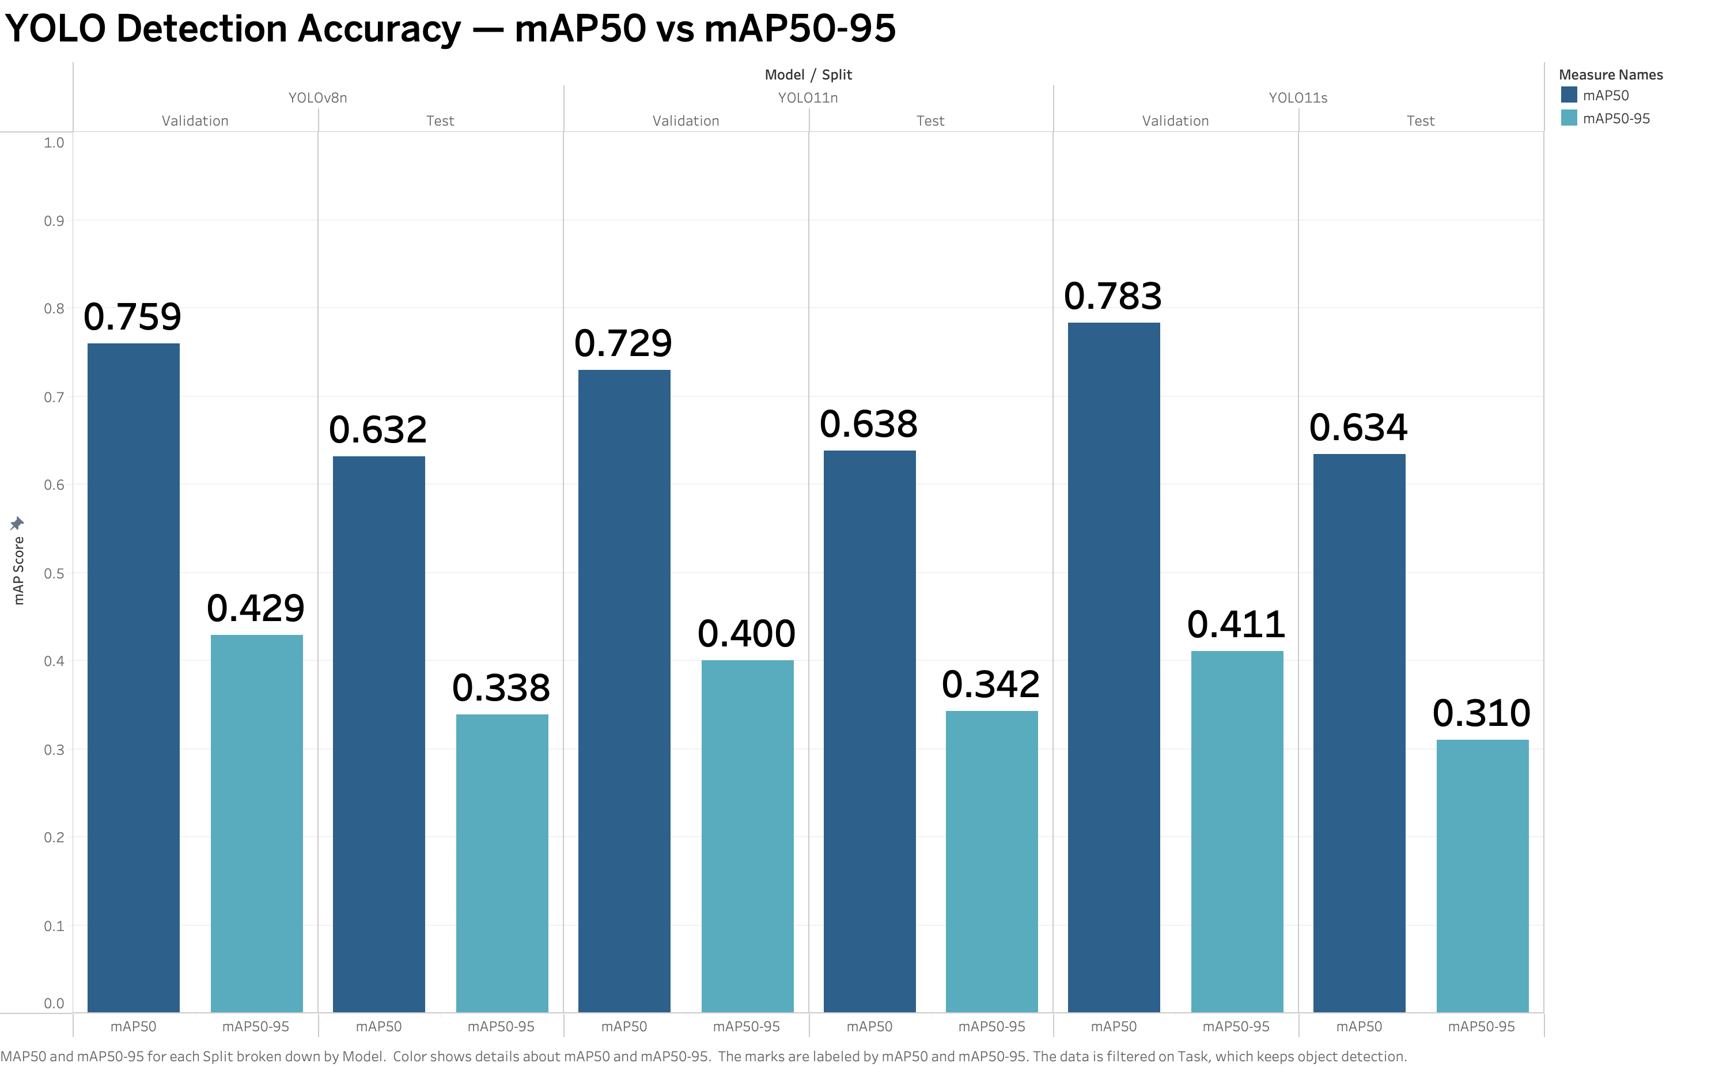
12 | MODEL SELECTION
YOLOv8n Achieves Highest Validation Localisation Quality
Validation Evaluation Summary
• YOLOv8n achieved mAP50–95 of 0.4288, outperforming YOLO11n (0.4002) by +7.1% and YOLO11s (0.4107) by +4.4%.
• Although YOLO11s scored slightly higher on F1 (0.782 vs 0.718) and mAP50 (0.783 vs 0.759), its 9.4M parameter size tripled compute requirements.
• YOLOv8n offered the optimal balance: top localisation precision with minimal 3.2M parameter footprint.
• Checkpoint weights were frozen and passed to the multi-format edge export pipeline.
mAP50 & mAP50–95 Comparison
Figure 3.6: mAP50 and mAP50–95 comparison across candidate YOLO models on validation and test partitions.
University of Bristol • MSc Data Science Dissertation Project • McCain Foods & Dalhousie Collaboration
Notes:
YOLOv8n delivered superior localisation precision while maintaining a compact 3.2M parameter footprint.

Slide 13
13 | MODEL DIAGNOSTICS
Class Breakdown Reveals the Inherent Difficulty of Half-Buried Rocks
Class-Specific Performance Asymmetry
• Evaluating YOLOv8n on the held-out 90-image test set revealed a significant disparity between classes:
• • Completely Exposed: 64 / 69 rocks detected correctly (92.8% operational accuracy).
• • Half-Buried: Only 23 / 66 rocks detected correctly (34.8% operational accuracy).
• Visual Causes of Half-Buried Failures:
• • Smooth gradual transitions between rock surfaces and surrounding dried soil.
• • Partial occlusion by mud clods, crop residue, and shadow contours.
• • Absence of distinct continuous bounding edges.
• Proves that burial-status classification is the primary computer vision bottleneck in field settings.
Key Takeaway for Field Operations
• Exposed rocks are easily detected with >90% reliability, sufficient to trigger fast surface-sweep mechanisms.
• Half-buried rocks require deeper soil penetration and higher actuation forces; misclassification leads to mechanical jams.
• Future multi-spectral or depth sensing will be required to elevate half-buried detection rates to industrial levels.
University of Bristol • MSc Data Science Dissertation Project • McCain Foods & Dalhousie Collaboration
Notes:
Exposed rocks achieved 92.8% detection, whereas half-buried rocks achieved only 34.8% due to visual soil occlusion.

Slide 14
14 | AUXILIARY INVESTIGATION
CLIP Enhances Crop Classification but Lacks Native Localization
Zero-Shot vs Fine-Tuned Vision-Language Model
• Investigated whether foundation models (OpenAI CLIP ViT-B/32) could enhance burial status discrimination.
• Experimental Setup: Cropped rock image chips evaluated under zero-shot prompting vs fine-tuned linear probe.
• Results on Rock Chips:
• • Zero-Shot CLIP: 50.4% accuracy (essentially random guess between exposed vs buried).
• • Fine-Tuned CLIP: 80.0% accuracy on cropped chips.
• Why CLIP Was Not Deployed on Edge:
• • CLIP is a whole-image/crop classifier, NOT a native object detector; requires pre-extracted bounding boxes.
• • ViT-B/32 requires ~350 MB RAM and ~850 ms inference per crop on Raspberry Pi 5 — prohibitively slow.
Role in the Project Scope
• Confirmed that foundation vision-language models have strong semantic feature representations once fine-tuned.
• However, single-stage YOLO remains vastly superior for joint localisation, classification, and edge throughput.
• CLIP findings documented as a valuable auxiliary diagnostic in Chapter 3.
University of Bristol • MSc Data Science Dissertation Project • McCain Foods & Dalhousie Collaboration
Notes:
Fine-tuned CLIP reached 80% accuracy on cropped chips, but was not viable for edge detection due to heavy compute demands.

Slide 15
15 | EDGE PIPELINE
End-to-End Edge Pipeline: Letterboxing to Count Telemetry
Optimized Edge Data Flow
• 1. Input Normalisation: 640x640 letterboxing with aspect ratio preservation and symmetric fill (value 114).
• 2. Tensor Pre-processing: RGB normalization [0, 1] and NCHW format conversion.
• 3. Runtime Engine Inference: Multi-backend forward execution (PyTorch, TFLite, NCNN, ONNX).
• 4. Anchor Decoding: Extracting box coordinates and multi-class confidence scores.
• 5. Post-Processing & NMS: Threshold filtering (conf >= 0.25, IoU = 0.70).
• 6. Agricultural Metric Telemetry: Frame latency, FPS, memory usage, total rock count, and per-class counts.
Counting Accuracy Metric
• Mean Absolute Error (MAE) on total rock counts per image:
• • PyTorch FP32: MAE = 0.600 rocks/image
• • TFLite FP32: MAE = 0.600 rocks/image
• • TFLite INT8: MAE = 0.633 rocks/image (+0.033 rock count delta)
• • NCNN FP32: MAE = 0.600 rocks/image
• • NCNN FP16: MAE = 0.611 rocks/image
• Shows that INT8 quantization maintains excellent aggregate field rock counting fidelity.
University of Bristol • MSc Data Science Dissertation Project • McCain Foods & Dalhousie Collaboration
Notes:
The edge pipeline letterboxes images to 640x640, runs inference, applies NMS, and outputs bounding boxes, labels, and count MAE.

Slide 16
16 | MODEL DIAGNOSTICS
Qualitative Failure Modes: Soil Clods & Occlusion Boundaries
Systematic Error Pattern Analysis
• False Positives (Soil Clods):
• • Dry, crusted soil clumps frequently exhibit convex shapes and shadow gradients mimicking small rocks.
• • Can be mitigated by elevating confidence threshold (e.g. 0.35) at the cost of slight recall reduction.
• False Negatives (Deeply Buried Rocks):
• • Rocks with <20% surface exposure blend into surrounding tillage patterns.
• Class Confusion:
• • Edge boundary uncertainty: Rocks with ~50% burial often oscillate between exposed and half-buried classes.
• Conclusion: 2D RGB imagery alone reaches an empirical performance ceiling; 3D surface profiling is recommended for future work.
Visual Diagnostic Lessons
• Illumination Invariance: Photometric augmentation successfully prevented false alarms under harsh direct sunlight.
• Scale Sensitivity: Rocks < 30 pixels across have lower detection confidence; 640x640 resolution represents optimal speed-resolution trade-off.
• All visual failure cases thoroughly categorized to guide industrial implementation.
University of Bristol • MSc Data Science Dissertation Project • McCain Foods & Dalhousie Collaboration
Notes:
Failure analysis shows soil clods cause false positives and deep burial causes false negatives, indicating 2D RGB limits.

Slide 17
17 | EDGE METHODOLOGY
Preparation of Frozen Checkpoint & Representative Calibration Set
Standardized Edge Preparation Protocol
• The selected YOLOv8n weights were permanently frozen into a master PyTorch checkpoint (`best.pt`, 6.2 MB).
• 90 Test Images Standardized: Letterboxed to 640x640 format, creating a fixed evaluation testbed.
• INT8 Calibration Dataset Preparation:
• • Extracted 200 original training images containing 304 rock objects.
• • Strictly balanced: exactly 152 completely exposed and 152 half-buried instances.
• • Used to compute static scale factor S and zero-point Z for integer-only quantisation without backpropagation.
• Ensured zero test data was observed during quantisation calibration.
Affine INT8 Quantisation Formula
• Quantisation mapping: q = round(r / S) + Z
• • r: 32-bit floating point activation/weight
• • q: 8-bit signed integer [-128, 127]
• • S: positive real scaling factor
• • Z: integer zero-point offset
• Enables ARM NEON integer dot-product SIMD instructions, unlocking massive throughput gains.
University of Bristol • MSc Data Science Dissertation Project • McCain Foods & Dalhousie Collaboration
Notes:
We prepared a frozen checkpoint, 90 standardized test images, and a balanced 200-image calibration set for INT8 quantization.

Slide 18
18 | EDGE METHODOLOGY
Six Deployment Representations Span FP32, FP16 & INT8
The Six Evaluated Edge Representations
• 1. PyTorch FP32 (6.2 MB): Native baseline running in PyTorch Python runtime.
• 2. TorchScript FP32 (12.3 MB): JIT-compiled PyTorch intermediate representation.
• 3. ONNX FP32 (12.2 MB): Open Neural Network Exchange format with ONNX Runtime.
• 4. TFLite FP32 (12.0 MB): TensorFlow Lite flatbuffer single-precision candidate.
• 5. TFLite INT8 (3.3 MB): TensorFlow Lite 8-bit post-training integer quantized model (-73% file size).
• 6. NCNN FP32 (12.1 MB) & FP16 (6.1 MB): Tencent NCNN embedded framework for mobile ARM CPUs.
Candidate Export Summary
• All models generated from identical YOLOv8n weights.
• Memory footprint drops from 12.3 MB (TorchScript) down to 3.3 MB (TFLite INT8).
• Enables direct empirical comparison across runtime engines (PyTorch vs TFLite vs NCNN vs ONNX) and numerical precisions (FP32 vs FP16 vs INT8).
University of Bristol • MSc Data Science Dissertation Project • McCain Foods & Dalhousie Collaboration
Notes:
We exported the same YOLOv8n detector into six deployment formats spanning PyTorch, ONNX, TFLite, and NCNN across FP32, FP16, and INT8.

Slide 19
19 | EDGE METHODOLOGY
Hardware Testbed: Raspberry Pi 5 (8GB) in CPU-Only Mode
Raspberry Pi 5 Hardware & OS Environment
• SoC: Broadcom BCM2712 quad-core ARM Cortex-A76 processor @ 2.4 GHz.
• Memory: 8 GB LPDDR4X SDRAM.
• Power Supply: Official 27W (5.1V / 5.0A) USB-C power delivery to prevent under-voltage throttling.
• Operating System: Debian GNU/Linux 13 (Trixie), 64-bit kernel.
• Cooling Condition: Passive heatsink only (No Active Cooler attached) to simulate realistic enclosed tractor equipment enclosures.
• Software Stack: Python 3.13.5, Ultralytics 8.4.115, ONNX Runtime 1.28.0, OpenCV 5.0.0, NumPy 2.5.1, psutil 7.2.2.
Experimental Isolation Protocols
• No GUI Desktop: Background services minimized to eliminate operating system jitter.
• Single Batch Inference: Batch size = 1 strictly enforced (real-time stream simulation).
• Hardware Telemetry: psutil and vcgencmd polled every 10 ms for CPU load, RSS RAM, and SoC core temperature.
University of Bristol • MSc Data Science Dissertation Project • McCain Foods & Dalhousie Collaboration
Notes:
Our testbed is a Raspberry Pi 5 with 8GB RAM running headless Debian Linux, actively monitoring CPU, memory, and thermal state.

Slide 20
20 | EDGE METHODOLOGY
Dual Testing Protocol: Fixed Benchmark & Continuous Endurance
Two-Phase Evaluation Protocol
• Phase 1: Canonical Fixed Benchmark (90 Images)
• • 3 warmup inferences to stabilize cache and JIT compilation.
• • 90 timed sequential inferences over the held-out test partition.
• • Records per-frame latency, median FPS, CPU %, peak RAM, mAP50, mAP50-95, and Count MAE.
• Phase 2: Continuous Operational Endurance Test (10 Passes)
• • 900 consecutive inferences (10 passes of the 90-image test set).
• • Evaluates memory leak accumulation, thermal throttling thresholds, and runtime crash vulnerability.
Why Dual Testing Was Essential
• A model can pass a short 90-image benchmark but crash after 20 minutes in field conditions.
• Exposes hidden edge runtime bugs (memory leaks, threading lockups, segmentation faults).
• Ensures the selected model is truly robust for continuous tractor deployments.
University of Bristol • MSc Data Science Dissertation Project • McCain Foods & Dalhousie Collaboration
Notes:
We implemented both a 90-image canonical benchmark and a 900-image continuous endurance run to evaluate operational stability.

Slide 21
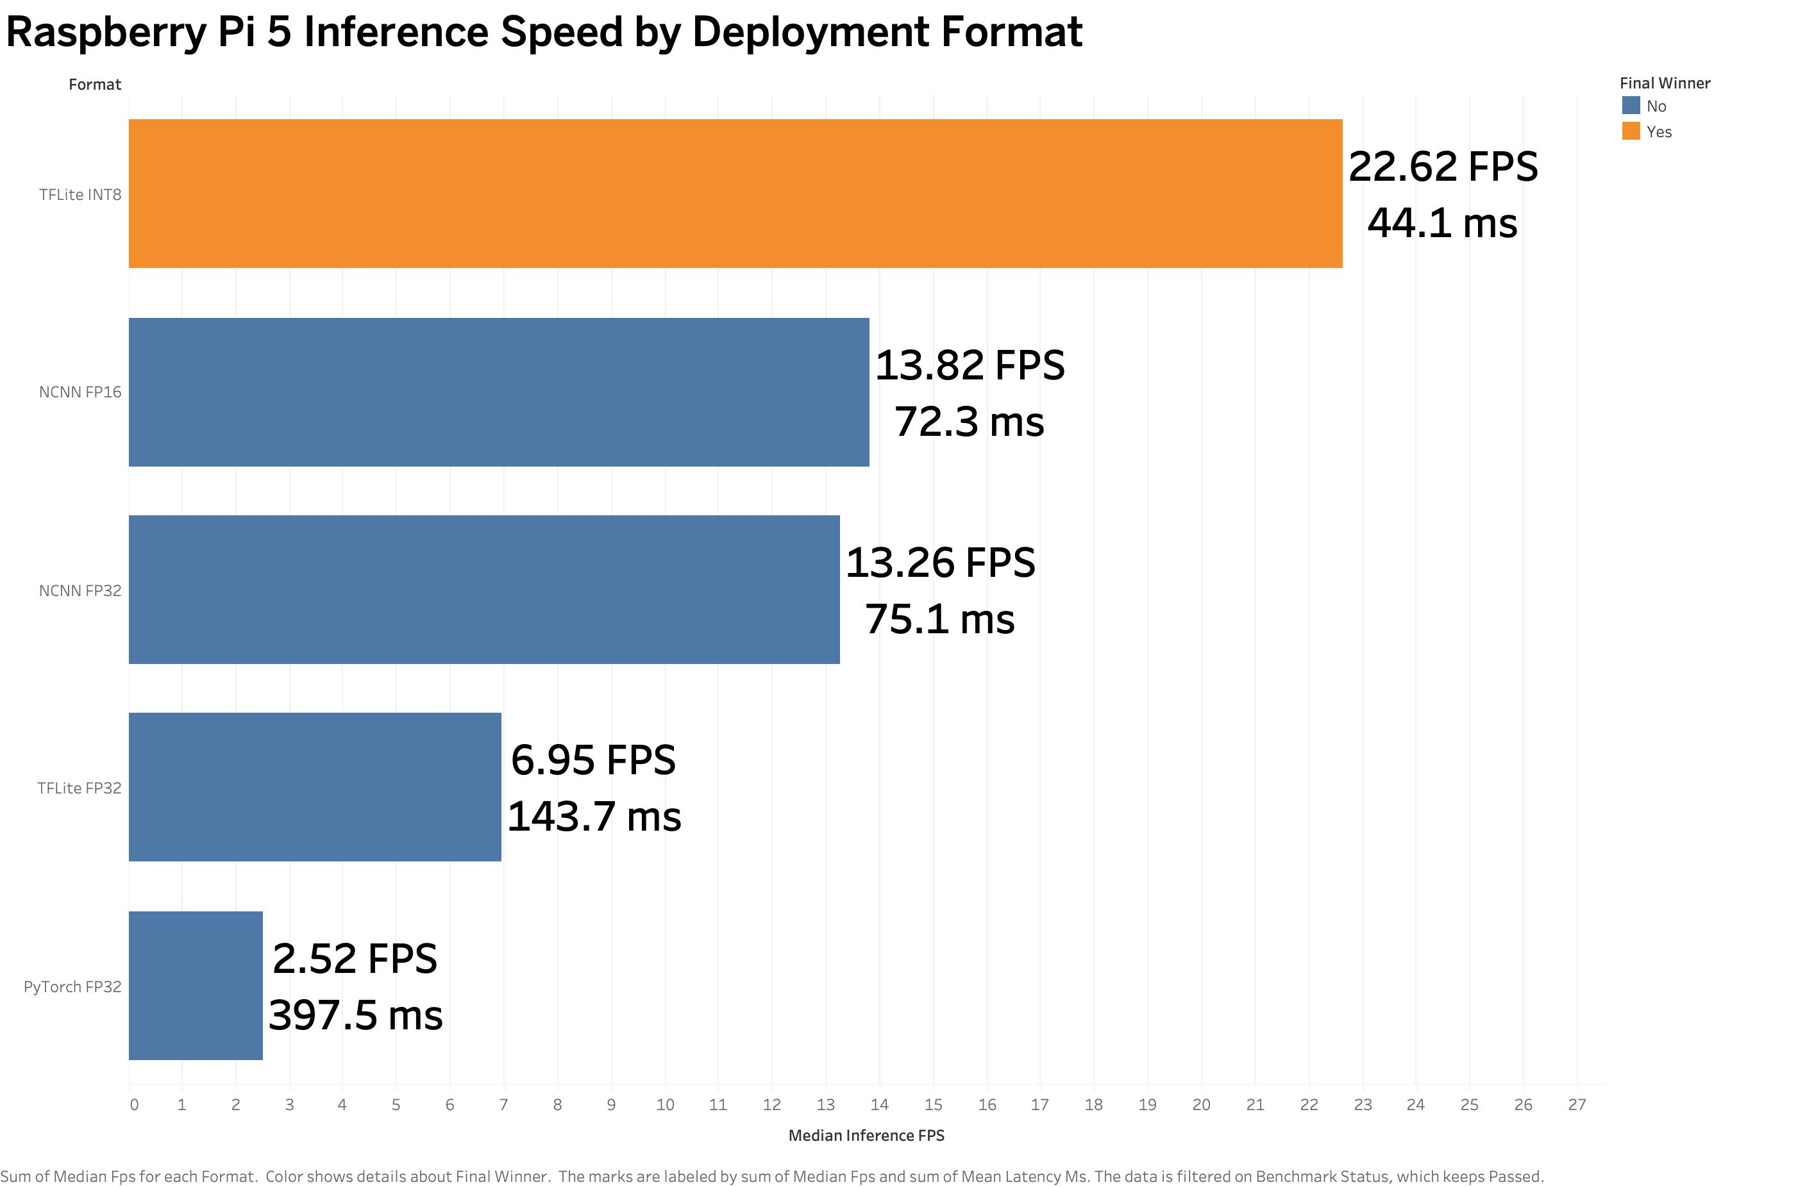
21 | EVALUATION RESULTS
TFLite INT8 Delivers 22.62 FPS — 9.01x Speedup over PyTorch
Canonical Runtime Latency & Throughput
• PyTorch FP32 (Baseline): 397.48 ms latency | 2.52 FPS — unusable for real-time control.
• TFLite FP32: 143.70 ms latency | 6.95 FPS (2.77x speedup over PyTorch).
• NCNN FP32: 75.09 ms latency | 13.26 FPS (5.29x speedup).
• NCNN FP16: 72.31 ms latency | 13.82 FPS (5.49x speedup).
• TFLite INT8 (WINNER): 44.13 ms latency | 22.62 FPS (9.01x speedup!).
• TFLite INT8 is the ONLY representation that exceeds the 20 FPS threshold required for real-time potato harvesting.
Throughput & Latency Comparison
Figure 4.3: Median throughput (FPS) and mean latency (ms) across completed deployment formats on Pi 5.
University of Bristol • MSc Data Science Dissertation Project • McCain Foods & Dalhousie Collaboration
Notes:
TFLite INT8 achieved 22.62 FPS and 44.13 ms latency — a 9.01x speedup over PyTorch and the only format exceeding the 20 FPS real-time target.

Slide 22
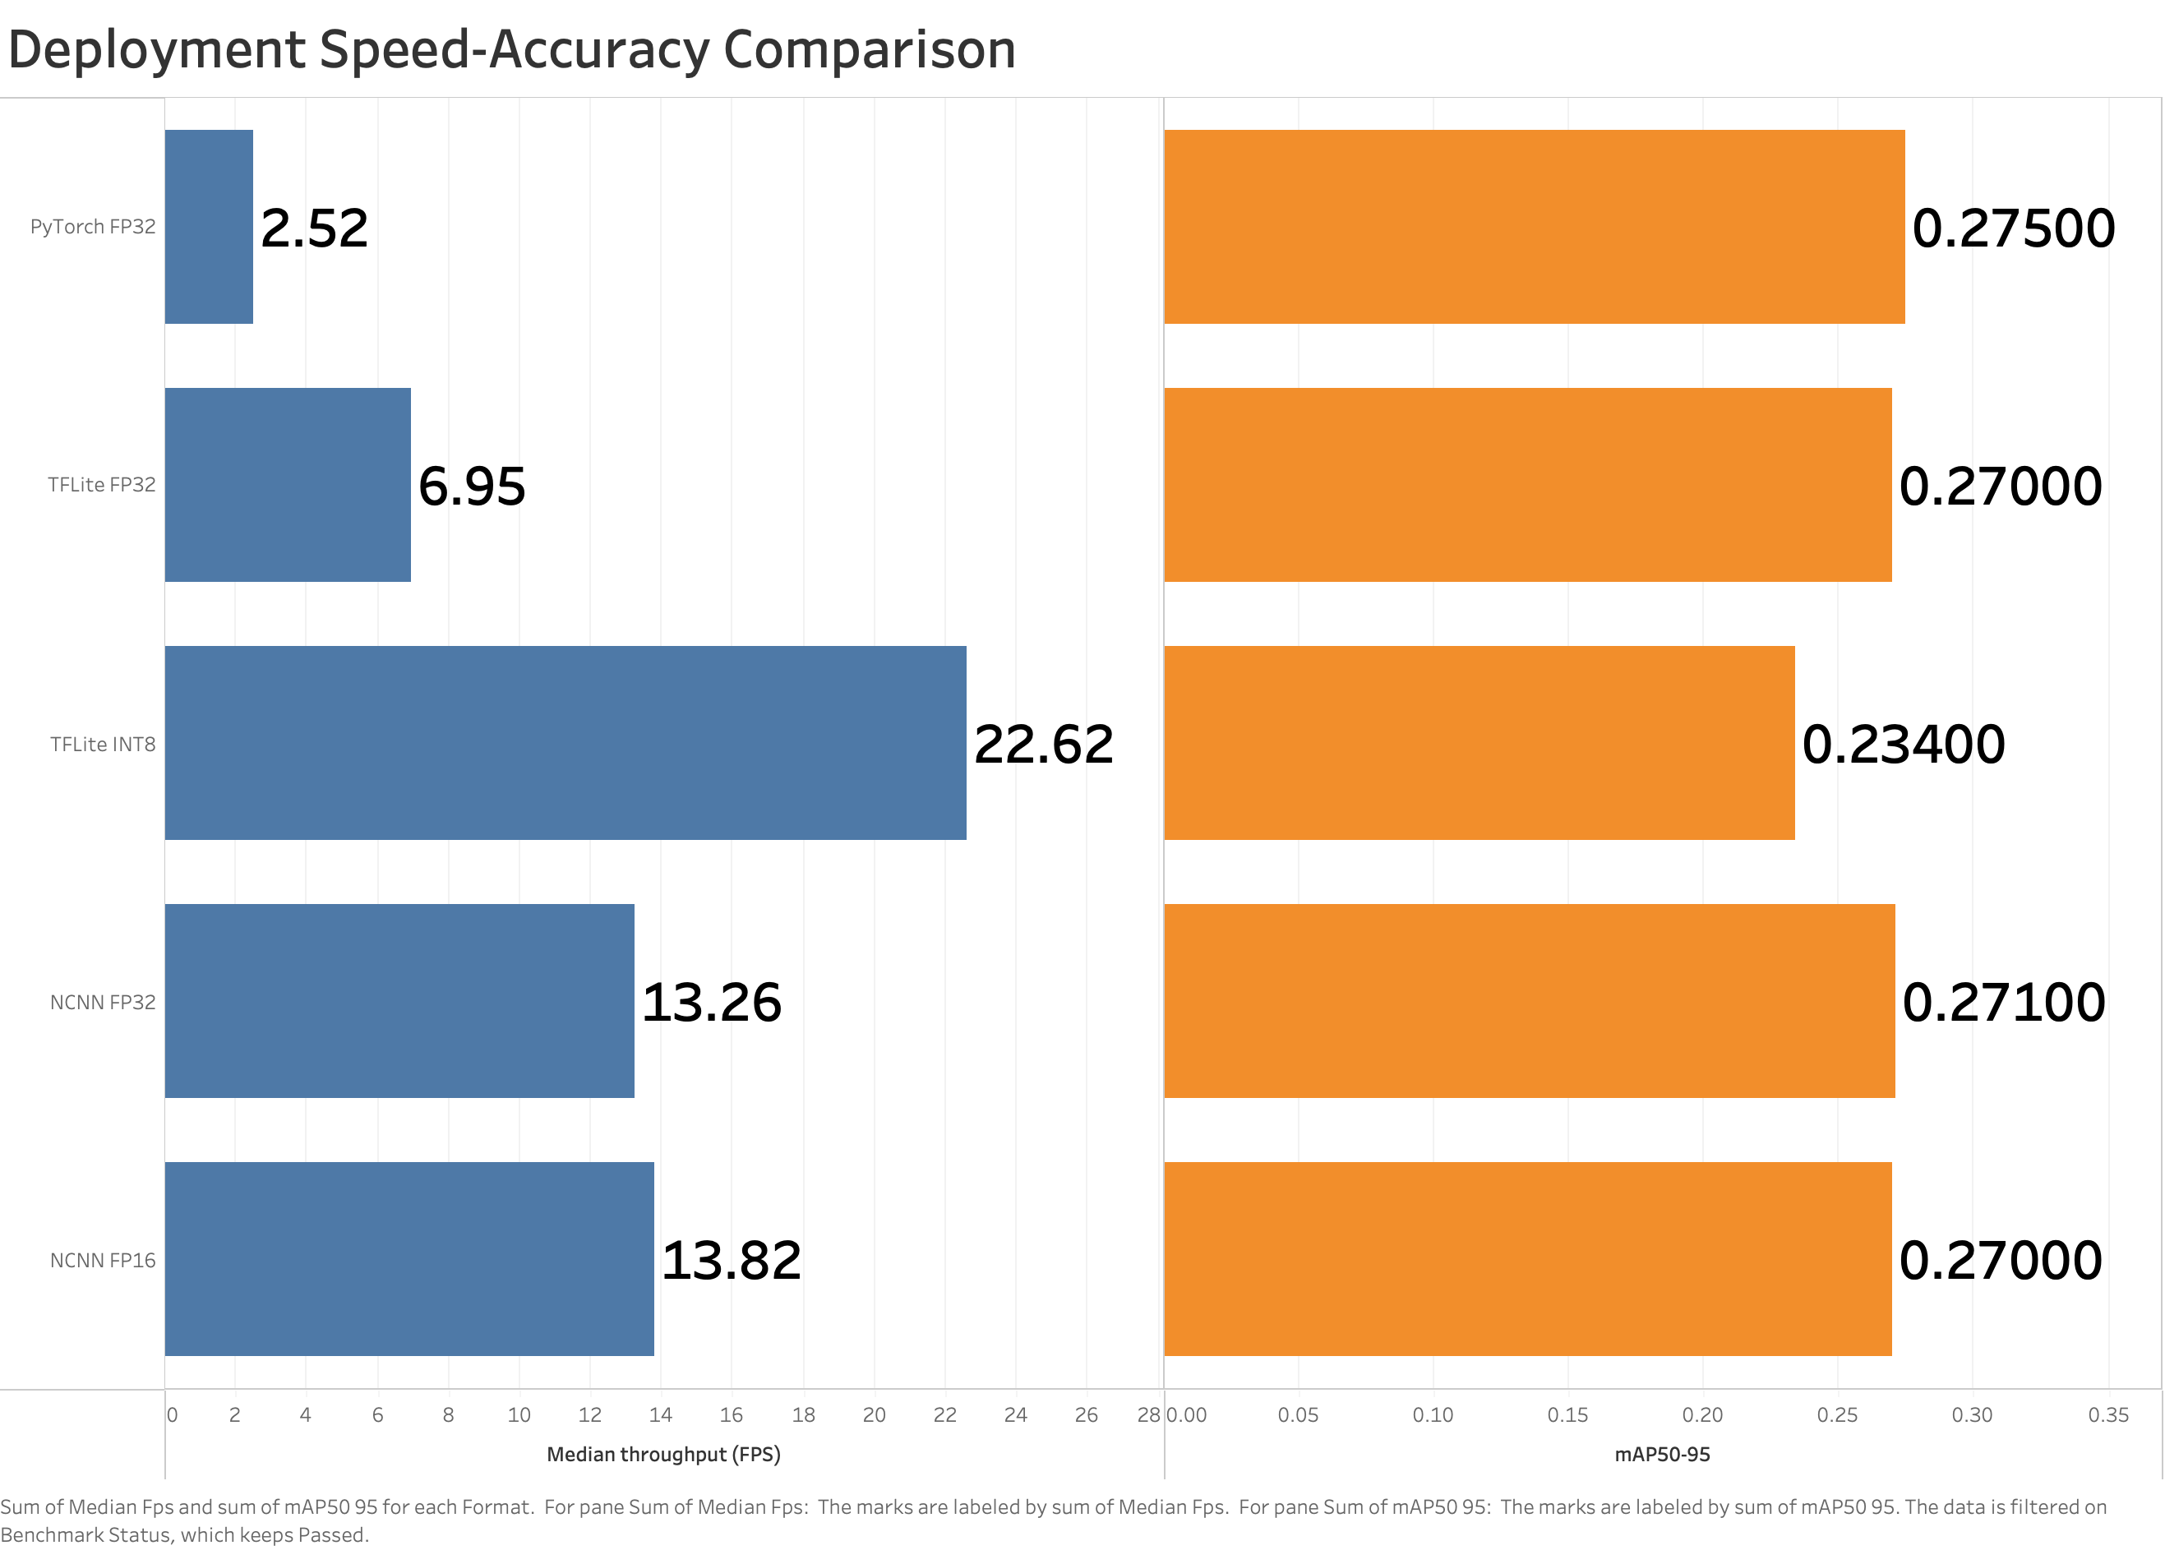
22 | EVALUATION RESULTS
Throughput vs Accuracy: A Quantifiable, Acceptable Trade-Off
Localisation Quality vs Inference Speed
• Full-Precision Quality Retention:
• • PyTorch FP32: mAP50 = 0.548, mAP50-95 = 0.275, F1 = 0.622
• • TFLite FP32: mAP50 = 0.535, mAP50-95 = 0.270, F1 = 0.599
• • NCNN FP16: mAP50 = 0.537, mAP50-95 = 0.270, F1 = 0.600
• INT8 Quantisation Impact (TFLite INT8):
• • mAP50: 0.503 (-0.045 vs PyTorch baseline)
• • mAP50-95: 0.234 (-0.041 vs PyTorch baseline)
• • F1 Score: 0.594 (-0.028 vs PyTorch baseline)
• Trade-Off Assessment: A 14.9% decrease in mAP50-95 buys an 800% increase in frame rate (2.5 -> 22.6 FPS). Highly favorable for field deployment.
Speed vs Accuracy Pareto Chart
Figure 4.2: Median throughput (FPS) plotted against mAP50-95 showing TFLite INT8 as the clear Pareto-optimal choice.
University of Bristol • MSc Data Science Dissertation Project • McCain Foods & Dalhousie Collaboration
Notes:
The minor mAP reduction from INT8 quantization is heavily outweighed by the massive 9x speedup, establishing TFLite INT8 as Pareto-optimal.

Slide 23
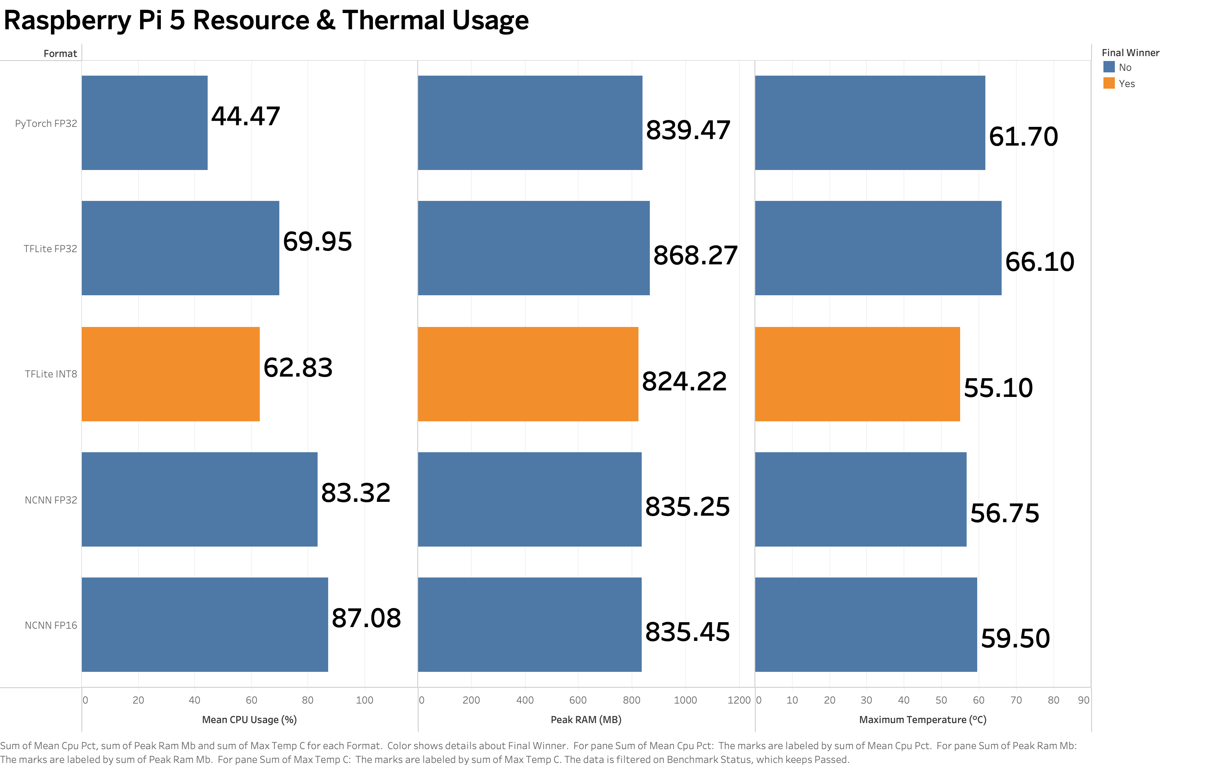
23 | EVALUATION RESULTS
System Resources: INT8 Optimizes CPU, Memory & Thermal Load
Hardware Resource Utilization on Pi 5
• Peak Process RAM:
• • TFLite INT8 had the lowest memory footprint: 824.2 MB (vs 868.3 MB for TFLite FP32).
• • Fits easily within low-cost 2GB or 4GB Raspberry Pi variants.
• CPU Core Utilization:
• • TFLite INT8: 62.8% average CPU load across 4 cores.
• • NCNN FP16: 87.1% CPU load (heavier ARM thread saturation).
• Thermal Dissipation (Short-run Max):
• • TFLite INT8: 55.10 °C (Coolest operating temperature).
• • NCNN FP32: 56.75 °C | NCNN FP16: 59.50 °C | PyTorch: 61.70 °C | TFLite FP32: 66.10 °C.
• INT8's integer SIMD operations generate significantly less heat, preventing thermal throttling.
Resource & Thermal Comparison
Figure 4.5: CPU load, peak RAM, and short-run temperature across completed formats.
University of Bristol • MSc Data Science Dissertation Project • McCain Foods & Dalhousie Collaboration
Notes:
TFLite INT8 was also the most power-efficient format, running coolest at 55.1°C with only 62.8% CPU load.

Slide 24
24 | OPERATIONAL STABILITY
Stability Testing Exposes Critical Runtime Failures
Negative Results & Runtime Crashes
• Export Success Does NOT Equal Deployment Stability!
• ONNX FP32 Fatal Failure:
• • Successfully exported from Ultralytics without errors.
• • Completely crashed during benchmark aggregation due to an internal ONNX Runtime memory management fault on ARM64.
• NCNN Continuous Endurance Failure:
• • Successfully passed the 90-image benchmark at 13.8 FPS.
• • However, crashed during the continuous 10-pass endurance run due to thread contention and memory leakage.
Robustness & Deployment Findings
• TFLite INT8 Robustness Winner:
• • The ONLY deployment format that completed 100% of both fixed benchmark and continuous endurance runs without a single crash.
• System-Level Validation Necessity:
• • Demonstrates the indispensable need to test models under sustained workload stress on target edge hardware.
• Reporting Integrity:
• • Transparently disclosing runtime crashes prevents costly real-world field deployment failures.
University of Bristol • MSc Data Science Dissertation Project • McCain Foods & Dalhousie Collaboration
Notes:
Crucially, ONNX crashed during benchmarking and NCNN crashed during endurance testing. TFLite INT8 was the only format with 100% stability.

Slide 25
25 | CONCLUSIONS & ROADMAP
Final Selection: TFLite INT8 Validated; Future Roadmap Defined
Final Deployment Selection: TFLite INT8
• Selection Justification across All Four Criteria:
• 1. Speed: 22.62 FPS (9.01x faster than PyTorch, exceeding 20 FPS threshold).
• 2. Localisation: Retains 0.234 mAP50-95 and 0.633 count MAE.
• 3. Efficiency: Lowest peak RAM (824 MB) and lowest temperature (55.1 °C).
• 4. Reliability: 100% stability across all continuous endurance workloads.
• Hypothesis Assessment: All three hypotheses (H1 Speedup, H2 Accuracy Cost, H3 Stability Divergence) fully supported.
Prioritised Future Roadmap
• 1. Multi-Spectral & 3D Depth Sensing: Integrate stereo vision or LiDAR to elevate half-buried detection accuracy above 35%.
• 2. Live Tractor Camera Stream: Build GStreamer / Video4Linux2 real-time camera ingestion pipeline with GPS geo-tagging.
• 3. Hardware Accelerator Offload: Deploy on Raspberry Pi AI Kit (Hailo-8L NPU, 13 TOPS) for sub-10 ms inference.
• 4. Closed-Loop Actuator Integration: Interface with hydraulic rock-picker control PLC via CAN bus.
University of Bristol • MSc Data Science Dissertation Project • McCain Foods & Dalhousie Collaboration
Notes:
In conclusion, TFLite INT8 is our definitive edge deployment choice. Future work will integrate 3D depth sensing and NPU hardware.

