Slide 1
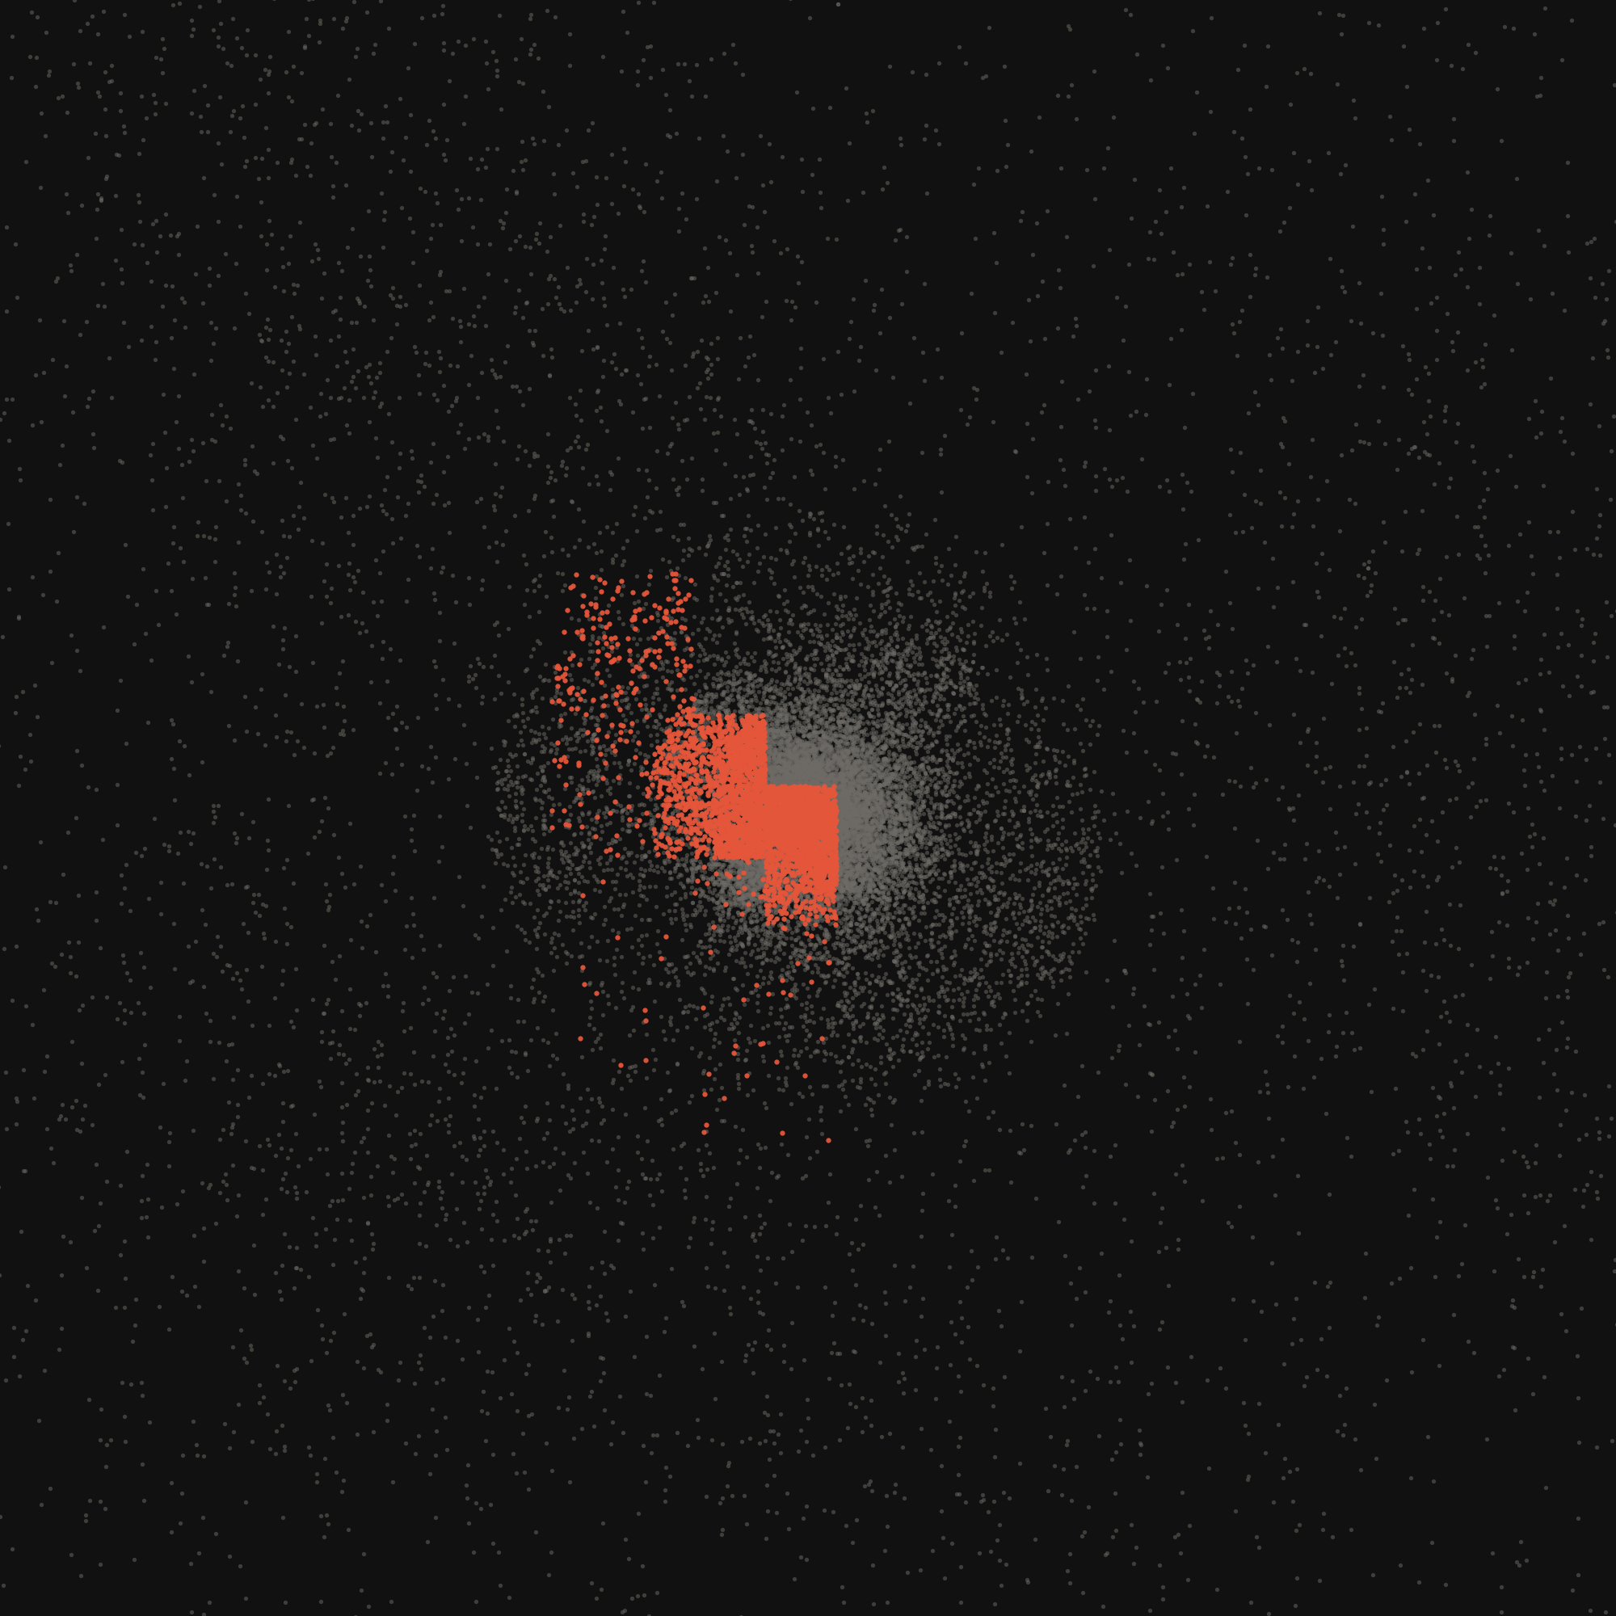
PCAP · COURSE PROJECT
Adaptive Scheduling for Load-Balanced Parallel N-Body Simulation
A hybrid MPI–OpenMP–CUDA Barnes–Hut simulator that chooses its OpenMP loop schedule at run time from measured thread imbalance
Tanish Hemant Kuvar 240962540
M. Vishal Kumar 240962546
Samyak Jain 240962638
AIML-A
Guide [GUIDE / FACULTY NAME]
Institution [INSTITUTION]
Parallel Computing Architecture and Programming · [COURSE CODE]
27 October 2026
Cold collapse, N = 32,768, t = 1.50 · vermilion: bodies of the busiest thread
Notes:
Introduce the team and the one-line idea: a gravity simulation parallelised at three levels, plus a controller that changes how OpenMP shares work when the work becomes uneven.
The image is our own simulation after a cloud collapsed; vermilion stars are the ones computed by the single busiest thread.

Slide 2
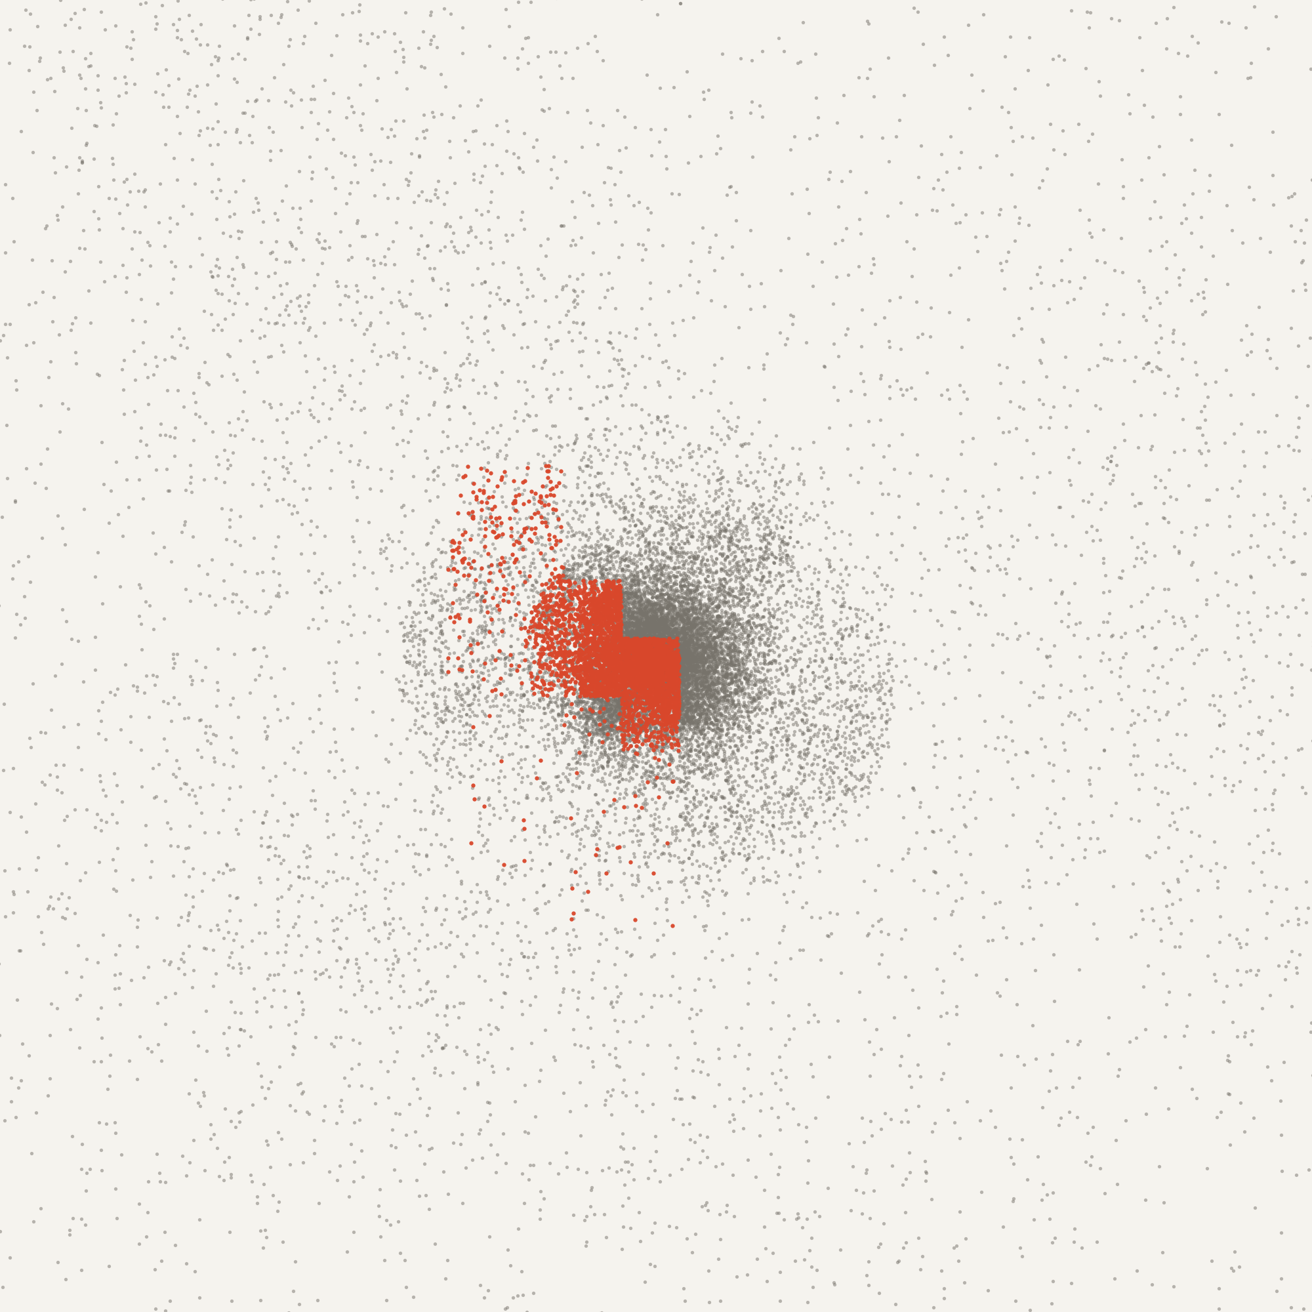
Clustering turns equal shares of bodies into unequal shares of work
01 — PROBLEM
With a static schedule, the thread that owns the dense core sets the pace for all eight.
COST
FORCE-LOOP TIME PER THREAD [ms]
Every step needs the force on every body: N(N−1)/2 ≈ 2.1 × 10⁹ pairs at N = 65,536.
SHORTCUT
Barnes–Hut octree: a distant cell acts as one mass (θ = 0.5), giving O(N log N).
IMBALANCE
A body in a dense region opens more cells, so its force costs more.
3.7×
SCHEDULE
Static gives each thread an equal count of Morton-ordered bodies, i.e. one region of space.
busiest vs least-loaded thread; λ = 0.63 at this step
Cold collapse, N = 32,768, 8 threads, static, t = 1.50. Vermilion: bodies computed by thread T2.
Notes:
An N-body step needs the gravitational force on every body; done exactly that is N squared pairs, which is why we use the Barnes-Hut tree. Its cost per body depends on how dense the neighbourhood is.
Because we sort bodies along a Morton curve, a static schedule hands each thread one region of space. In this frame thread T2 owns part of the dense core and takes 3.7 times as long as the lightest thread, so seven threads wait.
Demo option: open results/presentation.html (section 2) and play the animation here.

Slide 3
All four synopsis objectives are implemented and measured
02 — OBJECTIVES
Each objective maps to code in the repository and to a measured result.
OBJECTIVE
IMPLEMENTED AS
EVIDENCE
OBJ
1
Sequential direct-sum and Barnes–Hut baselines with energy and momentum checks
--force direct | bh, 1 thread
max ΔE/E 1.1 × 10⁻⁷ (direct)
OBJ
2
OpenMP force loop; characterise static, dynamic and guided schedules
schedule(runtime)
4 inputs × 3 sizes × 1–8 threads
OBJ
3
MPI distribution across ranks and a CUDA force kernel
MPI_Allgatherv; tiled kernel via NVRTC
1–4 ranks bit-identical; GPU fp32 error 4.6 × 10⁻⁶
OBJ
4
Adaptive controller, evaluated on uniform and clustered inputs
omp_set_schedule, k = 5
faster than static in 9/9 clustered cases
+
Beyond the synopsis: corrected imbalance metric under dynamic, thread pinning, thermal gate
slides 04 and 05
8/8 correctness checks
Notes:
These are the four objectives from our synopsis. O1 gave correct sequential baselines, O2 the OpenMP loop and the three built-in schedules, O3 the MPI decomposition and the CUDA kernels, O4 the adaptive controller.
The last row is what we added because the measurements required it; slide 04 explains the controller correction.

Slide 4
Every rank replicates the tree; threads and the GPU share the force work
03 — ARCHITECTURE
One timestep crosses three levels of parallelism. Bodies are re-sorted along a Morton curve every step.
kick + drift
MPI_Allgatherv
Morton sort
octree build
force loop
kick
controller
MPI
ACROSS RANKS
rank 0
rank 1
rank 2
rank 3
each rank owns one contiguous Morton block;
positions and velocities exchanged every step
OPENMP
ACROSS CORES
T0
T1
T2
T3
T4
T5
T6
T7
controller → omp_set_schedule()
#pragma omp for schedule(runtime)
CUDA
ON THE GPU
tiled direct kernel · 256-body shared-memory tiles
near-field kernel · leaf ranges from the CPU walk
compiled at run time with NVRTC for the detected GPU (no nvcc / MSVC needed)
Notes:
Read the top row left to right: that is one timestep. Every rank holds the full state, sorts it and builds the same tree, then computes forces only for its own block.
Inside a rank the force loop is an OpenMP loop with schedule(runtime), so the controller can change the schedule between steps without recompiling.
The GPU either computes all pairs with a tiled kernel, or takes the near-field pairs that the CPU tree walk collected.
Live option (needs internet): results/web/viewer.html shows the thread ownership in 3D.

Slide 5
The controller switches schedule when measured imbalance crosses a threshold
04 — ADAPTIVE CONTROLLER
λ = max(tᵢ) / mean(tᵢ) − 1 over a k = 5 step window, with hysteresis between 0.05 and 0.15.
01
time each thread's share of the force loop
STATIC
equal contiguous blocks
λ > 0.15
DYNAMIC
chunks of 8 on demand
02
accumulate over a window of k = 5 steps
predicted λ < 0.05
03
compute λ for the window
CORRECTION TO ALGORITHM 1
Under dynamic the measured times are balanced by construction, so λ would always fall below 0.05 and the policy would oscillate. The controller instead predicts the times static would give:
04
compare with 0.15 (switch up) and 0.05 (switch back)
T_{i} = B_{i} / v_{i} v_{i} = W_{i} / t_{i}
05
omp_set_schedule(policy, chunk = 8)
Tᵢ predicted static time · Bᵢ work in thread i's static block · Wᵢ work it executed. Under static, Tᵢ = tᵢ.
Notes:
Every five steps the controller looks at how long each thread spent in the force loop and computes lambda, the slowest thread relative to the average. Above 0.15 it switches to dynamic; below 0.05 it switches back. Two thresholds stop it flipping on noise.
The synopsis algorithm measured lambda directly in both states. Under dynamic that is always near zero, so it would oscillate. We predict what static would cost from each thread's measured speed and the work in its static block.
Live demo: python demo.py --part 2 shows lambda rising and the switch.

Slide 6
Experiments cover four inputs, three sizes, 1–8 threads and 1–4 ranks
05 — EXPERIMENTAL SETUP
Medians of three shuffled repetitions on one hybrid laptop, with threads pinned to the performance cores.
CORRECTNESS
HARDWARE
Intel i7-14700HX (8 P + 12 E cores) · RTX 4060 Laptop GPU
8/8
SOFTWARE
GCC 15.1 -O3 -march=native · MS-MPI 10.1 · NVRTC 12.9
uniform (balanced control) · plummer · collide · collapse
automated validation checks passed
INPUTS
N = 4,096 · 16,384 · 65,536 · 150 steps, dt = 0.01, θ = 0.5
0.25 %
SIZES
rms Barnes–Hut force error, θ = 0.5
PARALLEL
1, 2, 4, 8 threads per rank · 1, 2, 4 MPI ranks
1.1 × 10⁻⁷
max energy drift, direct sum
METRICS
S(p) = T(1) / T(p) · E(p) = S(p) / p · λ per step
1 checksum
across 13 thread / rank / schedule configurations
Notes:
All measurements are medians of three repetitions run in shuffled order, so slow drift affects every schedule equally. Threads are pinned to the eight performance cores because the slower efficiency cores alone produced lambda of about 0.3 on a balanced job.
Later experiments ran behind a thermal gate after we saw the laptop throttle; throttled data is kept in results/archive.
Correctness: the final state is bit-identical for every configuration. Live option: python demo.py --part 1.

Slide 7
Imbalance appears only once the core forms, and the controller follows it
06 — RESULTS · IMBALANCE
Cold collapse, N = 65,536, 8 threads. Work imbalance stays below 0.05 until t = 1.00, then rises to 0.64.
ADAPTIVE RUN
t = 0.41
brief switch on a timing spike, reverted by the 0.05 threshold
t = 1.16
sustained switch as the core forms
λ 0.57 → 0.04
measured λ at the last step, static vs adaptive
Notes:
This is one benchmark run of the collapsing cloud. The dark line is the imbalance implied by counted work: almost zero while the cloud is uniform, then up to 0.64 once the core forms after t = 1.
Grey is what static actually measured; vermilion is the adaptive run. Its controller reacted briefly to a noise spike at t = 0.41 and the 0.05 threshold sent it back, then switched for good at t = 1.16, after which its measured imbalance stays near zero.
Live option: results/presentation.html, section 3.

Slide 8
Adaptive beats static in all nine clustered cases; guided gains more
07 — RESULTS · SCHEDULES
Time saved vs static at 8 threads. Speed-up at 8 threads (N = 65,536): 5.6–6.4×.
CLUSTERED CASES FASTER THAN STATIC
9/9
adaptive saves 1.5–16.6 % of run time
UNIFORM INPUT
within 2.3 % of static, all sizes
SMALL BALANCED JOB
dynamic +46 % time; adaptive stays static
BEST FIXED SCHEDULE
guided in 9 of 12 cases, adaptive in 3
Notes:
Each pair of bars is one clustered case at 8 threads: how much run time each schedule saves compared with static. Adaptive is faster than static in all nine cases, between 1.5 and 16.6 percent.
On the uniform input it stays within 2.3 percent of static, which is what the synopsis predicted, and it avoids the 46 percent penalty that dynamic pays on a small balanced job.
Guided was the best fixed schedule in nine of twelve cases; we say so plainly and discuss why on the next slide.

Slide 9
The GPU removes the O(N²) cost; imbalance between ranks remains open
08 — GPU · LIMITATIONS · NEXT STEPS
Tiled CUDA direct sum vs 8 CPU threads, and what the measurements say we should do next.
88×
fp32 kernel vs 8 CPU threads, N = 65,536
24.0 vs 2117 ms per step
rms force error 4.6 × 10⁻⁶
LIMITATIONS
Guided matched or beat adaptive in 9 of 12 cases
A timing spike can trigger a false switch (uniform, 1 × 8: +17 % time)
Imbalance between ranks reached λ = 0.11 (threads only fixed)
NEXT STEPS
Cost-weighted rank partitioning: up to 17.2 % faster
Controller that also picks guided; multi-node runs
Notes:
On the GPU, the tiled kernel computes the exact all-pairs force 88 times faster than eight CPU threads in single precision; double precision is slow on this laptop GPU. The Barnes-Hut hybrid gains 1.3 to 1.4 times.
Limitations: guided is the strongest fixed schedule here, a time-based trigger can react to noise, and the OpenMP controller cannot fix imbalance between MPI ranks.
Vishal implemented two next steps already: cost-weighted rank partitioning and an auto mode that tries dynamic and guided.
Live option: python demo.py --part 4 runs the GPU comparison.

Slide 10
Thank you
Questions?
Tanish Hemant Kuvar · M. Vishal Kumar · Samyak Jain
github.com/tanishkuvar11/N-Body-Simulation
Notes:
Invite questions. Have results/presentation.html open in a browser tab and the demo terminal ready in case the professor wants to see a run again.

