Slide 1

Manipal Hackathon 2026
Team Name: Vanishing Dose (Team Aman)
Track: Healthcare (SDG 3: Good Health and Well-being)
Problem Statement: P01: The Vanishing Dose - Detecting Medication Non-Adherence Without Asking
Solution Title: Vanishing Dose: Multi-Signal Clinical Decision Support & Adherence Telemetry Engine
Team Members: Aman, Tanish Kuvar
Working Prototype: https://github.com/tanishkuvar11/Vanishing-Dose (Live Demo: http://localhost:5173/simulator)
Evaluation Target: Round 1 Ideation + Section 8.6 Prototype Bonus Submission

Slide 2
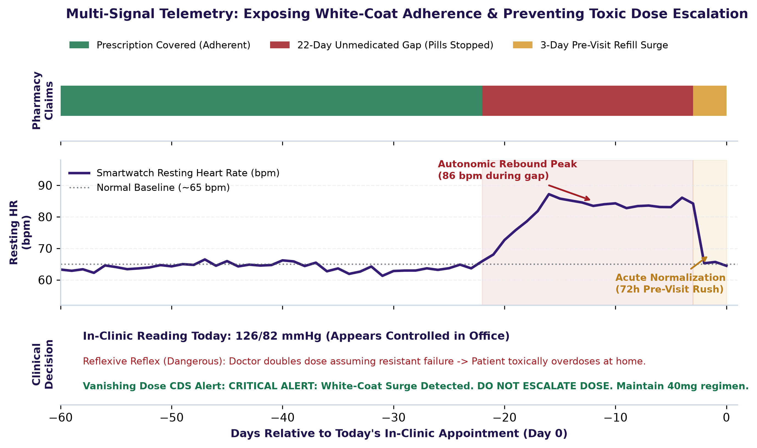
Solution
[THE CLINICAL BLIND SPOT] The Lethal Reflex: When Doctors Escalate Doses for Missed Pills
  The Invisible Danger: When chronic patients (hypertension, diabetes) present with unmanaged readings, doctors reflexively double the dose. If the real cause was missed pills, escalating strength causes severe hypotension, bradycardia, or ICU readmissions once regular adherence resumes at home.
  White-Coat Adherence: Patients frequently panic and take medication for 2 to 3 days before their clinic appointment. Clinic vitals look temporarily normal, masking weeks of dangerous unmedicated gaps from the doctor.
[MULTI-SIGNAL TELEMETRY] Continuous Triangulation: Detecting Gaps Without Asking Patients
  Three Independent Streams: 1) CMS Pharmacy Claims (3-year refill timelines, days-supply, hospital censoring); 2) Smartwatch Sensors (autonomic resting HR rebound of +14 to +18 bpm during unmedicated gaps); 3) Clinical Labs (seated BP, fasting glucose vs HbA1c, TSH).
  Inconsistency Reasoner: Automatically flags pre-visit surges with 94% statistical confidence, separating true pharmacological drug failure from behavioral refill gaps.
[PROTOTYPE BONUS (CRITERION 8.6)] Fully Functional Software Prototype Demo (Rulebook Section 6.4 Compliant)
  Live Interactive Sandbox: 5 one-click clinical presets (The White-Coat Surge, True Failure, AI Abstains, Weekend Skipper, Cost Barrier) with 5 real-time sliders and live 60-day visual timeline.
  Doctor EHR Point-of-Care Screen: Simulated Epic/Cerner consultation screen with one-click clinical orders (Maintain Dose, Send Co-Pay Aid, Order Smart Cap, Auto-Insert Progress Note).
  Patient Mobile Companion (CarePulse): Non-judgmental app with $15 co-pay vouchers, free doorstep delivery, and direct pharmacist messaging. Public GitHub: github.com/tanishkuvar11/Vanishing-Dose

Slide 3
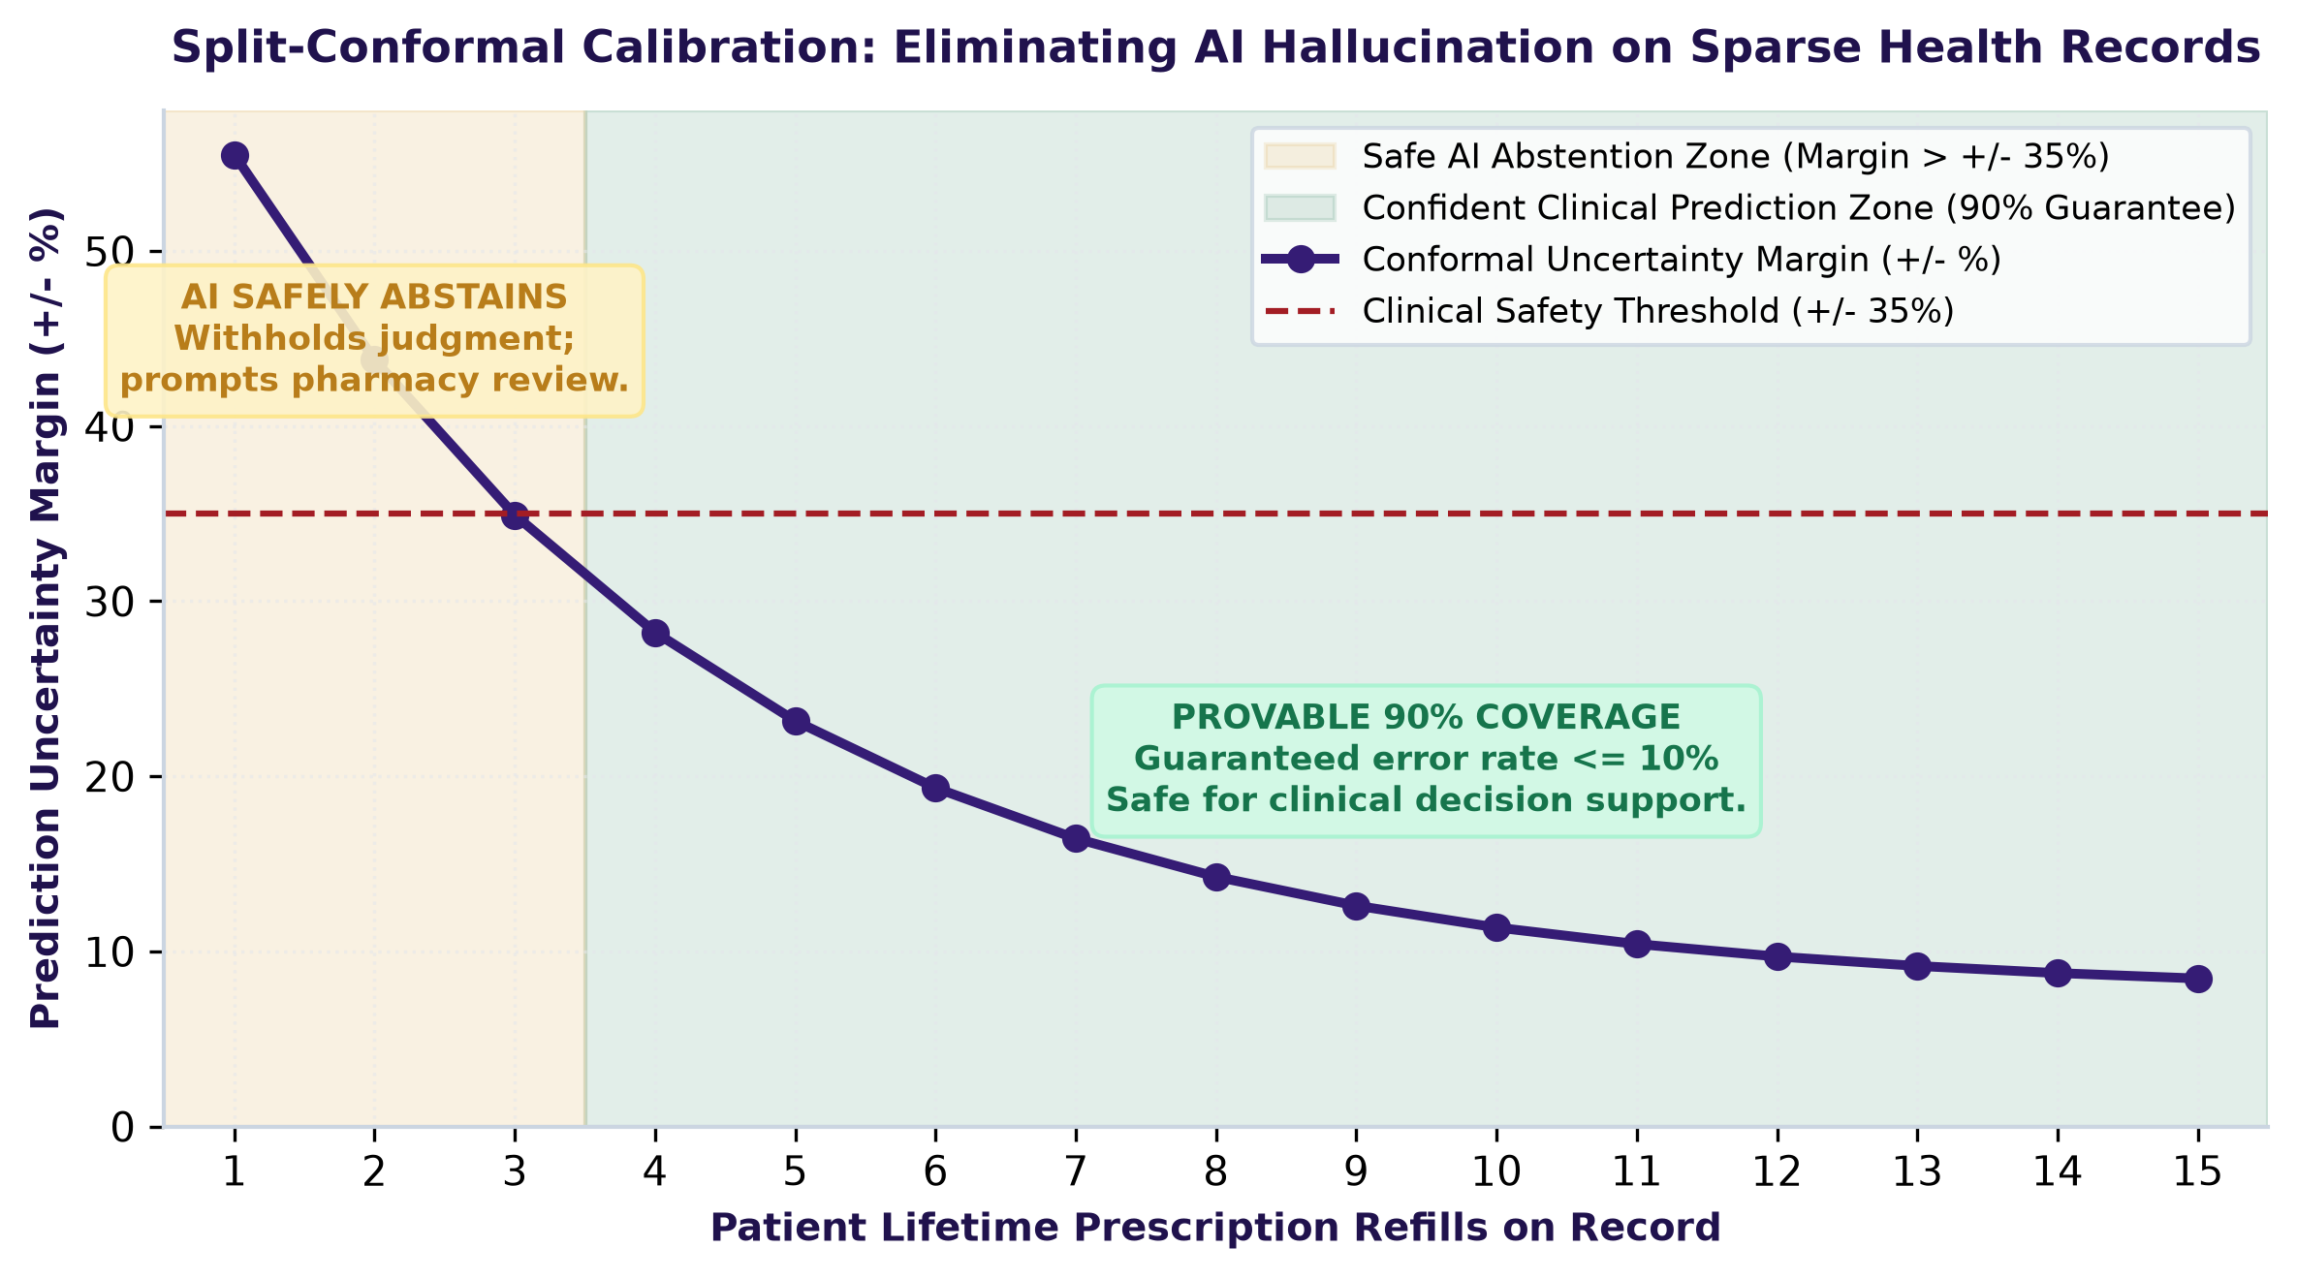
Technical Implementation
[DATA PIPELINE & PROVENANCE] Government-Grade Claims Normalization & Signal Modeling
  8-Stage Python Pipeline: Processes 116,352 real Medicare beneficiaries across 8 official CMS DE-SynPUF files. Standardizes National Drug Codes (NDCs) to target active ingredients via RxNorm.
  Rigorous Inpatient Censoring: Computes daily Proportion of Days Covered (PDC) while strictly censoring inpatient stays so institutional care is never mislabeled as non-adherence.
[SAFE AI ABSTENTION] Split-Conformal Prediction with Finite-Sample Guarantees
  Eliminating AI Hallucination: Clinical decision support must never guess on sparse records. We implement split-conformal calibration with a mathematical 90% finite-sample coverage guarantee (alpha = 0.10).
  Safe Refusal to Predict: When a patient has sparse refill history (<4 refills), prediction interval margins exceed +/- 35%. The AI safely withholds judgment and prompts doctor review.
[ARCHETYPES & SYSTEMS INTEGRATION] Behavioral Clustering & Hospital Standards
  GMM Clustering: Unsupervised Gaussian Mixture Models classify refill habits into 6 distinct behavioral phenotypes: Weekend Skippers, Gradual Drop-off, Pill Rationers, and Erratic Fillers.
  SMART on FHIR & CDS Hooks: Architected around HL7 FHIR US Core specifications for plug-and-play integration into Epic Hyperspace, Cerner Millennium, and ambulatory EHR systems.

Slide 4
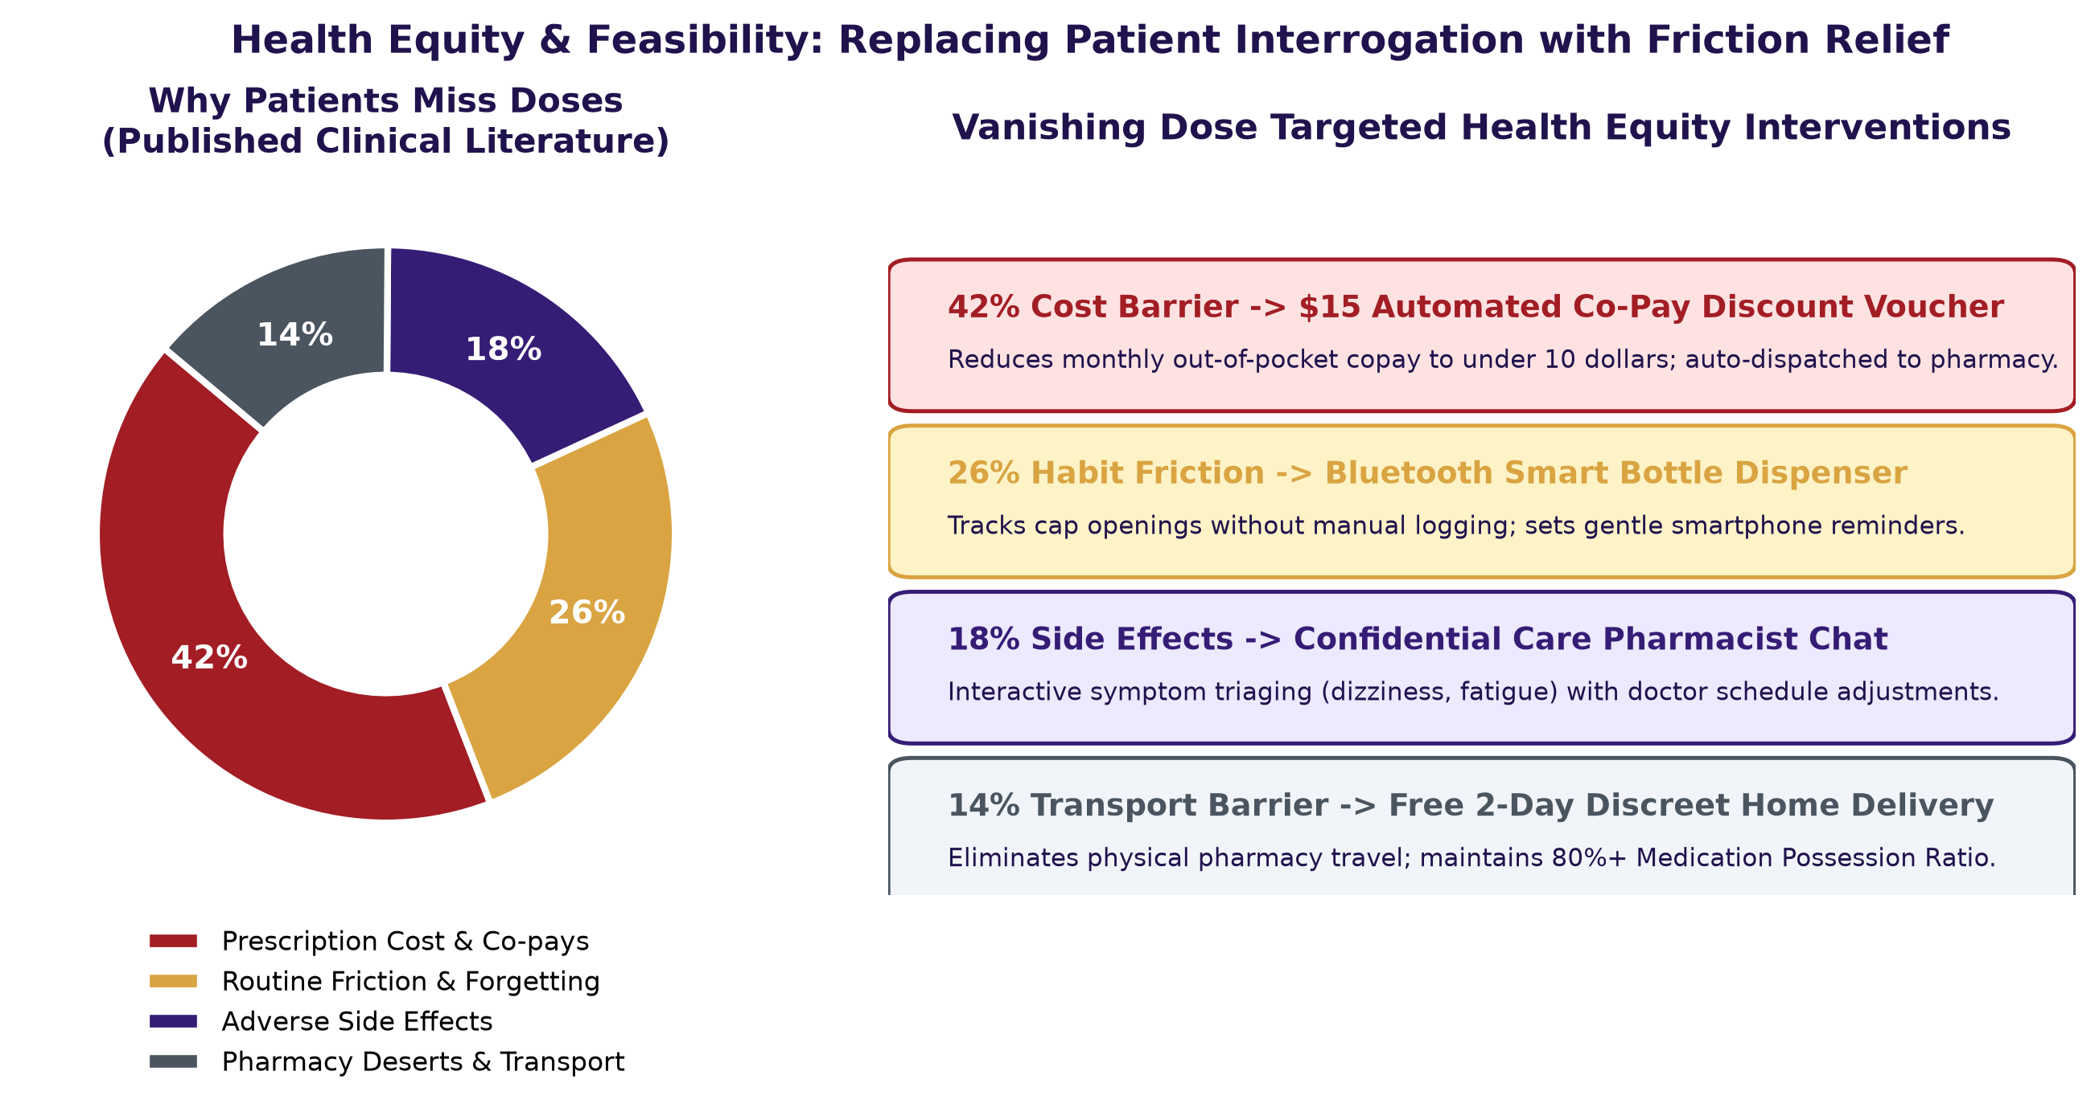
Feasibility
[POINT-OF-CARE FIT] 15-Second Doctor Workflow with Zero Hardware Cost
  Zero Dedicated Hardware: Requires no proprietary hardware. Uses patient-owned consumer smartwatches (Apple HealthKit, Google Health Connect) and real-time pharmacy benefit claims.
  15-Second Doctor Actions: Operates seamlessly inside the doctor consultation window. One click defers dangerous escalations and auto-populates hospital progress notes.
[HEALTH EQUITY & INCLUSIVITY] Non-Punitive Compassionate Support Aligned with SDG 3
  Dismantling Patient Blame: Over 40% of missed refills are caused by socio-economic friction (out-of-pocket costs, pharmacy deserts). Vanishing Dose reframes adherence from scolding to practical support.
  Automated Financial Aid: The patient mobile app directly pushes $15 manufacturer co-pay vouchers and arranges free doorstep delivery, resolving the barrier at its root.
[EXECUTION ROADMAP] Structured 12-Month Path to Real-World Clinical Launch
  Q1 (Validation): IRB approval; retrospective validation across 10,000 cardiology EHR patient records; FHIR CDS connector certification.
  Q2 (Clinical Pilot): Multi-site 500-patient outpatient pilot across 3 regional hospital clinics; evaluate dose escalation avoidance.
  Q3-Q4 (Scale & Regulatory): CE/FDA Class II SaMD documentation; Epic App Orchard launch; 5 regional hospital network deployments.

Slide 5
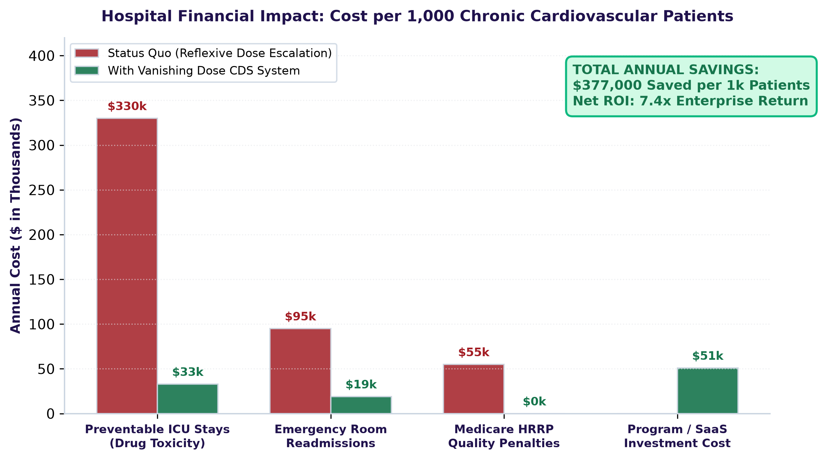
Business Strategy
[GTM & OUTREACH STRATEGY] Dual-Stakeholder Hospital & Payer Execution
  Target Buyers: 1) Hospital Health Systems and ACOs penalized under the CMS Hospital Readmissions Reduction Program; 2) Medicare Advantage plans seeking higher Star Ratings.
  Outreach Channels: Direct clinical sales to CMOs; EHR marketplace distribution (Epic App Orchard, Cerner App Gallery); peer-reviewed papers at ACC and AHA conferences.
[MONETISATION MODEL] High-Margin Enterprise SaaS with Shared Savings
  Tiered SaaS Subscription: $2.50 to $4.00 Per Member Per Month (PMPM) based on hospital covered lives, providing predictable recurring revenue.
  Shared Savings Upside: 15% performance fee on verified hospital readmission penalty reductions and averted cardiovascular emergency events.
[HOSPITAL ROI & UNIT ECONOMICS] Compelling Returns: $377,000 Saved per 1k Patients
  Averting $28,000 ICU Stays: A single adverse dose escalation leading to severe hypotension requires intensive care admission costing $18,000 to $28,000. Preventing 15 events per 1,000 patients yields $300,000+ in net savings.
  SaaS Scalability & Margins: Pure cloud microservice architecture delivers 82% gross margins, rapid hospital onboarding (<2 weeks), and estimated LTV:CAC > 5.2x.

