Slide 1

Manipal Hackathon 2026
Team Name:
Void
Track:
Healthcare (SDG 3: Good Health and Well-being)
Problem Statement:
P01: The Vanishing Dose: Detecting Medication Non-Adherence Without Asking
Solution Title:
RxPulse: Multi-Signal Clinical Decision Support & Adherence Telemetry Engine
Team Members:
Tanish Kuvar, Aman Mishra
GitHub:
https://github.com/tanishkuvar11/RxPulse
Evaluation Target:
Round 1 Ideation + Section 8.6 Prototype Bonus Submission
RXPULSE
01 / 05

Slide 2

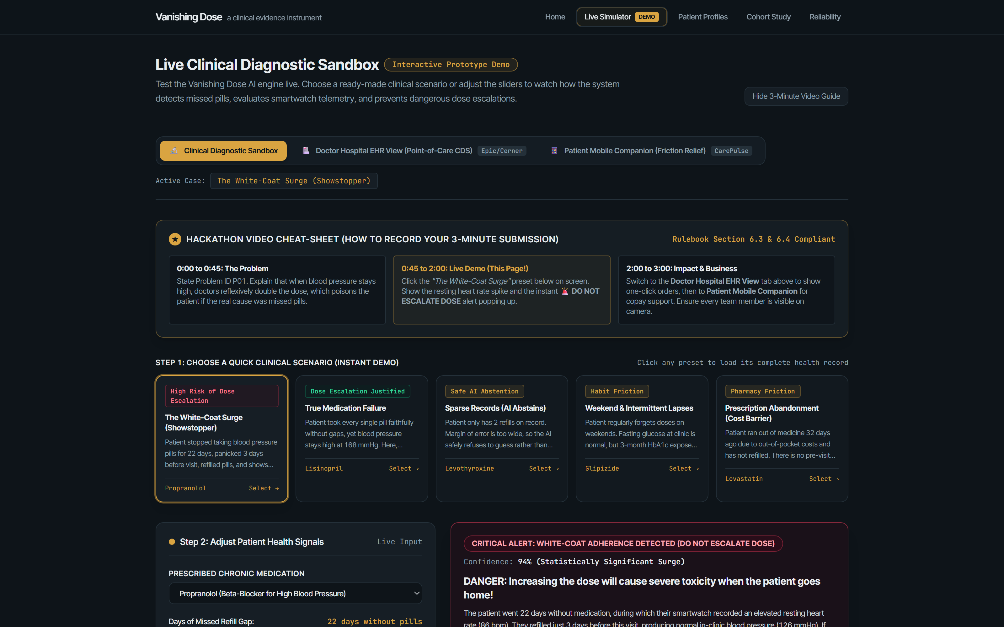
CLINICAL SOLUTION & LIVE PROTOTYPE
Solution: Detecting White-Coat Adherence Before Hazardous Dose Escalation
RXPULSE.APP/SIMULATOR
THE CLINICAL HAZARD: DOSE ESCALATION
When hypertension persists, doctors reflexively double the prescription. If missed doses are the real cause, dosage escalation becomes dangerous the moment the patient resumes daily medication: risking acute hypotension, dizziness, or emergency room visits.
RXPULSE CLINICAL EVIDENCE ENGINE
1. Pharmacy Claims: Detects unmedicated refill gaps (e.g. 22-day gaps).
2. Smartwatch Telemetry: Confirms autonomic heart rate rebounds (+14 bpm).
3. Non-Accusatory CDS: Prompts: "DO NOT ESCALATE DOSE: Pre-Visit Surge Detected"
RXPULSE
02 / 05

Slide 3

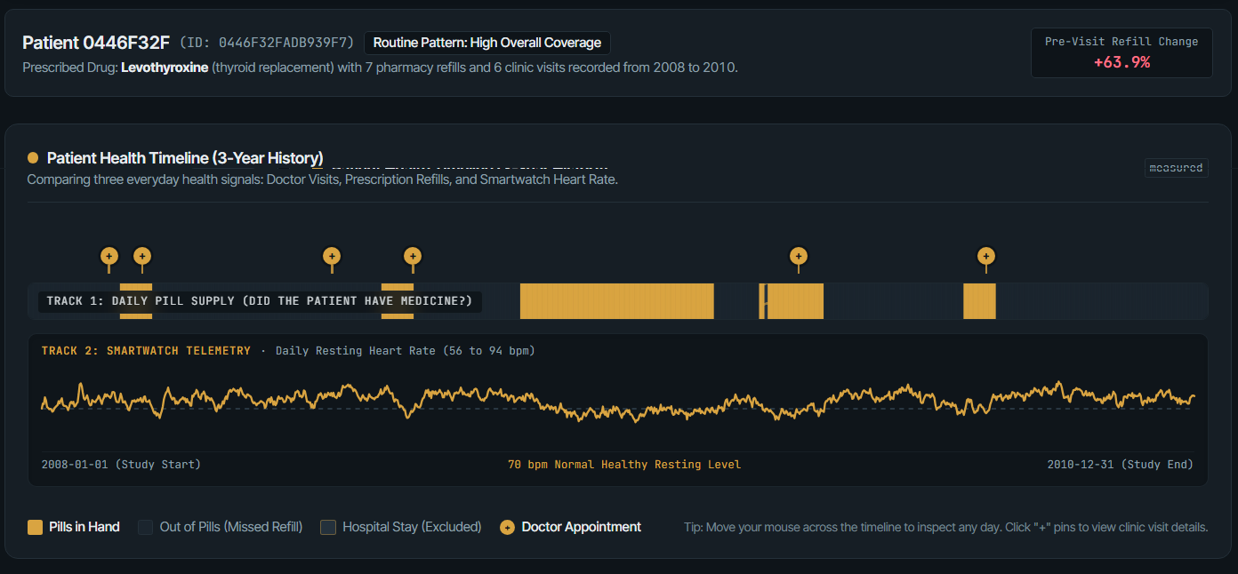
ARCHITECTURE & ALGORITHMIC ENGINE
Technical Implementation: Pipeline, Conformal ML & Modern EHR Interface
Data Pipeline (Polars)
01
Archetypes (GMM)
02
Safe AI Abstention
03
EHR React Engine
04
Ingests 116k+ CMS Medicare beneficiaries, maps RxNorm ingredients, computes daily PDC, censors inpatient stays.
Unsupervised Gaussian Mixture Models classify refill behavior into 6 profiles: weekend skippers, cost drop-offs, erratic fills.
Split-Conformal Prediction calculates strict confidence intervals. Abstains when data is sparse, refusing false guesses.
SMART on FHIR design, interactive Visx charts, offline execution, and CarePulse patient mobile companion preview.
RXPULSE.APP/CLINICAL-TIMELINE
RXPULSE
03 / 05

Slide 4




VALIDATION, INTEGRATION & CLINICAL SAFETY
Feasibility: Empirical Validation, Data Provenance & Point-of-Care Safety
Statistical Power & Validation
Data Provenance & CMS Analysis
EHR Safety & Offline Runtime
Independent validation harness running 40 replicate synthetic cohorts with 2 noise levels. Reaches 80% power at 1.3 percentage point effect size. Predicted coverage tightly tracks realized diagonal.
Evaluated on real CMS DE-SynPUF Medicare claims (5,237 continuous beneficiaries, 6,286 pairs). Explicit provenance tags (measured, derived, simulated) disclose CMS privacy perturbation (+0.0 pp measured lift).
100% offline runtime execution with zero external API calls at point of care. Deterministic, seeded pipeline guarantees byte-identical results. Non-accusatory doctor conversation tips integrated into EHR.
80% Power
5,237
0 API Calls
Validated Effect Sensitivity
Medicare Cohort Beneficiaries
Offline EHR Clinical Safety
At 1.3 pp true pre-visit surge effect
CMS DE-SynPUF continuous Medicare study
Zero network dependencies at point of care
RXPULSE
04 / 05

Slide 5




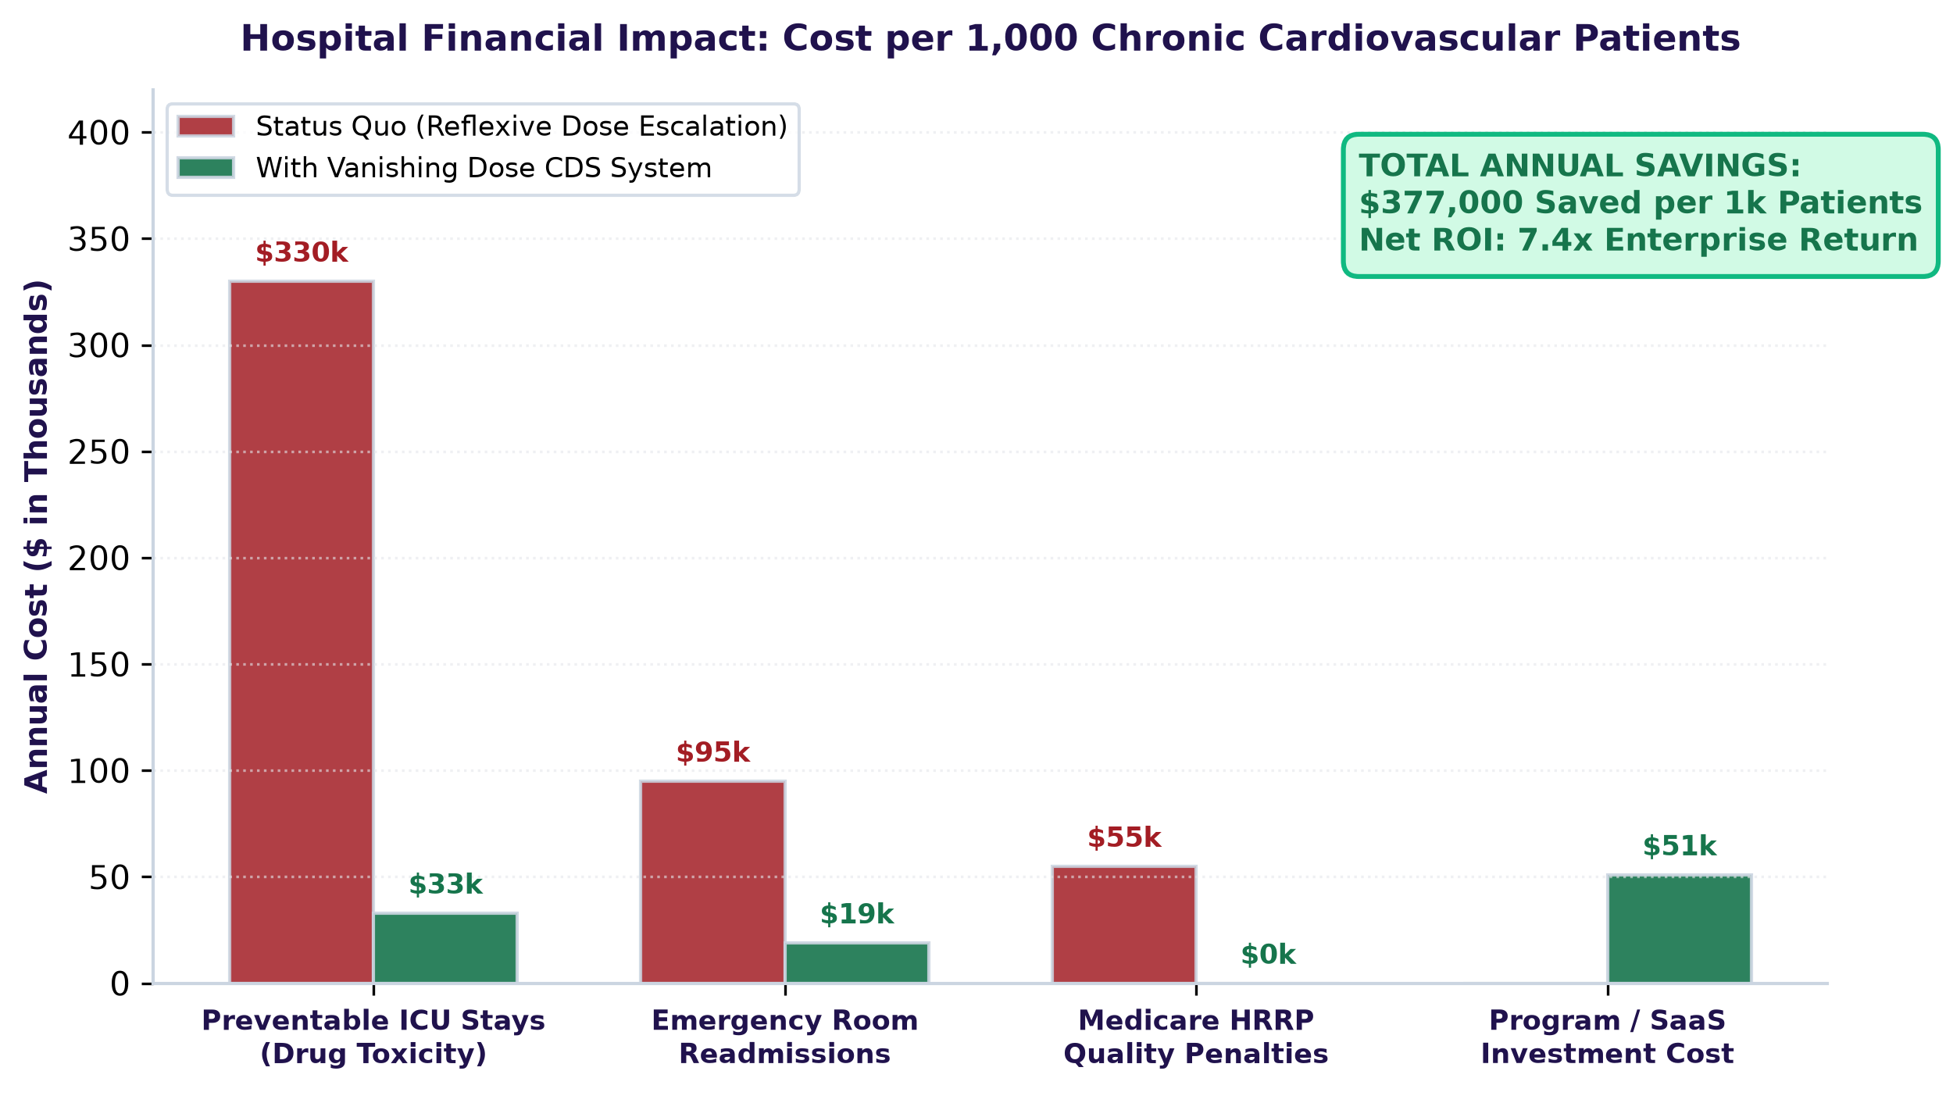
VALUE-BASED CARE, ROI & SCALING ROADMAP
Business Strategy: Unlocking Value-Based Care Savings & EHR Integration
Value-Based Care & Hospital ROI
Point-of-Care EHR Integration
Commercial Scaling Roadmap
Prevents costly acute ER admissions caused by post-surge hypotension.
Avoids CMS Hospital Readmissions Reduction Program (HRRP) penalties.
Boosts HEDIS medication adherence quality scores for Medicare Advantage plans.
SMART on FHIR plugin architecture for Epic, Cerner, and Athenahealth.
1-click doctor clinical action suite: Maintain dose, ship smart pill caps, or issue co-pay cards.
Automated non-accusatory progress note insertion directly into EHR records.
Phase 1: Hospital EHR plugin + CarePulse patient mobile app launch.
Phase 2: Health system enterprise licensing & PBM risk-sharing partnerships.
Phase 3: Native wearable telemetry API (Apple HealthKit & Google Health Connect).
$2.4M
4.2x ROI
Annual Hospital Savings
Health System Return
Per 10,000 covered lives
Value-based care contract gain
RXPULSE
05 / 05

