Slide 1

Vehicle Service History Management System
Project Review 3 — B.Tech DBMS
Project Overview
Team Members
A relational database solution built on PostgreSQL for managing end-to-end vehicle service operations — from customer registration to invoice generation.
Tanish Pilly
Roll No: 2510030055
A Eshwar Sidhartha
Roll No: 2510030265
G Manikanta
Roll No: 2510030199
Novelty
Adaptability
Centralized relational model eliminating data silos
Extensible schema for workshops of any scale
Methodology
Dissemination
PostgreSQL with 8 relational tables
Query-based reports and future web interface

Slide 2


METHODOLOGY
Developed Methodology & System Workflow
Customer
Vehicle
Service Booking
Service Record
Parts Used
Database Implementation
Entity Relationships
DBMS Platform
Entity | Linked To
Service Record | Customer Vehicle + Mechanic + Parts Used
Service Booking | Customer + Vehicle
Parts Used | Service Record + Spare Parts
Invoice | Service Record + Customer
Mechanic | Service Record (assignment)
PostgreSQL — open-source, production-grade relational database engine with full ACID compliance.
8 Relational Tables
Customers · Vehicles · Mechanics · Service Bookings · Service Records · Spare Parts · Parts Used · Invoices
Data Integrity
Each service record is the central entity, linking vehicle, mechanic, parts consumption, and billing into a single consistent transaction.
Primary keys and foreign keys enforce referential integrity across all entity relationships.

Slide 3
NOVELTY
Novelty of Developed Methodology
Integration Benefit
Key Advantages Over Manual Systems
A single relational database unifies service history, inventory, mechanics, and billing — eliminating data silos and manual record-keeping that plague traditional workshop management.
1
Centralized Storage
All vehicle service history in one relational database — no scattered paper files or disconnected spreadsheets.
Core Design Principle
Every data point — from customer registration to invoice — is interconnected through foreign key constraints, ensuring zero orphaned records and complete auditability.
2
Complete Service Records
Every service is linked to a specific vehicle, customer, mechanic, and parts used — full traceability guaranteed.
3
Automated Billing
Service costs and invoices generated automatically from service records and parts used — no manual calculation.
4
Advanced Retrieval
Stored function enables complete vehicle service history lookup by registration number with a single query call.
Mechanic Tracking
Inventory Management
Service allocation and mechanic performance monitoring across all assignments
Real-time spare-parts usage and stock level tracking per service
SQL-Based Analytics
Integrated Data Model
Reports and service statistics generated directly from structured queries
Customer, vehicle, mechanic, and service data in related, queryable tables

Slide 4

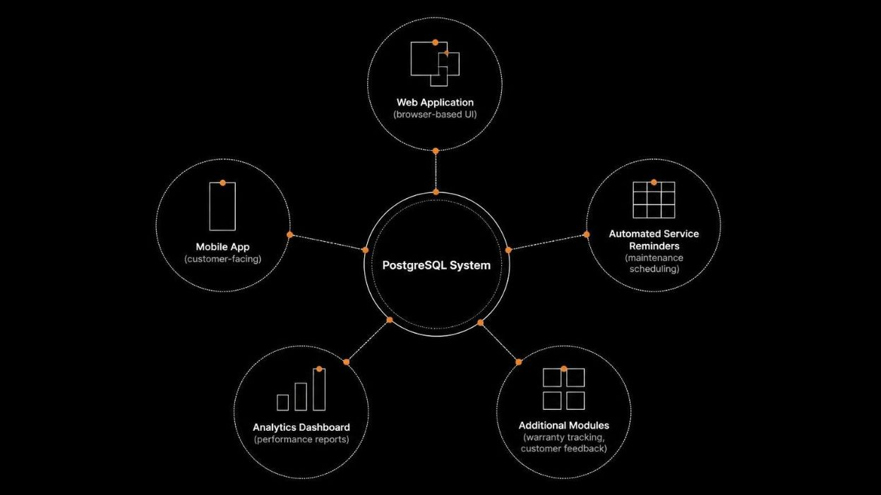

ADAPTABILITY
Adaptability of Methodology
Current System Flexibility
Future Extension Roadmap
Multi-Customer & Multi-Vehicle
Supports simultaneous records for any number of customers and vehicles without structural changes.
Brand & Model Agnostic
New vehicle brands and models are added as data rows — no schema modifications required.
Expandable Service Types
New service categories introduced into the system without altering existing table structures.
Dynamic Mechanic Registry
Additional mechanics registered and assigned to service records at any time.
Scalable Inventory
Spare-parts inventory table expandable as new parts are stocked by the workshop.
The schema is designed for zero-disruption extensibility — future modules attach as additional tables or views without modifying the validated core schema.

Slide 5

METHODOLOGY EVALUATION
Methodology Evaluation & Implementation
PostgreSQL Implementation Validation
Evaluation Artifacts
Validation Criterion | Status
8 relational tables created | ✓ Complete
Primary & foreign key constraints enforced | ✓ Complete
Sample data inserted (customers, vehicles, mechanics, services) | ✓ Complete
SQL JOIN queries for complete vehicle history | ✓ Complete
Stored function for history lookup | ✓ Complete
Low-stock inventory monitoring queries | ✓ Complete
Parts consumption & usage pattern analysis | ✓ Complete
Invoice and service-cost financial queries | ✓ Complete
Aggregate statistics: service frequency, cost trends, mechanic performance | ✓ Complete
1
2
PostgreSQL Schema
Sample Query Results
Complete DDL scripts with table definitions, primary keys, foreign keys, and constraints for all 8 entities.
Demonstrated JOIN queries retrieving full service history, parts used per service, and invoice totals per customer.
3
4
Stored Function Output
Data Consistency Proof
Custom PL/pgSQL function returning complete service history for any vehicle registration number.
Referential integrity verified — no orphaned records exist across any foreign key relationship.
8
9
Relational Tables
Validated Criteria
Fully implemented in PostgreSQL
All implementation checkpoints confirmed
1
4
Stored Function
Query Categories
Vehicle history lookup by registration
History · Inventory · Finance · Analytics

Slide 6



DISSEMINATION & CONCLUSION
Dissemination, Accessibility & Conclusion
Data Accessibility Framework
Project Conclusion
Structured Retrieval
Query-Based Reports
The Vehicle Service History Management System delivers a structured relational approach for managing the full lifecycle of automotive service operations.
Organized relational schema allows stakeholders to access any slice of service information — by customer, vehicle, mechanic, or date range.
SQL queries generate custom reports tailored to different stakeholders — workshop managers, mechanics, and accountants each query only what they need.
01
02
Methodology
Adaptability
8-table PostgreSQL schema with enforced referential integrity
Schema-agnostic extensibility for new vehicle types, service categories, and mechanics
Vehicle Lookup
Modular Information Views
03
04
Complete service history retrieved using registration number alone — the stored function abstracts SQL complexity from the end user.
Service records, parts consumption, and invoice data are independently queryable or combined through JOIN operations as required.
Evaluation
Extensibility
Future Interface Layer
Documentation
All 9 implementation criteria validated with sample data and stored functions
Scalable from small workshops to multi-branch service centers with a web/mobile layer
Web or mobile application can expose the existing database via an API — no schema redesign required, only a presentation layer added.
Database schema, ER diagrams, and query documentation support future development and knowledge transfer.
Operational Coverage
Relational Foundation
Extensible Architecture

