Slide 1
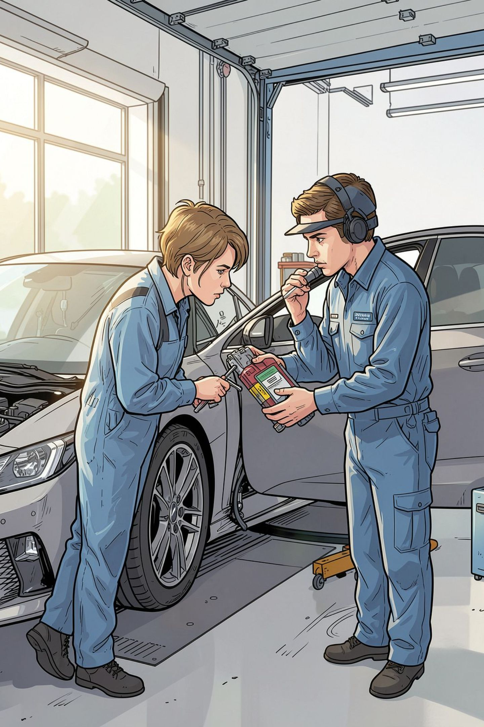
Vehicle Service History Management System
Review 2 — Literature Review
Tanish Pilly – 2510030055
A Eshwar Sidhartha – 2510030265
G Manikanta – 2510030199

Slide 2


Project Relevance & Problem Context
Service records are often lost, misfiled, or stored in paper form, preventing reliable maintenance histories.
Technicians and owners face difficulty accessing prior repairs, leading to redundant work and missed maintenance.
There is no single authoritative source tying vehicle, mechanic, parts and billing data together.
Spare-parts usage and inventory are poorly tracked, increasing costs and downtime.
Disconnected billing reduces transparency and complicates warranty/claims processing.
Connection to project: Each of these issues motivates a centralized, queryable system that records vehicles, services, mechanics, parts used, and invoices — reducing information loss and improving decision‑making.
Our system provides a centralized relational database for maintaining complete vehicle service history, service operations, spare parts and billing information.

Slide 3
Literature Review — Selected Studies (compact)
Four credible sources focused on digital vehicle/fleet maintenance and service-record systems.
Study / Sys.
Yr.
Goal
Approach / Tech.
Key finding / limit.
Hsieh et al. — “An IoT-based predictive maintenance system for vehicle fleets” (IEEE Access)
2019
Reduce downtime with sensor-based predictive maintenance.
IoT sensors + cloud analytics; time-series DB; REST APIs.
Improved uptime; service records and billing were not integrated.
Khraisat & Al-Kasasbeh — “A vehicle maintenance tracking system for small workshops” (JSS)
2018
Provide a lightweight workshop tracking app.
Web app, relational DB, mobile UI for mechanics.
Fits shop workflows; weak parts inventory and audit trails.
Chong & Kumar — “Digital vehicle record systems and owner-centric maintenance logs” (TRR)
2020
Test digital logs that follow the vehicle.
Centralized records; XML/JSON exchange formats.
Better owner visibility; inconsistent adoption and no billing link.
Fleetio (commercial) — product docs and case studies
2020–2023
End-to-end fleet maintenance: scheduling, work orders, parts, reports.
SaaS platform, relational DB, telematics APIs.
Robust features; enterprise cost and limited open schema.
Sources: IEEE Access 2019; JSS 2018; TRR 2020; Fleetio product documentation (public case studies).

Slide 4
Comparative Analysis of Reviewed Systems
Study / System
Focus
Key Features
Technology / Limitation
Hsieh et al.
Fleet predictive maintenance
Sensor alerts, ingestion, analytics
IoT + cloud; no integrated billing or parts history
Khraisat & Al-Kasasbeh
Workshop tracking
Work orders, job cards, basic DB
Web app; weak inventory and audit trails
Chong & Kumar
Owner-centric digital logs
Portable records, exchange formats
Central records; adoption and billing linkage issues
Fleetio
Enterprise fleet maintenance
Scheduling, parts, reporting, telematics
SaaS; cost and closed schema limit extensibility
Common Findings
Most systems centralize service events and schedules; work orders are core.
Common tech: relational DBs, REST APIs, cloud services; larger systems add IoT/telematics.
Uptime and record keeping improve, but parts, mechanic data, and billing are often not tightly linked.
Enterprise tools are feature-rich, but less customizable for academic and SME needs.

Slide 5

Critical Analysis & Synthesis
1
2
Similarities
Differences
Work orders, scheduling, and basic maintenance logs appear across studies; relational DBs are standard.
Scale and integrations differ: IoT-driven fleet systems vs lightweight workshop apps vs owner‑centric logs.
3
4
Strengths
Limitations
Improved maintenance planning, analytics for fleets, and user access to service history.
Gaps in unified parts tracking, mechanic provenance, invoice linkage, and open schemas for research/customization.
Existing Research → Findings → Design Decisions for Our System
Finding: Disconnected billing/parts — Decision: model invoices and parts usage as linked entities with FK constraints.
Finding: Mechanic data often absent — Decision: include mechanic profile and certifications as first-class records.
Finding: IoT analytics useful but separate — Decision: design schema that supports telematics join via vehicle_id for future analytics.

Slide 6



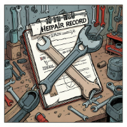
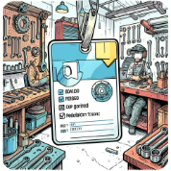
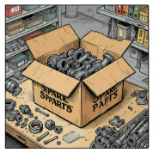
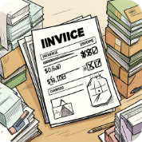
Identified Gaps
Incomplete consolidated vehicle service history.
Service booking not tightly linked to recorded work and invoices.
Poor spare-parts usage tracking and inventory control.
Mechanic information and audit trails missing.
Difficulty retrieving a complete vehicle history from one source.
How Our System Addresses Them
Implementation note: All components integrated into a PostgreSQL relational schema using primary keys, foreign keys, JOINs, and triggers to guarantee referential integrity and automate updates.
Customer Management
Vehicle Management
Service Booking
Service Records
Bookings linked to scheduled work orders and mechanics.
Normalized service_events table; timestamps, notes, and references.
Customer table with contact and ownership relationships.
Vehicle table linked to customer and VIN, primary vehicle keys.
Mechanic Management
Spare Parts & Inventory
Invoice / Billing
Invoices linked to service_events and parts_used via foreign keys.
Mechanic profiles and certifications linked to performed tasks.
Parts catalog + inventory table with consumption logs.

Slide 7
Conclusion & Project Contribution
Literature indicates a clear shift to digital and connected maintenance systems for vehicles and fleets.
Existing approaches offer scheduling, work orders, and analytics but commonly lack integrated parts, mechanic provenance, and billing linkage.
Our review identified these recurring gaps and informed core design choices: a normalized relational schema and explicit linkages between customers, vehicles, services, mechanics, parts, and invoices.
Implementation will use PostgreSQL with primary keys, foreign keys, JOINs, stored functions and triggers to enforce integrity, automate stock updates, and produce comprehensive vehicle histories.
Conclusion: The literature review helped identify the limitations of existing vehicle maintenance systems and guided the design of an integrated Vehicle Service History Management System.
THANK YOU
Questions & feedback welcome

