Slide 1

Vehicle Service History Management System
Name: Tanish Pilly, A Eshwar, G Manikanta
Roll Number: 2510030055, 2510030265, 2510030199
Department: Computer Science & Engineering

Slide 2


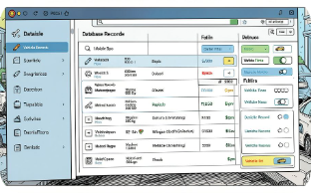
Why this name?
Complete Service History
Maintenance & Reminders
Centralized Management
Stores repair entries, part replacements, invoices, mileage, and technician notes in one place.
Automated future-service reminders and scheduling replace manual follow-ups.
Replaces paper-based records with an efficient digital database for fast retrieval and reporting.

Slide 3
Problem Statement
Lost Paper Records
Poor Traceability
Operational Overload
Schedule Monitoring
Customers lack easy access to prior services, part replacements, and costs.
Service histories on paper get misplaced, causing information gaps and disputes.
Service centers struggle to manage large volumes of physical records and bookings.
No centralized reminders → missed maintenance and reduced vehicle longevity.
Data Fragmentation
Distributed records cause delays, inefficiency, and poor analytics.
Solution: A centralized digital database that stores, indexes, and exposes service data securely for customers and centers.

Slide 4









Project Objectives
Digitize Records
Customer & Vehicle Info
Track Maintenance
Convert paper files into searchable digital entries.
Chronological service logs with parts, labor, and mileage.
Maintain profiles with VIN, owner, and vehicle specs.
Manage Bookings
Auto Invoicing
Spare Parts Tracking
Online service booking and slot management for shops.
Generate and store invoices linked to service entries.
Inventory usage, reorder alerts, and cost tracking.
Service Reminders
Reports & Analytics
Customer Satisfaction
Automated notifications based on time or mileage.
Operational and customer-facing reports to inform decisions.
Faster service, transparency, and convenient records access.

Slide 5
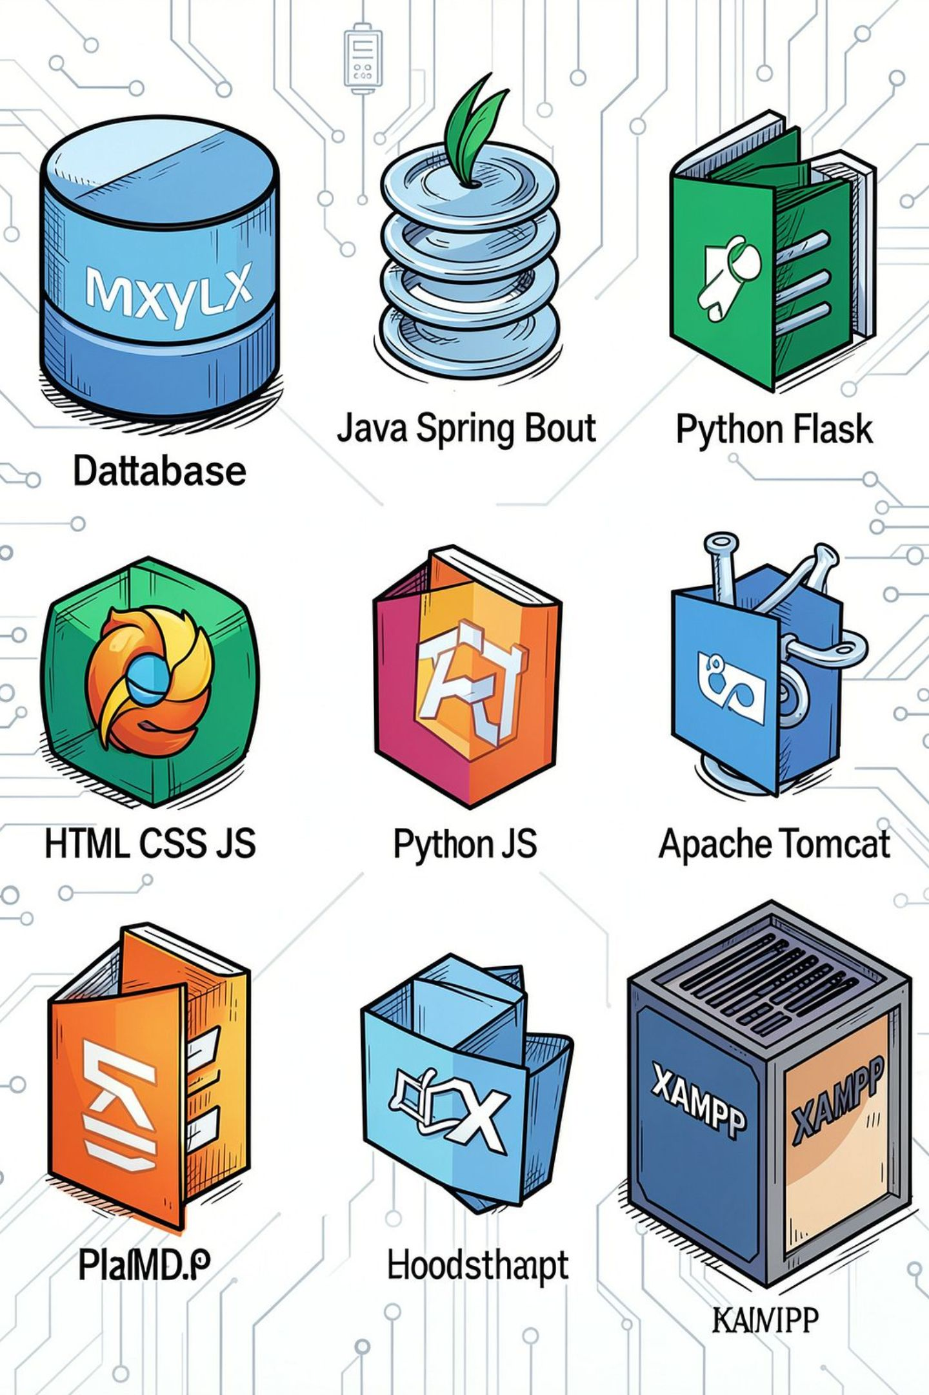
Technical Feasibility
Proposed Technologies
Feasibility Highlights
MySQL for relational storage and indexing
Back-end: Java (Spring Boot/JSP) or Python Flask
Front-end: HTML, CSS, JavaScript, Bootstrap
Server: XAMPP (dev) or Apache Tomcat (production)
Low hardware footprint; runs on modest server or cloud VM
Scalable schema—normalized tables for vehicles, services, parts
Secure storage: role-based access, encrypted connections
Easy deployment and maintainability with container or LAMP/Tomcat stack

Slide 6
Operational Feasibility
Simple UI for Staff
Intuitive interfaces for search, check-in, and invoicing—minimal training required.
Quick Customer Registration
Fast onboarding with VIN scanning or manual entry.
Fast Retrieval
Instant lookup of past services and parts history.
Report Generation
On-demand reports for revenue, parts usage, and service trends.
Paper Reduction
Significantly reduces paperwork, storage costs, and retrieval time.
Minimal Training
Role-based views and contextual help reduce the learning curve.

Slide 7
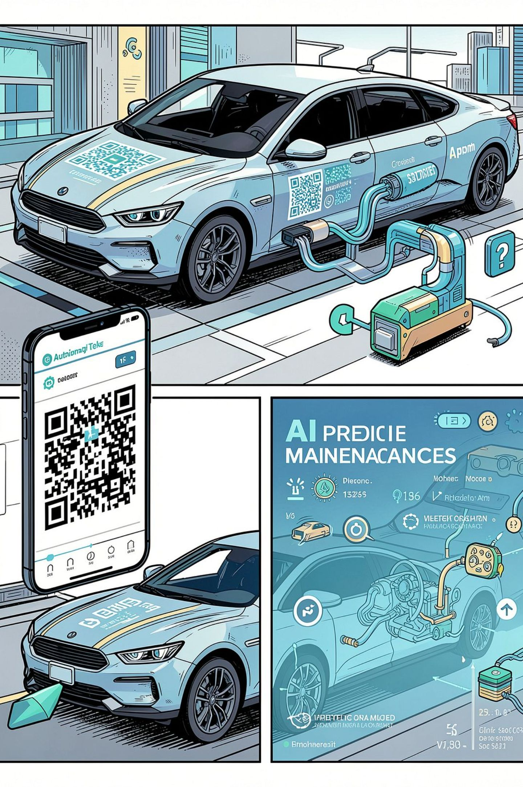


Novelty & Extensions
Future Extensions
QR codes on vehicles to pull up history at any service point
Mobile app for owners with reminders and service booking
Predictive maintenance using usage and sensor data
AI-based parts-replacement recommendations and cost forecasting
What’s Unique
Complete digital history, automated reminders, integrated parts inventory, and digital invoices.
Built-in Analytics
Operational dashboards for shops to monitor KPIs and costs.

Slide 8


Societal Need
Better Maintenance
Improved Road Safety
Timely services extend vehicle life and performance.
Tracking critical repairs reduces breakdowns and accidents.
Paperless Processes
Faster Service
Reduces environmental impact and administrative overhead.
Quicker check-ins and transparent pricing improve customer experience.
Cost Efficiency
Digital Transformation
Better parts tracking and preventive maintenance lower long-term costs.
Modernizes local service centers and supports scalable operations.

Slide 9

Centralized DB
Efficient Ops
Better Outcomes
The Vehicle Service History Management System provides a secure centralized platform that:
Consolidates customer and vehicle records for fast lookup.
Automates bookings, invoices, inventory, and reminders to streamline operations.
Enables analytics and extensions (mobile, QR, predictive AI) for future scalability.

Slide 10

Thank You

