Slide 1
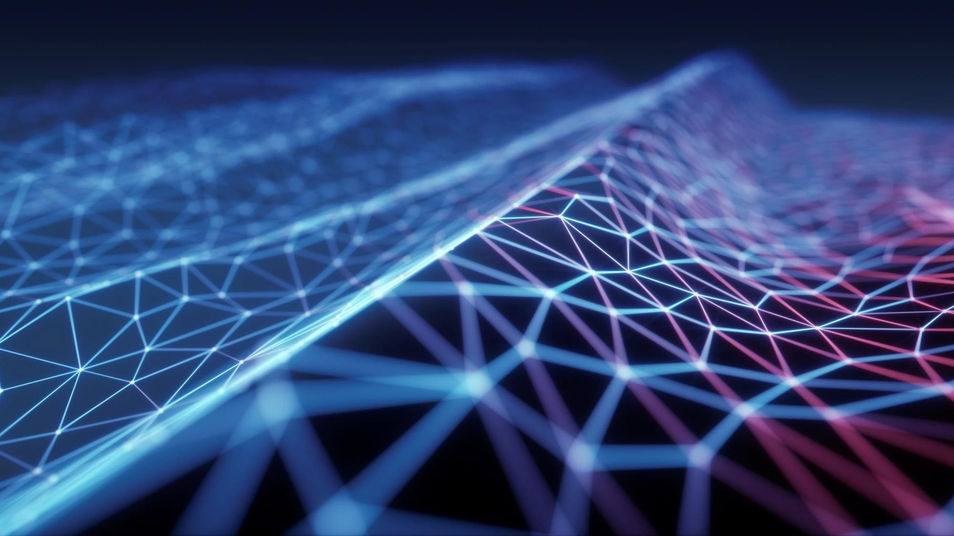
ARTIFICIAL EVOLUTION OF ANT
BY: TANISHQ AND AMAN

Slide 2
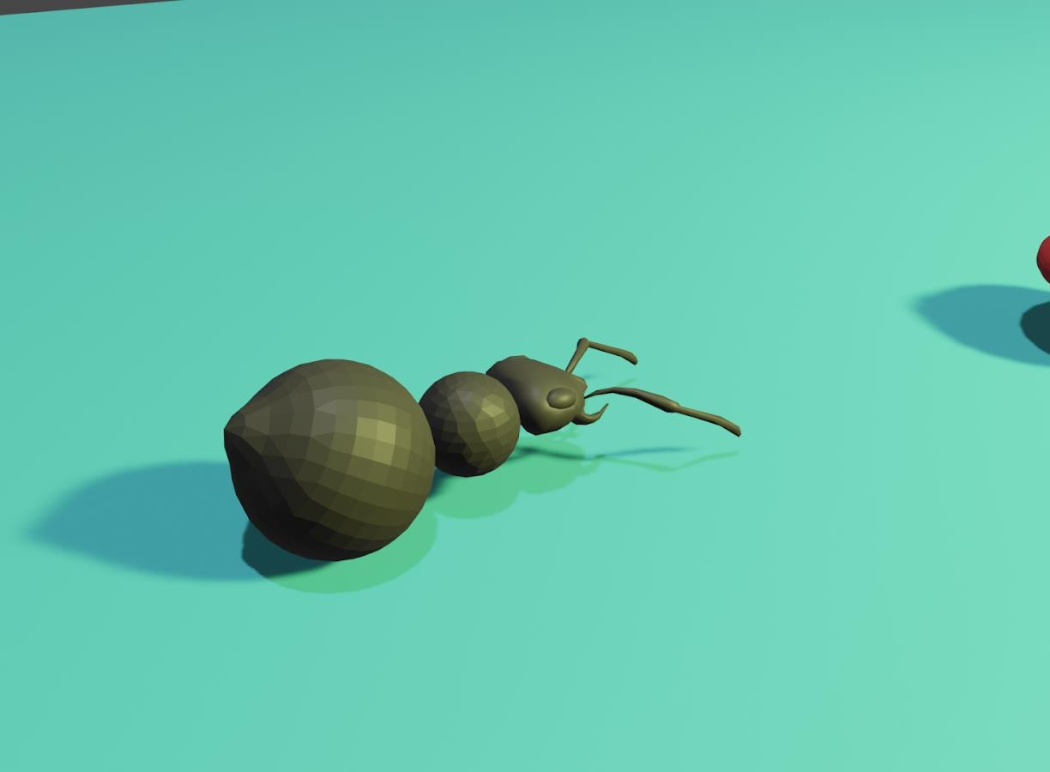
PROJECT OVERVIEW
Nature is full of miracles, just a little genetic shift can promote the inception of a new species. In this new era of artificial intelligence, we are keen to replicate it on artificial species to thrive in their artificial environment.
Ant is a small yet complex creature on earth, different species have different traits and they possess some of the most complex behaviour due to natural selection and survival of the fittest.
In our artificial earth, we want to produce complex behaviour in ants with the help of artificial intelligence.
Algorithms used for artificial earth:
Genetic Algorithm
Artificial Neural Network

Slide 3
PROJECT DESCRIPTION
Single Ant Interaction and Evolution
In our artificial environment, there is a single ant.The ant's motive is to eat food which is present in the environment.

Slide 4
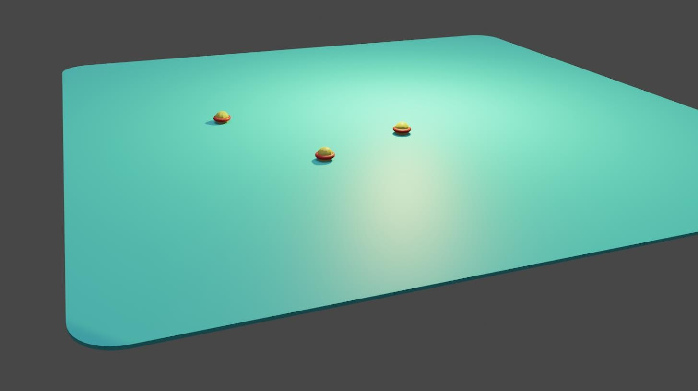
ENVIRONMENT
The artificial environment consists of a grid of 20 x 20. The ant can't go out of the grid.The environment provides food on the grid, the ant has to eat the food to survive.

Slide 5
ANT
The ant resides in the grid in the environment.The ant can move in four directions - left, right, forward and backward. The ant can roam freely in the environment, the constraint for the ant is that if it goes out of board it will die.

Slide 6
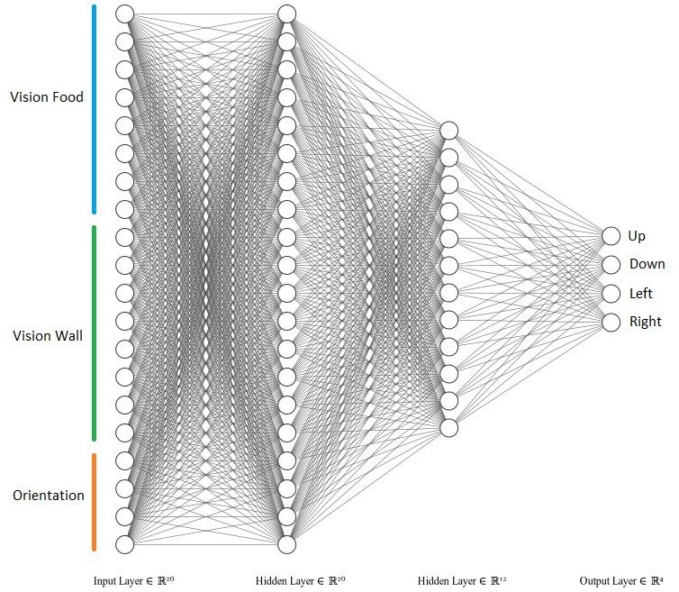
NEURAL NETWORK ARCHITECTURE

Slide 7
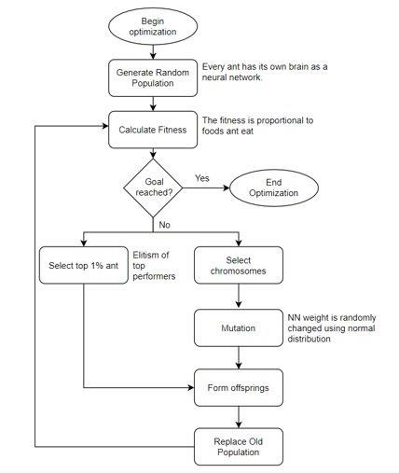
FLOW CHART

Slide 8
ALGORITHM
Initialize 100 ants | Put the ant in a grid | Calculate fitness | If Goal reached then | Select top one per | Select chromosomes | Merge the array in 5 Repeat from 2 to 7.
having brain as | in the environment, | according to the | End the optimization | cent ant and add to | randomly from top | and 6 to make a new
Neural | let it move | food eaten by it. | Else goto 5. | new population | 50 per cent parent | population array.
Network.(Each | according to the |  |  | array. | then mutate it using
Neural Network has | decisions made by |  |  |  | normal distribution.
two hidden layer | neural network(brai
with 20 Neurons in | n)
first layer and 12
neurons in second
layer.

Slide 9
LIMITATIONS
Geometry
More complex Environment
Ants complex behavior
Slow training rate of Genetic Algorithm

Slide 10
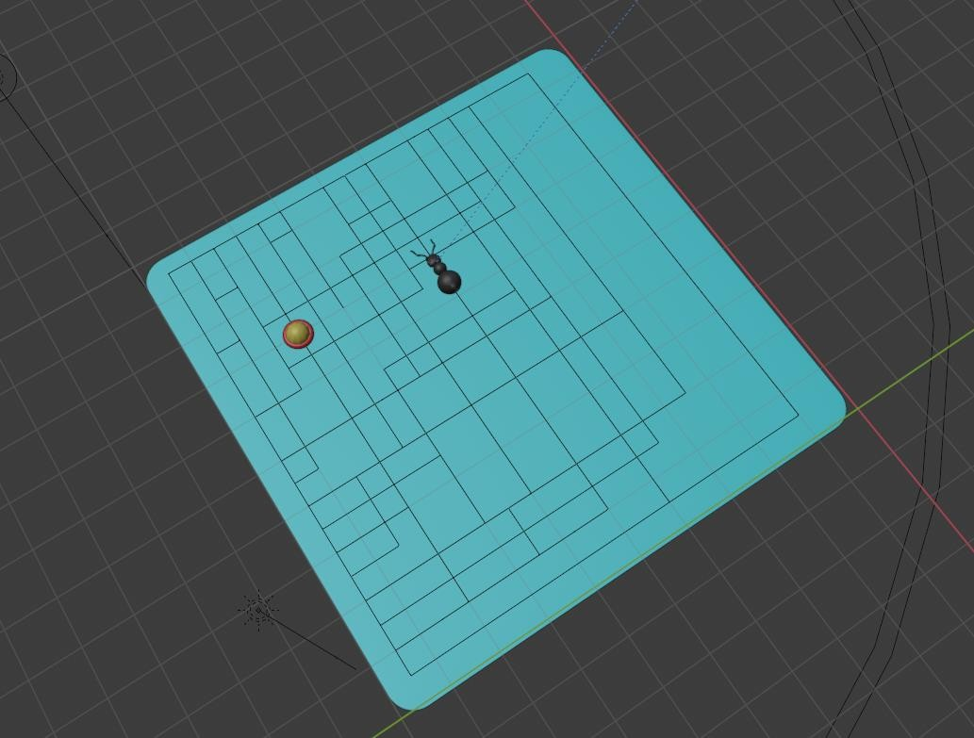
LIMITATION

Slide 11
FUTURE WORK
In our model we have taken a single ant to learn the direction it needs to go to get the food, the next goal is to make an artificial environment of multiple ants to interact with each other and the environment to learn some complex behaviours like teamwork, self-organizing, ant colony building, dead reckoning. For training, we have used a genetic algorithm and it has slow learning due to its brute force nature, so for learning reinforcement learning can be used to optimize.

Slide 12

THANK YOU

