Slide 1


SMART INDIA HACKATHON 2024
Problem Statement ID –SIH1661
Problem Statement Title - Implement Software Solutions to Reduce Student Dropout Rates at Various Educational Stages
Theme- Smart Education
PS Category- Software
Team ID- 40936
Team Name : Tech_Warriors_18

Slide 2

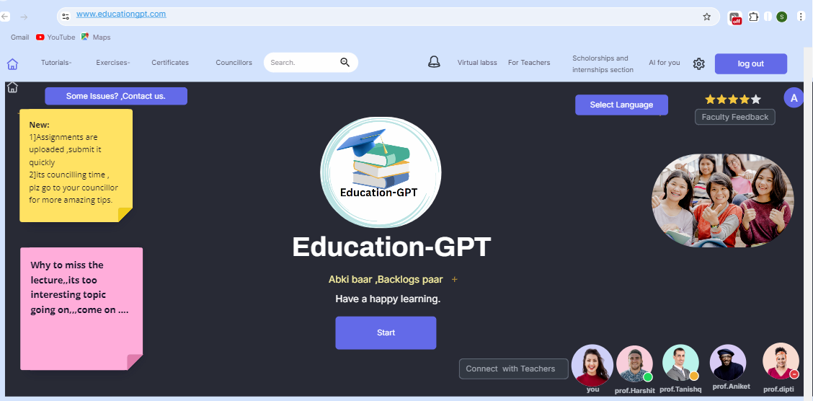
IDEA TITLE
Tech_Warriors_18
Proposed Solution
Detailed explanation of the proposed solution:
How it addresses the problem
To address the problem of reducing student dropout rates,The proposed solution aims to reduce student dropout rates by enhancing communication, support, and engagement among students, teachers, and parents through mobile apps and portals.
The solution aims to decrease dropout rates by providing a mobile app, portal, chatbots, biometric attendance tracking, career guidance, mentorship, and academic support.
Innovation and uniqueness of the solution
Biometric Attendance Tracking
Personalized Academic Support
Guidance and Mentorship
Flexible schooling options ,Virtual labs
Interactive other resources for learning
Example: H5P,NPTEL ,etc
Multilanguage system, multiple teacher platform
Chatbots for Instant Support
Prototype Interface (Education-GPT)

Slide 3
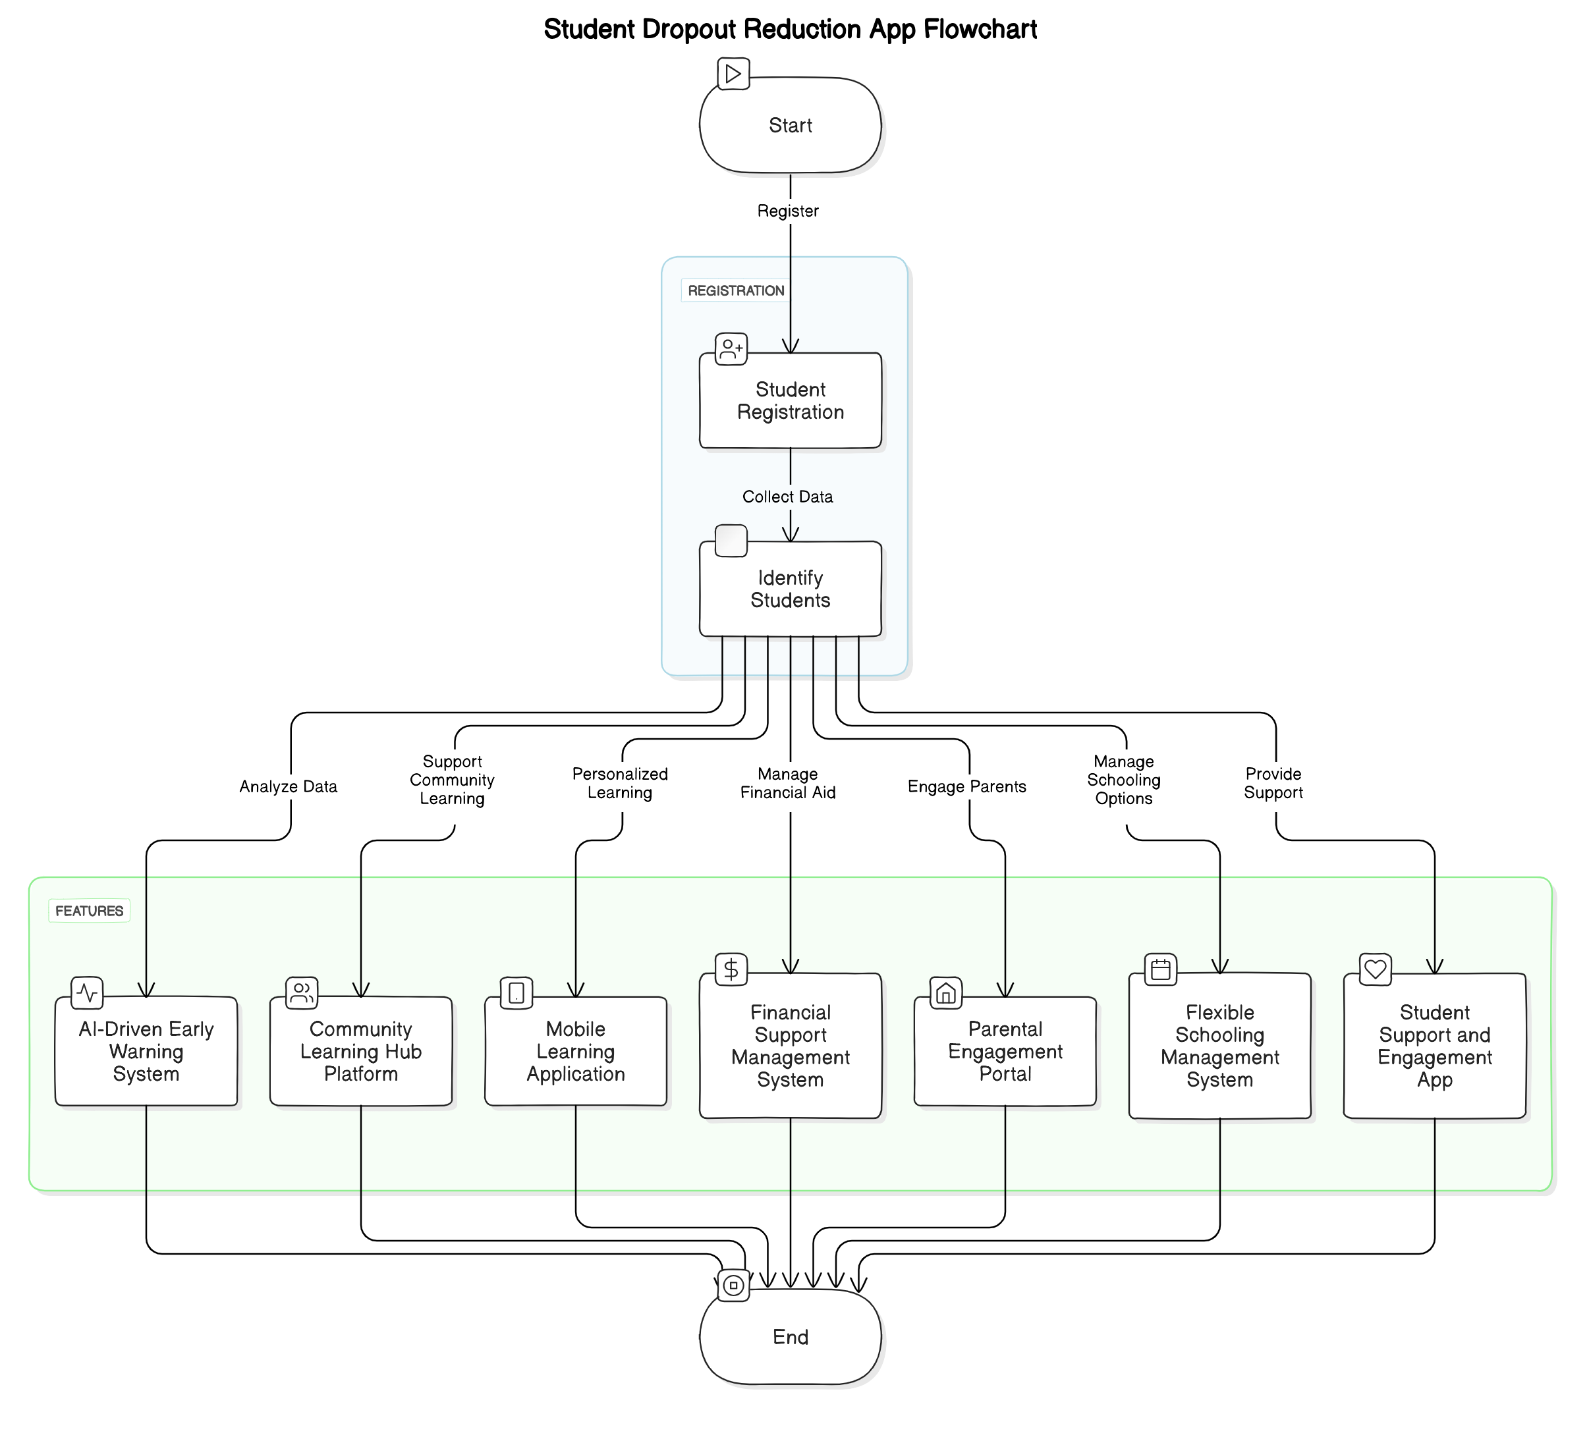
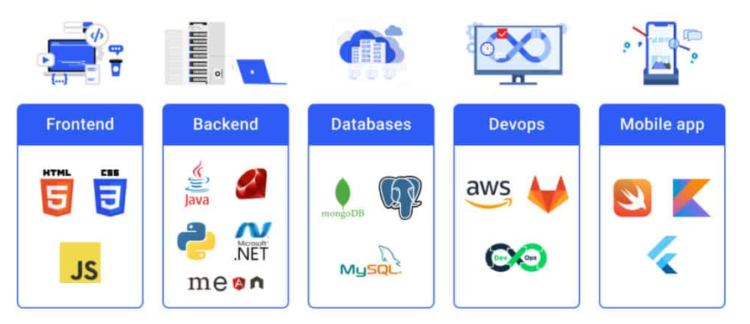
TECHNICAL APPROACH
Tech_Warriors_18
Methodology and process for implementation .
Technologies to be used:
Prototypes logo:

Slide 4
FEASIBILITY AND VIABILITY
Tech_Warriors_18
Analysis of the feasibility of the idea
Potential challenges and risks:
Strategies for overcoming these challenges:
Technical feasibility: Development of a Biometric system, Chatbots ,Portals of student teacher communication ,multi-language support.
Financial feasibility: Funding could be challenging, especially for under-resourced schools
• Implement strong data encryption.
• Provide comprehensive training, user-friendly interfaces, and ongoing support.
• Regular maintenance.
• Collect and act on user feedback for iterative improvements.
1
Collection and storage of biometric information.
2
Resistance to new technologies among teachers,students, parents.

Slide 5
IMPACT AND BENEFITS
Tech_Warriors_18
Potential impact on the target audience.
Benefits of the solution (social, economic, environmental, etc.)
Improved Emotional and Social Well-Being
Access to Career Guidance and Mentorship
Enhanced Learning Experience
Increased Engagement and Motivation
Reduction in Dropout Rates
Early Identification of At-Risk Students.
Development of Digital Literacy
Social Benefits: Improves social equity for marginalized students.
Economic Benefits :Increases productivity,job opportunities and earning potential.
Environmental Benefits: Promotes Sustainable Resource Management
Technological Benefits: Enhances quality and accessibility of Education

Slide 6
RESEARCH AND REFERENCES
Tech_Warriors_18
Details / Links of the reference and research work
Title: Biometrics in Education: A Boon or Bane? Link: IEEE Xplore - Biometrics in Education
Title: AI Chatbots in Education: A Comprehensive Overview Link: SpringerLink - AI Chatbots in Education
Title: Designing Educational Mobile Apps: Strategies and Case Studies Link: ACM Digital Library - Designing Educational Mobile Apps
Title: Multilingual Education: Approaches, Implementation, and Challenges Link: Taylor & Francis Online - Multilingual Education
Title: The Role of Parental Involvement in Academic Achievement Link: Educational Research Review - Parental Involvement

