Slide 1


SMART INDIA HACKATHON 2024
Problem Statement ID –SIH1714
Problem Statement Title- Software for Speech Language Therapy Clinical Services
Theme- MedTech/BioTech/HealthTech
PS Category- Software
Team ID- 40936
Team Name : Tech_Warriors_18

Slide 2
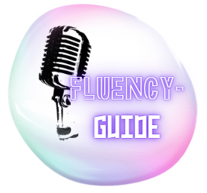
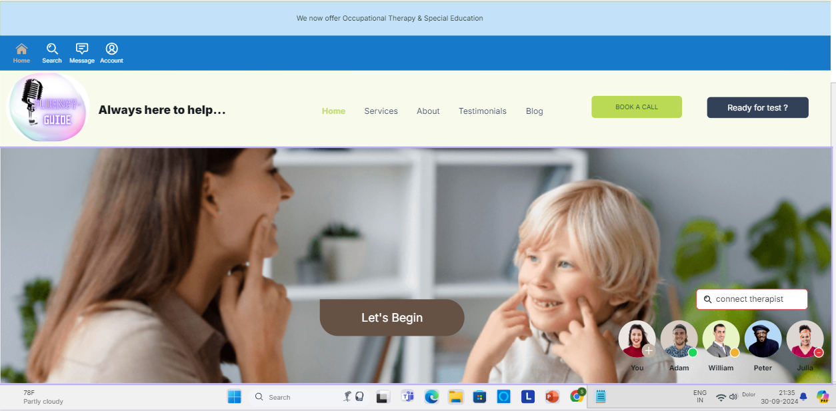
Fluency-Guide
Tech_Warriors_18
Proposed Solution
Detailed explanation of the proposed solution:
How it addresses the problem
The system streamlines caseload management, reduces administrative burden, and provides real-time feedback, ensuring a structured, structured therapy approach with a 10-week schedule.
The system automates patient assignment to therapists based on workload and expertise, creates customized therapy plans, monitors progress, and provides supervisor feedback. It also includes video uploads, clinical evaluation, and a real-time feedback system for continuous improvement.
Innovation and uniqueness of the solution
Automated Patient Allocation.
Reduces administrative burden.
Digital records for research improvement.
Structured system for patient and therapist evaluation.
Unique feature for continuous remote supervision.
Customizable standardized therapy plans
Video-based monitoring.
Prototype Interface (Fluency-Guide)

Slide 3
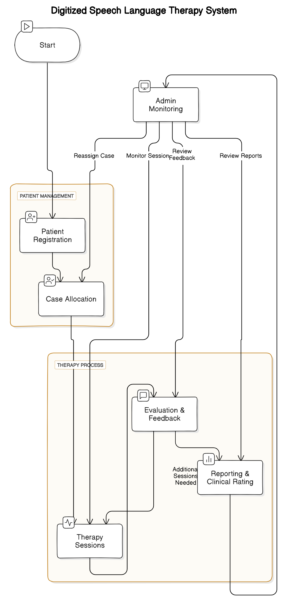
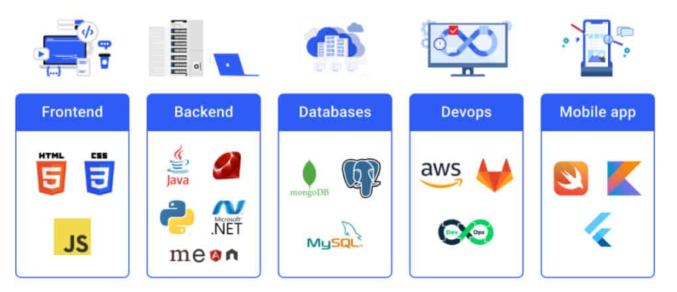
TECHNICAL APPROACH
Tech_Warriors_18
Technologies to be used:
Prototype logo

Slide 4
FEASIBILITY AND VIABILITY
Tech_Warriors_18
Analysis of the feasibility of the idea
Potential challenges and risks:
Strategies for overcoming these challenges:
Utilizes modern technology for patient data and therapy plans.
Streamlines operations for remote collaboration and training.
Emphasizes data privacy, security, user-friendliness.
• Suggests strong encryption, expert partnerships, regular audits.
• Calls for training, user-friendly documentation, scalable cloud infrastructure
• Regular maintenance and system upgrades.
1
Data privacy issues.
2
Financial burden.
Resistance to adoption.
Dependability and downtime issues.

Slide 5
IMPACT AND BENEFITS
Tech_Warriors_18
Potential impact on the target audience.
Benefits of the solution (social, economic, environmental, etc.)
Higher Patient satisfaction
Reduced caseload Burden
Scalability for Rehabilitation Center
Data Driven Insight
Increased Efficiency in
Therapy
Management
Standardization of Treatment
Enhanced
Collaboration
Social Benefits: more access to quality therapy and reduced patient dropouts
.
Economic
Benefits :lower operational cost and improved resource utilization with
automation.
Environmental Benefits: Reduced paper usage through
Digitization ,promoting
Sustainability
Technological Benefits:
Real Time data
tracking

Slide 6
RESEARCH AND REFERENCES
Tech_Warriors_18
Details / Links of the reference and research work
Title: An Ecosystem of Intelligent ICT Tools for Speech-Language Therapy Based on a Formal Knowledge Model
Link: IOS Press Ebooks - An Ecosystem of Intelligent ICT Tools for Speech-Language Therapy Based on a Formal Knowledge Model
Title: Telehealth in speech and language therapy during the COVID-19 pandemic: a systematic review
Link: Telehealth in speech and language therapy during the COVID-19 pandemic: a systematic review (connectwithcare.org)
Title: Delivery of Speech-Language Therapy and Audiology Services Across the World at the Start of the COVID-19 Pandemic: A Survey
Link: Delivery of Speech-Language Therapy and Audiology Services Across the World at the Start of the COVID-19 Pandemic: A Survey (researchgate.net)
Titlle:Technology assisted speech and language therapy Link:j.ijmedinf.2004.03.00520160926-18541-6aggxg-libre.pdf (d1wqtxts1xzle7.cloudfront.net)

