Slide 1


DEPARTMENT OF COMPUTER SCIENCE AND ENGINEERING FACULTY OF ENGINEERING AND TECHNOLOGY
UNIVERSITY OF LUCKNOW
Presentation on Major Project:
SONICFUND
Online Transaction Website
Team Members:
Tanishq Singh (2110013135118),
Shivam Patel (2110013135103),
Vishal Singh (2110013135128)
B.Tech CSE-4th Year(2024-25)
PROJECT GUIDE: Dr. Zeeshan Ali Siddiqui
PROJECT SUPERVISOR: Asst. Professor Prem Shankar Yadav,
Asst. Professor Himanshu Kumar Shukla

Slide 2
Outline
Problem Definition
Related Studies
Tech Stack
Our Solution
Methodology
Time Line
Future Scope
Conclusion
References

Slide 3

Problem Definition:
The Need for a Secure and Efficient Digital Wallet Solution
Shift in Payment Systems: Traditional cash payments are being replaced by digital payments for their convenience, speed, and global accessibility.
Key Issues Identified:
Accessibility for All: Older adults and less educated people face difficulties navigating complex payment apps, highlighting the need for a more intuitive and simplified interface.
Privacy Concerns: Users worry about their personal and financial data being exposed.
User Experience: Many existing apps are too complex, lack user-friendliness, and have limited payment options.
The Need for a Solution: There is a clear demand for a secure, user-friendly, and privacy-focused payment solution that addresses these challenges.
Fig. 1 – Showcasing Digital Wallet in Modern world

Slide 4
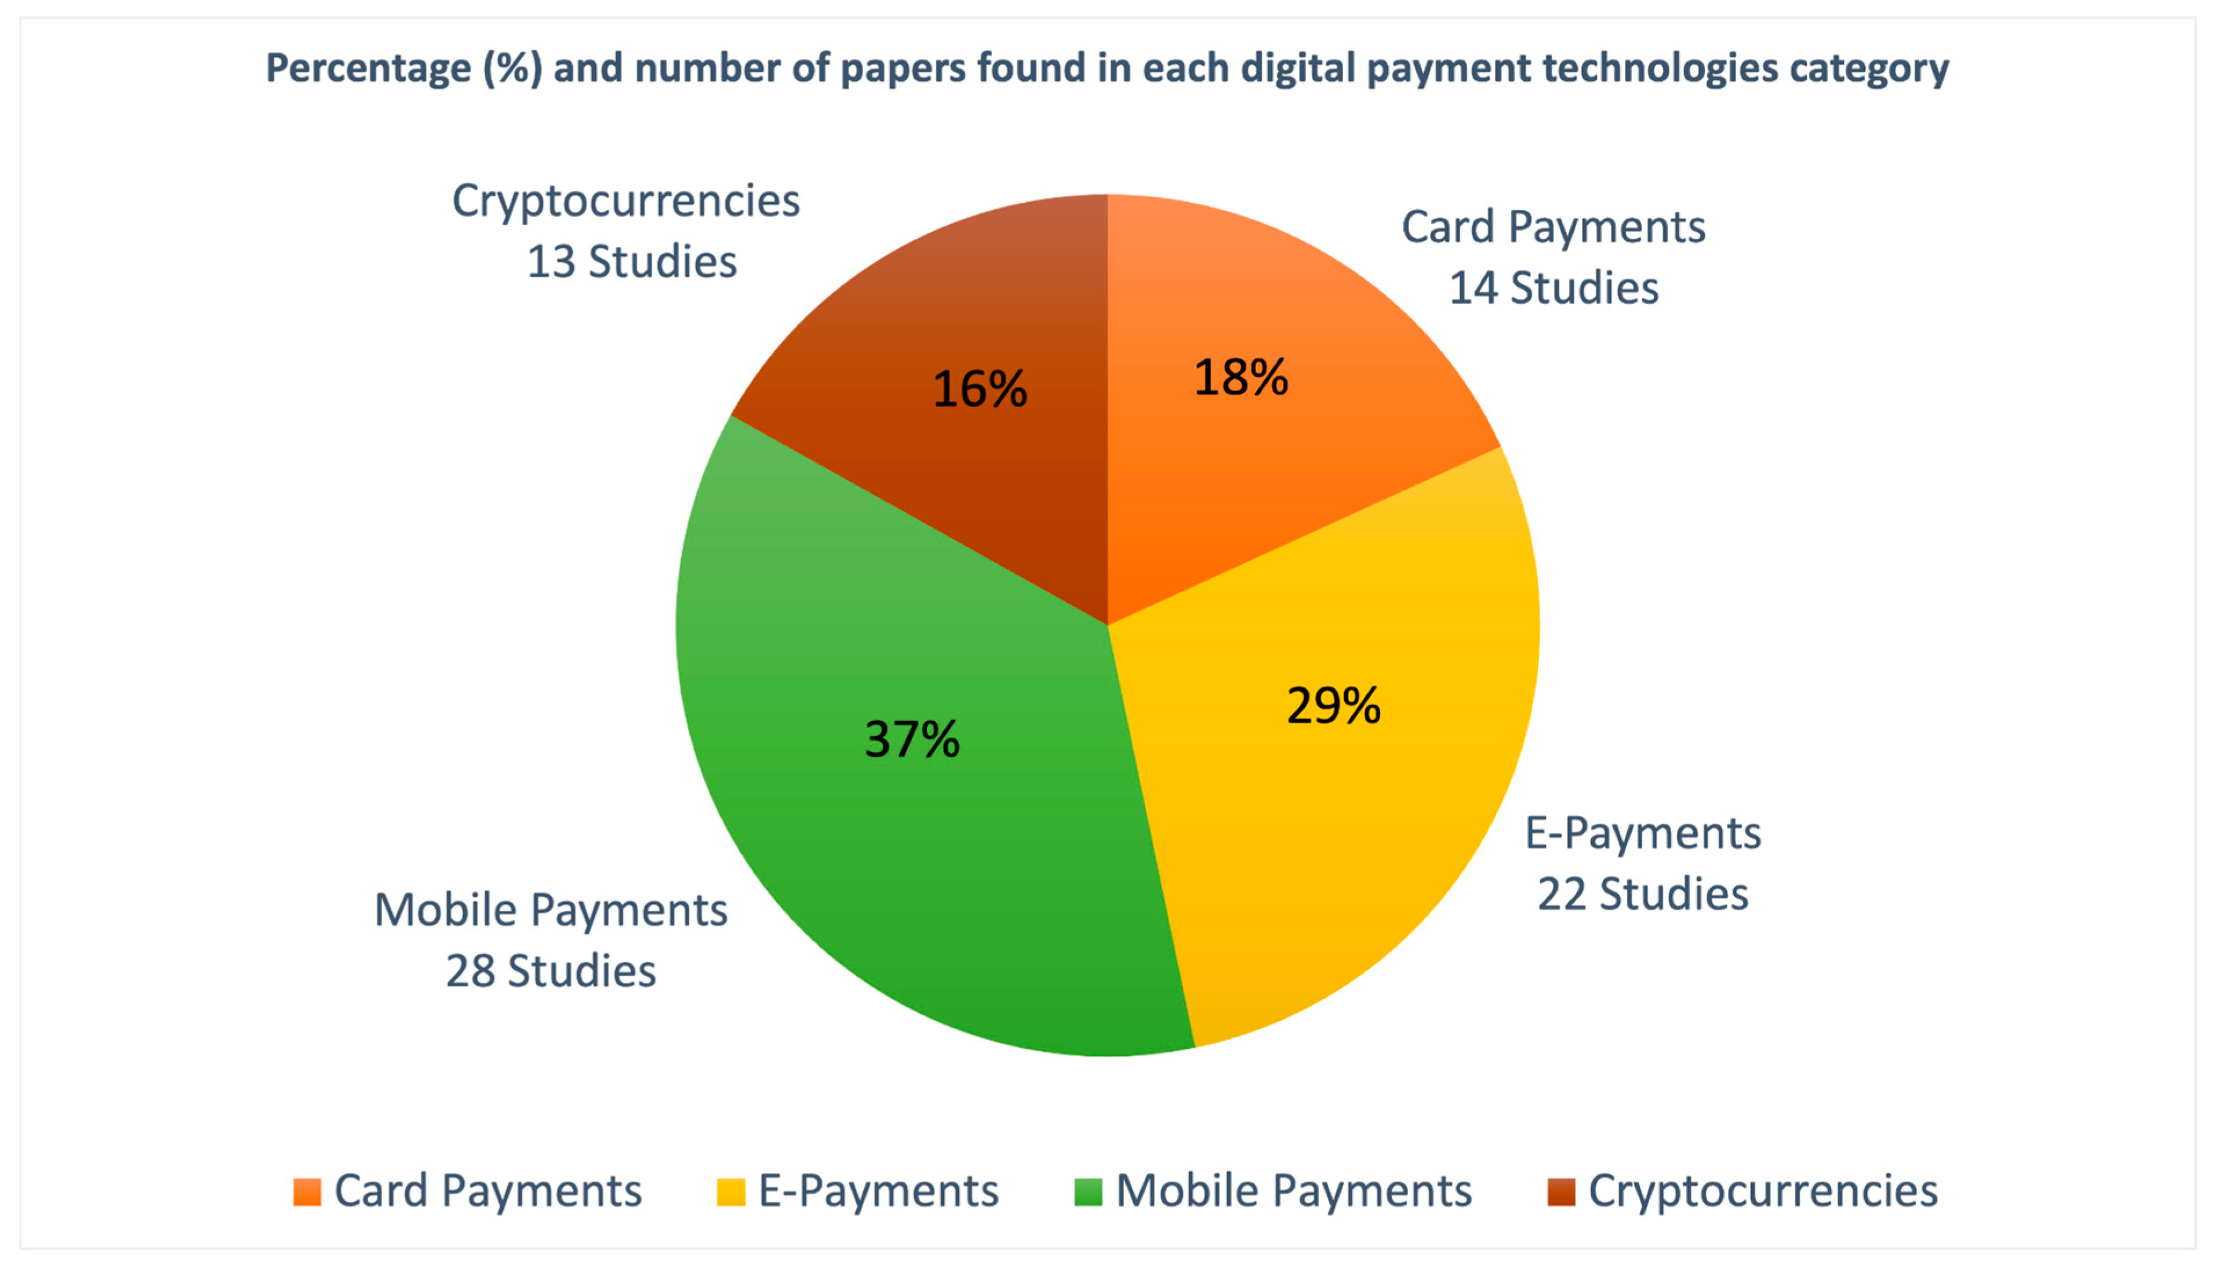
Related Studies:
Emerging Trends in Digital Payments and E-Wallets
Existing Digital Wallets: Paytm, Google Pay, PhonePe, and similar payment platforms are widely used.
Issues in Current Solutions:
Security Gaps: Weak authentication, inadequate encryption, and vulnerabilities to phishing.
Limited User Control: Users have little control over their data and payment flow.
Research Insight: Users prefer apps that offer strong security, privacy, multi-platform support, and fast payments. This insight forms the foundation for SonicFund's development.
Privacy Flaws: Platforms collect and track user data for marketing purposes.
Fig. 2 – Numbers of studies related to each payment technologies

Slide 5
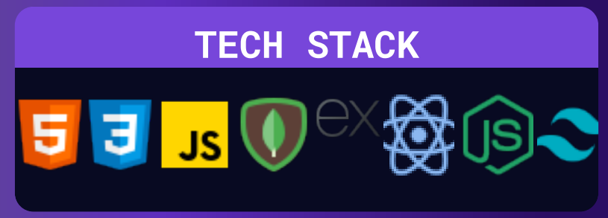
Tech Stack
Frontend
React & React Native: For building responsive, cross-platform user interfaces (web and mobile).
Redux: Manages app state across platforms.
CSS/SCSS: Styling for responsive designs.
Backend
Node.js: Fast and scalable backend for handling requests.
Express.js: Framework for building APIs.
MongoDB: NoSQL database for storing user data and transactions.
JWT: Secure authentication for users.
Payment Integration
UPI APIs: For fast and secure money transfers.
Stripe/PayPal/Razorpay: Payment gateways for card, UPI, and net banking transactions.
This tech stack ensures SonicFund is secure, scalable, and delivers a seamless user experience.
Fig. 3 – Image showing tech stack used in development

Slide 6
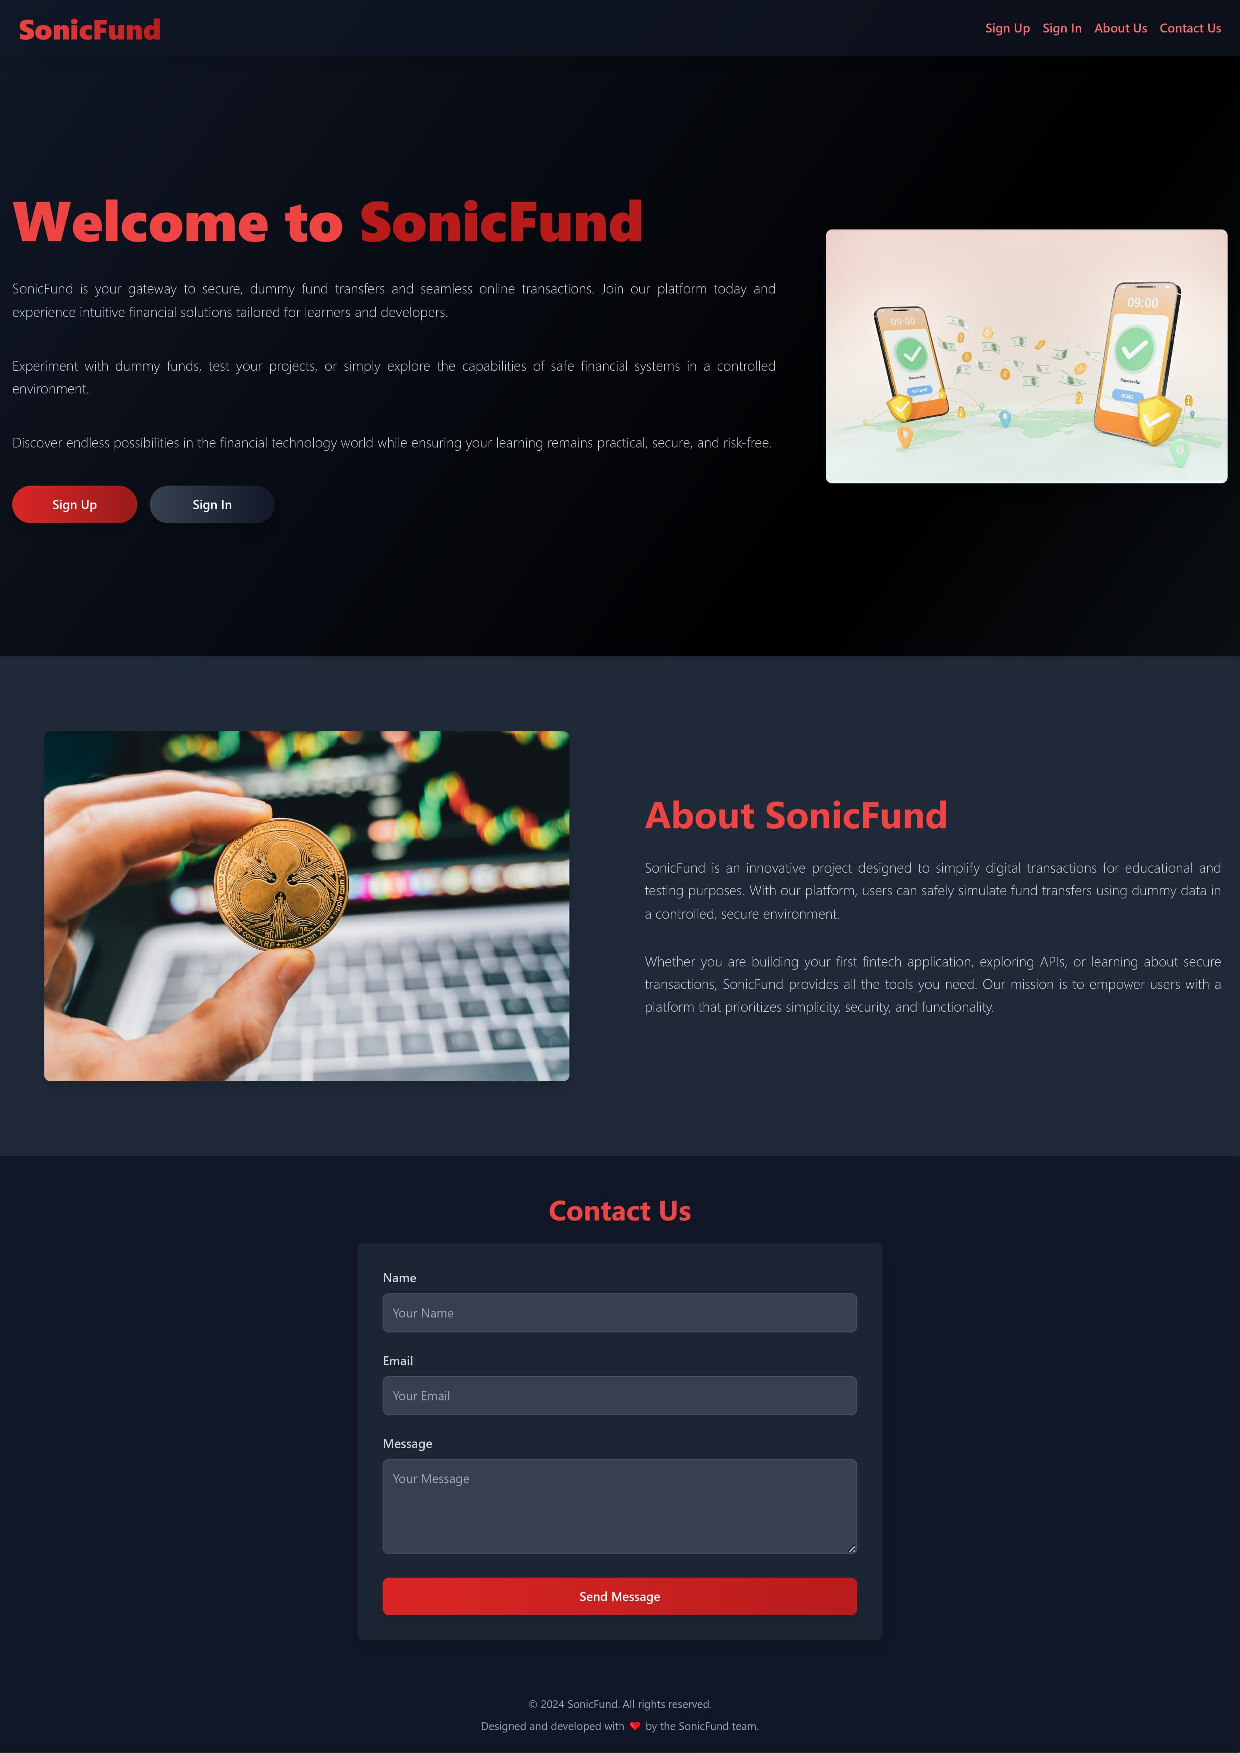
Preposed Solution:
SONICFUND
A Comprehensive Digital Wallet Platform
What is SonicFund?
A next-gen secure digital wallet based website designed to ensure fast, safe, and private online payments.
Core Features of SonicFund:
Security First: Multi-factor authentication (MFA), end-to-end encryption, and real-time fraud detection.
Multiple Payment Options: Supports UPI, credit/debit cards, and net banking to give users flexibility.
User-Centric Design: A clean, easy-to-use interface that works on mobile, web, and desktop platforms.
How it Solves the Problem: By focusing on security, speed, and ease of use, SonicFund directly addresses user concerns with existing digital wallets.
Fig. 4 – Overview of Website

Slide 7
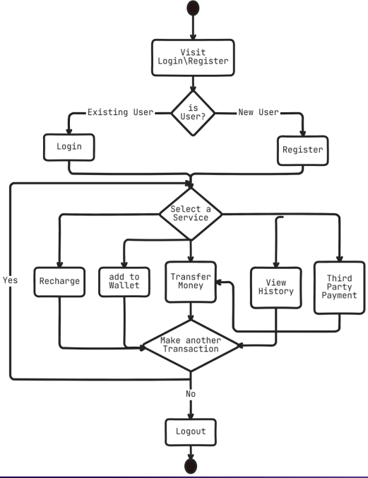
Methodology:
Flowchart (Simple Payment Flow):
User Registration: Users sign up and verify via email/phone OTP.
User Authentication: Multi-factor authentication (MFA) using biometrics or OTP.
Payment Initiation: User selects payment method (UPI, card, or net banking).
Transaction Processing: Payment is processed with encryption to ensure security.
Response: User receives confirmation of success or failure of the transaction.
System Model:
User Layer: Mobile app and web platform for direct user interaction.
Application Layer: API services to handle payment requests, security, and data processing.
Data Layer: Secure database with encryption to store transaction history and user details.
Security Layer: Advanced security protocols like end-to-end encryption (E2EE), Multi-Factor Authentication (MFA), and Firewalls.
Fig. 5 – Flow Chart

Slide 8
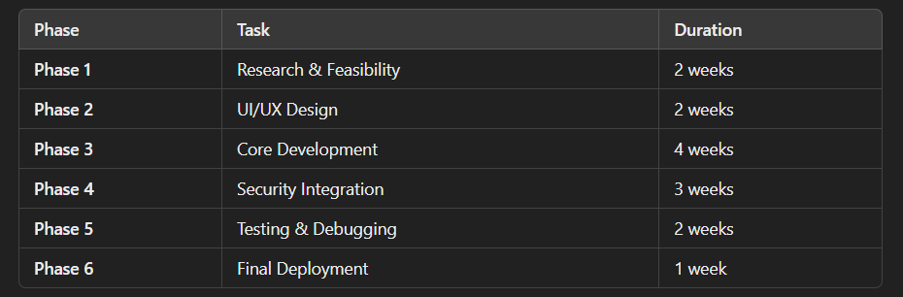
Implementation Timeline:
Phased Rollout and Milestones
SonicFund follows a structured timeline, ensuring that all key tasks are completed efficiently and effectively to create a secure, user-friendly digital wallet.
Phase 1: Research & Feasibility (2 Weeks)
Phase 2: UI/UX Design (2 Weeks)
Phase 3: Core Development (4 Weeks)
Phase 4: Security Integration (3 Weeks)
Phase 5: Testing & Debugging (2 Weeks)
Phase 6: Final Deployment (1 Week)
Each phase ensures that SonicFund is developed with careful attention to detail, from design to deployment, making it a robust and secure digital wallet solution.
Fig. 6 – Timeline table

Slide 9
Future Scope:
Expanding Services and Integrations
Advanced Security Upgrades: Use of AI/ML for anomaly detection and enhanced fraud prevention.
International Payment Support: Enable cross-border payments to make SonicFund a global wallet.
Cryptocurrency Integration: Support for payments using Bitcoin, Ethereum, and other cryptocurrencies.
Offline Payments: Integration of NFC (Near Field Communication) technology for offline transactions.
Voice-Powered Payments: Use of voice commands for quick, hands-free payments.

Slide 10
Conclusion:
Revolutionizing Digital Transactions with SONICFUND
Summary of Key Points:
SonicFund addresses key issues in the digital wallet space: security, privacy, speed, and user experience.
By focusing on strong encryption, multi-factor authentication, and privacy-first principles, SonicFund is a unique and next-gen payment solution.
The platform aims to offer fast, secure, and user-friendly payments with support for multiple payment methods like UPI, cards, and net banking.
Closing Remark: As digital payments grow worldwide, SonicFund positions itself as a trusted and reliable alternative to existing payment apps.

Slide 11
References
Reference Books
"MERN Quick Start Guide: Build web applications with MongoDB, Express.js, React, and Node" by Eddy Wilson Iriarte Koroliova
"Node.js Web Development: Server-side web development made easy with Node 14 using practical examples" by David Herron.
Reference Websites
Digital Wallets API:
https://developers.google.com/pay/
MongoDB Documentation
https://docs.mongodb.com/
Express.js Documentation
https://expressjs.com/en/resources/glossary.html
React.js Documentation
https://legacy.reactjs.org/docs/
Node.js Documentation
https://nodejs.org/docs/
Inspired by
https://100xdevs.com/

