Slide 1




Robust Multimodal Deepfake Analysis
Detecting fake faces and cloned voices, robust to real-world degradation and explained with Grad-CAM
Face model
Voice model
Fusion
Grad-CAM
Project review · October 2026
Notes:
Title. The project detects deepfake videos by checking both the face and the voice, tests how robust the detector is to compression and noise, and explains every decision with heatmaps. Today: what is built, the first real trained model (the voice model), the demo, and what is still pending.

Slide 2

Fakes can hit the face, the voice, or both
Fake faces
Cloned voices
Real-world damage
Face swap, face reenactment and lip-sync models produce realistic manipulated faces.
Text-to-speech and voice conversion imitate a real speaker's voice convincingly.
Compression, noise and missing audio tracks break detectors that check only one channel.
A practical detector must answer “is this video fake?” even when only one channel was manipulated, and show evidence a person can check.
Notes:
Problem. Deepfakes can manipulate the face, the voice, or both. A face-only detector misses a real face with a cloned voice, and an audio-only detector misses a face swap with the original audio. Social platforms also re-compress videos, which is known to hurt detectors. So we need a multimodal, robust and explainable detector.

Slide 3


Four objectives
Detect and combine
Stay robust
Score the face and the voice separately, then fuse them into one decision: fake if either is fake.
Measure and improve accuracy under 7 degradations × 3 severities and missing modalities.
Explain decisions
Reproducible, with a demo
Grad-CAM heatmaps on face crops and on the voice spectrogram.
Tested pipeline, Colab notebooks for training, and an interactive Gradio app.
Notes:
Objectives. One: detect fake faces and fake voices and combine them. Two: stay reliable under compression, blur, noise and missing audio or video. Three: explain each decision with heatmaps. Four: deliver a reproducible pipeline and a working demo.

Slide 4
Related work and the gaps we address
Work | Contribution | Gap this project addresses
FaceForensics++ (Rössler et al., 2019) | Benchmark of 4 face manipulations at several compression levels | Accuracy drops on compressed video → robustness tests
Celeb-DF (Li et al., 2020) | High-quality face swaps for cross-dataset evaluation | Generalisation → cross-dataset test of the face model
ASVspoof 2019 LA (Wang et al., 2020) | Spoofed speech from many TTS / voice-conversion systems; unseen attacks in evaluation | Audio only → combined with the face
AASIST (Jung et al., 2022) | Graph-attention anti-spoofing countermeasure | Stronger audio model → future work
FakeAVCeleb (Khalid et al., 2021) | Audio-visual fakes with separate face and voice labels | Shows which modality a detector relies on
Grad-CAM (Selvaraju et al., 2017) | Class-discriminative heatmaps from CNN gradients | Evidence for both branches
Notes:
Related work. FaceForensics++ showed that compression hurts detectors, which motivates the robustness tests. Celeb-DF is our cross-dataset face test. ASVspoof 2019 is the standard voice anti-spoofing dataset and the one we trained on. FakeAVCeleb labels face and voice separately, so we can tell which modality a detector relies on. Grad-CAM gives the explanations.

Slide 5
Datasets and leakage-free splits
Dataset | Role | Status
FakeAVCeleb v1.2 | Main face + voice training and test | Awaiting access
DFDC sample | Pipeline development, face baseline | Pending
ASVspoof 2019 LA | Voice training, per-attack evaluation | Used
Celeb-DF v2 | Cross-dataset face test | Awaiting access
ASVspoof subset used for the voice model
Split | Official partition | Clips | Spoof | Bona fide
Train | train | 5,000 | 2,500 | 2,500
Validation | development | 5,000 | 2,500 | 2,500
Test | evaluation | 5,000 | 2,500 | 2,500
Balanced subset: up to 2,500 clips per class from each official partition (seed 42). Evaluation attacks A07–A19 are mostly absent from training, so the test measures generalisation to new attacks.
Splits group by person ID (FakeAVCeleb), source video (DFDC) or official protocol (ASVspoof, Celeb-DF test list), so the same face or voice never appears in both training and test. Training refuses data whose groups or files cross splits.
Notes:
Datasets. FakeAVCeleb is the main dataset but needs author approval, which is still pending, as is Celeb-DF. ASVspoof 2019 LA is free and is what we trained the voice model on: a balanced subset of 5,000 clips per split taken from the official partitions. Splits are leakage-free: the same person or voice never appears in both training and test.

Slide 6
Architecture: two branches, one decision
pending data
Video
16 frames, uniform
YuNet face crops 224²
EfficientNet-B0 face model
Fusion
late: max · noisy-OR · weighted
intermediate: MLP + modality dropout
P(fake)
+ Grad-CAM evidence
Audio track
16 kHz log-mel, 4 s window
ResNet-18 voice model
trained
Face label
Voice label
Overall label
video_label: a real face with a cloned voice counts as real
audio_label: bona fide vs. spoofed speech
fake if the face OR the voice is fake
Notes:
Architecture. The video branch samples 16 frames, finds faces with YuNet and scores each crop with EfficientNet-B0. The voice branch converts the audio to a log-mel spectrogram and scores a 4-second window with ResNet-18. Fusion combines them: late fusion with max, noisy-OR or a weighted average, or an intermediate MLP with modality dropout so it still works when one input is missing. The voice branch is trained; the face branch is waiting for FakeAVCeleb.

Slide 7



Preprocessing, training and evaluation
Preprocessing
Training recipe
Evaluation protocol
16 frames per video, YuNet faces, 224² crops (margin 1.3)
Audio: 16 kHz mono, first 10 s, 128-bin log-mel (25 ms window, 10 ms hop)
Processed data stored on Google Drive
AdamW, cosine schedule, mixed precision on a Colab T4
Backbone frozen in epoch 1; head learning rate 10×
SpecAugment for audio; class-balanced loss
Early stopping on validation AUC, resumable checkpoints
Primary metric: AUC; also EER
Accuracy, precision, recall, F1 at threshold 0.5
Best checkpoint chosen on validation; test evaluated once
Per-category results (per attack system)
Colab T4 GPU
≈ 2.6 min
6 of max 15
32 · 1e-4
Hardware
Time per epoch
Epochs run
Batch · learning rate
Notes:
Setup. Preprocessing is identical in training and in the demo. Training uses AdamW with a cosine schedule on a free Colab T4, freezes the pretrained backbone for the first epoch, and stops early on validation AUC. The test split is evaluated once with the best validation checkpoint.

Slide 8
Voice model: AUC 0.977 and EER 6.2% on the test set
0.977
6.2%
Test AUC
Equal error rate
ranking quality, 1.0 = perfect
lower is better
91.2%
93.8%
Accuracy at 0.5
Accuracy at EER threshold
precision 0.991 · recall 0.832
threshold 0.0102
 | Predicted real | Predicted fake
Actually real | 2,481 | 19
Actually fake | 419 | 2,081
n = 5,000 test clips; threshold 0.5
Notes:
Main voice result. On the 5,000 test clips from ASVspoof's evaluation partition, which mostly contains attacks never seen in training, the voice model reaches AUC 0.977 and an equal error rate of 6.2%. At the default threshold of 0.5 it accepts almost every real voice, with 19 false alarms out of 2,500, but misses 419 of 2,500 fakes. At the equal-error threshold accuracy rises to 93.8%. The ROC curve is computed from all 5,000 saved test predictions.

Slide 9


Most unseen attacks are caught; A17 slips through
8 of 13 attack systems
94% or more detected, AUC ≥ 0.997
A10, A12, A13, A18
AUC ≥ 0.985 but only 64–80% detected at 0.5: the threshold is the problem
A17: 1.2% detected
AUC 0.725, EER 34.4%; scores almost like real speech
Real speech: 99.2% accepted
19 false alarms in 2,500 bona fide clips
Notes:
Per attack. Eight of the thirteen evaluation attacks are detected 94% of the time or more. Four attacks, A10, A12, A13 and A18, are ranked above real speech with AUC 0.985 or higher, yet only 64 to 80% cross the 0.5 threshold, so a calibrated threshold would catch many more. A17 is the hard case: only 1.2% detected, AUC 0.725. A16 and A19 reuse training algorithms A04 and A06, which explains their near-perfect scores.

Slide 10
Training converged fast; validation then saturated
Why it stopped at epoch 6: the validation partition contains the same attacks as training (A01–A06), so validation AUC reached 1.0 by epoch 3 and could not improve. Early stopping kept epoch 3. The test AUC of 0.977 on mostly unseen attacks is the meaningful measure.
Notes:
Training. Epoch 1 trains only the new head with the backbone frozen, which is why validation AUC starts at 0.85. From epoch 2 the model separates the validation set almost perfectly, because the development partition shares its attack systems with training. Early stopping triggered after three epochs without improvement, and the epoch-3 checkpoint was kept. A validation set with held-out attacks would be a better guide; this is listed as future work.

Slide 11
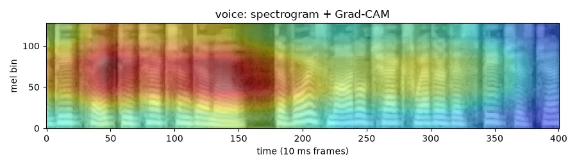

Grad-CAM shows where the voice model looks
Synthetic speech (macOS text-to-speech) analysed in the demo: P(fake) = 100%. Red marks the time–frequency regions that drove the decision.
Voice heatmaps
Face heatmaps
Gradients of the decision at ResNet-18's last block (4 × 13 cells), upsampled onto the 128 × 401 spectrogram.
Per-frame maps on the face crops (EfficientNet-B0). Shown once the face model is trained on FakeAVCeleb.
Notes:
Explainability. This is the heatmap the demo produced for a synthetic voice made with macOS text-to-speech. The model flagged it as fake with 100% probability, and the red region shows which part of the spectrogram drove that decision. Heatmaps show where the model looked, not proof of manipulation. The same method works on face crops once the face model is trained.

Slide 12
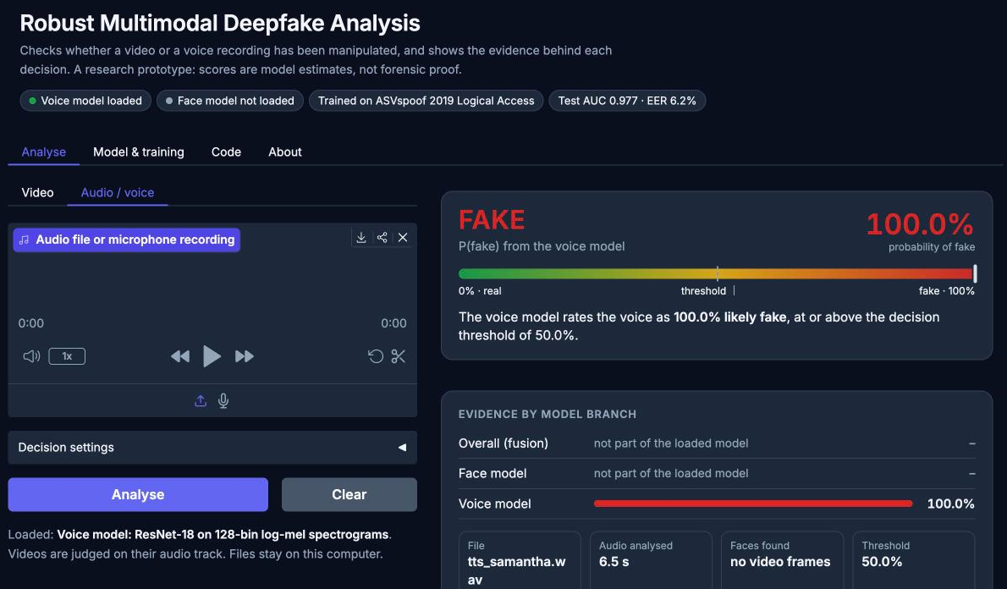


Demo app: verdict, evidence, model card, code
Analyse
Video, audio or microphone; verdict gauge, score per branch, Grad-CAM
Model & training
Splits, settings, test metrics, per-attack table, curves, ROC
Code
Exact training command and model source
About
How it works, how to read a result, limitations
python app/app.py · Colab: --share for a public link
Notes:
Demo. The Gradio app takes a video, an audio file or a microphone recording. It shows the verdict with a probability gauge and an adjustable threshold, the score of each branch, the input checks and the heatmap. The Model and training tab shows the data, settings and test results of the loaded model, and the Code tab shows the exact command that trained it. Live demo here.

Slide 13
Built and tested, waiting for FakeAVCeleb
Face model
pending data
Fusion comparison
pending data
EfficientNet-B0 on FakeAVCeleb and DFDC; cross-dataset test on Celeb-DF
Face-only vs voice-only vs late vs intermediate fusion, overall and per category
Robustness
pending data
Voice fine-tuning
pending data
7 degradations × 3 severities, missing modality, standard vs robust training
ASVspoof model fine-tuned on FakeAVCeleb; with vs without pre-training
Every code path above runs end to end on synthetic data: 82 automated tests pass. Only the real-data runs are missing.
Notes:
Pending. Everything on this slide is implemented and covered by tests, but needs the FakeAVCeleb dataset, which requires the authors' approval. Once it arrives, the notebooks run the face model, the fusion comparison, the robustness study and the fine-tuning of the voice model.

Slide 14
Development status by phase
0
1
2
3
4
5
6
7
8
Setup
Data pipeline
Face branch
Voice branch
Fusion
Robustness
Explain-
ability
Demo app
Report
Code
Code
Code
Code
Code
Code
Code
Code
Code
done
done
done
done
done
done
done
done
done
Real data
Real data
Real data
Real data
Real data
Real data
Real data
Real data
Real data
n/a
partial
pending
done
pending
pending
partial
done
partial
Partial: ASVspoof is processed, FakeAVCeleb, DFDC and Celeb-DF are not; Grad-CAM shown on the voice only; report section 6.2 (voice) is written.
The trained voice model, its test results and every prediction are published on GitHub (models/ and a GitHub Release).
Notes:
Status. All nine phases are implemented and tested. On real data, the voice branch and the demo are complete; the data pipeline, explainability and the report are partially complete; the face branch, fusion and robustness are waiting for data. The trained model and its results are published in the GitHub repository.

Slide 15
Limitations and next steps
Limitations
Next steps
Subset results (5,000 clips per split), not the full ASVspoof benchmark
Studio speech only: other microphones, rooms and compression are untested
Threshold 0.5 under-detects several unseen attacks
Validation shares attacks with training, so it saturates
Face and fusion models not yet trained; Grad-CAM is coarse (4 × 13 on audio)
Obtain FakeAVCeleb: train face and fusion models, run robustness
Validation with held-out attacks and a calibrated threshold
Stronger audio models (AASIST, self-supervised speech features)
Temporal and lip–audio synchronisation features
Test on real recordings from everyday devices
Notes:
Limitations: these are subset results; the voice model has only seen studio-quality speech; the default threshold misses several unseen attacks; and the validation set cannot separate checkpoints because it shares attacks with training. Next steps: FakeAVCeleb for the face and fusion models, a held-out-attack validation set with a calibrated threshold, stronger audio models such as AASIST, and tests on everyday recordings.

Slide 16
Conclusion
1
Working pipeline
Data → training → evaluation → explainable demo, reproducible on Colab, 82 automated tests.
2
Voice model: AUC 0.977, EER 6.2%
On mostly unseen ASVspoof attacks; strong on most, A17 remains the hard case.
3
Next: the multimodal claim
FakeAVCeleb unlocks the face and fusion models, the core comparison still to be measured.
github.com/tanishq1101/robust-multimodal-deepfake
Notes:
Conclusion. One: the full pipeline works end to end and is tested. Two: the first trained model, the voice model, reaches AUC 0.977 and EER 6.2% on mostly unseen attacks, with A17 as the hard case. Three: the core multimodal comparison needs FakeAVCeleb, which is the next step.

Slide 17
References
Rössler et al. FaceForensics++. ICCV 2019.
Li et al. Celeb-DF. CVPR 2020.
Dolhansky et al. The DeepFake Detection Challenge Dataset. arXiv:2006.07397, 2020.
Khalid et al. FakeAVCeleb. NeurIPS Datasets and Benchmarks, 2021.
Wang et al. ASVspoof 2019. Computer Speech & Language 64, 2020.
Jung et al. AASIST. ICASSP 2022.
Tan & Le. EfficientNet. ICML 2019.
He et al. Deep Residual Learning (ResNet). CVPR 2016.
Park et al. SpecAugment. Interspeech 2019.
Selvaraju et al. Grad-CAM. ICCV 2017.
Neverova et al. ModDrop. IEEE TPAMI 38(8), 2016.
Wu et al. YuNet. Machine Intelligence Research 20, 2023.
Notes:
Main references; the full list is in reports/report.md.

