Slide 1


DATA ANALYTICS PROJECT
SUPERSTORE SALES
PERFORMANCE DASHBOARD
Prepared By: Tanishq
Tools Used: Microsoft Power BI
2014 – 2017

Slide 2






01 · PROJECT OVERVIEW
Project Overview
Scope
Objective
Analyze overall sales performance
Develop an interactive Power BI dashboard to analyze Superstore sales performance and generate meaningful business insights for better decision-making.
Monitor profit and quantity sold
Compare category-wise sales
Identify profitable sub-categories
4
4
17
Analyze sales trends over time
YEARS
REGIONS
SUB-CATEGORIES
Evaluate regional sales performance
Superstore Sales Performance Dashboard
02 / 09

Slide 3






02 · TOOLS & DATASET
Tools & Dataset
Tools Used
Dataset Information
DATASET
Superstore Sales Dataset
Microsoft Power BI
Power Query
TIME PERIOD
2014 – 2017
Data Visualization & Reporting
Data Cleaning & Transformation
SOURCE
CSV File
DATA COVERAGE TIMELINE
DAX
CSV Dataset
Custom Calculations & Measures
Source Data Format
2014
2015
2016
2017
Superstore Sales Performance Dashboard
03 / 09

Slide 4
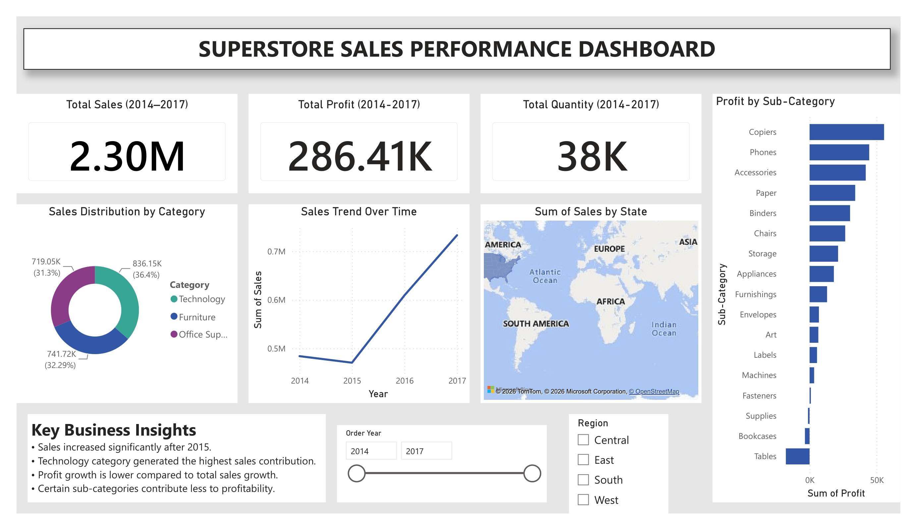


03 · DASHBOARD OVERVIEW
Dashboard Overview
Dashboard Components
KPI Cards
Sales Distribution by Category
Sales Trend Over Time
Sales by State Map
Profit by Sub-Category
Year Filter
Region Slicer
Business Insights Panel
Superstore Sales Performance Dashboard
04 / 09

Slide 5


04 · KEY PERFORMANCE INDICATORS
Dashboard KPIs
2.30M
286.41K
38K
TOTAL SALES (2014–2017)
TOTAL PROFIT (2014–2017)
TOTAL QUANTITY (2014–2017)
Purpose: These KPIs provide a quick overview of the company's overall business performance.
Superstore Sales Performance Dashboard
05 / 09

Slide 6
05 · DASHBOARD ANALYSIS
Dashboard Analysis
Sales Distribution
Sales Trend
Technology contributed the highest share of total sales.
Furniture and Office Supplies also generated significant revenue.
Sales increased steadily after 2015.
Highest sales were recorded in 2017.
Profit Analysis
Regional Analysis
Copiers generated the highest profit.
Tables and Bookcases showed comparatively lower profitability.
Interactive filters allow analysis by year and region.
Enables drill-down across Central, East, South, and West regions.
Superstore Sales Performance Dashboard
06 / 09

Slide 7




06 · KEY BUSINESS INSIGHTS
Key Business Insights
1
Overall sales increased significantly after 2015.
2
Technology category contributed the highest sales.
3
Profit growth remained lower than overall sales growth.
4
Some sub-categories require profitability improvement.
5
Interactive dashboard enables faster business analysis and reporting.
Superstore Sales Performance Dashboard
07 / 09

Slide 8


07 · CONCLUSION
Conclusion
The Superstore Sales Performance Dashboard provides an interactive and comprehensive view of sales performance, profitability, product categories, and regional sales trends. It enables users to monitor KPIs, identify profitable business areas, and support data-driven decision-making.
Performance Monitoring
Profitability Insights
Data-Driven Decisions

Slide 9
Thank You
Questions & Discussion
Tanishq · Superstore Sales Performance Dashboard · Microsoft Power BI

