Slide 1
PolyMix Algorithm Comparison
Augmentation Ratio 1.0 vs Ratio 2.0 Capstone Project

Slide 2
Experiment Setup
Experiment Configuration:
• Batch Size: 8
• Learning Rate: 0.0001
• Image Size: 224 × 224
• Early Stopping: 10 epochs patience
• Maximum Epochs: 50
Training Sizes Tested:
• 25, 50, 75, 100, 490 images
Model Selection Criterion:
• Best Validation Dice Score

Slide 3
Performance Comparison

Slide 4
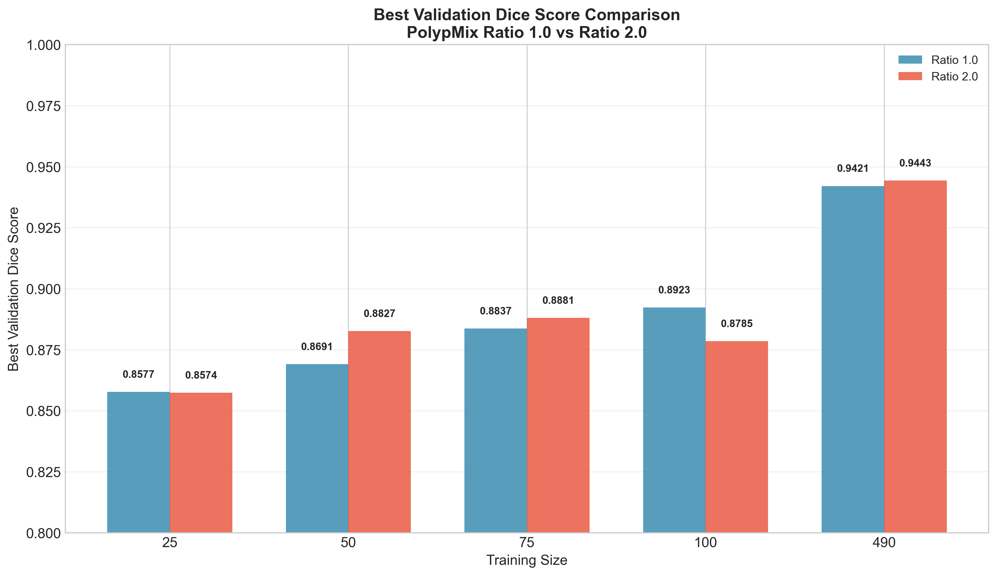
Best Validation Dice Score Comparison
Notes:
Bar chart comparing best dice scores between ratios across training sizes

Slide 5
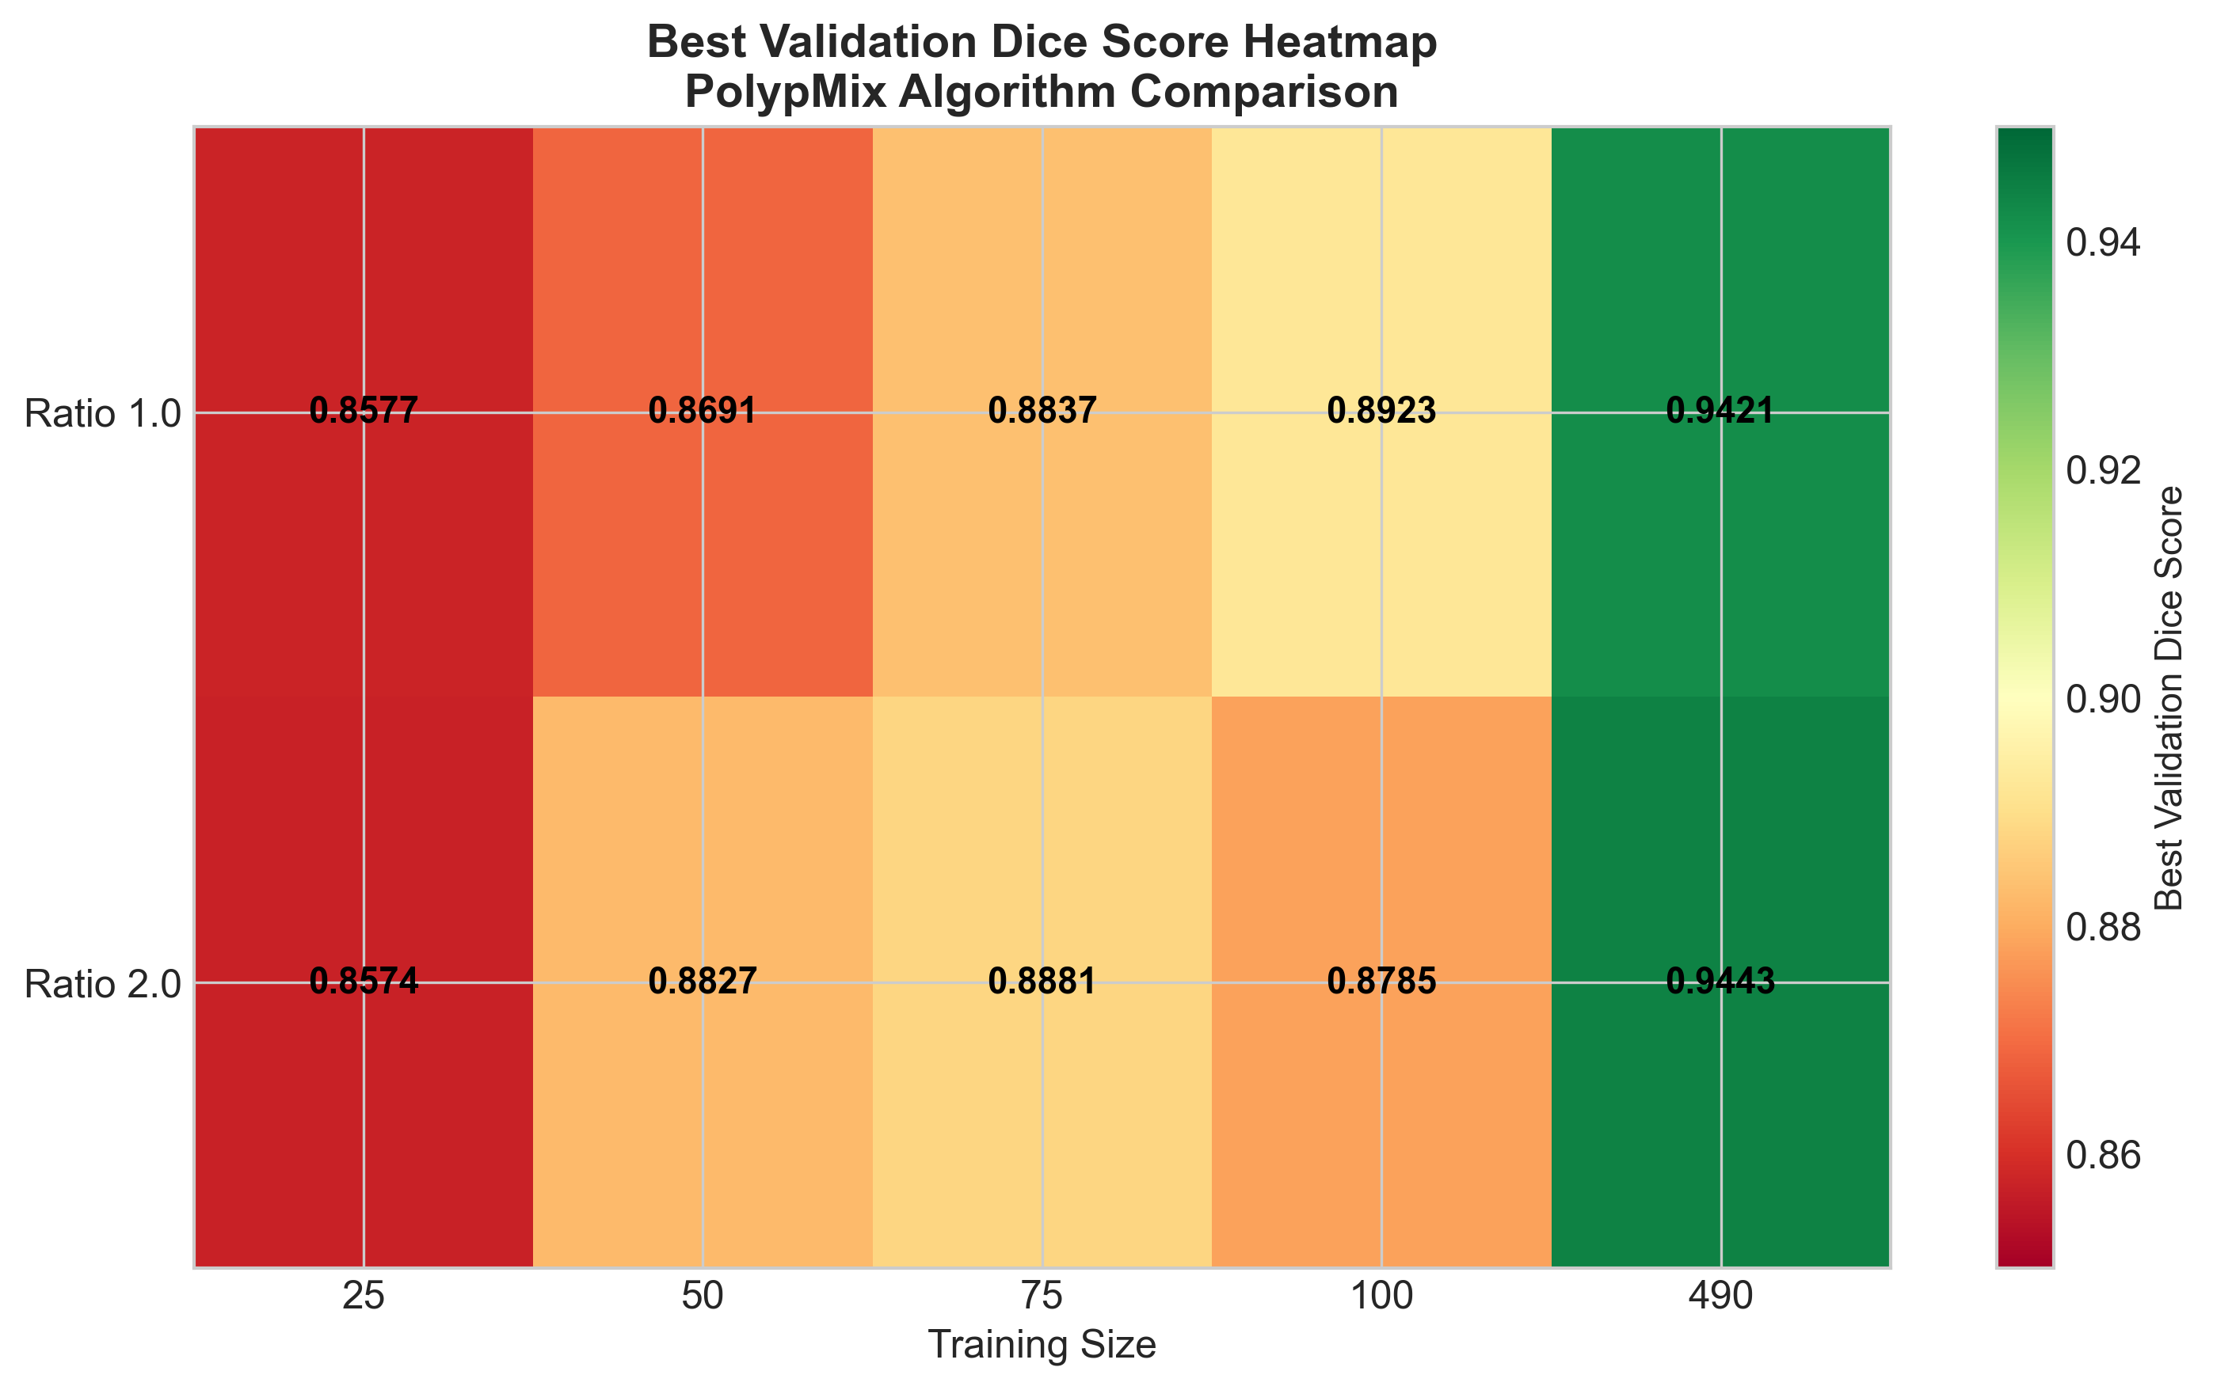
Performance Heatmap Overview
Notes:
Heatmap showing dice scores for both ratios and all training sizes

Slide 6
Best Validation Dice Scores
Training Size | Ratio 1.0 | Ratio 2.0 | Winner
25 | 0.8577 | 0.8574 | Ratio 1.0 (+0.03%)
50 | 0.8691 | 0.8827 | Ratio 2.0 (+1.6%)
75 | 0.8837 | 0.8881 | Ratio 2.0 (+0.5%)
100 | 0.8923 | 0.8785 | Ratio 1.0 (+1.4%)
490 | 0.9421 | 0.9443 | Ratio 2.0 (+0.2%)

Slide 7
Training Dynamics

Slide 8
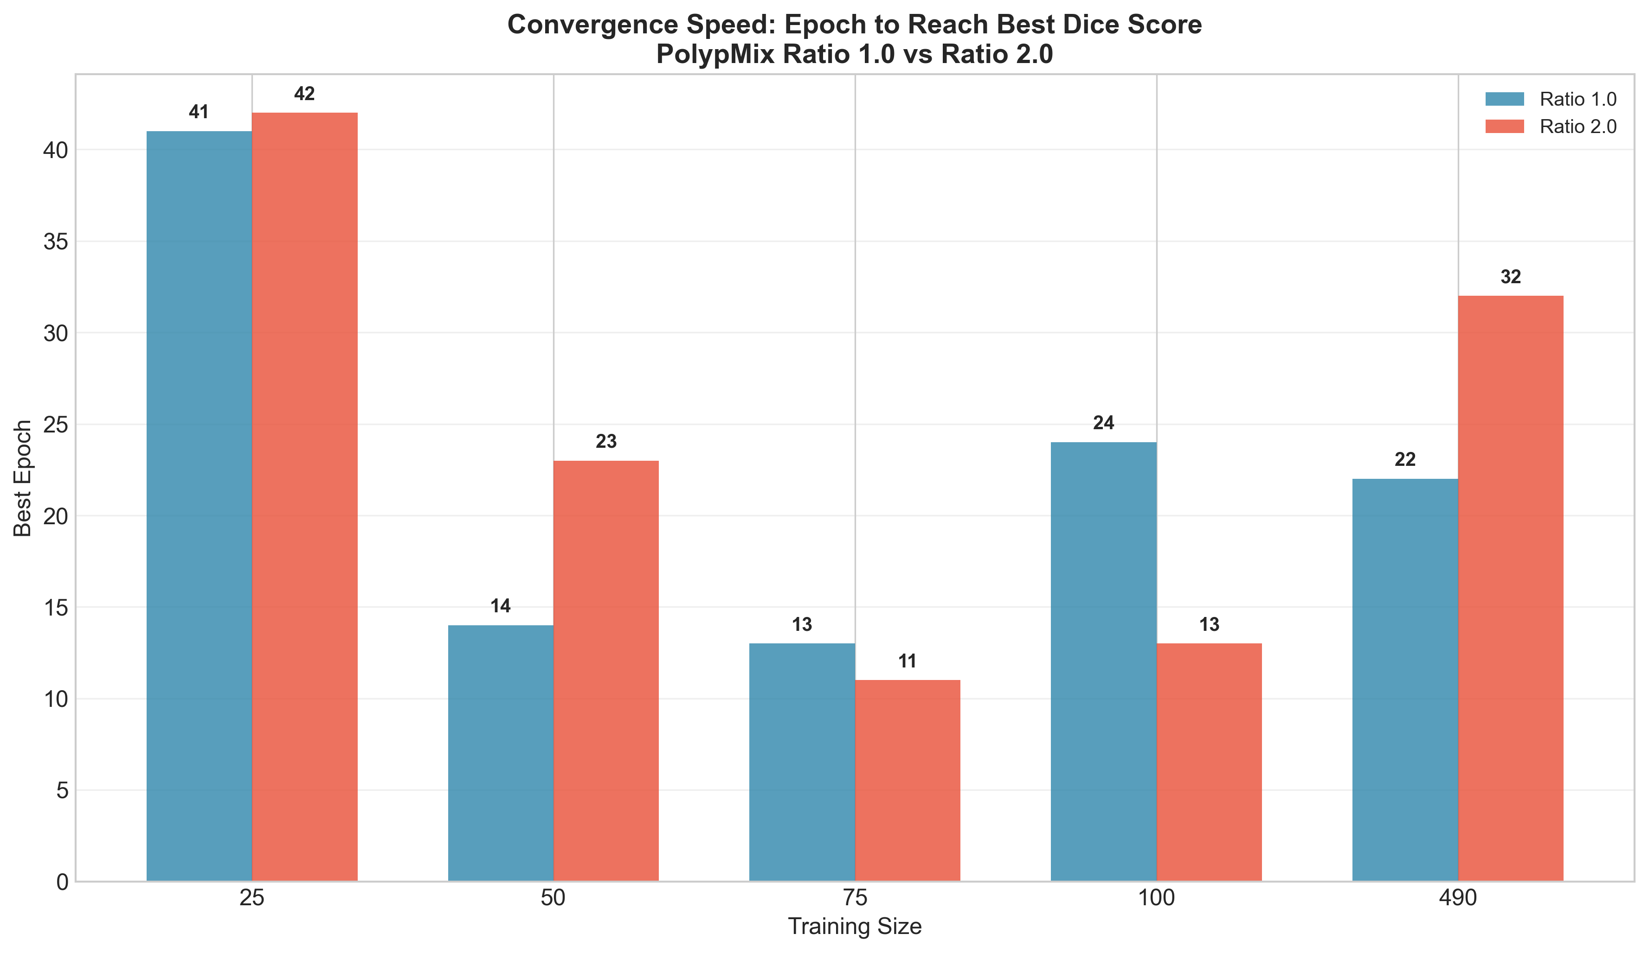
Convergence Speed Analysis
Notes:
Number of epochs to reach best dice score

Slide 9
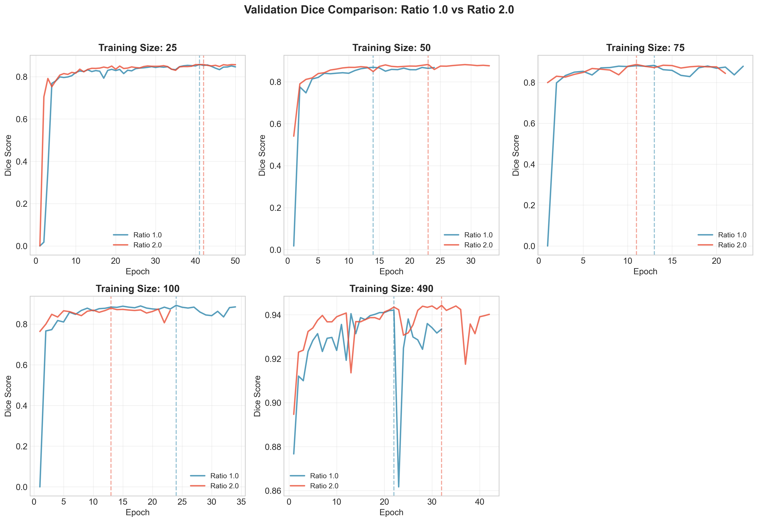
Validation Dice Across Training Sizes
Notes:
Epoch-wise validation dice comparison for each training size

Slide 10
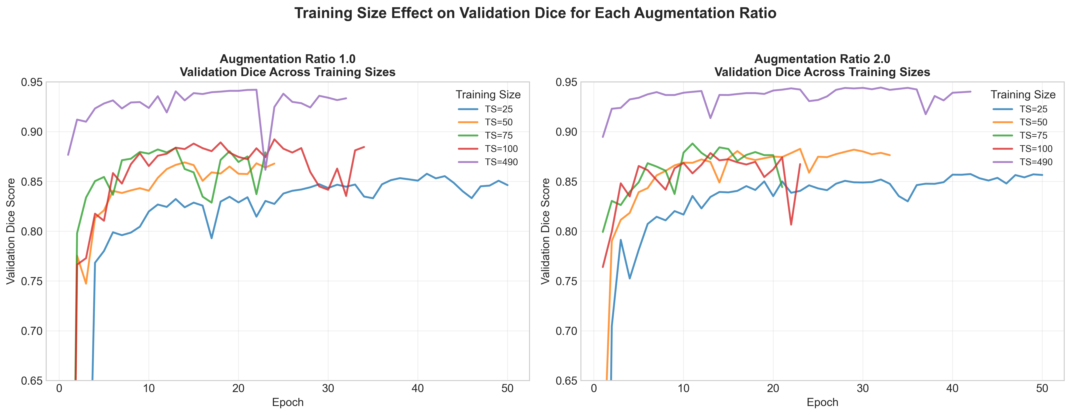
Training Size Effect per Augmentation Ratio
Notes:
How training size affects performance within each ratio

Slide 11
Detailed Training Curves

Slide 12
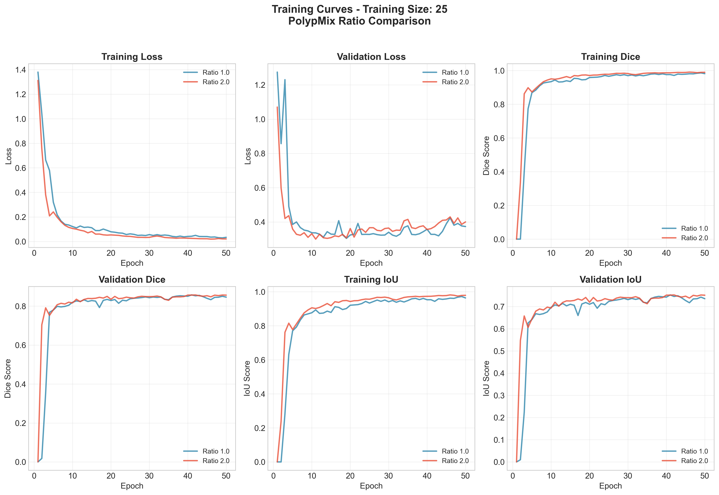
Training Curves - 25 Images
Notes:
Detailed training curves for training size 25

Slide 13
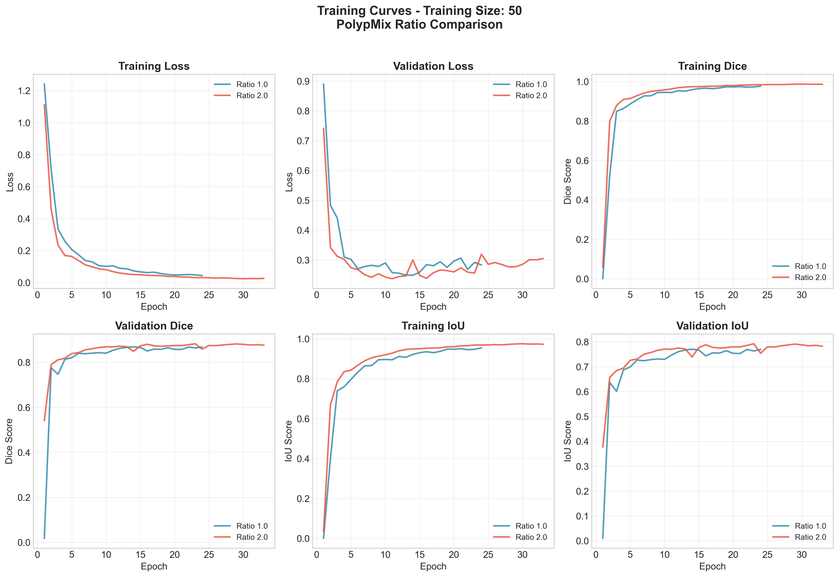
Training Curves - 50 Images
Notes:
Detailed training curves for training size 50

Slide 14
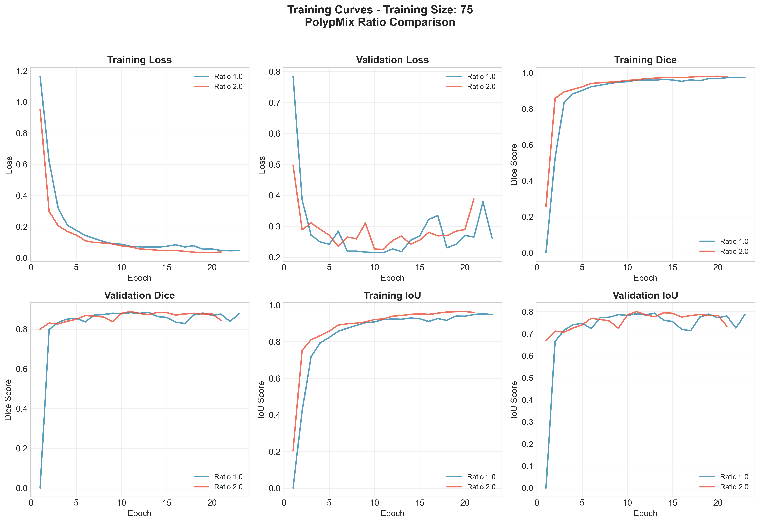
Training Curves - 75 Images
Notes:
Detailed training curves for training size 75

Slide 15
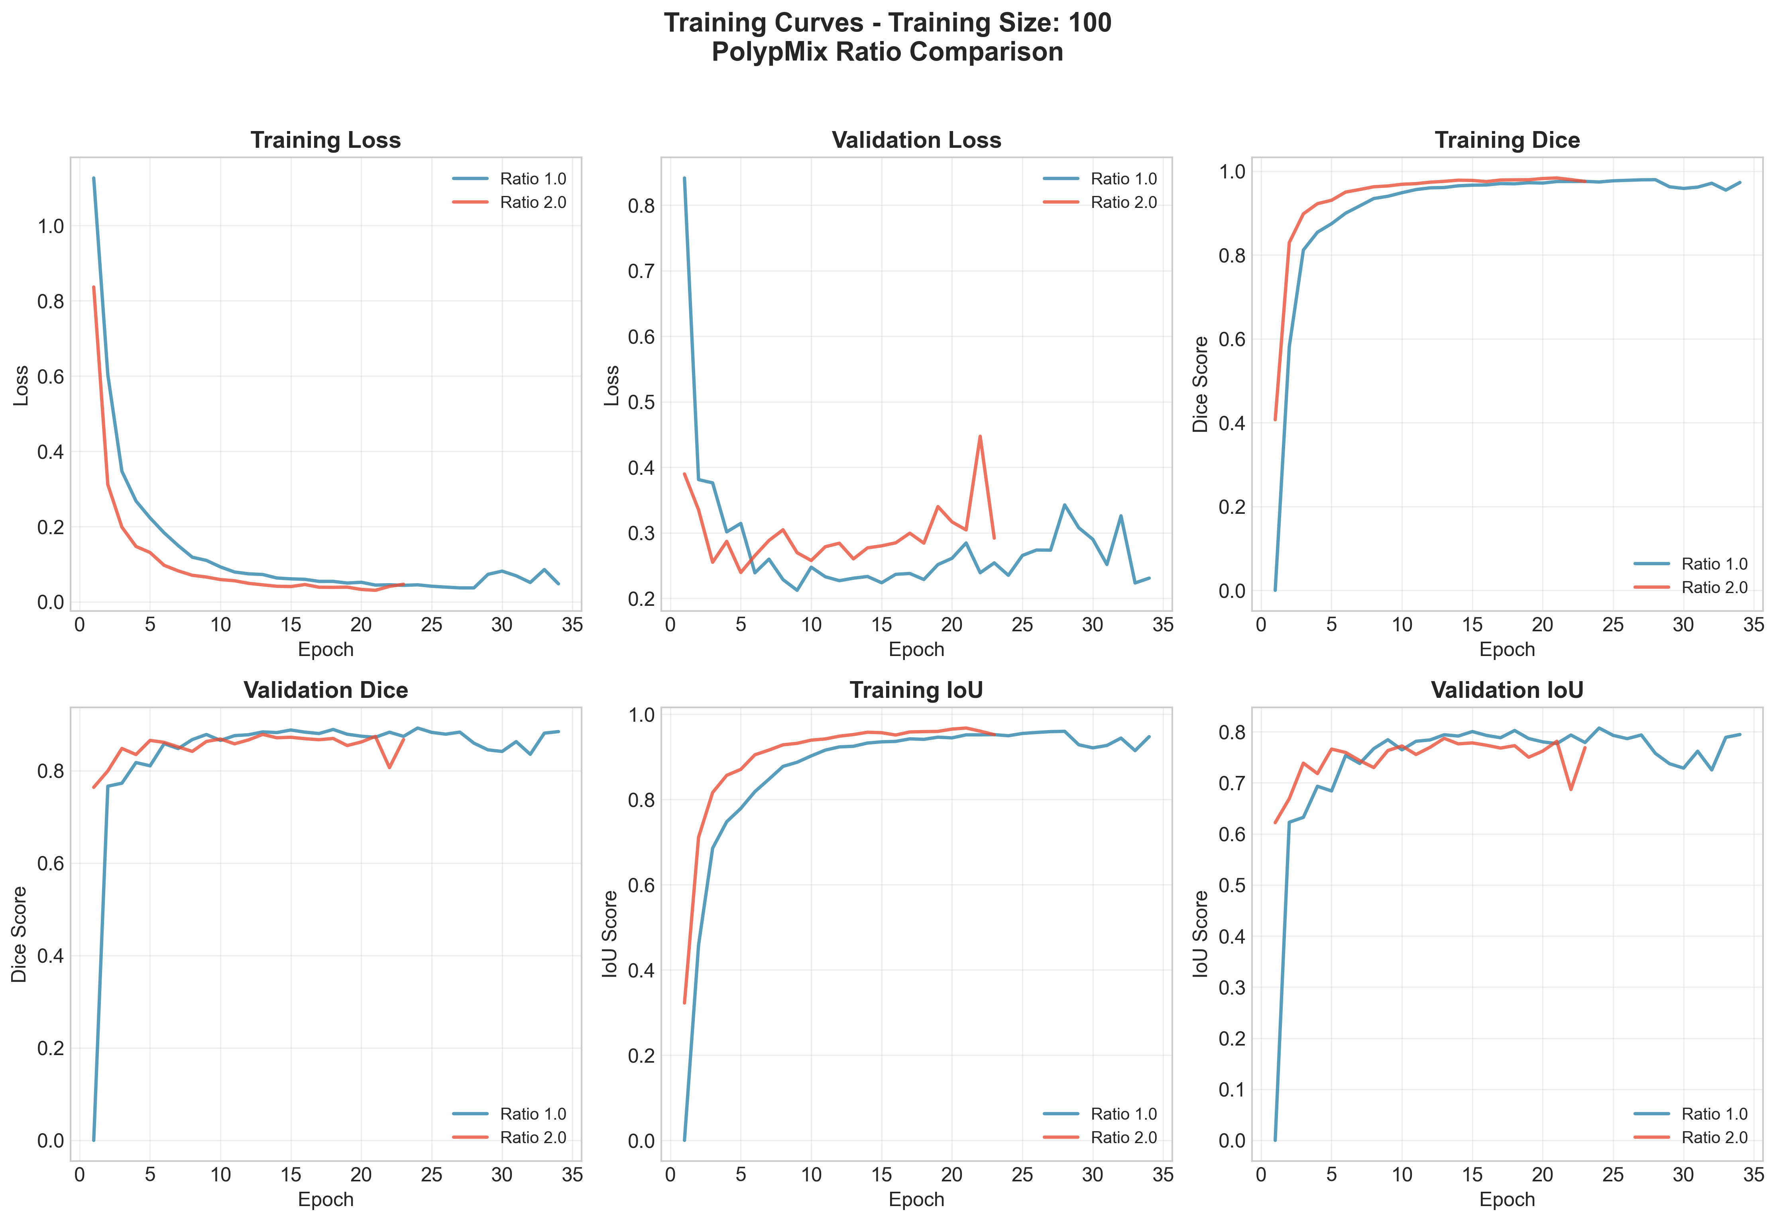
Training Curves - 100 Images
Notes:
Detailed training curves for training size 100

Slide 16
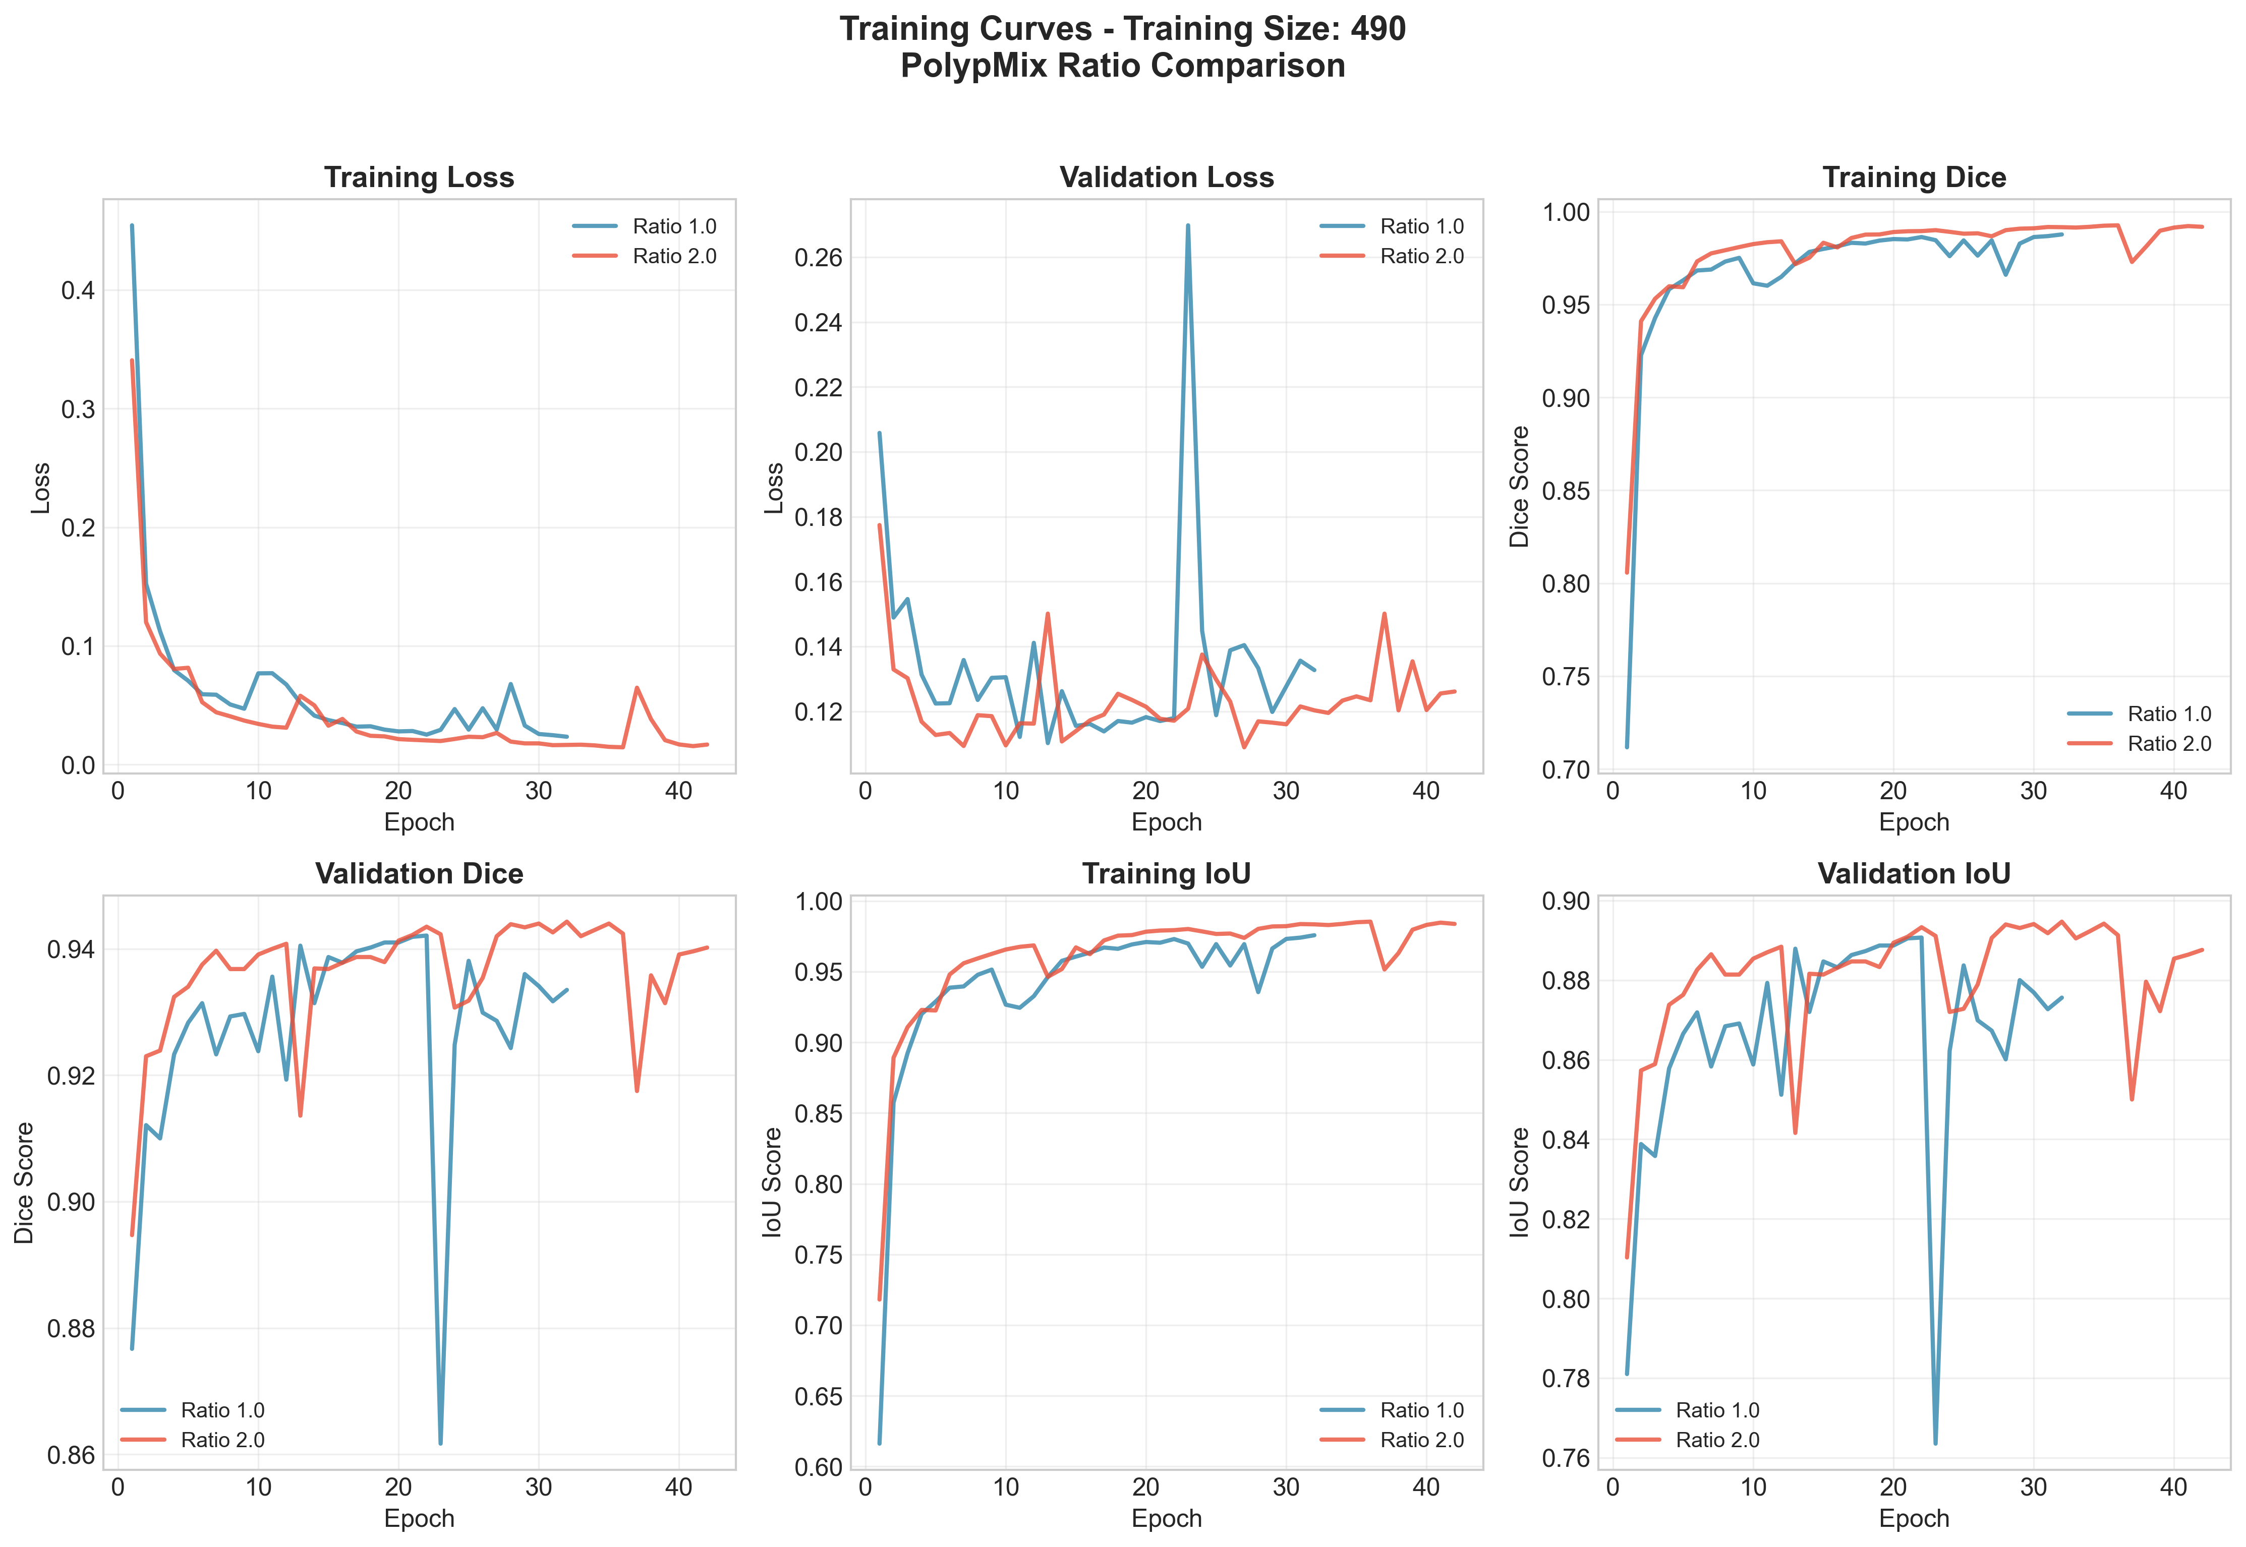
Training Curves - 490 Images
Notes:
Detailed training curves for training size 490

Slide 17
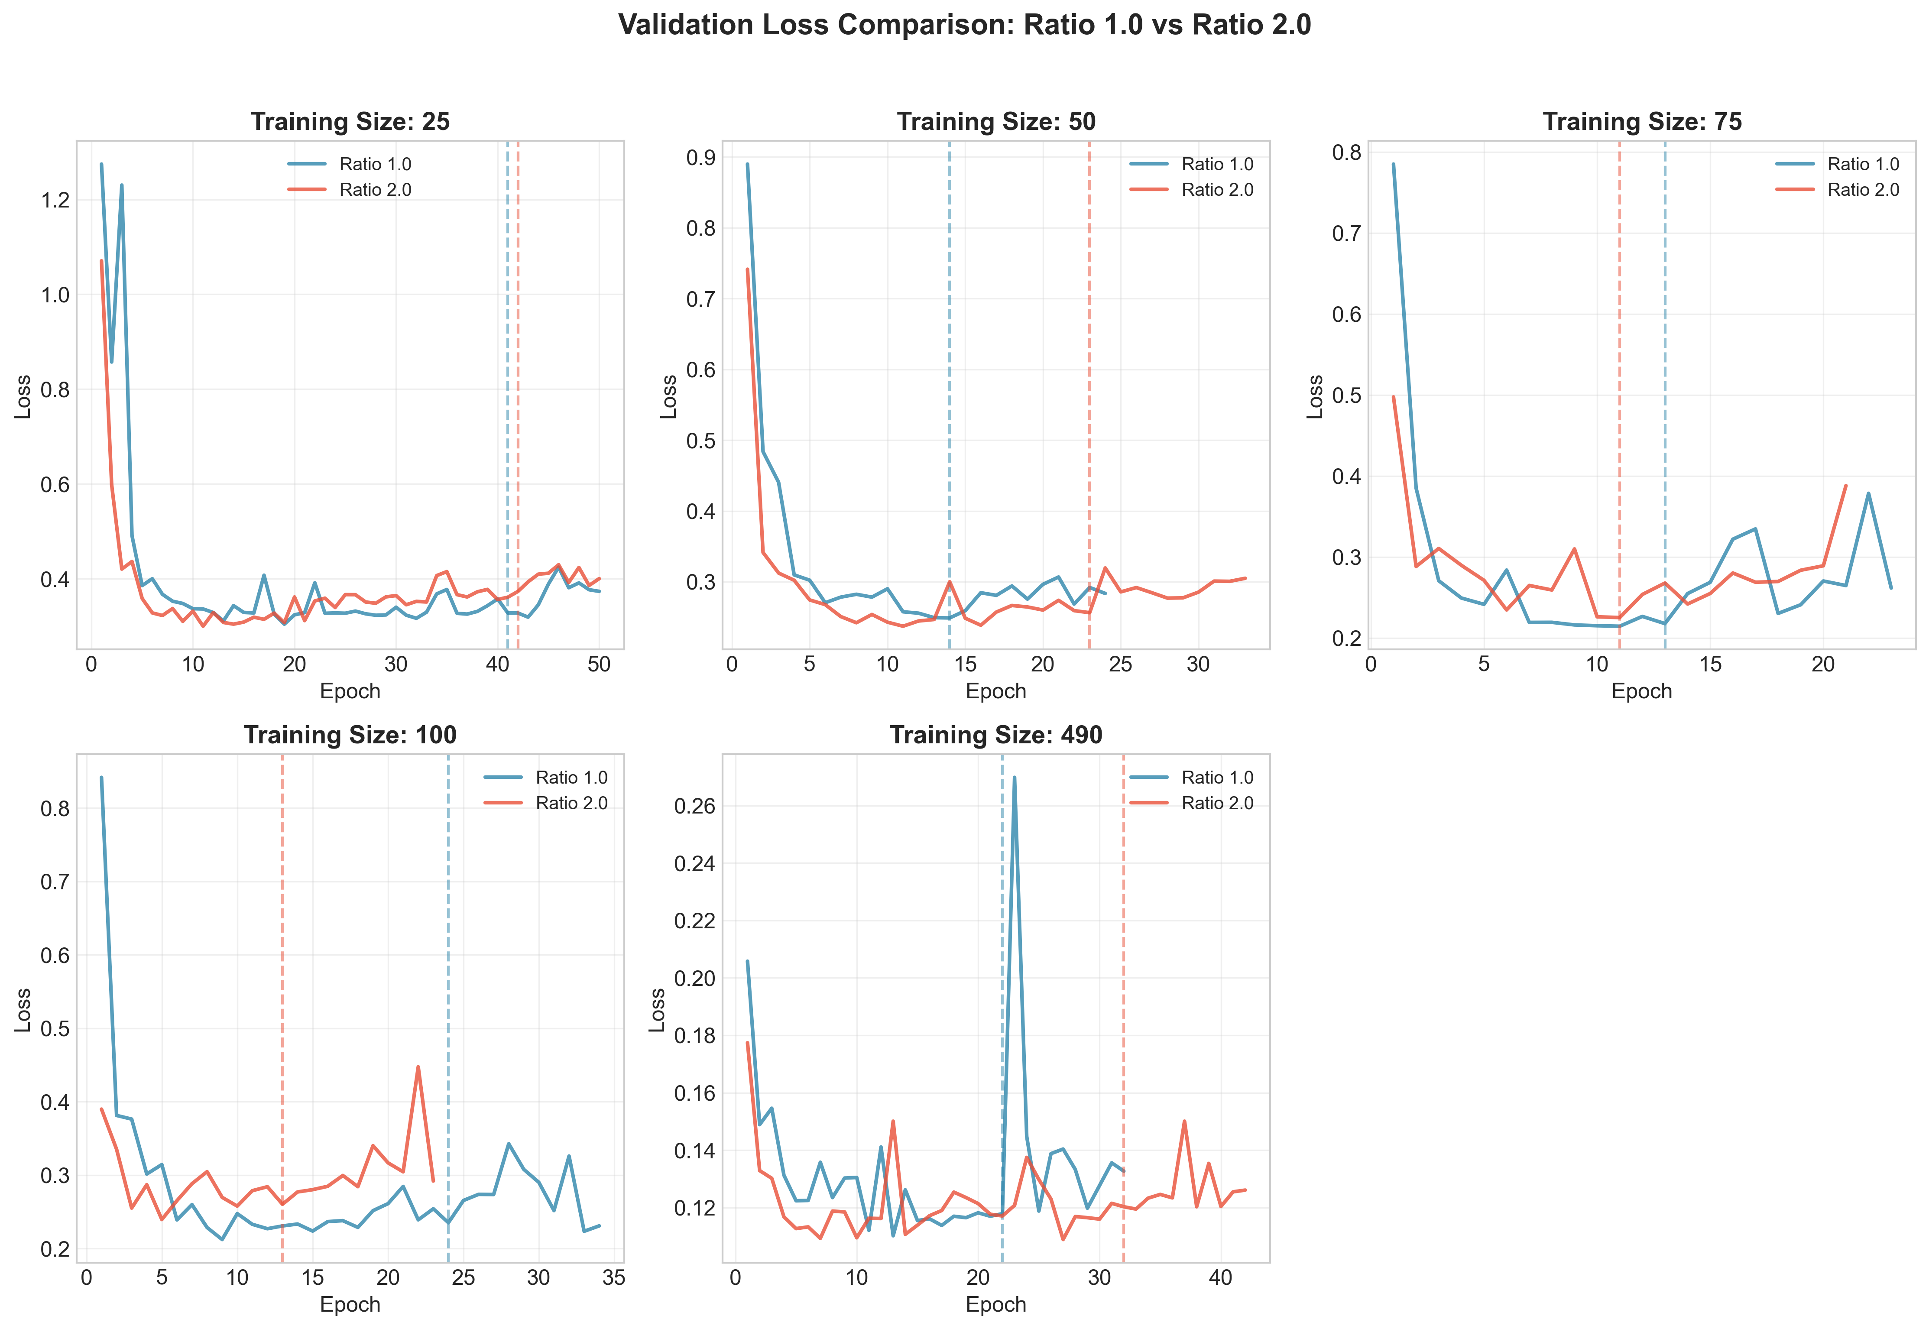
Validation Loss Comparison
Notes:
Validation loss curves across training sizes

Slide 18
Summary & Conclusions

Slide 19
Key Findings & Recommendations
Overall Performance:
• Ratio 2.0 wins in 3/5 training sizes (50, 75, 490)
• Ratio 1.0 wins in 2/5 training sizes (25, 100)
Best Results Achieved:
• Highest Dice Score: 0.9443 (Ratio 2.0, TS=490)
• Both ratios achieve >94% Dice with full dataset
Convergence Patterns:
• Smaller datasets (25, 50) require more epochs
• Larger datasets converge faster (within 15-25 epochs)
Recommendations:
• Use Ratio 2.0 for limited data scenarios (50-75 images)
• Both ratios work similarly well with large datasets

Slide 20
Conclusions
Conclusions:
1. Both augmentation ratios achieve strong performance
with best Dice scores exceeding 94%
2. Ratio 2.0 shows slight advantage for medium-sized
datasets (50-75 images)
3. Ratio 1.0 performs better with very small (25) and
moderate (100) training sets
4. Training size has the most significant impact on
final model performance
5. Early stopping effectively prevents overfitting
in all configurations

Slide 21
Thank You!

