Slide 1
Project Presentation of CO-OP Project at Industry (Module-2) (22CS421)
On
Smart Billing Management System
A Full-Stack Web Application for Inventory Management, Billing & Payments
Avantika (2210990197)
Shiven Narang (2210990835)
Preksha Mahajan(2210992083)
Tanishq Garg (2210990899)
Supervised By
Dr. Rajat Takkar
Department of Computer Science and Engineering,
Chitkara University, Punjab

Slide 2
Introduction
Problem: Small and medium businesses struggle with manual inventory tracking, handwritten invoices, and unorganized payment records, leading to errors, stock mismanagement, and revenue loss.
Objective: Build a web-based system that allows businesses to:
Manage inventory with categories, stock alerts, and image uploads
Generate professional invoices with tax and discount calculations
Accept online payments via Razorpay
View business analytics through a dashboard
Support role-based access for admins and regular users
AI based suggestions according to the purchased products
‹#›

Slide 3
Technologies Used
Frontend:
React.js (UI library)
Redux + Redux Persist (state management)
Tailwind CSS (styling)
Chart.js + react-chartjs-2 (analytics charts)
jsPDF (client-side PDF generation)
Axios (API calls)
Backend:
Node.js + Express.js (server framework)
MongoDB Atlas + Mongoose (database & ODM)
JWT + bcryptjs (authentication & password hashing)
Razorpay SDK (payment gateway)
Multer (file/image uploads)
Nodemailer (email notifications)
Google Generative AI: Gemini (AI product suggestions)
‹#›

Slide 4
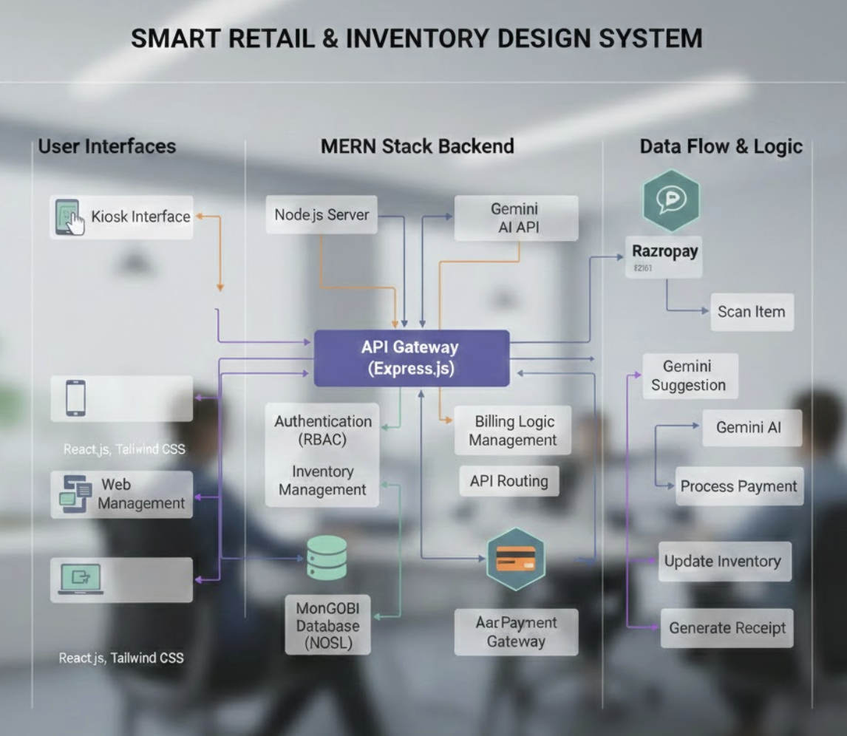
System Architecture
‹#›

Slide 5
Key Features
Authentication & Authorization:
Signup/Login with JWT, Google OAuth, OTP verification
Password reset via email token (1-hour expiry)
Role-based access: Admin (max 2) vs User
Inventory Management:
CRUD with image upload (Multer — JPEG/PNG, 5MB limit)
Category → Subcategory hierarchy with cascade delete
Search (MongoDB $regex), Low stock alerts (qty < 10), Restock
Billing & Invoice:
Cart system with auto-calculated totals (Mongoose pre-save hook)
Invoice with tax (7%) and discount (5%) calculation
PDF generation (jsPDF) and email delivery (Nodemailer + html-pdf)
‹#›

Slide 6
Key Features
Payment Integration:
Razorpay checkout → HMAC SHA256 signature verification
Payment history (admin: all users, user: own payments)
Business Analytics (Admin):
KPI cards: new items, purchase value, sales value, total stock
Monthly sales & purchase line charts (MongoDB aggregation pipeline)
AI Suggestions:
Google Gemini API recommends complementary products post-payment
Dark Mode:
App-wide theme toggle using React Context API
‹#›

Slide 7
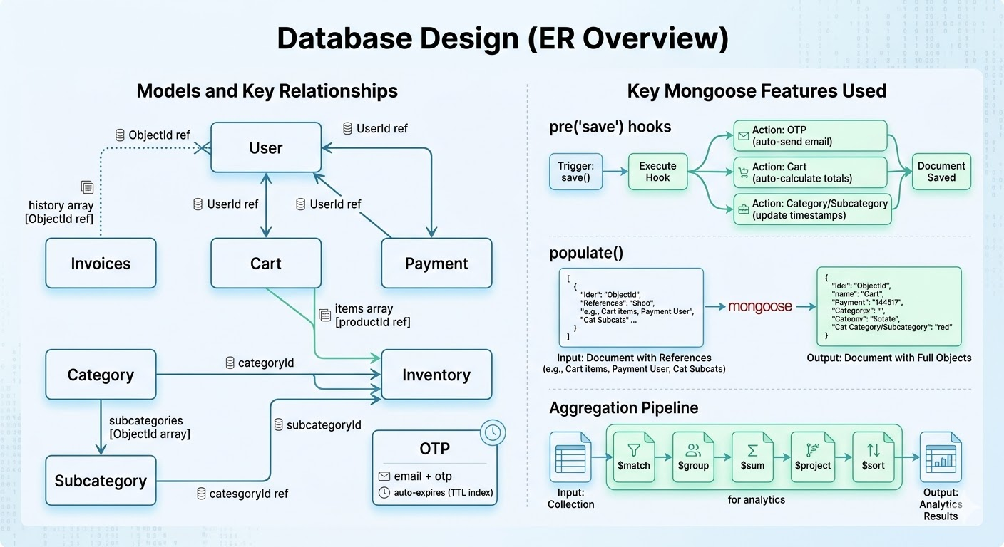
Database Design (ER Overview)
‹#›

Slide 8
Conclusion
The Smart Billing Management System successfully addresses the core pain points faced by small and medium businesses:
manual billing errors
disorganized inventory, and
fragmented payment tracking.
By leveraging the MERN stack, the system delivers a unified, role-based platform that automates invoice generation, integrates secure online payments via Razorpay, and provides real-time business analytics.
The addition of Google Gemini-powered AI suggestions adds a layer of intelligent upselling that goes beyond traditional billing software.
Overall, the project demonstrates how modern full-stack development combined with AI can meaningfully improve retail and inventory operations.
‹#›

Slide 9
Future Scope
1. Mobile Application: Developing a React Native or Flutter app to allow on-the-go inventory management and billing from smartphones, especially useful for field staff.
2. Barcode/QR Code Scanning: Integrating a barcode scanner for faster product lookup and checkout, reducing manual entry errors at the point of sale.
3. Multi-store/Multi-branch Support: Extendinf the system to manage multiple store locations under a single admin account with centralized analytics.
4. GST-Compliant Invoicing: Adding GST number support, HSN codes, and GSTIN-based tax breakdowns to make invoices legally compliant for Indian businesses.
5. Demand Forecasting with ML: Using historical sales data to predict future stock requirements, helping businesses avoid both overstocking and stockouts.
‹#›

Slide 10
Thank You
‹#›

