Slide 1
5G Technology: The Future of Connectivity
An insight into next-gen mobile technology and its significance.

Slide 2
Introduction to 5G Technology

Slide 3

Introduction
WHAT WE GOING TO EXPLORE:-
-What 5G is ?
-How it Works….
-Its Key Features……
-The impact it will have on industries and our daily lives

Slide 4
WHAT 5G IS?
5G stands for the Fitfth generation of mobile networks.
Successor to 4G LTE technology.
Offers ultra fast speed,low latency,and fifth conectivity.
Design for IOT ,smart Devices and advanced applications.

Slide 5
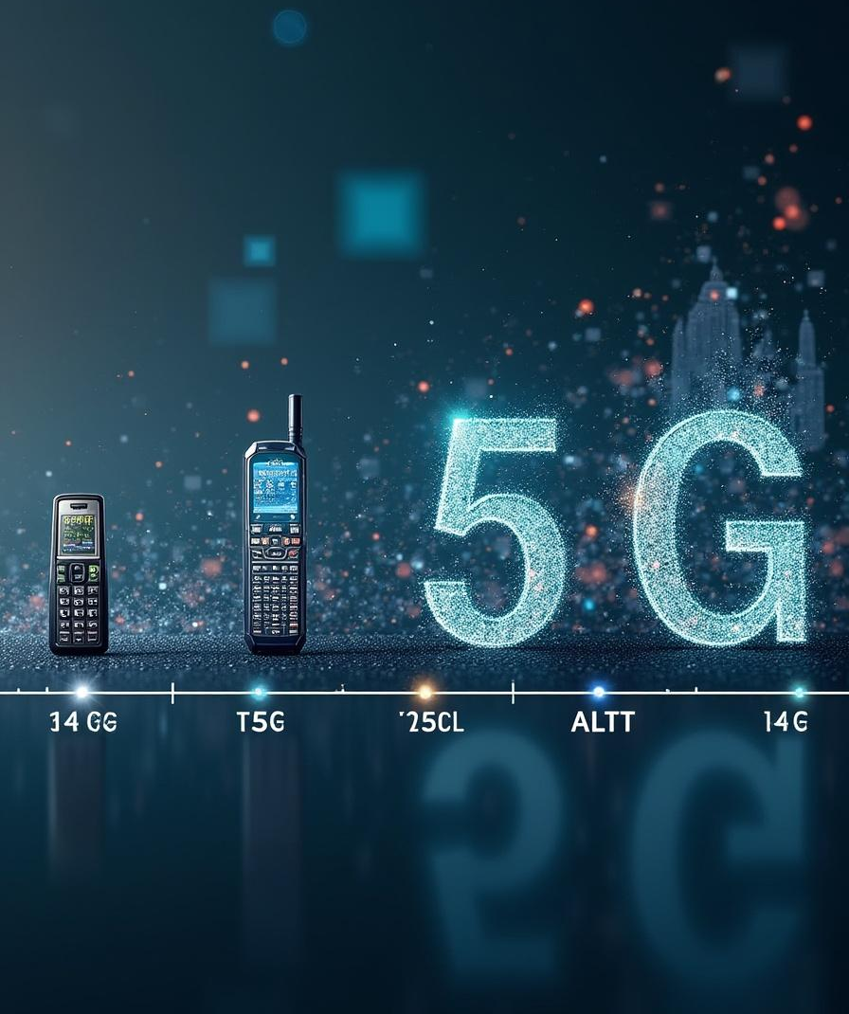
Evolution of Mobile Networks
-1G(1980s):Analog Voice calls only
-2G(1990s):Digital Voice and SMS
-3G(2000s):Mobile network and Vedio calling
-4G LTE(2010s):High Speed internet and HD streaming
-5G (2020s):Ultra-fast speed,Smart Application,low latency.

Slide 6
HOW IT WORKS
-Uses high-frequency millimeter waves for faster data transfer.
-Employs small cell technology for better coverage
-UtiliZes Massive MIMO for multiple connections at once
-Supports network Slicing for customized virtual networks.
-integrates with edge computing for low latency processing

Slide 7
Key Featuers and benefits

Slide 8
Speed and Performance
5G offers remarkable data speeds, reaching up to 10 Gbps. This swift performance allows for seamless streaming, enhanced gaming experiences, and efficient data transfer, enabling users to access information and services more quickly than ever before, thereby enhancing user satisfaction and productivity.

Slide 9

Low Latency
One of the standout features of 5G is its low latency, potentially as low as 1 millisecond. This near-instantaneous response time is crucial for applications like autonomous vehicles and remote surgeries, where every millisecond counts, enabling real-time communication and interaction that were previously not possible.

Slide 10
Massive Connectivity
5G networks can support up to 1 million devices per square kilometer. This capacity ensures that smart devices, IoT applications, and connected vehicles can all function without interference, paving the way for innovations in smart cities, industrial automation, and enhanced connectivity in urban environments.

Slide 11
HOW IT IMPACT OUR LIVES
1.Enhanced Mobile Experience- Seamless 4K/8K video streaming, cloud gaming, and remote learning.
2. Faster Internet Speeds – Up to 10 Gbps, making downloads, streaming, and browsing extremely fast.
3. Low Latency – 1 millisecond latency enables real-time gaming and smooth video calls.
4. Better Connectivity – Handles massive device connections (IoT devices like smart home gadgets, wearables).

Slide 12

Conclusions
5G is not just an upgrade – it is a revolution.
It promises ultra-speed, real-time communication,and massive connectivity.
From smart cities to remote surgeries,5G redefining the future.
The question is not if 5G will change our world ,but how Fast.

Slide 13
Thank you!
Do you have any questions?
Presented by Tanishq
+00 000 000 000

