Slide 1
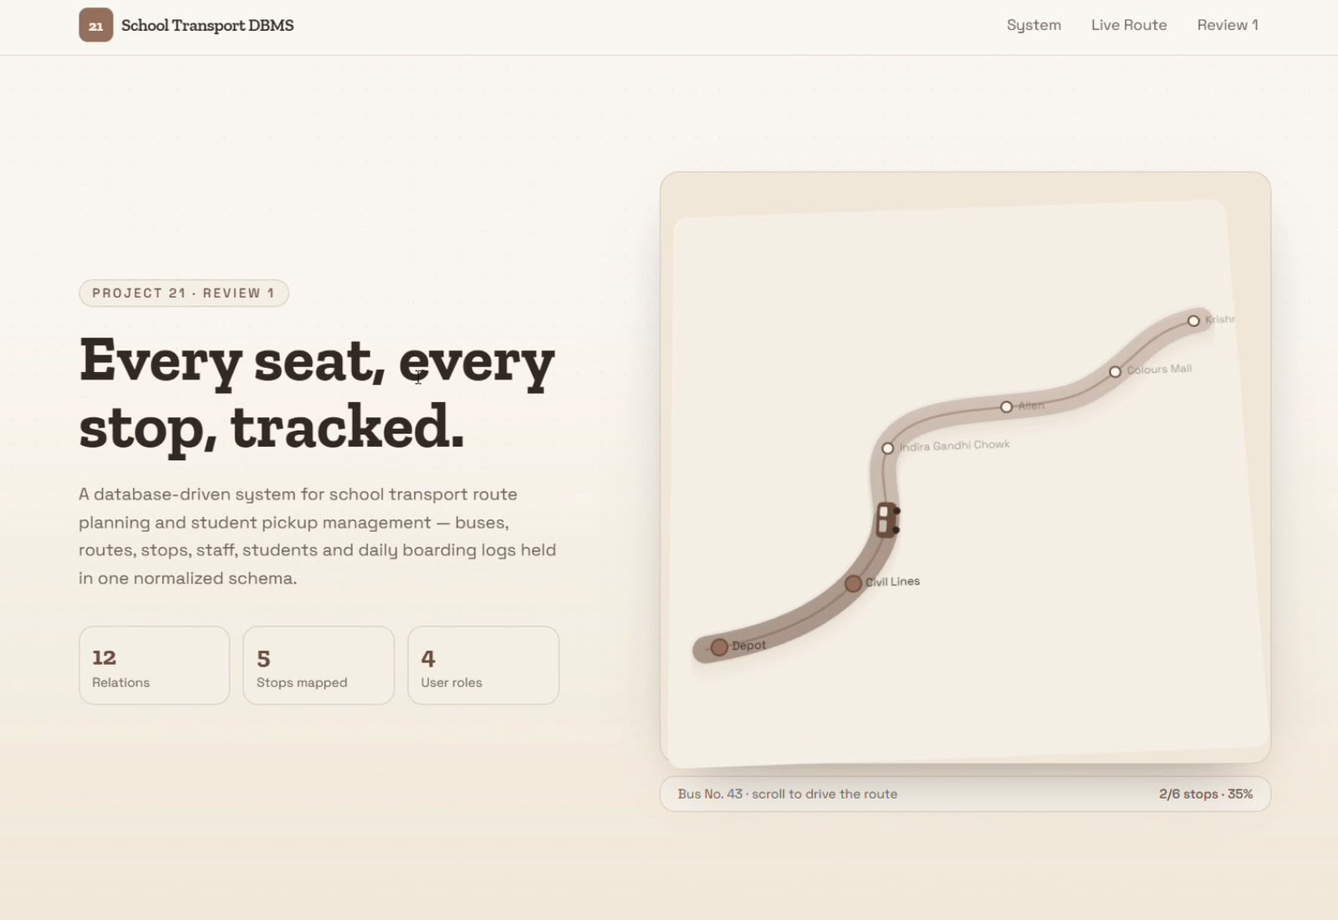
SCHOOL TRANSPORT
Route & Student
Pickup Management
DBMS Project • Review 1
Website overview, database design and core features

Slide 2
Project Website Overview
The interface is designed around school transport routes and student pickup visibility.
Main idea
Help administrators and families understand bus routes, pickup points and transport operations through a clear visual interface.
Design direction
A calm, map-focused layout with route cards and structured information.

Slide 3
Problem Identification
Why the system is useful
School transport information can be spread across paper records, calls and messages.
Parents and staff need a clear way to identify routes, stops and pickup details.
Administrators need organized records for vehicles, drivers, students and transport activity.
A database-backed website can reduce duplication and make updates easier to manage.

Slide 4
Project Objectives
What the system aims to achieve
Represent buses, routes, stops, drivers, attendants and students in a structured database.
Show route and stop information in a map-oriented interface.
Support student pickup and drop-off tracking.
Keep transport-related records consistent using primary and foreign keys.
Provide a foundation for fee tracking, maintenance records and reporting.

Slide 5
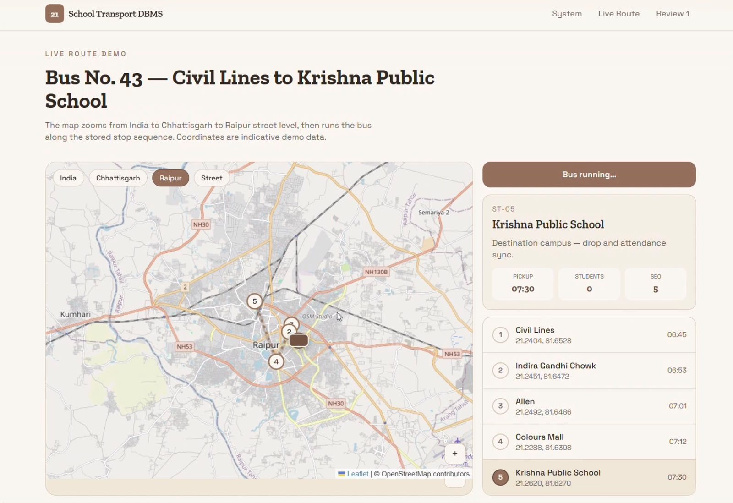
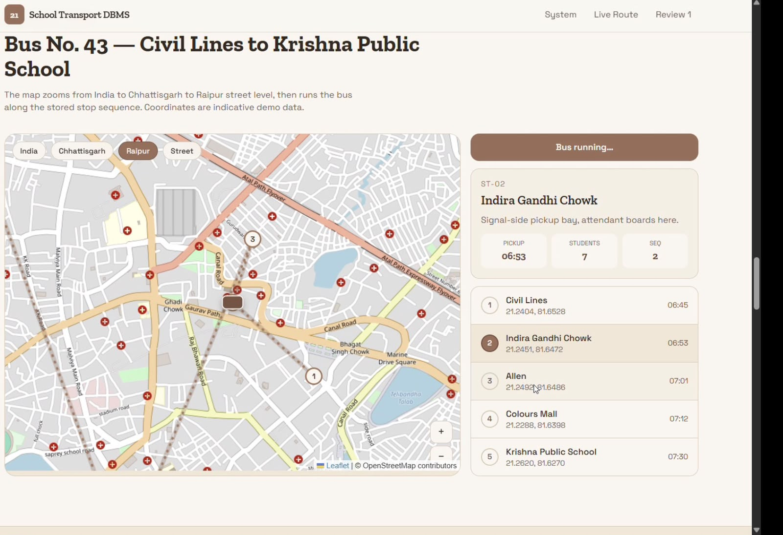
Route Map & Stop Details
Website screenshots showing route map views and route information.
Route view
Zoomed map / pickup context

Slide 6
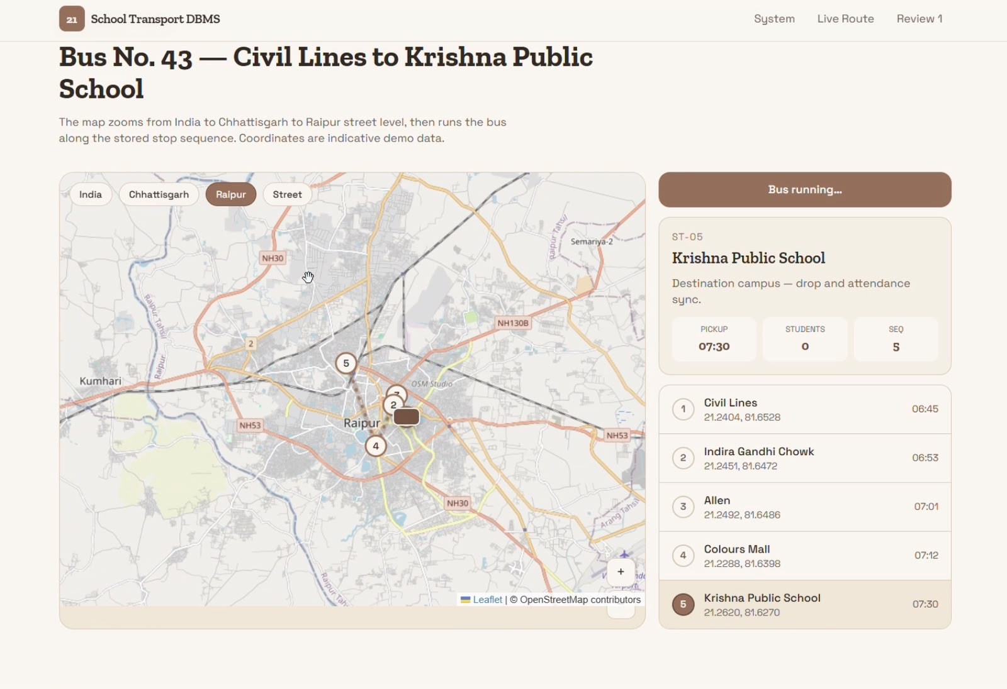
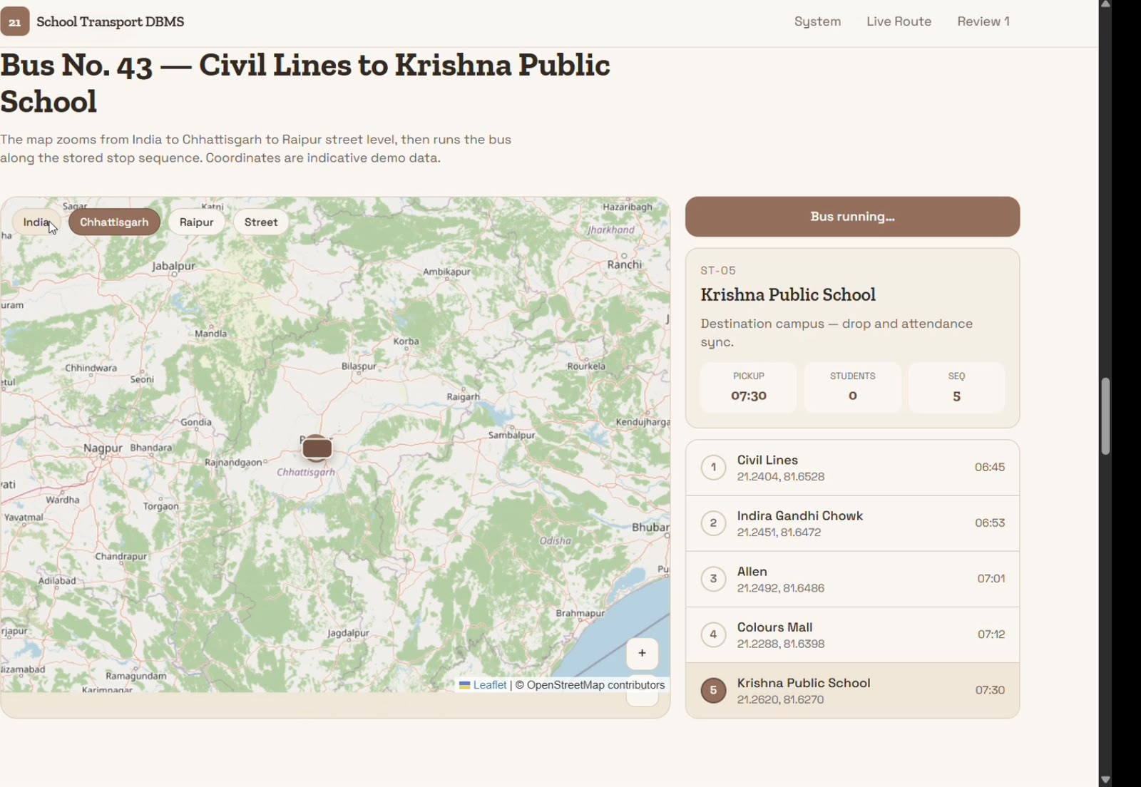
Route Coverage & Map Context
Multiple zoom levels help users understand local route detail and wider geography.
Local area
Wider geographic context

Slide 7
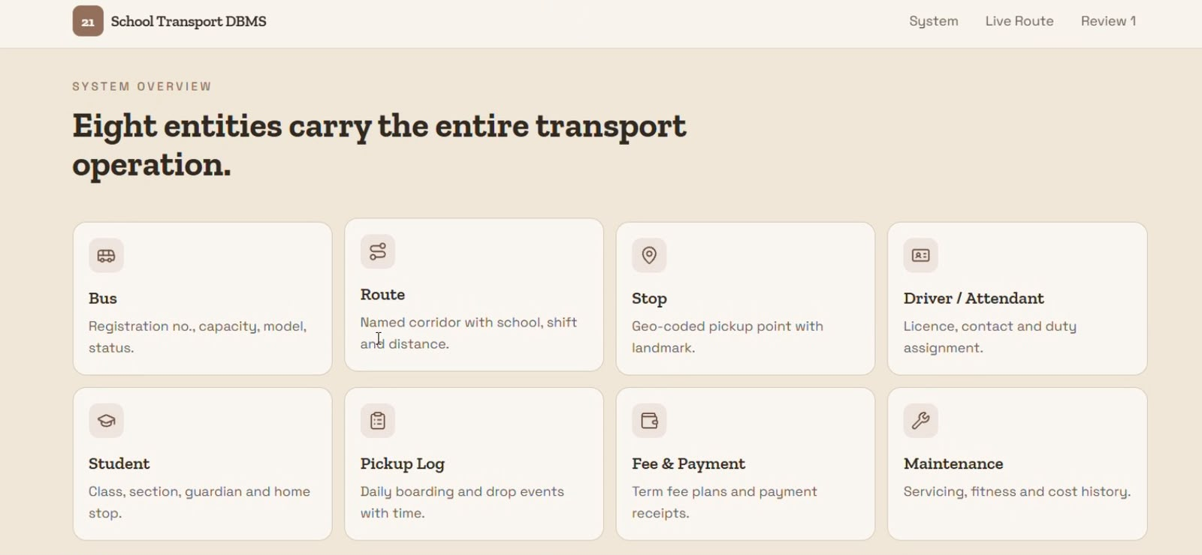
Core Database Entities
The schema separates the key parts of the transport domain.

Slide 8
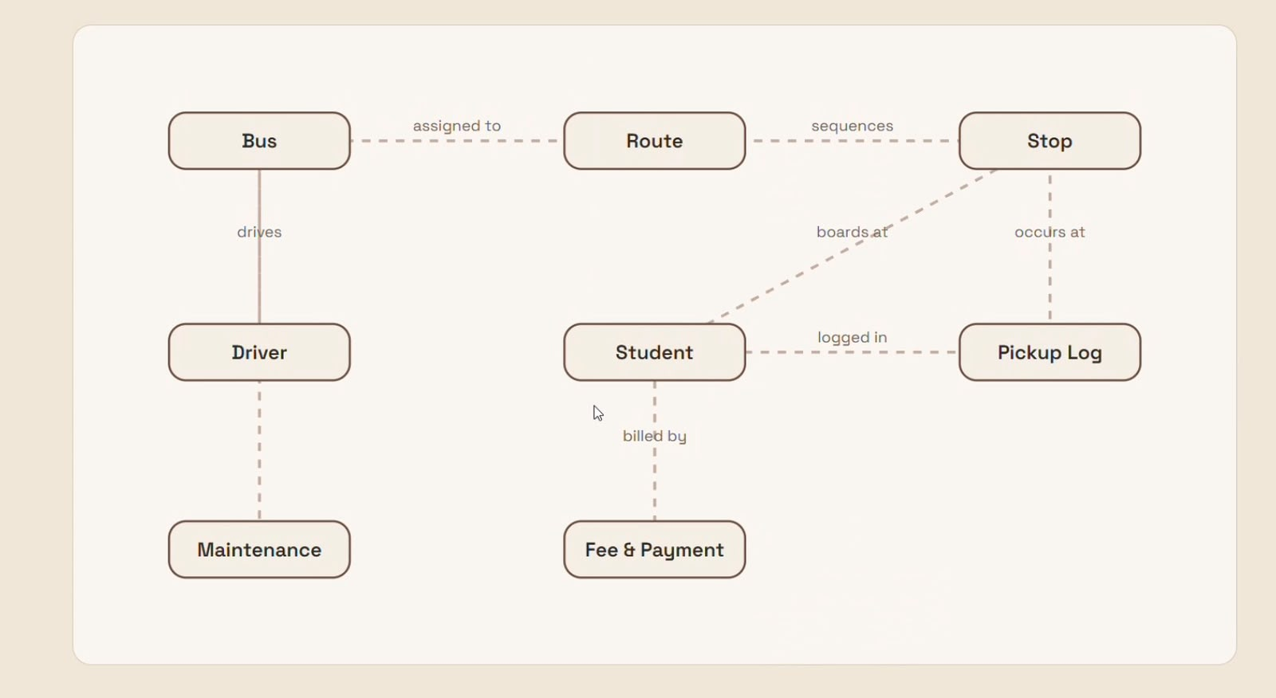
Entity Relationship Diagram
The ERD illustrates how operational records connect.

Slide 9
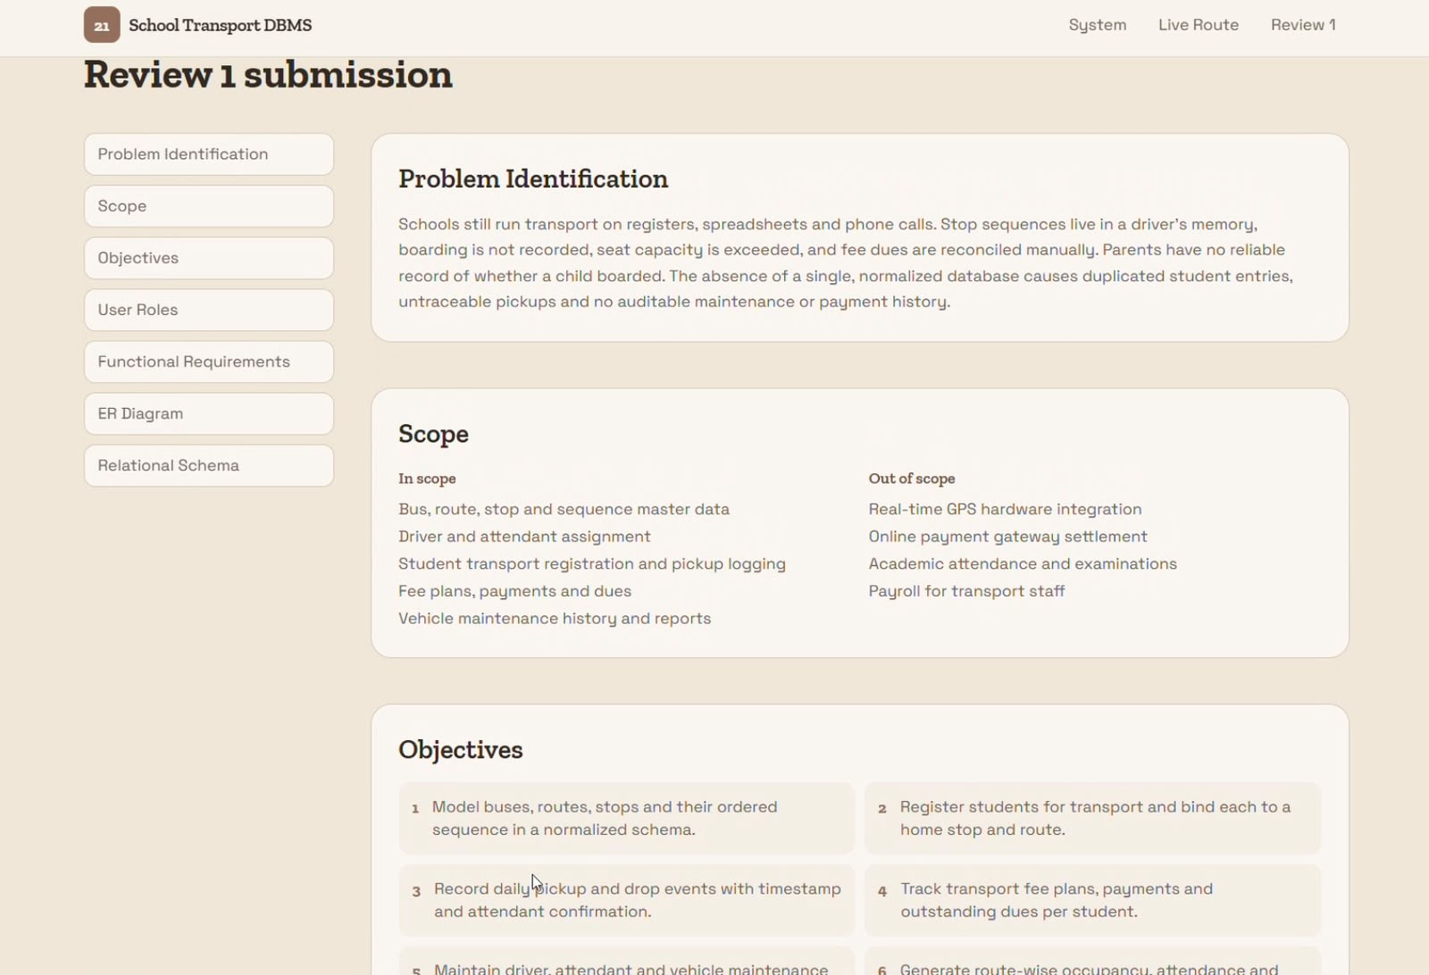
Review 1 Documentation — Page 1
Content adapted from the supplied project review screenshots.

Slide 10
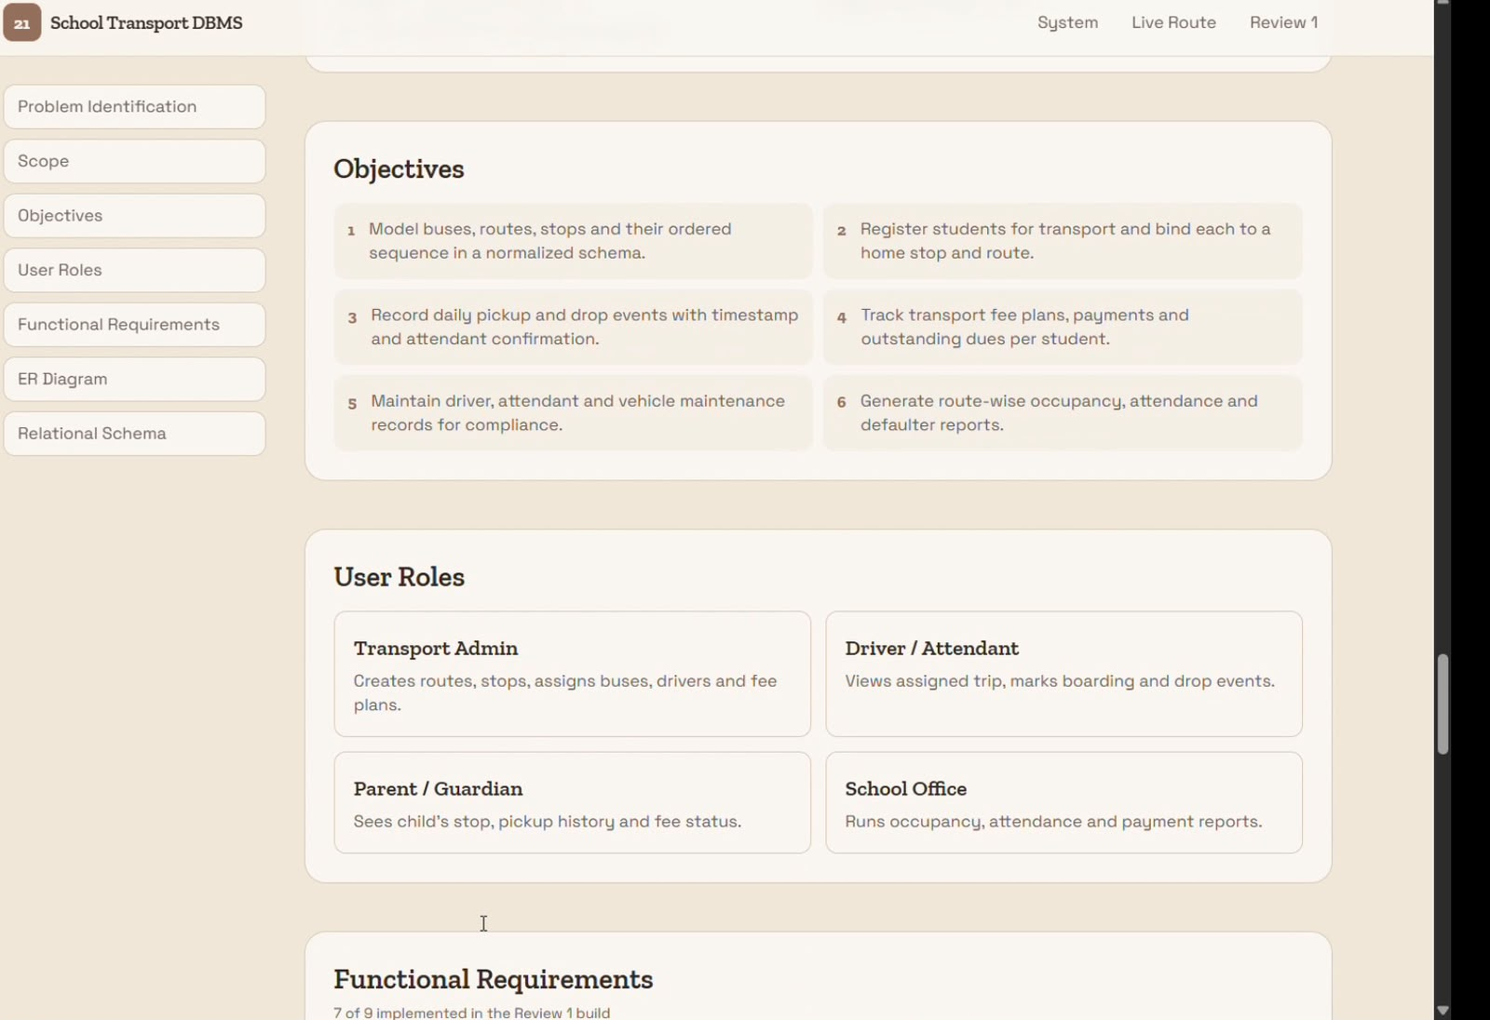
Review 1 Documentation — Page 2
Content adapted from the supplied project review screenshots.

Slide 11
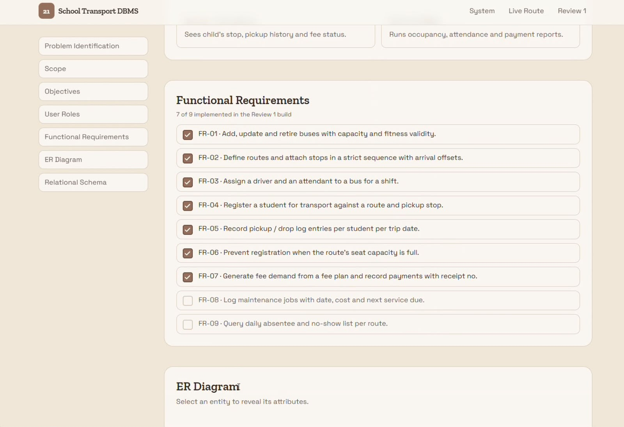
Review 1 Documentation — Page 3
Content adapted from the supplied project review screenshots.

Slide 12
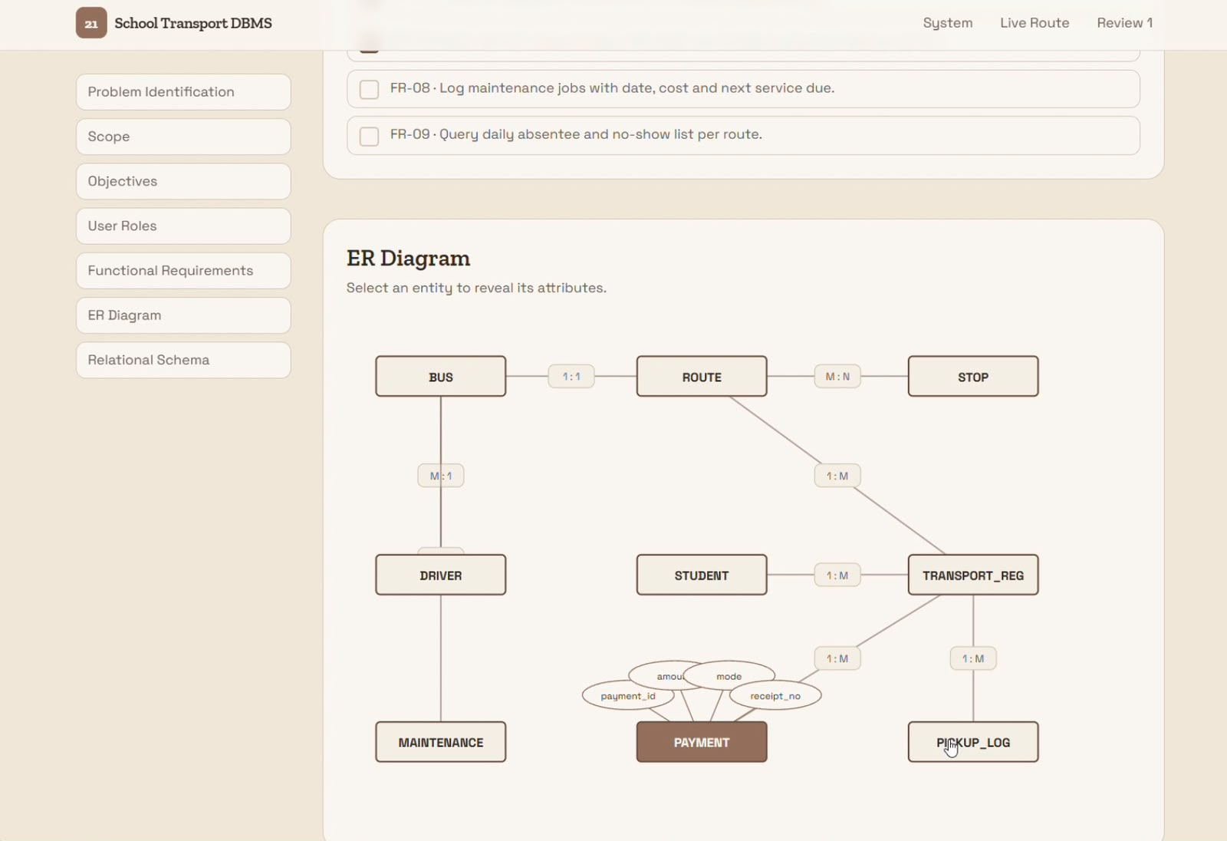
Review 1 Documentation — Page 4
Content adapted from the supplied project review screenshots.

Slide 13
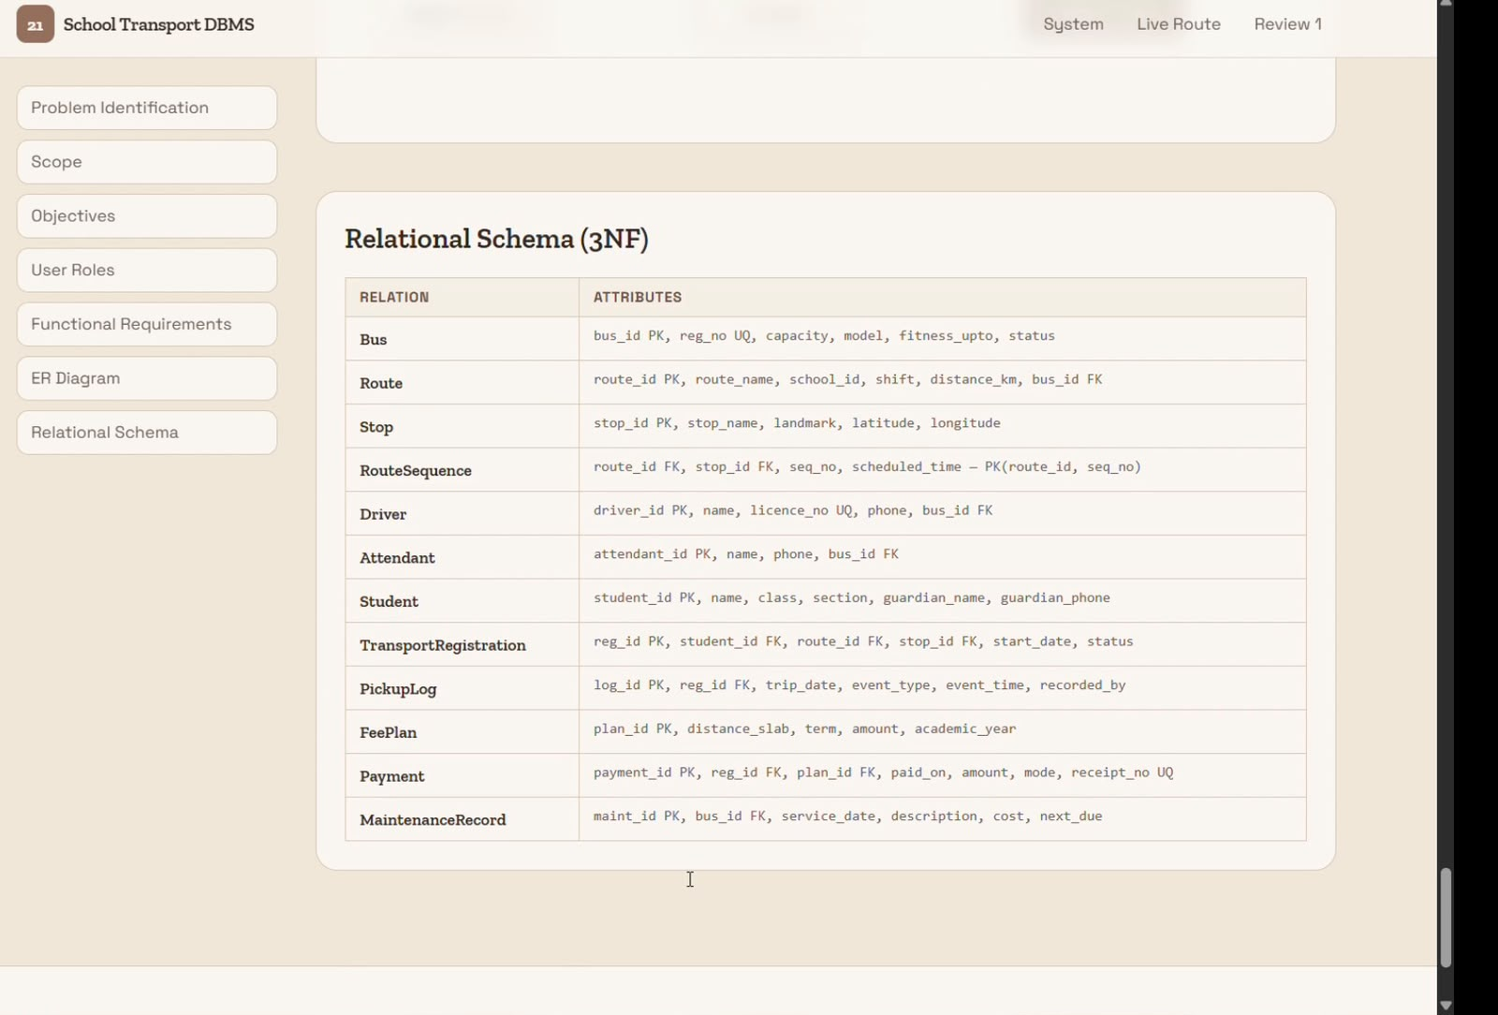
Review 1 Documentation — Page 5
Content adapted from the supplied project review screenshots.

Slide 14
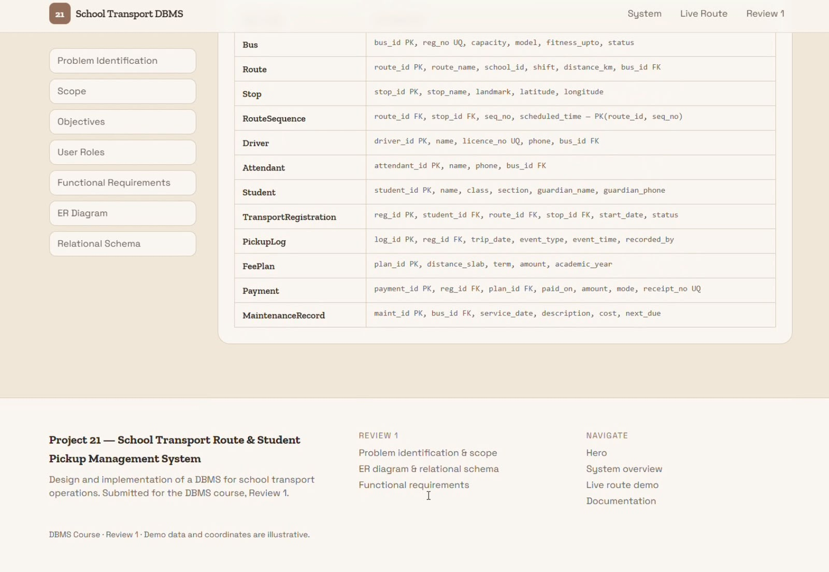
Review 1 Documentation — Page 6
Content adapted from the supplied project review screenshots.

Slide 15
Database Design Summary
Suggested functional tables for the school transport website
Bus and Maintenance — vehicle details and service history.
Driver and Attendant — staff records connected to transport assignments.
Route, Stop and Route_Stop — routes and the ordered stops they include.
Transport_Assignment and Student — the scheduled transport and student stop assignments.
Pickup_Log and Fee_Payment — student trip activity and transport payment records.

Slide 16
Data Integrity & Relationships
How the schema protects consistency
Primary keys uniquely identify each record.
Foreign keys connect students, routes, buses, staff and pickup logs.
Unique constraints prevent duplicate registration, admission and licence numbers.
Validation checks can prevent invalid capacities, costs and payment amounts.
Create parent tables before dependent tables when running the SQL script.

Slide 17
Typical System Workflow
From setup to daily use
Administrator enters bus, driver, route and stop details.
Stops are ordered along each route and schedules are attached.
A transport assignment connects the route, bus and staff for a period.
Students are assigned pickup and drop-off stops.
Pickup and drop-off outcomes are recorded for each trip.
Reports can summarize fees, route activity and vehicle maintenance.

Slide 18
THANK YOU
School Transport Route & Student Pickup DBMS
Review 1 • Project 21
Note: Confirm the final schema against the live website and actual backend requirements before deployment.

