Slide 1
29
BENFORD'S LAW
Suppliers Analysed
FRAUD DETECTION
3
Financial Columns Tested
34
A Statistical Forensic Analytics System Built in PostgreSQL
Flagged Transactions
4
PostgreSQL
Power BI
Investigation Candidates
Dataset: Northwind Database | Aug 1994 – Jun 1996
Domain: Retail / Food & Beverage Distribution
0
Python / ML Libraries Used

Slide 2
WHAT IS BENFORD'S LAW?
The mathematical foundation of the detection engine
The Core Principle
Expected First Digit Frequencies
In any large, naturally occurring financial dataset — invoices, revenues, transaction amounts — the leading (first) digit does NOT appear randomly. It follows a precise logarithmic pattern where smaller digits appear far more often than larger ones.
Formula: Expected % = log₁₀(1 + 1/d)
When humans fabricate numbers, they instinctively avoid this natural pattern — creating a statistically detectable deviation. That deviation is the fraud signal.
1
30.1%
Most common — ~1 in 3 numbers
2
17.6%
~1 in 6
3
12.5%
~1 in 8
4
9.7%
~1 in 10
5
7.9%
~1 in 13
6
6.7%
~1 in 15
7
5.8%
~1 in 17
8
5.1%
~1 in 20
9
4.6%
Least common
Real-World Applications
Enron Accounting Scandal (2001)
Greek GDP Manipulation (EU Entry)
Employee Expense Fraud Detection
Invoice Splitting Detection

Slide 3
DATASET OVERVIEW
Northwind Database — PostgreSQL
TRANSACTIONS
PRODUCTS & CATEGORIES
830 total orders across the dataset
order_details — line-item sales data
OrderID, Quantity, UnitPrice, Discount, TotalSales
77 unique products across 8 categories
29 suppliers from 17 countries
Categories: Beverages, Dairy, Confections, Seafood, Meat/Poultry, and more
CUSTOMERS
COLUMNS TESTED
91 unique customers across 21 countries
No demographic data (age/gender) available
Customer distribution: USA, Germany, France dominate
TotalSales — final revenue per line item
UnitPrice — price per unit before discount
Freight — shipping cost (orders table)
⚠ Data Caveat: Dataset covers 23 months (Aug 1994–Jun 1996). Benford's Law applied only to financial columns (TotalSales, UnitPrice, Freight) — not to IDs, quantities, or percentages.

Slide 4
METHODOLOGY
6-step analytical pipeline — pure PostgreSQL, Power BI
01
Benford Expected
Frequency Engine
02
First Digit
Extraction
03
Chi-Square
Significance Test
Recursive CTEs generate all 9 expected digit frequencies using log₁₀(1+1/d). Stored as a reusable PostgreSQL VIEW.
Leading digit extracted from TotalSales, UnitPrice, Freight using LEFT/CAST/ABS/FLOOR with full edge-case handling.
χ² implemented in pure SQL. Tests whether Benford deviations are statistically real (p<0.05) or just random noise.
04
Z-Score Anomaly
Detection
05
Duplicate &
Pattern Detection
06
Weighted Risk
Scoring Engine
Individual transaction values flagged using STDDEV window functions. Identifies extreme outliers at ±3 standard deviations.
Near-duplicate detection, threshold avoidance analysis, and round number clustering across all suppliers.
All signals combined into one 0-100 risk score per supplier. Chi=40%, Z-Score=35%, Benford=25%, Round modifier flat.

Slide 5
CHI-SQUARE SIGNIFICANCE FINDINGS
df=8 | Critical values: 13.36 (90%) · 15.51 (95%) · 20.09 (99%)
Column-Level Chi-Square Results
UnitPrice
χ²=217.69
VERY HIGH RISK (p < 0.01)
TotalSales
χ²=21.12
VERY HIGH RISK (p < 0.01)
Freight
χ²=10.79
CONFORMS
💡 Key Insight: UnitPrice (χ²=217.69) is 10× above the 99% confidence threshold — suggesting manipulation occurs at the pricing level before the final invoice is calculated, not at the TotalSales level.
Supplier-Level Chi-Square — Top Flagged
Supplier
Chi-Square
Risk Level
Transactions
Key Note
Nord-Ost-Fisch Handelsgesellschaft
21.34
VERY HIGH
32
Highest chi-square with only 32 transactions — strongest signal per transaction in dataset
New Orleans Cajun Delights
21.19
VERY HIGH
70
Two independent signals: chi-square + elevated round number rate (47.1%)
Bigfoot Breweries
16.09
HIGH
65
Crosses 95% confidence threshold — secondary investigation candidate
Mayumi's
15.90
HIGH
68
Just above 95% threshold — tertiary flag

Slide 6
Z-SCORE & DUPLICATE DETECTION FINDINGS
Transaction-level anomaly detection + pattern analysis
Order #10983 — Cross-Validated Finding
Aux joyeux ecclésiastiques — Luxury Product Caveat
Freight = $657.54 on goods worth only $720.90 = 91.2% freight-to-revenue ratio
Flagged independently by 3 separate methods: EDA ratio analysis, Z-score anomaly detection (Z=4.96), and cross-reference validation
Cross-method validation on a single transaction eliminates the possibility of a false positive
SAVEA customer — largest customer in dataset — freight cost almost equals product cost
17 of 34 total Z-score outliers (50%) concentrated in one supplier
All driven by large-volume orders of Côte de Blaye — priced at $263.50/unit
Analytical conclusion: legitimate premium purchases, NOT fraud — demonstrates Z-score limitation on right-skewed luxury price distributions
31.5% outlier rate noted as highest in dataset for context
Plutzer — Cross-Signal Alert (Most Analytically Interesting)
Duplicate Detection — All Clear + Key Findings
Passes chi-square (χ²=11.07 — CONFORMS) but produces 8 Z-score outliers (4.5% rate)
Normal digit pattern + abnormal individual transaction values = classic hidden fraud profile
All 8 outliers on Thüringer Rostbratwurst — highest at Z=9.61 ($9,903)
Proves why running both chi-square AND Z-score simultaneously is necessary
Zero near-duplicate transactions in 830 orders — no double-billing pattern detected
No threshold avoidance: $500 zone shows 76 below vs 84 above — natural distribution
Nord-Ost-Fisch: lowest round number rate (3.1%) in a dataset averaging 55-60% — consistent with biased algorithmic decimal generation
All 34 Z-score outliers are HIGH direction only — manipulation inflates values, not deflates

Slide 7
WEIGHTED RISK SCORING ENGINE
All signals combined into one normalised 0-100 score per supplier
Risk Score = (Benford Score × 25%) + (Chi-Square Score × 40%) + (Z-Score Score × 35%) + Round Modifier (flat ±5)
Chi-Square
Z-Score Outliers
Benford Deviation
Round Modifier
40%
35%
25%
Flat ±5
Max: 40 pts
Most rigorous signal — statistically grounded thresholds
Max: 35 pts
Catches individual extreme transactions chi-square misses
Max: 25 pts
Simpler version of chi-square — avoids double-counting
Max: 5 pts
Qualitative adjustment — not statistically reliable enough for primary signal
Final Supplier Risk Rankings — Top 4 Investigation Candidates
Rank
Supplier
Risk Score
Level
Benford
Chi
Z-Score
Key Note
#1
Nord-Ost-Fisch Handelsgesellschaft
MEDIUM
50
100
0
57.5
Highest chi-square (21.34) + lowest round no. % (3.1%) in dataset
#2
Aux joyeux ecclésiastiques
MEDIUM
10
25
100
Maximum Z-score outliers (17) — luxury product caveat documented
47.5
#3
New Orleans Cajun Delights
46.3
MEDIUM
25
100
0
VERY HIGH-RISK chi-square (21.19) + elevated round number rate
#4
Plutzer Lebensmittelgroßmärkte AG
MEDIUM
10
25
96
Cross-signal: passes chi-square but 8 Z-score outliers (4.5%)
46.1
No supplier crossed the HIGH-RISK threshold (>70) — consistent with Northwind being a clean demonstration dataset. The model's value lies in the relative ranking.

Slide 8
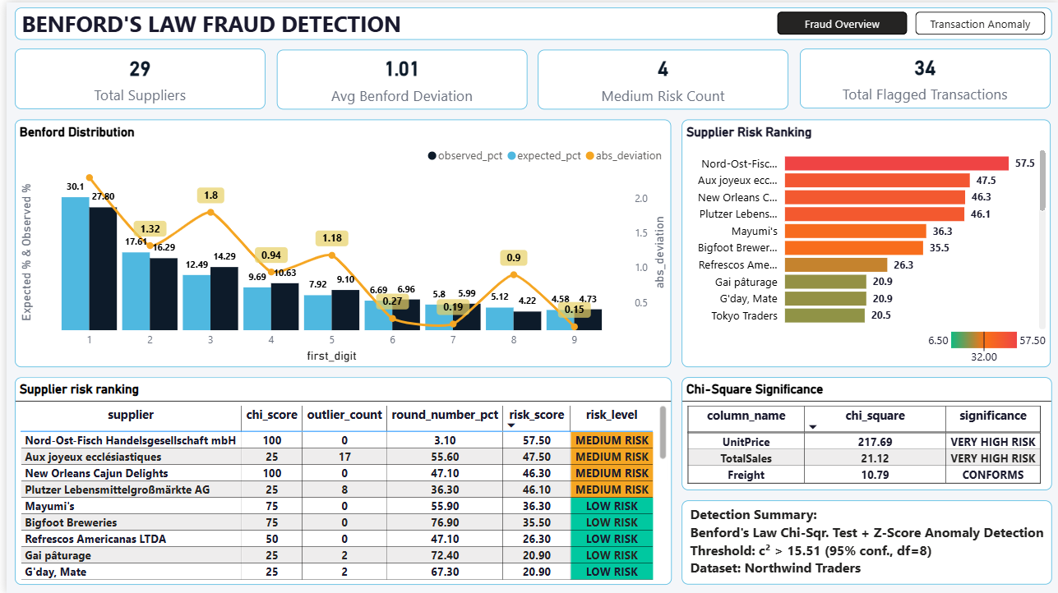
POWER BI DASHBOARD
2-page interactive fraud investigation tool
Page 1 — Fraud Overview
Benford Distribution Curve
Supplier Risk RAG Ranking
Chi-Square Significance Table
Z-Score Outlier Transactions
Freight-to-Revenue Chart (Order #10983)
Interactive Supplier Slicer

Slide 9
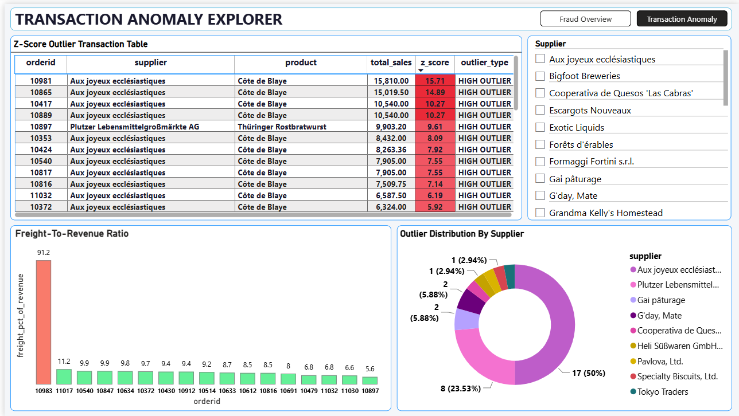
POWER BI DASHBOARD
2-page interactive fraud investigation tool
Page 2 — Transaction Anomaly Explorer
Benford Distribution Curve
Supplier Risk RAG Ranking
Chi-Square Significance Table
Z-Score Outlier Transactions
Freight-to-Revenue Chart (Order #10983)
Interactive Supplier Slicer

Slide 10
OVERALL INSIGHTS
What the data is telling us — quantified and actionable
PRICING ANOMALY
CROSS-VALIDATED TRANSACTION
📊 Finding: UnitPrice shows the strongest Benford signal (χ²=217.69) — 10× above the 99% confidence threshold
🚨 Finding: Order #10983: freight=$657.54 on goods worth $720.90 = 91.2% freight-to-revenue ratio
Meaning: Manipulation likely enters at the pricing decision level, not at the final invoice total. This is more specific and actionable than a TotalSales anomaly alone.
Meaning: The same order was independently flagged by three separate analytical methods — EDA ratio analysis, Z-score (Z=4.96), and cross-reference validation. Three independent flags on one transaction eliminates false positive risk.
→ Review pricing authority controls for Nord-Ost-Fisch and New Orleans Cajun Delights
→ Investigate Order #10983 and all SAVEA freight charges above 15% ratio threshold
MULTI-SIGNAL DETECTION VALIDATED
CLEAN DATASET CONFIRMATION
✅ Finding: Zero overlap between chi-square suspects and Z-score suspects across all 29 suppliers
🔍 Finding: Zero near-duplicate transactions. No threshold avoidance pattern. No supplier reaches HIGH RISK (>70)
Meaning: Chi-square and Z-score catch completely different fraud profiles — proving both tests are necessary. A single-signal model would miss half the flagged suppliers entirely.
Meaning: The negative results are findings too — they eliminate double-billing and structuring as fraud vectors in Northwind. The model's ranking (top 4 cluster at 46-58) is analytically meaningful even without a HIGH-RISK classification.
→ Maintain all three detection signals in any extension of this engine to real company data
→ In a real deployment, these negative results would narrow the investigation scope significantly

Slide 11
LIMITATIONS & RECOMMENDATIONS
Professional disclosure — what the model can and cannot do
Known Limitations
Strategic Recommendations
Benford's Law does not apply to constrained ranges (IDs, percentages, fixed price lists) — only naturally occurring financial figures
Chi-square unreliable on very small samples (<15 transactions). Nord-Ost-Fisch's flag is stronger precisely because it crosses 99% with only 32 transactions
Z-score assumes normal distribution. Financial data is right-skewed — luxury products (Côte de Blaye, $263.50/unit) legitimately produce high Z-scores on large orders
Northwind is a clean demonstration dataset — no supplier reached HIGH RISK (>70). In real company data with actual fraud, scores would be significantly higher
Round number baseline in Northwind (~55-60%) is elevated due to round UnitPrice structure — dataset-specific calibration required
Investigate Order #10983 immediately — freight cost 91.2% of goods value, cross-validated by 3 independent methods
Audit Nord-Ost-Fisch and New Orleans Cajun Delights — both exceed 99% chi-square confidence threshold independently
Review Plutzer's large Thüringer Rostbratwurst orders — 8 Z-score outliers despite clean chi-square
Set minimum order value for subsidised shipping to eliminate high freight-to-revenue ratio edge cases
Deploy this engine on real company financial data with known fraud cases to validate detection accuracy and calibrate thresholds to actual company approval policies
"Benford's Law is a screening tool, not a verdict. Its job is to narrow thousands of transactions to a shortlist of dozens worth manual investigation. Combined with Z-score and duplicate detection — implemented entirely in pure PostgreSQL without any Python or machine learning library — it makes systematic fraud extremely difficult to hide, because every countermeasure creates a new detectable pattern somewhere else."
Benford's Law Fraud Detection | PostgreSQL · `Power BI | Northwind Database | Aug 1994 – Jun 1996 | 29 Suppliers · 77 Products · 830 Orders

