Slide 1



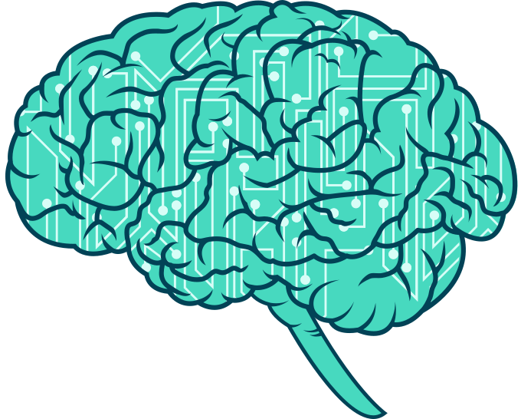
Brain Stroke Prediction using Machine Learning
A Comprehensive Analysis and Model Implementation
-- Tanishq Mahajan

Slide 2
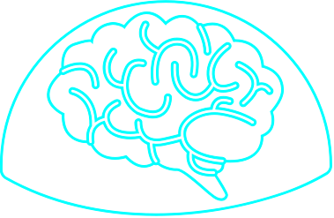
What is brain stroke?
Brain stroke occurs when the blood supply to the brain is interrupted or reduced, causing brain cells to die due to lack of oxygen and nutrients.
Impact:
Leading cause of disability and death worldwide
Affects over 20 million people annually
Can result in cognitive, emotional, and physical impairments
Origin/History:
First described by Hippocrates in 400 BCE
Understanding of stroke evolved over centuries, with major breakthroughs in 20th century
Now recognized as a medical emergency requiring prompt treatment
Types:
Ischemic (80-90%): Blood clot blocks blood flow
Hemorrhagic (10-20%): Blood vessel ruptures, causing bleeding

Slide 3
Problem Statement
Brain stroke is a leading cause of death and disability worldwide. Early detection and intervention can significantly improve patient outcomes, but predicting stroke risk remains a challenging task due to the complex interplay of various factors such as age, lifestyle, and pre-existing health conditions.
The Challenge:
Medical Complexity: Identifying individuals at high risk of stroke requires analyzing multiple variables, including medical history, lifestyle factors, and demographic information.
Data-Driven Prediction: Leveraging data to predict the likelihood of a stroke can help healthcare providers take preventive measures, but it necessitates accurate and reliable models that can handle diverse datasets.
Impact on Healthcare: An effective prediction model can aid in reducing the incidence of strokes by enabling timely interventions, thereby lowering the overall healthcare burden.
The Objective:
Develop a machine learning model that accurately predicts the likelihood of a brain stroke, helping healthcare providers in early diagnosis and prevention efforts.

Slide 4
Project Overview
Objective: Predict brain strokes using machine learning techniques.
Scope: Data preprocessing, exploratory data analysis (EDA), model training, and evaluation.
Tools Used: Python, Jupyter Notebook, scikit-learn, pandas, matplotlib.

Slide 5

Dataset Description
Source: Kaggle - Brain Stroke Dataset
Features: Age, Hypertension, Heart Disease, BMI, Smoking Status, etc.
Target Variable: Stroke occurrence (Yes/No)
Dataset Size: 11 Columns & 4982 Rows

Slide 6

Data Preprocessing
Handling Missing Values: Techniques used to handle missing data (e.g., mean/mode imputation).
Encoding Categorical Variables: Converting categorical variables into numerical format using techniques like Label Encoding and One-hot encoding.
Normalizing Numerical Features: Scaling numerical features to ensure uniformity.

Slide 7

Exploratory Data Analysis (EDA)
Distribution Analysis: Analysis of feature distributions (e.g., histograms, box plots).
Correlation Analysis: Identifying relationships between features using correlation matrices and heatmaps.
Key Insights: Summarize important findings from the EDA (e.g., age distribution, prevalence of conditions).

Slide 8


Model Training
Algorithms Used: Decision Tree, Random Forest, Gradient Boosting.
Training Process: Splitting data into training and testing sets, model initialization, and training.
Hyperparameter Tuning: Use of grid search for optimizing model parameters.

Slide 9
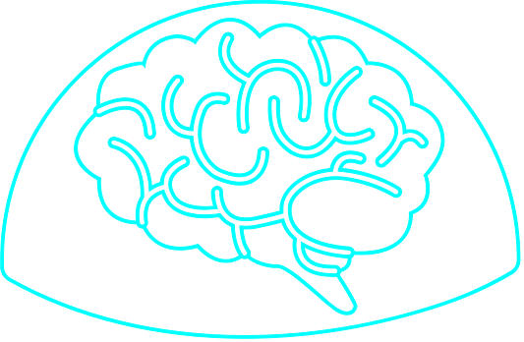
Model Evaluation
Evaluation Metrics: Accuracy, Confusion Matrix.
Decision Tree: Accuracy, confusion matrix results.
Random Forest: Accuracy, confusion matrix results.
Gradient Boosting: Accuracy, confusion matrix results.
Comparison: Comparison of models based on performance metrics.

Slide 10

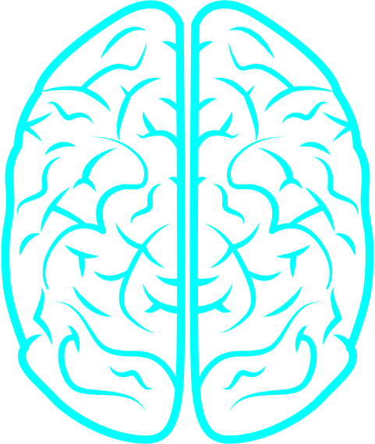
Hyperparameter Tuning
Grid Search Methodology: Implementation of grid search for finding optimal hyperparameters.
Results: Optimal hyperparameters and their impact on model performance.
Improvement: Improvement in accuracy and other metrics post tuning.

Slide 11
Results and Discussion
Summary of Findings:
Decision Tree:
Training Accuracy: 95.38%
Testing Accuracy: 94.91%
Random Forest:
Training Accuracy: 95.15%
Testing Accuracy: 94.51%
Gradient Boosting:
Training Accuracy: 94.97%
Testing Accuracy: 95.25%
Key Findings:
The Decision Tree model has a solid accuracy but higher false positive and false negative rates compared to the other models.
The Random Forest model shows improved accuracy and a better balance of true positives and false negatives.
The Gradient Boosting model achieves the highest accuracy and the best overall performance in terms of precision and recall, indicating its effectiveness in correctly identifying both stroke and non-stroke cases.

Slide 12
Conclusions
Effective Prediction Model:
Through the implementation of various machine learning models, including Decision Tree, Random Forest, and Gradient Boosting, we successfully developed a robust predictive model for brain stroke risk.
Gradient Boosting emerged as the most accurate model with an accuracy of 95%, effectively balancing precision and recall, making it the optimal choice for predicting strokes.
Addressing the Problem Statement:
The project addressed the challenge of predicting brain stroke by analyzing multiple health and demographic factors. The developed model offers a data-driven solution to identify high-risk individuals, allowing for timely preventive interventions.
Impact and Implications:
By accurately predicting stroke risk, the model has the potential to significantly reduce the incidence of strokes, improve patient outcomes, and lower the overall burden on healthcare systems.
Healthcare providers can utilize this model to enhance early diagnosis, initiate preventive measures, and allocate resources more effectively.

Slide 13

A PICTURE IS WORTH THOUSAND WORDS
Stay Safe. Stay Happy. Thank You

