Slide 1






Slide 2
Team Details
Team name:
CodeAlchemy
Track:
Healthcare
Problem Statement:
AI-Powered Medical Report Simplifier

Slide 3
Key Features
List core Functionalities & Benefits:
Image-Based Report Analysis
Privacy-First by Design
Multi-Biomarker Detection
Simplified Explanations
Historical Trend Tracking
Fully Offline Capable

Slide 4
Tech Stack
Tech Stack Overview with its Benefits:
1. Frontend : HTML5 , CSS3 , Vanilla JavaScript (ES6+)
2. AI / OCR Model : Tesseract.js
3. Charting : Chart.js
4. Styling : Pico.css for a clean and semantic layout

Slide 5
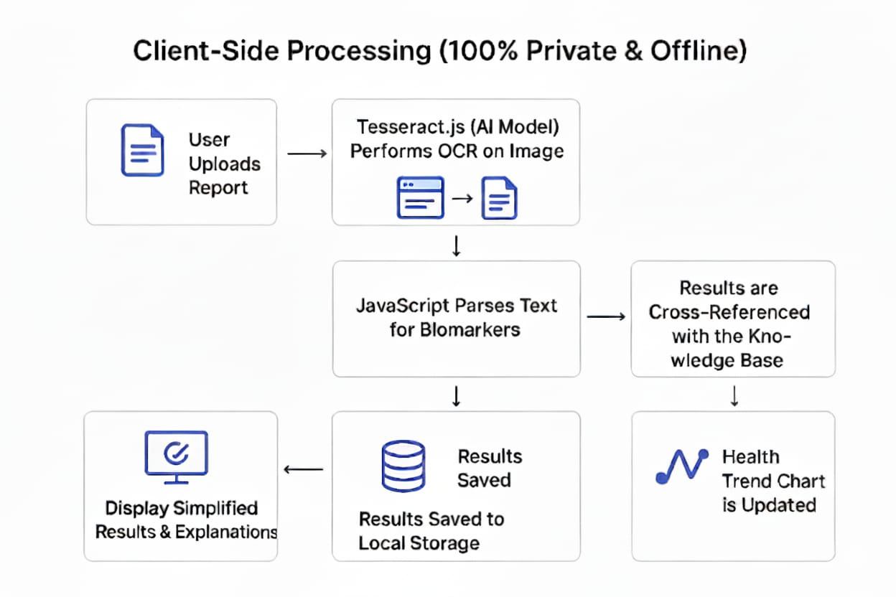
Flow Diagram

Slide 6
Scalabality
Infinite user scalability because of zero server load as it runs locally.
Effortless knowledge expansion into the (knowledge_base.json) file.
Expanding global reach by adding new languages.

Slide 7
Interface
Section to choose a file.
Results section for personalized report.
Health Trends with the graphical representation.
History of previous reports.

Slide 8
Conclusion
100% Private by Design - No data ever goes to a server.
Works completely offline – Works without internet access.
Keeps track of your health trends.
Scalable in many ways.

