Slide 1
KL UNIVERSITY | DDCA | BATCH 13
Design and Simulation of a
Digital Access Verification System
Using XOR / XNOR Logic
Team members
Tanish
2620080073
Vrithika
2620080089
Sujeet
2620090014
Prakash
2620080060
Meghana
2620080049
Section: ______

Slide 2
Introduction and Objective
INTRODUCTION
Digital access verification system: a circuit that checks whether an entered code matches a stored (authorized) code, and grants or denies access. The same logic is used in keypad locks, ID card readers and PIN checks.
Objective
Build a 4-bit code checker using XNOR and AND gates
Compare each entered bit with the stored bit
Show Access Granted or Denied on LEDs
Simulate and verify the design in Logisim
Input: user enters a 4-bit code
Compare: XNOR checks each bit
Decide: AND gives grant / deny

Slide 3
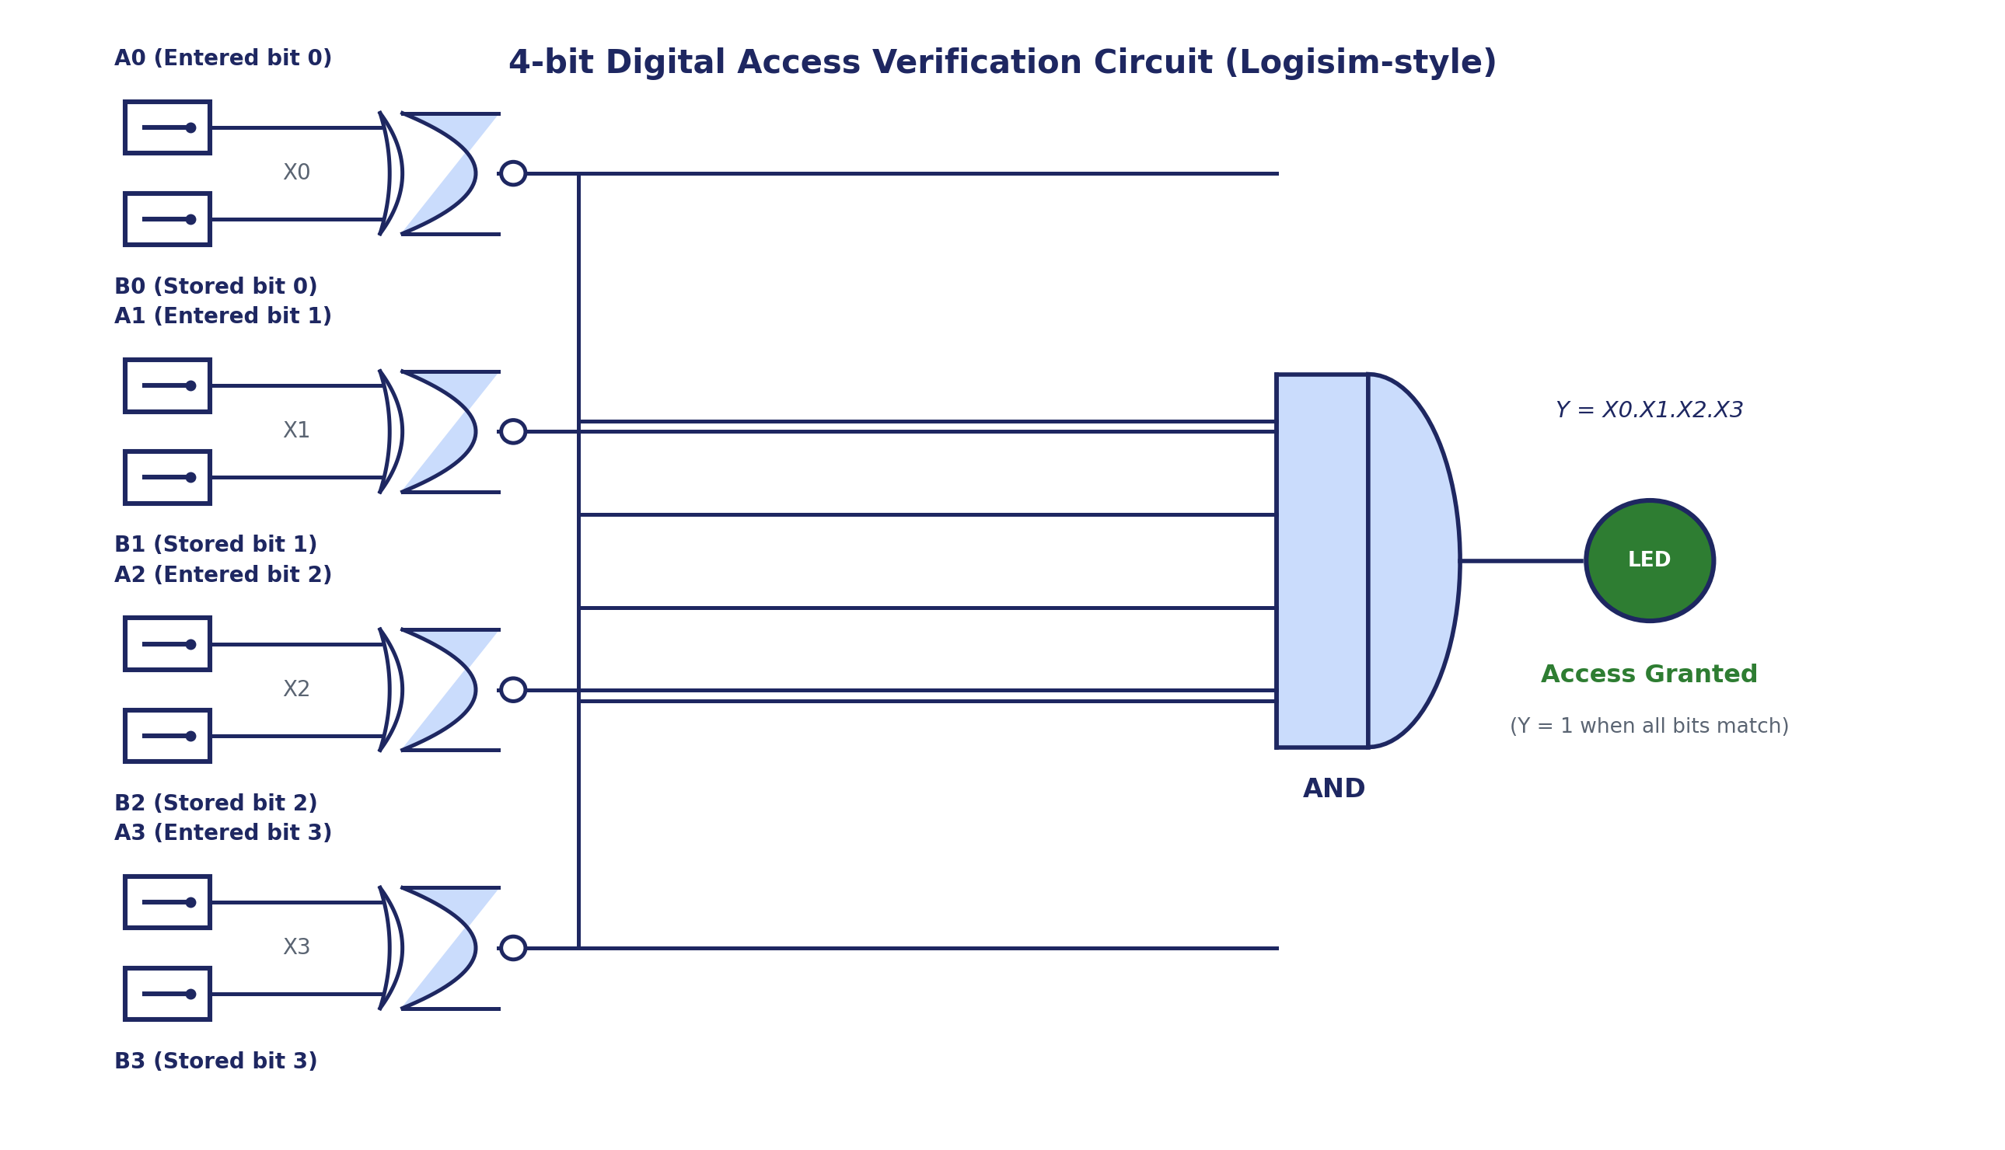
Theory and Logic Circuit
THEORY
XOR: Y = A ⊕ B
XNOR: Y = (A ⊕ B)′
A | B | Y
0 | 0 | 0
0 | 1 | 1
1 | 0 | 1
1 | 1 | 0
A | B | Y
0 | 0 | 1
0 | 1 | 0
1 | 0 | 0
1 | 1 | 1
XOR gives 1 when the bits differ. XNOR gives 1 when they match, so XNOR is the bit comparator. An AND gate combines the four XNOR outputs.
Logic circuit: 4 XNOR gates (one per bit) feed one AND gate

Slide 4
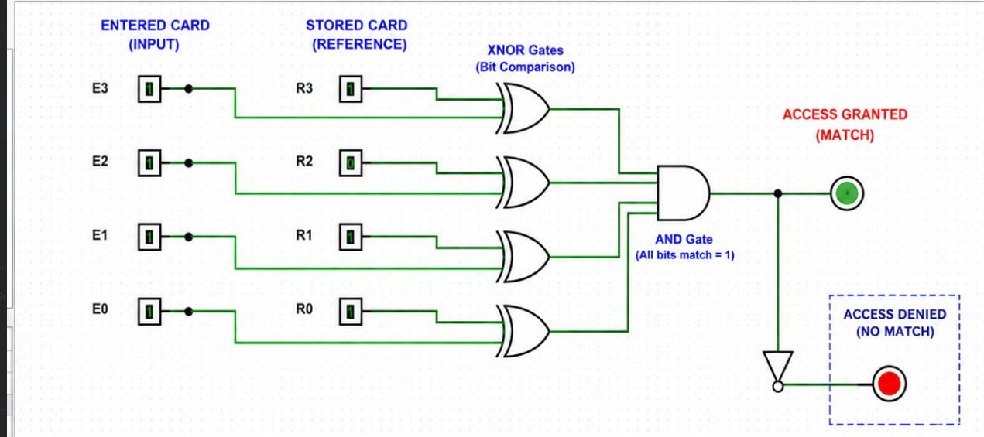
Circuit Design in Logisim
LOGISIM DESIGN
1
Set entered bits E3–E0 and stored bits R3–R0 with switches
2
Each XNOR compares one pair: 1 = match
3
AND outputs 1 only if all four bits match
4
Green LED = granted; NOT gate drives red LED = denied
Components: 8 input switches, 4 XNOR gates, 1 AND gate, 1 NOT gate, 2 LEDs

Slide 5
Simulation Results
RESULTS
Entered | Stored | XNOR | AND | Result
1011 | 1011 | 1111 | 1 | GRANTED
1111 | 1011 | 1011 | 0 | DENIED
1010 | 1011 | 1110 | 0 | DENIED
0000 | 1011 | 0100 | 0 | DENIED
Logisim run: entered 1111, stored 1011 (bit 2 differs), so the red LED shows Access Denied
Result: Y = X0·X1·X2·X3 is 1 only when all four bits match, so only the correct code turns the green LED on.

Slide 6
Conclusion and Applications
CONCLUSION
Outcome
4-bit access checker built with XNOR and AND gates
Verified with truth tables
Simulated successfully in Logisim
Applications
Door locks and keypad entry
ATM PIN checks
RFID / ID access panels
Vehicle immobilizers
Possible improvements
Store the code in a register so it can change
Add encryption
Lock after 3 wrong tries
Extend to 8 or 16 bits
Takeaway: XNOR compares, AND decides. A simple, low-cost access checker.

