Slide 1

Retail Sales Analysis — Superstore (2014–2017)
Python • Microsoft SQL Server • Power BI
Total Sales
₹2.30M
Total Profit
₹286K
Total Orders
9,994
Profit Margin
12.47%

Slide 2
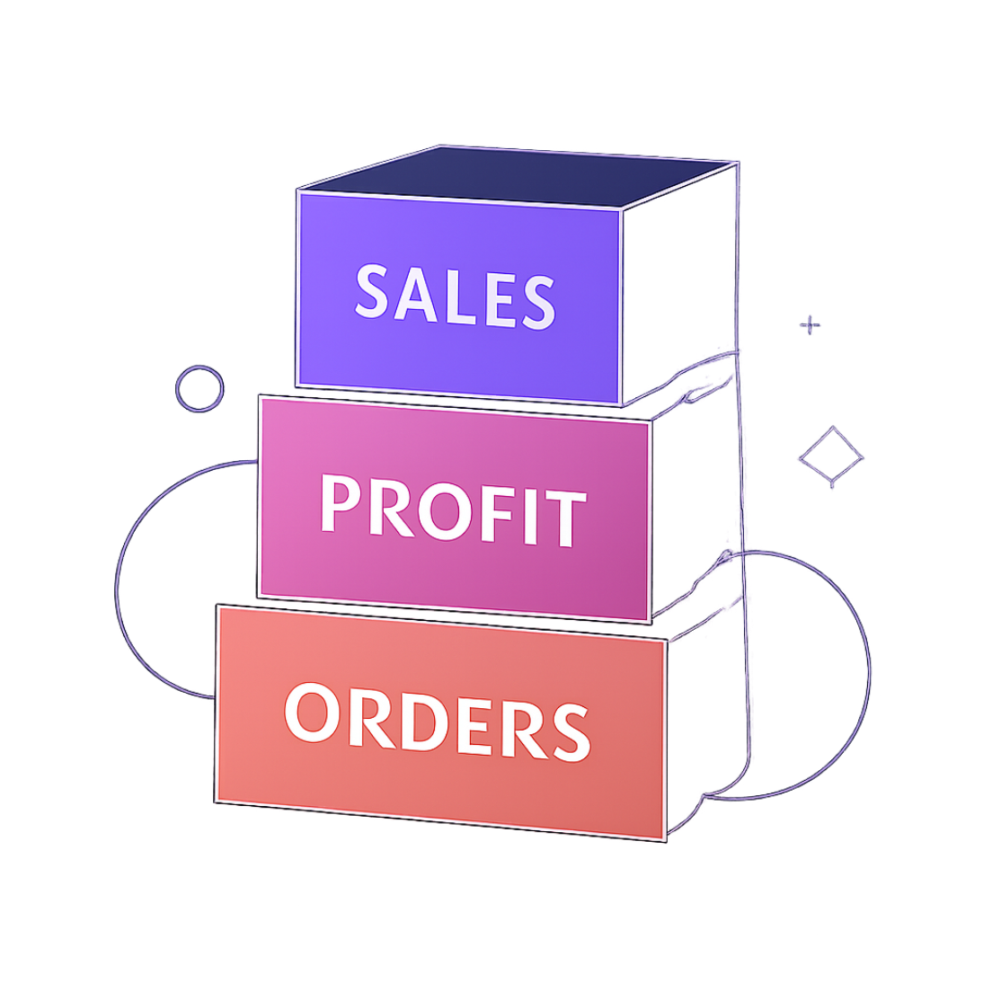
Executive Summary
Analyze 9,994 orders (2014–2017) to reveal profit drivers, loss areas, and guide pricing, discounting, and regional strategy.
Key takeaway: Technology drives most profit
Furniture (Tables, Bookcases) drags profitability
West region leads; Central lags

Slide 3
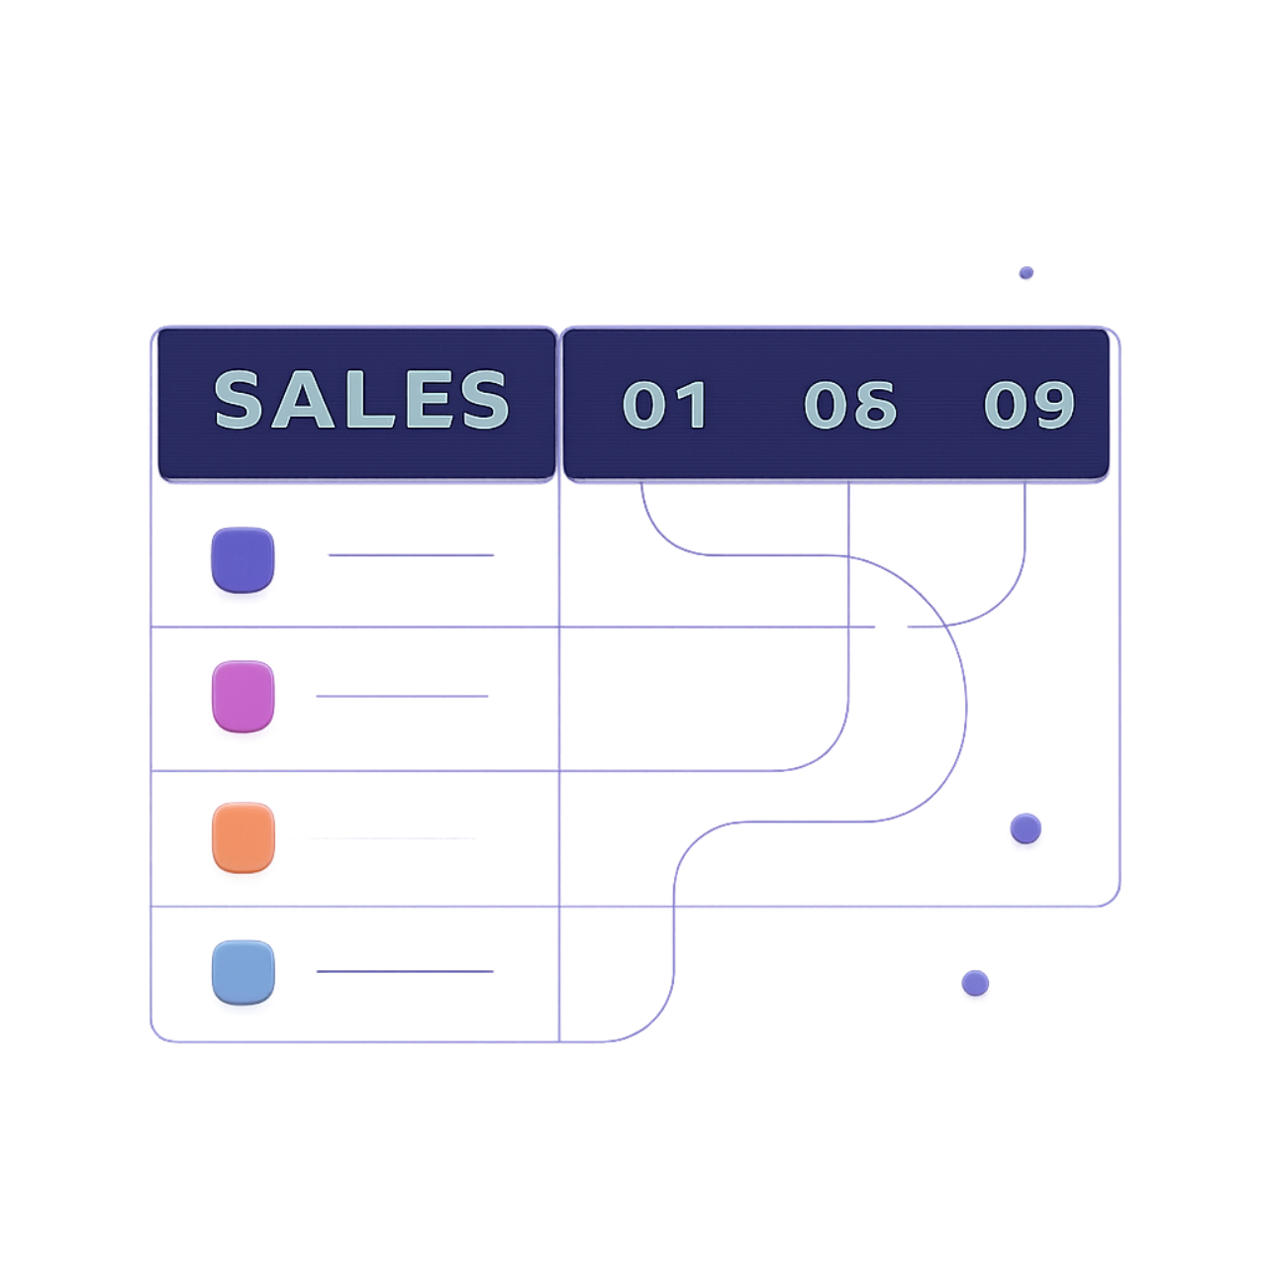
Dataset Snapshot
Rows
Key fields
9,994
Order, Customer, Location, Product, Sales, Profit, Discount
Data quality
Engineered
No missing values; no duplicates
order_year, order_month, shipping_days

Slide 4
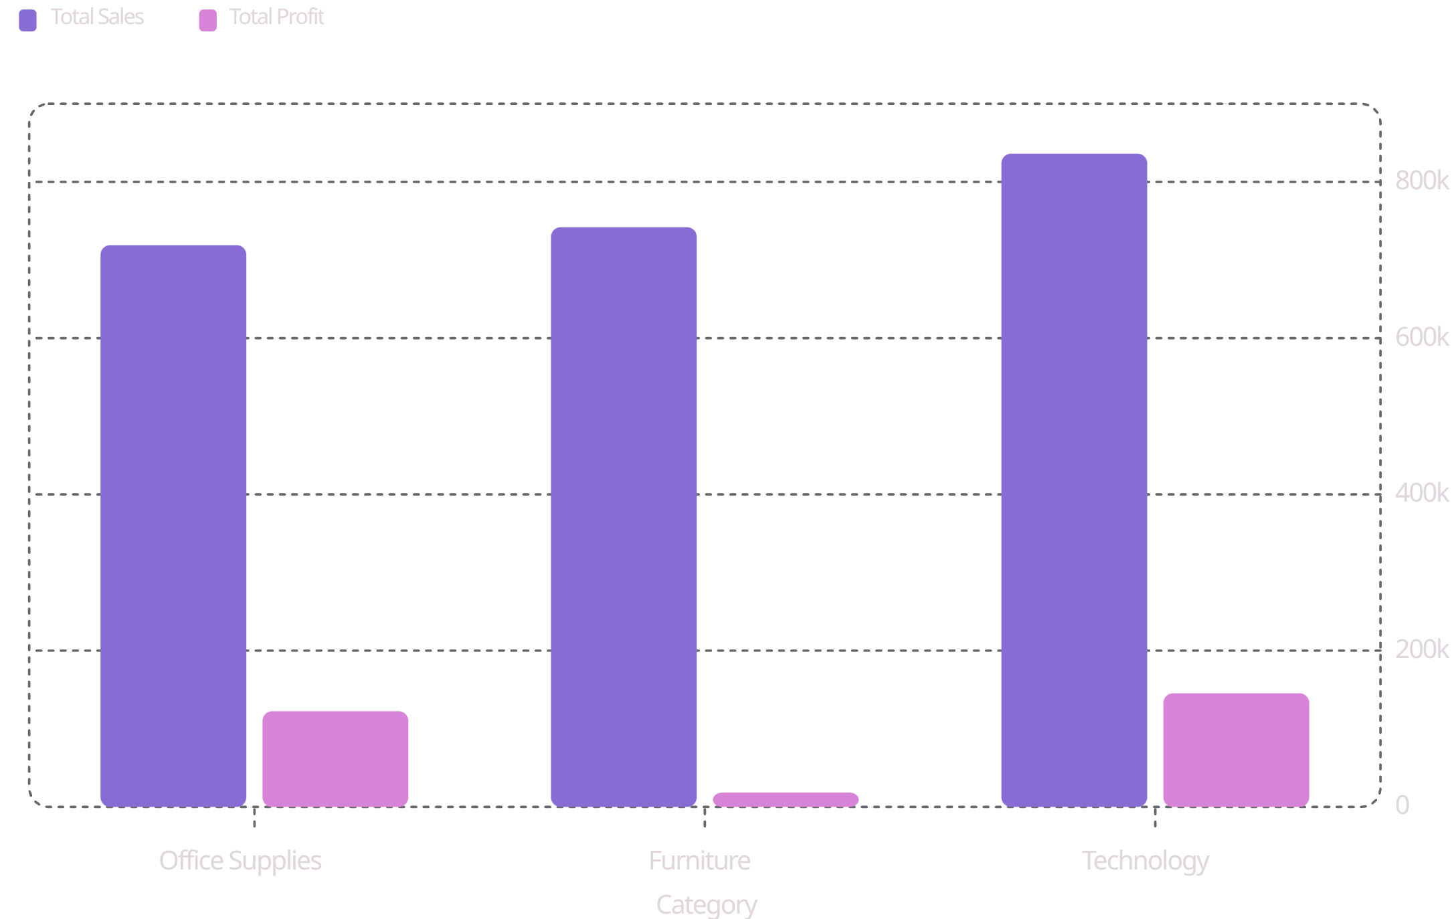

Category Performance
Technology: highest sales & profit. Furniture: high sales, low profit — big sales-to-profit gap.

Slide 5



Top & Worst Products
Best seller
Worst loss
Loss-makers
Canon imageCLASS 2200 — 20 units, ₹61,599.82
Cubify CubeX 3D Printer — Profit: -₹8,879.97
Large tables & bookcases among top losses

Slide 6
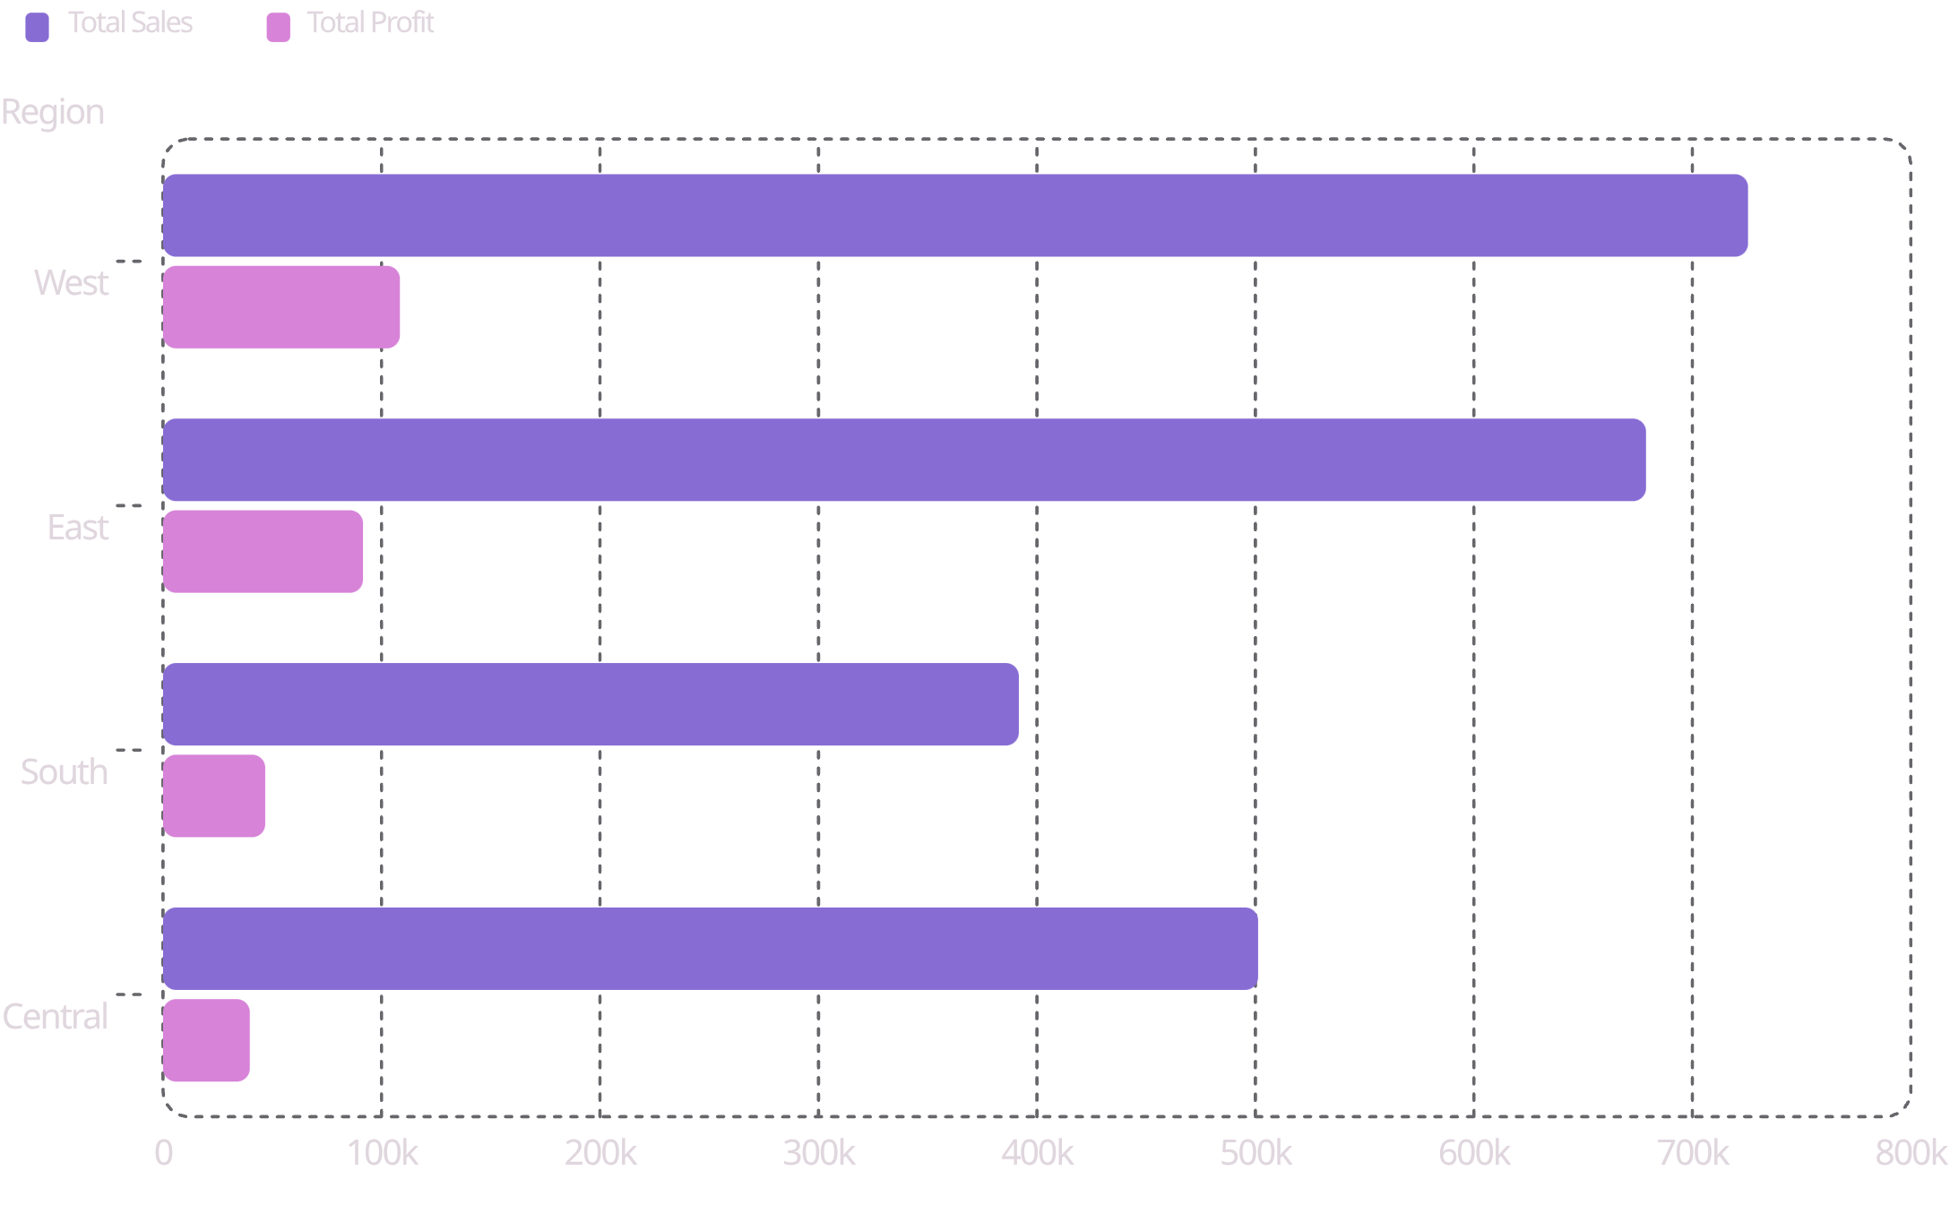

Regional Results
West leads profitability; Central shows low profit despite mid sales — investigate costs/discounts.

Slide 7

Discounts vs Profit
Furniture: highest avg discount (17.4%) and lowest avg profit per order. Technology: lowest discount and best margin.

Slide 8
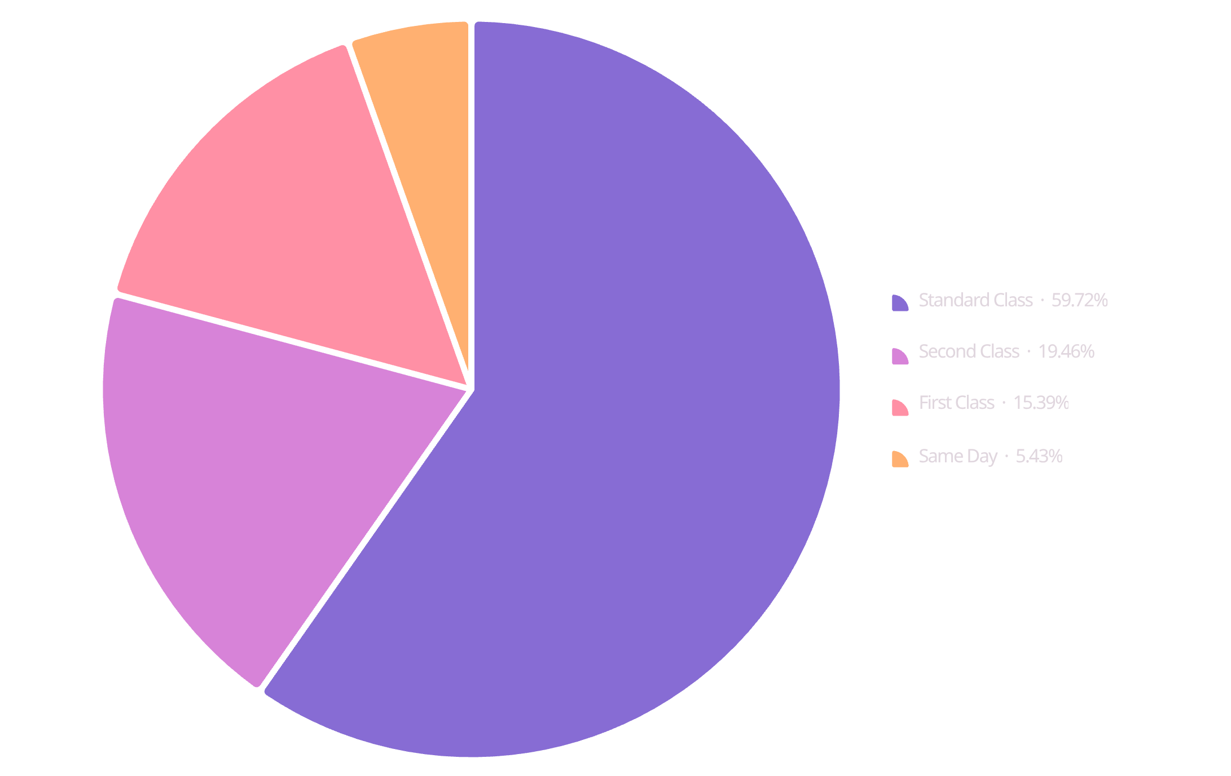

Order & Shipping Insights
Standard Class ~60% of orders and sales
Avg shipping days: Same Day 0, First 2, Second 3, Standard 5
Loss orders: 1,871 / 9,994 = 18.72%

Slide 9
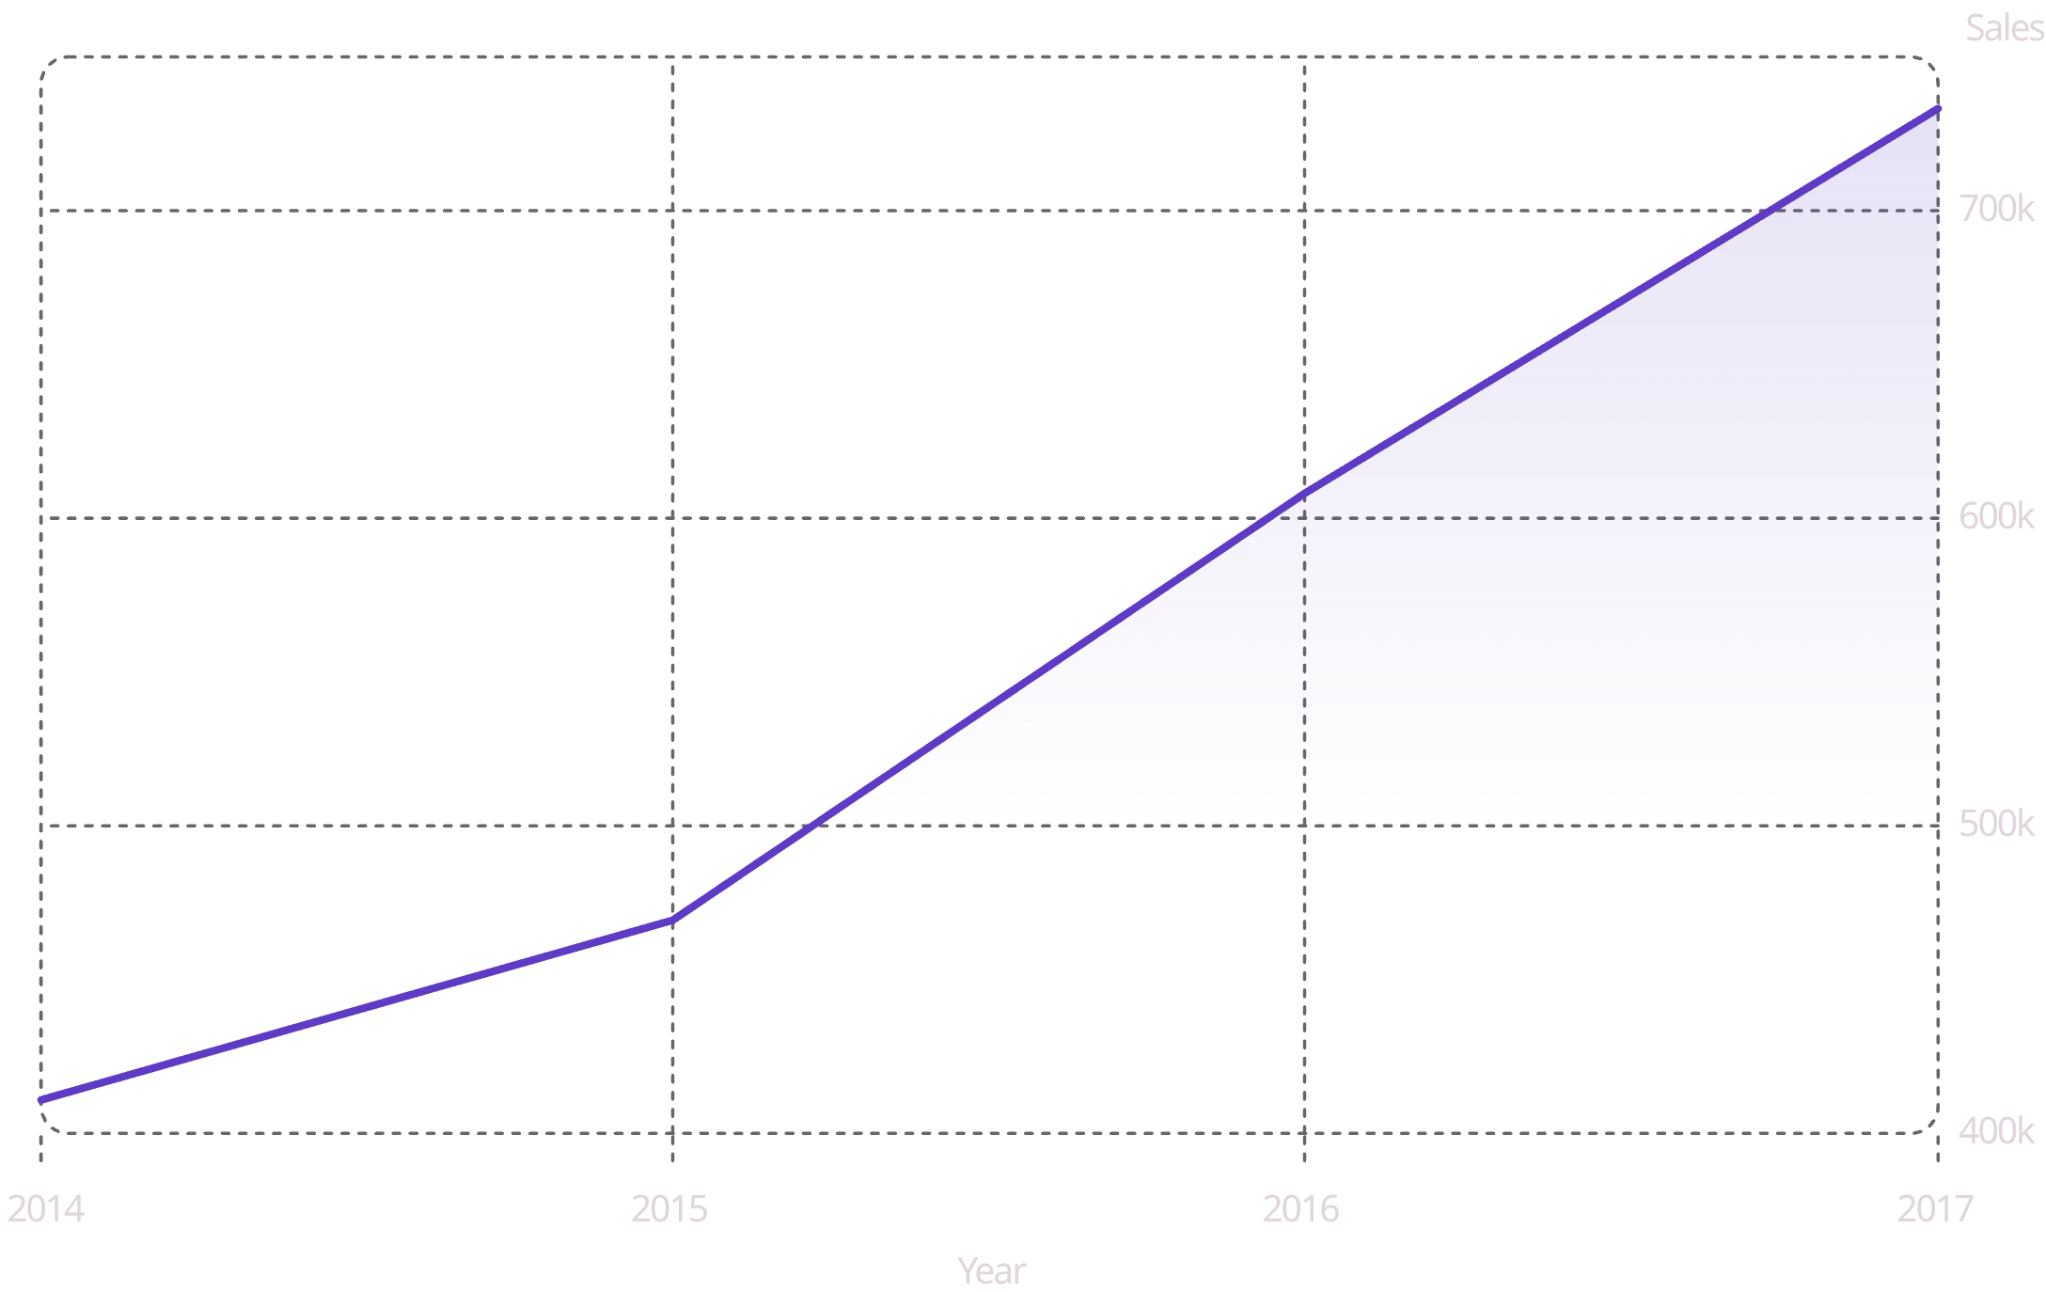

Trends & Seasonality
Sales grew year-over-year. Peak months: Nov/Dec (seasonal spikes).

Slide 10


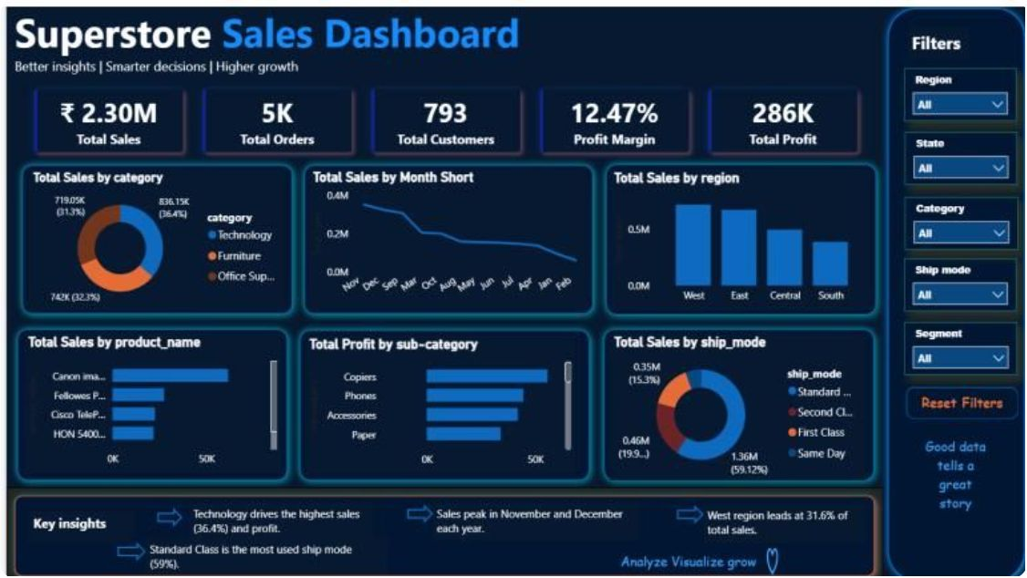
Recommendations & Conclusion
Review Furniture Discounts
Investigate Loss Products
Invest in Technology
Regional Focus
Reprice or limit discounts on 3D printers and large tables.
Scale inventory & marketing for Tech (high profit per order).
Audit Central region for costs/discounting; replicate West practices.
Cap discounts on Tables & Bookcases to recover margin.
Plan Seasonality
Account Reviews
Staffing & inventory scale-up before Nov/Dec peaks.
Reassess high-spend, low-profit customers (e.g., Sean Miller).
Full workflow: Clean in Python → Analyze in SQL → Communicate in Power BI

