Slide 1
Presentation for B.Tech Project review
Predicting Diabetes Using Random Forest
Under the Guidance of
Mrs. K. Divya Kalyani
-BY
P.SIRISHA(20U41A4226)
A.TANIYA (20U41A4224)
N.RAHI (20U41A4234)
S.SAI (20U41A4244)

Slide 2
Presentation for B.Tech Project review
CONTENTS
Abstract
Introduction
Literature Survey
Existing System
Limitations
Proposed System
Proposed System Advantages
Proposed Model Architecture
Outputs and References

Slide 3
Presentation for B.Tech Project review
1. Abstract
Background: Diabetes is a major health problem that affects many people around the world.
Objectives: To solve this problem, we use data from Kaggle, a popular data-sharing site.
Methods: We use computer intelligence called a random forest algorithm to test for diabetes based on age, diabetes level and other factors.
Statistical Analysis: Our random forest model has proven to be very effective at accounting for complex patterns in data, helping us accurately predict whether a person will develop diabetes.
Findings: Our method stands out because we focus on factual accuracy, which makes it different from other methods.
Applications and Improvements: This study, part of the growing use of computers in healthcare, shows that random forest tools may be a reliable and easy way to diagnose early diabetes.
Keywords: Machine learning, Diabetes, Disease Prediction, Health care, Random Forest.

Slide 4
2. Introduction
Presentation for B.Tech Project review
Diabetes is a chronic disease that can cause health problems worldwide. Based on the International Diabetes Federation, 38.2 crore people worldwide have diabetes. In 2035, this number will double to 59.2 crore. Diabetes is a disease caused by high glucose level. Insulin dependence and diabetes are the most common diseases, but other diseases occur during pregnancy, such as gestational diabetes and others. Machine learning is an emerging field in information science that studies how machines learn from experience. Disease management can be prevented more accurately in patients by using random forests
Types of diabetes:
Insulin Dependent diabetes:
diabetes mellitus
Gestational Diabetes

Slide 5
3. Literature Survey
Presentation for B.Tech Project review
K .Vijiyakumar proposed random Forest algorithm for the Prediction of diabetes develop a system which can perform early prediction of diabetes for a patient with a higher accuracy by using Random Forest algorithm in machine learning technique. The proposed model gives the best results for diabetic prediction and the result showed that the prediction system is capable of predicting the diabetes disease effectively, efficiently and most importantly, instantly
Tejas N. Joshi presented Diabetes Prediction Using Machine Learning Techniques aims to predict diabetes via three different supervised machine learning methods including: SVM, Logistic regression, ANN This project proposes an effective technique for earlier detection of the diabetes discasc.
Nonso Nnamoko presented predicting diabetes onset an ensemble supervised learning approach they used five widely used classifiers are employed for the ensembles and a metaclassifier is used to aggregate their outputs. The results are presented and compared with similar studies that used the same dataset within the literature. It is shown that by using the proposed method, diabetes onset prediction can be done with higher accuracy

Slide 6
Deeraj Shetty proposed diabetes disease prediction using data mining assemble Intelligent Diabetes Disease Prediction System that gives analysis of diabetes malady utilizing diabetes patient's database. In this system, they propose the use of algorithms like Bayesian and KNN (K-Nearest Neighbor) to apply on diabetes patient's database and analyze them by taking various attributes of diabetes for prediction of diabetes disease.
Muhammad Azeem Sarwar proposed study on prediction of diabetes using machine learning algorithms in healthcare they applied six different machine learning algorithms Performance and accuracy of the applied algorithms is discussed and compared. Comparison of the different machine learning techniques used in this study reveals which algorithm is best suited for prediction of diabetes.
Diabetes Prediction is becoming the area of interest for researchers in order to train the program to identify the patient are diabetic or not by applying proper classifier on the dataset. Based on previous research work, it has been observed that the classification process is not much improved. Hence a system is required as Diabetes Prediction is important area in computers, to handle the issues identified based on previous research.

Slide 7
Methodology
Clearly define the problem of diabetes prediction using the Random Forest algorithm, specifying the objective and the importance of accurate predictions.
Gather a dataset with features and a target variable indicating diabetes status, preprocess the data, and select relevant features for enhanced model performance.
Choose the Random Forest algorithm for its effectiveness, split the dataset, train the model, and evaluate its performance using metrics like accuracy.
Ensure model robustness through cross-validation across different data subsets to identify potential overfitting or underfitting issues.
Interpret the model's significance in predicting diabetes, and optionally consider deployment into applications with thorough documentation of the entire process.

Slide 8
4. Existing System
Presentation for B.Tech Project review
A literature review of many research articles on predicative analysis reveals many results on diabetes in India. With the help of data mining the research developed various predictive models to predict diabetes.
The researcher focused on classification regression neural network, handles the missing and outlier values in the diabetic data send and they replaced the missing values of their corresponding domains. They also concluded that, the drug treatment for young patients can be delayed whereas older patients were prescribed drug treatment immediately.
In another study, risk accumulated by the diabetic patient was found using soft computing based prediction models.In that study they experimented the real time data using Genetic Algorithm for diabetes models.
In one more study B. Rodriguez Sanchez, they predicted the relationship between diabetes, diabetes related complication and productive activates of among older in Europe. They concluded that diabetes significantly affects the perception of people regarding the effects of their condition.
This study also showed that diabetes increases the likelihood people aged 50-65 years old. 23 In one more review we found according to the international diabetes federation regression and logistic regression models is not useful in age of 65 years because they have been applied in people in whom treatment to prevent heart disease had already been initiated.

Slide 9
Presentation for B.Tech Project review
5. Limitations
Limited Labeled Data: Insufficient labeled datasets hinder the development of robust and generalizable models. In obtaining diverse and representative samples for comprehensive training.
Dynamic Nature of Diabetes: Diabetes is influenced by evolving lifestyle factors, making predictions challenging. Adapting to real-time changes in patient behavior and health conditions remains a significant obstacle.
Ethical and Privacy Concerns: Integrating sensitive health data raises ethical issues regarding patient privacy and consent. Striking a balance between effective prediction and preserving individual privacy is a persistent challenge.
Lack of Standardization: Absence of standardized protocols for data collection and model evaluation poses challenges in comparing and validating different predictive models. Hinders the establishment of a unified approach across studies and healthcare systems.
Interpretability Challenges: Numerous machine learning models, particularly those with intricate architectures, exhibit a lack of transparency. The challenge lies in comprehending and articulating the rationale behind decision-making processes, diminishing confidence among healthcare professionals.

Slide 10
6. Proposed System
Presentation
for B.Tech
Project review
To deal with the problem, we developed automatic diabetic prediction using machine learning techniques. We will train the machine with previous dataset.
Then machine will check the details of patient and give us result as Diabetic or Non-Diabetic.
Data Collection and Preprocessing
Feature Selection and Engineering
Machine Learning Model Selection
Model Training and Validation
Deployment and Integration
Continuous Monitoring and Updates

Slide 11
Presentation for B.Tech Project review
7.Proposed System Advantages
Enhanced Accuracy: The integration of advanced machine learning algorithms leads to superior prediction accuracy compared to traditional methods.
Early Detection and Prevention: Early identification of diabetes risk factors allows for preventive measures. Empowers healthcare providers to initiate timely interventions and mitigating of diabetes-related complications.
Adaptability to Dynamic Patient Profiles: The system's ability to adapt to changing patient profiles accommodates the dynamic nature of diabetes. Continuously learns and updates predictions based on evolving lifestyle factors and health conditions.
Personalized Healthcare: The proposed system enables tailored predictions by considering individual patient characteristics, including genetic factors, lifestyle, and historical health data.
User-Friendly Interface: An user-friendly interface facilitates seamless integration into healthcare workflows. Healthcare professionals can easily interpret and act upon the system's predictions, fostering trust and adoption.

Slide 12
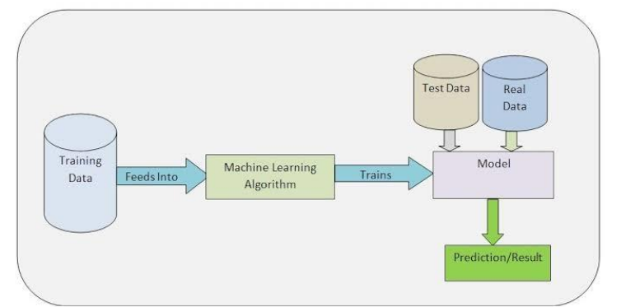
8.Proposed Model Architecture
Presentation
for B.Tech
Project review

Slide 13
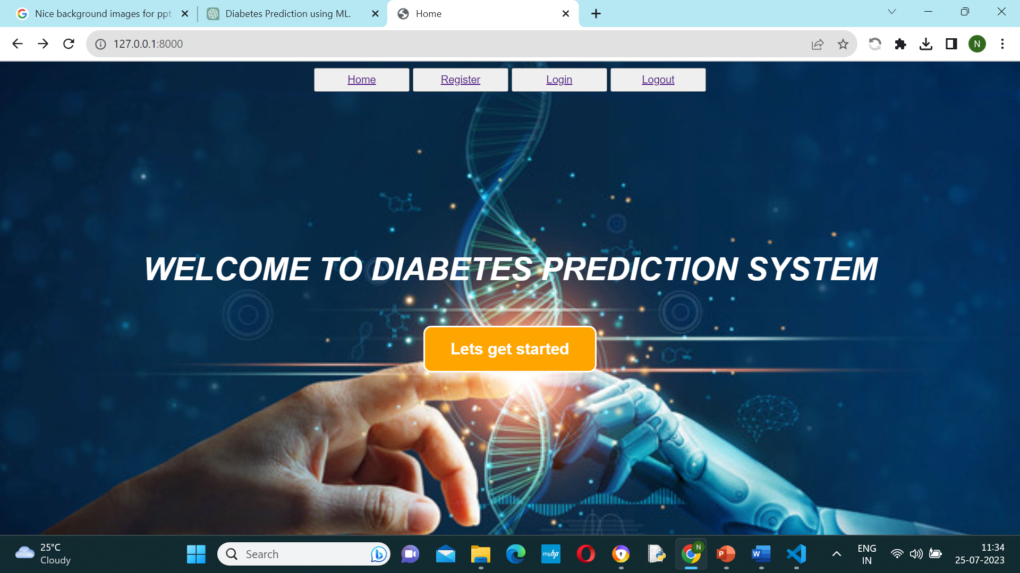
9.Outputs

Slide 14
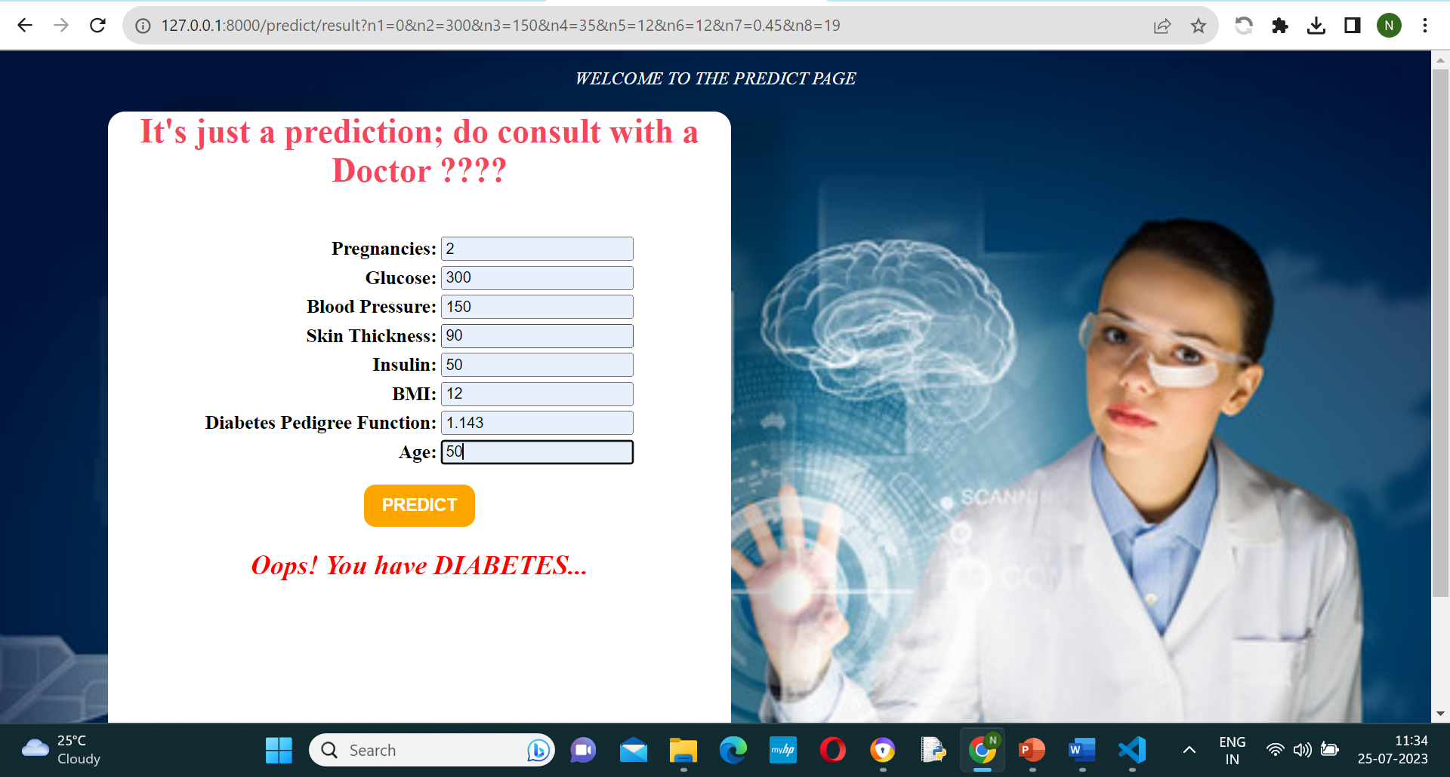

Slide 15
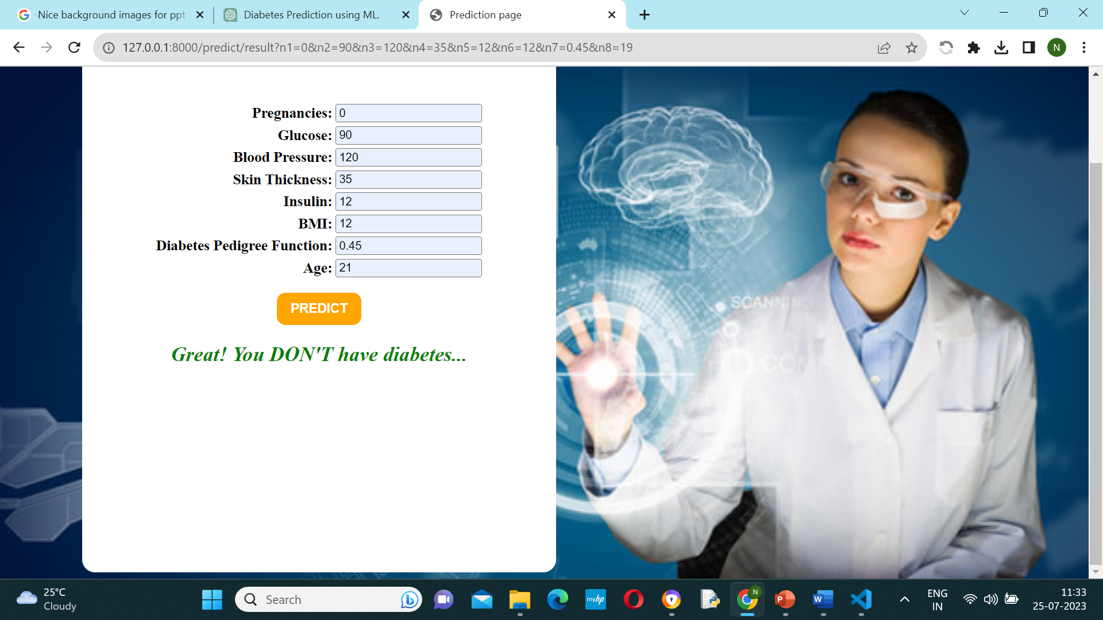

Slide 16
Conclusion
Prediction with help of classification algorithm. Detection of diabetes in its early stages Machine Learing has the great ability to revolutionize the diabtes rick is the key for treatment. This work has described a machine learning approach to predicting diabetes levels. The technique may also help researches to develop an accurate and effective tool that will reach at the table of clinicians to help them make better decision about the disease status.
In this Project, we have used different machine learning techniques to predict the performance of different classification techniques. It further proposes the conceptual prediction model that includes the different machine learning classifiers.
Future Work:
Acquire and preprocess large-scale diabetic patient data, including demographics, medical history, and clinical measurements.
Train a Random Forest model on the prepared dataset to predict diabetic outcomes such as risk of complications or progression

Slide 17
References
Presentation
for B.Tech
Project review
[1] Liu, J., Zhang, S., & Sun, C. (2018). A Novel Random Forest Based Approach for Diabetes Prediction. In 2018 IEEE International Conference on Systems, Man, and Cybernetics (SMC) (pp. 3833-3837). IEEE.
[2] Al-Fuqaha, A., Javed, H., Guizani, M., & Rayes, A. (2018). Machine Learning for IoT Big Data and Streaming Analytics: A Survey. IEEE Communications Surveys & Tutorials, 20(4), 2923-2960.
[3] Tave, G. M., & Zhang, S. (2019). A predictive analysis of the USA diabetes population using random forest. Informatics in Medicine Unlocked, 16, 100203.
[4] Patel, D. A., Patel, A. A., & Pandya, S. N. (2016). Prediction of Diabetes using Random Forest Algorithm. International Journal of Computer Applications, 135(10), 23-26.
[5] Kumar, P. B., & Srinivas, K. (2018). Diabetes Prediction using Random Forest Classification Algorithm. Procedia Computer Science, 133, 157-162
[6]. https://www.kaggle.com/johndasilva/diabetes

Slide 18
Presentation for B.Tech Project review
Thank You

