Slide 1
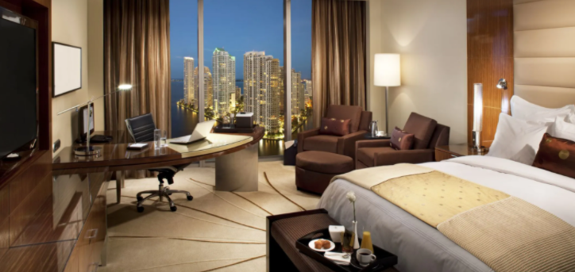

Presenter Name: Taniya Dhar
Dataset: Hotel Bookings
Visualization Tool: Power BI
Email ID: txd180011@utdallas.edu/ taniyadhar2@gmail.com

Slide 2
Project Motivation
The Hotel Booking dataset contains booking information for city hotel and resort hotel and includes information such as when the booking was made, length of stay, the number of adults, children, and/or babies, and the number of available parking spaces.
The dataset has 32 variables and approximately 120k rows.
With the hotel booking dataset, I explored some of the questions using Power BI to understand the demand of hotel bookings. The answers to these questions can help hotels to predict things like rooms requirements, meal preference, parking spaces, etc.
Some of the questions covered from the data:
What type of hotel the customers prefer?
Which is the busiest month of the year?
How many bookings were canceled?
Which month have the highest number of cancelations and actual guests?
Who are the customers (professional / vacation) and where do they come from?
How long do people stay at the hotels?
Do the customers require car parking facilities?
What type of meal is pre-booked by customers?

Slide 3
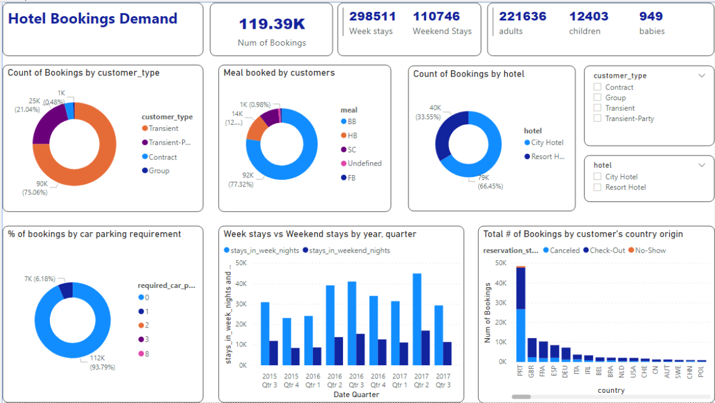

Slide 4
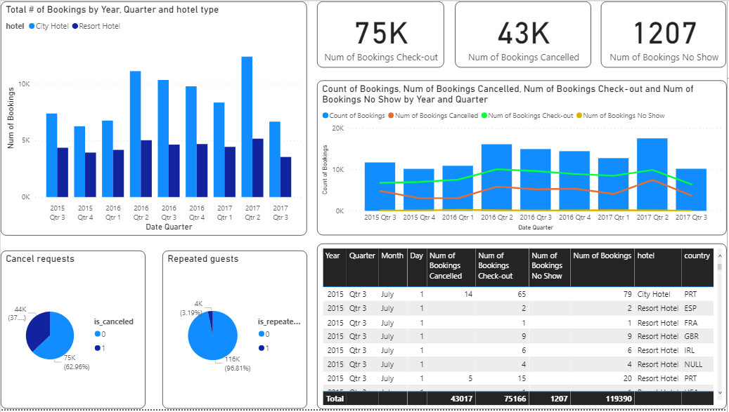

Slide 5
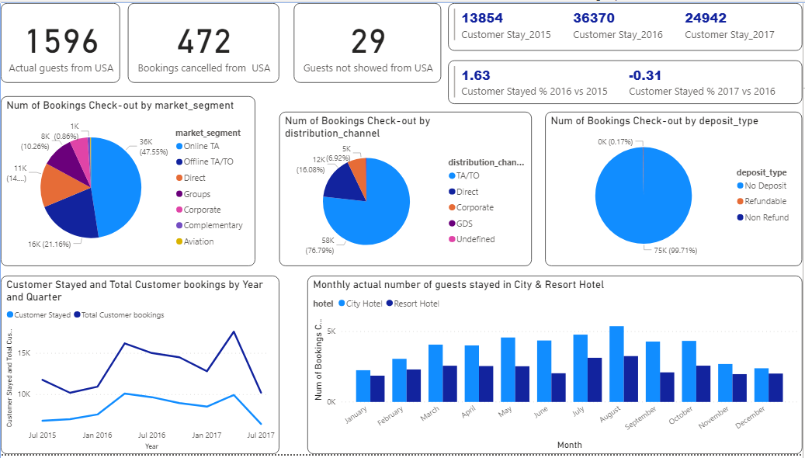

Slide 6
Key Insights
A total of 119,390 hotel bookings were made within the period of Q3 2015 to Q3 2017
Most of the bookings are for short period of stay. 75% is transient customer type which means 75% booking is not part of a group or contract and is not associated to other transient booking. Most of the customers must be business professionals
94% of the customers who booked the hotel rooms did not require car parking spaces. There is not much demand for car parking spaces.
Total number of week stays are more than the weekend stays which also suggests the customers booked hotels for professional work, or short visit and not for vacation
77% of the meal was booked for Bed & Breakfast, 12 % for Half board (breakfast and one other meal – usually dinner) & 0.67% for Full Board. There is less demand for Full Board mostly because the customers are not present during the lunch time.
City Hotels are more preferred/booked by customers. Out of the total number of hotel bookings, 66% (79330) was for City Hotels & 34% (40060)was for Resort Hotels. One of the reasons why customers book more City Hotels than Resort Hotels might be because they are less expensive and most of the customers are business professionals.
2017 Q2 has the highest number of hotel bookings both for City Hotels & Resort Hotels . 2017 Q2 also has the highest number of cancellation requests and actual guests.
Reservation status: Check-Out – 75 K customers are actual guests who stayed; Canceled – 43K customers have cancelled their hotel bookings.; No-Show – 1207 customers did not check-in and did inform the hotel of the reason
37% of the bookings were cancelled and 3.19% of the bookings were done by repeated guests.
The busiest month is August for both City and Resort Hotels with the highest number of actual guests.
1596 actual guests who stayed in the hotel were from USA origin which is about 0.02% of overall actual guests
About 48% bookings were done by Online Travel Agents

