Slide 1


Automobile Part Manufacturer Company's Data MRA Project - Milestone 1
By: Taniya Dubey

Slide 2

Contents:
Agenda & Executive Summary of the data
Problem statement
Executive Summary
Data Sictionary
Summary Stats
Assumptions about data
Exploratory Analysis & Insights
Univariate, Bivariate, and multivariate analysis using data visualization
Weekly, Monthly, Quarterly, Yearly Trends in Sales
Sales Across different Categories of different features in the given data
Summarize the inferences from the above analysis
Customer Segmentation using RFM analysis
What is RFM and which tool used
What all parameters used and assumptions made
Output table head
Workflow image to be put when KNIME used
Inferences from RFM Analysis and identified segments
Who are your best customers?
Which customers are on the verge of churning?
Who are your lost customers?
Who are your loyal customers?

Slide 3
Agenda :
Exploratory analysis and insights
02
RFM analysis for customer segmentation
03
Identification of customers based on different parameters
04
Recommendations
05
Agenda & Executive Summary of the data
01

Slide 4
01 Agenda & Executive Summary of the data
Problem statement
About Data (Info, Shape, Summary Stats, your assumptions about data)

Slide 5
Problem Statement:
An automobile parts manufacturing company has collected data of transactions for 3 years. They do not have any in-house data science team, thus they have hired you as their consultant. Your job is to use your magical data science skills to provide them with suitable insights about their data and their customers.

Slide 6

Executive Summary:
Data: past 3 years.
Objective: identify the underlying buying patterns of the customers and recommend customized marketing strategies for different segments of customers.
Dataset: 20 columns and 2747 rows,
Missing values and Duplicate values: None
Outliers: some columns has few outliers
The exploratory analysis and insights provide a clear understanding of the data and highlight the key trends and patterns in sales.
RFM analysis has been performed to segment the customers into four categories based on their buying behavior, and customized marketing strategies have been recommended for each segment.
The presentation concludes with recommendations for the company to enhance its customer relationships and drive business growth.

Slide 7
Data Dictionary
ORDERNUMBER : Order Number
CUSTOMERNAME : customer
QUANTITYORDERED : Quantity ordered
PHONE : Phone of the customer
PRICEEACH : Price of Each item
ADDRESSLINE1 : Address of customer
ORDERLINENUMBER : order line
CITY : City of customer
SALES : Sales amount
POSTALCODE : Postal Code of customer
ORDERDATE : Order Date
COUNTRY : Country customer
DAYS_SINCE_LASTORDER : Days_ Since_Lastorder
CONTACTLASTNAME : Contact person customer
STATUS : Status of order like Shipped or not
CONTACTFIRSTNAME : Contact person customer
PRODUCTLINE : Product line – CATEGORY
DEALSIZE : Size of the deal based on Quantity and Item Price
MSRP : Manufacturer's Suggested Retail Price
PRODUCTCODE : Code of Product
Numeric columns: ORDERNUMBER, QUANTITYORDERED, PRICEEACH, ORDERLINENUMBER SALES, DAYS_SINCE_LASTORDER, MSRP.

Slide 8
Assumptions:
Each row in the data represents a unique transaction made by a customer.
The customer segments may be defined based on the purchasing frequency, amount spent, and recency of purchases (RFM Analysis).
The marketing strategies may vary for each customer segment, and the company may need to personalize their marketing efforts accordingly.
The order date and days since last order columns are accurately calculated.
The sales column is calculated as the product of quantity ordered and price each.
The status column indicates the current status of the order accurately.
The recommendations provided in the presentation are based on the insights gained from the analysis of the transaction data.

Slide 9
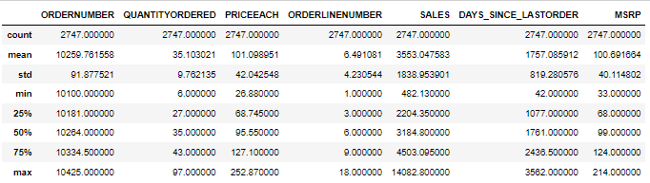
Statistical Summary of Numerical Columns
Inference :
The average number of items ordered per sales order is 35, with a standard deviation of 9.76.
The average price of each item is 101.09, with a standard deviation of 42.04.
The average sales amount per order is 3553.05, with a standard deviation of 1838.95.
The average time since the last order is 1757.09 days, with a standard deviation of 819.28.
The summary statistics do not indicate any red flags or abnormalities that could potentially indicate issues with the data.

Slide 10
02 Exploratory Analysis & Insights Univariate, Bivariate, and multivariate analysis using data visualization
Weekly, Monthly, Quarterly, Yearly Trends in Sales
Sales Across different Categories of different features in the given data
Summarize the inferences from the above analysis
Outliers has not been treated.

Slide 11

Bivariate Analysis

Slide 12
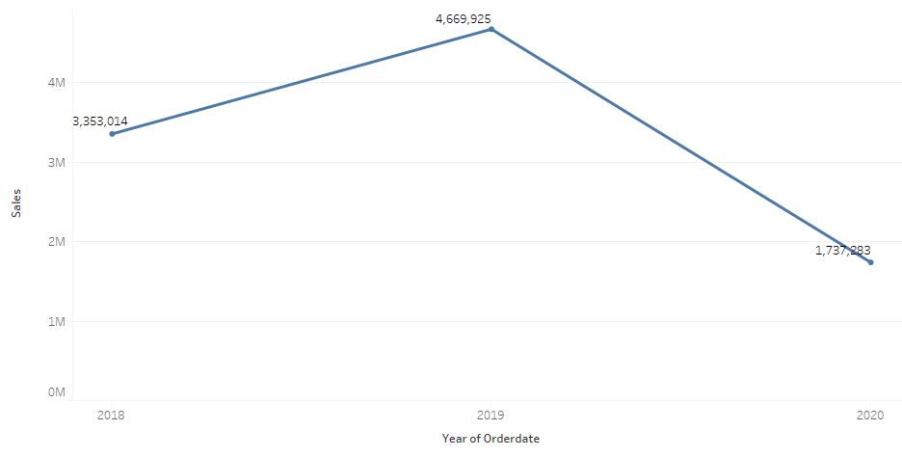
Yearly Sales
We can see that there is a dip in the yearly sales.
We need to find more information regarding this as its not a good sign.

Slide 13
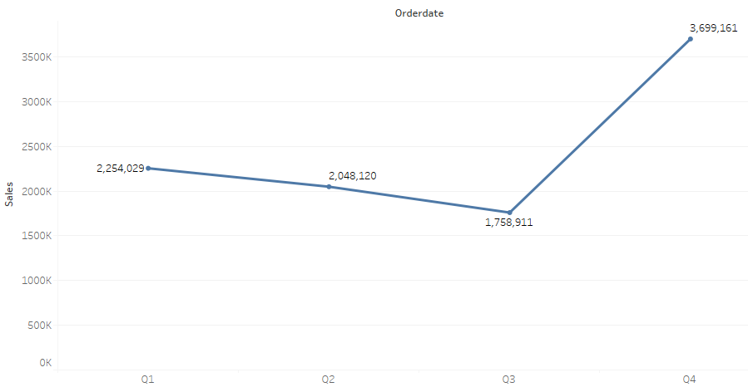
Quarterly Sales
We can see that in the quarter 4 there is high sales as compared to other quarters.

Slide 14
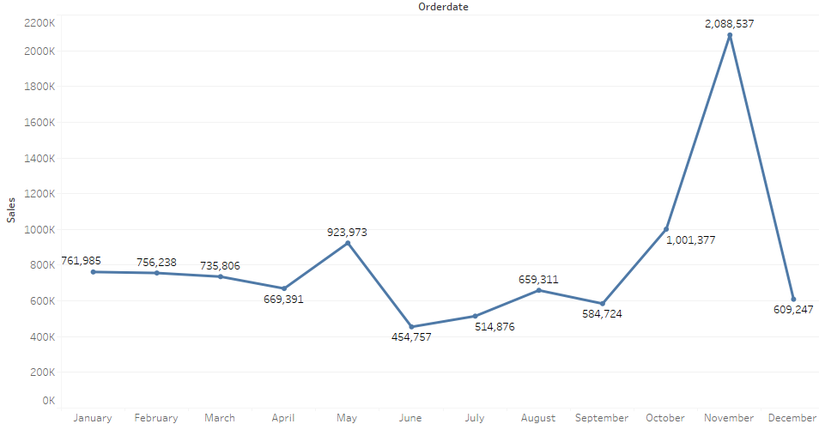
Monthly Sales
We can see that in the 11th month there is highest sales.
And in 6th month the sales is the lowest.
Sales is consistent in the first 4 months of the year.

Slide 15
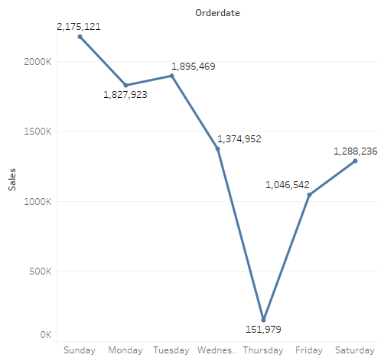
Weekday Sales
We can see Thursday has the lowest sales and Sunday has the highest sales.
Sales increases from Friday to Sunday and dips from Monday to Thursday

Slide 16
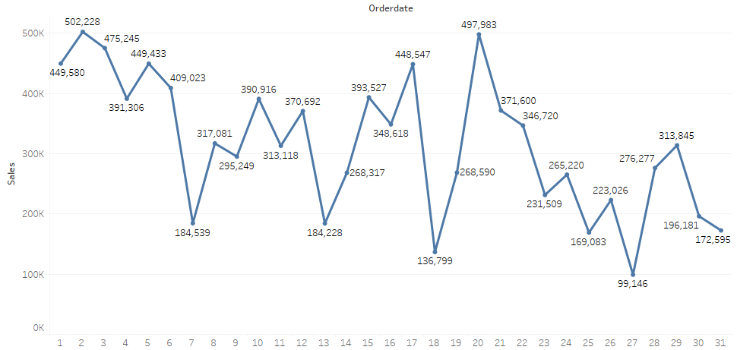
Day Sales
In the stating days of month there is more sales as compared to the end days.

Slide 17

Multi-Variate Analysis

Slide 18
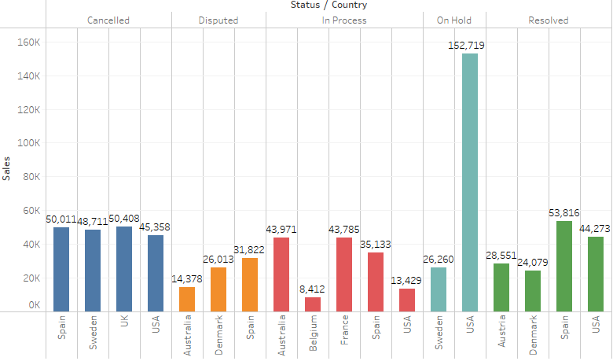
Status, Country & Sales
We can see most of the orders which are on hold belongs to usa, some orders on hold belong to sweden.
UK, USA, Spain, Sweden have aprox same number of canceled orders.
Spain has most disputes and also most disputes are solved.

Slide 19
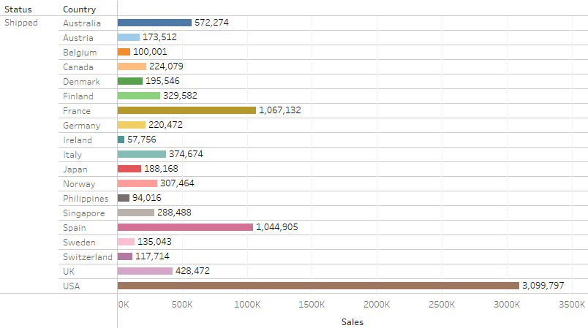
Order Shipped & Sales
Usa has most shipped orders.
Spain and France have aprox same number of orders.
Ireland have the least number of orders shipped.

Slide 20
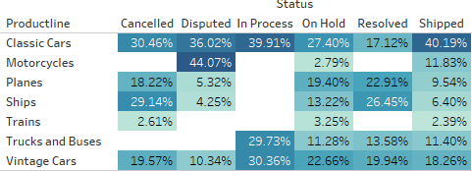
Pivot Table
Most people deal parts of classic car as it has the higher %.
Parts of motercycles are the most Disputed category.
Least people deal with Train parts.

Slide 21
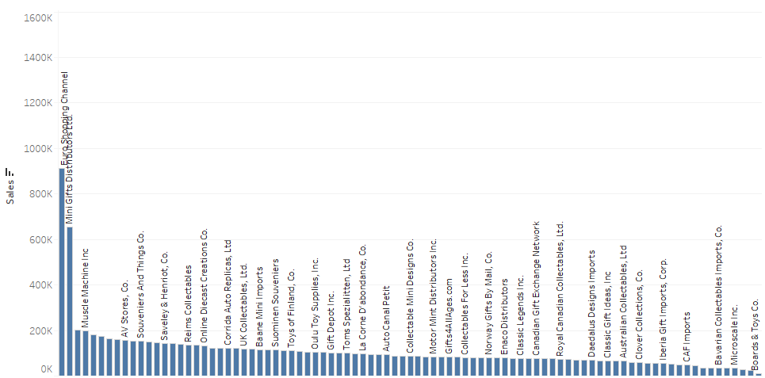
Sales & Customer names

Slide 22
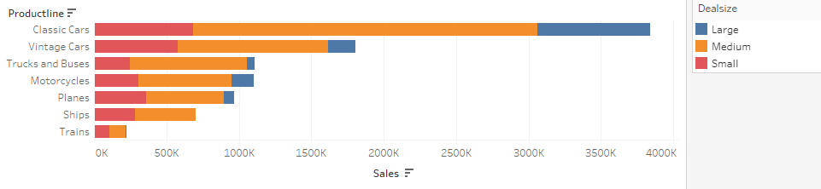
Sales & Deal Size
Most sales: Classic cars
Least sales: Trains
Most Deal size: medium
Least Deal size: large
Sales of truckandbuses and motercycle are aproxx same

Slide 23
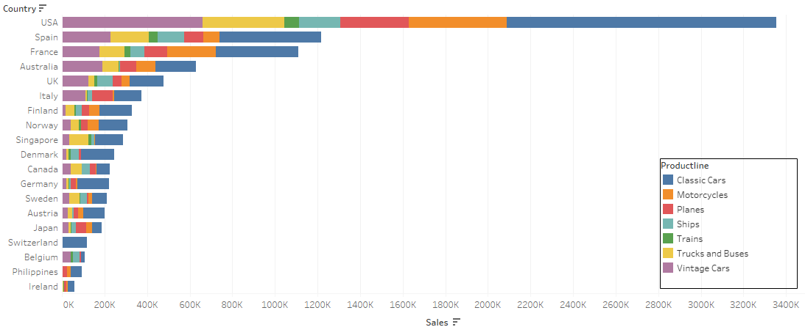
Country, Product line, Sales
Highest sales : USA
Least sales: Ireland
Switzerland deals with Only classic car parts.

Slide 24
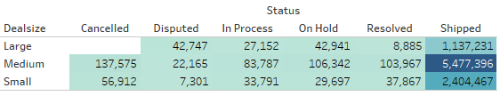
Status, Sales and Deal Size
No order of large deal type is cancelled it’s a good sign.
Most shipped parts belong to medium deal size type.

Slide 25
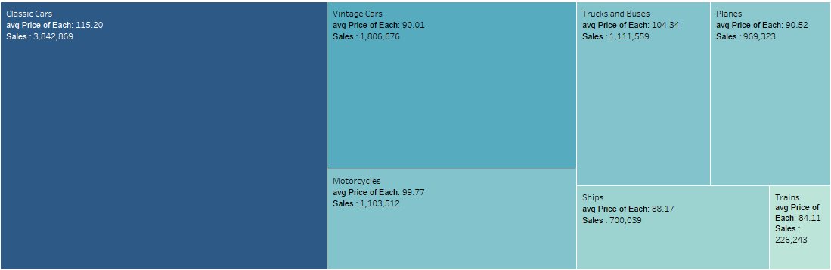
PRODUCT LINE AND SALES

Slide 26
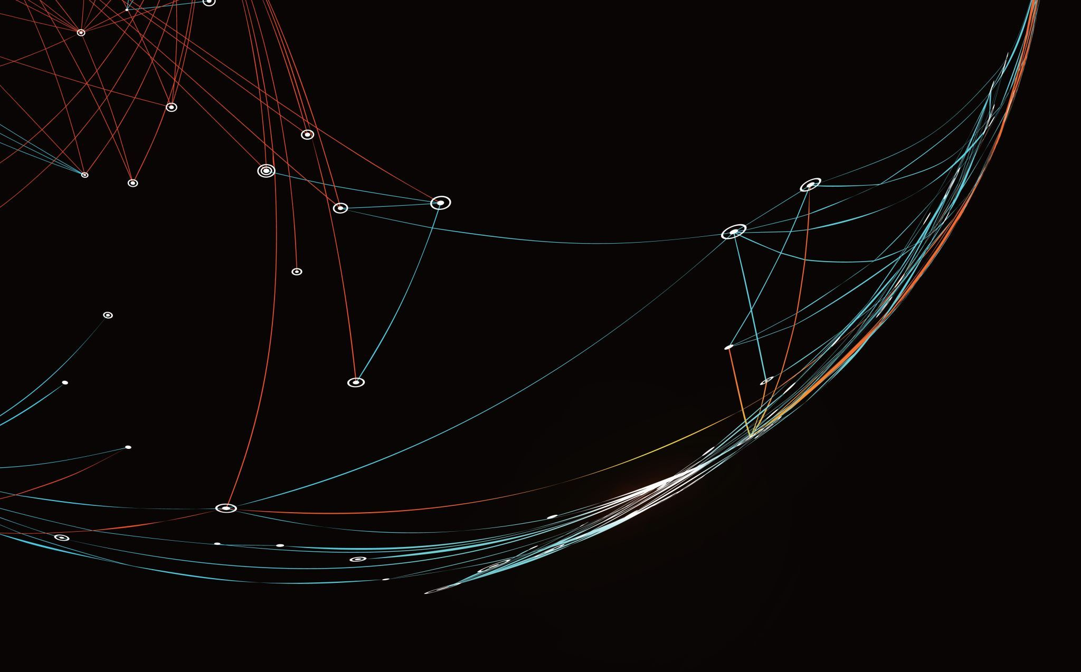
Univariate Analysis

Slide 27
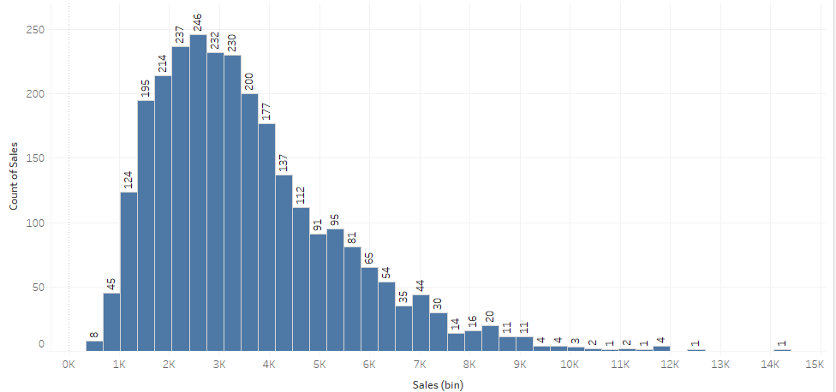
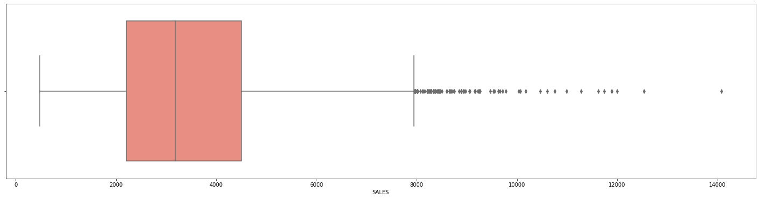
Sales
We can see that sales data is skewed toward left.
There are many outliers.
Most data exist between 1.5k - 3.5k.

Slide 28
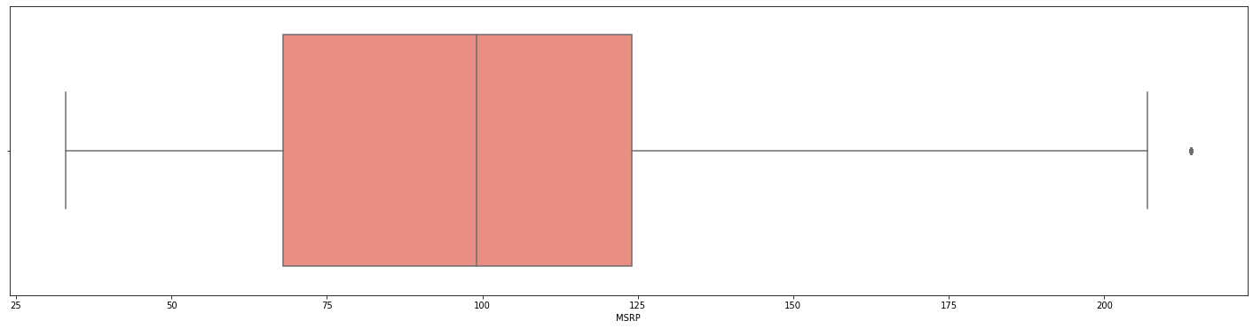
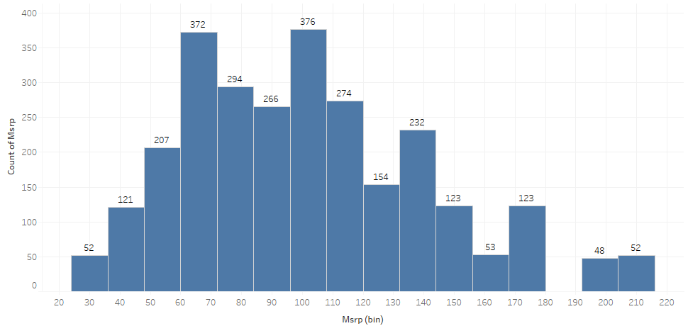
MRSP
Outliers are present in the MRSP Data
This data is shewed toward left .

Slide 29
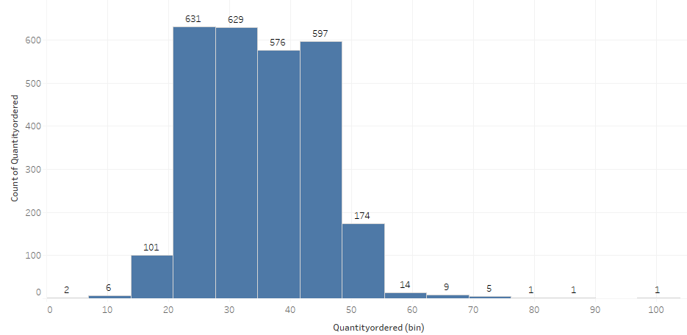
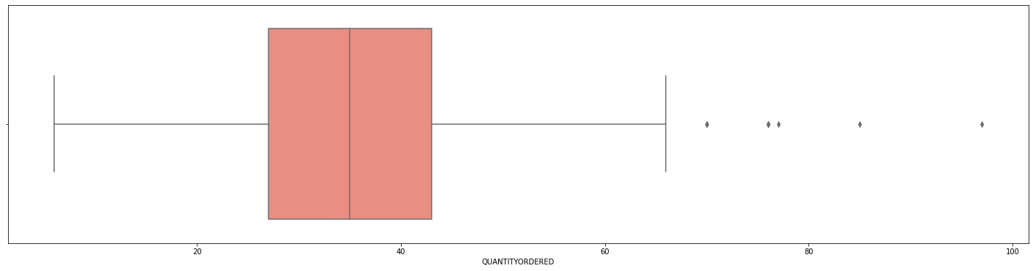
QUANTITY ORDERED
Outliers are present in the data of Quantity Ordered.

Slide 30
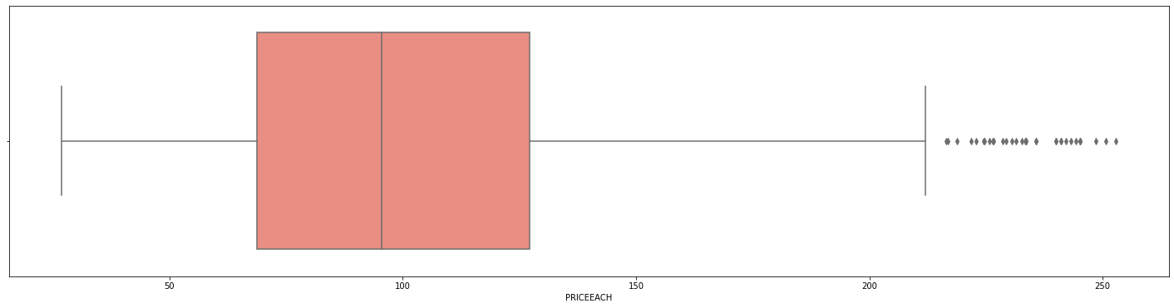
PRICE OF EACH
Price of Each data has money outliers

Slide 31

Dashboard : Sales

Slide 32
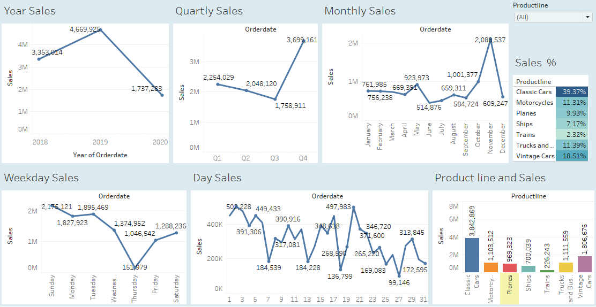

Slide 33
INFERENCES
The yearly sales have dipped, which is not a good sign.
Quarter 4 has higher sales compared to other quarters.
Sales are consistent in the first 4 months of the year.
Thursday has the lowest sales, and Sunday has the highest sales.
Sales increase from Friday to Sunday and dip from Monday to Thursday.
In the starting days of the month, there are more sales than the end days.
Most orders on hold belong to the USA, and some belong to Sweden.
Spain, USA, UK, and Sweden have approximately the same number of canceled orders.
Spain has the most disputes, and most disputes are solved.
Classic car parts have the highest percentage of sales.

Slide 34
Recommendation
Further investigation is necessary to identify the reasons for the dip in yearly sales.
To capitalize on the high sales in quarter 4, businesses should focus on increasing their inventory during this period.
Businesses should identify the reasons behind the low sales in the 6th month and work towards addressing them.
Businesses should focus their marketing efforts on Thursdays to improve sales on this day.
Strategies such as weekend sales can be employed to increase sales from Friday to Sunday.
Businesses should consider offering discounts or promotions during the start of the month to increase sales.
Efforts should be made to resolve the orders on hold to prevent revenue loss.
Businesses should monitor canceled orders closely and identify any trends to address them.
Steps should be taken to resolve disputes quickly and efficiently to maintain customer satisfaction.
Businesses should consider expanding their inventory of classic car parts, given their high sales percentage.

Slide 35
03 Customer Segmentation using RFM analysis
What is RFM and which tool used
What all parameters used and assumptions made
Output table head
Workflow image to be put when KNIME used

Slide 36
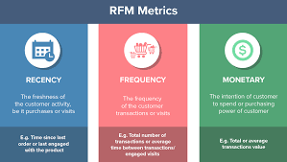
What is RFM ?
Recency, frequency, monetary value (RFM) is a marketing analysis tool used to identify a firm’s best clients based on the nature of their spending habits.
An RFM analysis evaluates clients and customers by scoring them in three categories: how recently they’ve made a purchase, how often they buy, and the size of their purchases.

Slide 37

Tool used : KNIME
KNIME, the Konstanz Information Miner, is a free and open-source data analytics, reporting and integration platform.

Slide 38
What all parameters used and assumptions made
As per instructions the column 'Days since last order' is ignored and new column Recency as '[Max(order date)-order date]'
We have assumed ‘01-06-2020’ as a reference date and created recency column.
The calculated formula for:
Recency :- [min(Recency) customer wise].
Frequency:- [count(customer name) customer wise]. We can also take order quantity
Monetary:- [sum(unit price + qty ordered) customer wise]. We can also take sales
Based on above we have made 3 bins : high , medium , low

Slide 39
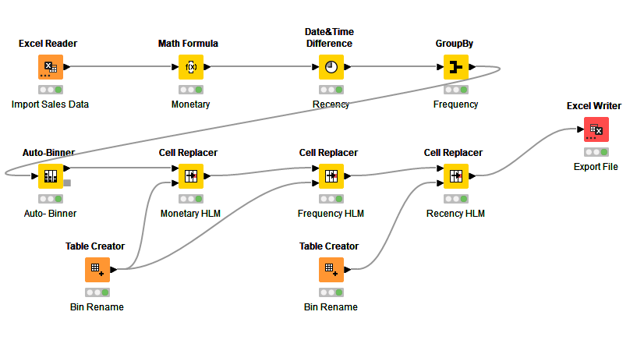
KNIME Workflow

Slide 40
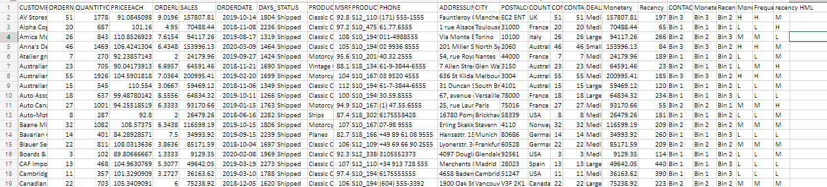
Few rows of output

Slide 41
Inferences from RFM Analysis and identified segments
Who are your best customers? Which customers are on the verge of churning? Who are your lost customers?
Who are your loyal customers?

Slide 42
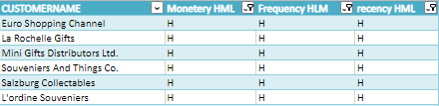
Top 5 best customers
According to RFM score we have grouped the top customers.
We have given importance to recency more and ordered the customers accordingly.

Slide 43
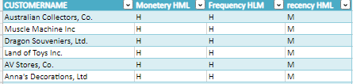
Top loyal customers
Based on RFM analysis these are the loyal customers
We have focused on monetary value
If we focus on these customer we can turn them in to best customers.

Slide 44
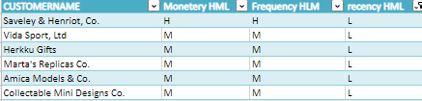
Verge on churning Customers
As per RFM score we can see that these are the top customers on the verge of churning.
We should focus on these customers before we lose them.
We should try some action plan to convert them into regular customers.

Slide 45
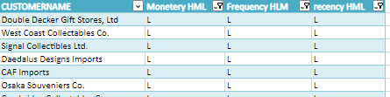
Top Lost Customers
As per RFM score we can see that these are the customers which we have lost.
There recency is very low as well as they have not made purchase frequently.
We should study them survey them to understand the reasons why we lost them. And take further steps so that we do not lose the customers.

Slide 46
05 Recommendations

Slide 47

Recommendations
According to RFM analysis, customers can be categorized into four distinct groups: best, loyal, verge of churn, and lost customers. It is important to develop a focused approach for each group in order to optimize customer retention and enhance customer experience.
best customers, it is recommended to provide personalized recognition, exclusive offers, and incentives to ensure that they continue to choose our company over others. By doing so, we can maintain their loyalty and strengthen the long-term relationship.
loyal customers, it is essential to offer periodic discounts and offers to keep them engaged and interested in our products or services. By keeping them engaged, we can turn them into our best customers and improve their satisfaction level with our brand.
verge of churn customer, we need to develop an effective action plan to prevent them from leaving the company. We can conduct surveys, offer incentives, and personalize the communication to identify and address their concerns, and thereby increase their loyalty towards our brand.
lost customers, it is important to analyze their behavior and preferences to identify the reasons for their departure. By identifying the key drivers of customer churn, we can develop targeted strategies to prevent such occurrences in the future and improve our overall retention rate.

Slide 48

Thank you

