Slide 1

Computer Information Technology (CIT) – Final Project
Exploring MS Word &
MS Excel TOOLS

Slide 2
Title: Introduction to the CIT Project
Computer Information Technology teaches essential computer skills.
This project highlights my practice in MS Word and MS Excel.
Focus on creating professional documents and analyzing data.
Demonstrates use of formulas, charts, and data tools.

Slide 3

MS Word
Microsoft Word is a popular word processing software that helps in creating, editing, and formatting documents. It provides many useful tools such as page layout, tables, fonts, and bullet points to make documents professional and well-organized. In this project, I used MS Word to create a professional resume, applying different formatting features to arrange the information neatly and give it a clean look.

Slide 4
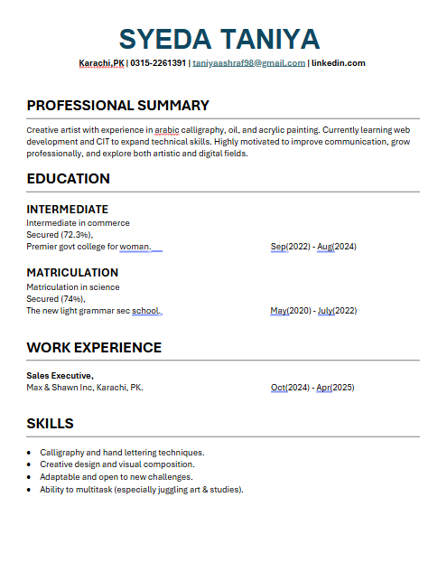
Resume In MS Word
Tools Used
Bullet Points: To list skills and details in a clear, easy-to-read format.
Line Spacing: To maintain proper distance between lines for better readability.
Text Formatting: Applied different fonts, sizes, and colors to highlight key sections.
Bold / Underline: To emphasize headings and important information.
Page Layout: Adjusted margins and alignment for a balanced appearance.
Paragraph Alignment: Used left and center alignment to keep the layout organized.

Slide 5

Additional MS Word Features
While learning MS Word, I explored many useful tools beyond creating a resume. I worked with Styles and Templates to quickly format documents and maintain a consistent design. I practiced inserting images and creating tables to organize information in a clear way. I also learned how to save and export files in different formats such as PDF and DOCX for easy sharing. Other features I explored include using Page Borders and Page Color for a polished look, adding a Table of Contents for automatic section listing, inserting Citations for references, applying a Watermark, creating Headers and Footers for page numbers, and adding a Page Break to neatly start a new page.

Slide 6

MS Excel
Microsoft Excel is a powerful spreadsheet program used for managing, organizing, and analyzing large amounts of data. It allows the creation of structured workbooks and worksheets where information can be stored in rows and columns for easy calculation and reporting. During my project, I created a student record sheet where I used different formulas and tools to perform calculations, summarize information, and format the data in a clear and professional way. These features made it easier to manage records, highlight important details, and present results with visual elements.

Slide 7


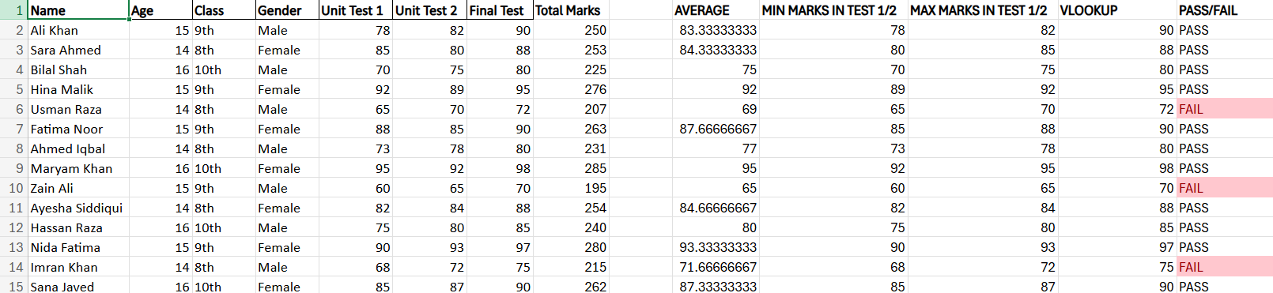
Student Record Spreadsheet in MS Excel

Slide 8
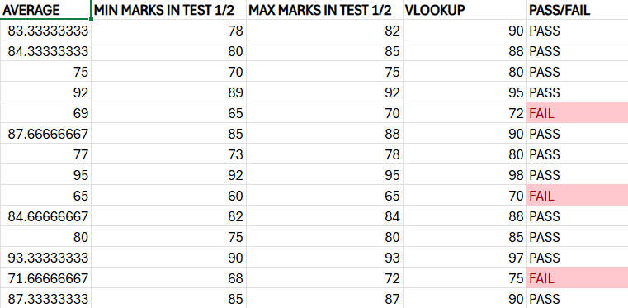
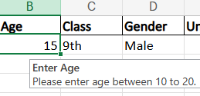
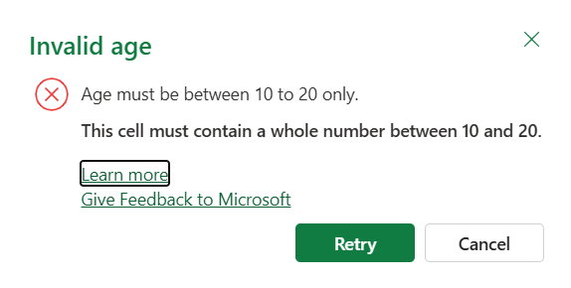
Formulas and Tools Used in Excel
Formulas Used: SUM, MIN, MAX, AVERAGE, IF, VLOOKUP Data Tools Used: Conditional Formatting, Data Validation, Pivot Table, Charts
Formulas Used: SUM, MIN, MAX, AVERAGE, IF, VLOOKUP
Data Tools Used: Conditional Formatting, Data Validation, Pivot Table, Charts

Slide 9
FORMULAS
MIN Function
What it Does: Finds the smallest value inside a selected range of cells.
In My Sheet: I applied it to the marks column to instantly show the lowest score in the class.
Why It’s Useful: Saves time by locating the minimum result without manually checking each entry.
MAX Function
What it Does: Returns the largest value from a chosen range.
In My Sheet: Used on the same marks column to reveal the student with the highest marks.
Why It’s Useful: Quickly highlights top performance at a glance.
SUM Function
What it Does: Adds together all numbers in a selected range.
In My Sheet: Helped me calculate the total marks of all students in just one click.
Why It’s Useful: Eliminates manual addition and ensures accurate totals for big datasets.

Slide 10
FORMULAS
AVERAGE Function
What it Does: Calculates the mean value of a group of numbers.
In My Sheet: I used it on the marks column to get the average score of the whole class.
Why It’s Useful: Gives a clear picture of overall performance instead of only looking at highs and lows.
VLOOKUP Function
What it Does: Searches for a specific value in the first column of a table and returns related information from another column.
In My Sheet: I typed a student’s name and used VLOOKUP to instantly fetch their final test marks.
Why It’s Useful: Makes it easy to find exact data without scrolling through the entire sheet.
IF Function
What it Does: Tests a condition and shows one result if true and another if false.
In My Sheet: I applied it to decide whether a student is “Pass” or “Fail” based on their marks.
Why It’s Useful: Automates decision-making and reduces manual checking for each entry.

Slide 11
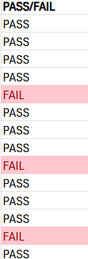
DATA TOOLS
Conditional Formatting – To highlight important marks or top scorers.
Data Validation – To ensure only correct values (like age) is entered.

Slide 12
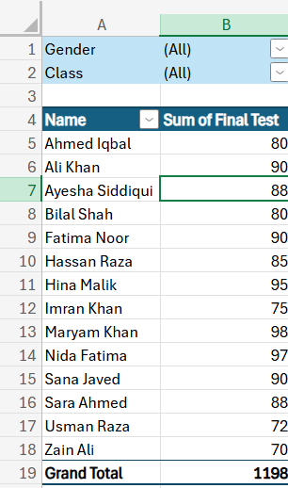
PIVOT TABLE
A Pivot Table is a powerful feature in Excel that allows you to quickly summarize, analyze, and organize large amounts of data.​ In my project, I created a pivot table to display each student’s name with the Sum of their Final Test marks and a Grand Total at the bottom.​ I also added Gender and Class filters so the results can be viewed for specific groups without changing the main sheet.​ This makes it easy to review scores, compare performances, and get an overall summary at a glance.​

Slide 13
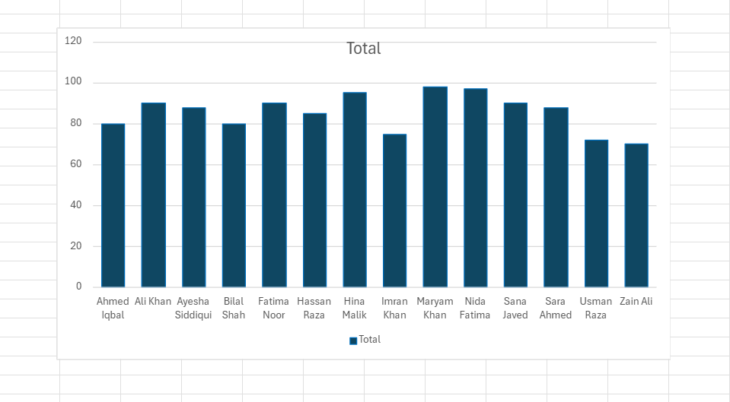
CHART
Charts in Excel help visualize data so that trends and comparisons are easier to understand. For this project, I inserted a column chart to display the Final Test marks of all students, making it simple to see who scored higher or lower at a glance. The chart converts numbers into a clear graphic, which is perfect for presentations and quick analysis.

Slide 14

KEY TAKEAWAY
“This project clearly showed how valuable Microsoft Word and Microsoft Excel are in both academic and professional work. Through the CIT course, I learned to create well-formatted documents, such as resumes, and to apply advanced features like headers, footers, and page design for a polished finish. In Excel, I practiced organizing large sets of data, using formulas to perform accurate calculations, and applying tools like Pivot Tables, Charts, and Conditional Formatting to analyze and present information in a clear way.
This project reflects the practical side of the CIT course and how it connects learning with real-world applications”

