Slide 1
Presentation
on
Plant Monitoring System
Presented
by
TANIYA TANDON – 2410993067
NAVYA GARG – 2410993059
YETIN ASIJA – 2410993077
RUDRAKSH GUPTA – 2410993061
Department of Electronics and Communication Engineering

Slide 2
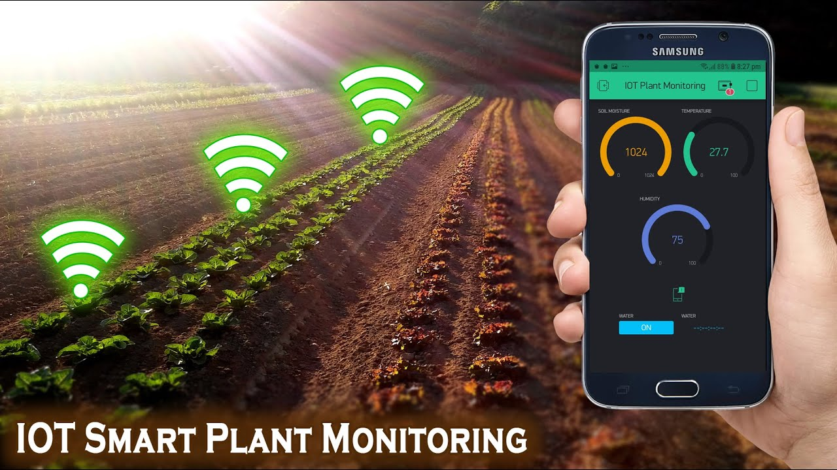
PROBLEM STATEMENT
Plants require regular attention to maintain proper growth, but due to busy lifestyles, people often forget to water or monitor them. Our system automates this process by continuously checking soil moisture, temperature, and humidity, and sends data to the cloud for analysis.

Slide 3
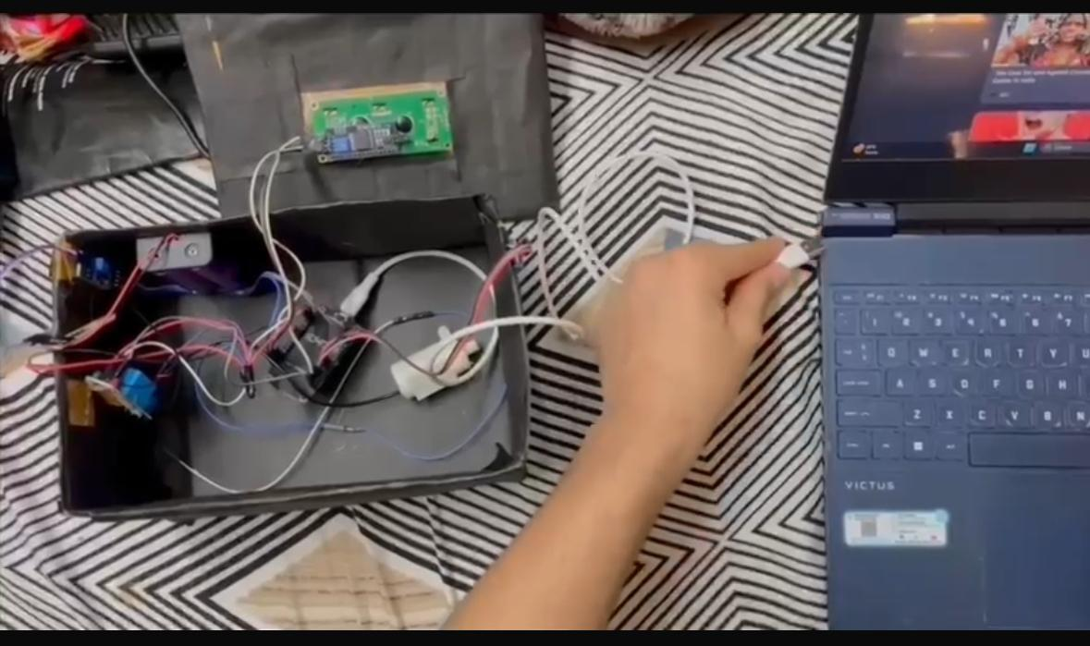
OBJECTIVE
To design an IoT-based system that monitors soil moisture, temperature, and humidity in real time.
To automatically water the plant or alert the user when the soil becomes dry.
To visualize environmental data such as temperature, humidity, and soil moisture on the Blynk dashboard.

Slide 4
HARDWARE COMPONENTS
NodeMCU ESP8266 – Wi-Fi-enabled microcontroller for IoT communication.
DHT11 Sensor – Measures temperature and humidity.
Resistive Soil Moisture Sensor – Detects soil moisture levels.
1-Channel Relay Module – Controls the 6V water pump
6V DC Water Pump – Used for automatic watering.2 battery 18650
2 × 18650 Lithium Batteries – Power supply for portability.
2-Cell Battery Holder – Holds and connects the batteries.
Step-Down Buck Converter (1584) – Regulates voltage from 7.4V to 5V.
ESP Cable (Rx/Tx) – For programming NodeMCU and serial communication.
Jumper Wires & Breadboard – For connections between components

Slide 5
WORKING PRINCIPLE
DHT11 sensor measures surrounding temperature and humidity.
Resistive soil moisture sensor detects soil moisture level.
NodeMCU (ESP8266) reads sensor data via analog/digital pins.
Data is sent to the Blynk Cloud using ESP8266WiFi and Blynk libraries.
Blynk app displays real-time graphs for temperature, humidity, and moisture.
When moisture is low, NodeMCU triggers the relay to start the 6V DC pump.
When moisture is sufficient, the pump stops to prevent overwatering.

Slide 6
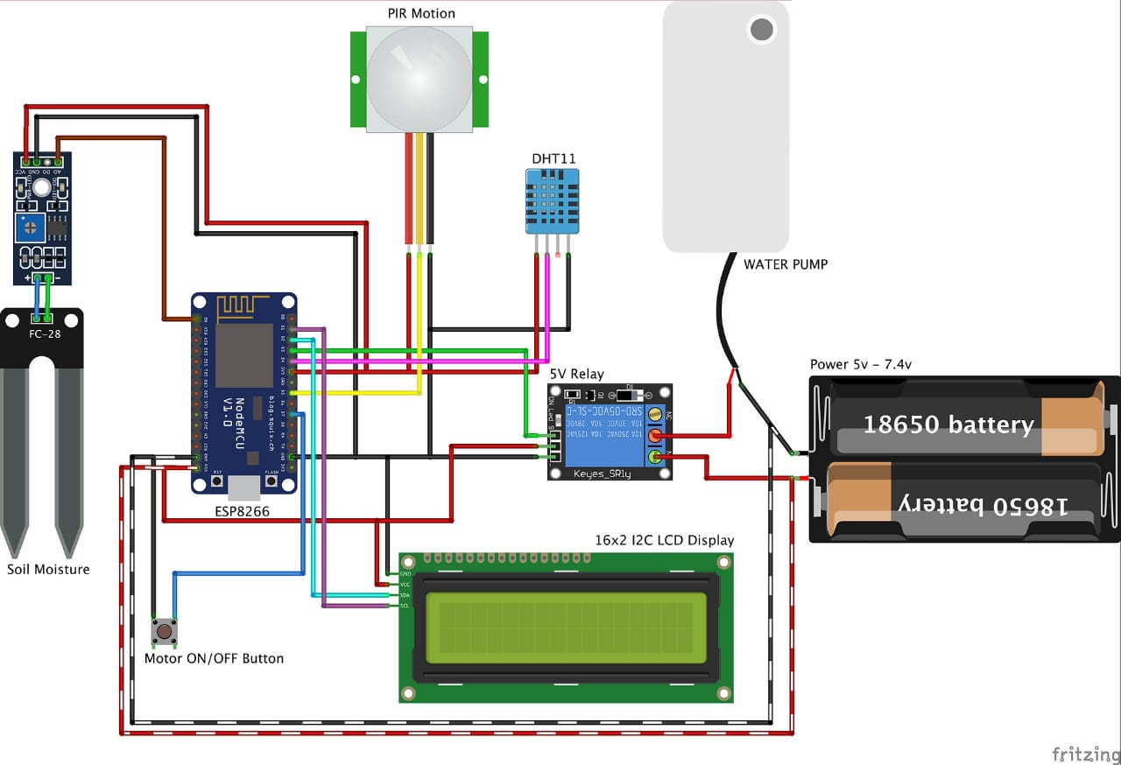
CIRCUIT DIAGRAM

Slide 7
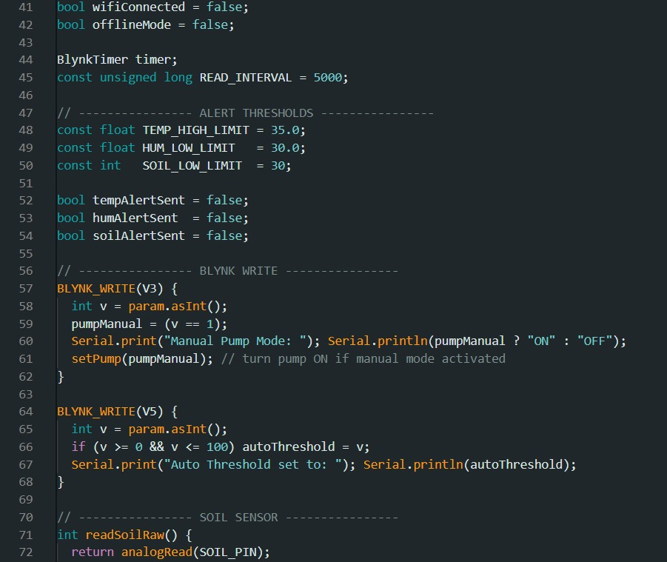
CODE SNIPPETS

Slide 8
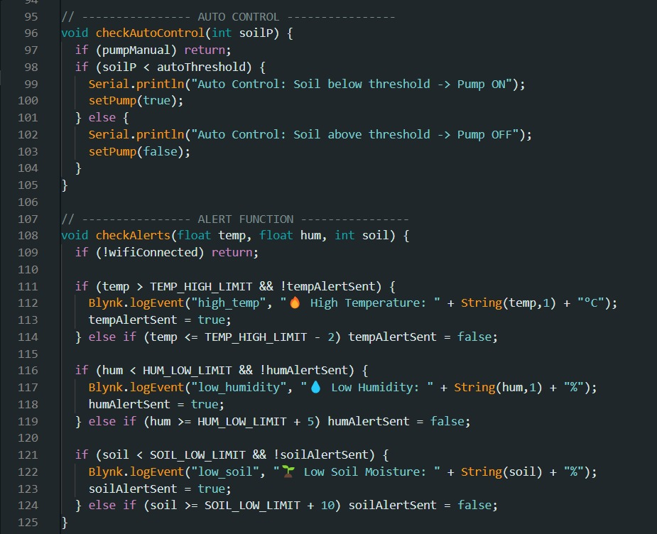

Slide 9
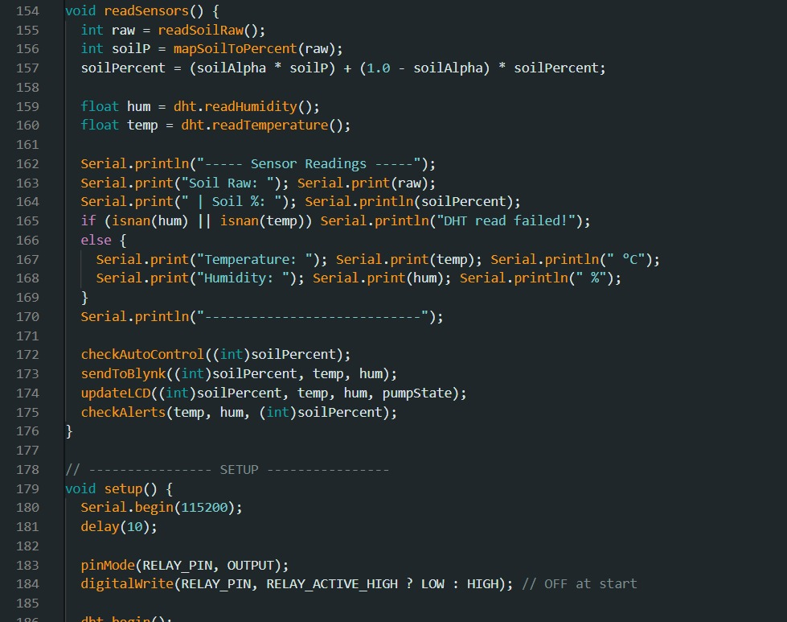

Slide 10
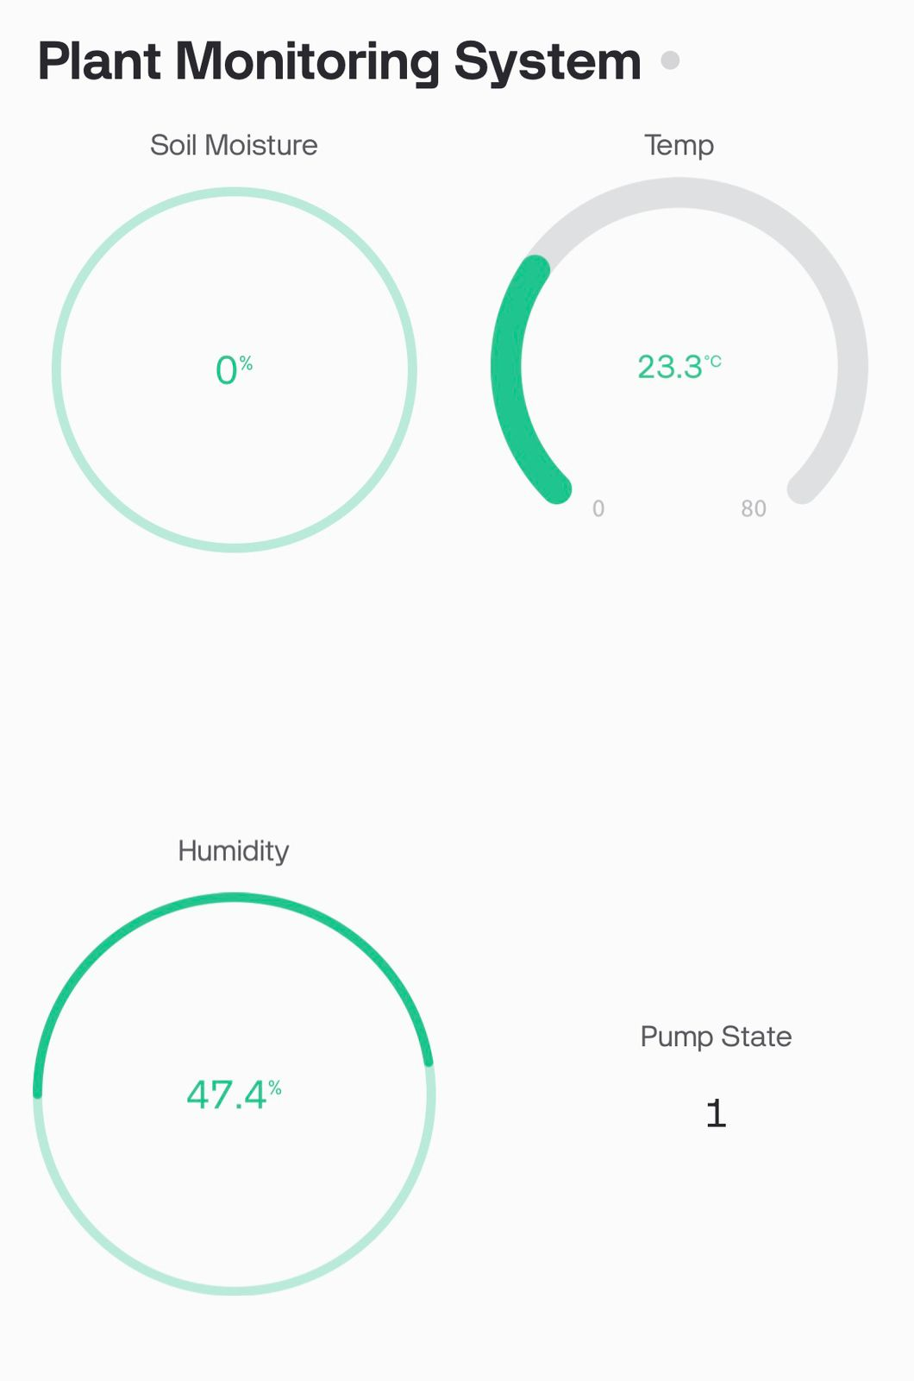
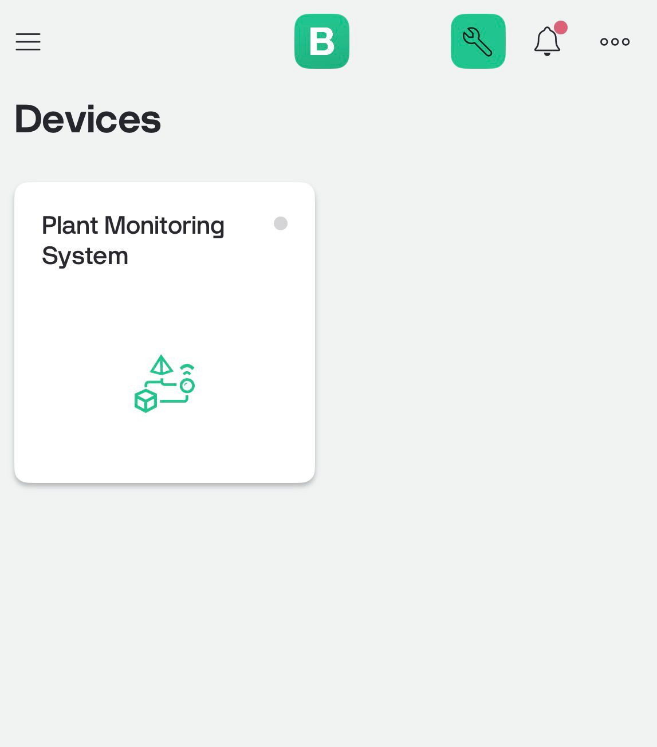
BLYNK DASHBOARD

Slide 11
CONCLUSION
The system successfully monitors temperature, humidity, and soil moisture in real time.
Automatic watering ensures that plants receive adequate water without human intervention.
The NodeMCU (ESP8266) and Blynk platform provide efficient IoT-based control and monitoring.
This project demonstrates the use of IoT in smart agriculture and home automation applications.

Slide 12
APPLICATIONS
Smart agriculture and gardening.
Greenhouse monitoring.
Smart home automation.
Precision farming.

Slide 13
THANK YOU

