Slide 1

Fingerprinting Relational Databases Quality Evaluation and Impact on Learning Tasks
Tanja Šarčević
Notes:
Hello to everyone and welcome to my presentation.
Today I will present my master thesis with the title F…..
The topic tackles ownership verification of published data, specifically of the relational datasets.

Slide 2

Outline
Introduction
Fingerprinting techniques
Robustness Evaluation
Data Utility Evaluation
Conclusion and Future Work
Notes:
The outline looks as follows:
I will start with a short introduction where I will through one use case present the concept of fingerpritning and the problem it aims to solve.
After that I will talk a bit more into detail about the requirements and general workflow of a good fingerprinting technique for relational data and present a few techniques which were implemented and analyzed as the part of this thesis, as well as the challenges that fingerprinting relational data faces.
Then we will come to the results of the robustness evaluation of the techniques and comparison in from that angle.
Furthermore, I present the results of the data utility evaluation, and again, the comparison of different fingerprirnting techniques
For the wrap up, i will bring out some conclusions and possibilities for future work.

Slide 3


Use case: medical data
Medical data – sensitive and a valuable asset to the hospital
The owner wants to share data with researchers
The owner wants to have a claim of the ownership and trace the source of an unauthorised publishing
Idea: hide a piece of information in the data before the distribution
Notes:
Let us imagine a scenario where the hospitals hold medical data containing personal information about the patients, their medical records, ets.
But wants to share the data with researchers for example
Because the data can be used for example to train machine lerning models for predicting some disease
Since the data is a valuable asset to the hospital and holds sensitive information, the hospital who owns it wants to have some kind of control over publishing
1st: the owner of the data wants to be able to claim ther ownership whreveer the data is being published, and second in a case of an unauthorised data publishing the owner wants to identify a recipient of who published
The idea would be to hide a piece of information into the dataset before the distribution that would identyify the owner and the recipent of a specific data copy

Slide 4


Fingerprinting
Age | BloodPress. | Diabetes
32 | 64 | 1
31 | 66 | 0
50 | 72 | 1
48 | 70 | 0
Age | BloodPress. | Diabetes
33 | 64 | 1
31 | 68 | 0
50 | 72 | 1
47 | 70 | 0
Notes:
this idea of hiding an information has already been very well researched in the domain of multimedia data, for example, images. Since the images contain a lot of redundancy, hiding a piece of information within is not a hard task while preserving the quality level of original data
The same concept is applied to the relational data, while the alterations in this case are easy to spot
? CHALLENGE finding a fingerprint such that the alterations are affecting the data as little as possible

Slide 5

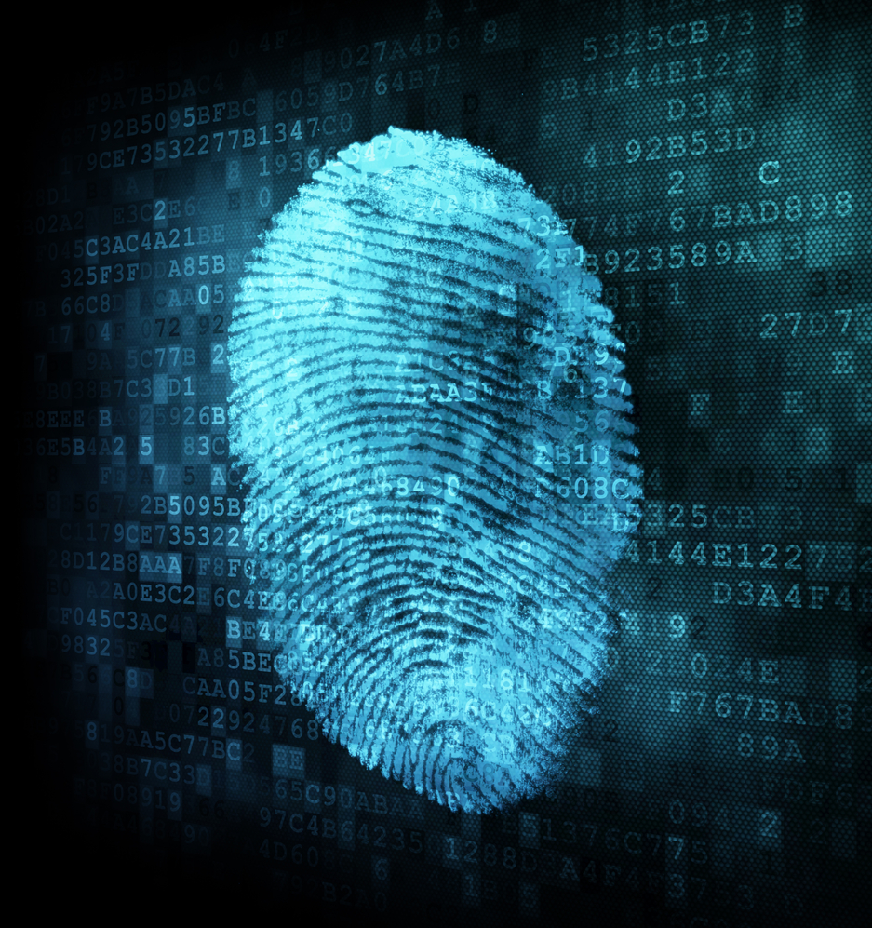
Fingerprinting
FINGERPRINT - string of bits containing information about the owner and the recipient of the specific data copy
FINGERPRINTING - an information hiding technique that embeds the fingerprint into the data
Notes:
To wrap up this story, we say that the fingerprint is a string of bits containing information about the owner and the recipient
Robust to attacks, that is, robust to purpose changes in the fingerprinted data in orred to remove the fingerprint
And last but not least, it should not change the utilityof the data too much

Slide 6
Fingerprinting
Requirements of the fingerprint:
recognizable by the owner
not detectable and consequently removable by the recipients
robust to attacks
does not change the utility of the data too much
Notes:
To wrap up this story, we say that the fingerprint is a string of bits containing information about the owner and the recipient
Robust to attacks, that is, robust to purpose changes in the fingerprinted data in orred to remove the fingerprint
And last but not least, it should not change the utilityof the data too much

Slide 7

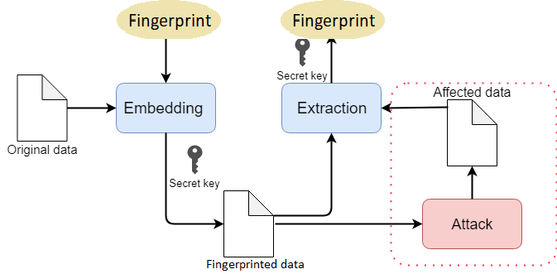

Fingerprinting Schemes: workflow
Notes:
The general fingeprirntg scheme contains two processes, embeding the fingerpirnt and extracting the fingeprrint
The distinct fingerpritn is being created fro eevery recipient and using the private secret key know only to the owner, the fingerprint is embedded into the data in a certain patter.
The inverse process is extraction where we extract the fingerpritn frmm aa fingepringd data and associate it to a certain recipient.
The fingerprinted data could be affected by the malicious attack, and the exraction process shoudl be robust enough to still recognise the correct fingerprint even though the data is altered

Slide 8
Fingerprinting Schemes:
Numerical data
AK (Agrawal and Kiernan) Scheme:
Pseudorandom choice of a row, a column and a least significant bit of a value to be marked
Block Scheme:
The data is first divided into blocks
Pseudorandom choice of the value to be marked within every block
Two-level Scheme:
1st layer: Pseudorandomly selects the values to be marked; this pattern identifies the owner
2nd layer: Pseudorandomly selects the values to be marked; this pattern identifies the recipient
Age | BloodPress. | Diabetes
32 | 64 | 1
33 | 66 | 0
49 | 72 | 1
48 | 70 | 0
Age | BloodPress. | Diabetes
33 | 64 | 1
31 | 66 | 0
50 | 71 | 1
48 | 70 | 0
Age | BloodPress. | Diabetes
31 | 64 | 1
31 | 69 | 0
50 | 72 | 1
45 | 70 | 0
Notes:
There are a few schemes that we have implemetned and analyzed in our work,namely the pioniring work in area of fingeprirnitng relational data: AK Scheme
All these scehmes have in comon that they are applied onyl to the numerical values. However many real world datasets contain categorical values so it is importan tot address that problem as well. It is less researched and there is a reason beind it

Slide 9


Numerical vs. Categorical Data
Decimal: 32.3 32.7
Integer: 32 34
Non-numerical: France Germany
Notes:
So with fingerprint ing numerical values we can easily introduce a small change. For decimal values we can cahnge a decimal value, in integer values we can as well mark a value to a little bit smaller or biger value
What we would nt like to have is a mixture of values because it is easy to tdetect
But for categical values we cant really speak abput the concept of small change. The cahnges are discreet.
Chneging letters in the words also doesnt not
So chnging values is Somehow it is still necessaty
…Correction lowers the robustness…

Slide 10
Fingerprinting categorical data: Approach #1
Insertion
London, Paris, Vienna
Encoding: 0,1,2 (00,01,10)
Fingerprinting: 10 -> 11
Decoding: 11 -> ??
Correction: 11 mod 3 = 00
Decoding: 00 -> London
Number-encode categorical values
Apply fingerprinting insertion algorithm for numerical data
Correction
Decode to the categorical values
Notes:
The first naive approach is to add a preprocessing step to some of the schemes for numerical data that encodes the categorical values into numbers
The encoder must be saved for the extraction process. The number encoded dataset is then fingerprinted using the AK scheme.
The fingerprinted values are converted back to their respective categorical.
However, the fingerprinting process may cause that the values outside of the categorical attributes domain appear, and cannot be converted. Let us look at the examample here the situation that may happen. ….
We address this problem and solve it by introducinfg an additional step – correction.
In the process of decoding, if the value is the illegal one, we simply take it‘s modulo value and decode it.
The problem

Slide 11
Fingerprinting categorical data: Approach #2
Pseudorandomly choose a value to fingerprint - target
Addressing the problem of semantic relations between categorical attributes that can be disturbed by fingerprinting
gender: male, pregnant: yes
The fingerprinted value will be a value that is likely to occur in a combination with other values from the row
Find a neighbourhood based on all but the target value
Calculate the frequencies of target attribute values
Choose randomly a mark value (weighted by the friequencies)
Notes:
TODO
Ovdje treba dodat primjer kako se odabere nova oznaka

Slide 12
Robustness Evaluation: Attacks
Malicious operations on the fingerprinted dataset with the goal of
disabling the extraction of the correct fingerprint or
disabling association of a fingerprint with the correct recipient
Subset Attack
Superset Attack
Bit-flipping Attack
Additive Attack
Misdiagnosis False Hit Rate: measures the likelihood of extracting a valid fingerprint from non-fingerprinted data

Slide 13
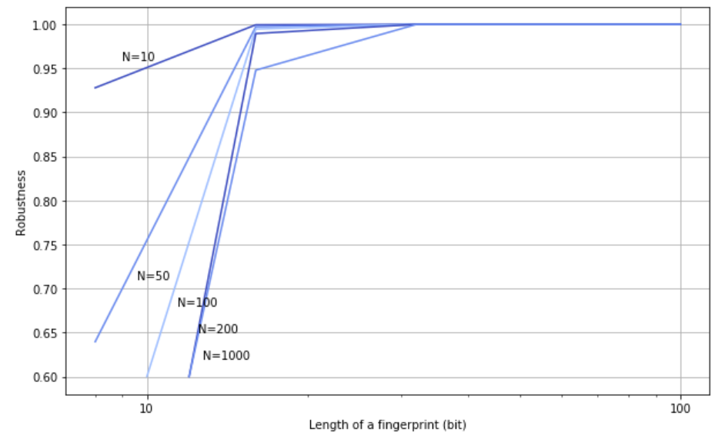
Robustness Evaluation Misdiagnosis false hit
Notes:
The robustness is defined as a percentage of rows of the data that can be removed and the fingerprint……
On the x axis we have a very important parameter numebr of marsk, and here it si represented as a percentage of rows that are marked

Slide 14
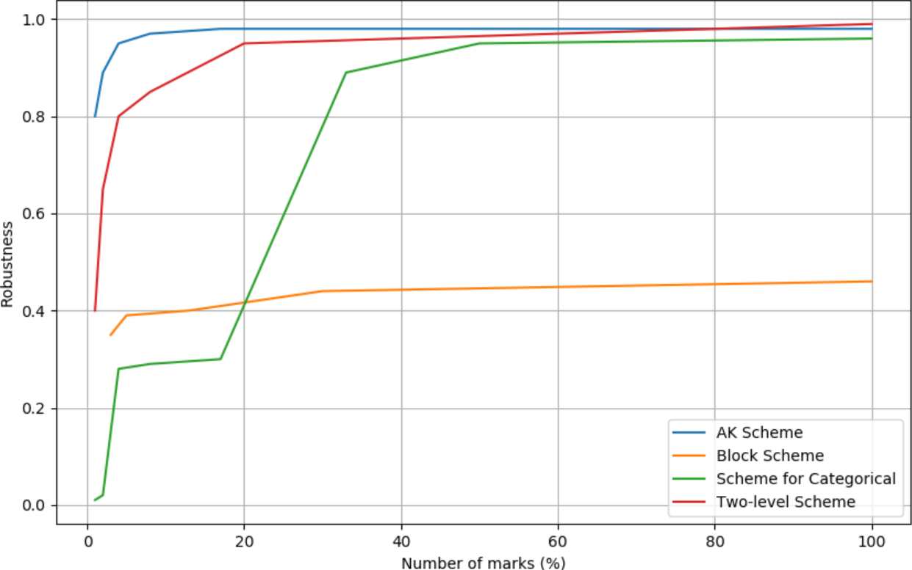
Robustness Evaluation Subset Attack
Notes:
The robustness is defined as a percentage of rows of the data that can be removed and the fingerprint……
On the x axis we have a very important parameter numebr of marsk, and here it si represented as a percentage of rows that are marked

Slide 15
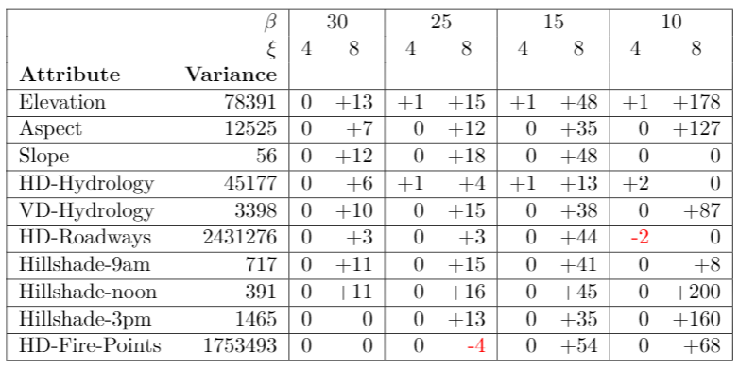
Utility Evaluation Mean and Variance
Less marks
More marks
Number of Least Significant Bits being marked
Notes:
On the other had we also focused on evaluating utility of the data.
We measured utility from two angles. Fist is measuring the change in mean and variance. Here we exper. With forest dataset.

Slide 16
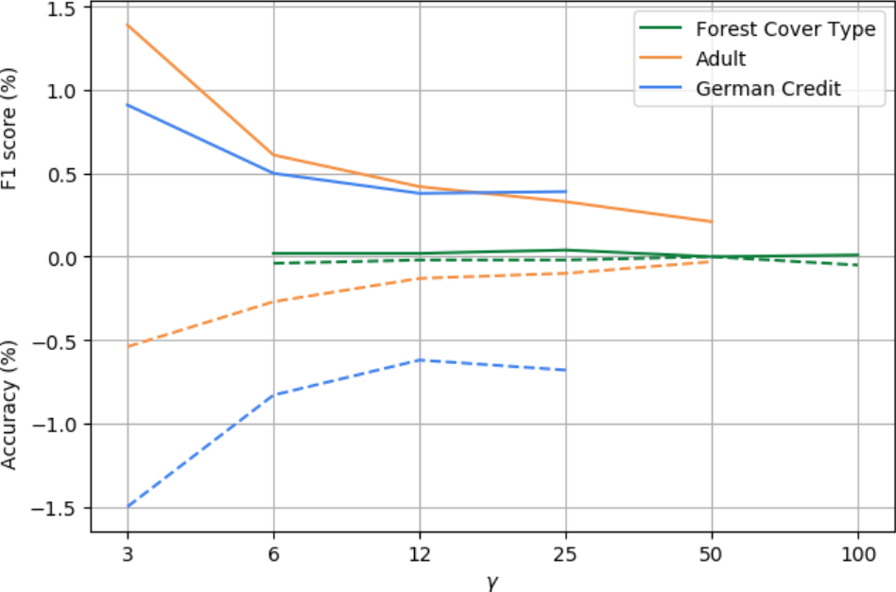
Utility Evaluation ML Classification
More marks
Less marks
Notes:
Another angle of evalueating utility was to compare the performaces of Machine learning classifiers trained with original and trained with fingerprined . Here we have the results from Random Forest classifier and three different datasets. We measured f1 score and classification accuracy – f1 score is flipped to the upped side of the graph so that is more readable. Both measures have a higher decrease for more marks in the data and the decrease
The other classifiers like logistic regression and decision tree had very similar behavior
Size of the dataset
Mirrored graph
4 more classifiers – similar results (add one more)

Slide 17
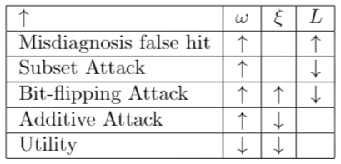
Conclusion and Future Work
Number of marks
Trade-off: robustness of the scheme and the utility of fingerprinted data
Future work
Fingerprinting scheme for categorical data
Further analysis on robustnes of the neighbourhood-search approach
Blind scheme for fingerprinting relational data with categorical values

Slide 18
Thank you for your attention

