Slide 1

Malware and Intrusion Detection
Chapter Eight
Implementing the Bastion Host

Slide 2
Overview
Describe the general requirements for installing a bastion host
Select the optimal attributes—memory, processor speed, and operating system—for the bastion host
Evaluate different options for positioning the bastion host, both physically and within the network
Discuss critical components of the bastion host configuration

Slide 3
Overview (cont’d.)
Explain how to provide for backups of the bastion host operating system and data
Establish a baseline performance level and audit procedures

Slide 4
Introduction
Bastion host
  System specifically designed and implemented to withstand attacks
  Usually placed in the demilitarized zone (DMZ) or outside the firewall
  Must withstand direct assault from external attackers
  Organization’s public face on the Internet
  Needs to be highly secured

Slide 5
Installing a Bastion Host: General Requirements
Can be any server
  Hosts a Web server, e-mail server, FTP server, or other network service
Typically provides only one service
Present intruders with only a minimal set of resources and open ports
Administrators level of comfort with the system, its security, and its reliability
  Most important criteria

Slide 6
Installing a Bastion Host: General Requirements (cont’d.)
Steps to secure a bastion host
  Obtain a machine with sufficient memory and processor speed
  Choose and install the operating system
  Determine where the host will fit in the network configuration and put it in a safe and controlled physical environment
  Enable the host to defend itself
  Install the services to provide or modify existing services

Slide 7
Installing a Bastion Host: General Requirements (cont’d.)
  Remove any and all services and accounts that aren’t needed
  Back up the system and all data on it, including log files
  Run a security audit
  Connect the machine to the network

Slide 8
Selecting the Host Machine
Choose a combination of machine type and software with which you are familiar
  Can work easily if you need to

Slide 9
Do You Need More Than One Machine?
Ideal to have one service on each bastion host
Conduct comprehensive risk analysis of all the resources in your organization
Get as many bastion hosts as you can afford
  In order to maximize security

Slide 10
Memory Considerations
Do not need multiterabytes worth of RAM
Operate program that maintains, rotates and clears outdated log files
Hard disk storage space
  Multiterabyte
  Accumulate vast quantities of log file
Create a page file on hard disk
  Make use of additional memory, if needed

Slide 11
Processor Speed
Processor speed
  Rate at which logic circuitry or microprocessor within a computing device processes basic instructions
Clock speed
  Expressed in GHz (gigahertz)
    Includes cache speed descriptor, in MHz (megahertz)
Three independent caches:
  Instruction cache
  Data cache
  Translation lookaside buffer

Slide 12
Processor Speed (cont’d.)
Obtain machine with the fastest processor you can afford
  When using Secure Sockets Layer (SSL) encryption
  Processor speed becomes even more critical so that the firewall doesn’t add latency to the network

Slide 13
Choosing the Operating System
Most important consideration: familiarity with the system
  Get machine up and running
  Maintain it smoothly

Slide 14
UNIX and Linux Hosts
UNIX
  Most popular operating system used to provide services on the Internet
syslog daemon
  Enable logging
  Standard for logging program messages
Security patches
  Must correspond to the operating system
chkconfig
  Utility which reports on the services currently running

Slide 15
Windows Hosts
Windows Server 2003 and 2008
  Excellent choices for bastion host operating systems
  Reliability and widespread use as servers
Security Compliance Manager
Disable
  NetBIOS interface, Server service, and Workstation service
Set up logging for:
  Account logon and logoff, object access, policy changes, privilege use, and system events

Slide 16
Keep Your Operating System Updated
Pick version of system that is stable and secure
Observe extreme caution when using automatic updating
Make sure your system of choice can reliably provide the services you want to make available on the public DMZ
Table 8-1
  Configuration of a standard high-end and a standard mid-range corporate server

Slide 17
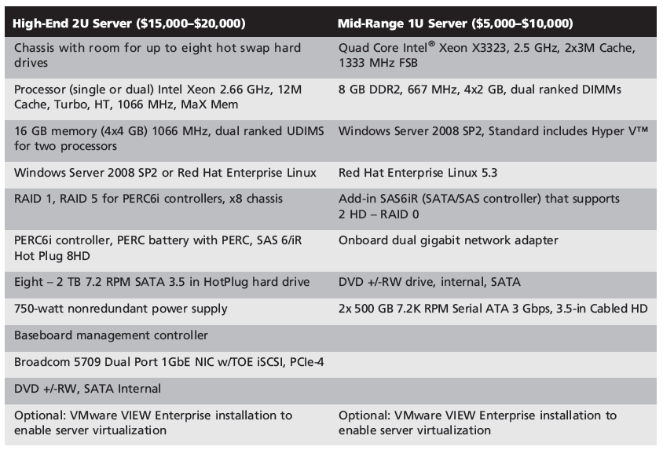
Table 8-1 Corporate Server Configurations

Slide 18
Positioning the Bastion Host
Bastion hosts sit on the perimeter of the network
  Provide a buffer between the Internet and the internal network that is being protected
Options for locating the host
  Physically and logically

Slide 19
Physical Location
Exact building and room in which the device is located
Room
  Properly ventilated
  Adequate cooling
  Backup power system
May co-locate Web servers and other bastion hosts off-site
  Many hosting services are available

Slide 20
Physical Location (cont’d.)
Research and ask questions
Pin the hosting service down on all fees
Get a Service-Level Agreement (SLA)
Do a risk-benefit analysis
Ask for references
Shop around
Contracts typically range from 12 to 36 months
Co-locating makes it more complicated for the administrator

Slide 21
Network Location
DMZ
  Network of publicly accessible servers connected to the firewall, but that is isolated from the internal network
  Protect internal users from intrusions and attacks
Logical location for a bastion host
Shown in Figure 8-1

Slide 22
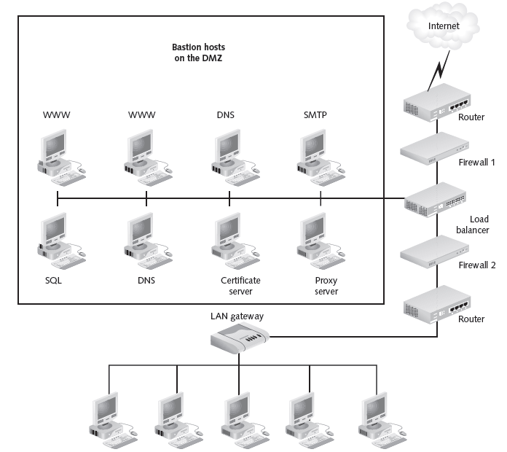
Figure 8-1 The Application Layer of an IP Packet
@ Cengage Learning 2012

Slide 23
Network Location (cont’d.)
Bastion host can be located at any point in a network that is considered vulnerable
  Or where an extra level of security is needed
Defense in Depth
  Single hardened bastion host should not be relied on as the sole source of security for a network

Slide 24
Securing the Machine Itself
Consider using it as a spare server
  Connect to the network in case of disaster
Disaster recovery plan
  Strategies have to weigh budgetary demands against the techniques that can help a company get back online

Slide 25
Hardening a Windows or Linux Server
Online references:
  Microsoft hosts podcasts and TechNet discussion boards
  Vendors support sites
    Example: IBM

Slide 26
Selecting a Secure Location
Should not leave bastion host out in middle of an office or in a high-traffic area
Protect by an alarm system
  Battery backup
  Connected to a central alarm service that can notify the police in case of trouble
Set up a password-protected screen saver
  Short time to display
  Blank screen saver

Slide 27
Installing the Operating System Securely
May want to reinstall an operating system you consider to be more secure
  With a minimum configuration
Windows bastion host
  Create two partitions: one for the operating system and one for the Web server, DNS server, or other software
  Use only the NTFS file system

Slide 28
Installing the Operating System Securely (cont’d.)
Virus protection software
DNS server should be configured to prohibit unauthorized zone transfers
Zone transfer
  Also known as AXFR
  Allows DNS database duplication and replication

Slide 29
Documenting Your Work
Document steps to secure the machine
  Make it easy for other personnel to do the repair
Make sure instructions include:
  Name and location of the bastion host
  The bastion host’s IP address and domain name
  Bastion host operating system
  Location of backup files
  What to do in case the system crashes

Slide 30
Documenting Your Work (cont’d.)
  The levels of the patches (if any) that have been made to the bastion host’s operating system
  Any customized scripts that have been developed to support the host

Slide 31
Configuring Your Bastion Host
Look to security policy to determine:
  Resources to be protected
  Threats need to be addressed

Slide 32
Making the Host Defend Itself
Honeypot server
  Machine that is placed in the DMZ to attract hackers and direct them away from other servers
  Configured the same as a normal bastion host
  Appears to be a real network server containing Web, FTP, or DNS services
  Not connected to any other machines on the network
  Does not contain valuable files

Slide 33
Making the Host Defend Itself (cont’d.)
Some security professionals advise against using honeypots
  May attract as many attackers as they deflect
Intrusion detection and prevention systems
  Notify IT staff of possible intrusion attempts

Slide 34
Selecting Services to Be Provided
Determine primary service to run on the bastion host
  Make sure the server software is the latest version
Table 8-2
  Provides the URLs for various operating systems
Observe extreme caution when installing software on the bastion host

Slide 35
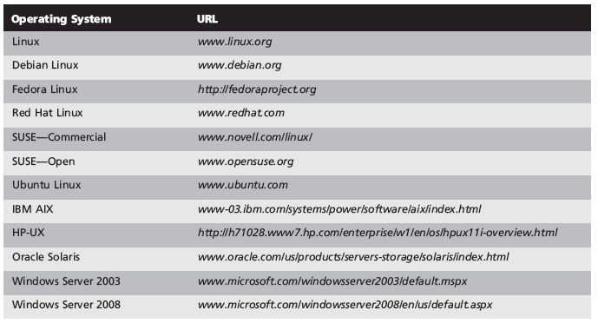
Selecting Services to Be Provided (cont’d.)
Table 8-2 URLs for Various Operating Systems

Slide 36
Special Considerations for UNIX Systems
security_patch_check
  UNIX utility
  Automates the process of analyzing security patches that are already on the system
  Reports patches that should be added
Trusted Computing Base (TCB) check
  Set of software programs that makes sure any software you’re running on your system is a trusted program
Enable system logging
  Provide sufficient room for log files to grow

Slide 37
Special Considerations for Windows Systems
Microsoft Baseline Security Analyzer
  Analysis of the current Windows configuration patches
  Isolates vulnerabilities such as open “Guest” accounts and anonymous connections being enabled
Microsoft Security Assessment Tool (MSAT)
  Tap into a large knowledge base of details about vulnerabilities
  Get advice from vendor and security experts on how to make specific Microsoft products more secure

Slide 38
Disabling Accounts
Delete all user accounts from the bastion host
Rename the administrator account
Use passwords that contain:
  At least eight alphanumeric characters
  At least one numeric or special character

Slide 39
Disabling Unnecessary Services
Services listen on open ports
  Can provide hackers with entry points
Disable services that enable the host to do routing or IP forwarding
Table 8-3
  Services and features that a network administrator should typically disable for UNIX and Windows
Do not disable any dependency services
  Those system needs to function correctly
Stop services one at a time

Slide 40
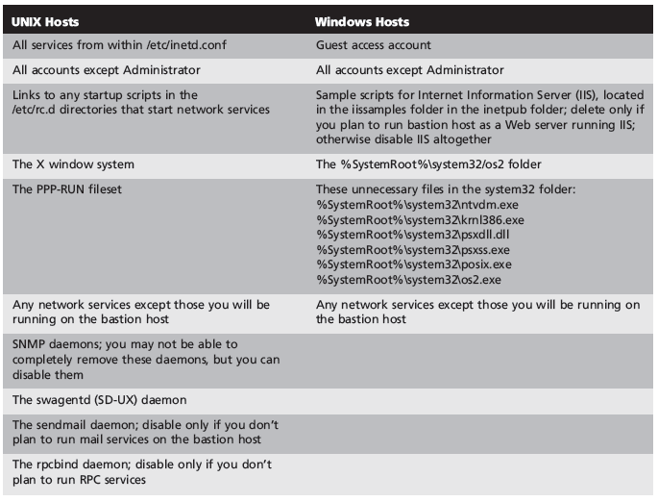
Table 8-3 Services and Features to Disable on a Bastion Host

Slide 41
Limiting Ports
Limit traffic on all ports
  Except ones needed to provide services on the network
Nmap or SuperScan
  Scan your system for active ports
  Close any ports that are being used by unknown or unneeded services

Slide 42
Handling Backups
Back up the data on the machine
  So you can restore it if needed
Binary drive image
  Best kind of backup
  Mirror image of all the data on a hard disk or partition
  Includes files, applications, and system data
  Symantec’s Norton Ghost
  Clonezilla

Slide 43
Auditing the Bastion Host
Audit system
  By testing it for vulnerabilities and evaluating its performance
Establish a baseline for system performance
  Level of performance that you consider acceptable and against which the system can be compared
Check system logs, event logs, and performance information
  Record the information you uncover

Slide 44
Auditing the Bastion Host (cont’d.)
Do not use production servers for testing
  Apply hardening actions to a server in a test environment
  Then move new functionality to a quality assurance server
  Finally, perform the same steps on a production server

Slide 45
Connecting the Bastion Host
Test the system and check it against your baseline level of performance
Performance Monitor Wizard (for Windows Server 2003) and the System Center Operations Manager (for Windows Server 2003 or 2008)
  Assist in keeping an eye on systems performance
Continue to audit the host on a periodic basis
Security Space Security Audits
  Test system and provide a detailed security report

Slide 46
Summary
Bastion host
  Specially hardened computer that is located on the network perimeter
  Hosts firewall software and/or publicly accessible services such as Web, FTP, and e-mail servers
  Should be placed on the perimeter of the network
  Installation and configuration
  Backups and maintenance

